Slide 1

Title
Learning How to Demodulate from Few Pilots via Meta-Learning
Group - 11

Slide 2
Problem Undersatanding
In IoT systems, devices transmit very short packets, so only a few pilot symbols are available
The communication channel introduces:
Noise
Time variations
Non-linear distortions
Due to limited pilot data, the receiver cannot accurately learn channel behavior
less information
Less pilots
poor learning

Slide 3
Limitation of Traditional Method
Conventional techniques first estimate the channel using pilot symbols
These methods assume:
Sufficient pilot data
Known or simple channel models
In practical IoT scenarios, these assumptions do not hold
Result: Channel estimation becomes inaccurate, leading to poor symbol detection
Traditional methods depend on accurate channel estimation, which is not possible here

Slide 4
ML-Based Approach
Instead of estimating the channel, demodulation is modeled as a data-driven classification problem
A neural network is trained to map:
Received signal → Transmitted symbol
The model learns the combined effect of channel, noise, and distortion directly from data
Benefit: Removes dependency on explicit channel estimation

Slide 5
Meta-Learning Idea
Each device experiences a different channel, so it can be treated as a separate learning task
Meta-learning trains the model across multiple such tasks
This allows the model to learn shared patterns and structures across devices
The model can quickly adapt to a new device using only a few pilots

Slide 6
﻿Research Methods
Why MAML Works
MAML learns an initial set of parameters that is not task-specific but easily adaptable
During training, it optimizes the model such that small updates with limited data lead to good performance
This makes it highly suitable for scenarios with few training samples
Key idea:
Traditional ML focuses on accuracy for one task
MAML focuses on fast adaptability across tasks

Slide 7
Analyzed Results
Rapid Adaptation: MAML achieves an order of magnitude lower error (10-2 SER) than Joint Training with only 4 pilots (Fig. 4).
Realistic Robustness: Outperforms conventional methods in fading channels, reaching 0.3 SER at 16 pilots (Fig. 6).
Increased Confidence: Fig. 5 shows probability distributions shifting from uncertain (overlapping) to sharp peaks (distinct) after adaptation, ensuring accurate symbol recovery.

Slide 8
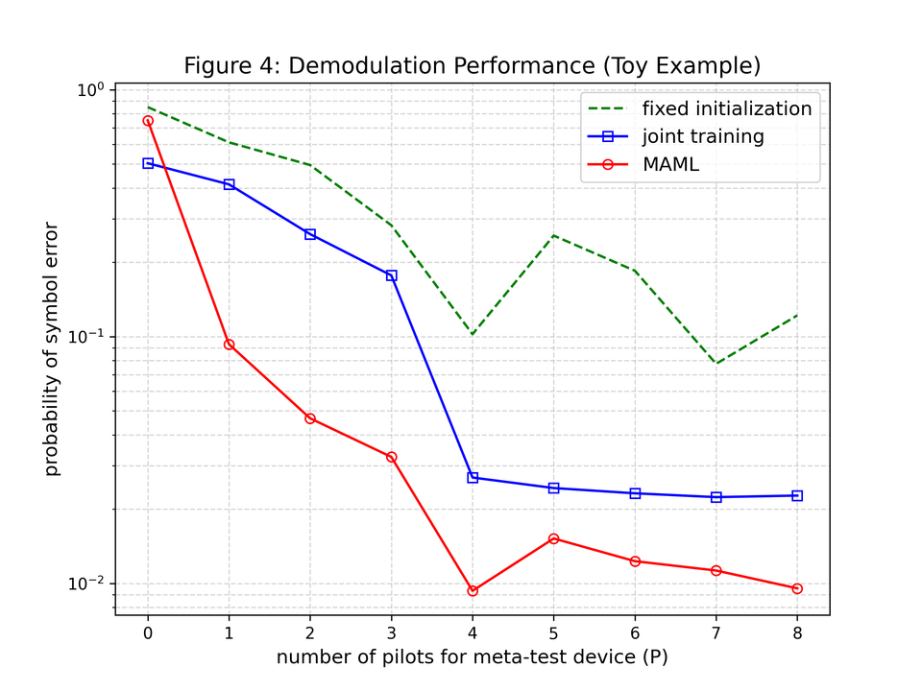
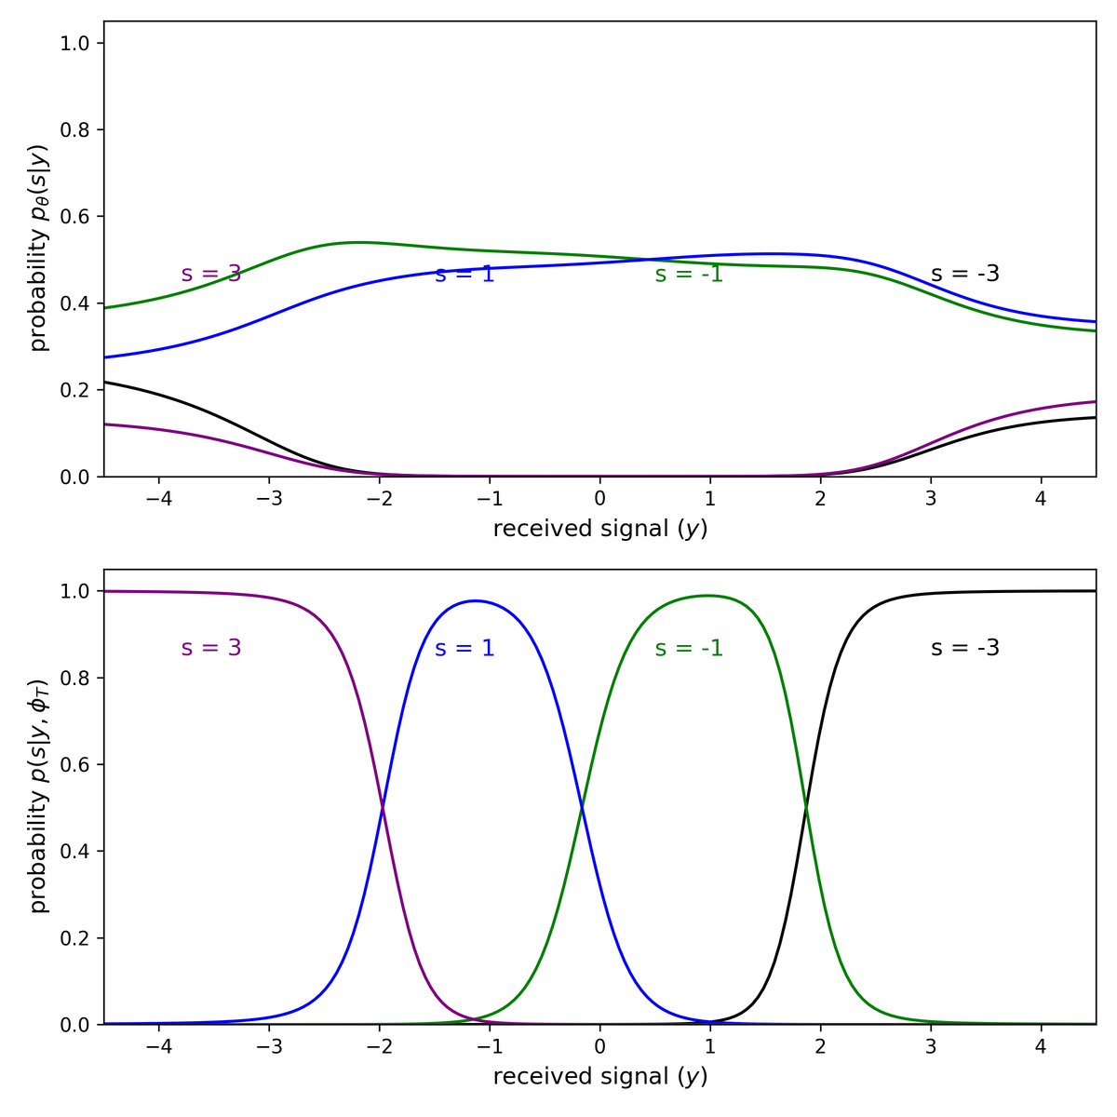
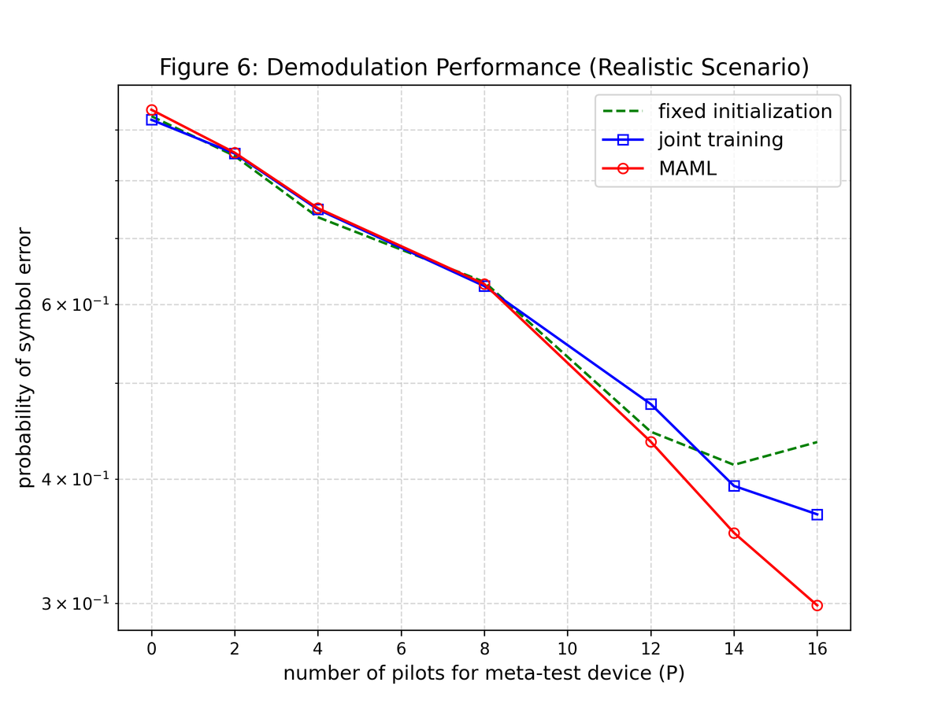

Slide 9
Novelties
4D Physics-Informed Input: Added Magnitude and Phase to 2D I/Q to capture non-linear distortion.
ResNet Backbone: Replaced MLP with Residual blocks for superior feature extraction.
Online Adaption: Implemented a Replay Buffer for continuous learning without forgetting.
The Results:
Efficiency: Achieves 10-2 SER with only 4 pilots (Fig. 4).
Online Gain: proposed 4D-ResNet reduces error by ~35% over 3000 time slots compared to baseline.

Slide 10
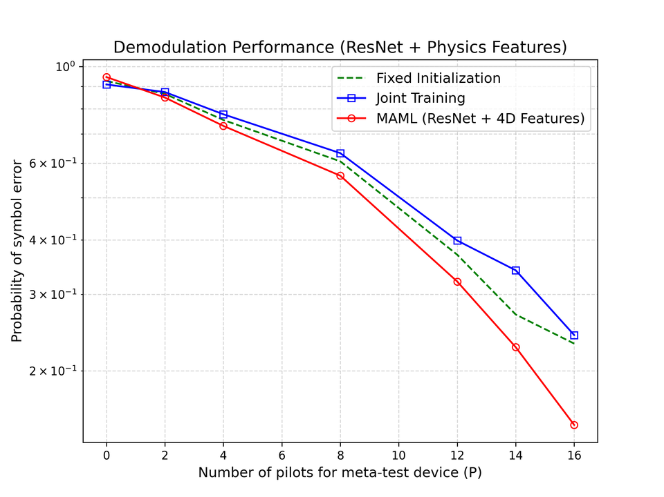
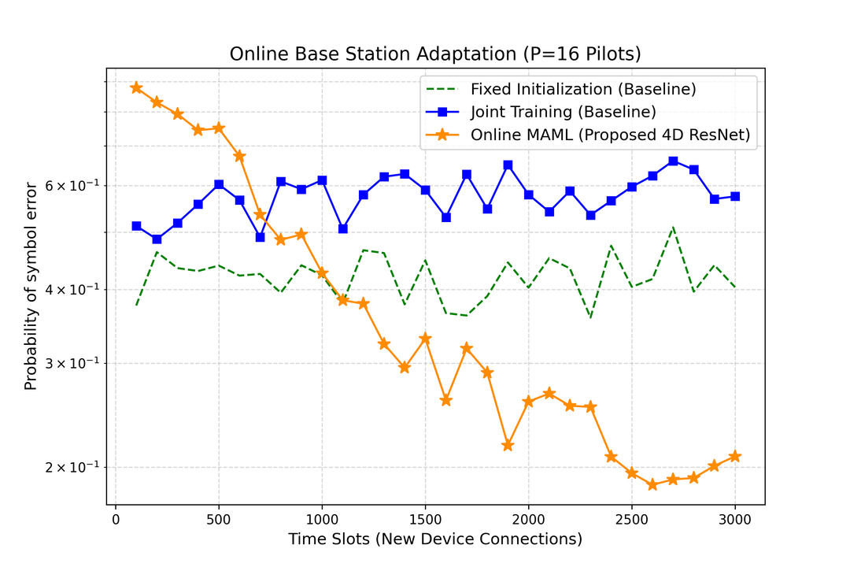
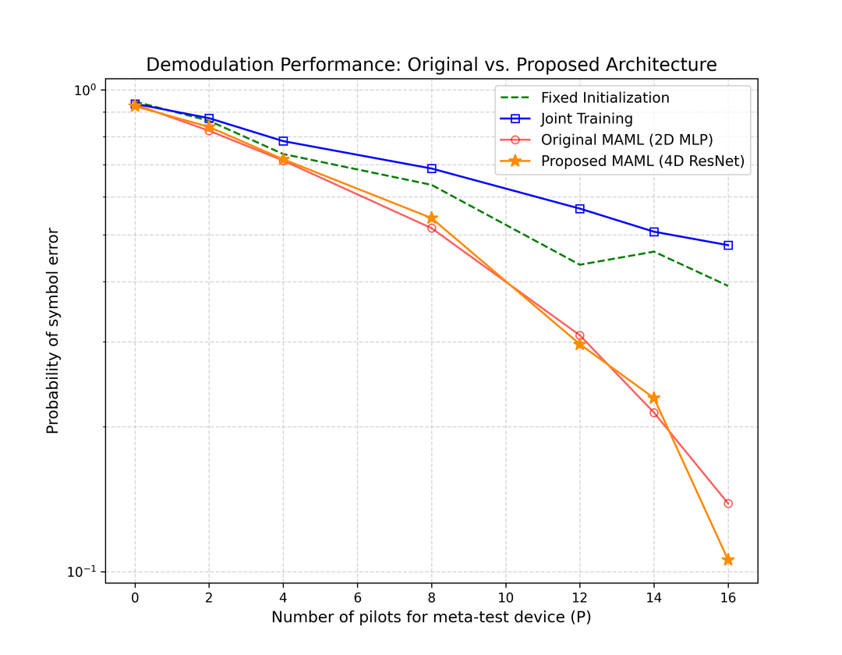
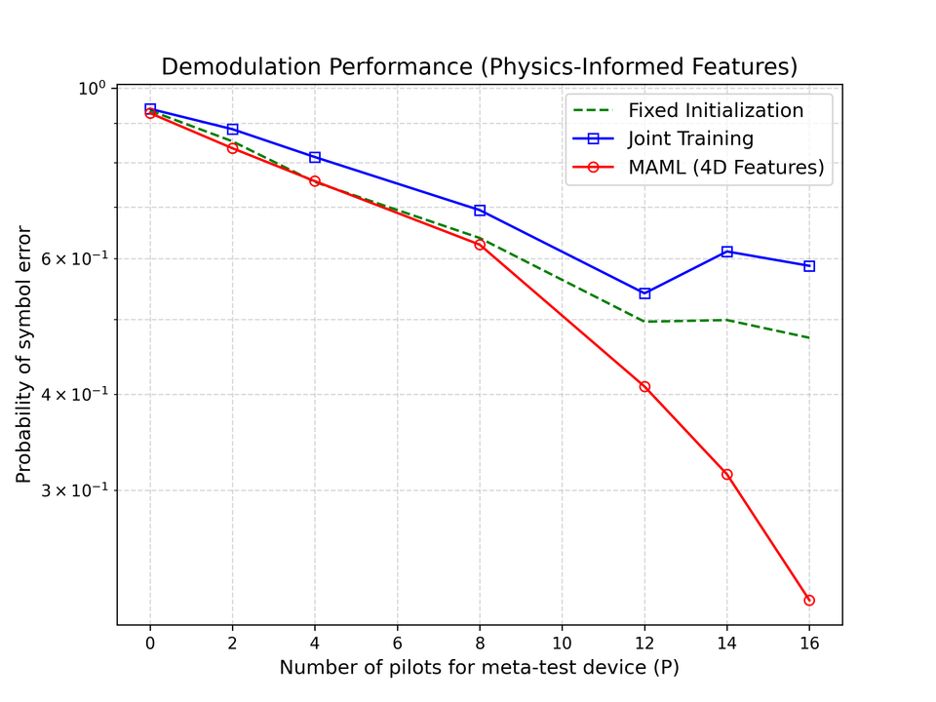

Slide 11
Thank You
Group Members
Pragati Khandelwal (B23EE1054)
Parth Khiriya(B23EE1051)
Palli Sunil Kumar (B23EE1050)
Palavalasa Varshith Narayan (B23EE1049)
Nitin Verma (B23EE1048)

