Slide 1
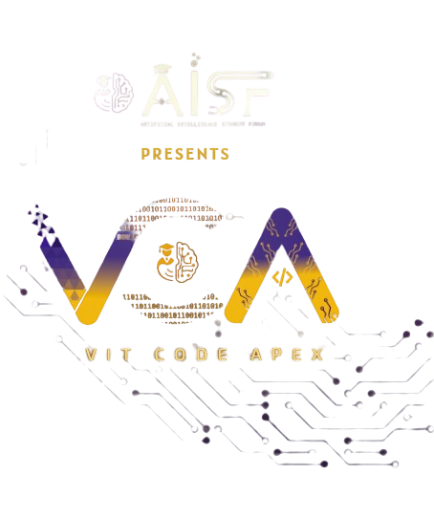

Slide 2

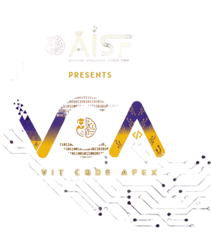

CODE VERSE HACKATHON 2025
Problem Statement Title -
Create a "living itinerary" system that dynamically adjusts a traveler's plans in real-time based on live events and user feedback.
Team Name - Koders
Team Members-
1. Shriyash Santosh Kulkarni
2. Parth Amit Kulkarni
3. Kaustubh Kulkarni
4. Parth Bhushan Kulkarni

Slide 3
ROAMIFY
Detailed explanation of the proposed solution
Dynamic Travel Companion: An intelligent itinerary that proactively adjusts your schedule, routes, and reservations in real-time.
Real-Time Data Integration: Synthesizes live information from traffic, weather, transit, and event APIs to inform decisions.
Always Optimized: Continuously recalculates your plans to avoid disruptions and capitalize on new opportunities.
Learns from You: Uses machine learning to analyze your preferences, making recommendations increasingly personalized over time.

Slide 4
ROAMIFY
How it addresses the problem
Automatic Stress Reduction: Handles unforeseen changes and disruptions automatically, significantly lowering travel-related anxiety.
Intelligent Time-Saving: Suggests faster routes and alternative activities in real-time to maximize valuable vacation time.
Live Event Adaptation: Dynamically adapts to delays, closures, and live events to help travelers avoid disruptions.
Always Relevant Plans: Ensures travel itineraries are constantly optimized and up-to-date, unlike static traditional planners.

Slide 5
ROAMIFY
Innovation and uniqueness of the solution
Proactive Learning: Uses machine learning to analyze your preferences and anticipate your needs.
Personalized Discovery: Unlike travel agencies it will work completely personalized for you.
Real-Time Data Fusion: Combines live traffic, weather, and event data with your personal profile.
Self-Improving System: Learns from your feedback and behavior to constantly enhance its recommendations.

Slide 6
TECHNICAL APPROACH
Technologies to be used
Backend (Python): Uses Django/Flask for robust core logic, API integrations, and scalable data processing.
Frontend (React Native): A cross-platform framework for a seamless mobile experience on both iOS and Android.
Database (MongoDB): A NoSQL database chosen for storing flexible user profiles, travel plans, and preferences.
APIs (Real-Time Data): Integrates Google Maps for location/traffic and public APIs for live events and transport updates.
Machine Learning (TensorFlow/Scikit-learn): Powers the app's predictive analytics and personalization features to learn from user behavior.

Slide 7
TECHNICAL APPROACH
Methodology and process for implementation
Agile Framework: Development is structured into two-week iterative sprints to ensure adaptability and consistent, measurable progress.
MVP-Centric Launch: We prioritize a rapid market launch with a Minimum Viable Product focused on core real-time rerouting and itinerary adjustment.
Continuous Feedback Loop: We integrate user testing and feedback directly into each development cycle to guide prioritization and feature refinement.
Data-Driven Decisions: Product evolution is guided by real-world user data and behavior, not just assumptions, ensuring we build features people want.
Regular Check-Ins: The team holds short meetings to review progress and quickly improve how we work.

Slide 8
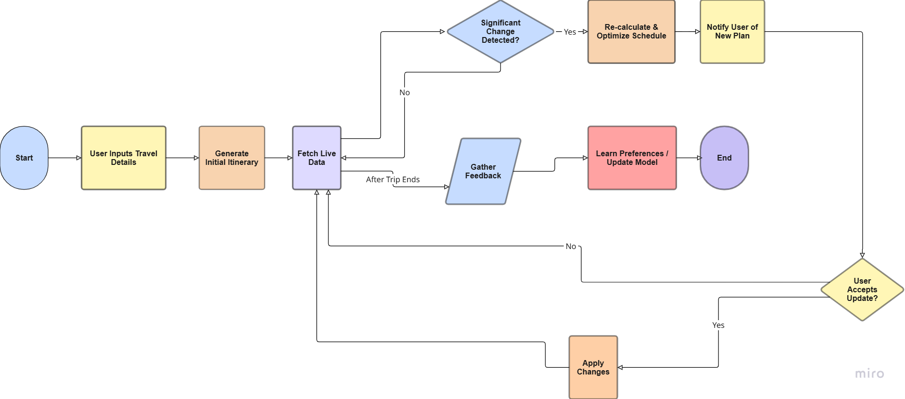
TECHNICAL APPROACH
Workflow

Slide 9
FEASIBILITY AND VIABILITY
Technical Feasibility
Proven Technology: Uses established, well-supported frameworks (React Native, Python/Flask) for easier development and hiring.
Third-Party Data Integration: Relies on reliable APIs (Google Maps, transit data) for real-time updates without building complex systems from scratch.
Economic Feasibility
Low Startup Cost: Leverages free, open-source tools to significantly reduce initial development expenses.
Scalable Infrastructure: Cloud hosting (AWS, Google Cloud) ensures costs only increase with user growth, aligning expenses with revenue.
Operational Feasibility
Clear User Benefit: Solves a common problem (travel stress) with a simple, intuitive design that encourages adoption.
Easy Maintenance: Modern, popular technology stack allows for quick updates, bug fixes, and feature additions.
Why It's Viable
Technically Sound: Uses reliable, established technology and third-party services.
Cost-Effective: Low startup costs with scalable infrastructure.
User-Focused: Solves a clear problem with an easy-to-use and maintainable solution.

Slide 10
FEASIBILITY AND VIABILITY
Challenges we might face
Strategies for overcoming these challenges
Unreliable Data: Third-party APIs (maps, events, transit) can have delays, errors, or sudden changes.
User Trust: People may not trust an AI to change their travel plans automatically.
Over-Personalization: The app might recommend only similar places, reducing exploration and diversity.
Handles API Complexity: Uses strong data validation and error handling to ensure reliable and consistent information.
Builds User Trust: Includes a manual override feature, giving users final control over all changes and recommendations.
Ensures Product-Market Fit: Starts with a simple MVP to gather early feedback and quickly improve the product based on real user needs.

Slide 11
IMPACT AND BENEFITS
Potential impact of the solution
Benefits of the solution
Eliminates Travel Stress: Automatically manages delays and disruptions for a smoother journey.
Discovers Hidden Gems: Recommends personalized off-the-beaten-path locations based on your preferences.
Full User Control: Maintain complete flexibility to accept, modify, or override any suggestion.
Adapts and Improves: Continuously learns from your choices to deliver increasingly accurate recommendations.
Effortless Experience: Removes the burden of constant replanning so you can fully enjoy your adventure.
Reduces Travel Stress: Creates a more fluid, adaptable, and less stressful experience by automatically handling disruptions.
Maximizes Travel Time: Helps users avoid delays and discover new places, ensuring they get the most value from their trip.
Supports Sustainable Tourism: Distributes visitor traffic more evenly, reducing overcrowding and benefiting local businesses in lesser-known areas.
Transforms Travel Planning: Shifts from a rigid, pre-planned itinerary to a dynamic, real-time adventure.

Slide 12
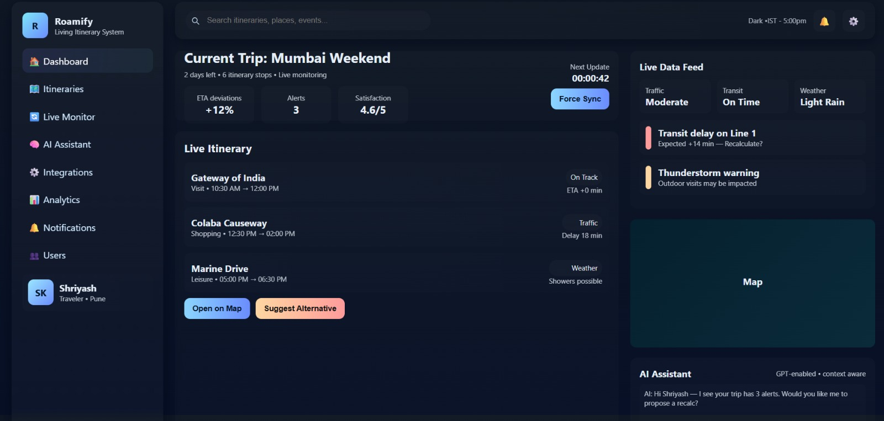
PROTOTYPE

Slide 13
THANK YOU !

