Slide 1
PREDICTIVE MAINTENANCE
BY SAYANTANI SARKAR
GUIDE : PROF. SIULI MUKHOPADHYAY

Slide 2
INTRODUCTION
Maintenance costs are a major part of the total operating costs of any manufacturing unit. In order to avoid the impact of unexpected breakdowns, the simplest process for performing scheduled maintenance is to assign technicians to check the equipment on a regular basis. This is referred to as Preventative Maintenance. However, this approach is not cost-effective, since too frequent visits result in wasted labor and travel costs, while too large a gap between visits can result in problems occurring without warning.
Predictive Maintenance (PdM) is a promising alternative that makes predictions about equipment failures to allow for advance scheduling of corrective maintenance. It thus aims to :
Prevent unexpected equipment breakdowns and improve asset reliability for customers
Reduces the additional operational costs caused by over-maintenance.
OBJECTIVE
In this study, our focus is on formulating the PdM model for ATMs under the Bank of Baroda. In simple terms, the goal is to predict whether or not an ATM will fail in the given time window. This is thus analogous to a binary classification problem.

Slide 3
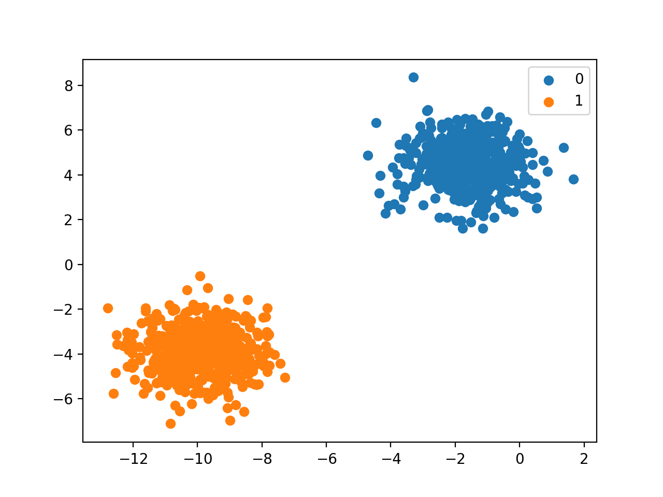
WHAT IS BINARY CLASSIFICATION?
Classification is a supervised learning method which assigns a class label to input data points.
We use classification algorithms when the target variable is not quantitative but is rather a set of discrete values or labels.
These class labels denote some statistical populations, such that data points belonging to the same class share identical properties.
A classification problem can have 2 or more distinct classes.
Accordingly we have binary classification (with classes 0 and 1) and multi-class classification.
In this study, we classify a data point into,
class 1 if the machine is likely to experience break down
class 0 if its predicted to be working fine.

Slide 4
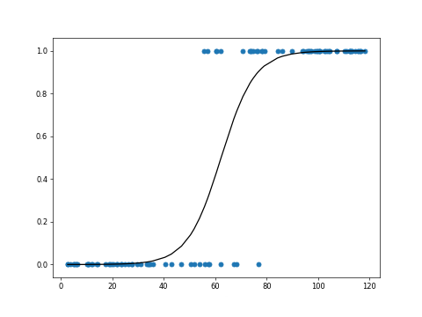
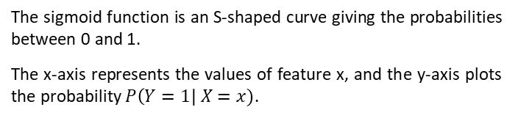
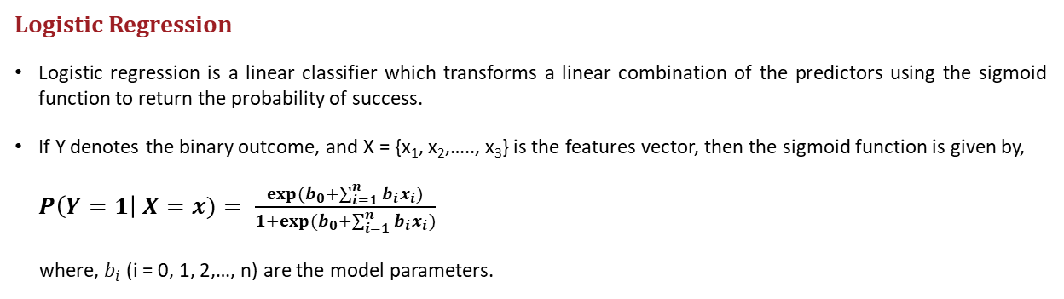
METHODS OF CLASSIFICATION
Here, three algorithms have been discussed – Logistic Regression, Decision Tree, Random Forest.
Logistic Regression
Logistic regression is a linear classifier which transforms a linear combination of the predictors using the sigmoid function to return the probability of success.
If Y denotes the binary outcome, and X = {x­₁, x₂,….., x₃} is the features vector, then the sigmoid function is given by,
$P\left(Y=1\right| X=x)= \frac{exp(b_{0}+\sum_{i=1}^{n}{b_{i}x_{i}})}{1+exp(b_{0}+\sum_{i=1}^{n}{b_{i}x_{i}})}$
where, $b_{i}$ (i = 0, 1, 2,…, n) are the model parameters.
The sigmoid function is an S-shaped curve giving the probabilities between 0 and 1.
The x-axis represents the values of feature x, and the y-axis plots the probability $P\left(Y=1\right| X=x)$.

Slide 5
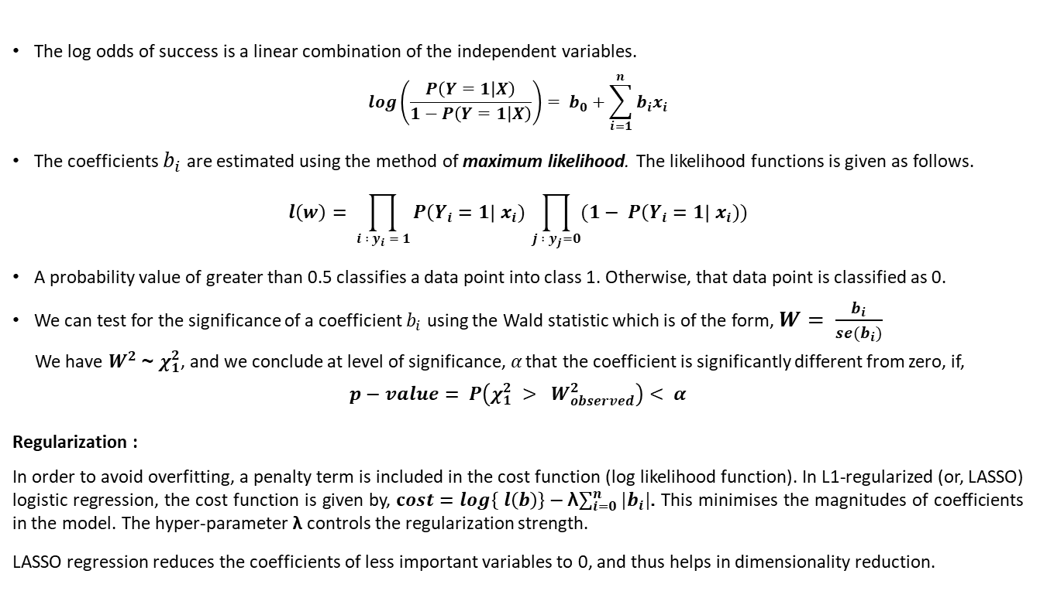
The log odds of success is a linear combination of the independent variables.
$$log\left(\frac{P\left(Y=1 | X\right)}{1−P\left(Y=1 | X\right)}\right)= b_{0}+\sum_{i=1}^{n}{b_{i}x_{i}}$$
The coefficients $b_{i}$ are estimated using the method of maximum likelihood. The likelihood functions is given as follows.
$$l\left(w\right)= \prod_{i : y_{i} = 1}{P\left(Y_{i}=1\right| x_{i})} \prod_{j :{ y}_{j}=0}{(1− P\left(Y_{i}=1\right| x_{i}))}$$
A probability value of greater than 0.5 classifies a data point into class 1. Otherwise, that data point is classified as 0.
We can test for the significance of a coefficient $b_{i}$ using the Wald statistic which is of the form, $W= \frac{b_{i}}{se(b_{i})}$
We have $W^{2}$ ~ $χ_{1}^{2}$, and we conclude at level of significance,$α$ that the coefficient is significantly different from zero, if,
$$p−value= P\left(χ_{1}^{2} > W_{observed}^{2}\right)< α$$
Regularization :
In order to avoid overfitting, a penalty term is included in the cost function (log likelihood function). In L1-regularized (or, LASSO) logistic regression, the cost function is given by, $cost=\log\left\{ l\left(b\right)\right\}−$λ$\sum_{i=0}^{n}{|b_{i}|}$. This minimises the magnitudes of coefficients in the model. The hyper-parameter λ controls the regularization strength.
LASSO regression reduces the coefficients of less important variables to 0, and thus helps in dimensionality reduction.

Slide 6
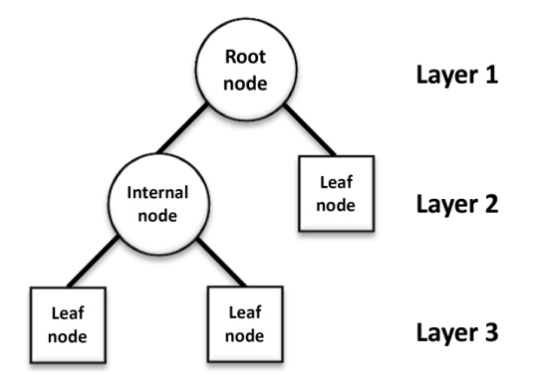
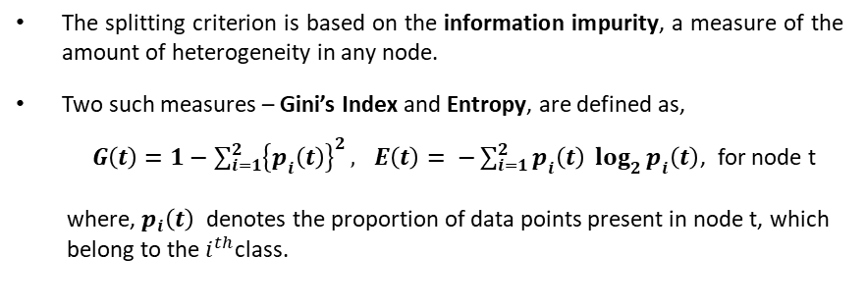
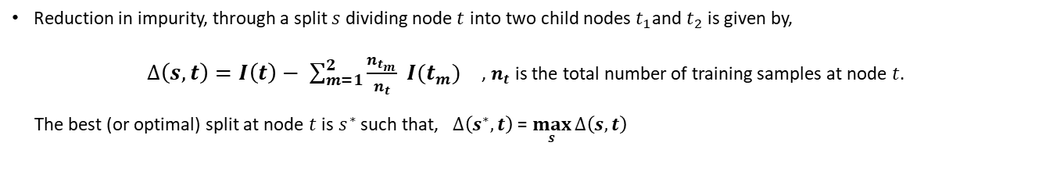
Decision Tree and Random Forest
Classification trees divide the dataset into distinct and non-overlapping groups.
The data-points within a group are more or less homogenous to each other.
We start at the top, from the root node containing all training samples, and then divide it into two child nodes through an appropriate splitting criterion. Each child node is then split recursively, as per the same spitting condition.
The splitting criterion is based on the information impurity, a measure of the amount of heterogeneity in any node.
Two such measures – Gini’s Index and Entropy, are defined as,
$G\left(t\right)=1−\sum_{i=1}^{2}{{\left\{p_{i}\left(t\right)\right\}}^{2}}, E\left(t\right)= −\sum_{i=1}^{2}{p_{i}\left(t\right) \log_{2}{p_{i}\left(t\right)}}$, for node t
where, $p_{i}\left(t\right)$ denotes the proportion of data points present in node t, which
belong to the $i^{th}$class.
Reduction in impurity, through a split $s$ dividing node $t$ into two child nodes $t_{1}$and $t_{2}$ is given by,
$∆\left(s,t\right)=I\left(t\right)− \sum_{m=1}^{2}{\frac{n_{t_{m}}}{n_{t}}} I(t_{m})$ , $n_{t}$ is the total number of training samples at node $t$.
The best (or optimal) split at node $t$ is $s^{∗}$ such that, $∆\left(s^{∗},t\right)$ = $\max_{s}{∆\left(s,t\right)}$

Slide 7
In order to prevent overfitting, we need to stop splitting the nodes according to the following stopping conditions.
Split the tree till a predefined maximum depth is attained.
A node is made terminal if the optimal gain in splitting the node is less than a specified threshold.
For a fully constructed binary classification tree, we classify all observations in a particular group or node into the majority class.
A Random Forest consists of multiple decisions trees.
For building each individual tree, it uses a random subset of features and a random sample of training observations with replacement, which is known as a bootstrap dataset.
This step of randomization on features and data helps to reduce overfitting and gives more accurate and stable predictions than those of any individual tree.
Every new input is run down each tree in a forest and is then classified into the majority class.
Random Forests also give an idea on the importance of variables.
For any variable, the sum of the decrease in Gini’s index across every tree of the forest is calculated every time that variable
is chosen to split a node. The sum is divided by the number of trees in the forest to give an average. The features with higher
average reductions in Gini’s impurity are the more important variables in the model.

Slide 8
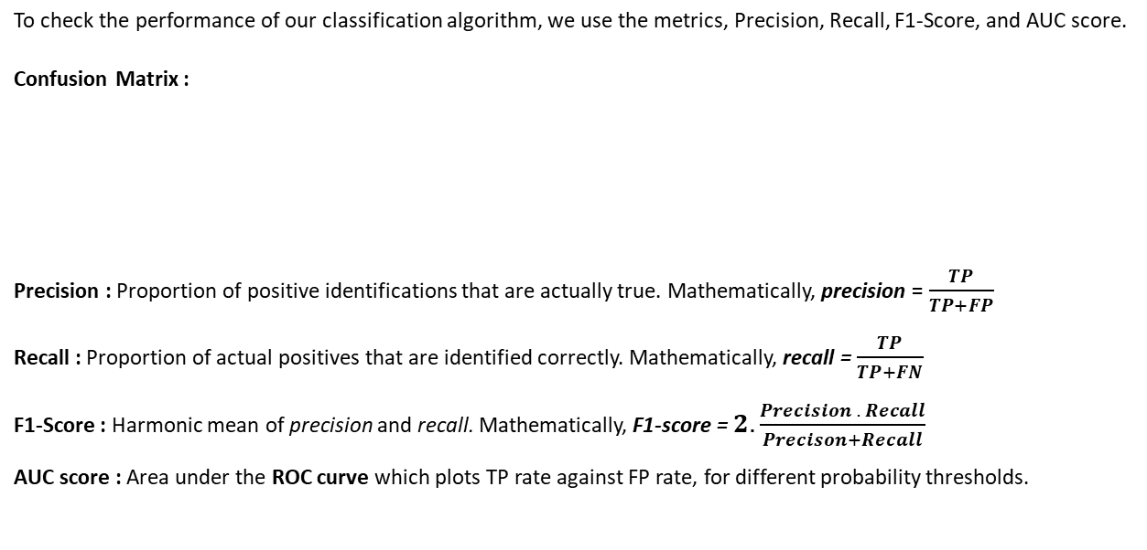
EVALUATION METRICS
To check the performance of our classification algorithm, we use the metrics, Precision, Recall, F1-Score, and AUC score.
Confusion Matrix :
Precision : Proportion of positive identifications that are actually true. Mathematically, precision = $\frac{TP}{TP+FP}$
Recall : Proportion of actual positives that are identified correctly. Mathematically, recall = $\frac{TP}{TP+FN}$
F1-Score : Harmonic mean of precision and recall. Mathematically, F1-score = $2.\frac{Precision . Recall}{Precison+Recall}$
AUC score : Area under the ROC curve which plots TP rate against FP rate, for different probability thresholds.
Predicted Actual | 0 | 1
0 | True negative (TN) | False positive (FP)
1 | False negative (FN) | True positive (TP)

Slide 9
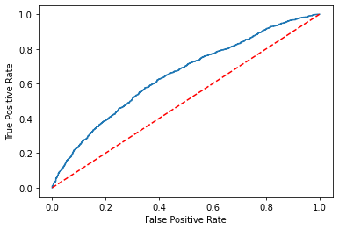
Fig 3 : Graph showing the ROC curve (blue) and the line of equal TPR and FPR (red)

Slide 10
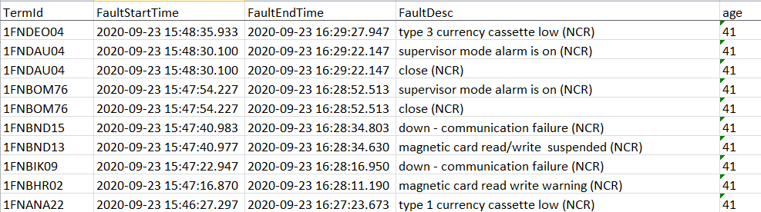
Source of data
We have two main sources from which instances is to be generated.
System logs, that include error event data. This data is provided by the equipment owner.
TermId : ATM Id. There are 3681 unique machines.
FaultStartTime : Start time of system error, in the format, YYYY-MM-DD HH:MM:SS.
FaultEndTime : End time of system error, in the format, YYYY-MM-DD HH:MM:SS.
FaultDesc : Type of error or system warning. There are 103 different errors.
Age : Difference in start time and end time, in nearest minutes.

Slide 11
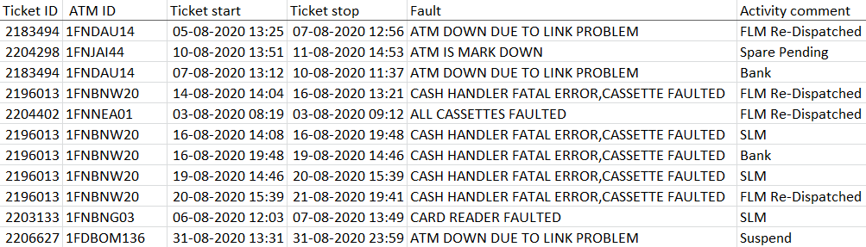
Ticket creation data, that gives information regarding the tickets created in response to past failures. The data is given by the Maintenance Service Providers (MSP).
Ticket ID : Identification number for ticket raised.
ATM ID : Machine Id. There are 3702 unique machines for which tickets are created.
Ticket Start : Time when ticket is created, in the format, DD-MM-YYYY HH:MM.
Ticket Stop : Time of closing ticket, in the format, DD-MM-YYYY HH:MM.
Fault : Description of the error for which the ticket is created.
Activity comment : Comment on the maintenance process.
NOTE : Only data for the month of August has been considered in the analysis.

Slide 12
DATA GENERATION
Prediction Point | A time point when the model makes a prediction as to whether or not the device will fail in the near future. For each different prediction point, we get a separate set of values of features and the target.
Observation Window (OW) | It consists of all occurrences of errors and systems warnings, prior to the prediction point. The OW is further divided into X periods each of length M days. Each sub-window is called a measurement unit. Features are created based on data observed during these measurement units. Length of entire OW is (X x M).
Prediction Window (PW) | Having a length Y, the prediction window comes after the prediction point. The PW gives us the value of the target variable for a particular instance. We define the target as 1, if there is any ticket created during this period, 0, otherwise.
Buffer Window | Between the prediction point and the prediction window, there might be an optional buffer window of Z days, which controls the minimum time duration between prediction point and impending ticket creation. For training data, the buffer window will have no tickets.

Slide 13
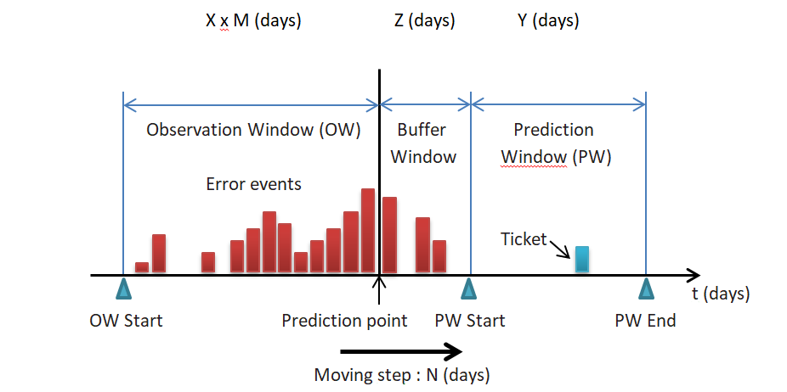
Source - Predictive Maintenance based on event-log analysis : A case study
By J. Wang, C. Li, S. Han, S. Sarkar, X. Zhou.

Slide 14
Steps taken in data generation :
Take a particular length of OW, with optimal values of X and M (discussed later), select length of Y. Set Z = 0.
Extract features from the observation window. The different features created are discussed later.
A particular time period consisting of OW, prediction point and PW will give us one row or data instance in our dataset.
Shift the prediction point by 2 days (can be varied), to generate more rows. This means shifting the entire period of observation window-prediction point-prediction window by 2 days, along a time axis of length N.
This entire window from OW start to PW end is shifted with respect to time in such a way that PW end does not go beyond 31st August, 2020. This implies that in this problem, N = 31 days.
For one particular machine, the above 5 steps will give a set of rows.
If these steps are repeated for all 3681 machines, we construct the full dataset for the month of August.

Slide 15
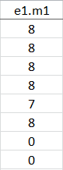
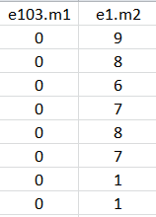

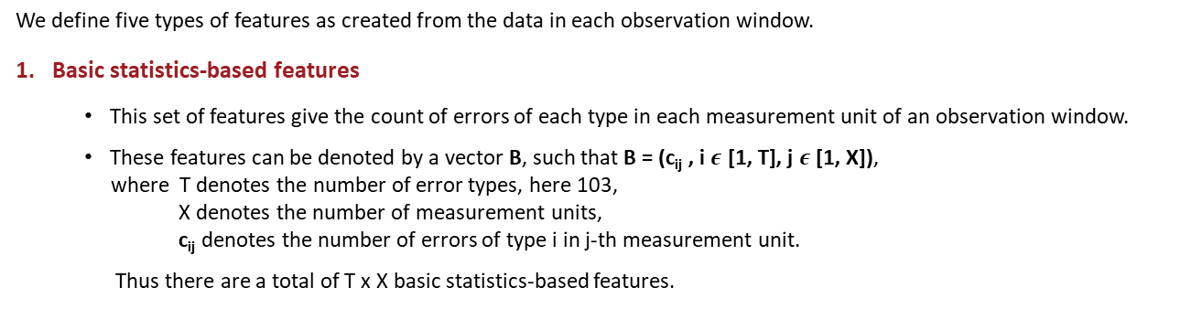
Feature extraction
We define five types of features as created from the data in each observation window.
1. Basic statistics-based features
This set of features give the count of errors of each type in each measurement unit of an observation window.
These features can be denoted by a vector B, such that B = (c_{ij} , i $ε$ [1, T], j $ε$[1, X]),
where T denotes the number of error types, here 103,
X denotes the number of measurement units,
c_{ij} denotes the number of errors of type i in j-th measurement unit.
Thus there are a total of T x X basic statistics-based features.
……
……
……
……
For example, by taking X = 2, we get the following table.
We get a total of 206 features.

Slide 16
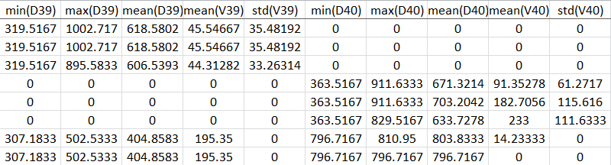
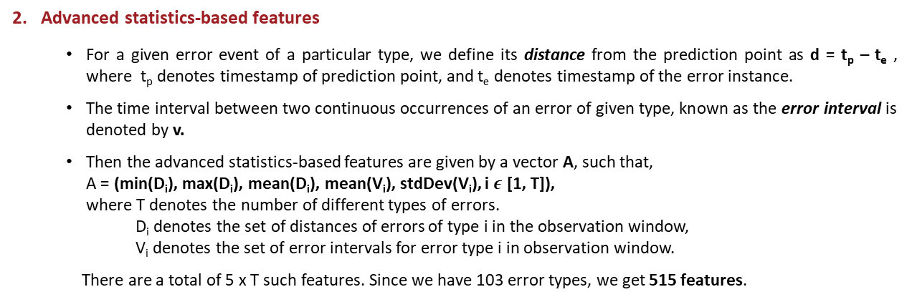
2. Advanced statistics-based features
For a given error event of a particular type, we define its distance from the prediction point as d = t_{p} – t_{e} , where t_{p} denotes timestamp of prediction point, and t_{e} denotes timestamp of the error instance.
The time interval between two continuous occurrences of an error of given type, known as the error interval is denoted by v.
Then the advanced statistics-based features are given by a vector A, such that,
A = (min(D_{i}), max(D_{i}), mean(D_{i}), mean(V_{i}), stdDev(V_{i}), i $ε$ [1, T]),
where T denotes the number of different types of errors.
D_{i} denotes the set of distances of errors of type i in the observation window,
V_{i} denotes the set of error intervals for error type i in observation window.
There are a total of 5 x T such features. Since we have 103 error types, we get 515 features.
We give a snapshot of features generated for error types
39 and 40.

Slide 17
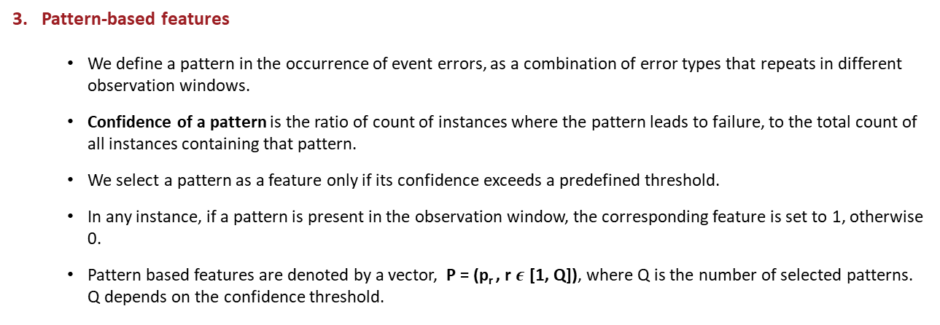
(Discussed in details in later slides)
3. Pattern-based features
We define a pattern in the occurrence of event errors, as a combination of error types that repeats in different observation windows.
Confidence of a pattern is the ratio of count of instances where the pattern leads to failure, to the total count of all instances containing that pattern.
We select a pattern as a feature only if its confidence exceeds a predefined threshold.
In any instance, if a pattern is present in the observation window, the corresponding feature is set to 1, otherwise 0.
Pattern based features are denoted by a vector, P = (p_{r} , r $ε$ [1, Q]), where Q is the number of selected patterns. Q depends on the confidence threshold.

Slide 18
(Yet to be extracted)
4. Feature Similarity based features
Failure similarity features deal with the repeated failures of the device in the past.
Failures of a given type often repeat and the occurrence of each such failure is preceded by similar types of errors. This helps to predict future failures by looking at past failures and the errors leading to them.
For a particular prediction point or a particular instance, the different types of errors appearing in the observation window is denoted by a set G.
A ticket created most recently with respect to the current instance, also has an observation window prior to it, which further consists of a collection of error types denoted by the set H.
The failure similarity feature F for the given instance is calculated as the Jaccard distance between G and H.
5. Profile-based features
Profile based features denoted by the vector R, include equipment related information such as,
Device model name | Device ID/code | Date of installation | Device location

Slide 19
STEps of algorithm
Step 1 : Experiments on model parameters – tuning X, M, Y and Z.
Step 2 : Experiments on features - analyzing predictive effectiveness of features groups and their combination.
Step 3 : Dimensionality reduction.
Step 4 : Classification model building
Step 5 : Model validation and selection.

Slide 20
1. Experiments on model parameters
Features : Basic and Advanced statistics-based (Pattern features are not used)
Classifier : Random Forest (maximum depth = 5, number of trees = 50)
Category 1 : Tune X keeping Y, Z, M fixed.
Y = 5 Z = 0 M = 5 |  | Precision | Recall | F1-score | AUC
 | X = 1 | 0.6336 | 0.5899 | 0.6109 | 0.6414
 | X = 2 | 0.6222 | 0.5487 | 0.5831 | 0.6287
 | X = 3 | 0.6038 | 0.6290 | 0.6162 | 0.6211
 | X = 4 | 0.5950 | 0.6819 | 0.6355 | 0.6332
 | X = 5 | 0.6020 | 0.5733 | 0.5873 | 0.6077

Slide 21
Category 2 : Tune Y given fixed X, M, and Z. We observe that bigger the Y value, better is the performance.
X = 4 M = 5 OW = 20 Z = 0 |  | Precision | Recall | F1-score | AUC
 | Y = 2 | 0.6792 | 0.0195 | 0.0379 | 0.6256
 | Y = 3 | 0.7113 | 0.1013 | 0.1773 | 0.6307
 | Y = 4 | 0.6767 | 0.3110 | 0.4262 | 0.6399
 | Y = 5 | 0.5950 | 0.6819 | 0.6355 | 0.6332
 | Y = 6 | 0.5885 | 0.9837 | 0.7360 | 0.6498
Category 3 : Tune the combination of X and M, keeping OW, Y, and Z fixed.
OW = 20 Y = 6 Z = 0 |  | Precision | Recall | F1-score | AUC
 | X x M = 1 x 20 | 0.5889 | 0.9788 | 0.7354 | 0.6507
 | X x M = 2 x 10 | 0.5885 | 0.9870 | 0.7374 | 0.6519
 | X x M = 4 x 5 | 0.5885 | 0.9837 | 0.7360 | 0.6563
 | X x M = 5 x 4 | 0.5872 | 0.9846 | 0.7357 | 0.6494

Slide 22
2. Experiments on FEATUREs (PART I)
We use the two sets of features, basic statistics based features (B) and advanced statistics based features (A) (Pattern features are not yet used). We want to evaluate the predictive effectiveness of these groups individually and of their combination.
Classifier : Random Forest (maximum depth = 5, number of trees = 50)
Parameters : X x M = 2 x 10 (OW = 20), Y = 6, Z = 0
Data : There are 2 x 103 = 206 basic statistics based features, 5 x 103 = 515 advanced statistics based features (total, 721)
We do a 60%-40% split of the dataset consisting of 8964 instances, into training and test data.
Size of training set is 5378 samples, with 3117 positive samples and 2261 negative samples
Size of test set is 3586 samples, with 2078 positive samples and 1508 negative samples
Feature Groups | Precision | Recall | F1-score | AUC
B | 0.5818 | 0.9808 | 0.7298 | 0.6115
A | 0.5925 | 0.9774 | 0.7377 | 0.6491
B, A | 0.5885 | 0.9870 | 0.7374 | 0.6519
Both sets of features, B and A, individually or together are significant in predicting the target.

Slide 23
3. Experiments on FEATURE SELECTION
LASSO regression
L1 regularized Logistic regression with penalty parameter λ = 0.01, gives a reduced set of 381 features.
Wald Test
The target variable is regressed on one feature at a time, using Logistic Regression, to test for the significance of the feature. For all 381 features, the p-value of Wald statistic is less than 0.05 (level of significance), implying that all the features are important.
Feature Importance using Random Forest
Starting with the most important feature, we apply a stepwise approach and train increasingly more complex models, by adding a new feature at each step. Only those features are retained, for which the model performance, in terms of the F1-Score, improves by at least 0.0001. This further reduces the number of features to 190.
Number of features | Precision | Recall | F1-score | AUC
721 | 0.5885 | 0.9870 | 0.7374 | 0.6519
381 | 0.5903 | 0.9803 | 0.7368 | 0.6489
190 | 0.5896 | 0.9774 | 0.7355 | 0.6486

Slide 24
Modelling using subsets of errors, tickets and machines
So far, we have considered all the 103 unique errors. Now we consider only a set of Priority 1 errors as listed by the bank authorities. The list of Priority 1 errors are given alongside.
In addition we will now only focus solely on First Level and Second
Level Maintenance (FLM and SLM respectively) tickets.
Also, we calculate the average number of tickets in a month for every
ATM, and consider only those which have not more than 8 average
monthly number of tickets.
We now have data for 5 months starting from August till December.
From hereon, we include pattern based features in our analysis.
All Cassette Faulted (DIEBOLD)
All Cassette Faulted (NCR)
both supply and supervisor switches on (DIEBOLD 10xx)
card reader failure (DIEBOLD 10xx)
cash handler fatal (NCR)
cash handler reject bin overfill (NCR)
Cashout (DIEBOLD)
Cashout (NCR)
close (DIEBOLD 10xx)
close (NCR)
down - communication failure (DIEBOLD 10xx)
down - communication failure (NCR)
encrypted pin pad failure (DIEBOLD 10xx)
encryptor fatal (NCR)
journal paper out (NCR)
journal printer fatal (NCR)
journal printer paper out (DIEBOLD 10xx)
magnetic card read/write fatal (NCR)
supervisor mode alarm is on (NCR)
supervisor switch on (DIEBOLD 10xx)
receipt printer fatal (NCR)

Slide 25
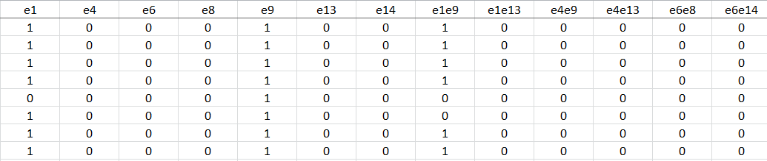
Extraction of Pattern-based Features
Instead of checking for all possible patterns of all possible lengths (<= number of errors), we take the following approach.
We first check the confidence of each of the single error types as patterns of length 1. We consider only the Priority 1 errors.
Next we form pairs of only those errors having confidence greater than a specific threshold, so that we get patterns of length 2.
If a pattern is recorded atleast once in an observation window, then the value of the pattern feature corresponding to that particular feature is 1, otherwise it is set to 0, (recall that each observation window maps to a single row).
For patterns of length 2, we check their presence in the OW, irrespective of the order of the two errors.
A snippet of the generated pattern based features is as follows.
The errors and patterns that qualify as valid features vary when we change the parameters of our model.

Slide 26
4. Experiments with different subsets
Features : Basic and Advanced statistics-based, and Pattern-based features
Classifier : Random Forest (maximum depth = 5, number of trees = 50)
Errors : 21 priority-1 errors as provided by Bank of Baroda
Parameters : X x M = 2 x 10 (OW = 20), Y = 10, Z = 0
We do a 70%-30% train-test split of the dataset in each case.
 | All machines |  |  |  | Machines with monthly average tickets not exceeding 8
 | Precision | Recall | F1-Score | AUC | Precision | Recall | F1-Score | AUC
All tickets | 0.6806 | 0.9980 | 0.8099 | 0.6535 | 0.6274 | 0.9900 | 0.7710 | 0.6248
FLM/SLM tickets | 0.6514 | 0.9117 | 0.7599 | 0.6676 | 0.6126 | 0.7908 | 0.6904 | 0.6337
Observations :
When we consider all the tickets, it makes no difference whether we are considering all machines or just the machines with less than 8 monthly tickets
However, when we focus on just FLM/SLM, the recall decreases significantly when we reduce the set of machines.

Slide 27
5. Experiments on FEATUREs (PART II)
Features : Basic and Advanced statistics-based, and Pattern-based features
Classifier : Random Forest (maximum depth = 5, number of trees = 50)
Errors : 21 priority-1 errors as provided by Bank of Baroda
Tickets : FLM and SLM
Machines : ATMs with not more than 8 average monthly tickets
Parameters : X x M = 2 x 10 (OW = 20), Y = 10, Z = 0
We do a 70%-30% train-test split of the dataset in each case.
Feature Groups | B | A | P | B, A | B, P | A, P | B, A, P
Precision | 0.6031 | 0.6117 | 0.5587 | 0.6096 | 0.6001 | 0.6110 | 0.6103
Recall | 0.8223 | 0.7891 | 0.9998 | 0.7909 | 0.8263 | 0.7879 | 0.7929
F1-Score | 0.6959 | 0.6892 | 0.7168 | 0.6885 | 0.6953 | 0.6883 | 0.6897
AUC | 0.6247 | 0.6306 | 0.5724 | 0.6316 | 0.6247 | 0.6306 | 0.6319

Slide 28
Profile Based Features
We have observed from the descriptive statistics on the different properties of the machines, that the type of machine (CAPEX or CR) has different distributions of tickets and errors and hence can be considered to be a variable in our predictive model.
Therefore, we introduce a new indicator variable, with 1 denoting a CAPEX machine and 0, a Cash-Recycler, and observe the evaluation metrics. This feature can be included in the dataset as a profile-based feature, which we denote as Pr.
Features : Basic and Advanced statistics-based, Pattern-based features, and Site Type indicator
Classifier : Random Forest (maximum depth = 5, number of trees = 50)
Errors : 21 priority-1 errors
Tickets : FLM and SLM
Machines : ATMs with not more than 8 average monthly tickets
Parameters : X x M = 2 x 10 (OW = 20), Y = 10, Z = 0
Feature Groups | Precision | Recall | F1-score | AUC
B, A, P, Pr | 0.6106 | 0.8027 | 0.6936 | 0.6356

Slide 29
FUTURE TASKS
The faikure similarity based (F) and other profile based features (R) need to be extracted from the data on ATMs.
In the next phase, we need to find a way to focus on only the tickets corresponding to SLM.
Different models, apart from Random Forest are to be fitted.

Slide 30
THANK YOU.

