Slide 1
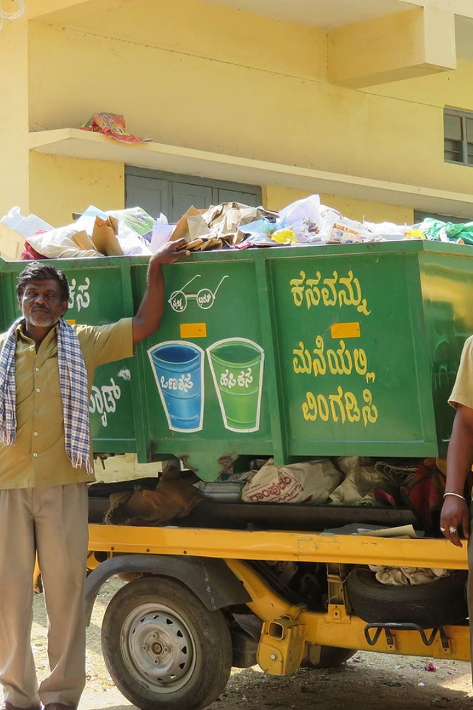
AI-Based Waste Segregation System
Introducing an innovative AI-based waste segregation system designed to tackle the challenges of environmental waste management.

Slide 2
Introduction
In this deck, we will discuss the challenges in waste segregation, provide an overview of our AI-based segregation system, explore its system architecture, highlight the advantages of AI for waste segregation, go through the implementation process, present the results and positive impact, and conclude with a call to action.
Waste segregation is an important aspect of proper waste management. However, it can be a challenging and time-consuming task. Our AI-based segregation system aims to address these challenges by leveraging the power of artificial intelligence. By using advanced algorithms and machine learning techniques, our system can accurately identify and separate different types of waste materials, such as plastic, paper, glass, and metal.
In the following slides, we will delve into the details of our AI-based waste segregation system, including its architecture, the benefits it offers over traditional methods, and the positive impact it can have on the environment and society as a whole. We will also provide insights into the implementation process and share the results of our system's performance.

Slide 3
Challenges in Waste Segregation
1
Inefficient Processes
2
Environmental Impact
3
Lack of Awareness
Manual waste segregation methods are time-consuming and error-prone.
Mixed waste contributes to pollution and affects natural ecosystems.
Many individuals are unaware of the importance of proper waste segregation.
4
Limited Resources
5
Behavioral Challenges
Insufficient infrastructure and funding hinder effective waste segregation.
Changing people's habits and attitudes towards waste segregation is a challenge.

Slide 4
AI-Based Segregation System Overview
Automated Sorting
Data Processing
User Interface
Utilizes advanced algorithms to automatically categorize different types of waste.
Analyzes various attributes of waste items for efficient segregation.
Provides a user-friendly interface for easy monitoring and system management.
This helps in saving time and effort required for manual sorting.
By analyzing data, the system can make accurate decisions on waste classification.
Users can easily access and control the system through the intuitive interface.

Slide 5
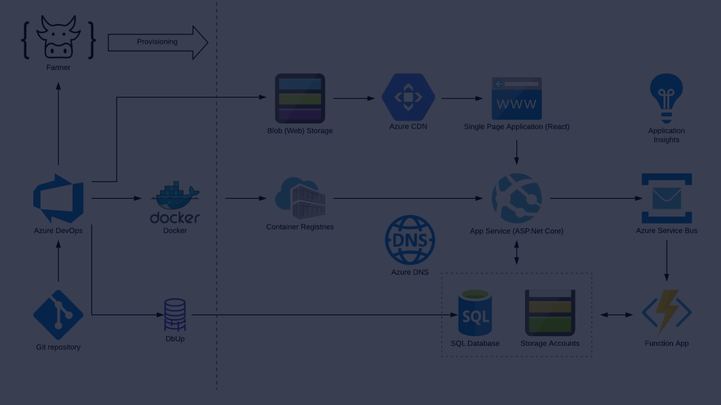
System Architecture
Components Overview
Workflow Process
Our system consists of image recognition modules, a database, and decision-making algorithms.
The system receives input, processes data, and directs items to the appropriate waste streams.
Integration with Existing Infrastructure
Data Security and Privacy
Scalability and Performance
User-Friendly Interface

Slide 6



Advantages of AI for Waste Segregation
Efficiency
Environmental Impact
Accuracy
AI optimizes waste segregation processes by utilizing advanced algorithms and machine learning techniques. It quickly and accurately sorts different types of waste, reducing sorting time and enabling effective waste management.
AI automates waste segregation, minimizing environmental pollution and promoting sustainable waste management. It identifies recyclable materials, reducing waste in landfills and incinerators, and contributing to resource conservation.
AI-based waste segregation systems precisely identify and categorize waste materials. This improves segregation quality, reduces errors, enhances recycling effectiveness, and minimizes contamination.

Slide 7

Implementation Process
1
Feasibility Study
Conduct a study to evaluate the site and assess waste types.
2
Installation & Testing
Implement the AI system and conduct comprehensive testing.
3
Training & Maintenance
Train staff and establish regular maintenance protocols.

Slide 8

Results and Positive Impact
Efficiency Gains
Environmental Conservation
Significant reduction in segregation time and increased accuracy.
Noticeable decline in environmental contamination and ecosystem preservation.

Slide 9



Conclusion
Revolutionary Technology
Environmental Preservation
The AI-based waste segregation system presents a groundbreaking approach to waste management. By leveraging the power of artificial intelligence, we can revolutionize how waste is sorted and processed, leading to more efficient and sustainable waste management practices.
Adoption of this system leads to a greener and cleaner future. By accurately identifying and sorting different types of waste, we can minimize the impact on the environment, reduce contamination, and promote recycling and resource recovery. Together, we can work towards a more sustainable and eco-friendly world.

Slide 10
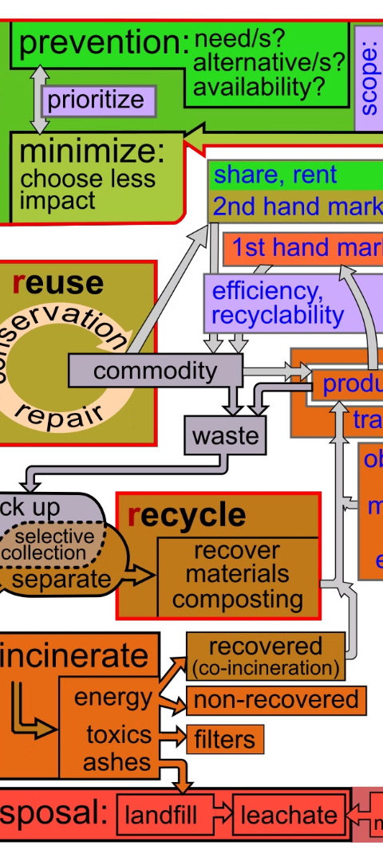
Call to Action
1
Explore Collaborations
2
Promote Awareness
Seek potential partnerships to deploy the AI segregation system on a larger scale. Collaborate with organizations, waste management companies, and technology providers to expand the implementation and impact of the system.
Educate communities about the benefits of environmentally conscious waste management. Conduct awareness campaigns, workshops, and educational programs to increase public understanding and participation in responsible waste segregation practices.
3
Community Engagement
Engage with local communities to foster a sense of ownership and involvement in waste segregation initiatives. Organize community events, volunteering activities, and interactive sessions to encourage active participation and collaboration.

Slide 11
Team Member
1. Yash Kumar Sriwastav - BTCS B - 2260468
2. Parth Lalit Limbani – 5 BTCS A - 2260412
3. Adarsh Ramani – 5 BTIT - 2261001
Educate communiabout the benefits of environmentally conscious waste management. Conduct awareness campaigns, workshops, and educational programs to increase public understanding and participation in responsible waste segregation practices.
Thank You

