Slide 1
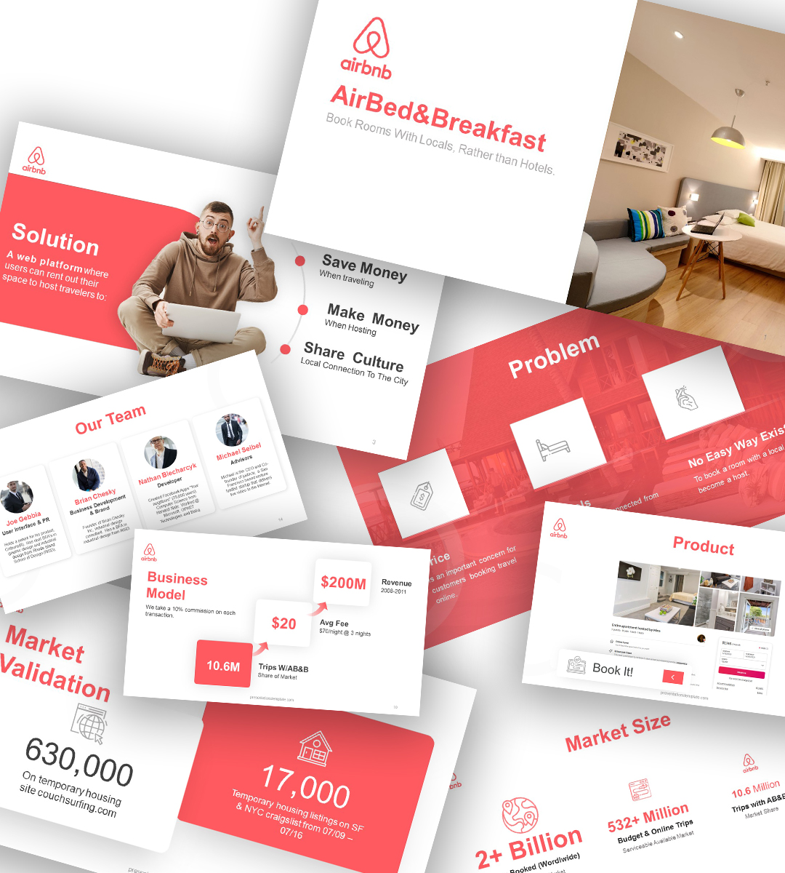


Airbnb Data Analysis
OBJECTIVE
Conduct a comprehensive exploratory analysis on consumer behavior and sales patterns to provide valuable insights for hosts seeking to optimize their rental income by strategically showcasing their properties during high-demand periods.
PROJECT & DATA
• Kaggle
LIMITATIONS
• Data only contains records from 2016.
TECHNIQUES APPLIED
• Data Exploration
• Exporting Data
• Building relations/Join between tables
• Creating Visualization in Tableau
TOOLS

Slide 2
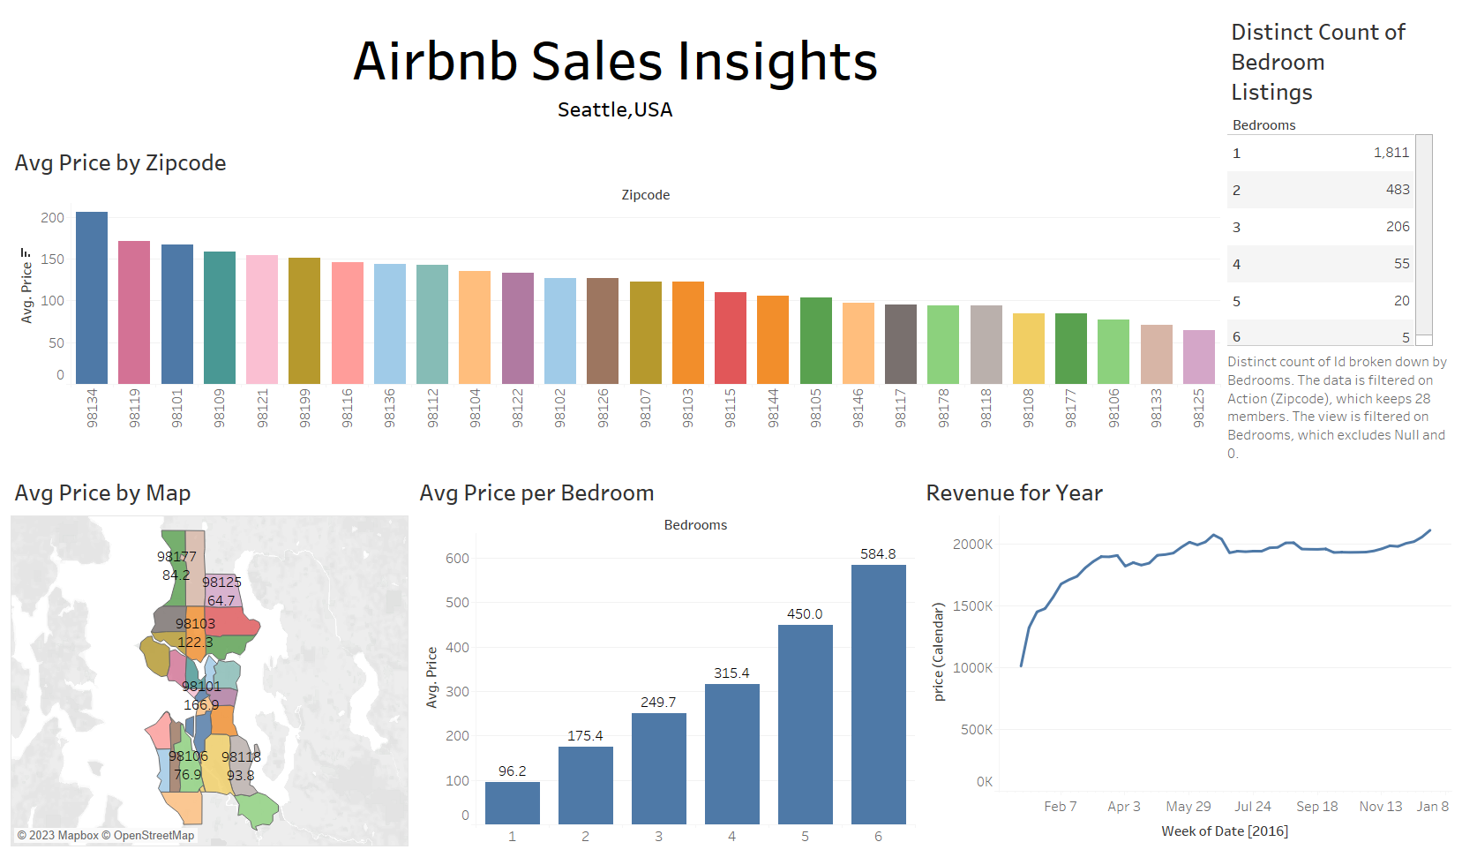

Slide 3
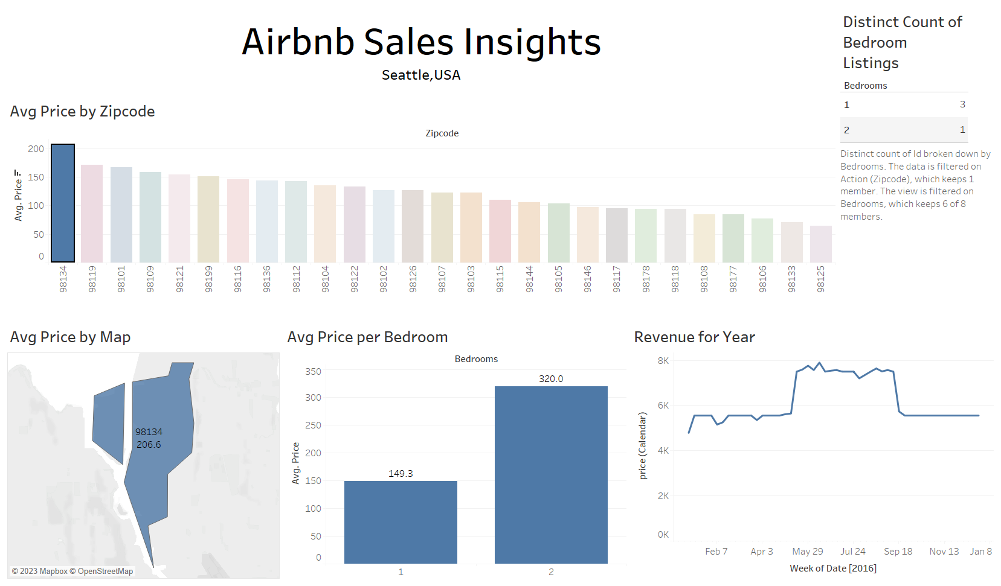
This dashboard highlights the highest avg price by zip code as filter.
Zip code: 98134 has one & two bedroom apartments only.
The best month for rental income for that zip code is from last week of May to last week of September.

