Slide 1




HACKTHIS
TUNE
By Devhacks

Slide 2

INTR
"GET READY TO JAM OUT WITH THE ULTIMATE MUSIC DESTINATION!"
"OUR WEBSITE BRINGS THE BEAT STRAIGHT TO YOU WITH ITS USER-FRIENDLY DESIGN AND TOP-NOTCH FEATURES."
"DISCOVER YOUR NEXT FAVORITE HIT, EASILY SEARCH FOR SONGS BY GENRE, ARTIST, AND MOOD, AND SAVE THEM FOR LATER LISTENING."
"SAY GOODBYE TO THE HASSLE OF SHUFFLING THROUGH ENDLESS PLAYLISTS"

Slide 3
FEATURES
" CUSTOMIZE AND CONQUER YOUR SOUNDTRACK! "
" SAVE YOUR FAVOURITE SONGS FOR LATER LISTENING "
" DISCOVER TRENDING SONGS FROM A VAST MUSIC LIBRARY "
" AN EASY-TO-USE AND INTUITIVE USER INTERFACE "
" DIRECTLY SEARCH SONGS FROM THE WEBSITE "

Slide 4
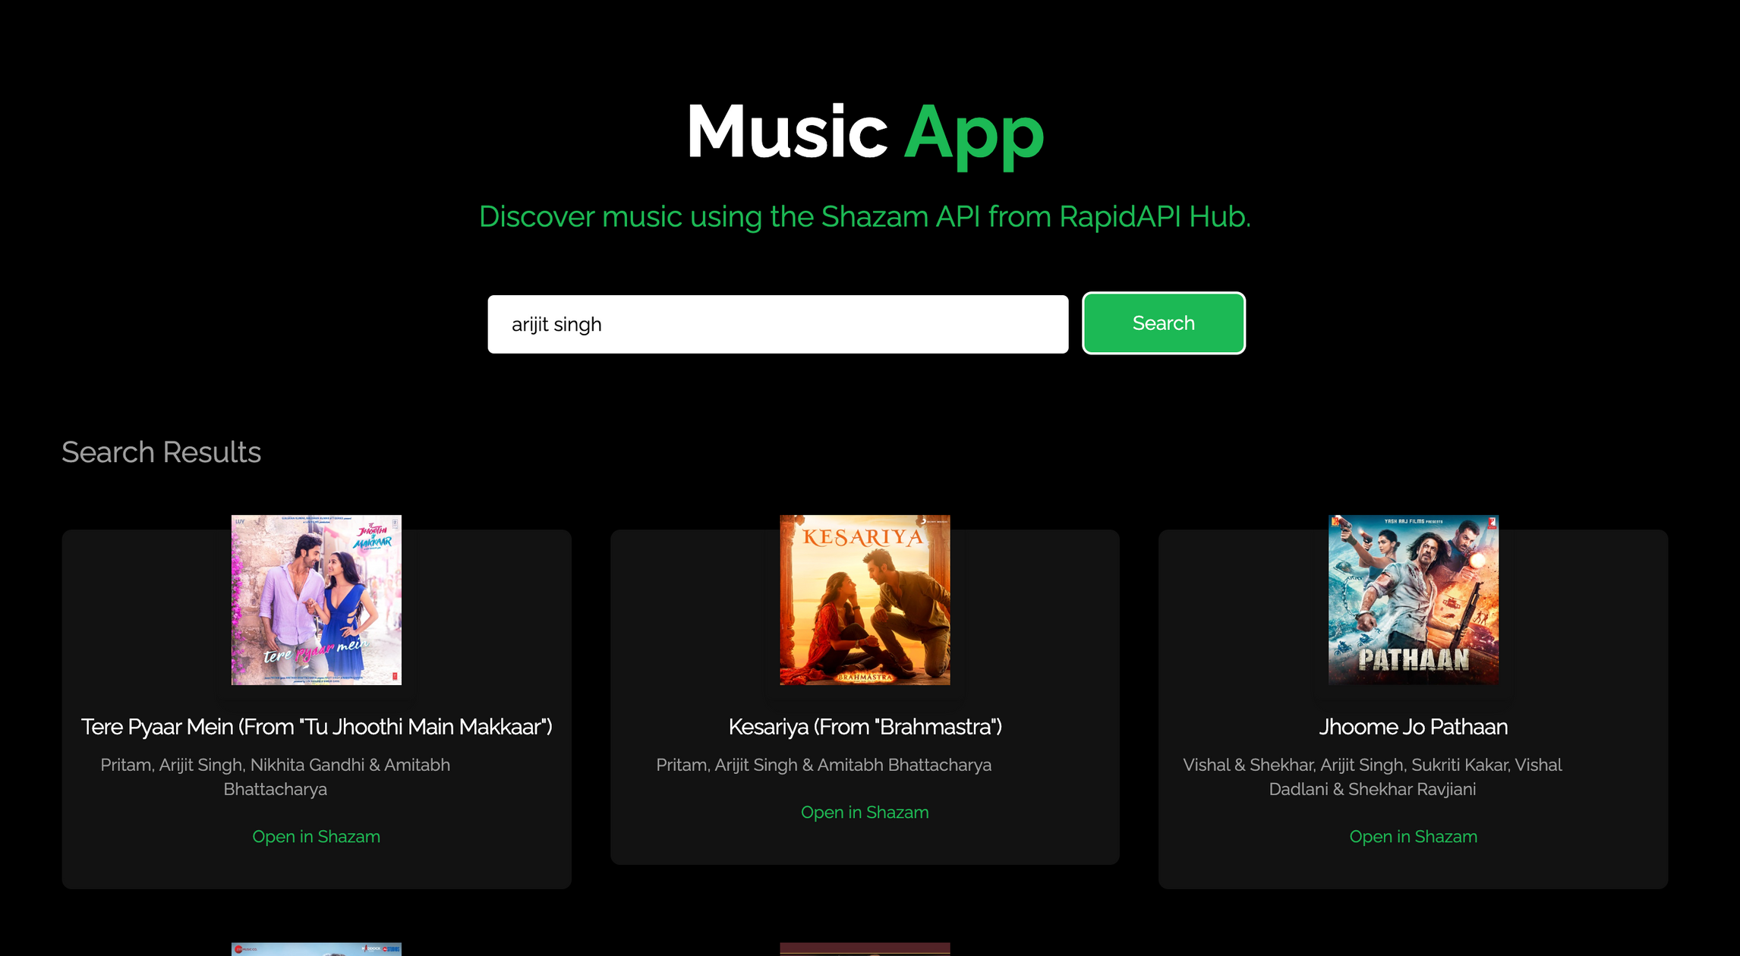

Slide 5
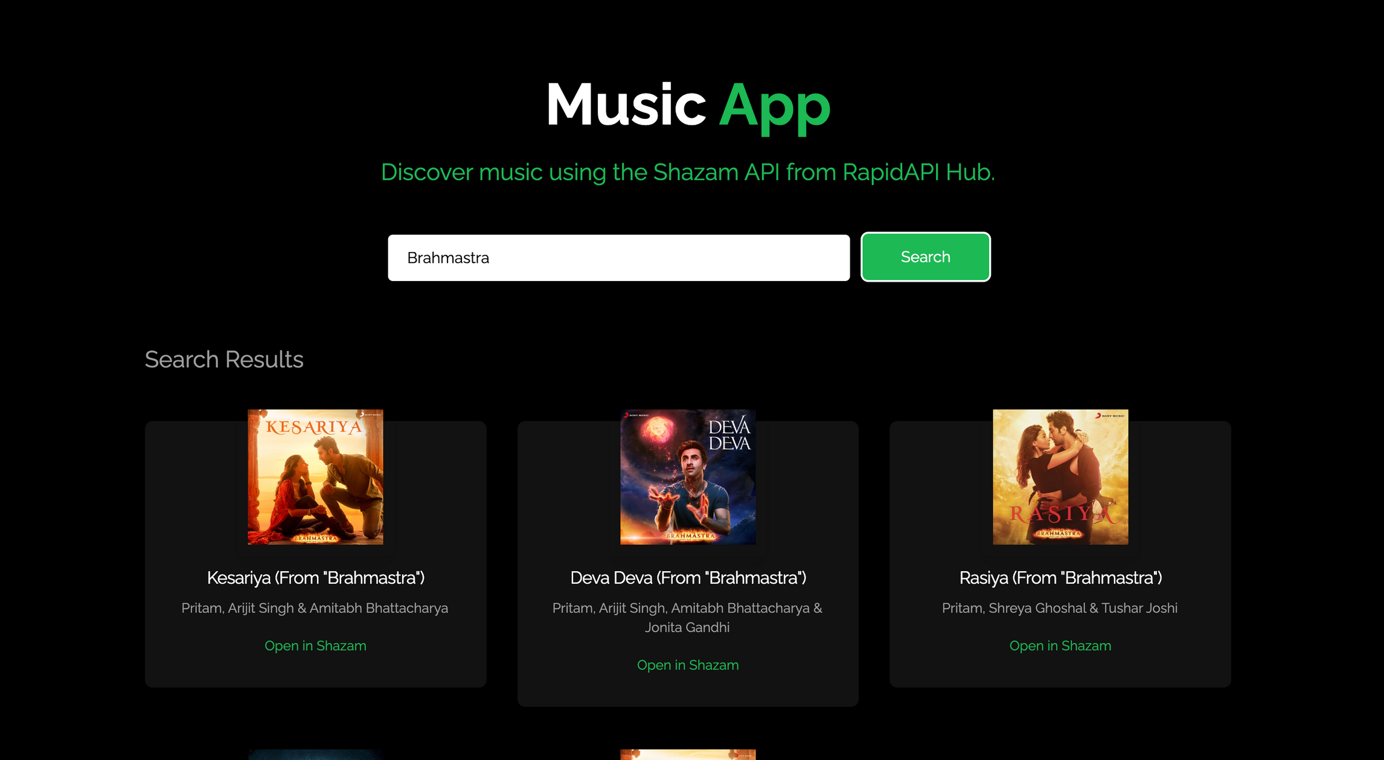

Slide 6


THANK YOU

