Slide 1


CAPSTONE PROJECT
E-Commerce Sales Performance Dashboard
Presented By
Student Name: Parth Santosh Mahadik
College Name: Sandip University
Department: B.Tech CSE
Email ID: parthmahadik08@gmail.com

Slide 2
OUTLINE:
Problem Statement
Proposed System/Solution
System Development Approach
Algorithm & Deployment
Result (Output Image)
Conclusion
Future Scope
References

Slide 3
Problem Statement:
Currently, the management team of an e-commerce retail store struggles to quickly understand their sales performance and profitability over time.
Data is stored in massive, difficult-to-read transactional spreadsheets.
This makes it challenging to identify which product categories are driving revenue, which customer segments are the most profitable, and whether certain regions or shipping methods are causing financial losses.
Eventually, providing the executive team with a clear, interactive, and accurate overview becomes a major concern for making data-driven business decisions.

Slide 4
Proposed Solution:
The proposed system aims to address the challenge of data visibility by developing a fully interactive Business Intelligence (BI) dashboard. This involves leveraging data analytics and visualization techniques to uncover business trends. The solution consists of the following components:
Data Collection: Gathered historical e-commerce sales data comprising over 9,800 records, including order dates, geographic locations, product categories, and financial metrics.
Data Preprocessing: Cleaned the raw data to handle missing values (e.g., missing postal codes) and corrected data types. Addressed date formatting issues by splitting and merging columns into a universal 'YYYY-MM-DD' format.
Feature Engineering: Created custom columns, such as Delivery Days (calculating the difference between Order Date and Ship Date), and engineered DAX measures including Total Sales, Total Orders, and Average Order Value.

Slide 5
System Approach:
Data Visualization & Modeling: Microsoft Power BI Desktop
Data Transformation: Power Query Editor (used for ETL - Extract, Transform, Load processes)
Analytics Language: DAX (Data Analysis Expressions) for creating custom aggregate measures.
Dataset: Flat file data modeling (CSV format).

Slide 6
Algorithm & Deployment:
Details on how the dashboard was constructed to provide interactive insights.
Data Modeling: Utilized a single-table flat file structure optimized for high-speed filtering and analysis.
Measure Creation: Developed dynamic DAX measures that recalculate instantly based on user filters.
Dashboard creation: Built a multi-page dashboard (Overview and Details pages) using synced slicers for cross-filtering. Implemented professional design principles including a clean layout, a suitable color theme, and custom page navigation buttons.

Slide 7
Algorithm & Deployment:
Dashboard Components & Visual Analytics: To provide a comprehensive view of the e-commerce data, specific Power BI visualizations were selected based on their analytical strengths:
Key Performance Indicators (KPI Cards):
Visuals Used: 4 Custom DAX Cards (Total Sales, Total Orders, Average Order Value, Total Customers).
Purpose: To provide stakeholders with an immediate, high-level snapshot of the most critical business metrics at a single glance without needing to analyze complex charts.
Trend & Categorical Analysis:
Visuals Used: Line Chart & Clustered Bar Charts.
Purpose: The Line Chart tracks revenue growth and seasonal spikes over multiple years. The Bar Charts are used to rank the best-performing product Sub-Categories and filter for the "Top 10" most valuable customers.
Proportional & Geographic Distribution:
Visuals Used: Donut Chart, Treemap, and Map.
Purpose: The Donut Chart and Treemap visually break down market share across different consumer segments (Consumer vs. Corporate) and major product categories. The Map visualizes regional dominance, showing exactly which states generate the most revenue.
Detailed Drill-Downs & Custom Metrics:
Visuals Used: Matrix Table (with conditional Data Bars) & Column Chart.
Purpose: The Matrix acts as an interactive pivot table, allowing users to drill down from broad Categories into individual Product Names to see specific sales performance. The Column Chart tracks supply chain efficiency by plotting the custom Delivery Days measure against different shipping modes.

Slide 8
Result:
The final product is a highly interactive dashboard that allows stakeholders to drill down into specific years, regions, and product categories.
Key Insights Discovered:
Category Performance: The Technology category generates the highest revenue, while specific Sub-Categories (like Tables) operate at lower margins or net losses.
Customer Base: The 'Consumer' segment drives the vast majority of overall sales compared to Corporate and Home Office segments.
Shipping Efficiency: Standard Class shipping takes an average of ~5 days, which provides a baseline to evaluate supply chain efficiency.
Github link: https://github.com/ParthMahadik04/ecommerce-sales-dashboard.git

Slide 9
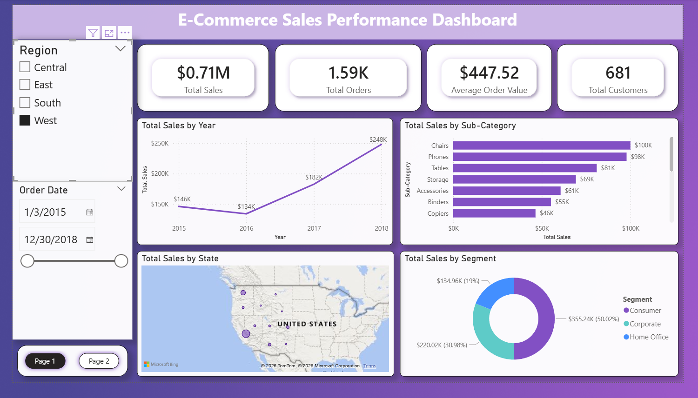
Result:
Page 1 of the dashboard

Slide 10
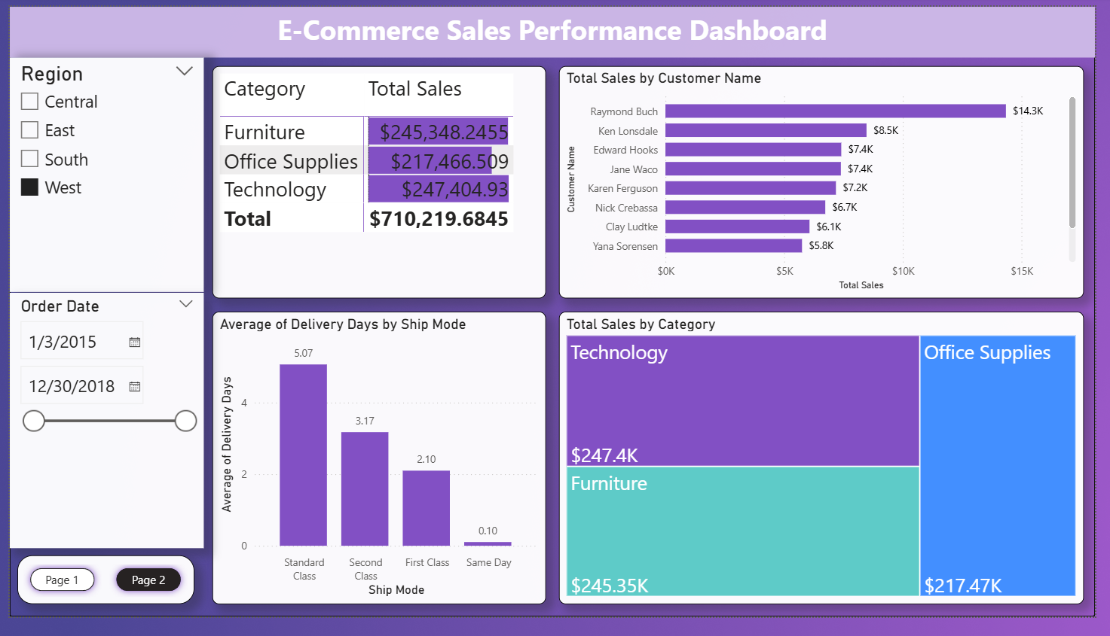
Result:
Page 2 of the dashboard

Slide 11
Conclusion:
The project successfully transforms raw e-commerce transaction data into an intuitive, high-level visual narrative.
By automating the calculation of key performance indicators (KPIs) like Total Sales and Average Order Value, the dashboard significantly reduces the time required for management to analyze business health.
The implementation of drill-down matrices and synced slicers proved highly effective in pinpointing exactly where the company is making—and losing—money.

Slide 12
Future scope:
Database Integration: Connect the dashboard directly to a live SQL Server or cloud database (like Azure or AWS) instead of a static CSV file for real-time automated data refreshes.
Predictive Analytics: Incorporate Power BI’s AI forecasting tools to predict next quarter's sales trends based on historical seasonality.
Returns Analysis: Integrate a secondary dataset containing "Returned Orders" to build a dedicated page analyzing product return rates and their impact on net profit.

Slide 13
References:
Dataset Source: Superstore Sales Dataset (Kaggle).
Dataset Link: https://www.kaggle.com/datasets/rohitsahoo/sales-forecasting
GitHub Repo Link: https://github.com/ParthMahadik04/ecommerce-sales-dashboard.git

Slide 14
Thank You

