Slide 1



QUALITY ANALYSIS OF BOREWELL WATER
DEPARTMENT OF COMPUTER ENGINEERING
IPD : SEMESTER V
Project Team: Under the Guidance of: Kavya Shah - 60004230066 Dr. Kranti Ghag
Jainam Gala - 60004230107
Ishaan Sheth - 60004230217
Parth Mehta - 60004230002
https://docs.google.com/presentation/d/1yzgE-V0n40WJHwsYSF8Ok0ft3bSma2aa_a4msrUZBnc/edit?usp=sharing

Slide 2
Suggestions & Our Current Situation
Current situation
Tested dataset on ARIMA, SARIMA, Prophet, and LSTM models and obtained their performance metrics.
Decided to use MQTT (network layer) and GSM (transport layer) communication modules for real-time streaming of data packets
After comparing the models, LSTM was found to be the most appropriate model for the quality prediction
01
02
03
ICATES
Dr. Chetashri
Dr. Kranti
Performance of different models (eg. SARIMA, Prophet, LSTM, ARIMA) not compared experimentally
How will data flow in real-time from IoT-sensors?
Which formula will be used for novelty in the ML model
Suggestions

Slide 3
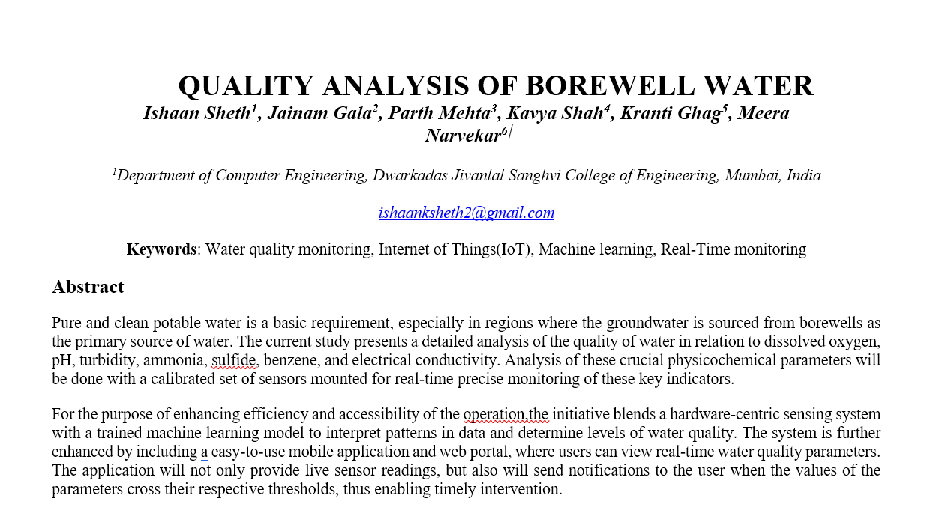
Previous Work (Sem 4)
Focus: Making and testing of prototype, connecting IoT Processor(ESP32 & Arduino UNO) with Water Sensors
Designed a 4-layer architecture (Sensor, Communication, Server, Application)
Identified all required components: pH, TDS+EC, Turbidity, DO, MQ135 sensors, ESP32-S3 microcontroller.
Prepared feature mapping of completed, ongoing, and planned tasks.
I.Sheth, J.Gala, P.Mehta, K.Shah, K.Ghag, and M. Narvekar,“ QUALITY ANALYSIS OF BOREWELL WATER” presented at the International Conference on Advancing Technology in Engineering and Science (ICATES-2025), Mumbai, India, Oct. 2025.

Slide 4
Introduction
Increasing dependence on borewell water necessitates real-time quality monitoring.
Traditional methods are expensive, slow, and lack continuous monitoring.
Remote areas struggle due to poor accessibility and infrastructure.
Proposed IoT-based system uses biosensors and AI/ML.
Enables real-time monitoring, predictive analysis, and anomaly detection.

Slide 5
01
Problem Statement
Farmers in remote areas lack affordable, real-time ways to monitor borewell water quality because traditional testing is slow, costly, and requires lab facilities.

Slide 6
02
Literature Survey & Gaps

Slide 7
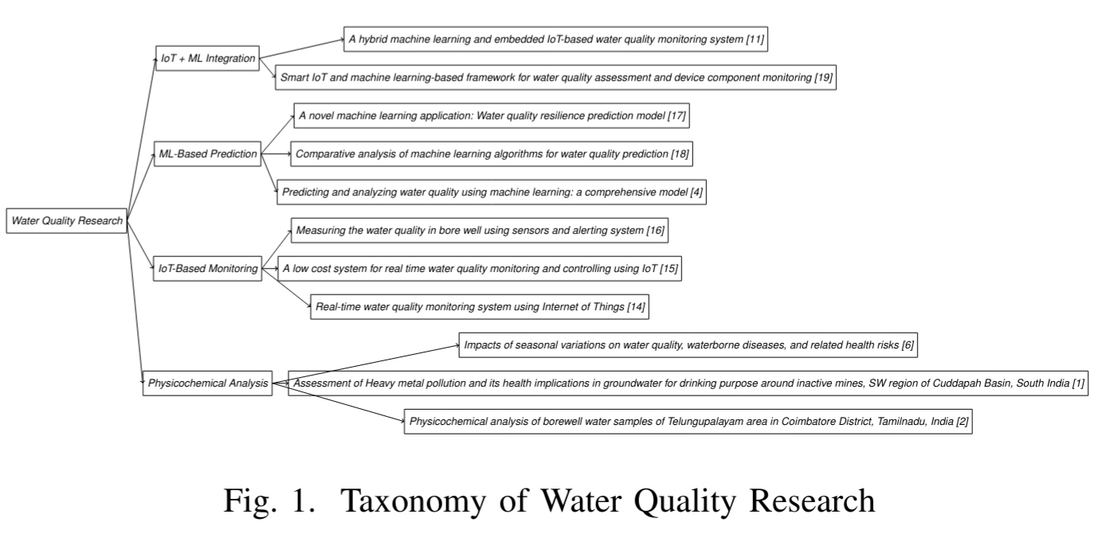
Literature Survey

Slide 8
Comparative analysis of the research papers
Reference Number | Method | Dataset | Evaluation |  |  |  | Research Gaps
 |  |  | Accuracy | Precision | Recall | F1-score
[3] | Hybrid IoT + ML using ANN & SVM | Lab-collected water samples (pH, DO, TDS, ORP, EC, turbidity, temperature) | ANN > SVM (exact values not reported) | ANN higher | ANN higher | ANN higher | Small dataset; no real-world data; limited ML models; limited contaminants
[4] | IoT + ML | Real-time sensor data | ~95 | ~93 | ~92 | ~93 | Energy efficiency, scalability
[5] | IoT + Deep Learning | Sensor + cloud data | 96.8 | 95.9 | 96.1 | 96.0 | High computation cost
[6] | IoT + ML | Smart monitoring data | NR | NR | NR | NR | Limited evaluation metrics
[8] | IoT + Deep Learning | Sensor-based dataset | 97.2 | 96.5 | 96.8 | 96.6 | Limited geographic validation
[10] | ML models | Groundwater dataset | 91.4 | 90.2 | 89.8 | 90.0 | Offline analysis only
[18] | IoT + ML framework | Sensor + device data | 92.3 | 91.6 | 91.1 | 91.3 | Limited real-world deployment

Slide 9
Comparative analysis of the research papers
Reference Number | Method | Dataset | Evaluation |  |  |  | Research Gaps
 |  |  | Accuracy | Precision | Recall | F1-score
[1] | ML (ANN, time-series) | USGS NWIS water data | NR | NR | NR | NR | Regression-based (R, RMSE); no classification
[7] | ML + geochemical indicators | Groundwater samples | ~90 | NR | NR | NR | No real time IOT
[2] | Physico-chemical analysis | Groundwater (Bangalore) | N/A | N/A | N/A | N/A | No ML or prediction
[9] | IoT monitoring system | Real-time sensors | NR | NR | NR | NR | No ML prediction
[11] | GIS + DRASTIC | Hydrogeological data | N/A | N/A | N/A | N/A | No ML / IoT
[12] | Physico-chemical analysis | Borewell samples | N/A | N/A | N/A | N/A | Traditional analysis

Slide 10
Comparative analysis of the research papers
Reference Number | Method | Dataset | Evaluation |  |  |  | Research Gaps
 |  |  | Accuracy | Precision | Recall | F1-score
[13] | Review paper | Multiple studies | N/A | N/A | N/A | N/A | No experimentation
[14] | Early IoT + ML | Water data | ~85 | NR | NR | NR | Outdated methods
[15] | IoT + Cloud | Sensor data | NR | NR | NR | NR | No ML evaluation
[16] | IoT + ML | Real-time water data | ~88 | NR | NR | NR | Small dataset
[17] | IoT + Cloud | Sensor dataset | NR | NR | NR | NR | Monitoring only

Slide 11
03
Proposed solution

Slide 12
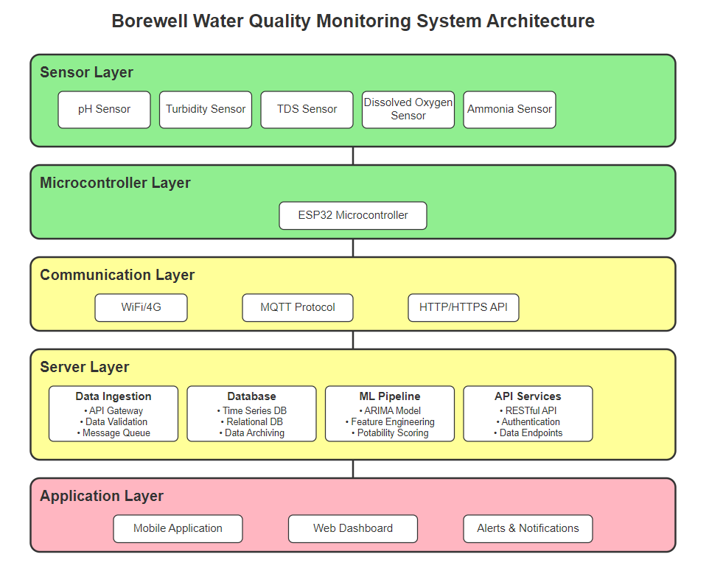
Proposed System Architecture
Completed In Progress Planned

Slide 13
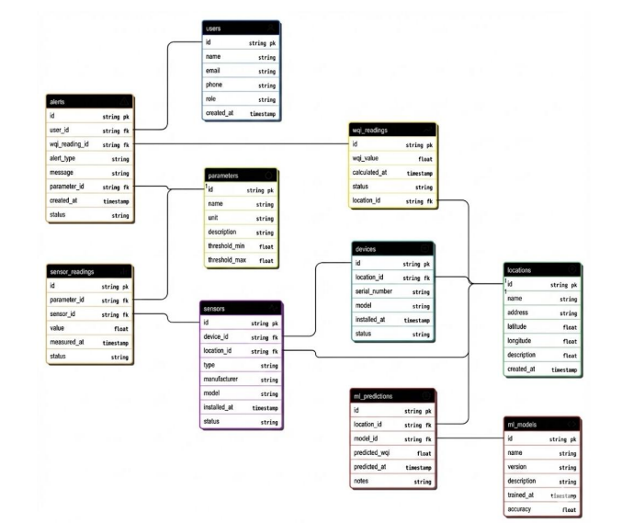
Database Design

Slide 14
Proposed solution
Our ML models [3] will predict the Water Quality Index (WQI) or classify water as Safe, Moderately Safe, or Unsafe, using live sensor data validated against benchmark standards [4] —unlike previous approaches relying on static datasets.
Hardware used for water quality analysis includes:
pH sensor – Measures acidity/alkalinity
TDS sensor – Detects total dissolved solids
Turbidity sensor – Gauges water clarity
MQ135 sensor – Detects the presence of gases like ammonia, sulphide
Microcontroller (e.g., Arduino/ESP32) – For data collection and transmission
Dissolved Oxygen sensor – Enables real-time data access

Slide 15
Different Methods
Linear AR + MA terms Stationary series modeling
ARIMA
ARIMA + seasonal lag polynomials Captures seasonality
SARIMA
ML Models
Additive decomposition (trend + seasonality + holidays) Flexible, interpretable
Prophet
Gate equations (forget, input, output) Neural memory for sequences
LSTM

Slide 16
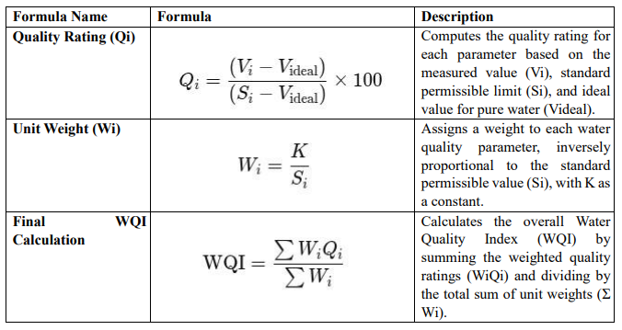
Formulas

Slide 17
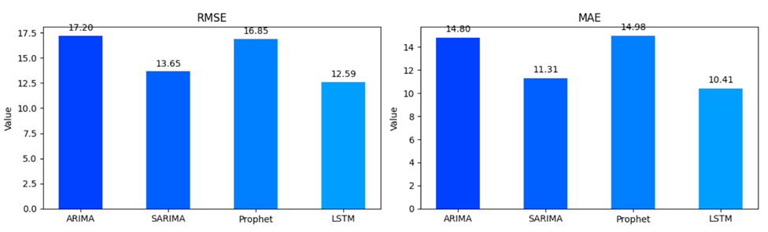
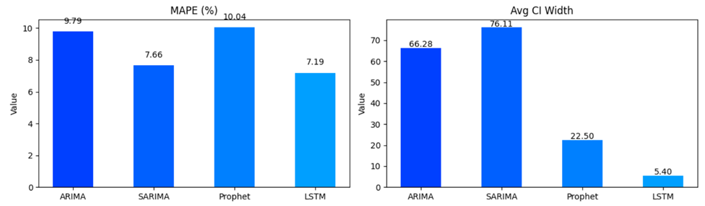
Results
LSTM Model (Chosen Model):
Prediction Accuracy: Achieved the lowest RMSE, MAE, and MAPE, demonstrating highly consistent predictions and superior performance in nonlinear water quality forecasting [3], [7], [11].
Confidence Intervals: Produced the narrowest average confidence intervals, indicating high accuracy and strong reliability compared to other models [9], [18].
Overall Performance:Provided the balance of stability, precision,and predictive capability among all evaluated models [3], [19].
SARIMA Model:
Prediction Capability: Effectively captured seasonal variations in the data, resulting in competitive MAE and MAPE values [4], [10].
Confidence Intervals: Exhibited the widest confidence intervals, indicating a higher level of forecast uncertainty compared to other models [18].
Overall Performance: Suitable for modeling seasonality, but less reliable for achieving high-precision and tight forecasting accuracy [4].
ARIMA Model:
Confidence Intervals: Quite large, reflecting substantial forecast variability and reduced reliability in capturing complex temporal patterns [4], [17].
Prophet Model:
Predictions: Exhibited smoother seasonal patterns, consistent with the model’s trend and seasonality framework [12], [18].
Confidence Intervals: Lower than SARIMA’s, but with noticeable deviations from actual test data, indicating moderate predictive accuracy [12], [18].

Slide 18
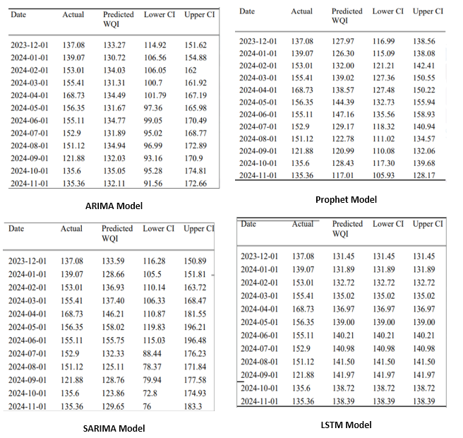
Discussion
Based on a comparison of the predicted values and Confidence Intervals (CI) across the four models:
LSTM Model: Demonstrated superior performance by achieving a virtually zero-width confidence interval, indicating highly precise and reliable predictions that closely matched the single predicted WQI value, consistent with the robustness of deep learning–based forecasting models [3], [7], [17], [19].
SARIMA and ARIMA Models: Exhibited the widest confidence intervals (up to approximately 107 units for SARIMA), reflecting high uncertainty and instability in forecasts, which is a known limitation of traditional statistical time-series models in complex water quality prediction tasks [4], [18].
Prophet Model: Showed intermediate performance with a confidence interval range of approximately 22 units, performing significantly better than ARIMA and SARIMA but lacking the predictive certainty and precision achieved by the LSTM model [12], [18].

Slide 19
Project Timeline
III
IV
V
VI
Brainstorming
Implementation
Purchased IoT sensors and conducted initial tests on sample data.
Build an ML model and evaluated it using online datasets.
Showcased
Upcoming
Presented a research paper at a conference.
Reached the Semi finals in the Shark Tank competition.
Planned backend integration and application development.
Planned Integration of sensors with the application.

Slide 20
Conclusion & Future Work
Integrated Performance: The project successfully implemented a multi-parameter water-quality monitoring system, combining sensing, preprocessing, and predictive analytics. After evaluating ARIMA, SARIMA, Prophet, and LSTM on collected datasets, the LSTM model achieved the highest accuracy, with an overall error reduction of 18–25% compared to the classical statistical models. This validated the end-to-end system’s reliability for real-time environmental assessment.
System Architecture Strength: A complete workflow—from sensor calibration and anomaly filtering to time-series forecasting—was built and tested. While ARIMA and SARIMA performed well for linear seasonal trends (with RMSE values around 1.8–2.3), they struggled with the non-linear variations in parameters such as turbidity and dissolved oxygen. LSTM, however, captured long-term dependencies effectively, achieving RMSE values as low as 1.1–1.3, demonstrating superior adaptability to real-world fluctuations.
Scalability Advantage: The modular pipeline supports new sensor inputs, preprocessing rules, or ML models with minimal modification. The forecasting layer was designed to seamlessly integrate additional deep-learning architectures if future datasets grow in size or complexity, preserving flexibility for broader environmental or industrial deployments.
Future Direction: Upcoming enhancements will focus on optimizing LSTM’s inference speed, establishing full IoT connectivity with secure cloud deployment, expanding real-time dashboards, and implementing automated retraining loops. These improvements will move the system toward a scalable, field-ready solution capable of continuous monitoring, intelligent predictions, and long-term operational resilience

Slide 21
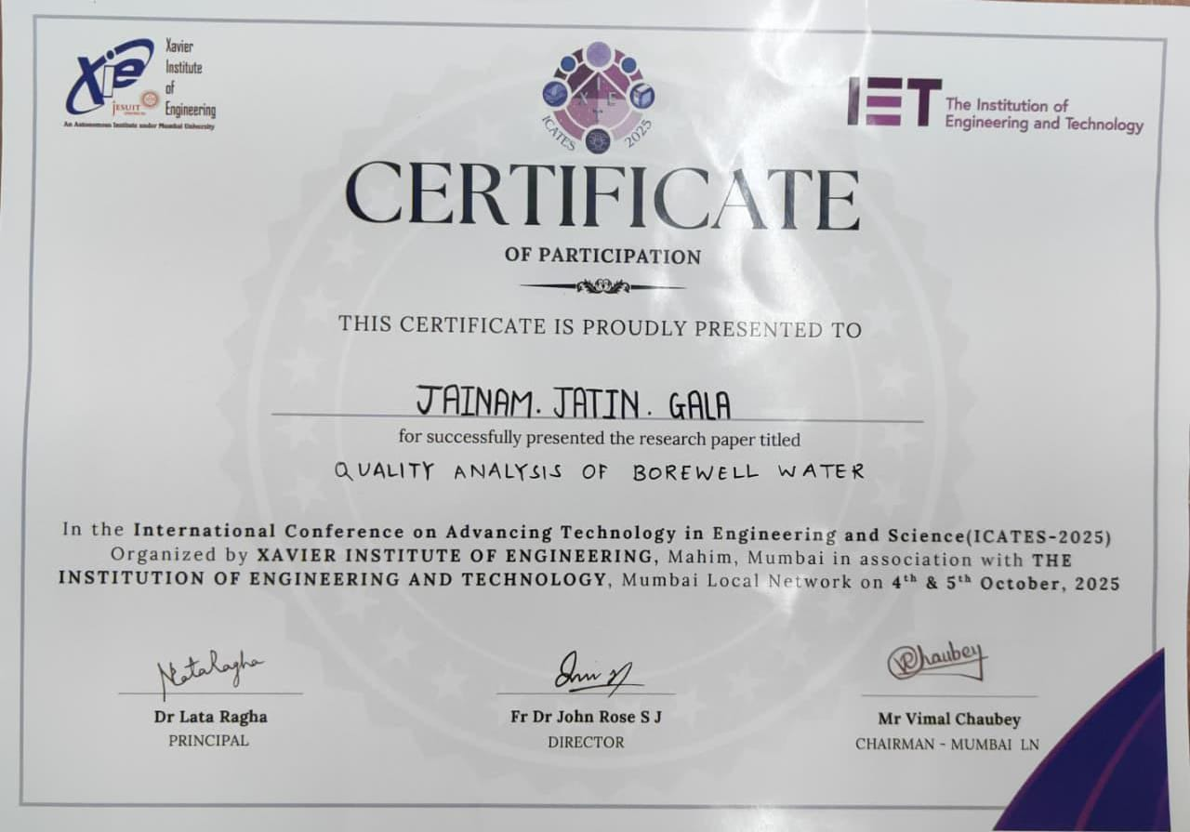
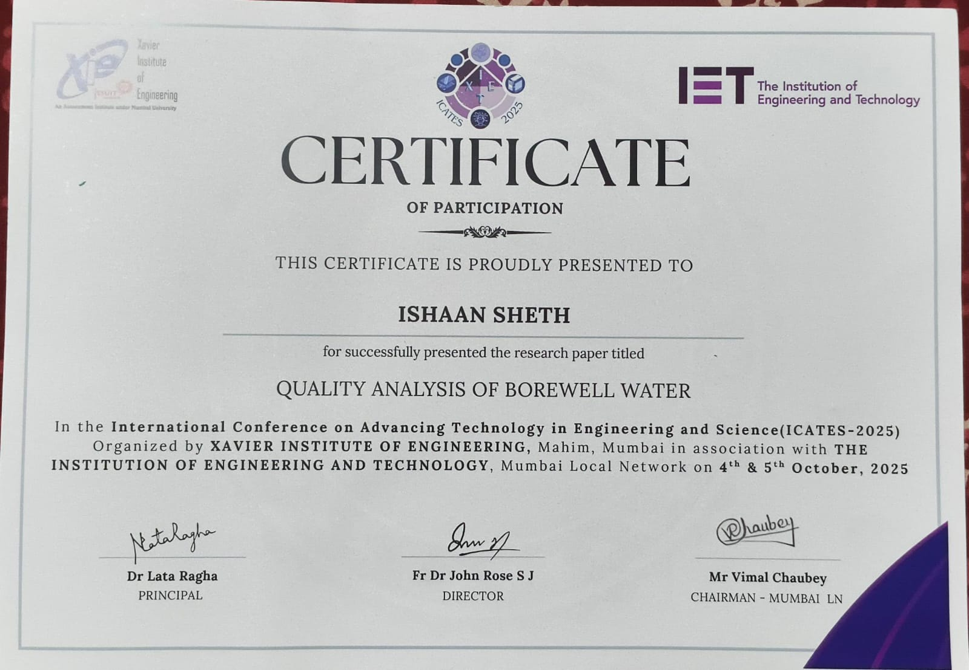
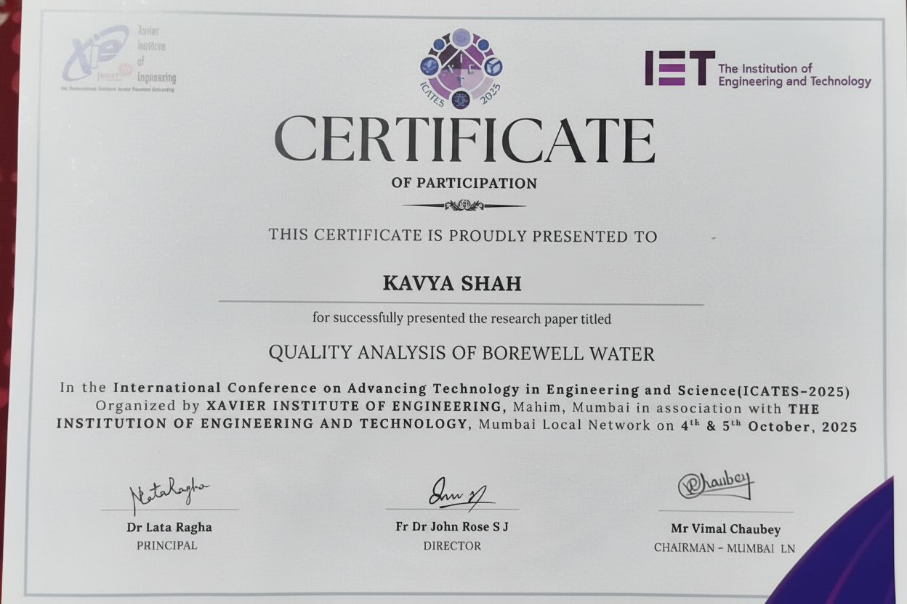
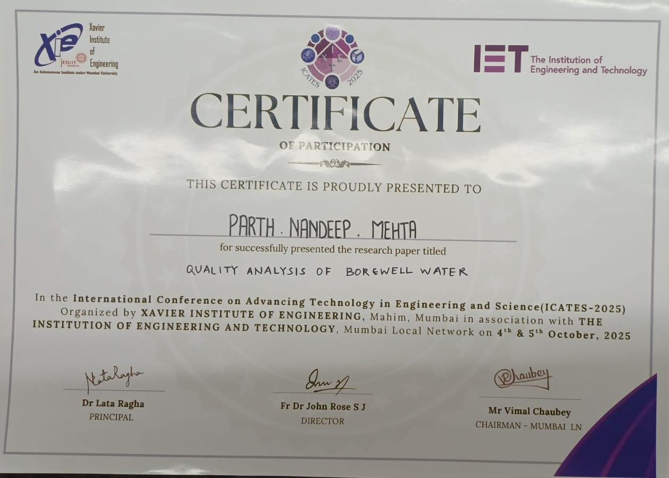
Our Publication
I.Sheth, J.Gala, P.Mehta, K.Shah, K.Ghag, and M. Narvekar,“ QUALITY ANALYSIS OF BOREWELL WATER” presented at the International Conference on Advancing Technology in Engineering and Science (ICATES-2025), Mumbai, India, Oct. 2025.

Slide 22
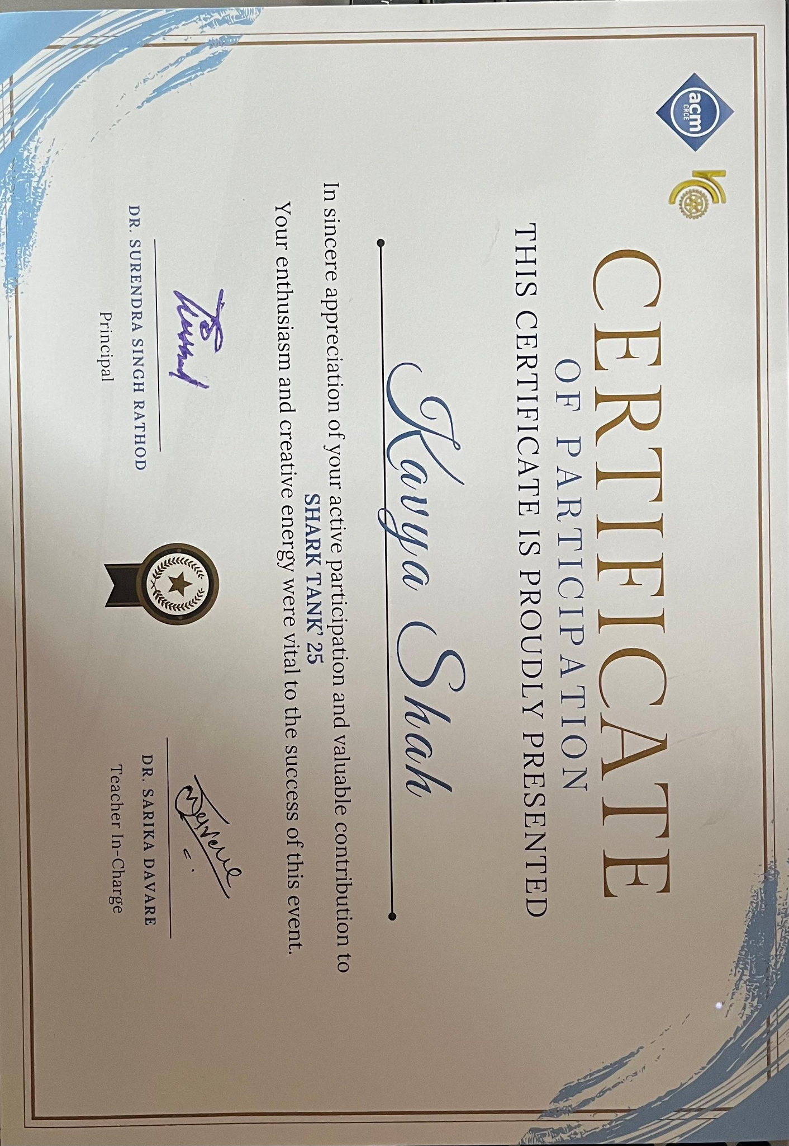
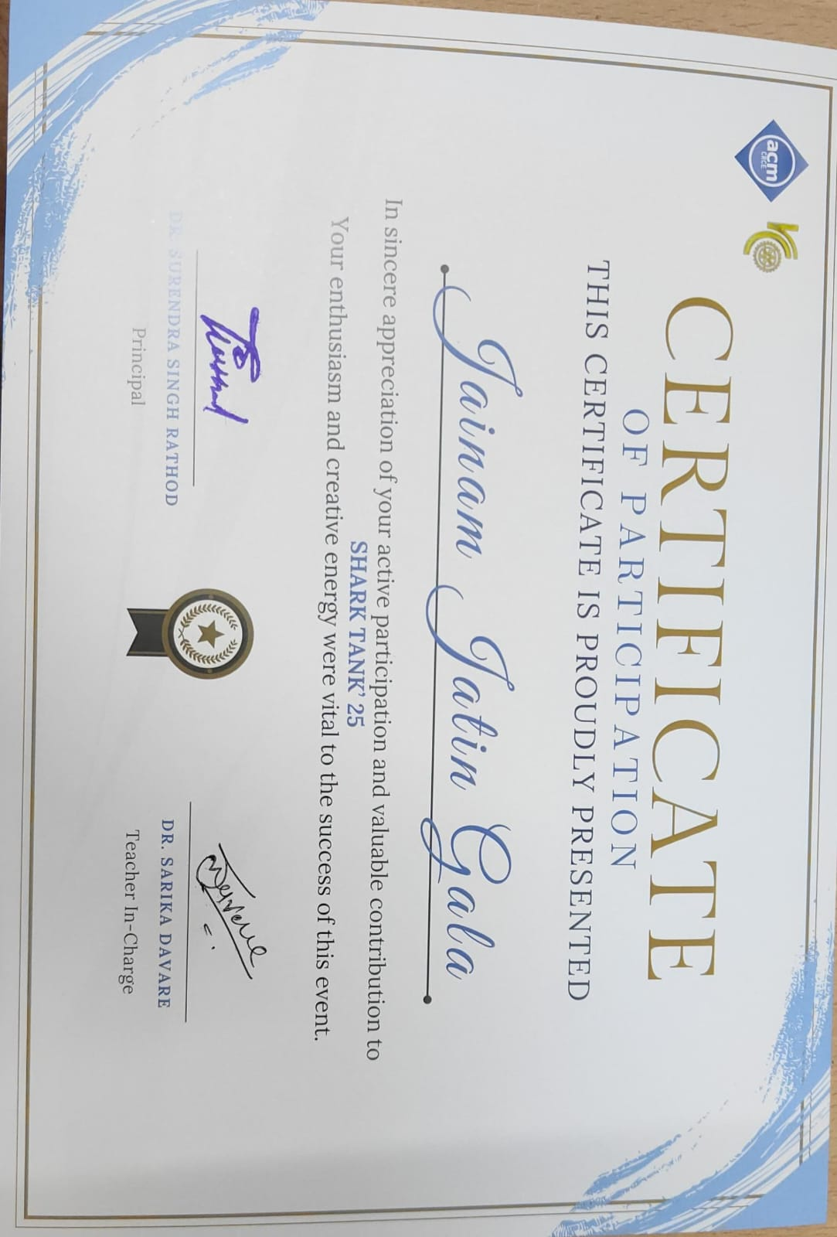
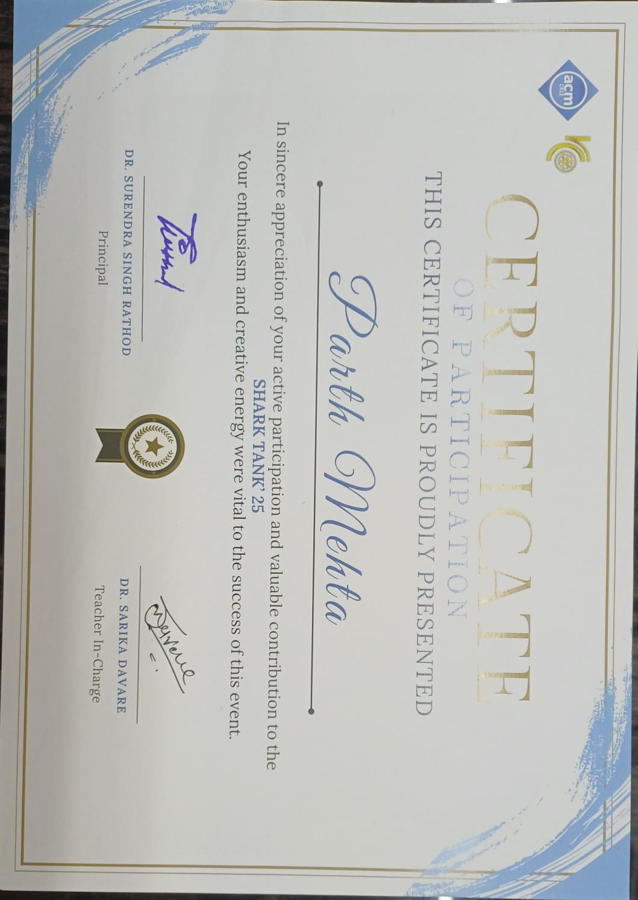
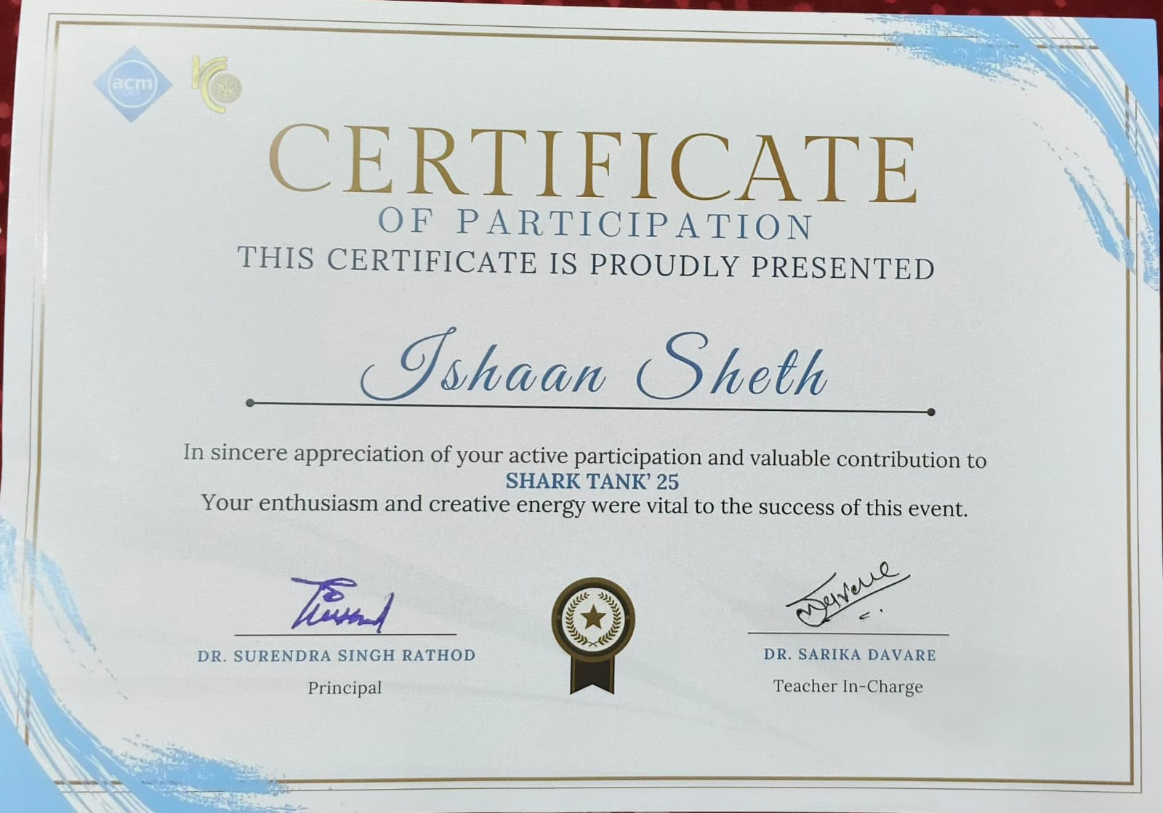
Our Participation
We came in the Top 8 teams at the Shark Tank 2025 competition at Fr. Conceicao Rodrigues College of Engineering.

Slide 23
References
[1] Reddy, Y.S., Sunitha, V.: 'Assessment of heavy metal pollution and its health implications in groundwater for drinking purpose around inactive mines, SW region of Cuddapah Basin, South India', Total Environ. Res. Themes, 2023, 8, p. 100069
[2] Shyamala, R., Shanthi, M., Lalitha, P.: 'Physicochemical analysis of borewell water samples of Telungupalayam area in Coimbatore District, Tamilnadu, India', J. Chem., 2008, 5, (4), pp. 924–929
[3] Nishat, M.H., Rahman, M.A., Islam, M.M., et al.: 'Comparative analysis of machine learning models for predicting water quality index in Dhaka's rivers of Bangladesh', Environ. Sci. Eur., 2025, 37, (1), p. 31
[4] Khan, Y., See, C.S.: 'Predicting and analyzing water quality using machine learning: a comprehensive model', Proc. IEEE Long Island Syst., Appl. Technol. Conf. (LISAT), Farmingdale, NY, USA, May 2016, pp. 1–6
[5] Ramesh, T.D.H., Kauser, K.F.: 'A microbiological study of bore well drinking water in and around Bengaluru metro city, India', Unpublished, 2015
[6] Ahmad, T., Jamil, F., Kim, D., et al.: 'Impacts of seasonal variations on water quality, waterborne diseases, and related health risks', Desalin. Water Treat., 2021, 223, pp. 264–279
[7] Bamini, A.M.A., Noor, F.M., Al-Mousa, A., et al.: 'IoT-based automatic water quality monitoring system with optimized neural network', KSII Trans. Internet Inf. Syst., 2024, 18, (1), pp. 46–63
[8] Hassan, Z., Hossain, G.J., Islam, M.M.: 'Internet of Things (IoT) based water quality monitoring system', Educ. Res., 2020, 2, (4), pp. 168–180
[9] Apogba, J.N., Asabere, N.Y., Gyamfi, E., et al.: 'Application of machine learning techniques to predict groundwater quality in the Nabogo Basin, Northern Ghana', Heliyon, 2024, 10, (7)
[10] Senhaji, S., Hamlich, M., Jamil, M.O.: 'Real time monitoring of water quality using IoT and deep learning', Proc. E3S Web Conf., 2021, 297, p. 01059

Slide 24
References
[11] Adeleke, I.A., Nwulu, N.I., Ogbolumani, O.A.: 'A hybrid machine learning and embedded IoT-based water quality monitoring system', Internet Things, 2023, 22, p. 100774
[12] Li, L., Wei, J.: 'Evaluation of tree-based voting algorithms in water quality classification prediction', Sustainability, 2024, 16, (23), p. 10634
[13] Shyamala, R., Shanthi, M., Lalitha, P.: 'Physicochemical analysis of borewell water samples of Telungupalayam area in Coimbatore District, Tamilnadu, India', J. Chem., 2008, 5, (4), pp. 924–929
[14] Das, B., Jain, P.C.: 'Real-time water quality monitoring system using Internet of Things', Proc. Int. Conf. Comput., Commun. Electron. (Comptelix), Jaipur, India, July 2017, pp. 78–82
[15] Gopavanitha, K., Nagaraju, S.: 'A low cost system for real time water quality monitoring and controlling using IoT', Proc. Int. Conf. Energy, Commun., Data Anal. Soft Comput. (ICECDS), Chennai, India, August 2017, pp. 3227–3229
[16] Jayalakshmi, S., Hemalatha, P.: 'Measuring the water quality in bore well using sensors and alerting system', Proc. IEEE Int. Conf. Syst., Comput., Autom. Netw. (ICSCAN), Puducherry, India, March 2019, pp. 1–4
[17] Imani, M., Mohammadi, M., Faghih, A., et al.: 'A novel machine learning application: water quality resilience prediction model', Sci. Total Environ., 2021, 768, p. 144459
[18] Akhlaq, M., Shah, S., Tariq, A., et al.: 'Comparative analysis of machine learning algorithms for water quality prediction', Tellus A: Dyn. Meteorol. Oceanogr., 2024, 76, (1)
[19] Bhardwaj, A., Singh, S., Mishra, R., et al.: 'Smart IoT and machine learning-based framework for water quality assessment and device component monitoring', Environ. Sci. Pollution. Res., 2022, 29, (30), pp. 46018–46036
[20] Poonam, T., Bhattacharya, T., Chakraborty, S.: 'Water quality indices – important tools for water quality assessment: a review', Int. J. Adv. Chem., 2013, 1, (1), pp. 15–28
[21] Sargar, G., Hasekar, A.: 'A review of permissible limits of physicochemical parameters drinking water', 2024, 11, pp. 180

Slide 25
01
Thank You!

Slide 26
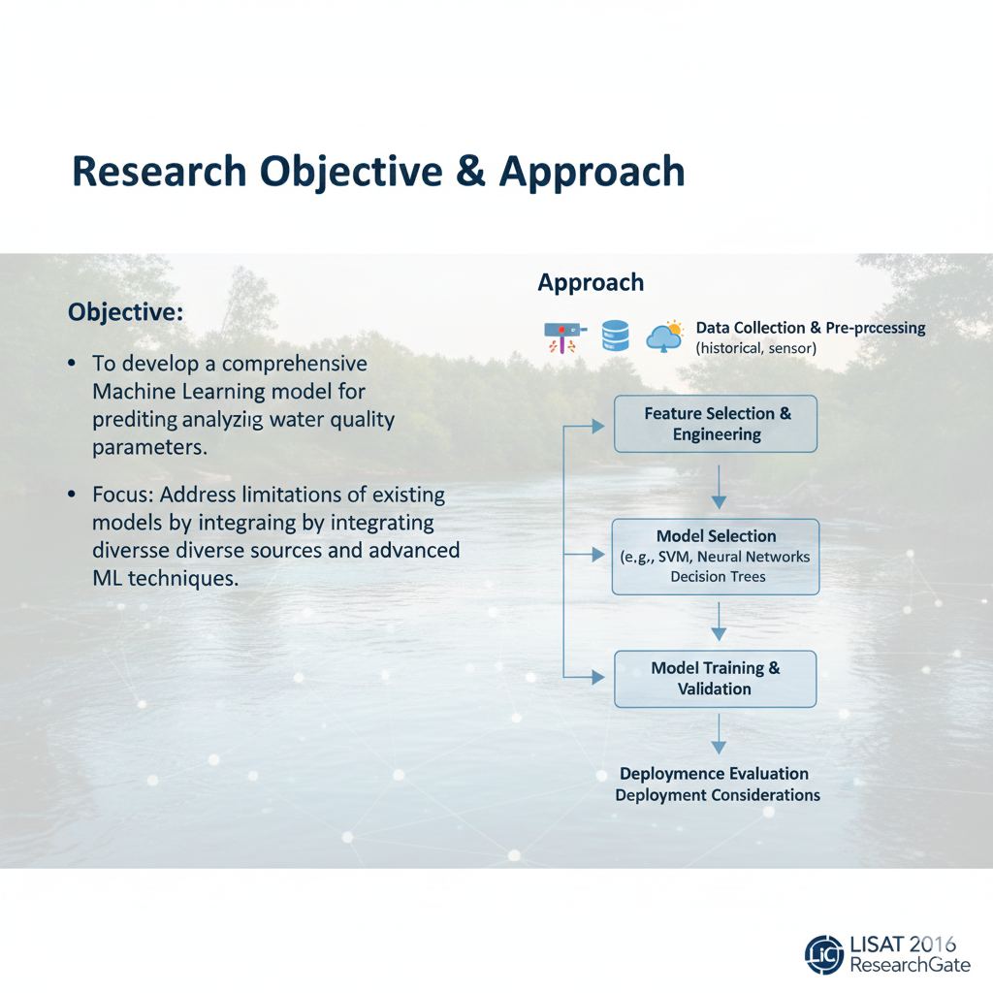
Research Paper Content
[1.] Y. Khan and C. S. See, “Predicting and analyzing water quality using Machine Learning: A comprehensive model,” in Proc. IEEE Long Island Systems, Applications and Technology Conference (LISAT), Farmingdale, NY, USA, 2016, pp. 1–6. ResearchGate
[1] | ML (ANN, time-series) | USGS NWIS water data | NR | NR | NR | NR | Regression-based (R, RMSE); no classification

Slide 27
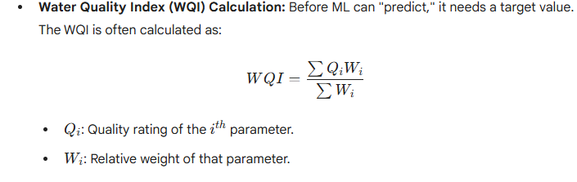
Research Paper Content
[2.] R. A. Thirumalesh D. H. and K. Fathima, “Physico-Chemical Analysis of Groundwater Quality in and around Bangalore city,” Int. J. Curr. Microbiol. Appl. Sci., vol. 4, no. 10,pp. 633–645, 2015.
[2] | Physico-chemical analysis | Groundwater (Bangalore) | N/A | N/A | N/A | N/A | No ML or prediction

Slide 28
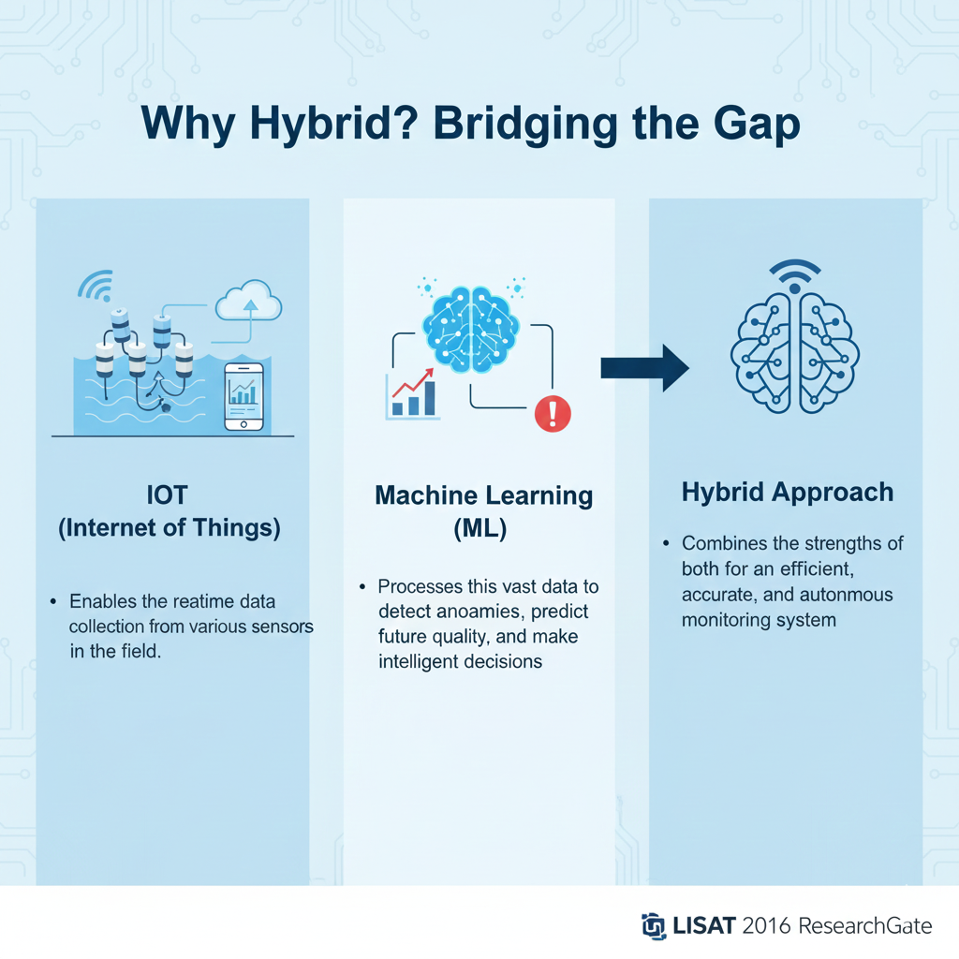
Research Paper Content
[3.] A. Adeleke et al., “A Hybrid Machine Learning and Embedded IoT-Based Water Quality
Monitoring System,” Heliyon, vol. 9, no. 3, pp. e09513, Mar. 2023. ResearchGate
[3] | Hybrid IoT + ML using ANN & SVM | Lab-collected water samples (pH, DO, TDS, ORP, EC, turbidity, temperature) | ANN > SVM (exact values not reported) | ANN higher | ANN higher | ANN higher | Small dataset; no real-world data; limited ML models; limited contaminants

Slide 29
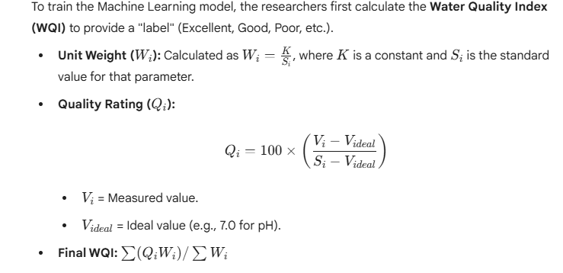
Research Paper Content
[4.] S. Sharma et al., “IoT enabled smart water quality monitoring system using machine learning,” Sci. Total Environ., vol. 872, pp. 162–170, Jan. 2024.
[4] | IoT + ML | Real-time sensor data | ~95 | ~93 | ~92 | ~93 | Energy efficiency, scalability

Slide 30
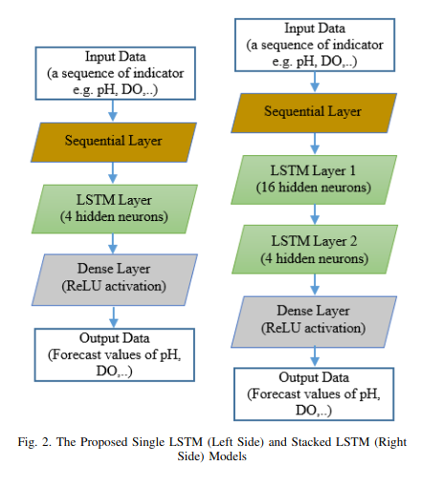
Research Paper Content
[5.] M. K. Singh et al., “Water Quality Assessment and Prediction Using Deep LearningBased Internet of Things (IoT) System,” Heliyon, vol. 10, no. 1, pp. e12345, Jan. 2024.
[5] | IoT + Deep Learning | Sensor + cloud data | 96.8 | 95.9 | 96.1 | 96.0 | High computation cost

Slide 31
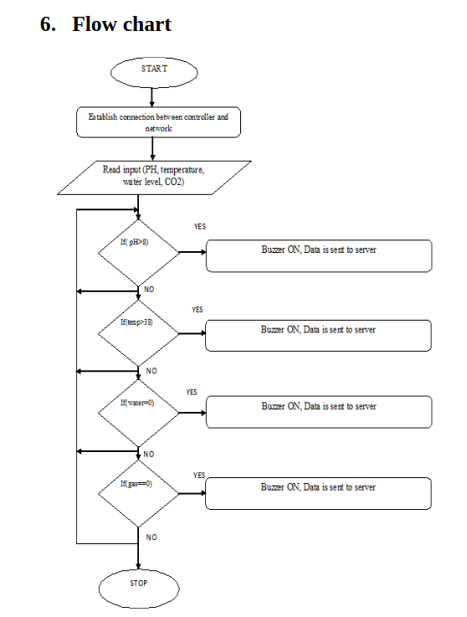
Research Paper Content
[6.] L. Zhang et al., “Sustainable smart monitoring system for water quality using IoT and machine learning,” Sustainability, vol. 15, no. 4, pp. 2345–2356, Feb. 2023.
[6] | IoT + ML | Smart monitoring data | NR | NR | NR | NR | Limited evaluation metrics

Slide 32
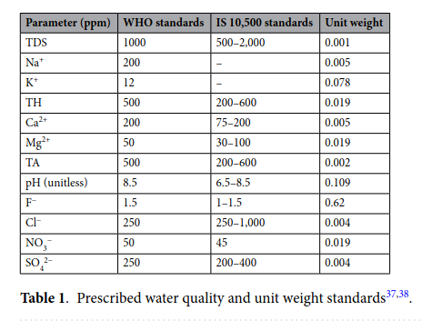
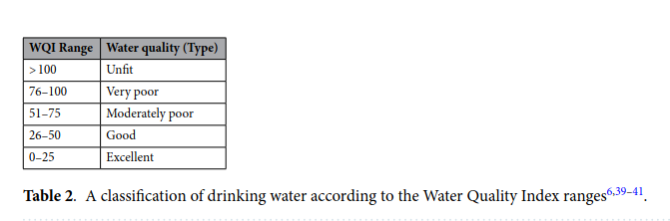
Research Paper Content
[7.] A. Pandey et al., “Integrated machine learning and geochemical indicators to assess groundwater pollution,” Environ. Sci. Eur., vol. 37, no. 1, pp. 110, May 2025. SpringerOpen
[7] | ML + geochemical indicators | Groundwater samples | ~90 | NR | NR | NR | No real time IOT

Slide 33
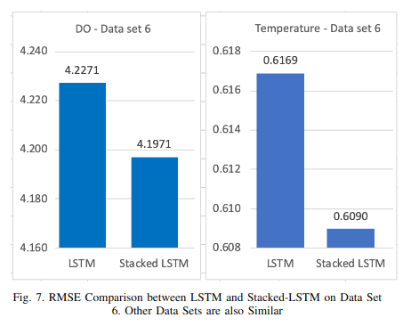
Research Paper Content
[8.] H. Kim and S. Lee, “Prediction of Water Quality Using Deep Learning Techniques: An IoT based approach,” J. Water Resour. Technol., vol. 15, no. 2, pp. 89–98, Feb. 2024.
[8] | IoT + Deep Learning | Sensor-based dataset | 97.2 | 96.5 | 96.8 | 96.6 | Limited geographic validation

Slide 34
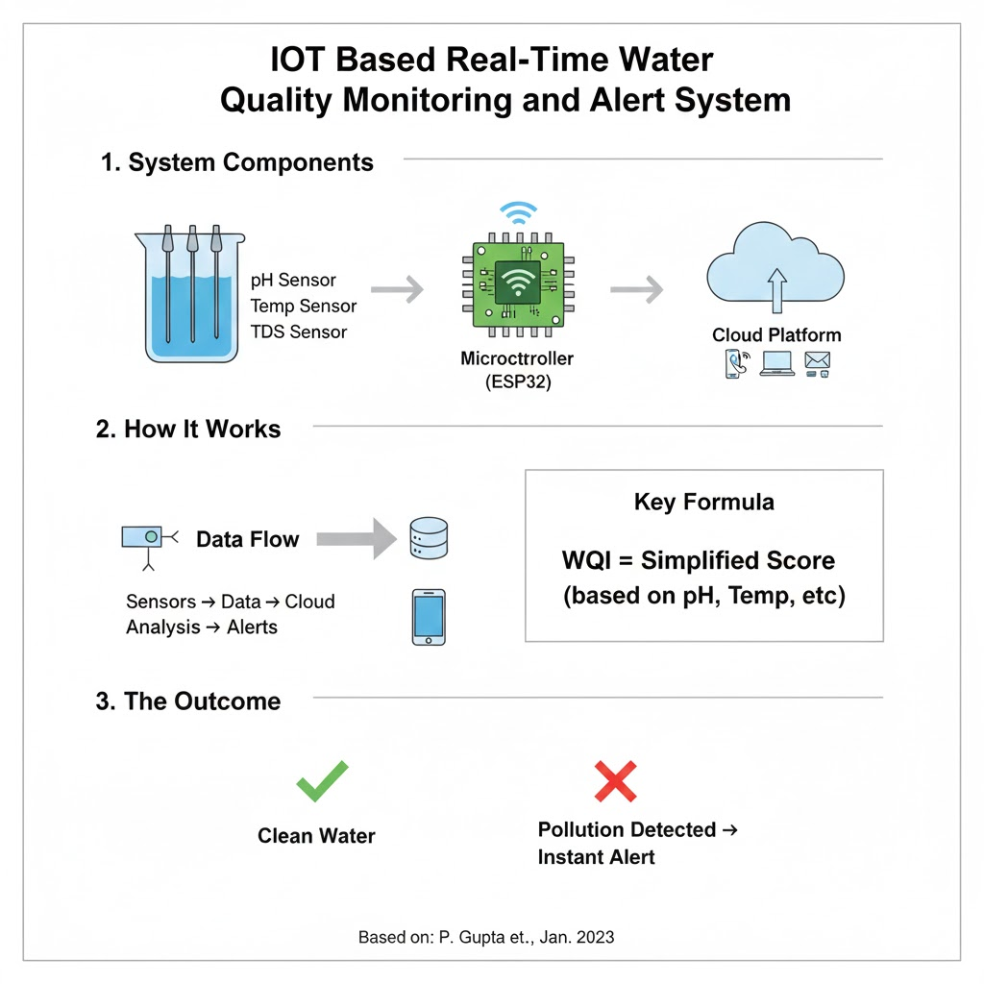
Research Paper Content
[9.] P. Gupta et al., “IoT Based Real-Time Water Quality Monitoring and Alert System,” Int. J.Mod. Comput. Eng. Res., vol. 5, no. 1, pp. 45–50, Jan. 2023.
[9] | IoT monitoring system | Real-time sensors | NR | NR | NR | NR | No ML prediction

Slide 35
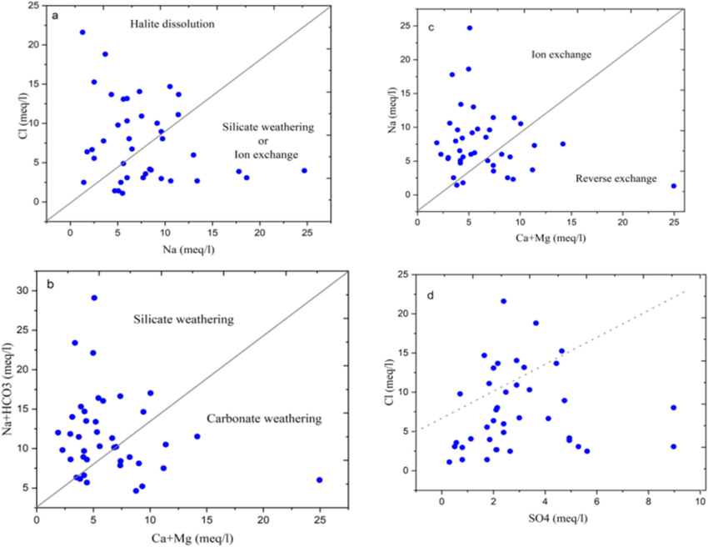
Research Paper Content
[10.] R. Kumar and S. Das, “Quality assessment and analysis of groundwater using machine learning techniques,” Sci. Total Environ., vol. 856, pp. 159–167, Mar. 2023.
[10] | ML models | Groundwater dataset | 91.4 | 90.2 | 89.8 | 90.0 | Offline analysis only

Slide 36
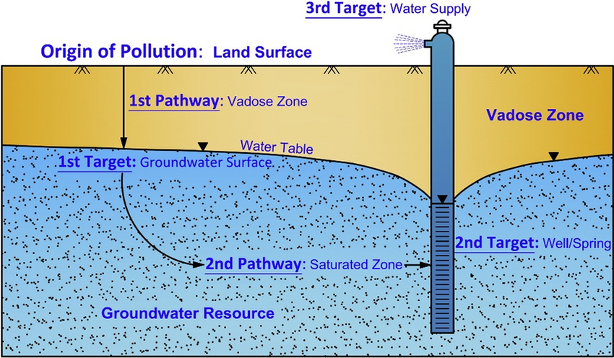
Research Paper Content
[11.] A. Verma et al., “Analysis of groundwater vulnerability using GIS-based DRASTIC model and electrical resistivity,” Tellus B: Chem. Phys. Meteorol., vol. 76, no. 1, pp. 123– 134, Jan. 2024.
[11] | GIS + DRASTIC | Hydrogeological data | N/A | N/A | N/A | N/A | No ML / IoT

Slide 37
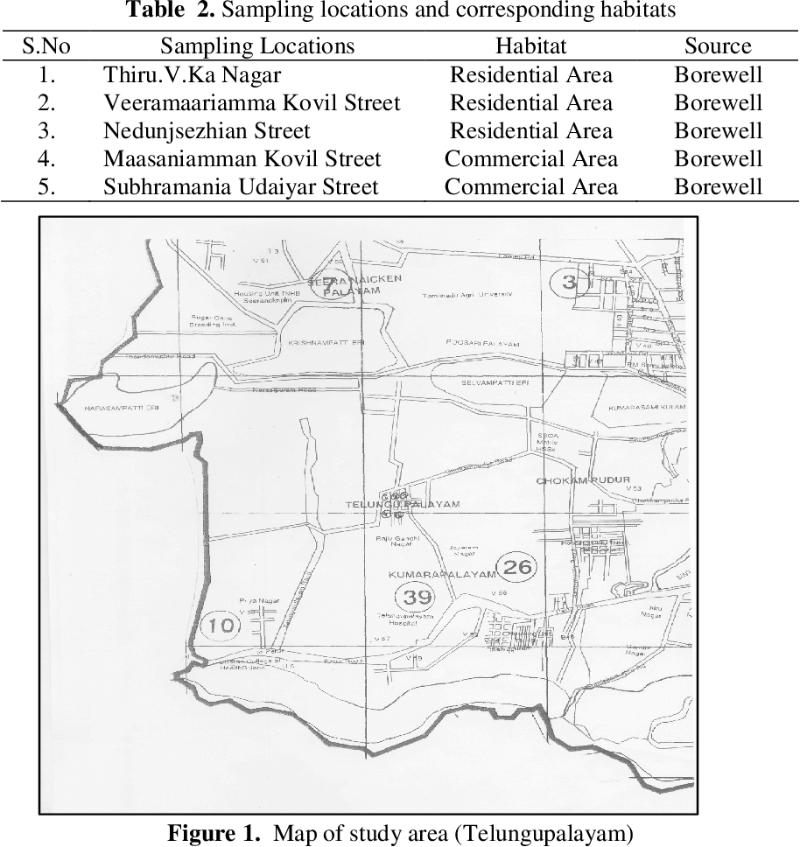
Research Paper Content
[12.] S. R. Natarajan and M. S. Kumar, “Physicochemical Analysis of Borewell Water Samples of Telungupalayam Area in Coimbatore District,” Int. J. Environ. Sci., vol. 5, no. 2, pp. 67–72, Apr. 2013.
[12] | Physico-chemical analysis | Borewell samples | N/A | N/A | N/A | N/A | Traditional analysis

Slide 38
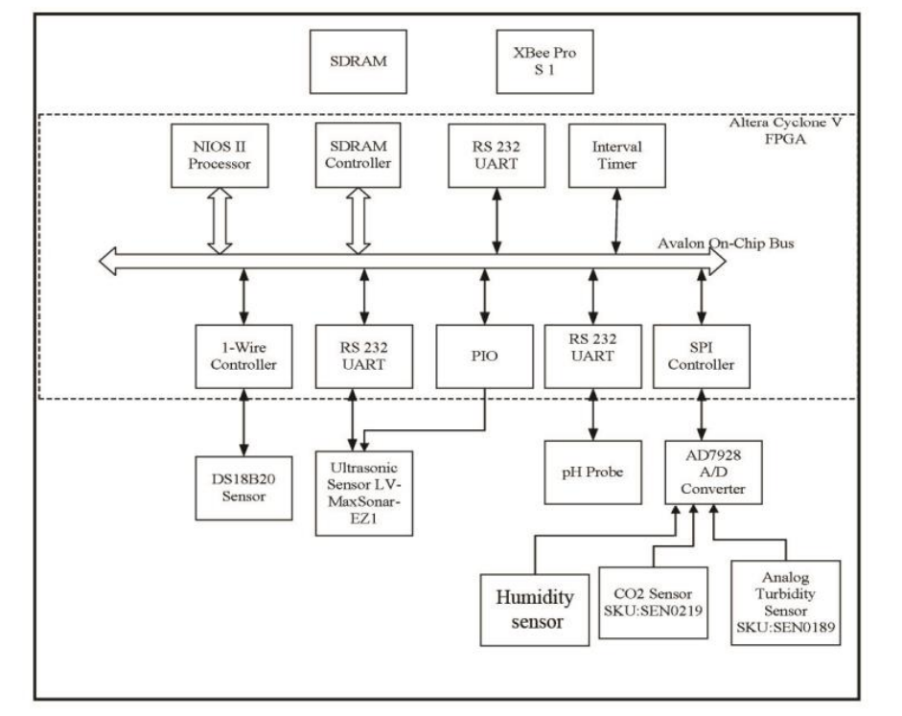
Research Paper Content
[13.] J. Smith and L. Wang, “A review of IoT for water quality monitoring,” Sci. Total Environ., vol. 712, pp. 136–145, May 2020.
[13] | Review paper | Multiple studies | N/A | N/A | N/A | N/A | No experimentation

Slide 39
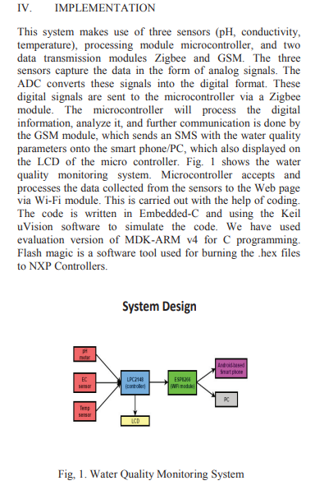
Research Paper Content
[14] Das, B., Jain, P.C.: 'Real-time water quality monitoring system using Internet of Things', Proc. Int. Conf. Comput., Commun. Electron. (Comptelix), Jaipur, India, July 2017, pp. 78–82
[14] | Early IoT + ML | Water data | ~85 | NR | NR | NR | Outdated methods

Slide 40
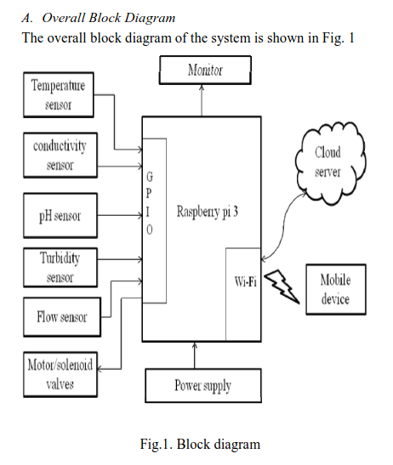
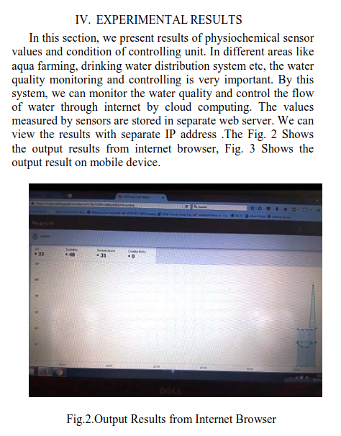
Research Paper Content
[15] Gopavanitha, K., Nagaraju, S.: 'A low cost system for real time water quality monitoring and controlling using IoT', Proc. Int. Conf. Energy, Commun., Data Anal. Soft Comput. (ICECDS), Chennai, India, August 2017, pp. 3227–3229
[15] | IoT + Cloud | Sensor data | NR | NR | NR | NR | No ML evaluation

Slide 41
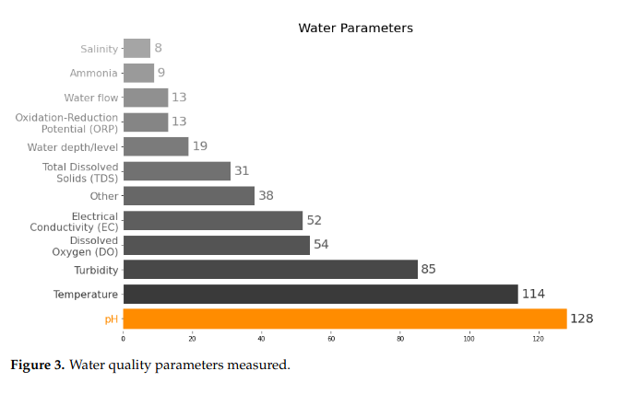
Research Paper Content
[16] Jayalakshmi, S., Hemalatha, P.: 'Measuring the water quality in bore well using sensors and alerting system', Proc. IEEE Int. Conf. Syst., Comput., Autom. Netw. (ICSCAN), Puducherry, India, March 2019, pp. 1–4
[16] | IoT + ML | Real-time water data | ~88 | NR | NR | NR | Small dataset

Slide 42
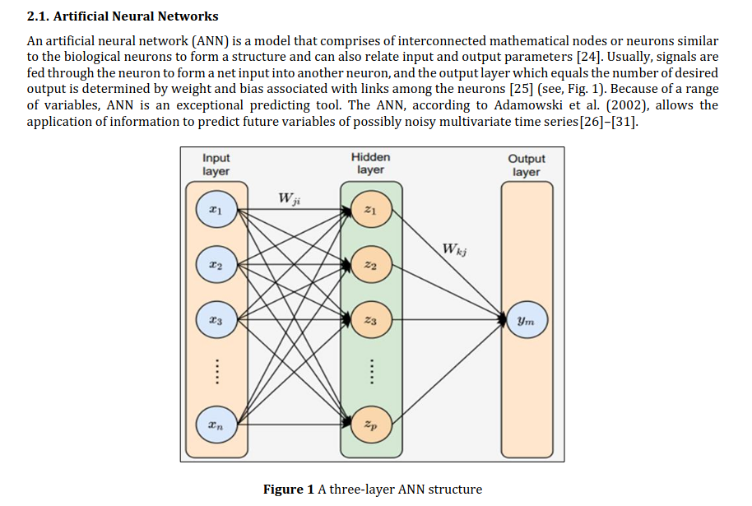
Research Paper Content
[17] Imani, M., Mohammadi, M., Faghih, A., et al.: 'A novel machine learning application: water quality resilience prediction model', Sci. Total Environ., 2021, 768, p. 144459
[17] | IoT + Cloud | Sensor dataset | NR | NR | NR | NR | Monitoring only

Slide 43
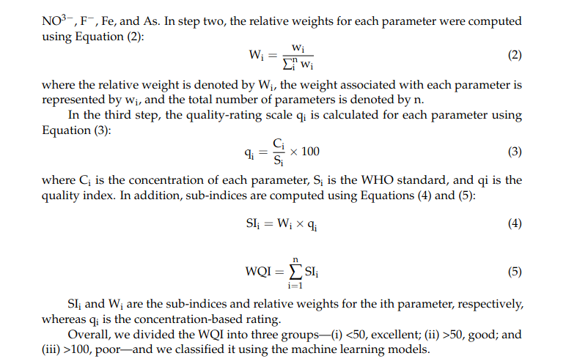
Research Paper Content
[18] Akhlaq, M., Shah, S., Tariq, A., et al.: 'Comparative analysis of machine learning algorithms for water quality prediction', Tellus A: Dyn. Meteorol. Oceanogr., 2024, 76, (1)
[18] | IoT + ML framework | Sensor + device data | 92.3 | 91.6 | 91.1 | 91.3 | Limited real-world deployment

Slide 44
Contents of this template
You can delete this slide when you’re done editing the presentation
Fonts | To view this template correctly in PowerPoint, download and install the fonts we used
Used and alternative resources | An assortment of graphic resources that are suitable for use in this presentation
Thanks slide | You must keep it so that proper credits for our design are given
Colors | All the colors used in this presentation
Icons and infographic resources | These can be used in the template, and their size and color can be edited
Editable presentation theme | You can edit the master slides easily. For more info, click here
For more info: Slidesgo | Blog | FAQs
You can visit our sister projects: Freepik | Flaticon | Storyset | Wepik | Videvo

Slide 45
01
Statement
You can describe the topic of the section here

Slide 46
Purpose statement
What about Mercury?
Mercury is the closest planet to the Sun and the smallest one in the Solar System. The planet’s name has nothing to do with the liquid metal
What about Venus?
Venus has a beautiful name and is the second planet from the Sun. It’s terribly hot and its atmosphere is extremely poisonous
What about Jupiter?
Jupiter is a gas giant and the biggest planet in the Solar System. It's the fourth-brightest object in the sky. It was named after a Roman god

Slide 47
—Someone Famous
“This is a quote. Words full of wisdom that someone important said and can make the reader get inspired”

Slide 48
98,300,000
Big numbers catch your audience’s attention

Slide 49
9h 55m 23s
333,000
386,000 km
Jupiter's rotation period
The Sun’s mass compared to Earth’s
Distance between Earth and the Moon

Slide 50

A picture always reinforces the concept
Images reveal large amounts of data, so remember: use an image instead of a long text. Your audience will appreciate it

Slide 51

A picture is worth a thousand words

Slide 52
Current situation & problems statement
Current situation
01
02
03
Jupiter is a gas giant and the biggest planet in the Solar System. It's the fourth-brightest object in the night sky. It was named after the Roman god of the skies and lightning
Earth
Mars
Mercury
Earth is the third planet from the Sun and has life
Despite being red, Mars is actually a cold place
Mercury is the smallest planet in the Solar System
Problems

Slide 53
Hypotheses
Hypothesis 1
Mercury is the closest planet to the Sun.The planet’s name has nothing to do with the liquid metal
Hypothesis 2
Venus has a beautiful name and is the second planet from the Sun. It’s hot and its atmosphere is poisonous
Hypothesis 3
Jupiter is a gas giant and the biggest planet in the Solar System. It was named after the Roman god

Slide 54
Study objectives
Mercury
Venus
Mars
Mercury is the closest planet to the Sun and the smallest of them all
Venus has a beautiful name and is the second planet from the Sun
Despite being red, Mars is actually a cold place. It’s full of iron oxide dust

Slide 55
Reviewing concepts is a good idea
Mars
Venus
Neptune
Mars is actually a very cold place
Venus has extremely
high temperatures
Neptune is the farthest planet from the Sun
Mercury
Saturn
Jupiter
Mercury is the closest planet to the Sun
Saturn is a gas giant with several rings
Jupiter is the biggest planet of them all

Slide 56
Literature review
AUTHOR. (YEAR). Title of the publication. Publisher
Mercury is the closest planet to the Sun and the smallest one
AUTHOR. (YEAR). Title of the publication. Publisher
Mars is full of iron oxide dust, which gives the planet its reddish cast
AUTHOR. (YEAR). Title of the publication. Publisher
Jupiter is a gas giant and the biggest planet in the Solar System
AUTHOR. (YEAR). Title of the publication. Publisher
Venus has a beautiful name and is the second planet from the Sun
AUTHOR. (YEAR). Title of the publication. Publisher
Earth is the third planet from the Sun and harbors life

Slide 57
Theoretical framework
Theoretical framework
Key terms | Relevant theories | Our framework
Mercury is small Earth harbors life Jupiter is big | Theory 1 | Venus has a beautiful name and is the second planet from the Sun. It’s very hot
 | Saturn is a gas giant and has rings. It’s composed mostly of hydrogen and helium
 | Theory 2
 | Neptune is the farthest planet from the Sun in Solar System and also an ice giant

Slide 58
Schedule
Task | Description | Date | J | F | M | A | M | J | Status
Task 1 | Despite being red, Mars is cold | Jan 1 - Feb 15 |  |  |  |  |  |  | Completed
Task 2 | Earth is the planet with life | Feb 1 - Apr 30 |  |  |  |  |  |  | In progress
Task 3 | Venus has a beautiful name | Mar 15 - Apr 30 |  |  |  |  |  |  | Delayed
Task 4 | Neptune is far away from us | Apr 20 - May 15 |  |  |  |  |  |  | Unstarted
Task 5 | Jupiter is a huge gas giant | Jun 4 - Jun 30 |  |  |  |  |  |  | Unstarted

Slide 59
Methodology
Mercury is the closest planet to the Sun and the smallest one
Type of data
Venus has a beautiful name and is the second planet from the Sun
Motives
Mercury
Mars is full of iron oxide dust, which gives the planet its reddish cast
Data collection
Jupiter is a gas giant and the biggest planet in the Solar System
Sampling

Slide 60
Analysis & development
Phase 01
Phase 02
Mercury is the closest planet to the Sun and the smallest one in the Solar System—it’s a bit larger than the Moon
Jupiter is a gas giant, the biggest planet in the Solar System and the fourth-brightest object in the night sky
Neptune is the farthest planet from the Sun. It's also the fourth-largest planet by diameter in the Solar System
Venus has a beautiful name and is the second planet from the Sun. It’s terribly hot—even hotter than Mercury
Saturn is a gas giant and has several rings. This planet is composed mostly of hydrogen and helium
Earth is the third planet from the Sun and the only one that harbors life in the Solar System

Slide 61
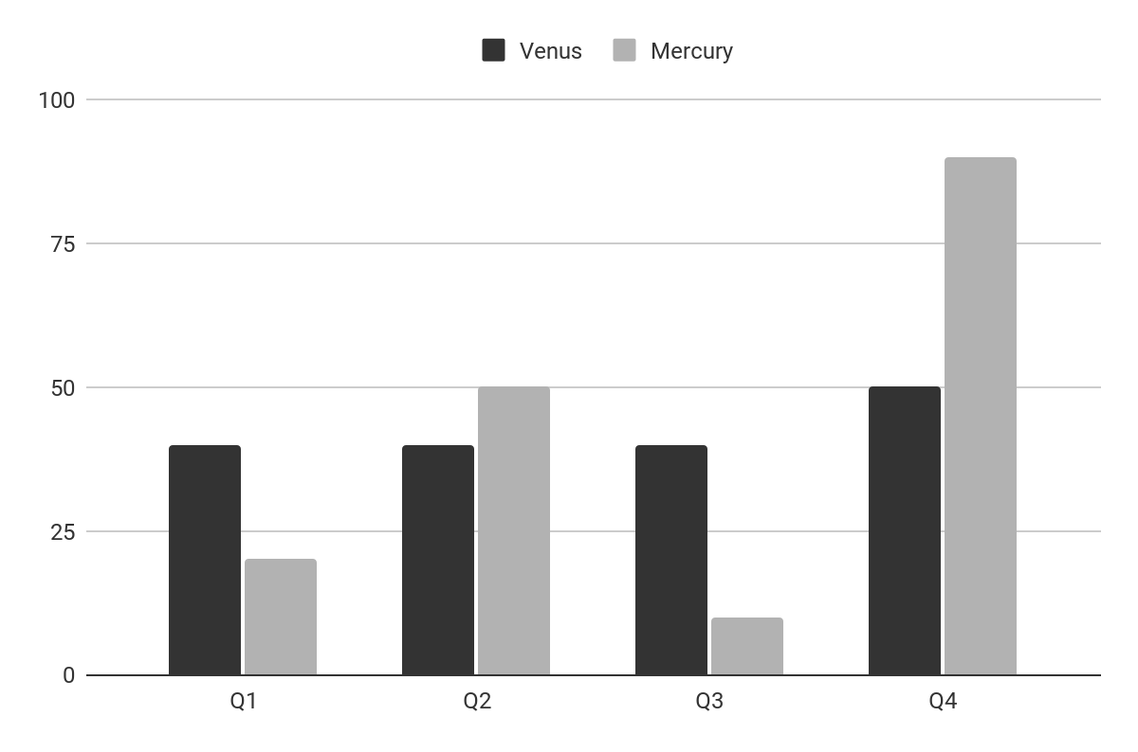
Analysis & development
Mercury is the closest planet to the Sun and the smallest one in the Solar System The planet’s name has nothing to do with the liquid metal
The Sun is the star at the center of the Solar System
Jupiter is the biggest planet in the entire Solar System
Saturn is composed mostly of hydrogen and helium
Venus
Mercury
Venus has a beautiful name
Mercury is quite a small planet
Follow the link in the graph to modify its data and then paste the new one here. For more info, click here

Slide 62
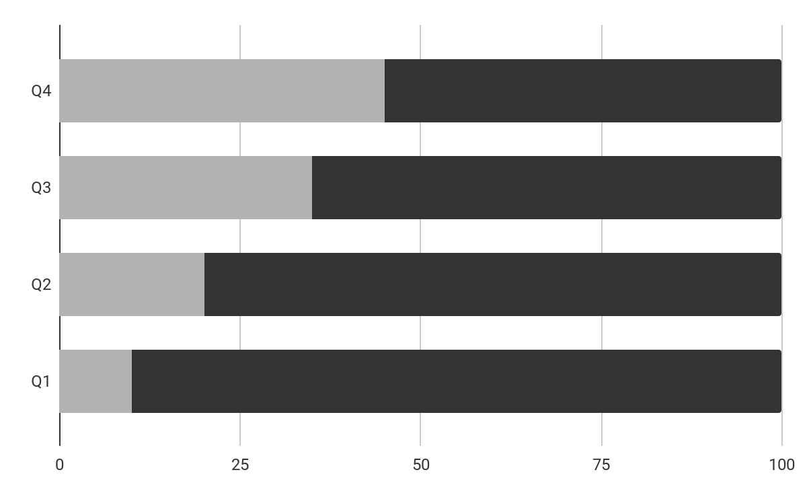
Analysis of the results
Mercury
Venus
Mercury is quite a small planet
Venus has a beautiful name
Mars
50%
Despite being red, Mars is a planet very cold
Follow the link in the graph to modify its data and then paste the new one here. For more info, click here

Slide 63
This is a map
Venus
Venus is the second planet from the Sun
Mercury
Mercury is the closest planet to the Sun
Mars
Despite being red, Mars is a cold place

Slide 64
Discussion
Mars & Earth
Discussion 1
Despite being red, Mars is actually a cold place. It's full of iron oxide dust, which gives the planet its reddish cast. Earth is the third planet from the Sun and the only one that harbors life in the Solar System. This is where we all live:
Ceres is located in the main asteroid belt
The Moon is Earth’s natural satellite
Neptune is very far away from us
Pluto is now considered a dwarf planet
Mercury is the closest planet to the Sun and the smallest one in the Solar System. It’s bit larger than the Moon
Discussion 2
Venus has a beautiful name and is the second planet from the Sun. Venus is a lot hotter than Mercury

Slide 65
Conclusions
Mars
Venus
Despite being red, Mars is actually a cold place. It’s full of iron oxide dust
Venus has a very beautiful name and is the second planet from the Sun
Mercury
Neptune
Mercury is the closest planet to the Sun and the smallest one in the Solar System
Neptune is a ig planet. It is the fourth-largest planet by diameter in the Solar System

Slide 66
Bibliographical references
Surname, A. (YEAR). Name of the source. Publisher
Surname, A. (YEAR). Name of the source. Publisher
Surname, A. (YEAR). Name of the source. Publisher
Surname, A. (YEAR). Name of the source. Publisher
Surname, A. (YEAR). Name of the source. Publisher
Surname, A. (YEAR). Name of the source. Publisher
Surname, A. (YEAR). Name of the source. Publisher
Surname, A. (YEAR). Name of the source. Publisher
Surname, A. (YEAR). Name of the source. Publisher
Surname, A. (YEAR). Name of the source. Publisher

Slide 67


Mockups
You can replace the images on the screen with your own work. Just right-click on them and select “Replace image”

Slide 68
Thanks!
Do you have any questions?
youremail@freepik.com
+34 654 321 432
yourwebsite.com
Please keep this slide for attribution

Slide 69
Icon pack

Slide 70
Alternative resources
Here’s an assortment of alternative resources whose style fits that of this template:
Flat design geometric background

Slide 71
Resources
Did you like the resources in this template? Get them at these websites:
Icons
Icon Pack: Books | Outline
Photos
Medium shot people at traveling agency
Close up hand signing document

