Slide 1
JAIST — Taniike Lab
Integrating OCM Literature Data into Lab-Scale ML Models
A Walkthrough of Five Transfer-Learning Approaches
Partha Nupam Nagar
June 2026
OCM Dataset Integration | Slide 1 / 16

Slide 2
The Problem — Two Datasets, Three Systematic Differences
Chapter 1
Our Lab Data
Published Literature Data (≤2019)
Samples
89,074
Samples
3,852
Year
2025
Year
1982 – 2019
Preparation
Impregnation only
Preparation
15+ methods
Mean Y(C2)
5.25%
Mean Y(C2)
8.67%
Conditions
Fixed, one lab
Conditions
40 years of diverse labs
Can we use literature to improve our model — without hurting it?
1. Label shift
Literature mean is 3.42 pp higher (t = −32.2, p < 10⁻²⁰⁰) — a systematic offset from publication bias and optimised conditions.
2. Covariate shift
78.5% of literature samples describe chemistry our lab has never tested.
3. Publication bias
Literature is skewed, not just shifted — failed experiments are rarely reported, over-weighting high yields.
Why ML? The catalyst search space (65 elements × varying loadings × temperature) is too large to screen physically. A surrogate model guides experiments toward high-yield compositions.
OCM Dataset Integration | Slide 2 / 16

Slide 3
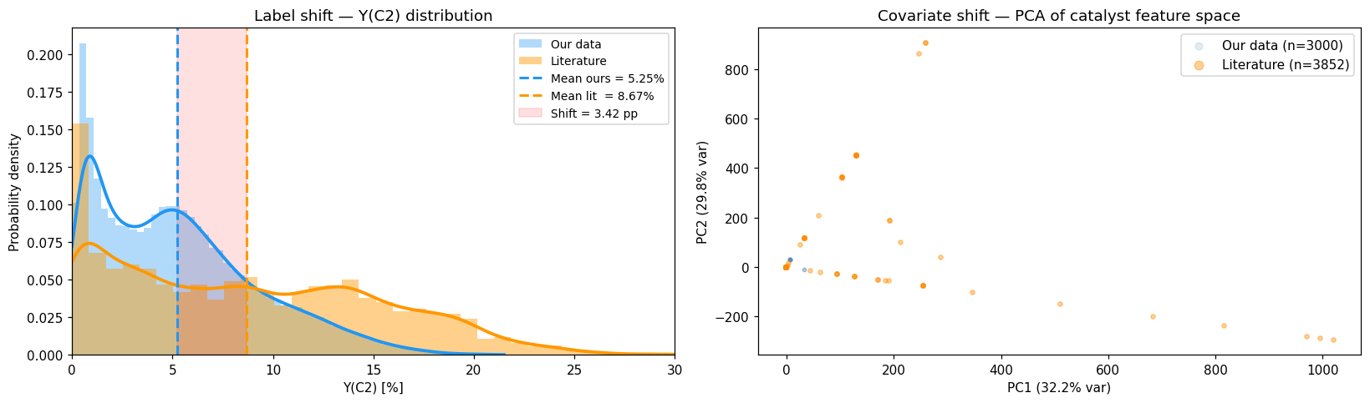
Setup — Label Shift & Covariate Shift
Chapter 2
Two panels, two shifts
• Left: yield KDE — blue peaks 3–4%
• Orange peaks 8–9% (3.42 pp gap)
• Red band = systematic gap (t = −32.2)
• Orange right tail = publication-bias skew
• Right: PCA of 67 features → 2D
• Orange outside blue = 78.5% OOD
Both signals — yield level AND chemistry composition — warn against naive concatenation (confirmed slide 6).
OCM Dataset Integration | Slide 3 / 16

Slide 4
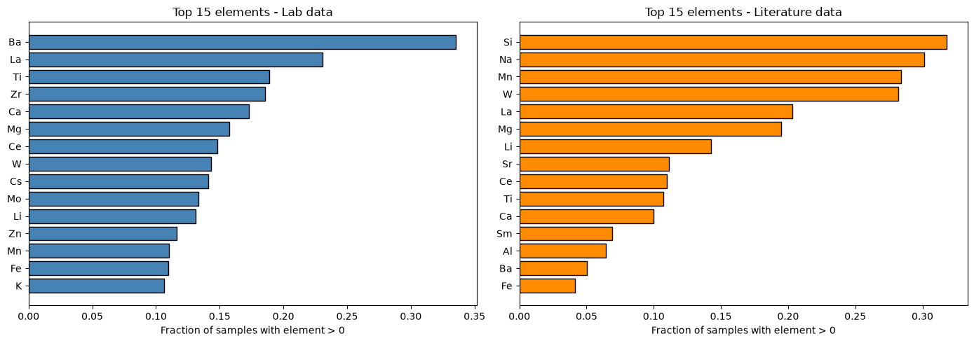
Setup — Which Elements Differ?
Chapter 2
Reading the chart
• Top 15 elements by usage frequency
• Different dominant elements each side
• Different active phases & promoters
• Our lab: focused 2025 programme
• Literature: 40 yrs, many groups
This is what '78.5% out-of-distribution' looks like in plain terms — literally different elements and preparation methods.
Selective filtering methods keep only literature whose element profile resembles our experimental programme.
OCM Dataset Integration | Slide 4 / 16

Slide 5
How We Measure Success — Catalyst-Grouped 5-Fold CV
Chapter 3
The validation rule
Primary metric: catalyst-level
• The 89,074 rows are only 917 DISTINCT CATALYSTS
Spearman on each catalyst's best yield, and enrichment@10%. Row RMSE is secondary — 19.9% of its variance is unreachable.
• Folds split by catalyst — all rows of a catalyst in one fold
• Validation fold = catalysts the model has never seen
• Literature never appears in validation
5-fold split by CATALYST (917 groups)
~183 catalysts
~183 catalysts
~183 UNSEEN
~183 catalysts
~183 catalysts
Why grouped, and not by row
• A row split puts the SAME catalyst in train and test
• The model then recalls catalysts instead of predicting new ones
+ literature (training only, never validation)
• Prof. Taniike raised exactly this — grouped CV is now the default
Rotate the held-out fold 5 times. Every number on the following slides uses this protocol; row-level figures appear only where they are labelled as historical.
OCM Dataset Integration | Slide 5 / 16

Slide 6
Baseline + Why Naive Merging Fails
Chapter 4
Step 1 — establish baseline (ROW-LEVEL CV, historical)
Why did it fail?
Method
CV RMSE
Model sees two catalysts with nearly identical composition:
Baseline (lab data only)
2.133
• One labelled 5.2% (our lab)
• One labelled 8.7% (literature)
Row-level protocol — kept only for comparison with the published numbers. Under catalyst-grouped CV the baseline is 2.9425.
No feature explains the gap — flow rate, gas ratio, etc. are absent. The model hedges and predicts both badly.
Step 2 — try the obvious
Method
CV RMSE
Baseline
2.133
The 3.42 pp offset is a SYSTEMATIC signal the model cannot account for — and incorrectly tries to fit. Mixing the two datasets can perform WORSE than using ours alone. ⇒ We need to be much more selective.
Naive merge (3,852 lit rows)
2.241
+5.1% worse than baseline (row-level). Re-tested at catalyst level, a direct merge again sits below the composition-only control (0.7577 vs 0.7606).
OCM Dataset Integration | Slide 6 / 16

Slide 7
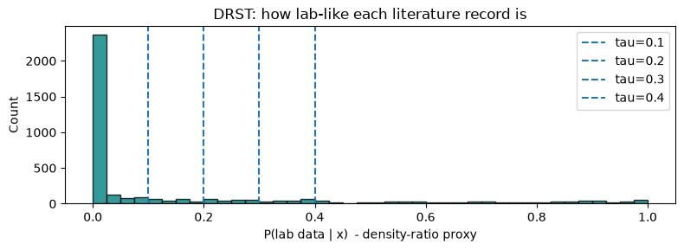
DRST — Filtering by Chemical Similarity
Chapter 5
How it works
• Train logistic classifier: ours=1, lit=0
• Score each lit sample: P(ours | x)
• Keep samples scoring ≥ τ
P(ours | x) is a similarity score: high = looks like our chemistry, low = foreign. We keep only literature scoring above τ.
Threshold sweep
τ
kept
RMSE
Histogram of P(ours | x) for every literature sample. Dashed lines = candidate thresholds.
τ = 0.10
1168 kept
2.068
τ = 0.20
987 kept
2.034
best τ
~200 kept
2.127
τ = 0.40
543 kept
2.045
Unsolved: hard cutoff is arbitrary — a sample at 0.29 is fully discarded; 0.31 gets full weight.
OCM Dataset Integration | Slide 7 / 16

Slide 8
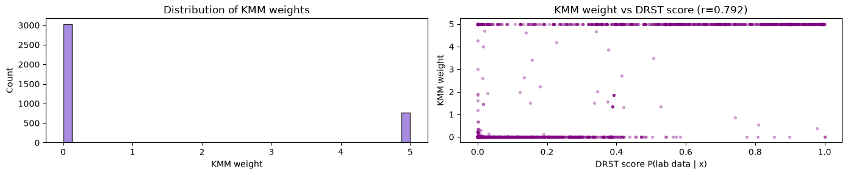
KMM — Soft Weights Instead of a Hard Filter
Chapter 6
How it works
• Each lit sample gets weight wᵢ ∈ [0, 10]
• RBF kernel: K(x,x′) = exp(−‖x−x′‖²/2σ²)
• Solve QP: ½ wᵀK_ss w − κᵀw
• σ via median heuristic (parameter-free)
KMM picks weights so the weighted literature cloud matches lab data cloud. Samples inside our chemistry earn weight; those outside fade to zero.
Result
KMM CV RMSE
2.261
Δ vs baseline
+6.0% (worse)
Near-zero weights
78.5%
Agreement w/ DRST
r = 0.79
Reassuring: two unrelated methods flag the same 78.5% of samples ⇒ real signal, not artifact. Still unsolved: literature labels remain in training, so the 3.42 pp offset still bleeds in.
OCM Dataset Integration | Slide 8 / 16

Slide 9
Prior Feature Transfer — The Method That Exposed the Leak
Chapter 7
STAGE 1 — Pre-train on Literature Chemistry
Literature
Stage 1
lit_prior
3,852 samples (DRST filtered)
XGBoost pre-train
prediction (68th feature)
STAGE 2 — Fine-tune on Our Labels Only
Our Lab Data
Append
Stage 2
Prediction
89,074 samples
68th feature
LightGBM our labels only
Y(C₂) %
The design was sound. The evaluation was not.
Literature enters as a FEATURE, never as a label, so the 3.42 pp offset cannot corrupt the training loss. That reasoning still holds. But Stage 1 was trained on literature TOGETHER WITH the lab training rows, and under a row-level split those rows included the test catalysts — so the prior feature partly carried each test catalyst's own measured yields. The gain was recall, not prediction. Ruling this out is what produced the protocol on slide 5; the mechanism is named in ocm_eval.stage1_data().
OCM Dataset Integration | Slide 9 / 16

Slide 10
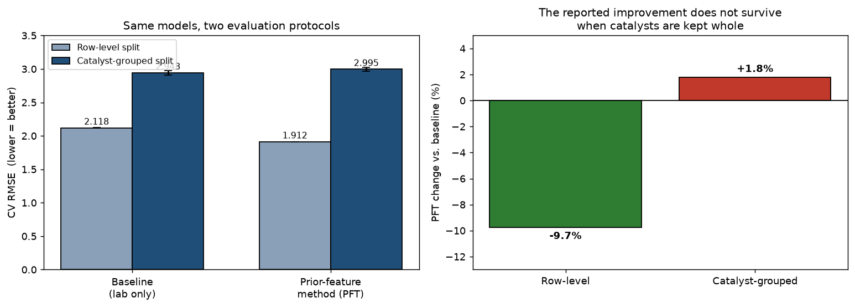
Results — The Same Models Under Two Protocols
Chapter 8
Row-level CV — HISTORICAL, leaked
Method
RMSE
Δ
Baseline
2.1184
—
PFT (filtered)
1.9120
−9.7%
PFT (all lit.)
1.9194
−9.4%
Catalyst-grouped CV — DEFAULT
Method
RMSE
Δ
Baseline
2.9425
—
PFT (filtered)
2.9955
+1.8%
PFT (all lit.)
2.9817
+1.3%
Same models, same data, two protocols. The published −9.7% becomes +1.8% WORSE once a catalyst cannot appear in both train and test. The difference is leakage, not modelling.
OCM Dataset Integration | Slide 10 / 16

Slide 11
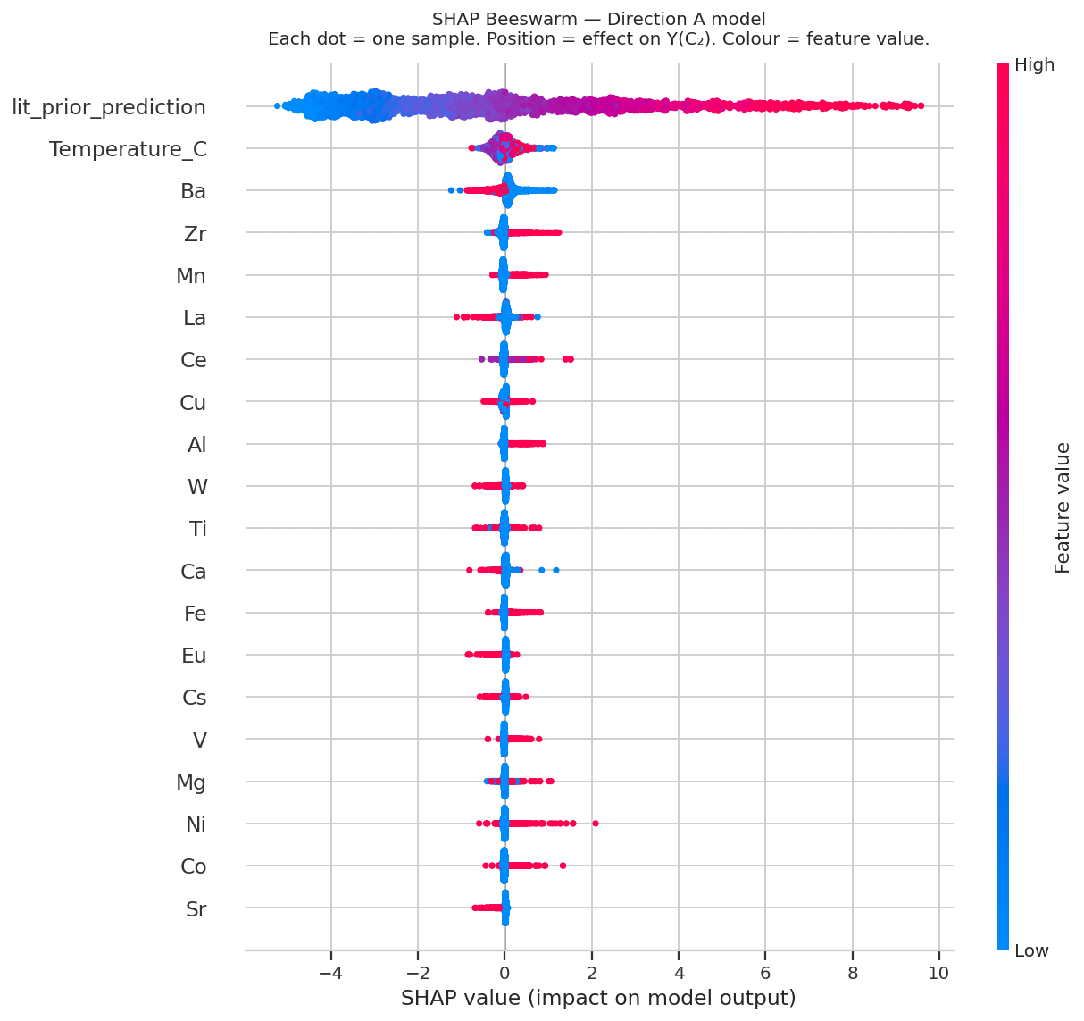
SHAP — Feature Importance Beeswarm
Chapter 8
Key signals
• #1: lit_prior — transfer used
• Temp ↑ → yield ↑ (correct OCM)
• Ba, Mn, La, Ce: net positive
• Li, K: mixed / suppressive
The model uses real OCM chemistry — transfer learning is not dead weight.
See next slide for residual breakdown →
TreeExplainer on 3,000-sample subsample. Each row = feature ranked by mean |SHAP|. Colour = feature value (red=high); x-position = prediction impact.
OCM Dataset Integration | Slide 11 / 16

Slide 12
SHAP — Ceiling Effect & Model Limits
Chapter 8
Residual breakdown by yield range
What SHAP confirmed
Y(C₂) range
RMSE
• #1: lit_prior_prediction — transfer learning actively used
0 – 6%
1.43 – 1.48
• Temperature: high T → yield up (correct OCM physics)
6 – 10%
1.95
• Ba, Mn, La, Ce — known active phases and promoters
10 – 15%
2.58
• Li, K — mixed / suppressive (can over-reduce surface)
> 15%
4.70 (−4.2 pp bias)
The ceiling is NOT a modelling failure — it is a DATA failure. Missing columns (GHSV, CH₄:O₂, pressure) explain why Y>15% catalysts exist. No algorithm can compensate for absent input features.
Root cause: GHSV, CH₄/O₂ ratio, pressure absent from the feature set — a data limit, not a model failure.
Fix the data → the model automatically improves. That is the single highest-impact next step.
OCM Dataset Integration | Slide 12 / 16

Slide 13
Statistical Rigour & Honesty
Chapter 8
The headline was coverage-inflated
The sharpest test we could devise
• Cells run further contain better yields, so a score over all
• We retrained the model to predict HOW MANY measurements a
• 917 catalysts is partly a record of which runs were finished.
• catalyst received. It never sees a yield.
• All 917: Spearman 0.767 enrichment 4.35×
• That model reaches Spearman 0.400 against observed max yield…
• Equal effort (771): Spearman 0.724 enrichment 3.77×
• …but its enrichment is 0.87× — no better than random.
• Coupling removed BY MEASUREMENT: ρ(n_rows, max) +0.293 → +0.003
• Rank correlation is partly purchasable from experimental effort.
• 300 random 771-subsets give 0.767 [0.756, 0.780] — 0.724 sits
• Enrichment is not. That is why enrichment is the primary metric.
• below that interval, so the drop is real, not a smaller-sample effect.
And the open question is bounded: ranking catalysts by their observed FLOOR instead of their ceiling shares only 7 of the top 20, but a ceiling-trained model loses just 0.017 Spearman against floor ground truth — less than seed-averaging alone buys — and never drops below 4.02× enrichment. The answer changes the labels, not the decision.
OCM Dataset Integration | Slide 13 / 16

Slide 14
Critical Analysis — Per-Method Review
Chapter 9
Honest critique of each method
Cross-cutting limits
Method
Main limitation
• All methods evaluated on our-data CV only; OOD tested for Prior FT alone
Naive merge
Negative control — makes the model worse
• Point predictions — no uncertainty estimates to guide experiment selection
• Y>15% ceiling is DATA-bound (missing GHSV, CH₄:O₂, pressure), not model-bound
DRST
Hard cliff; discards ~80%; τ tuned on the reported CV
KMM
O(n²) kernel; σ-sensitive; labels still in loss; ties DRST
Key insight: the ceiling effect and much of the label shift share the same root cause — missing operating-condition features. Fix the data; the models follow.
Prior FT
Best — Stage-1 on 782 rows → high variance; two models
OCM Dataset Integration | Slide 14 / 16

Slide 15
What's Next — Priority-Ordered
Chapter 9
1
Ask JAIST for the reaction-condition columns
Re-scope the campaign before reactor time is spent
Highest impact
4
One email. Converts 19.9% of currently unreachable variance into modellable signal and turns 917 training examples back into 89,074.
20 runs per catalyst instead of 135 reproduces the full ranking at ρ = 0.949, buying ~72 catalysts plus a control arm for the budget of 17 exhaustive ones.
2
Ask whether the 27 slots are conditions or time-on-stream
Send the corrected work note
Highest impact
5
Provably unanswerable from the file: every cell is stored sorted by yield, so row order records rank, not acquisition sequence. Only the lab can settle it.
Complete and verified. Every number now traces to a JSON written by a committed script.
3
Ask why grid coverage is incomplete
6
Run the prospective validation
186 catalyst-temperature cells absent; only 811 of 917 catalysts have all five temperatures. Decides whether the bias is correctable or itself informative.
Prof. Taniike offered to synthesise candidates. A shortlist is a set to test, not a league table — the model cannot order within its own top 20.
OCM Dataset Integration | Slide 15 / 16

Slide 16
Summary
What we asked
Can published OCM literature improve a lab-data model — and can we rank UNSEEN catalysts well enough to guide synthesis?
What we learned
• The original −9.7% gain was catalyst-identity leakage. Under catalyst-grouped CV the same models are 1.8% WORSE than baseline.
• No literature-integration design beats composition alone in-domain — four pre-registered designs and a 28-family follow-up, all null.
• Literature helps only where the lab has NO coverage: on non-impregnation chemistry a plain merge lifts Spearman 0.24 → 0.39 and enrichment 0.42× → 1.34×. Plain merging beats the two-stage machinery — the value is the data, not the method.
• The composition-only model still screens unseen catalysts usefully: enrichment 3.77× on the equal-effort set (95% CI 3.04–4.89×), and that conclusion survives either reading of the open data question.
Next step that matters most
Ask for the reaction-condition columns. One email unlocks more than any modelling change we have tried.
OCM Dataset Integration | Slide 16 / 16

