Slide 1
Overview of the OSI and TCP/IP Models
Functions, Roles, and Comparisons in Network Protocols

Slide 2
Introduction
The OSI (Open Systems Interconnection) model and TCP/IP model are frameworks used to understand and implement network protocols. Each layer in these models has specific functions and roles that ensure successful data communication.

Slide 3
OSI Model Overview
The OSI model consists of 7 layers:
1. Physical Layer
2. Data Link Layer
3. Network Layer
4. Transport Layer
5. Session Layer
6. Presentation Layer
7. Application Layer
Each layer performs specific tasks to facilitate communication.

Slide 4
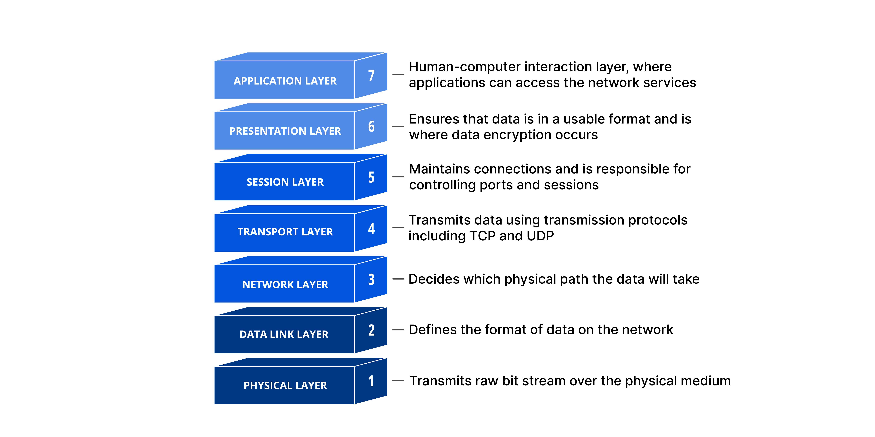
OSI Model Overview

Slide 5
Physical Layer
Purpose: Handles the physical transmission of raw data over a network.
Functions:
Transmission of binary data (0s and 1s) as electrical signals, light pulses, or radio waves.
Defines hardware specifications, such as cables, connectors, and voltage levels.
Manages data rate, synchronization, and topology.
Example Protocols/Standards: Ethernet (Physical), USB, Bluetooth.

Slide 6
Data Link Layer
Purpose: Ensures reliable data transfer between two nodes in the same network.
Functions:
Error detection and correction (e.g., using checksums).
Frame creation, transmission, and reception.
MAC (Media Access Control) addressing for identifying devices on the same network.
Example Protocols/Standards: Ethernet (Data Link), PPP, Wi-Fi (802.11)

Slide 7
Network Layer
Purpose: Responsible for routing, addressing, and delivering data across different networks.
Functions:
Logical addressing (e.g., IP addresses).
Path determination and routing of data packets.
Fragmentation and reassembly of packets if necessary.
Example Protocols/Standards: IPv4, IPv6, ICMP, OSPF, BGP

Slide 8
Transport Layer
Purpose: Ensures end-to-end communication, reliability, and error recovery.
Functions:
Segmentation and reassembly of data into manageable pieces.
Flow control and congestion management.
Error detection and retransmission for reliable data delivery.
Multiplexing to handle multiple communication sessions.
Example Protocols: TCP (Transmission Control Protocol), UDP (User Datagram Protocol)

Slide 9
Session Layer
Purpose: Manages and controls connections (sessions) between applications.
Functions:
Establishing, maintaining, and terminating sessions.
Synchronization (e.g., checkpointing during file transfers).
Dialog control for determining communication modes (half-duplex/full-duplex).
Example Protocols/Standards: NetBIOS, RPC (Remote Procedure Call).

Slide 10
Presentation Layer
Purpose: Translates data between application and network formats.
Functions:
Data encryption and decryption for secure communication.
Data compression to reduce size and improve transmission speed.
Translation of data formats (e.g., from EBCDIC to ASCII).
Example Standards: SSL/TLS, JPEG, GIF, XML, MPEG.

Slide 11
Application Layer
Purpose: Provides network services directly to end-user applications.
Functions:
Interface for the user to interact with network applications.
Supports services like file transfers, email, and remote access.
Ensures communication partners are identified and authenticated.
Example Protocols: HTTP, FTP, SMTP, DNS, SNMP.

Slide 12
Functions of OSI Layers
1. Physical: Transmission of raw bits.
2. Data Link: Error detection and MAC addressing.
3. Network: Routing and addressing.
4. Transport: Reliable data transfer (e.g., TCP, UDP).
5. Session: Establishing and managing sessions.
6. Presentation: Data translation and encryption.
7. Application: End-user services and interfaces.

Slide 13
TCP/IP Model Overview
The TCP/IP model consists of 4 layers:
1. Network Access Layer
2. Internet Layer
3. Transport Layer
4. Application Layer
It is the foundation of modern internet communication.

Slide 14
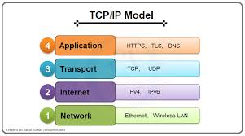
TCP/IP

Slide 15
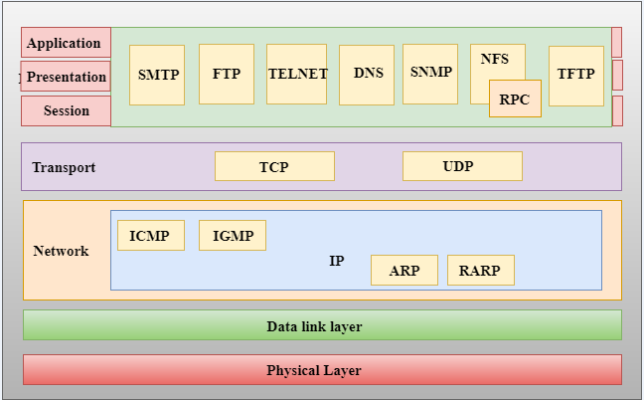

Slide 16
Functions of TCP/IP Layers
1. Network Access: Handles hardware addressing and framing.
2. Internet: Provides IP addressing and routing.
3. Transport: Ensures data delivery using protocols like TCP/UDP.
4. Application: Provides network services like HTTP, FTP, SMTP.

Slide 17
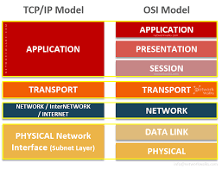
OSI to TCP/IP

Slide 18
Comparison of OSI and TCP/IP Models
1. OSI has 7 layers; TCP/IP has 4 layers.
2. OSI is a theoretical model; TCP/IP is practical and widely used.
3. OSI separates Presentation and Session layers; TCP/IP combines them into the Application layer.

Slide 19
Conclusion
Both OSI and TCP/IP models are essential for understanding network communication. They provide a layered approach to designing and troubleshooting network protocols.

