Slide 1
Introduction to Computer Networks
Definition, Importance, Types, Topologies, and Real-World Examples

Slide 2
Definition of Computer Networks
A computer network is a group of interconnected computers that share resources and communicate with each other. It enables the exchange of data, applications, and hardware devices like printers.

Slide 3
Importance of Networking
Enables resource sharing (files, printers, internet)
Facilitates communication (emails, video calls)
Supports business operations (cloud computing, ERP systems)
Enhances collaboration and productivity

Slide 4
Types of Networks
Local Area Network (LAN): Covers a small geographic area, like an office.
Wide Area Network (WAN): Spans large areas, such as cities or countries.
Metropolitan Area Network (MAN): Covers a city or large campus.

Slide 5
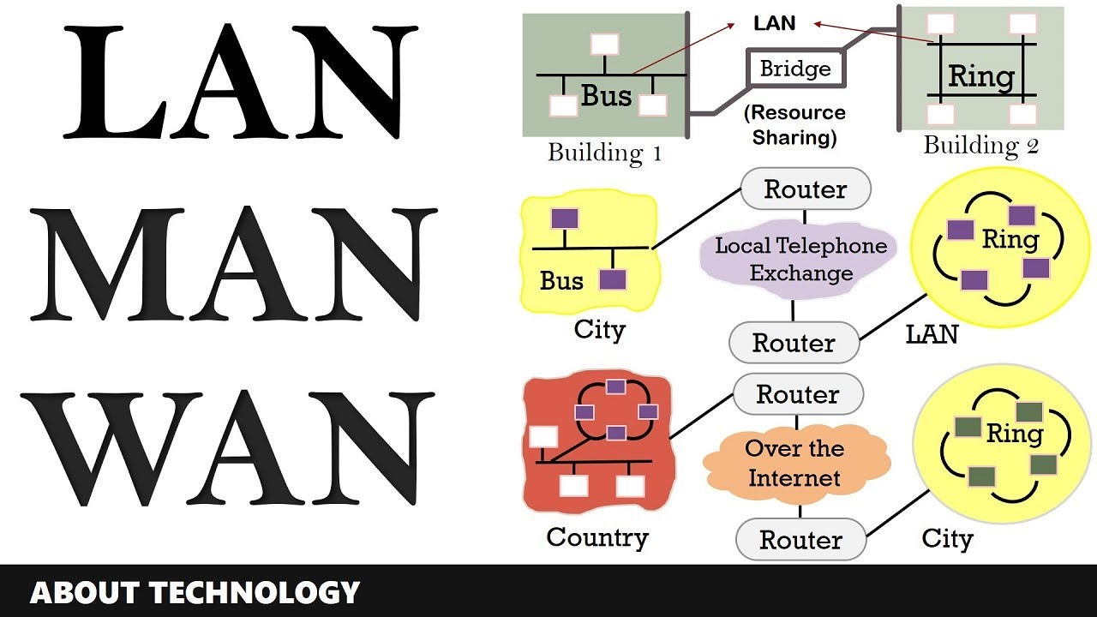

Slide 6
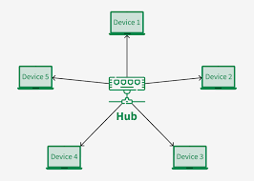
Network Topologies
Star Topology: Devices connect to a central hub.
.

Slide 7
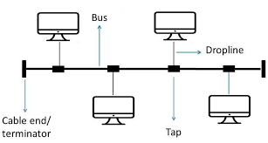
Contd….
Bus Topology: Devices share a single communication line.

Slide 8
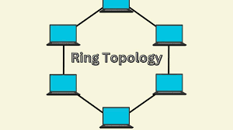
Contd……
Ring Topology: Devices form a closed loop.

Slide 9
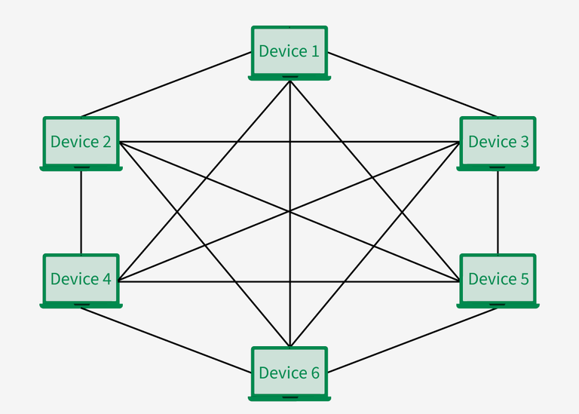
Contd…..
Mesh Topology: Devices connect to multiple other devices

Slide 10
Real-World Examples
LAN: Office network connecting employee computers.
WAN: The internet, connecting global networks.
MAN: City-wide Wi-Fi networks or university campuses.

