Slide 1
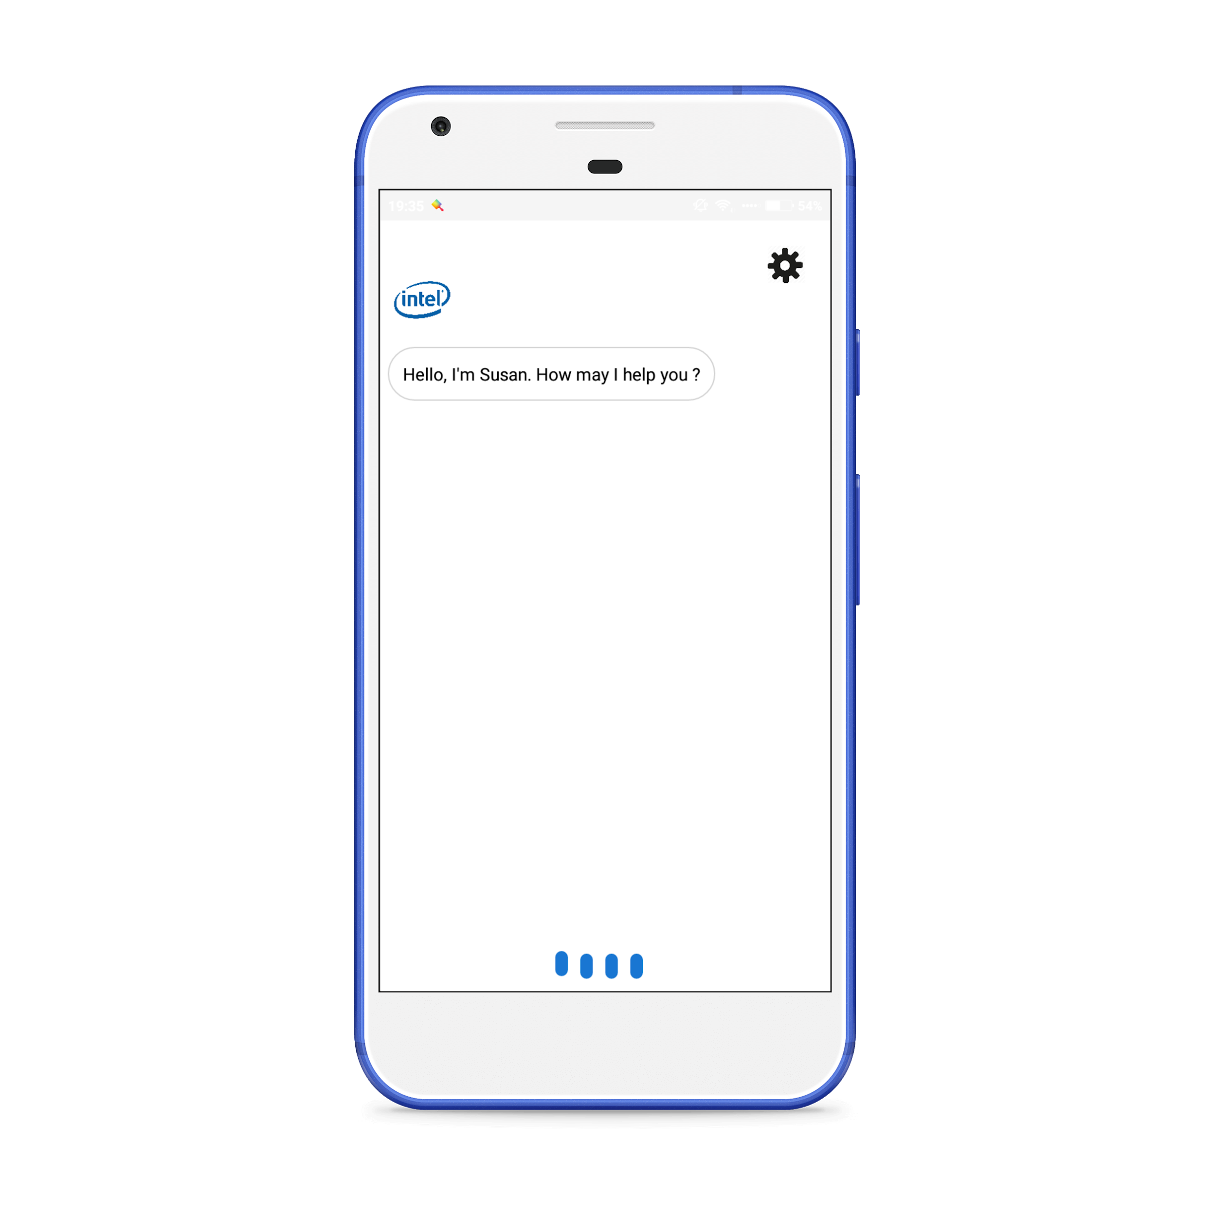


AASSIST
BY TEAM ONEMAN

Slide 2
WHAT?
ONE STOP INTERNET BANKING SOLUTION
ONE APP - MANY BANKS
VOICE ASSISTED BANKING

Slide 3
WHY ? not the straight way
1
2
3
MULTIPLE WEBSITES
MULTIPLE CREDENTIALS
MULTIPLE MOBILE APPS
ALL BANKS HAVE THEIR OWN INTERNET BANKING INTERFACE WHICH IS THE MAJOR PROBLEM FOR NEW USERS AS WELL AS OLD USERS TO ADJUST TO AS DIFFERENT WEBSITE ADDRESSES ARE NEEDED TO BE REMEBERED.
ALL BANKS HAVE THEIR OWN PERSONAL CUSTOMIZED APPS FOR INTERNET BANKING PURPOSE SO THE USER HAS TO DOWNLOAD ALL THE DIFFERENT APPS FOR ALL THE BANKS HE HAS A SUBSCRIPTION OF.
DIFFERENT USERNAME AND PASSWORDS ARE NEEDED TO BE REMEMBERED FOR DIFFERENT INTERNET BANKING SUBSCRIPTION.

Slide 4

“Susan”
VIRTUAL BANKING AASSISTANT

Slide 5
SERVICES OFFERED
1
MULTIPLE INTERNET BANKING ACCOUNTS OF MULTIPLE BANKS
8
ANALYZE YOUR PREVIOUS TRANSACTIONS
2
BALANCE INFORMATION
9
MAKE PULL TRANSFERS
3
FUND TRANSFER
10
EASY CONTEXT SWITCHING
4
FETCH LINKED ACCOUNTS WITH ANY INTERNET BANKING SUBSCRIPTION
11
UPI TRANSACTIONS
5
CREATE QUICK SEND CONTACTS FOR SENDING MONEY BY JUST HIS NAME
6
TRANSFER MONEY TO ANY OTHER AASSIST USER BY JUST HIS EMAIL ADDRESS
7
SELECT A DEFAULT ACCOUNT TO RECEIVE AND SEND MONEY

Slide 6




MAJOR COMPONENTS
+
+
+
=
Intel Python and Intel TBB powered Tornado Server
Android Application
Mysql Database
AWS EC2 C5 Instance

Slide 7
PERFORMANCE
4%
REDUCTION
100% THREAD
IN RESPONSE TIME
CONCURRENCY

Slide 8
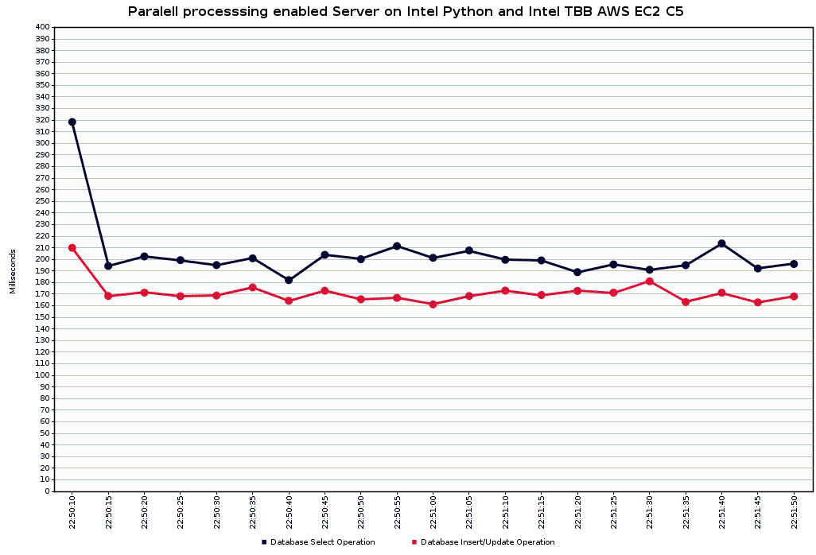
CONSTANT REQUEST CURVE

Slide 9
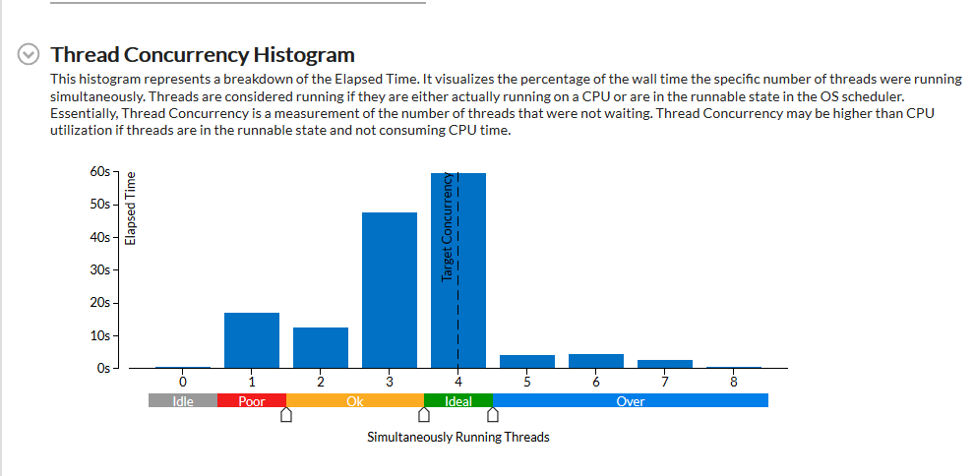
IDEAL THREAD CONCURRENCY
INTEL vTUNE AMPLIFIER ANALYSIS

Slide 10
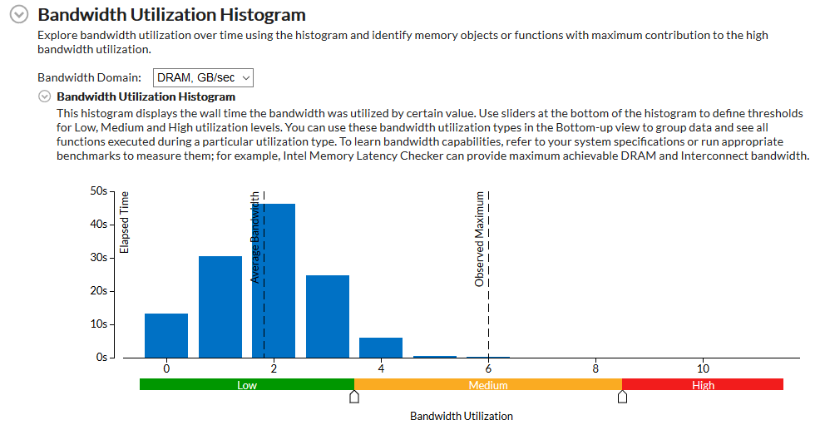
LOW BANDWIDTH UTILIZATION
INTEL vTUNE AMPLIFIER ANALYSIS

Slide 11
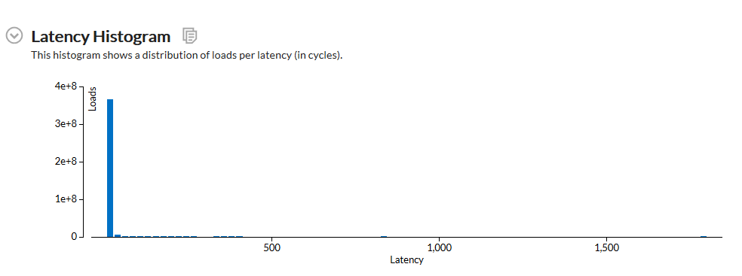
LOW LATENCY
INTEL vTUNE AMPLIFIER ANALYSIS

Slide 12
FUTURE FEATURES
BRINGING THE BANK TO THE PHONE
Download Bank Statements directly from within the app (of any bank)
Ordering cheque books (of any bank)
Viewing images of paid cheques Loan application
Credit Card application
Apply for Internet Banking of any registered Bank without visiting the bank
and so on...

Slide 13



THANK YOU
to be continued....

