Slide 1
CAMPUS INFRASTRUCTURE & FACILITY INTELLIGENCE
CampusPulse
Automated University Defect Allocation, Employment Roster & Real-Time Incident Infrastructure
• Technology Stack: Python 3.13 | Django 6.1 | MongoDB Atlas Cloud Cluster | Server-Sent Events (SSE)
• Deployment Gateway: Vercel Cloud WSGI (https://campus-pulse-nine-jade.vercel.app/)
• Architecture Core: Direct Hostel Auto-Allocation (26 Hostels), Corroboration Fingerprint Clustering & Scoped Duty Roster

Slide 2
CHALLENGES & MOTIVATION
The Problem: Traditional Campus Facility Operations Breakdown
01
48-to-72 Hour Resolution Lag
Manual physical logbooks in warden offices cause severe delays before complaints reach maintenance teams.
02
Severe Ticket Redundancy
Dozens of students file individual complaints for shared defects (e.g. broken water coolers or AC failure), overloading queues with noise.
03
Technician Misallocation
No direct building-to-staff routing. Electricians and plumbers wander across 26 vast hostels without clear zone or block ownership.
04
Zero Status Visibility
Students remain in the dark with zero real-time feedback, leading to repeated warden visits and frustration.

Slide 3
VALUE PROPOSITION
The Solution: Automated Facility Intelligence & Ecosystem
PILLAR 01
PILLAR 02
PILLAR 03
Student Experience Portal
• Frictionless defect submission with auto-filled residence coordinates.
• Atomic corroboration engine: upvote existing defects rather than duplicate.
• Digital Virtual Student ID Card verification.
• Live topbar notification drawer powered by Server-Sent Events (SSE).
Dedicated Technician Duty Portal
• Mobile-optimized gateway (/employee/login/) with ID authentication.
• Scoped duty queues: staff only receive tickets for their designated hostels & trade.
• Structured work lifecycle: Assigned -> In Progress -> Resolved.
• Mandatory diagnostic repair notes & verification records.
Operations Command Center
• Centralized registry managing all 26 university hostels (BH1-BH13, GH1-GH13).
• Employee roster & duty hostel assignment engine.
• Real-time KPI metrics, SLA adherence tracking, and 1-click bulk auto-allocation.
• End-to-end transparent defect lifecycle auditability.

Slide 4
SYSTEM TOPOLOGY
End-to-End System Architecture & Data Pipeline
1. Client Presentation Layer
Responsive Multi-Portal Web Clients (Tailwind CSS, Vanilla JS, Pure SVG Vector Icons, Zero Bloated Frameworks)
• Resident Student Portal | • Technician Duty Web App | • Stealth Facility Admin Console
2. Application Gateway Layer
Python 3.13 & Django 6.1 WSGI Application Gateway
• Session Authentication & Role RBAC | • Canonical Code Normalizer | • Server-Sent Events (SSE) Hub
• Deployed serverlessly via Vercel Cloud Serverless Function Runtime
3. Cloud Data Persistence Layer
MongoDB Atlas NoSQL Cloud Database Cluster (project.z8sdm3c.mongodb.net)
• Polymorphic Users Collection | • Embedded Issue Timelines | • Atomic $addToSet Deduplication
• PyMongo 4.19 Driver with DNS Resilience & Multi-Index Query Optimization

Slide 5
DATA ARCHITECTURE
MongoDB Atlas Cloud NoSQL Data Modeling
db.users
Polymorphic Collection
Single collection serving Students, Employees, and Admins via role discrimination.
• Students: registration_number, default_hostel_block, default_room_number
• Employees: employee_id, department_id, assigned_buildings (array), duty_shift
• Admins: master operational oversight & permissions
db.issues
Core Defect Documents
Rich document with embedded audit timelines and atomic arrays.
• ticket_id: Unique human-readable ticket code
• location: { location_type, building_or_block, room_or_area, normalized_key }
• corroborators: Atomic array of student IDs confirming defect
• timeline: Embedded chronological status transition logs
db.buildings & departments
Canonical Campus Registries
• buildings: Registry of all 26 hostels (BH1-BH13, GH1-GH13) + academic complexes, floor counts & capacities.
• departments: Maintenance units (HVAC, Electrical, Plumbing, IT Wi-Fi, etc.) with enforced SLA target hours.

Slide 6
ROUTING LOGIC
Defect Lifecycle & Algorithmic Routing Engine
01
02
03
04
05
Step 1: Submission & Autofill
Student initiates defect report. Hostel and room coordinates are automatically populated from the student profile.
Step 2: Fingerprint Deduplication
Generates cluster key (building:room:department). If active ticket exists, increments upvotes atomically and notifies reporter.
Step 3: Canonical Normalization
Building name aliases are resolved to canonical codes (e.g. 'Boys Hostel 13' -> 'BH13') for consistent indexing.
Step 4: Atlas Query & Staff Binding
Queries MongoDB for on-duty technician assigned to normalized building code. If found, sets status ASSIGNED & embeds tech metadata.
Step 5: Duty Execution & SSE Alert
Technician accepts task, marks IN_PROGRESS, fulfills repairs with technical notes. Live SSE stream broadcasts alerts to students.

Slide 7
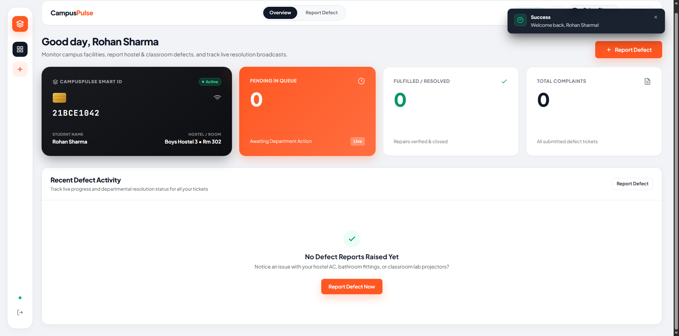
STAKEHOLDER USE CASE 1
Student Portal: Virtual Identity & Defect Management
Student Features & Experience
• Virtual Digital ID Card: Real-time verification badge displaying Reg No, Department, Year & Residence coordinates.
• Smart Active Defect Feed: Visual cards tracking complaint status (Reported, Assigned, In-Progress, Resolved).
• Real-Time Popover Bell: Header notification drawer powered by SSE broadcasting live repair updates.
• Corroboration Upvote Action: 1-click upvote on active roommate/floor issues to boost priority instantly.
• Clean Zero-Emoji Slate Design: High readability typography and SVG icons.
Live Web Capture: Student Dashboard with Virtual ID Card & Defect Feed

Slide 8
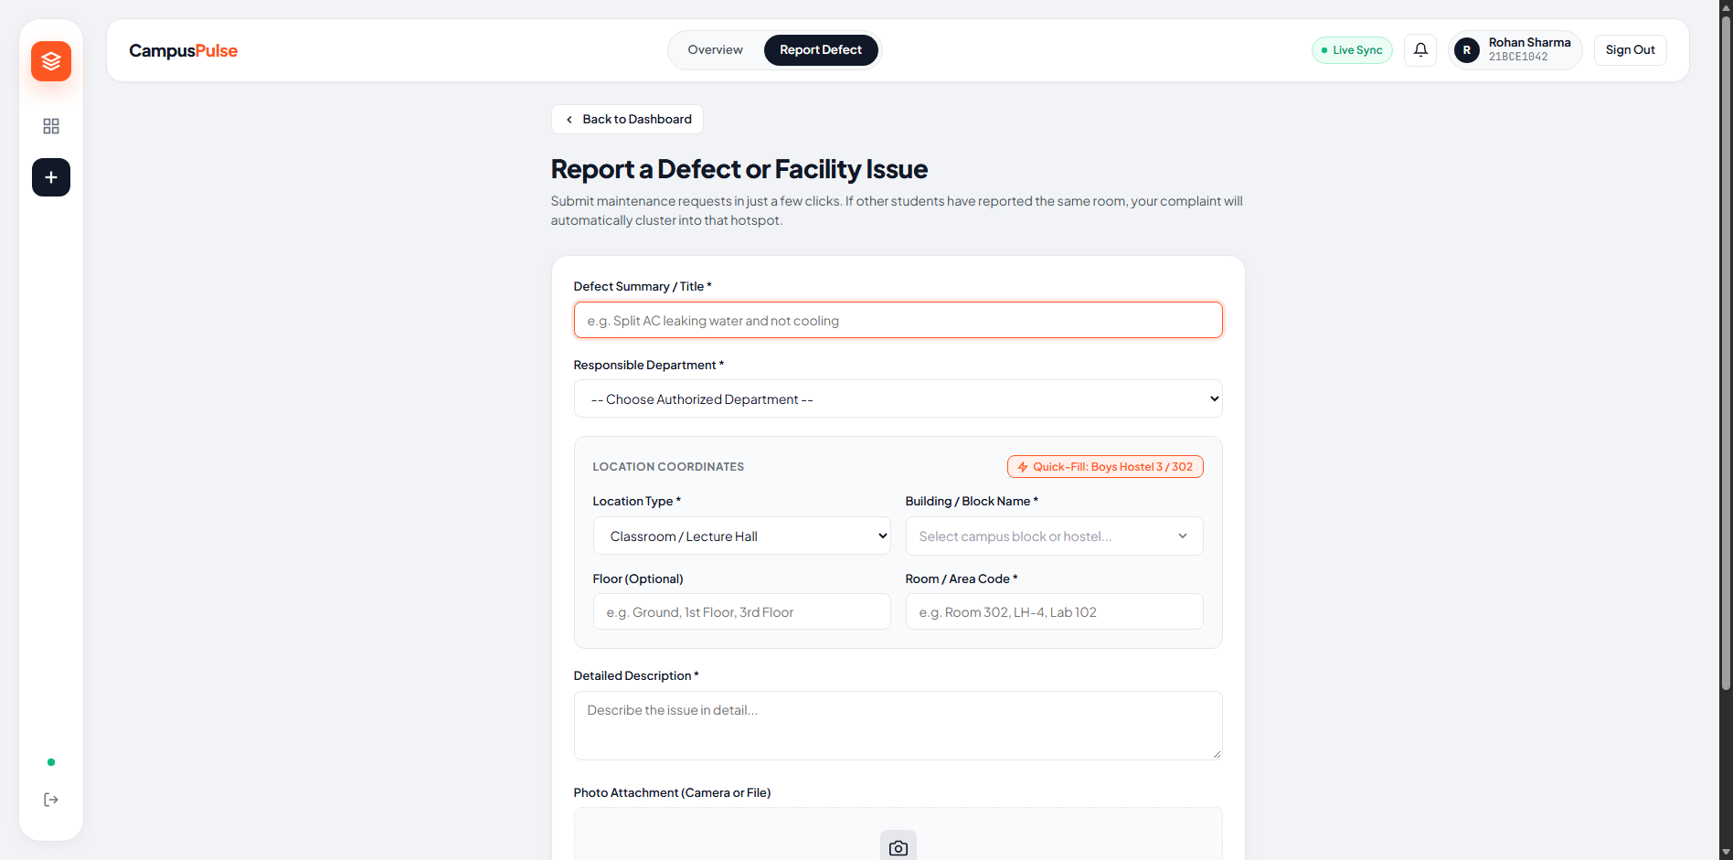
STUDENT DEFECT FILING
Frictionless Defect Submission & Deduplication
Smart Filing & Clustering Logic
• Profile Coordinate Auto-fill: Student's registered Hostel Block and Room Number are injected automatically, eliminating human typo errors.
• Photo Evidence Upload: Integrated image proof submission stored securely for technician triage.
• Category Specification: Department routing (HVAC, Electrical, Plumbing, IT Wi-Fi, Furniture, CCTV).
• Cluster Match Prevention: Prevents multiple redundant tickets from being created for the same broken facility.
• Mobile-Responsive Layout: Clean touch-friendly form controls.
Live Web Capture: Defect Reporting Interface with Photo Upload & Auto-fill

Slide 9
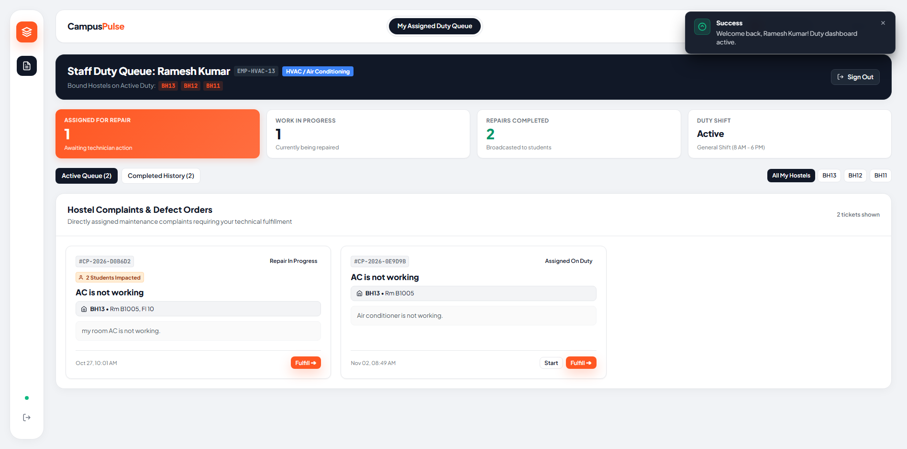
STAKEHOLDER USE CASE 2
Maintenance Operations: Dedicated Employee Duty Portal
Technician Workflow & Duty Queue
• Dedicated Staff Gateway: Authenticate securely via /employee/login/ using Employee ID (e.g. EMP-HVAC-13).
• Scoped Hostel Queues: Technicians only see defects matching their trade and assigned duty hostels (e.g. BH11, BH12, BH13).
• Work Progression Workflow: Instant 1-click status transitions: 'Start Work / En Route' -> 'Fulfill Repair'.
• Mandatory Diagnosis Logging: Technicians record technical remarks explaining component fixes before closure.
• Student Contact Access: Direct phone & room coordinates visible for immediate physical coordination.
Live Web Capture: Employee Duty Dashboard (/employee/dashboard/)

Slide 10
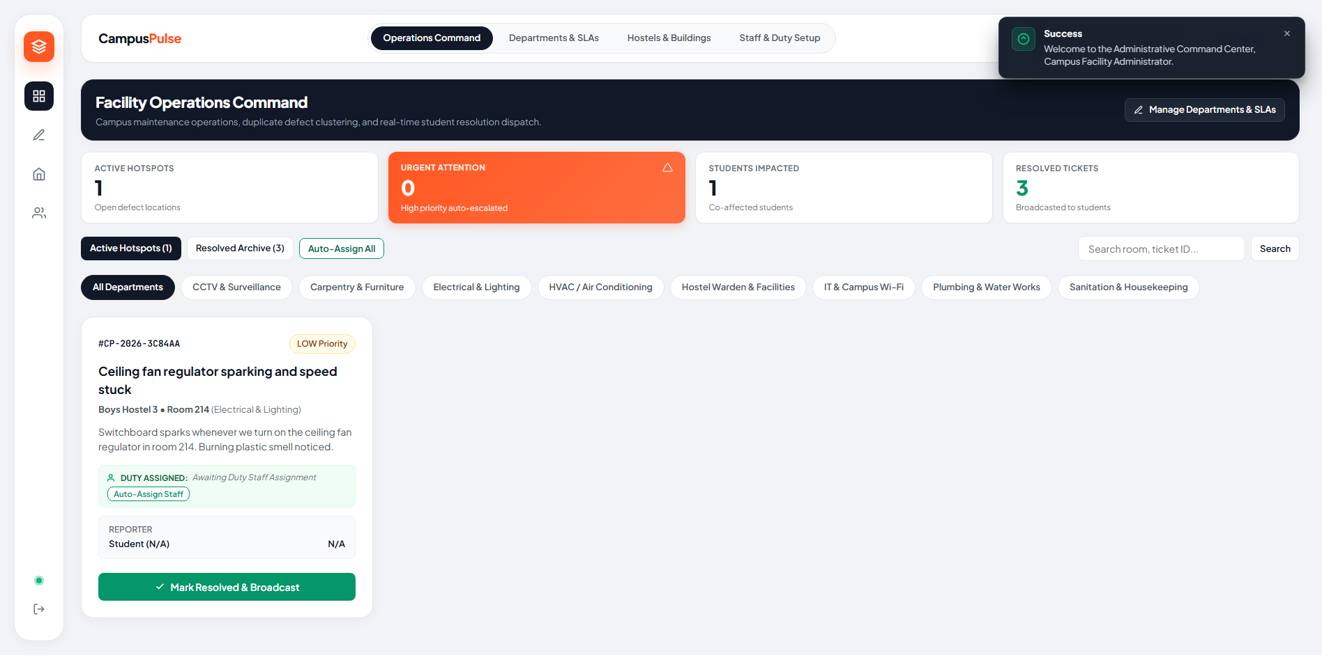
STAKEHOLDER USE CASE 3
Facility Operations Command Center: Live Analytics & Oversight
Operational Command Capabilities
• High-Altitude KPI Metrics: Live counters for Total Defects, Reported Backlog, In-Progress, and Resolved items.
• Batch Auto-Allocation: 1-click 'Auto-Assign All Complaints' algorithm matching pending issues with on-duty staff.
• Individual Override: Manual technician reassignment and supervisor escalation controls.
• Department SLA Visibility: Real-time monitors identifying overdue or high-priority tickets across campus.
• Stealth Security Perimeter: Strict session authentication preventing student cross-portal access.
Live Web Capture: Admin Command Center with KPI Counters & Allocation Controls

Slide 11
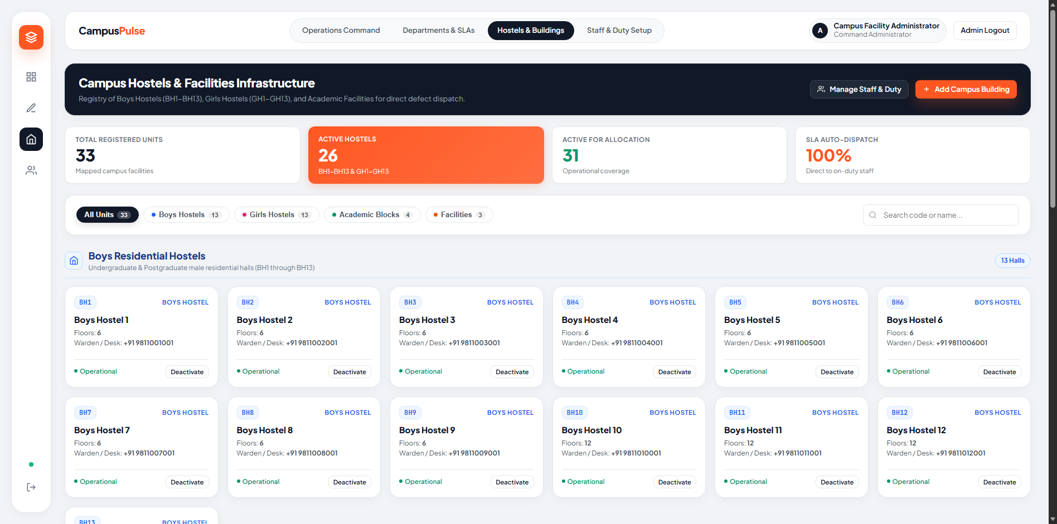
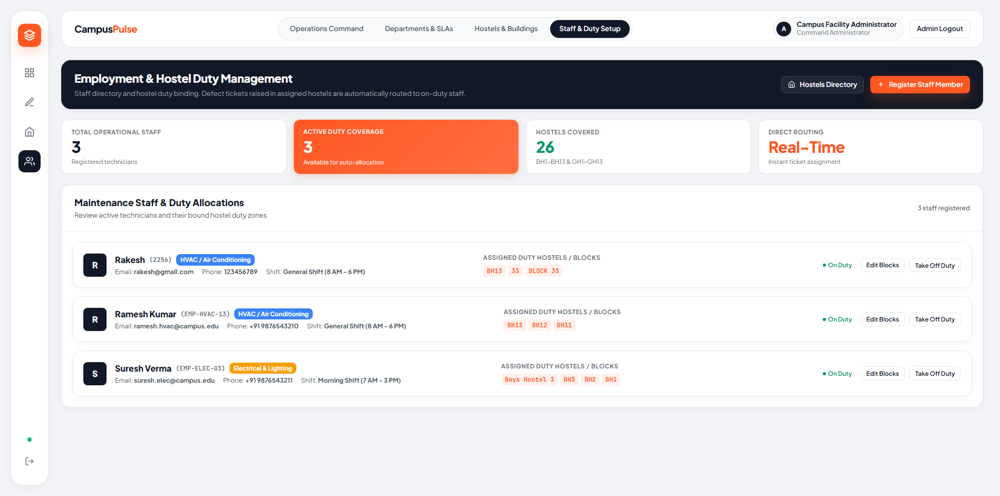
CAMPUS CONFIGURATION
Hostel Registry & Staff Duty Roster Management
Live Web Capture: 26 Hostels Registry (/admin/buildings/)
Live Web Capture: Employee Duty Allocation Console (/admin/employees/)
Infrastructure Registry Highlights
• Canonical Building Registry: Pre-loaded directory managing all 26 hostels (BH1-BH13, GH1-GH13), Academic complexes & Facility blocks with floor counts.
• Dynamic Duty Rostering: Facility managers bind technicians to specific hostel blocks with instant automatic dispatching on newly filed tickets.

Slide 12
SYSTEM PERFORMANCE
Server-Sent Events (SSE) & Measurable Operational Impact
72h -> <2h
Response Time Slashed
Automated direct routing bypasses physical warden logbooks completely.
>70%
Duplicate Tickets Reduced
Corroboration cluster key merges redundant complaints into unified work orders.
100%
Resolution Auditability
Technician diagnostic logs & timestamps recorded immutably in MongoDB.
Zero
Heavy Polling Overhead
Lightweight SSE push stream eliminates wasteful client-side interval polling.
Architectural Superiority: Server-Sent Events (SSE) Stream vs Traditional Polling
• EventSource Client Connection: Students maintain a single persistent HTTP connection to /api/notifications/stream/.
• In-Memory Thread-Safe Hub: The RealtimeNotificationHub dispatches events without burdening the MongoDB Atlas database cluster with repetitive read polling.
• Unread Popover Drawer: Notifications are immediately rendered in the topbar notification bell, updating the badge count and preview message instantly.

Slide 13
CONCLUSION & ROADMAP
Project Summary & Future Roadmap
Upcoming Engineering Milestones
• AI Predictive Maintenance:
Analyze ticket recurrence patterns to forecast AC compressor or water motor failures before complete breakdown.
• Spare Parts Inventory ERP:
Tie repair work orders to warehouse parts stock, automatically deducting capacitors, valves, and switches upon fulfillment.
• Geo-Fencing & Beacon Check-in:
Mobile GPS verification ensuring technicians are physically inside the specified hostel room before marking work in-progress.
• Student SLA Rating Feedback:
Allow residents to rate repair quality and speed, generating technician performance leaderboards.
Project Verification & Delivery
Production URL:
https://campus-pulse-nine-jade.vercel.app/
Core Backend:
Python 3.13 | Django 6.1 | PyMongo 4.19
Database Cluster:
MongoDB Atlas NoSQL (Cluster: project.z8sdm3c)
Campus Scope:
26 University Hostels (BH1-BH13, GH1-GH13) & Academic Blocks
Key Innovation:
Atomic Corroboration Deduplication + Direct Hostel Auto-Allocation
Thank You! Questions & Discussion Welcome.

