Slide 1

Privacy-first health research with federated learning
NPJ digital medicine, September 2021
Guided by:-
Prof. C Krishna Mohan
Presenter :-
Parth Thakkar
CS22MTECH14005
Teaching Assistant :-
Zarka Bashir
Research Scholar,
IIT Hyderabad

Slide 2
Contents
1)Introduction
2)Motivation
3)Problem Statement
4)Existing method(s)/Related work with limitations
5)Challenges
6)Paper Methodology in detail
7)Experiments and Results
8)Observations
9)Future work
10)References

Slide 3
1)Introduction
1.1)Federated Learning:-
Federated Learning is simply the decentralized form of Machine Learning.
Here, we train a centralized Machine Learning model on decentralized data!
Advantages:-
i) It’s collaborative in nature.
ii)It’s secure.
iii)It involves more diverse data.
Etc.

Slide 4
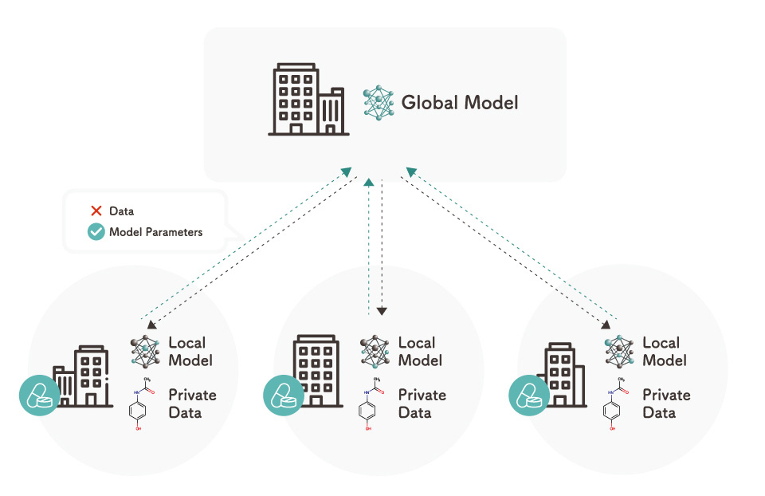
Introduction contd.
The following image is a simple example of the federated learning
Federated Learning

Slide 5
Introduction Contd.
1.2)Differential Privacy:-
Why differential privacy?
we could just anonymize the data by hiding the features that reveal the identity?
but there is an issue!
Let us take one example to show the same

Slide 6
Introduction Contd.
Why anonymization isn’t enough
In 2006 Netflix announced a competition called “Netflix Price”
Teams had to predict how someone would rate the movie out of 5 stars,Netflix provided the dataset with over 100 Million ratings and anonymized them
But 2 scientists Arvind Narayanan and Vitaly Shmatikov from the university of Texas published a paper known as “Robust De-anonymization of Large Sparse Dataset”, which claimed that they have successfully identified the people by combining the dataset with IMDB
These attacks are known as Linkage attacks

Slide 7
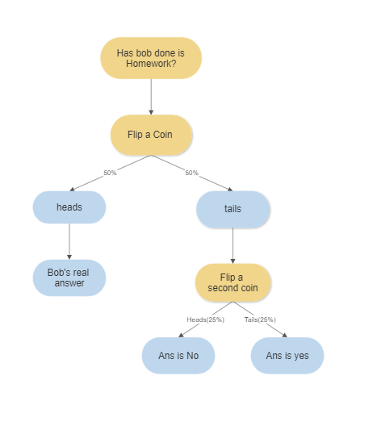
Introduction Contd.
We want the answer that how many people do their homework.
We setup a survey that has a question “have done your homework?”

Slide 8

Introduction Contd.
ε-differential privacy
Let ε be a positive real number
Let “A” be a randomized algorithm that takes a dataset as input
D1,D2 are the datasets that differ by atmost one entry
S is the set of all subsets that algorithm A will give as an output

Slide 9
Introduction contd.
1.3) Data Silo:-
A data silo is a collection of data held by one group that is not easily or fully accessible by other groups in the same organization
Finance, administration, HR, marketing teams, and other departments need different information to do their work. Those different departments tend to store their data in separate locations known as data or information silos
Data silos may seem harmless, but siloed data creates barriers to information sharing and collaboration across departments

Slide 10
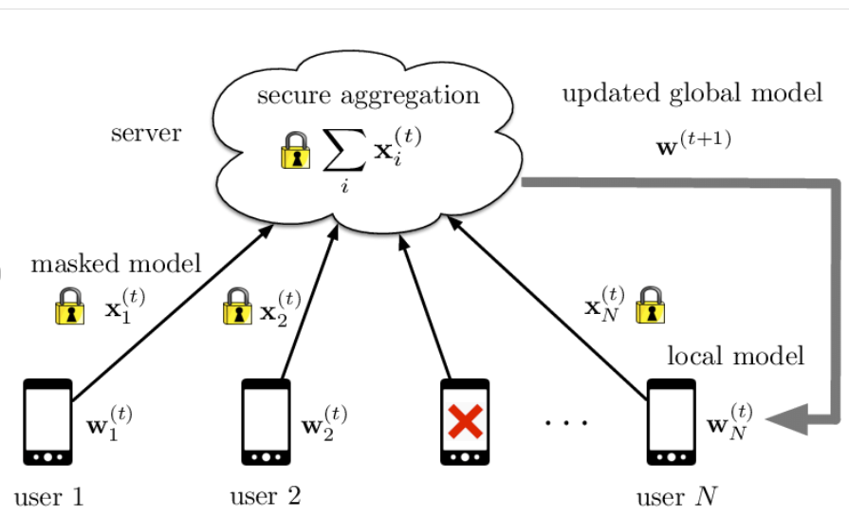
Introduction contd.
1.4)Secure Aggregation:-
It is a secure multi-party computation (SMPC) protocol, that enables a centralized server to compute the sum of values submitted by several clients, without learning the values themselves.
In the context of federated learning, each client’s update can be represented as a tensor of values, and secure aggregation enables the federated learning orchestration server to compute the sum of many client’s update, without accessing the values themselves
Secure aggregation in federated learning.

Slide 11
2)Motivation
most health research to date uses data stored in a centralized database (i.e., a database stored in a single site), where analysis and model fitting is done with full access to the sensitive underlying data
Federated learning techniques enable calculation of research study endpoints in a privacy-preserving fashion such that private data never leaves a given device
With these advantages, large fractions of the population that wanted to contribute to novel health findings, but had reservations about sharing raw data and digital signals, Now will contribute towards the same without any hesitations

Slide 12
3)Problem Statement
We are given n clients a1 , a2 , ..., an in which each client ai has in its own control local data Di . There is a central coordinator, C (the server). Our goal is to design a learning algorithm A that serves as a gradient-based learning algorithm to produce a machine learning model across all participating clients. The clients only send (differentially private) gradients back to the central coordinator. The method requires that Di not be revealed to C.

Slide 13
4)Existing method(s)/Related work with limitations
For the health care research Federated Learning has been deployed:-
Limitation:-
prior studies have not fully considered privacy, which is not guaranteed by default in an arbitrary federated learning setup, and needs to be treated, implemented, and studied explicitly

Slide 14
5)Challenges
How to Further improve privacy in the Federated learning setup
health research often involves a relatively small number of participants (small N) in each study, limited number of “rows” of data per participant
unequal levels of patient participation. Specifically, health study data is typically non-IID—not independent and identically distributed—which is compounded by the fact that in the federated regime, individual data points are distributed across many devices that participate asynchronously

Slide 15
6)Paper Methodology
Our work demonstrates the successful use of federated learning in the presence of these previously mentioned challenges in homogeneous data silo settings(i.e., where the output of federated computation from one data silo is composable with the output from another silo).
In this work we reproduce eight diverse health studies in a purely federated setting
Finally, to test various units of federation, we experiment with the extreme case of each patient being its own unit, as well as with groups of patients
Four out of the eight datasets are studied at both the individual level of federation as well as larger generally non-IID units (silos)

Slide 16
Paper Methodology Contd.
rather than developing a custom technique to federate learning of one specific class of models as done in prior work, we demonstrate how such encompassing work can be achieved within the unified framework of TensorFlow
We will use Logistic Regression and DNN models for our testing

Slide 17
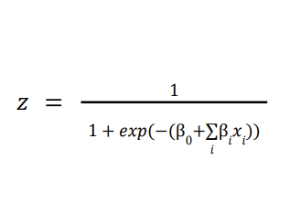
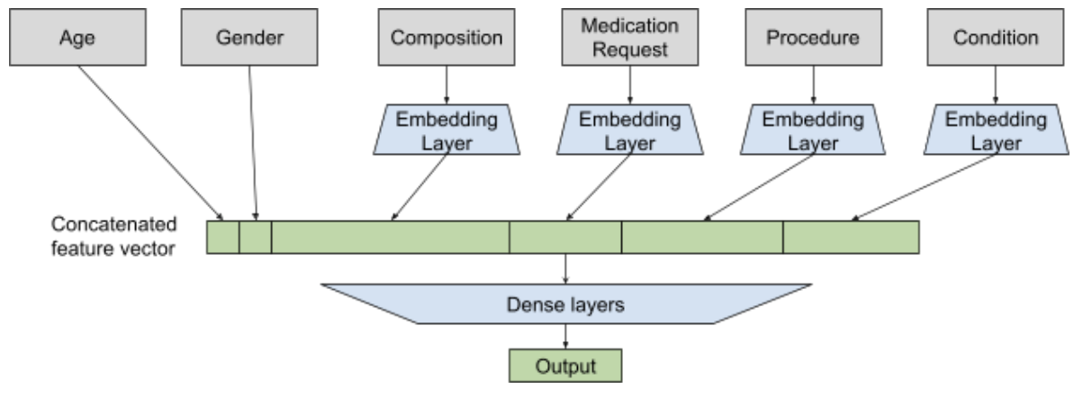
Paper Methodology Contd.
Logistic Regression Model:-
Deep Learning Model:-

Slide 18
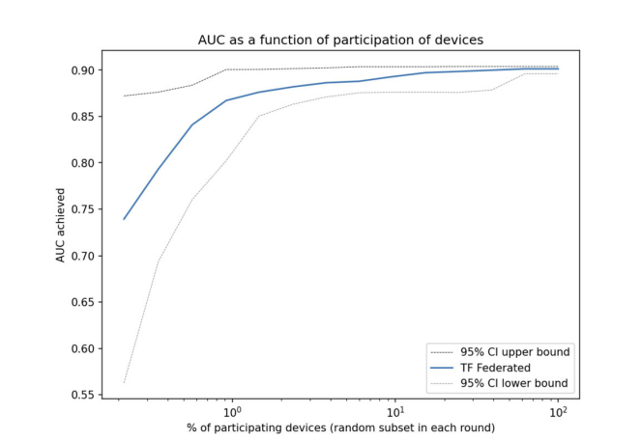
Paper Methodology Contd.
Since in general in the federated setting not all participants may be available at any one time, we explore model quality as a function of subjects’ participation rate. Across the datasets, we find that only a minority of clients need to participate in any one round
Area under the ROC curve (AUC) as a function of fraction of participants in each federated (server) round of learning for replicated model of SARS-CoV-2 and Cancer

Slide 19
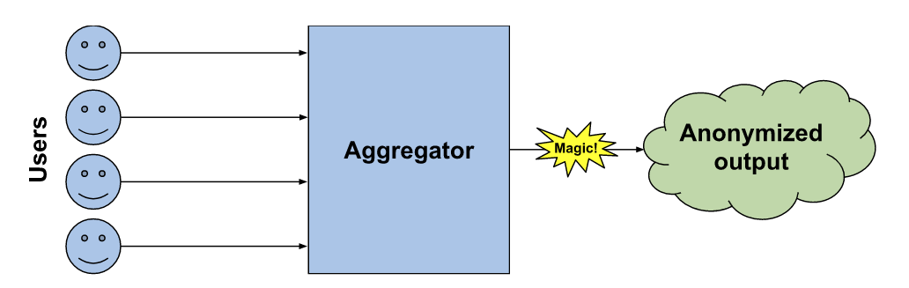
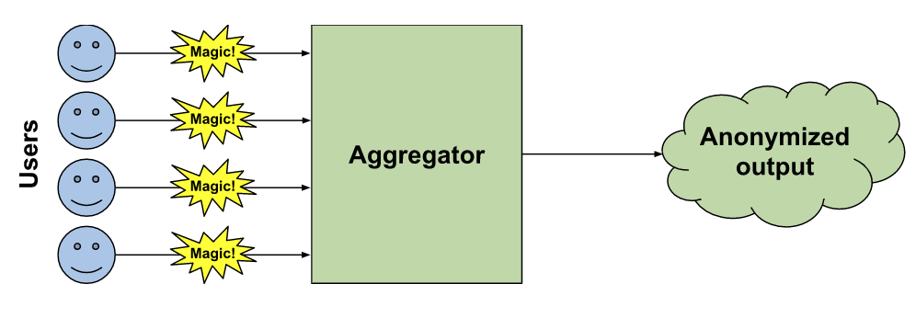
Paper Methodology Contd.
In this work we are using 2 Models of Differential Privacy
1)Central Model:-
2)Local Model:-
Local vs. central differential privacy

Slide 20
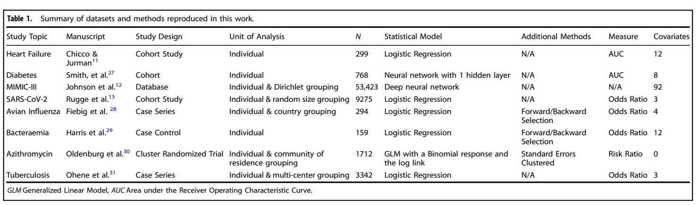
7)Experiments and Results
In this work we are using 8 different datasets whose summary is given in the table below

Slide 21
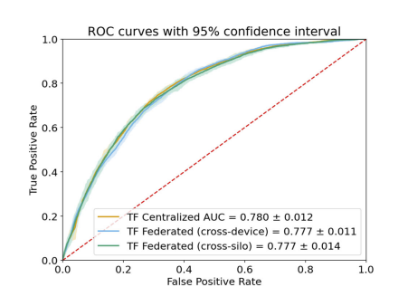
7)Experiments and Results
MIMIC-III
MIMIC-III is a large, freely-available database comprising deidentified health-related data associated with over 40,000 patients who stayed in critical care units of the Beth Israel Deaconess Medical Center between 2001 and 2012
Each patient in the dataset has a time series of medical encounters involving procedures, medications, diagnoses and other complex signals, such as medical notes

Slide 22
Experiments and Results contd.
Heart Failure
The Heart Failure Clinical Records Dataset from the University of California Irvine data repository involves 299 individuals with left ventricular systolic dysfunction and class III or class IV heart failure ranging from 40 to 95 years of age.
Our federated setting achieves 0.85 AUC(0.82 in the original work)
The higher AUC score in our setting is due to the addition of regularization while optimizing model parameters
Adding a central differential privacy module reduces AUC to 0.83
With local DP, the federated architecture achieves 0.82 AUC

Slide 23
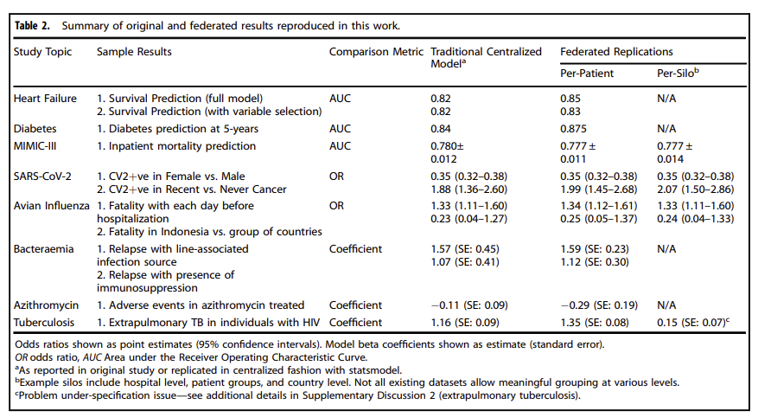
Experiments and Results contd.
Summary:-

Slide 24
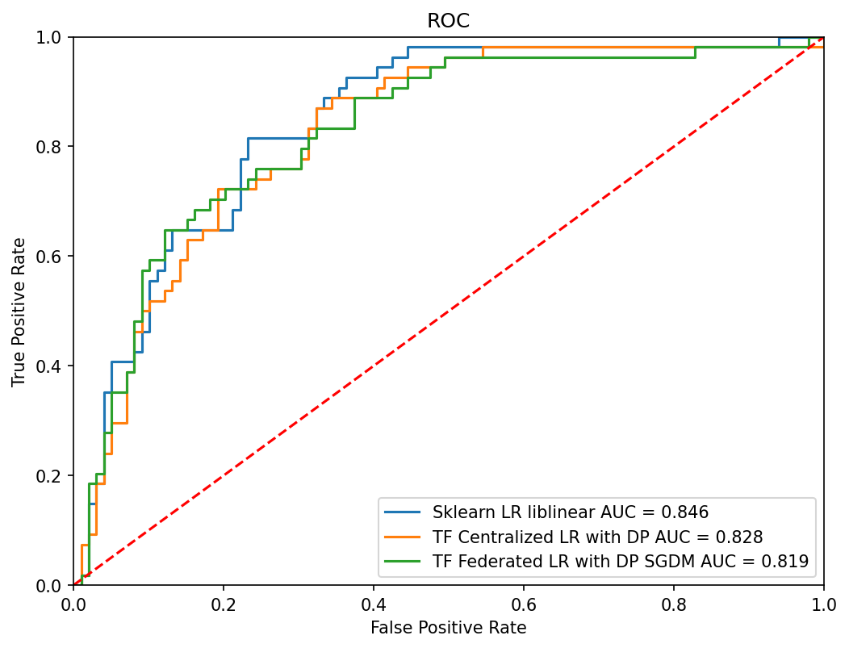
Experiments and Results contd.
Results obtained while implementing

Slide 25
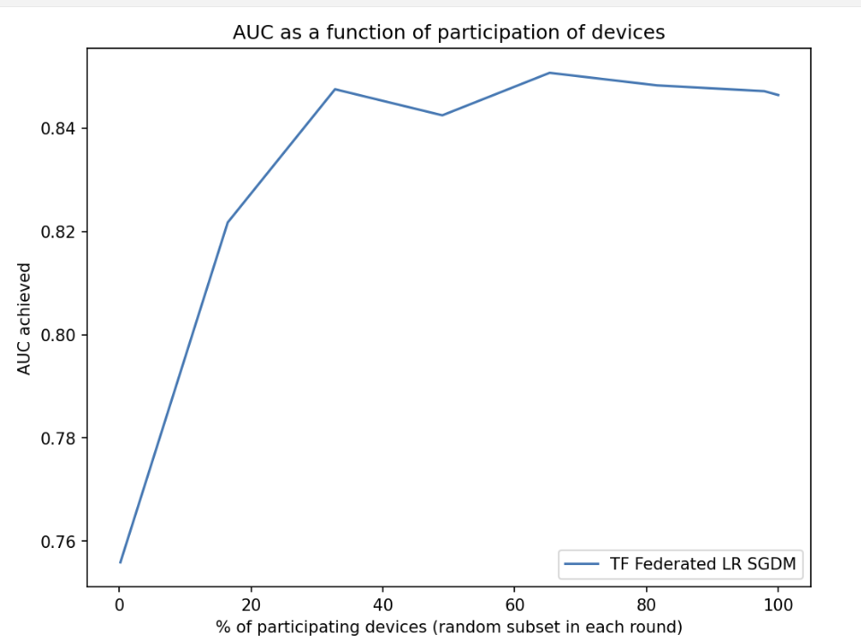
Experiments and Results contd.
Results obtained while implementing

Slide 26
8)Observations
Using the methods like differential privacy and secure aggregation in tandem with federated learning, we can ensure better privacy without much loss of performance and a small trick like regularization can help the cause.
In this work we also tested our methodology on different units of the federation like per Client or per Silo

Slide 27
9)Future Work
Literature Survey on related health care research
Analysing the possibility of integrating continual learning in the present work

Slide 28
10)References
[1] Zhu, W., Kairouz, P., Sun, H., McMahan, B. & Li, W. Federated heavy hitters with differential privacy. Proceedings of the Twenty Third International Conference on Artificial Intelligence and Statistics. PMLR 108, 3837–3847 (2020).
[2] Choudhury, O. et al. Predicting adverse drug reactions on distributed health data using federated learning. AMIA Annu. Symp. Proc. 2019, 313–322 (2020). eCollection 2019.
[3] Johnson, A. E. W. et al. MIMIC-III, a freely accessible critical care database. Sci. Data 3, 160035 (2016)
[4] Bonawitz K. et al. TensorFlow federated: machine learning on decentralized data. (2020). https://www.tensorflow.org/federated (accessed Nov 2020)
[5] Bonawitz K. et al. Practical secure aggregation for privacy preserving machine learning. In Proceedings of ACM Conference on Computer and Communications Security (ACM CCS). (2017).
[6] Video to understand Differential Privacy:-(160) Differential Privacy - Simply Explained - YouTube

