Slide 1




Guided by : Sagar Patel Prepared by : Harshil Sharaf (18ce121) Parth Trambadiya (18ce130) Yash Vaghani (18ce132) Prince Viradiya (18ce134)
TransVoice

Slide 2

Contents
Project Definition
Project Description
Similar Application
Motivation
Major Features/Functionalities
Development Environment
System Architecture
Live Demo
References

Slide 3

Project Definition & Description
Web application for transcribe multi-speaker audio file on AWS
The TransVoice is a web-application to be used by companies to transcript the audio file into dialogue form to store the important data for future use and records.
Also, for transcribers this web-based application will be very useful because with this app they easily transcript the audio file into dialogue form and also they can edit that transcript.
Features of download and sharing of transcript will be available in this web-application.
One important point is there will be no restriction in size of audio file that means user can convert any size of audio file to transcript.

Slide 4
Similar Application
We have taken reference of transcript based software present on online platform called “Rev”.
https://www.rev.com/
Parameter | TransVoice | Rev
Cost | It will be available totally free of cost. | It charges approximately $1.25 per minute for audio transcription.
Size | There will be no restriction for the size of audio file which user wants to transcript. | It gives restriction for the size of audio file up to 20mb only.

Slide 5

Motivation
Video and audio recordings are all well and good, but a text version of your meeting can be a lot easier to search if you’re looking for that one specific bit of data inside of an hour’s worth of conversation.
So, TransVoice can be very handy if you have trouble typing or just find speaking faster or easier than typing

Slide 6


Major Features/Functionalities
Architecture we designed for TransVoice is totally Serverless.
Login/Signup for user (using Google or Amazon account).
Audio file uploading feature without any restriction of size of audio file (which you want
to transcript).
Audio to text transcription with bifurcation of individual speaker’s dialogues.
Feature to edit the transcript is provided for future purpose.
Transcript downloading and sharing options are provided.
Live audio recording.

Slide 7













Development Environment
Web Front-End
Web Hosting
Back-End
AWS Services

Slide 8
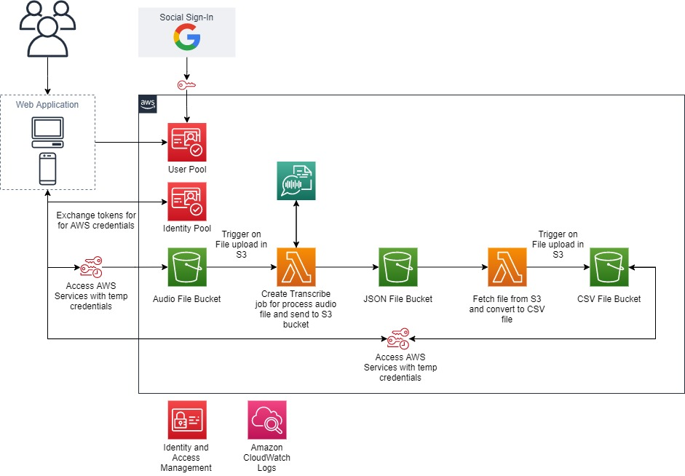
System Architecture

Slide 9
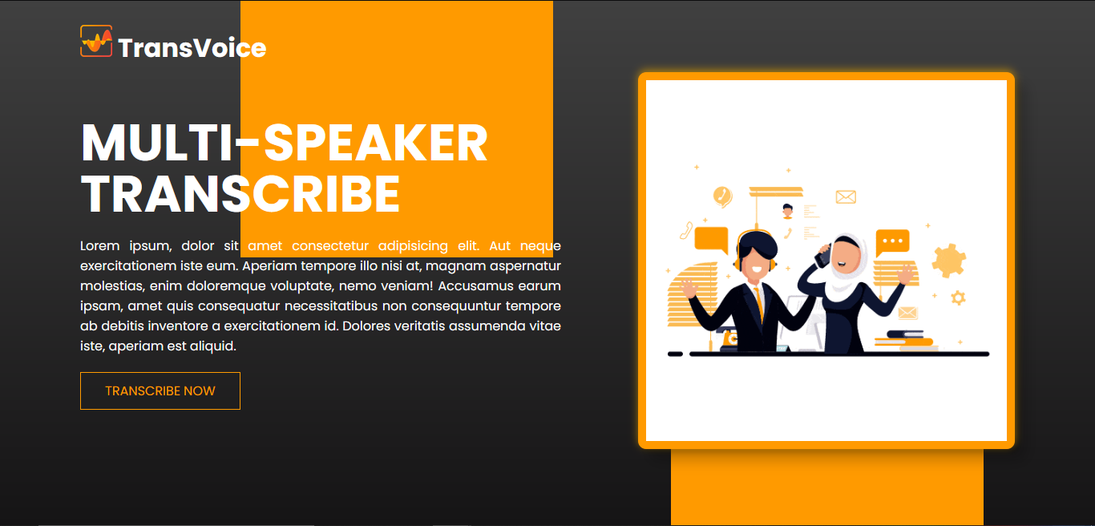
Live Demo
Link: https://parthtrambadiya.github.io/sgp-6/

Slide 10
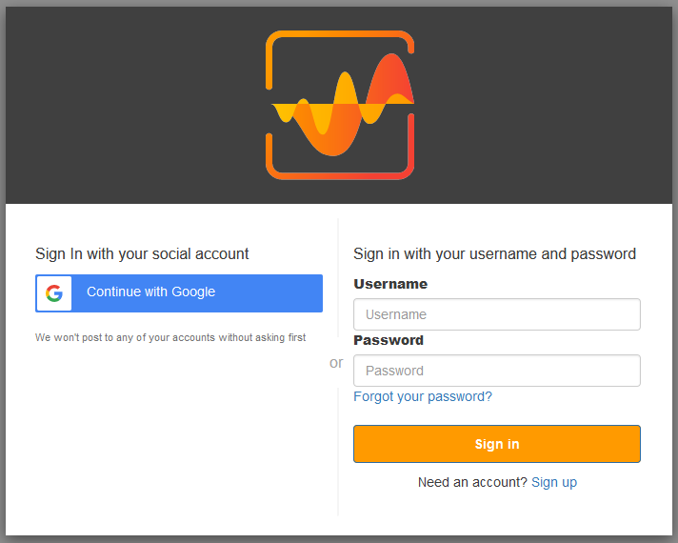
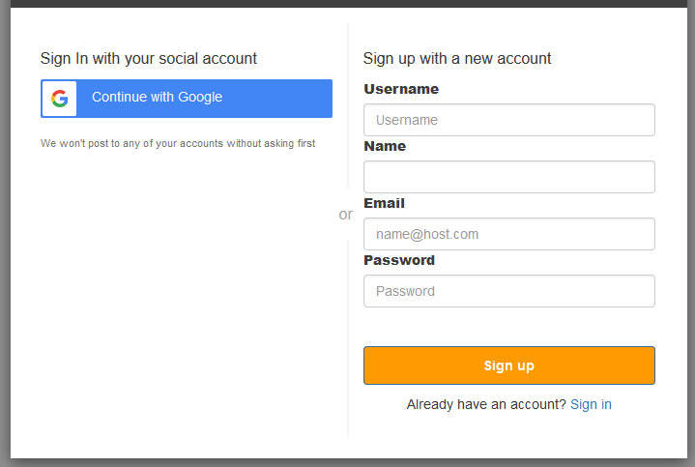
Live Demo

Slide 11
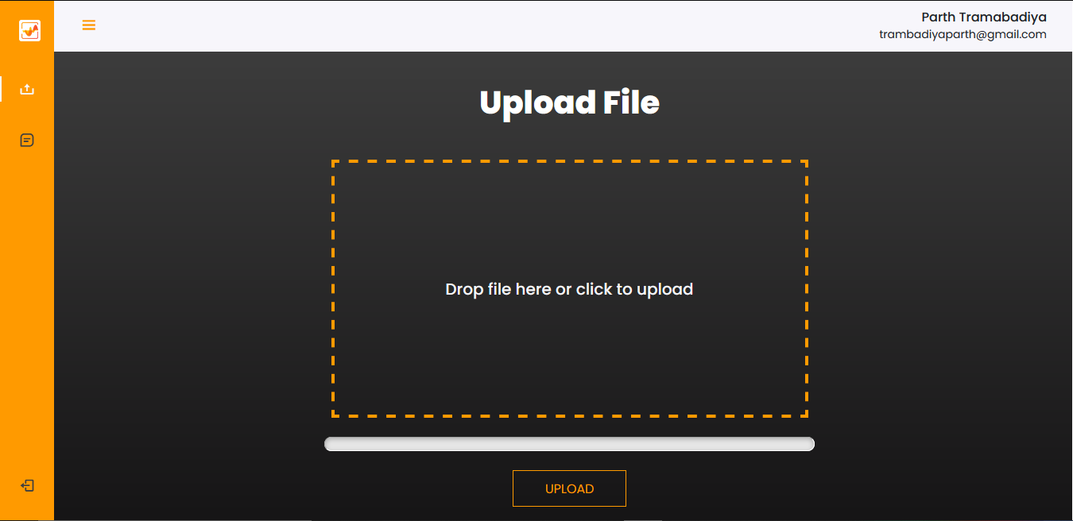
Live Demo

Slide 12
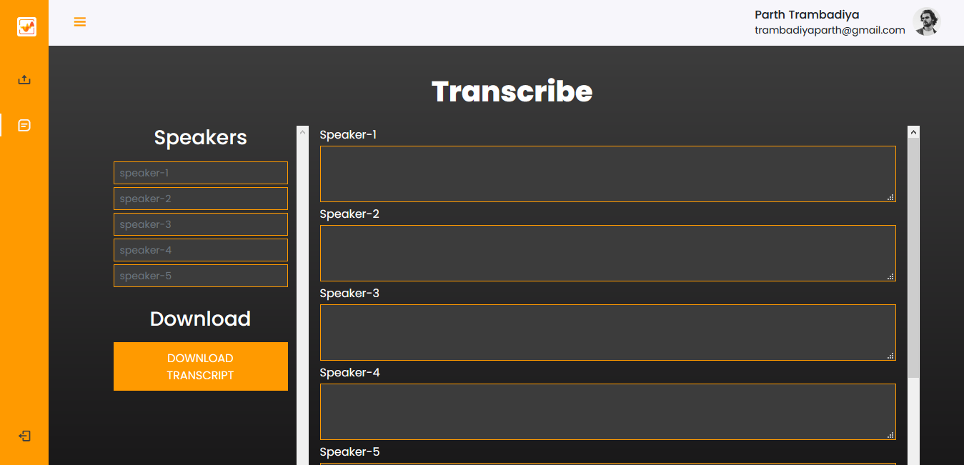
Live Demo

Slide 13

References
https://docs.aws.amazon.com/cognito/
https://docs.aws.amazon.com/s3/
https://docs.aws.amazon.com/lambda/
https://docs.aws.amazon.com/iam/
https://docs.aws.amazon.com/cloudwatch/
https://docs.aws.amazon.com/transcribe/
https://docs.aws.amazon.com/AWSJavaScriptSDK/latest/

Slide 14


