Slide 1

A Compare Productive Algorithms of ML (Phishing Detection )
Parth Vashishth – 001232207
MSc. Computer forensics and Cybersecurity

Slide 2
TABLE OF CONTENTS
01
02
03
04
What is Phishing?
Data Description
Machine Learning Model
Intro. Of Phishing
Avoid getting Phished
Concept
URL Collected and Segregated
Apply Various ML Model in our data to train model.
Model Evaluation
Base on ML results evaluat data.

Slide 3

Current in the Market

Slide 4
Introduction
The most frequent type of cyber assault is phishing.
There are such cyber attacks happened in UK like BBC, BA and Boots.
In order to avoid getting phished,
User should have awareness of phishing
Doing blacklist of phishing websites which requires the knowledge of website being detected as phishing.
Detect them in early appearance using machine learning algorithms.
Of the above three machine learning based method is better and most effective than the other methods.
Even, online users are still trapped into revealing sensitive information in phishing detection.

Slide 5
Objectives
A phishing website is a popular social engineering technique that imitates reliable URLs and online sites. The goal of this research is to train machine learning models using the dataset produced to identify phishing websites. In order to create a dataset from which the necessary URL- and website content-based attributes may be extracted, both phishing and benign URLs of websites are collected. Each model's performance level is assessed and contrasted.

Slide 6
Approach
Below mentioned are the steps involved in the completion of this project.
Collection dataset which contain phishing and legitimate websites from the open-source platform.
Write a code to extract the required feature from the URL database.
Analyze the dataset by using various techniques.
Divide the dataset into taring and testing sets.
Run selected machine learning algorithms like SVM, Random Forest and many more on the dataset.
Write a code for displaying the evaluation results considering accuracy metrics.
Compare the obtained results for trained models and specify which is better.

Slide 7
Data Collection overview

Slide 8
Data Collection
Legitimate and Phishing URLs are collected from the dataset provided in https://www.kaggle.com/datasets/eswarchandt/phishing-website-detector.
From this collection, 11000+ URLs are randomly Picked.
In this URLs are include phishing, legitimate. This service provide a set of phishing URLs in multiple formats like csv, txt etc.

Slide 9
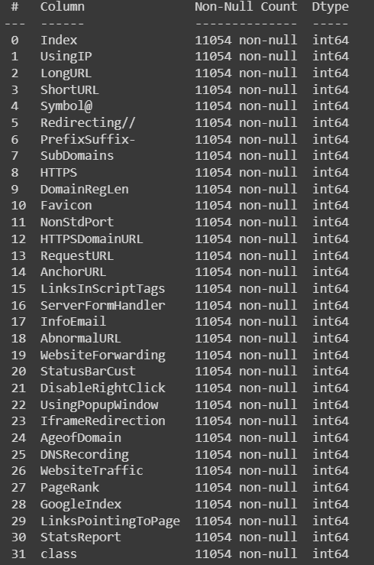
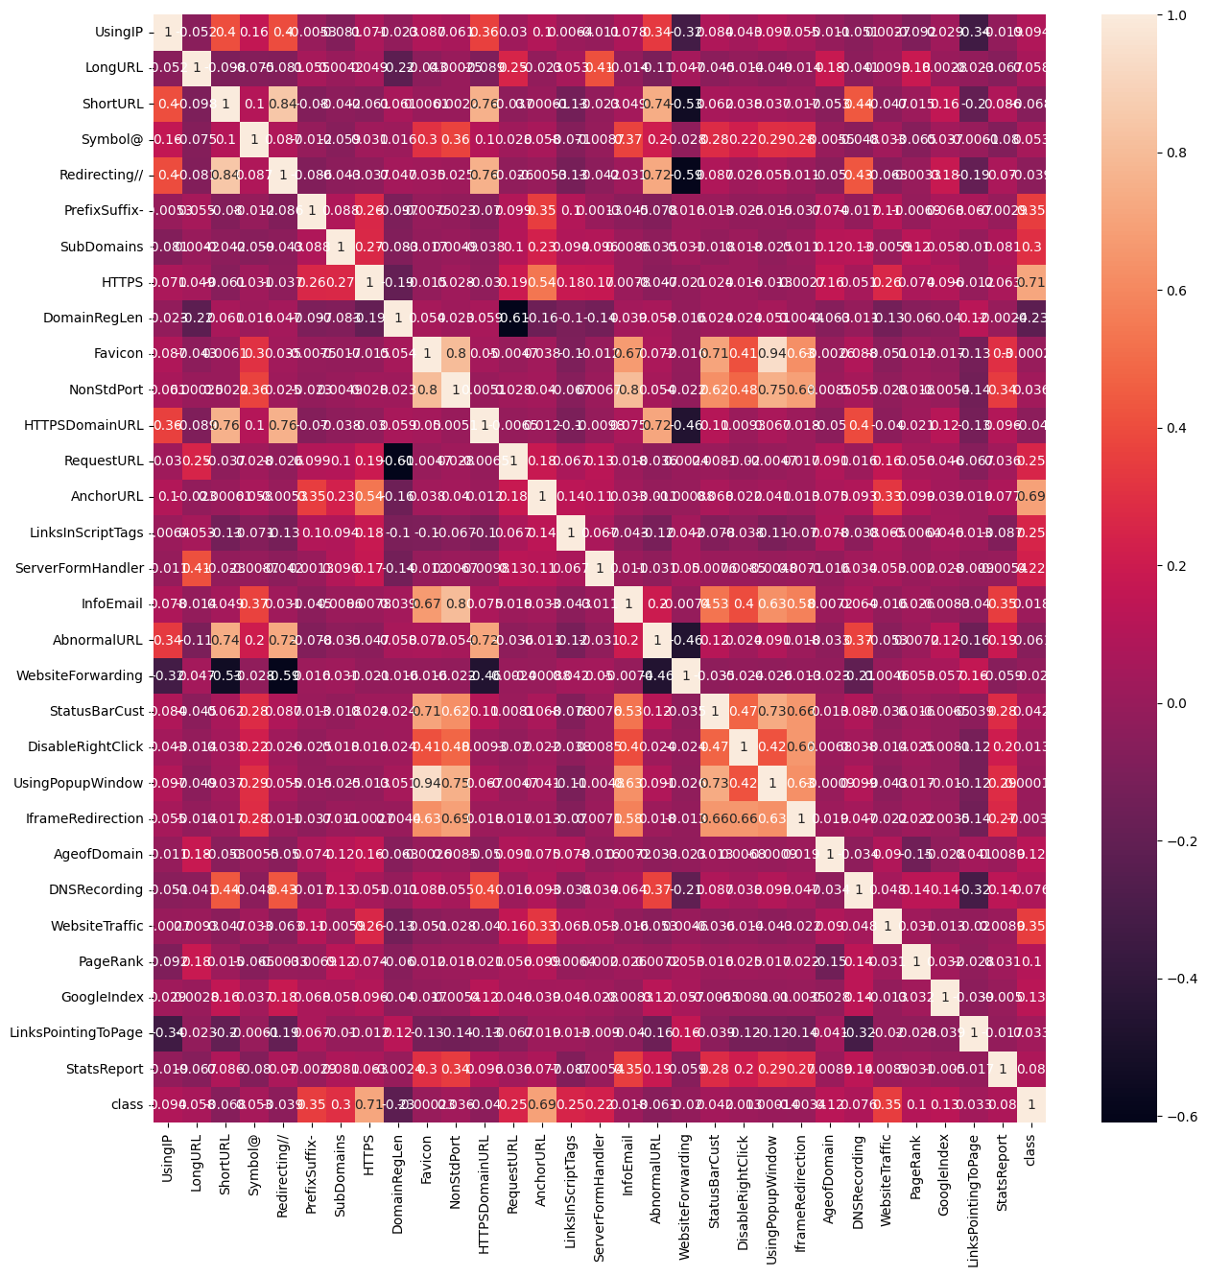
Feature Selection
All together 30 features are extracted from the dataset.

Slide 10
Machine Learning Models
This is a supervised machine learning task. There are two major types of supervised machine learning problems, called classification and regression.
This dataset comes under classification problem, as the input URL is classified as phishing (1) or legitimate (-1). The machine learning models considered to train the dataset in this system are:
Logistic Regression
K-Nearest Neighbors
Support Vector Machine
Naïve Bayes
Decision Trees
Random Forest
Gradient Boost

Slide 11
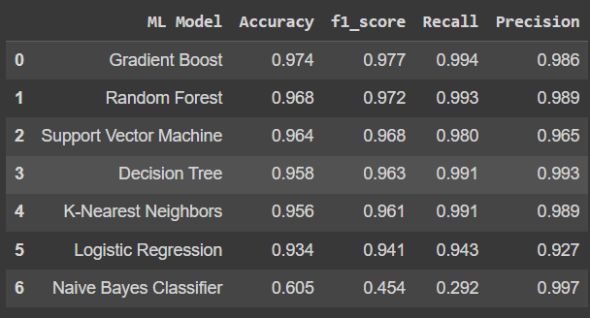
Model Evaluation
The models are evaluated, and the considered metric is accuracy.
Below figure shows the training and test dataset accuracy by the respective models.
It is evident from the preceding chart that the Gradient boost provides superior performance.

Slide 12


