Slide 1

PVPIT Grand Hackathon 3.0
  Problem Statement Title- GazeType - Eye tracking keyboard for unfortunate people with disabilities
  Theme- Human Assistive Technology and Human - Computer interaction
  PS Category- Software
  Team Name - Byte Builders
  Team Members - Parth Verma, Anushka Wankhede, Nupur Talathi, Vedika Kulkarni, Shroojan Dhok, Ayush Taske

Slide 2
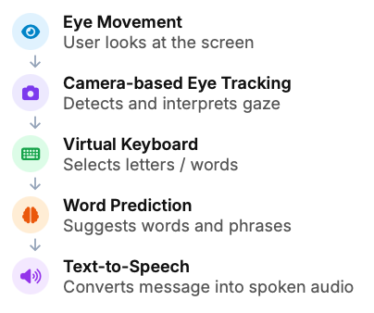
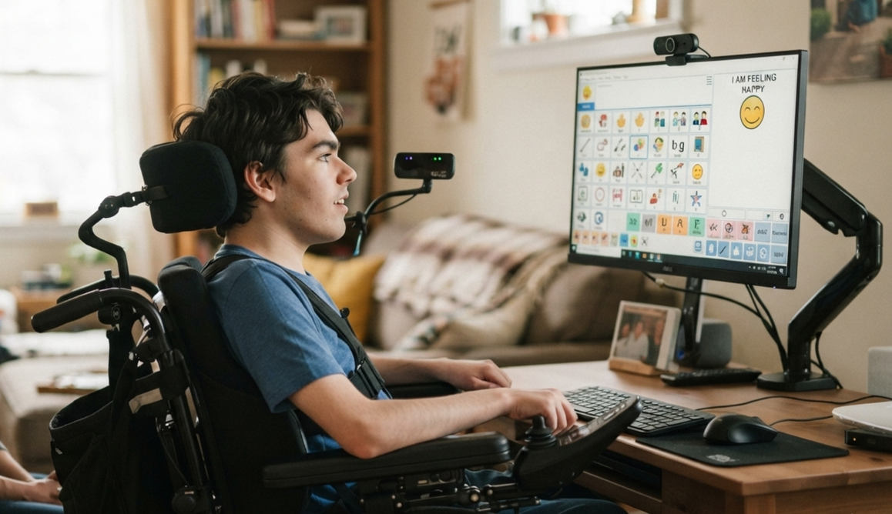
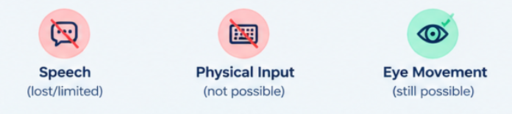

INTRODUCTION
THE CHALLENGE:
People with severe motor disabilities may lose the ability to speak or use conventional input devices, making it difficult to express their needs, thoughts and emergencies. For some users, eye movement may remain a usable channel for communication
OUR SOLUTION:
A Camera based eye-gaze communication system that converts controlled eye movemnets into text and speech
When speech and physical movement are no longer reliable ways to communicate, even a simple “I need help” can become difficult to express. By transforming eye movement into text and speech, our system aims to give users a faster, more independent way to communicate their needs, thoughts and emergencies.
2

Slide 3
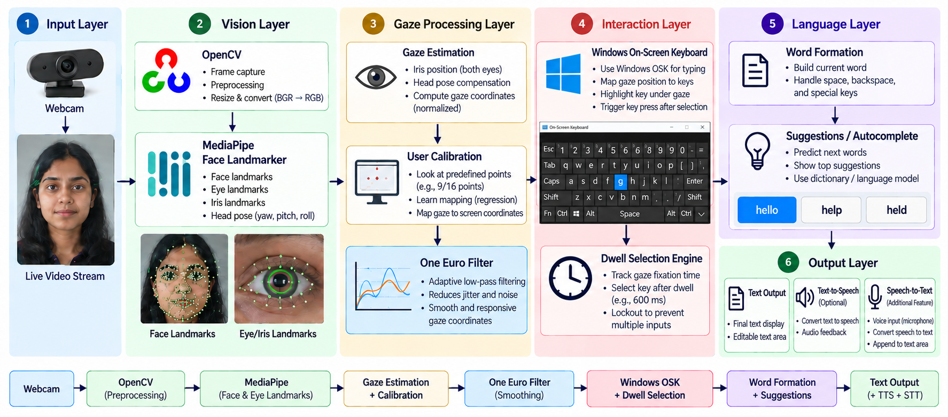
TECHNICAL APPROACH

Slide 4
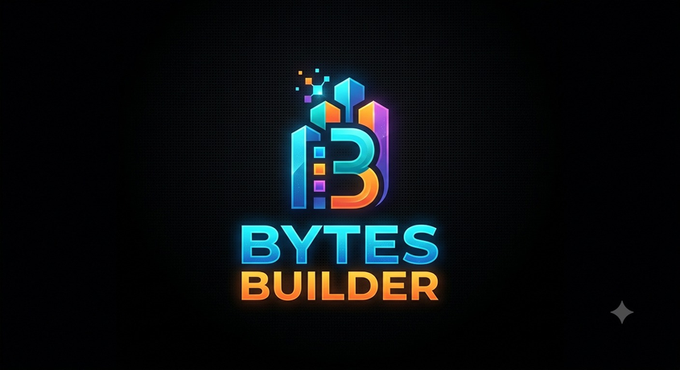

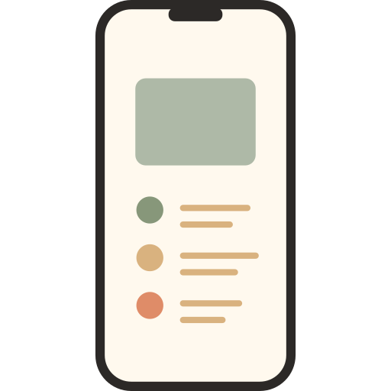


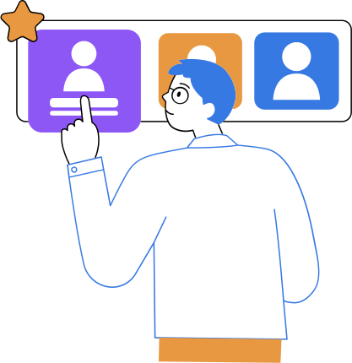









FEASIBILITY AND VIABILITY
Built with existing technology, designed for low-cost accessibility, and scalable from a laptop prototype to a dedicated assistive device
ANALYSIS OF THE FEASIBILITY OF THE IDEA
Existing Eye-Tracking Technology
Software-Based Implementation
Simple User Interface
Scalable Architecture
Reusable Across Conditions
Personalization Increases Usability
Webcam-based and infrared eye-tracking techniques can track gaze direction without requiring physical input.
The system can be developed using computer vision, gaze estimation, and machine learning, reducing the need for complex hardware.
A virtual keyboard with large, well-spaced keys can be designed specifically for users with limited movement.
The prototype can start with a webcam and laptop, and later be upgraded to dedicated eye-tracking hardware for improved accuracy.
The same system can assist people with different severe motor or speech impairments rather than being limited to one condition.
Custom keyboards, frequently used phrases, language selection, and personalized vocabulary can make the system more practical for individual users.
POTENTIAL CHALLENGES AND RISKS
MITIGATIONS
1. Lighting Variability
2.Calibration drift
Continuous recalibration
Glare, low light, or backlighting degrades iris and pupil detection, making gaze estimates unreliable. Real-world environments rarely match the controlled l
Head shifts or posture changes during a session slowly throw off the gaze-to-screen mapping.
Adaptive preprocessing
Auto-exposure/histogram correction in OpenCV, plus optional IR webcam support.
Head-pose compensation with periodic auto re-calibration during long sessions.
3.Diverse user conditions
4.Privacy concerns
Personalized profiles
On-device processing
Nystagmus or involuntary eye movement can reduce accuracy for some of the very users the system targets.
Continuous webcam capture of the face/eyes is sensitive data,
Per-user calibration with fallback modes like blink or switch-based selection.
Video stays local; no raw frames stored or transmitted.

Slide 5

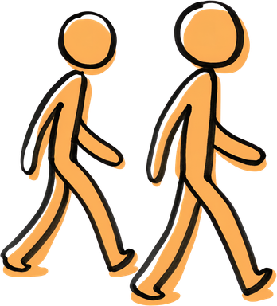


IMPACT AND BENEFITS
Your Team Name
They may lose the ability to speak, but they should never lose the ability to be heard
Gives a Voice to the Voiceless
Enables people who cannot speak to express their thoughts, needs, and feelings.
Enables Immediate Communication of Critical Needs
Allows users to communicate pain, discomfort, emergencies, or urgent requests
Eliminates Guesswork for Caregivers
Helps caregivers understand what the person actually wants instead of interpreting unclear gestures or expressions.
Restores Personal Independence
Gives individuals the ability to make choices and communicate decisions without constantly depending on another person.
5

Slide 6

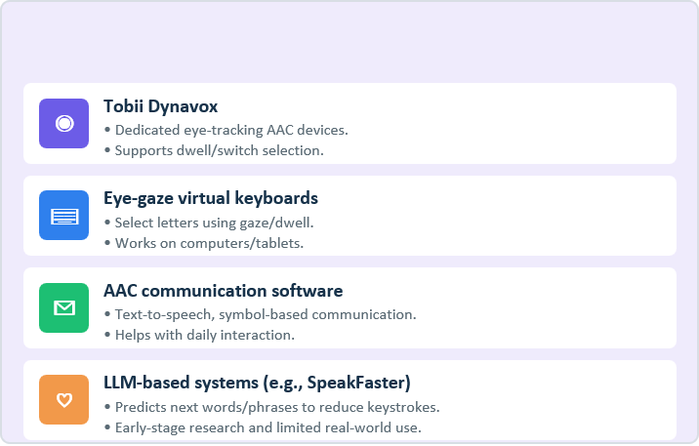
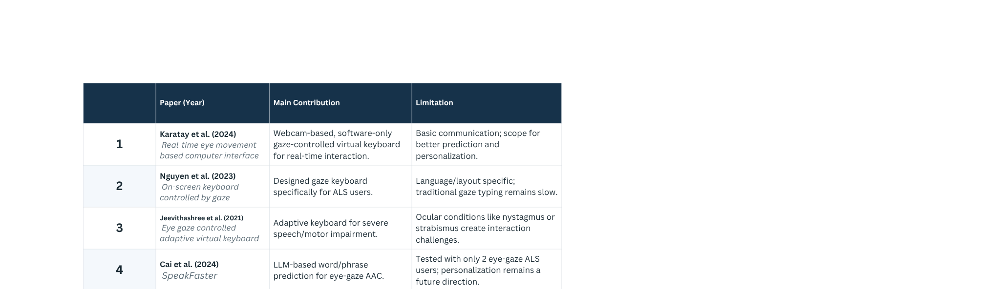


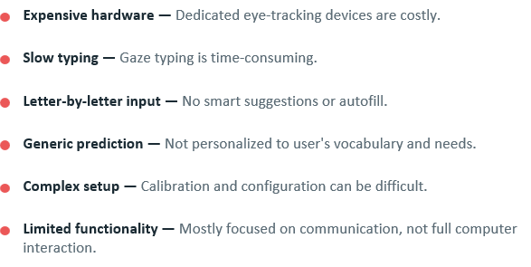
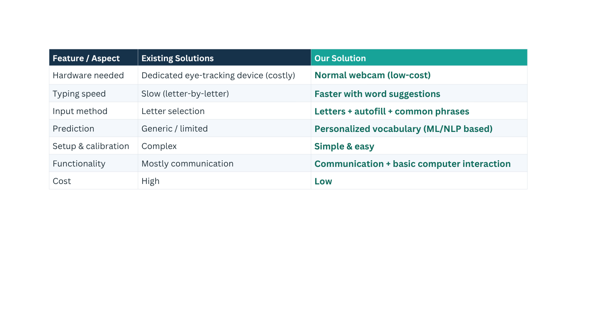
RESEARCH AND REFERENCES

Slide 7
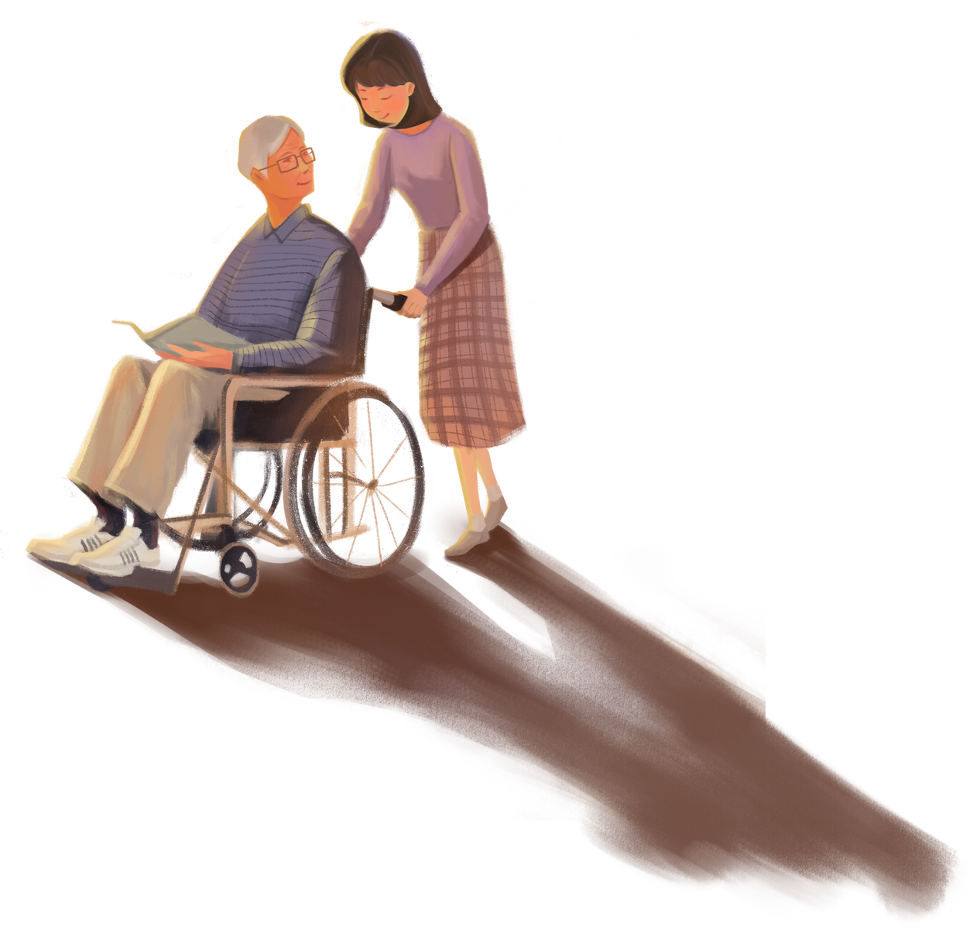
Thank You!
-Team Byte Builders

