Slide 1

Sorting Algorithms
The following slides will go over insertion, selection, bubble, merge, and quick sort.

Slide 2
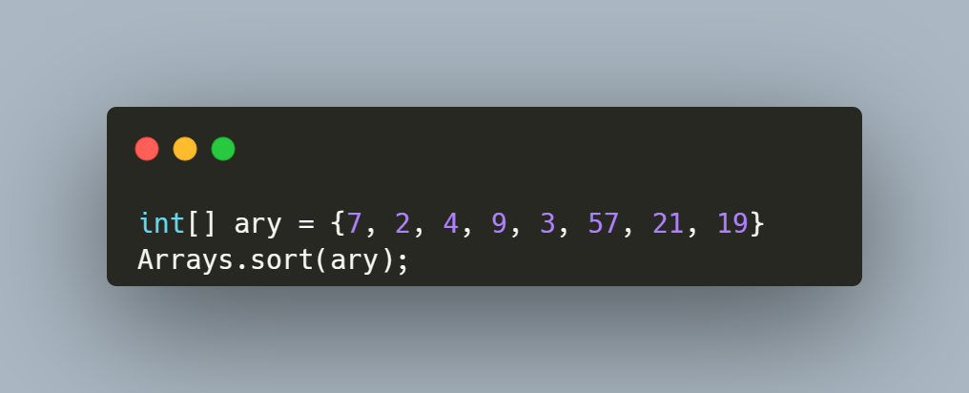
Arrays.sort()
Arrays.sort() is a method in the Arrays class which can sort an array for us
The method is useful, but true gigachads sort their arrays on their own

Slide 3
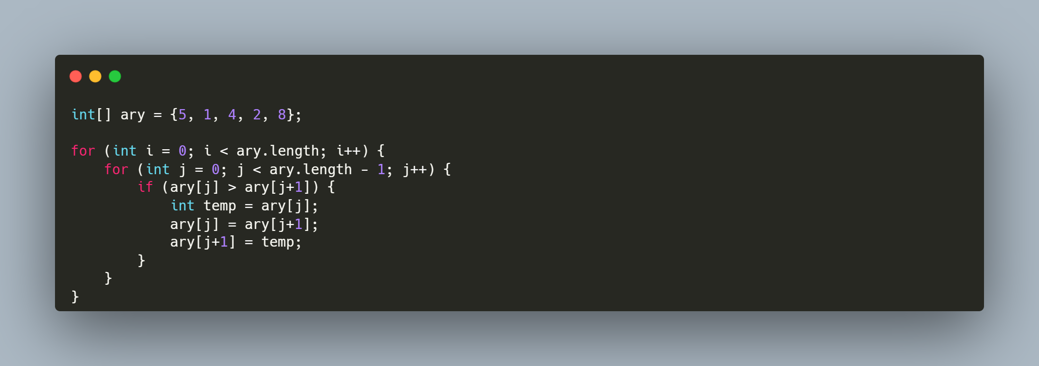
Bubble Sort
Bubble sort is one of the easiest sorting algorithms to learn, and it is one the least efficient ones
Intuition:
Iterate through the array and keep swapping two adjacent elements if they are not in order

Slide 4
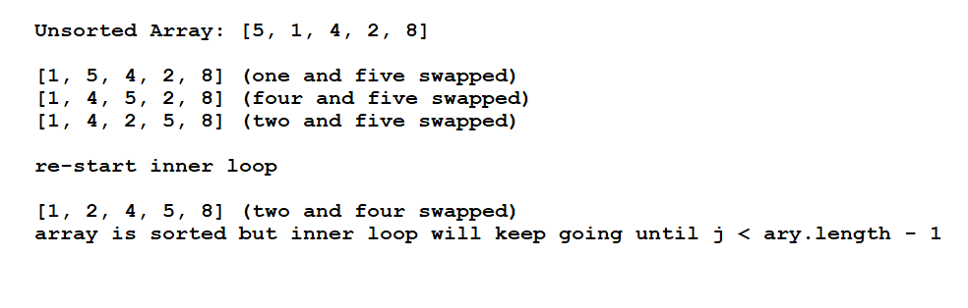
Tracing through earlier code
I did skip a few steps of the iteration as it would just repeatedly check the array

Slide 5
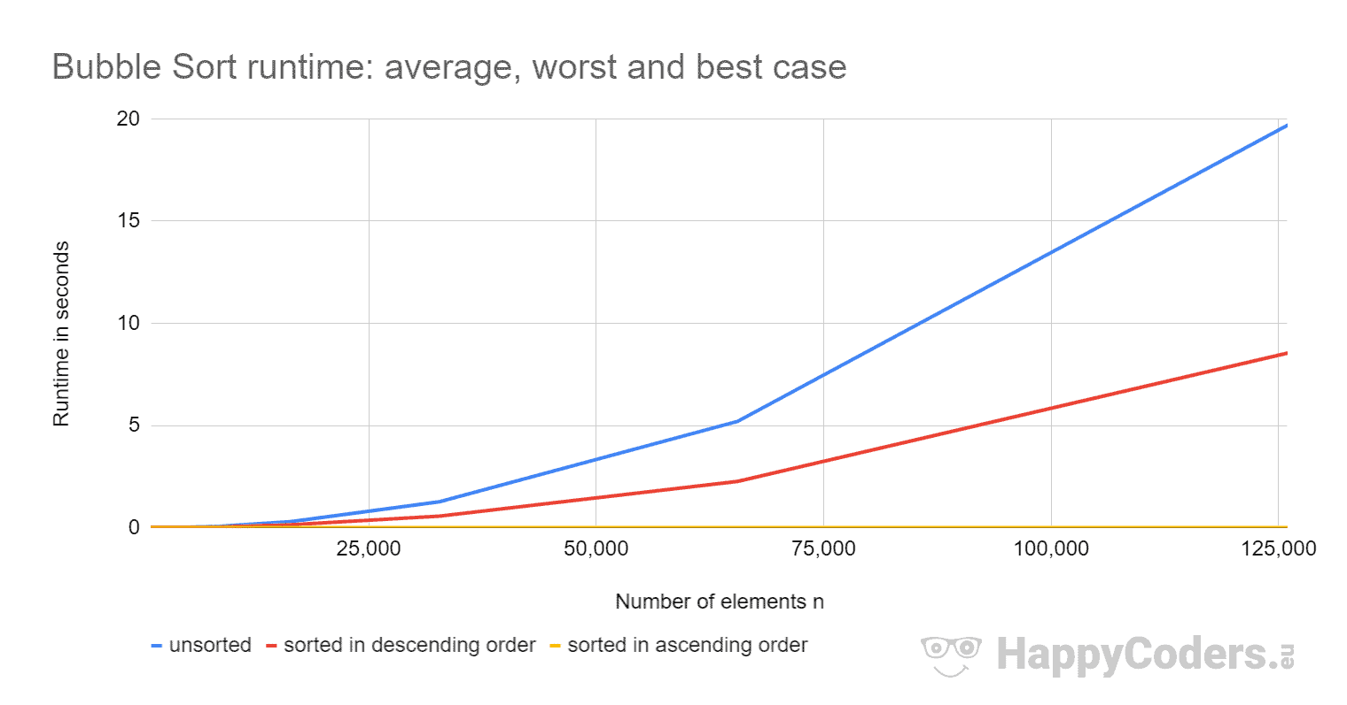
Time Complexity Analysis
Worst case and best is O(n²) where n is the number of elements in the array
Time it takes the program to run will increase quadratically as there are more elements to sort
If you were to sort x elements, this is how long it would take:
25 elements: 1 ms
2,500 elements: 32 ms
250,000 elements: 227,978 ms (4 minutes)

Slide 6
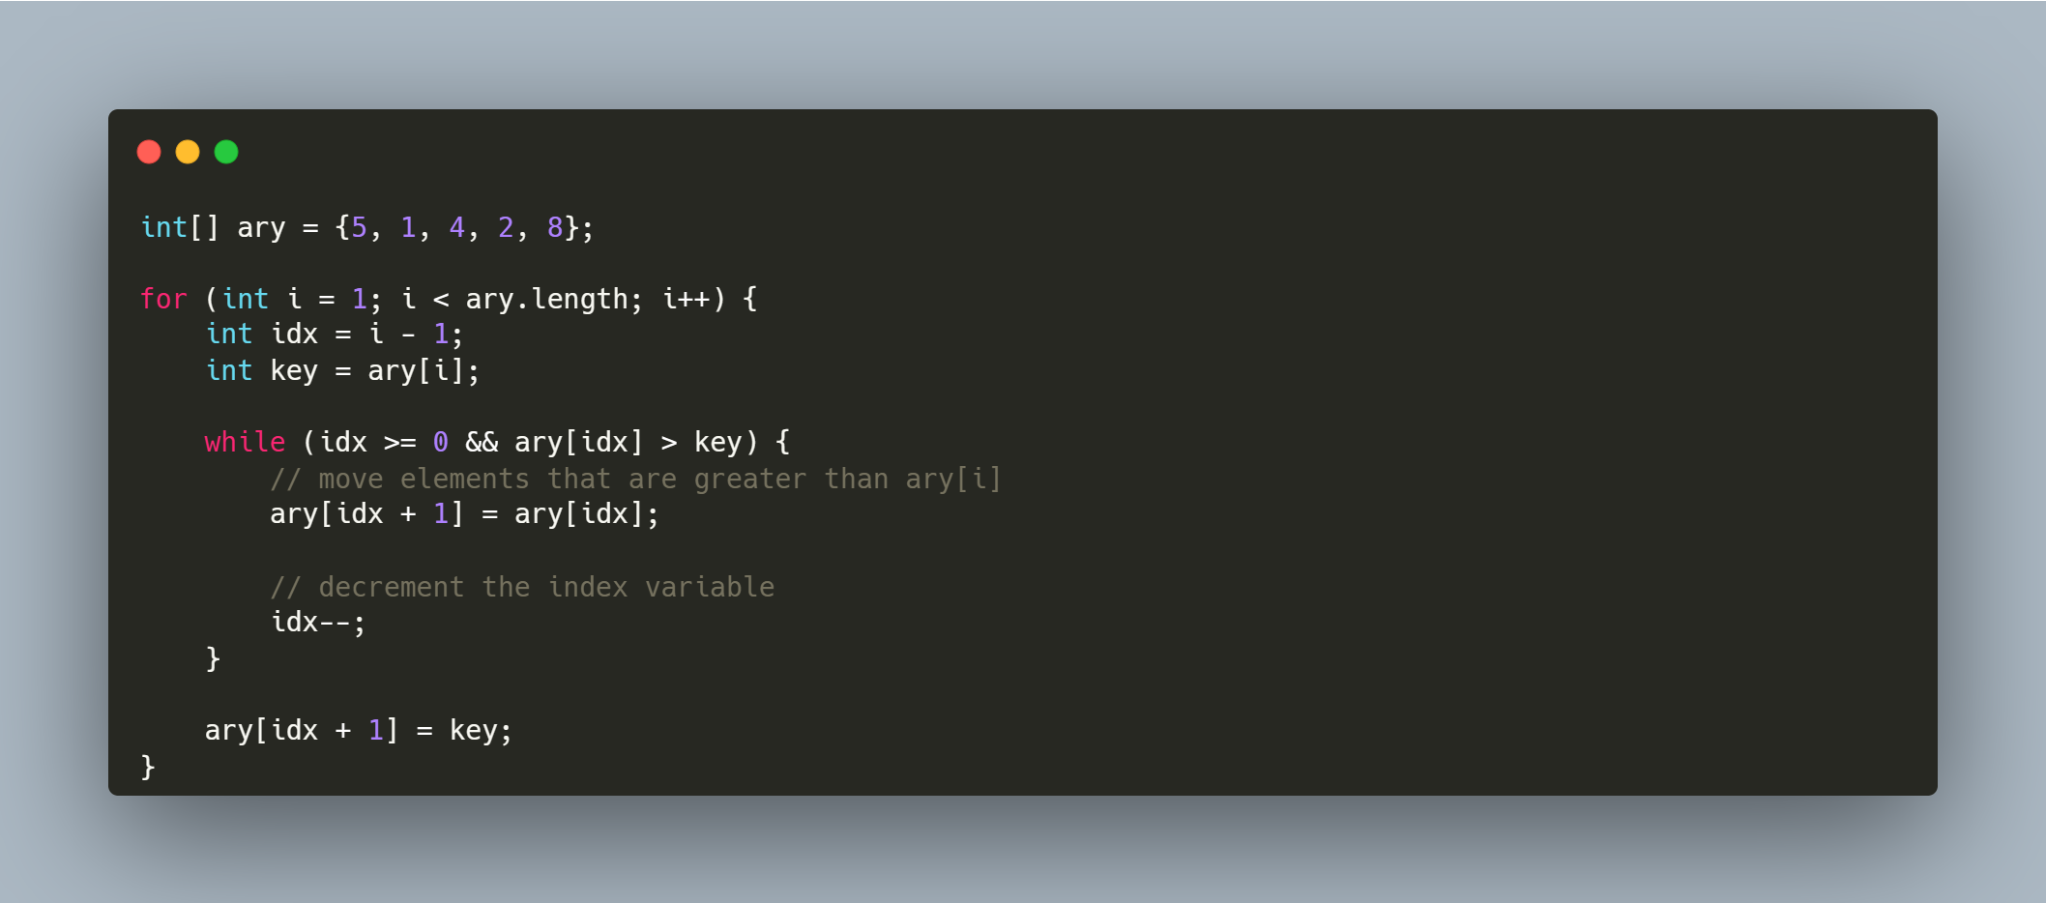
Insertion Sort
Insertion sort is more efficient than bubble sort and isn’t too bad to grasp
Intuition:
The array is split into two parts: sorted and unsorted
Values from the unsorted part are put into the correct spot in the sorted part

Slide 7
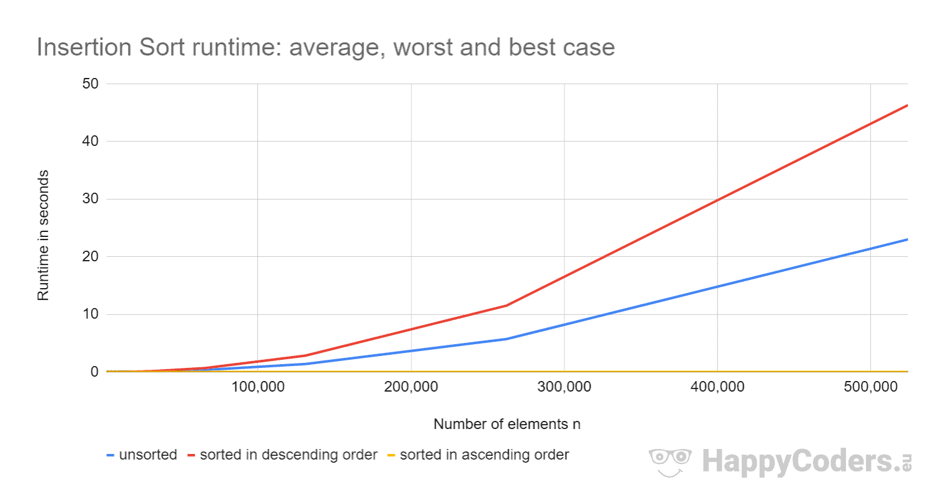
Time Complexity Analysis
O(N) best case as there would be one pass if the array is sorted
Otherwise, it’s O(N²), as there’s one loop that goes through the array
Time increases quadratically as there are more elements to sort
If you were to sort x elements, this is how long it would take:
25 elements: 1 ms
2,500 elements: 17 ms
250,000: 10,655 ms

Slide 8
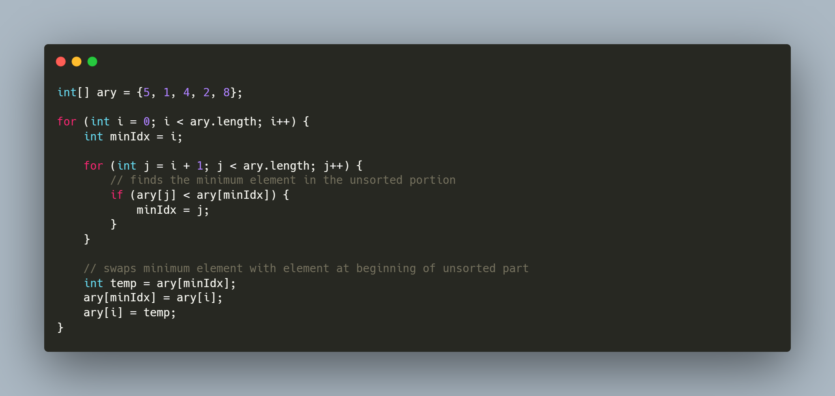
Selection Sort
Selection Sort is another sorting algorithm and follows the same concept of Insertion Sort as this sorting algorithms splits the array into a sorted part and an unsorted part
Intuition:
Search through the array and find the minimum element in the array and swapped to the beginning of the unsorted array

Slide 9
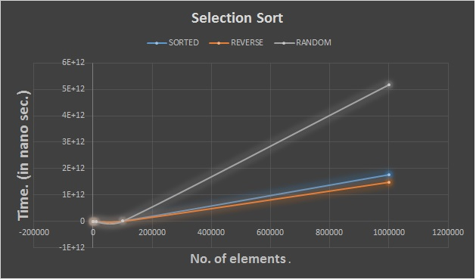
Time Complexity Analysis
Worst case and best case are O(N²) as it would have to at least make one pass through the array to find the minimum element and compare with the first element
If you were to sort x elements, this is how long it would take:
25 elements: 0 ms
2,500 elements: 18 ms
250,000 elements: 42,686 ms

Slide 10

Cool video (includes a lot more sorting algorithms)

Slide 11

