Slide 1
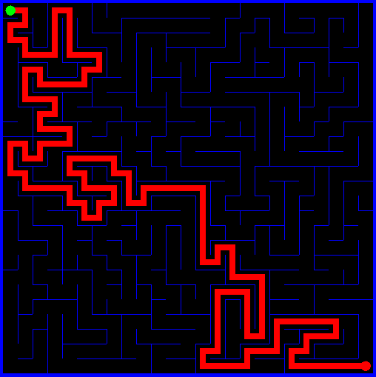
Graphical User Interfaces
Swing Controls
Buttons
Labels
Text fields
Panels
Layout Managers
Flow
Border
GridBag

Slide 2
Graphical User Interface
-pronounced “gooey” -type of interface that allows users to
interact through graphical icons and
visual indicators

Slide 3
Event-driven Programming
Actions performed on a graphical component generate an event.
In event driven programming the program responds to these events.

Slide 4
Object
Other classes
Component
Other AWT components
Button
Container
Canvas
JComponent
Window
Panel
Frame
Applet
JFrame
JApplet
Notes:
Hierarchy

Slide 5
Some Swing Classes
JComponent
JButton
JLabel
JPanel
JSlider
JTextComponent
Notes:
Hierarchy

Slide 6
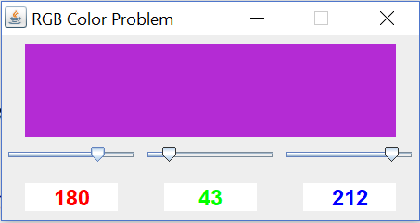
Swing Controls
A JFrame is just a window.
It’s a container object so GUI components may be placed in it.
Notes:
This JFrame contains a JPanel(colored purple), 3 JSliders and 3 JLables.

Slide 7

Swing Controls
A JButton starts some action.
The text property establishes the caption.

Slide 8
Buttons
Properties | Description
font | Font name, style, size
background | Button background color
foreground | Color of text
visible | If false, hides the button
Icon | Picture displayed on button
enabled | If false, button is visible, but cannot accept clicks
text | String displayed on button

Slide 9
Buttons
Methods | Description
setText | Sets the button text.
setFont | Sets font name, style, size.
setBackground | Sets the button background color.
setForeground | Sets color of text.
setEnabled | Sets boolean value to indicate if button is clickable.
setVisible | Sets boolean value to indicate if button is visible.
doClick | Generates a click event for a button.

Slide 10
Event Listener Object
For Swing components, like the button, event methods are added using the ActionListener. You must implement the ActionListener Interface which has one method:
public void actionPerformed(ActionEvent e);

Slide 11
Event Listener Object
public class TwoButtonsAlt extends JFrame {
ColorButton redButton = new ColorButton(Color.red,"Red");
ColorButton grnButton = new ColorButton(Color.green, "Green");
TwoButtonsAlt() {
setLayout(new FlowLayout());
redButton.addActionListener(redButton);
grnButton.addActionListener(grnButton);
redButton.setBackground(Color.red);
grnButton.setBackground(Color.green);
add(redButton);
add(grnButton);
setVisible(true);
setDefaultCloseOperation(JFrame.EXIT_ON_CLOSE);
setResizable(false);
setLocationRelativeTo(null);
pack();
}
public static void main(String[] args) {
TwoButtonsAlt demo = new TwoButtonsAlt();
}
}
// inner class of TwoButtonsAlt
class ColorButton extends JButton implements ActionListener {
Color col;
public ColorButton(Color col, String s) {
super(s);
this.col = col;
}
@Override
public void actionPerformed(ActionEvent ae) {
getContentPane().setBackground(col);
repaint();
}
}

Slide 12
Event Listener Object
public class TwoButtons extends JFrame implements ActionListener {
JButton redButton = new JButton("Red");
JButton grnButton = new JButton("Green");
TwoButtons() {
setLayout(new FlowLayout()); // choose the layout manager
redButton.addActionListener(this); // registers the TwoButtons object as the listener
grnButton.addActionListener(this);
redButton.setBackground(Color.red);
grnButton.setBackground(Color.green);
add(redButton); // add the redButton to the ContentPane
add(grnButton); // add the grnButton to the ContentPane
setVisible(true);
setDefaultCloseOperation(JFrame.EXIT_ON_CLOSE);
setResizable(false);
setLocationRelativeTo(null);
pack();
}
@Override
public void actionPerformed(ActionEvent evt) {
JButton currentButton = (JButton)evt.getSource();
getContentPane().setBackground(currentButton.getBackground());
repaint(); // ask the system to paint the screen.
}
public static void main(String[] args) {
TwoButtons demo = new TwoButtons();
}
}

Slide 13
Event Listener Object
For Swing components, like the button, event methods are added using the ActionListener. If the component is named control, the method is added by:
control.addActionListener(new ActionListener(){
public void actionPerformed(ActionEvent e){
// java code to execute
}
});
Notes:
Or you could create a class that extends JButton and implements ActionListener.

Slide 14
Event Listener Object
public class TwoButtonsAlt2 extends JFrame{
JButton redButton = new JButton("Red");
JButton grnButton = new JButton("Green");
TwoButtonsAlt2()
{
setLayout(new FlowLayout()); // choose the layout manager
redButton.addActionListener(new ActionListener() {
public void actionPerformed(ActionEvent ae) {
getContentPane().setBackground(((JButton)ae.getSource()).getBackground());
}
});
grnButton.addActionListener(new ActionListener() {
public void actionPerformed(ActionEvent ae) {
getContentPane().setBackground(((JButton)ae.getSource()).getBackground());
}
});
redButton.setBackground(Color.red);
grnButton.setBackground(Color.green);
add(redButton);
add(grnButton);
setVisible(true);
setDefaultCloseOperation(JFrame.EXIT_ON_CLOSE);
setResizable(false);
setLocationRelativeTo(null);
pack();
}
public static void main(String[] args) {
TwoButtonsAlt2 demo = new TwoButtonsAlt2();
}
}
Notes:
Or you could create a class that extends JButton and implements ActionListener.

Slide 15
Event Listener Object
For Swing components, like the button, event methods are added using the ActionListener. If using lambda expressions and the component is named control, the method is added by:
control.addActionListener((ActionEvent ae) -> {
// your code here
});
Notes:
Or you could create a class that extends JButton and implements ActionListener.

Slide 16
Event Listener Object
public class TwoButtonsFinalVersion extends JFrame{
JButton redButton = new JButton("Red");
JButton grnButton = new JButton("Green");
TwoButtonsFinalVersion() {
setLayout(new FlowLayout()); // choose the layout manager
redButton.addActionListener(ae -> getContentPane().setBackground(redButton.getBackground()));
grnButton.addActionListener(ae -> getContentPane().setBackground(grnButton.getBackground()));
redButton.setBackground(Color.red);
grnButton.setBackground(Color.green);
add(redButton);
add(grnButton);
setVisible(true);
setDefaultCloseOperation(JFrame.EXIT_ON_CLOSE);
setResizable(false);
setLocationRelativeTo(null);
pack();
}
public static void main(String[] args) {
TwoButtonsFinalVersion demo = new TwoButtonsFinalVersion();
}
}
Notes:
Lambdas to the rescue.

Slide 17
Event Listener Object
User clicks button, button generates event
ActionEvent object is sent to listener
Click
instanceof ButtonHandler
Visible JButton object
actionPerformed()
Event handling object of type ActionListener responds to the event

Slide 18

Swing Controls
A JLabel allows formatted text on a frame
The text property establishes the caption.

Slide 19
Labels
Properties | Description
text | String displayed in label.
font | Font name, style, size.
background | Label background color.
foreground | Color of text.
opaque | Determines whether the control is opaque or not.
horizontalAlignment | Horizontal position of text
verticalAlignment | Vertical position of text
border | Type of border used (if any)

Slide 20
Labels
Methods | Description
setText | Sets the label text.
setFont | Sets font name, style, size.
setBackground | Sets the label background color.
setForeground | Sets color of text.
setOpaque | If true, background colors can be applied.
setHorizontalAlignment | Sets horizontal position of text
setVerticalAlignment | Sets vertical position of text
setBorder | Used to establish border (if any) around label (see BorderFactory class)

Slide 21
Event Listener Object
For Swing components, like the JLabel, event methods are added using the MouseListener. The code to add the mouseClicked event for a label named myLabel is:
myLabel.addMouseListener(new MouseAdapter() {
public void mouseClicked(MouseEvent e) {
// do something
}
});

Slide 22
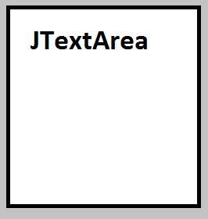
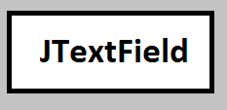
Swing Controls
A JTextField control allows a single line of typed information from the user while a JTextFieldArea allows multiple lines of scrollable typed information
Notes:
Event added with ActionListener.

Slide 23
Text Fields
Properties | Description
text | String displayed in text field.
font | Font name, style, size.
background | Text field background color.
foreground | Color of text.
columns | Displayed width of text field.
horizontalAlignment | Horizontal position of text.
editable | Indicates whether text in the text field is read-only.

Slide 24
Text Fields
Methods | Description
setText | Sets the text field text.
getText | Retrieves the text field text.
setFont | Sets font name, style, size.
setBackground | Sets the text field background color.
setForeground | Sets color of text.
setColumns | Sets the number of columns.
setHorizontalAlignment | Sets the horizontal alignment.
setEditable | If set to false, text field cannot be edited.

Slide 25
Event Listener Object
For Swing components, like the text, event methods are added using the ActionListener. If the component is named textField, the method is added by:
textField.addActionListener(new ActionListener(){
public void actionPerformed(ActionEvent e){
// java code to execute
}
});

Slide 26



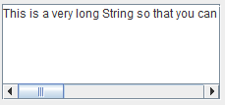
Swing Controls
JCheckBox
JRadioButton
JComboBox
JScrollPane
Notes:
To add items to a JComboBox reference.addItem(“choice A”) and so on.
JTextArea textArea = new JTextArea("This is a very long String....",5, 20);
JScrollPane scrollBar = new JScrollPane(textArea);
add(scrollBar);

Slide 27
Check Boxes
Properties | Description
text | String displayed next to check box.
font | Font name, style, size.
background | Check box background color.
foreground | Color of text.
selected | Indicates if box is selected or not.
Notes:
Event added with ActionListener and border added with BorderFactory.

Slide 28
Check Boxes
Methods | Description
setText | Sets the check box text.
setFont | Sets font name, style, size.
setBackground | Sets the check box background color.
setForeground | Sets color of text.
setOpaque | If true, background colors can be applied.
setSelected | Sets whether box is selected or not.
isSelected | If true, check box is selected.
doClick | Generates a click event for a check box.

Slide 29
Radio Buttons
Properties | Description
text | String displayed next to radio button.
font | Font name, style, size.
background | Radio button background color.
foreground | Color of text.
selected | Indicates if button is selected or not.
Notes:
Event added with ActionListener.
for mutually exclusive events

Slide 30
Radio Buttons
Methods | Description
setText | Sets the radio button text.
setFont | Sets font name, style, size.
setBackground | Sets the button background color.
setForeground | Sets color of text.
setOpaque | If true, background colors can be applied.
setSelected | Sets whether button is selected or not.
isSelected | If true, radio button is selected.
doClick | Generates a click event for a radio button.

Slide 31

Radio Buttons
Groups of radio buttons are defined using the ButtonGroup class.
ButtonGroup group = new ButtonGroup();
group.add(smallRadioButton);
group.add(mediumRadioButton);
group.add(largeRadioButton);

Slide 32
JPanel Control
Properties | Description
enabled | Indicates whether the panel is enabled. If false, all controls in the panel are disabled.
visible | If false, hides the panel (and all its controls).
Notes:
The panel control provides a convenient way of grouping related controls.

Slide 33
JPanel Control
Methods | Description
setBorder | Establishes the panel’s border (if any).
setOpaque | If true, background colors can be applied.
setEnabled | Sets whether panel is enabled.
setVisible | Sets whether panel is visible.

Slide 34
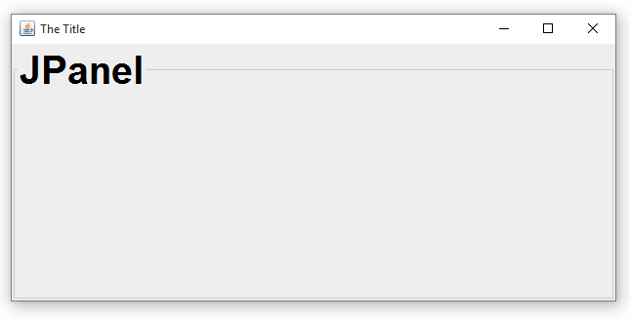
JPanel Control
A titled border is often added to a panel control. The code to add such a border with the title “JPanel” to our sample panel is:
panel.setBorder(BorderFactory.createTitledBorder(“JPanel"));
Notes:
I technically changed the font as well with a font reference and the following method call:
samplePanel.setBorder(BorderFactory.createTitledBorder(null, "JPanel", TitledBorder.LEFT, TitledBorder.DEFAULT_POSITION, font, Color.black));

Slide 35
Swing Controls
Handling Multiple Events in a Single Event Method
JCheckBox[] myCheck = new JCheckBox[10];
// code in one method
for (int i = 0; i < myCheck.length; i++){
if (myCheck[i].isSelected())
// do something
}

Slide 36
Layout Manager
When you add components to a container, a layout manager automatically decides what size they will be and where they will go.
Extremely convenient for us!
Multiple layouts to choose from.

Slide 37
FlowLayout
Components added by FlowLayout - it picks reasonable sizes for components and chooses how many rows.
Notes:
By default a JPanel uses a flowlayout.

Slide 38
BorderLayout
North
West
Center
East
South
Each area can hold a single component or it can be empty.
Notes:
BorderLayout is the default layout for the content pane of a frame.

Slide 39
GridLayout
7 | 8 | 9
4 | 5 | 6
1 | 2 | 3
+- | 0 | .
Has a fixed number of rows and columns and components are added row by row, left to right.

Slide 40
GridBagLayout
 | Column 0 | Column 1 | Column 2 | Column 3 | Column 4 | Column 5
Row 0
Row 1
Row 2
Row 3
Row 4
Row 5
More complex but provides much more versatility.
It divides the content pane into a grid of rows and columns.

Slide 41
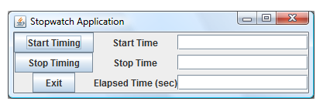
GridBagLayout
 | gridX = 0 | gridX = 1 | gridX = 2
gridY = 0
gridY = 1
gridY = 2

Slide 42
GridBagLayout
JButton startButton = new JButton(“Start”);
GridBagConstraints gridBagConstraints = new GridBagConstraints();
gridBagConstraints.gridx = 0;
gridBagConstraints.gridy = 0;
getContentPane().add(startButton,gridBagConstraints);
 | gridx = 0 | gridx = 1 | gridx = 2
gridy = 0 | startButton
gridy = 1
gridy = 2

Slide 43
GridBagLayout
gridConstraints.gridx = 1;
gridConstraints.gridy = 3;
gridConstraints.gridheight = 2;
gridConstraints.gridwidth = 3;
 | Column 0 | Column 1 | Column 2 | Column 3 | Column 4 | Column 5
Row 0
Row 1
Row 2
Row 3
Row 4
Row 5

Slide 44
GridBagLayout
Member/Field | Description
GridBagConstraints.NONE | Control is not resized(default value)
GridBagConstraints.HORIZONTAL | Control width fills display area.
GridBagConstraints.VERTICAL | Control height fills display area.
GridBagConstraints.BOTH | Control fills entire display area.
If a control is smaller than the region you may use:
gbc.fill = GridBagConstraints.HORIZONTAL;
Control

Slide 45
GridBagLayout
Member/Field | Description
GridBagConstraints.NORTH | Control is centered at top
GridBagConstraints.NORTHEAST | Control is in upper right corner
GridBagConstraints.EAST | At right, centered vertically
GridBagConstraints.SOUTHEAST | Control is in lower right corner
GridBagConstraints.SOUTH | Control is centered at bottom
GridBagConstraints.SOUTHWEST | Control is in lower left corner
GridBagConstraints.WEST | At left, centered vertically
GridBagConstraints.NORTHWEST | Control is in upper left corner
GridBagConstraints.CENTER | Centered horizontally/vertically

Slide 46
GridBagLayout
To center a control (in both directions) in its display area, use:
gbc.anchor = GridBagConstraints.CENTER;
Control

Slide 47
GridBagLayout
Smaller changes in control size can be made using the ipadx and ipady variables. These determine how much a control size is to be increased beyond its minimum size (in each direction). To add five pixels to the width and height of a control using our gbc example:
gbc.ipadx = 5;
gbc.ipady = 5;

Slide 48
GridBagLayout
If a control completely fills its allocated display area, a border region (free space) can be established around the control using the Insets object. Four values are used to define the top, left, bottom and right side margins from the side of the display area. The default is Insets(0, 0, 0, 0). If we want 10 pixels of space at the top and bottom, 20 on the left and 30 on the right, we would use:
gridConstraints.insets = new Insets(10, 20, 10, 30);
Control

Slide 49
Layout Managers
Layout | Description
FlowLayout | Places controls in successive rows, fitting as many as possible in a given row.
BorderLayout | Places controls in the specified framed border.
CardLayout | Places controls on top of each other like a deck of cards.
GridLayout | Places controls within a specified rectangular grid.
GridBagLayout | Places controls either in a row or column.
BoxLayout | Arranges controls either in a row or column.
SpringLayout | Arranges controls with positions defined by sprints and struts.

Slide 50
Layout Managers
public void pack()
Causes this Window to be sized to fit the preferred size and layouts of its subcomponents. The resulting width and height of the window are automatically enlarged if either of dimensions is less than the minimum size as specified by the previous call to the setMinimumSize method.
If the window and/or its owner are not displayable yet, both of them are made displayable before calculating the preferred size. The Window is validated after its size is being calculated.

Slide 51
Components
setSize() vs setPreferredSize()
Typically use setPreferredSize() if you have a layout manager and setSize() if the parent component doesn’t have a layout manager.
a.setPreferredSize(new Dimension(50, 100));
// where a is some control

