Slide 1
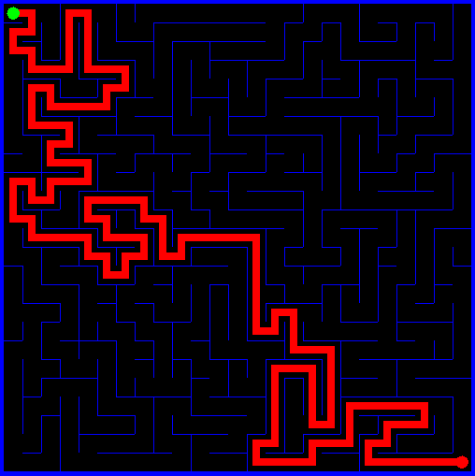
Graphical User Interfaces
Mouse Listeners
Clicks
Motion
Java2D
Shapes
Curves
Gradients/Texture

Slide 2
Event-driven Programming
Actions performed on a graphical component generate an event.
In event driven programming the program responds to these events.

Slide 3
Object
Other classes
Component
Other AWT components
Button
Container
Canvas
JComponent
Window
Panel
Frame
Applet
JFrame
JApplet
Notes:
Hierarchy

Slide 4
Some Swing Classes
JComponent
JButton
JLabel
JPanel
JSlider
JTextComponent
Notes:
Hierarchy

Slide 5
Event Listener Object
For Swing components, like the button, event methods are added using the ActionListener. If the component is named control, the method is added by:
control.addActionListener(new ActionListener(){
public void actionPerformed(ActionEvent e){
// java code to execute
}
});
Notes:
Or you could create a class that extends JButton and implements ActionListener.

Slide 6
Event Listener Object
User clicks button, button generates event
ActionEvent object is sent to listener
Click
instanceof ButtonHandler
Visible JButton object
actionPerformed()
Event handling object of type ActionListener responds to the event

Slide 7
Event Listener Object
For Swing components, like the JLabel, event methods are added using the MouseListener. The code to add the mouseClicked event for a label named label is:
label.addMouseListener(new MouseAdapter() {
public void mouseClicked(MouseEvent e) {
// do something
}
});

Slide 8
Mouse Listener
Method Signature
void mouseClicked(MouseEvent e)
void mouseEntered(MouseEvent e)
void mouseExited(MouseEvent e)
void mousePressed(MouseEvent e)
void mouseReleased(MouseEvent e)
The mouse events method is triggered whenever a mouse button is pressed while the mouse cursor is over a control.

Slide 9
Mouse Events
The mouseDragged event method is continuously triggered whenever the mouse is being dragged over a control.
panel.addMouseMotionListener(new MouseMotionAdapter(){
public void mouseDragged(MouseEvent e){
// do something
}
});
Notes:
e.getButton() Returns mouse button held while mouse is dragging.

Slide 10
Mouse Motion Listener Object
Method Signature | Description
void mouseDragged(MouseEvent e) | Invoked when a mouse button is presses on a component and then dragged.
void mouseMoved(MouseEvent e) | Invoked when the mouse cursor has been moved onto a component but no buttons have been pushed.

Slide 11
Mouse Listener Object
The MouseEvent argument e reveals which button was clicked and the coordinate of mouse cursor when button was pressed. Useful methods are:
Method | Description
e.getButton() | Returns: MouseEvent.BUTTON1 (left button) MouseEvent.BUTTON2 (middle button) MouseEvent.BUTTON3 (right button)
e.getX() | Returns X coordinate of mouse cursor
e.getY() | Returns Y coordinate of mouse cursor

Slide 12
JLabel Revisited
JLabels can display graphics files.
JPEG (Joint Photographic Experts Group)
GIF (Graphic Interchange Format)
PNG (Portable Network Graphics)
ImageIcon image = new ImageIcon("waldo.png");
label.setIcon(image); // set
label.setIcon(null); // clear
Notes:
Once created, you often need to know the width and height of the image. These properties are obtained using the getIconWidth and getIconHeight methods. For our example:
width = myImage.getIconWidth();
height = myImage.getIconHeight();
What determines how the image is displayed in the label control? If no preferred size is specified for the label control, it will take on the size of the graphic file.
If a preferred size is assigned to the label control, the vertical and horizontal alignments specify location of the graphic in the label. If the label is smaller than the graphic, the graphic will be “cropped.”
And, if the label is larger than the graphic, there will be “white” space.

Slide 13
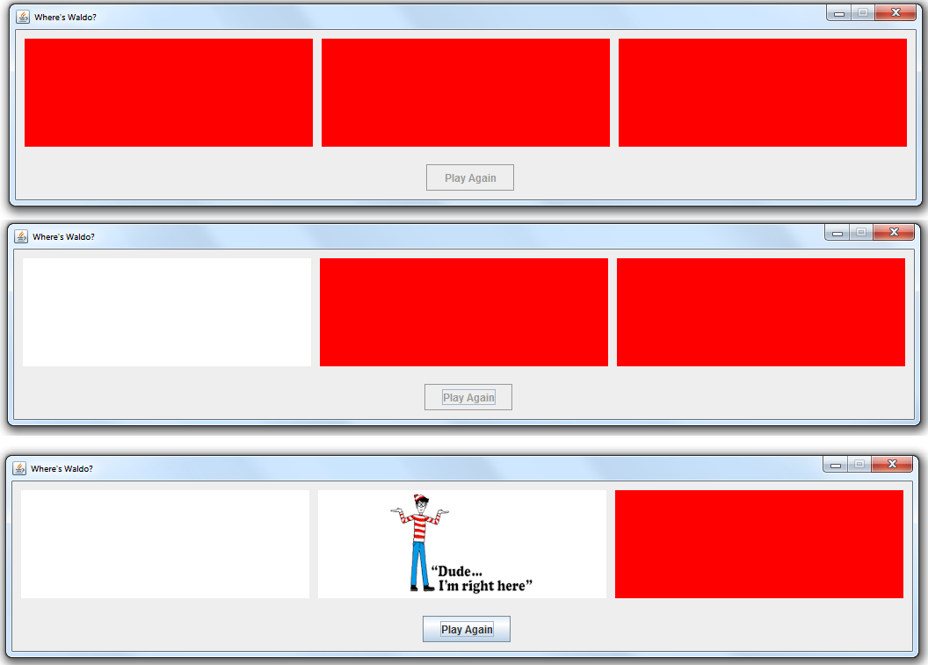
Where’s Waldo Lab

Slide 14
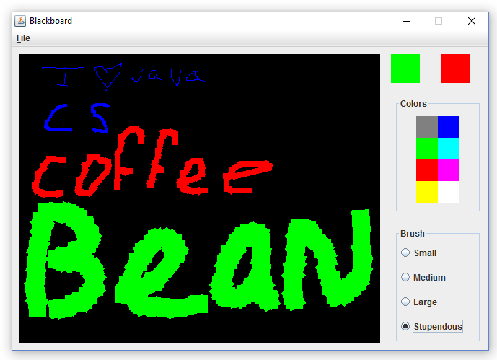
Paint Editor

Slide 15
Java 2D Graphics
Basic Approach:
Create a Graphics2D object.
Establish the Stroke and Paint objects needed for drawing.
Establish the Shape object for drawing.
Draw shape to Graphics2D object using drawing methods
Dispose of graphics object when done.
Notes:
Graphics can be created using either or both the Java Graphics class and the Java 2D Graphics2D class, an improved graphics environment. Be aware that Java references to graphics objects are usually passed as Graphics objects, so casting to Graphics2D objects will often be required.

Slide 16
Java 2D Graphics
A Graphics2D object (g2D) is created using:
Graphics g2D = (Graphics2D) hostControl.getGraphics();
where hostControl is the control hosting the graphics object. Or
Graphics g2D = (Graphics2D) g;
where g is from the paintComponent method.
g2D.setStroke(new BasicStroke(width));
g2D.setPaint(color);
g2D.drawingMethod(arguments);
g2D.dispose();
Notes:
Graphics can be created using either or both the Java Graphics class and the Java 2D Graphics2D class, an improved graphics environment. Be aware that Java references to graphics objects are usually passed as Graphics objects, so casting to Graphics2D objects will often be required.
Once you are done drawing to an object and need it no longer, it should be properly disposed to clear up system resources.
The attributes of lines (either lines or borders of shapes) drawn using Graphics2D objects are specified by the stroke. Stroke can be used to establish line style, such as solid, dashed or dotted lines, line thickness and line end styles. By default, a solid line, one pixel in width is drawn.
The setPaint method can also be used to establish the color and pattern used to fill a graphics region. Regions may be filled with solid colors, textures and patterns.

Slide 17
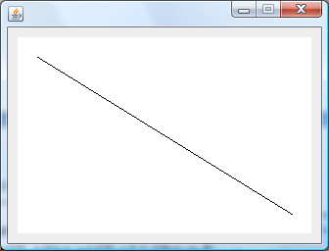
Java 2D Lines
Drawing Lines:
Line2D.Double line = new Line2D.Double(20, 20, 280, 180);
g2D.setPaint(Color.BLACK);
g2D.draw(line);
Notes:
Each coordinate value is a double type (there is also a Line2D.Float shape, where each coordinate is a float type).

Slide 18
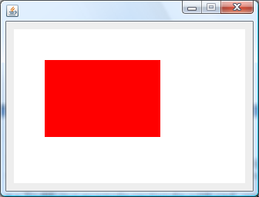
Java 2D Rectangles
Drawing Rectangles:
Rectangle2D.Double rect = new Rectangle2D.Double(40, 40, 150, 100);
g2D.setPaint(Color.RED);
g2D.fill(rect);
g2D.dispose();
Notes:
Each coordinate value is a double type (there is also a Line2D.Float shape, where each coordinate is a float type).

Slide 19
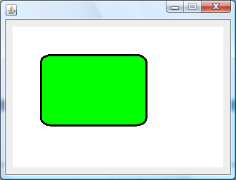
Java 2D Rounded Rectangles
RoundRectangle2D.Double rrect = new RoundRectangle2D.Double(40, 40, 150, 100, 30, 20);
g2D.setPaint(Color.GREEN);
g2D.fill(rrect);
g2D.setStroke(new BasicStroke(3));
g2D.setPaint(Color.BLACK);
g2D.draw(rrect);
g2D.dispose();
// corner width = 30
// corner height = 20
Notes:
Each coordinate value is a double type (there is also a Line2D.Float shape, where each coordinate is a float type).

Slide 20
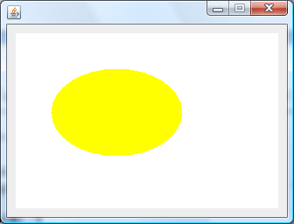
Java 2D Ellipses
Drawing Ellipses:
Ellipse2D.Double ellipse = new Ellipse2D.Double(40, 40, 150, 100);
g2D.setPaint(Color.YELLOW);
g2D.fill(ellipse);
g2D.dispose();
Notes:
Each coordinate value is a double type (there is also a Line2D.Float shape, where each coordinate is a float type).

Slide 21
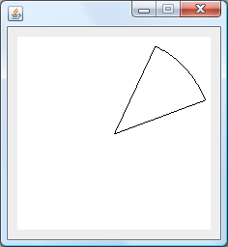
Java 2D Arcs
Drawing Arcs:
Arc2D.Double myArc = new Arc2D.Double(x, y, w, h, start, stop, arcType);
Arc2D.Double arc = new Arc2D.Double(0, 0, 200, 200, 20, 45, Arc2D.PIE);
g2D.setPaint(Color.BLACK);
g2D.draw(arc);
g2D.dispose();
Notes:
Arc segments can be defined using the Arc2D shape. To specify an arc, you first describe an enclosing rectangle, specifying the upper left corner (x, y), the width (w) and the height (h) of the enclosing rectangle. You then specify a start angle (in degrees), the angular extent(stop) of the arc (in degrees) and the arcType.
The start angle is measured counter-clockwise from the horizontal axis to the first side of the arc. stop is the counter-clockwise angle starting at start and ending at the second side of the arc. Notice if start = 0 and stop = 360, the Arc2D shape is the same figure as Ellipse2D (you get the whole ellipse!).

Slide 22
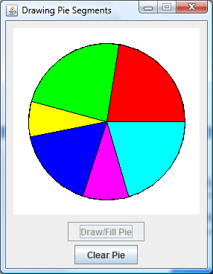
Pie Charts
arcType | Description
Arc2D.OPEN | Ends of arc are not connected.
Arc2D.CHORD | Ends of arc are connected by a straight line.
Arc2D.PIE | Ends of arc are connected by straight lines to center of bounding ellipse forming a pie segment.

Slide 23
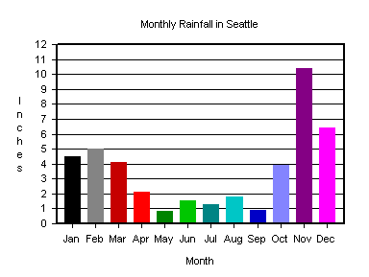
Java 2D Graphics

Slide 24
Point2D
The Point2D object has just two properties: x, the horizontal coordinate, and y, the vertical coordinate.
Point2D.Double p = new Point2D.Double(x, y);
To retrieve the x and y coordinates:
p.getX()
p.getY()
Notes:
Each argument value is a double type (there is also a Point2D.Float object with float type arguments).
We will look at shape objects that describe line and curve segments by connecting points. In order to reconstruct such shapes using a paintComponent method, it is helpful to have a convenient way to store points in a collection. The Point2D object, which specifies a Cartesian point, offers this convenience.

Slide 25
Java 2D Graphics
To draw more complex shapes(lines or curves), we use a GeneralPath object. Such an object is used to specify segments of a path to follow.
GeneralPath path = new GeneralPath();
Once created, the first point in the path is specified using the moveTo method.
path.moveTo(x, y);
Note the coordinates here (and for all path methods) are of type float.

Slide 26
Java 2D Graphics
Method | Description
lineTo(x,y) | Connects current path point to (x, y) using a straight line segment.
quadTo(x1,y1,x2,y2) | Connects current path point to (x2, y2) using a quadratic curve segment with ‘control point’ (x1, y1).
curveTo(x1,y1,x2,y2,x3,y3) | Connects current path point to (x3, y3) using a cubic curve segment with ‘control points’ (x1, y1) and (x2, y2).
closePath() | Connects current point to point established by last moveTo method with a straight line segment. To close with a curve, use quadTo or curveTo.
Notes:
Once a GeneralPath object (a shape) is complete, it is drawn with the usual Graphics2D draw and fill methods. If our object is myPath and the graphics object is g2D, the proper syntax for drawing and filling is:
g2D.draw(myPath);
g2D.fill(myPath);

Slide 27
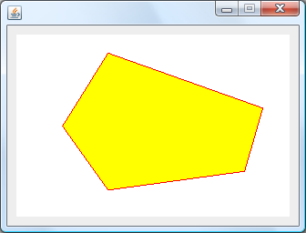
Java 2D Polygons
GeneralPath poly = new GeneralPath();
poly.moveTo(50, 100);
poly.lineTo(100, 20);
poly.lineTo(270, 80);
poly.lineTo(250, 150);
poly.lineTo(100, 170);
poly.closePath();
g2D.setPaint(Color.YELLOW);
g2D.fill(poly);
g2D.setPaint(Color.RED);
g2D.draw(poly);
g2D.dispose();
Notes:
When general path objects have intersecting sides, a winding rule is used to decide which areas should be filled and which shouldn’t. There are just two such rules. We use the default rule, called the non-zero winding rule. To use the other rule (even-odd rule), you need to use a different constructor for the path object. We won’t go into details here about the different rules. They don’t even matter if your shapes don’t have many areas to fill. Consult the usual Java references for more information on the two possible rules.

Slide 28
Java 2D Curves
(xc, yc)
(x2, y2)
(x1, y1)
curve
There are two methods that allow the drawing of curved segments: quadTo and curveTo.
GeneralPath myCurve = new GeneralPath();
myCurve.quadTo(xc, yc, x2, y2);
Notice (x1, y1) does not appear in the method – it is assumed to be the last point drawn to in the path construction. Quadratic curves smoothly transition from one point to the next.

Slide 29
Java 2D curveTo
(xc1, yc1)
(x2, y2)
(x1, y1)
(xc2, yc2)
curve
The segment is constructed such that the tangent from each curve point goes through its corresponding control point.
GeneralPath curve = new GeneralPath();
curve.curveTo(xc1, yc1, xc2, yc2, x2, y2);
Notes:
The curveTo method requires two control points for each curve segment. In mathematical terms, curveTo constructs a cubic (third-order) curve, also known as a Bezier curve, between the current path point and a new point using the two control points.
To draw general curved shapes requires some knowledge of calculus and optimization techniques for proper placement of curve and control points.

Slide 30
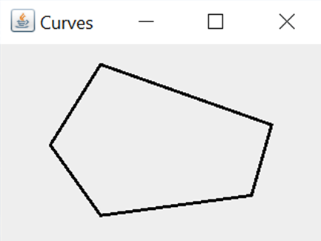
Java 2D Graphics
(100, 20)
(185, 50)
(270, 80)
(75, 60)
(50, 100)
(260, 115)
(75, 135)
(100,170)
(175, 160)
(250, 150)

Slide 31
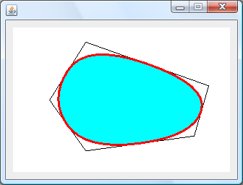
Java 2D Graphics
GeneralPath curve = new GeneralPath();
g2D.setStroke(new BasicStroke(3));
curve.moveTo(75, 60);
curve.quadTo(100, 20, 185, 50);
curve.quadTo(270, 80, 260, 115);
curve.quadTo(250, 150, 175, 160);
curve.quadTo(100, 170, 75, 135);
curve.quadTo(50, 100, 75, 60);
g2D.setColor(Color.CYAN);
g2D.fill(curve);
g2D.setColor(Color.RED);
g2D.draw(curve);
g2D.dispose();

Slide 32
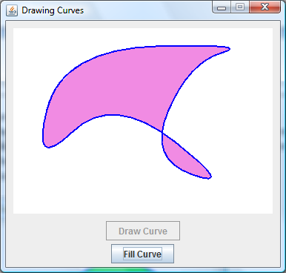
Java 2D Graphics
Notes:
Drawing Curves lab based on mouse clicks.

Slide 33
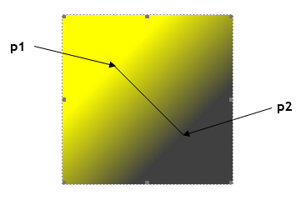
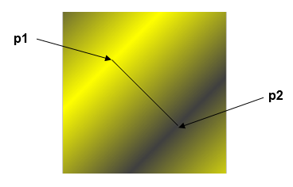
Java 2D GradientPaint
The GradientPaint class fills a shape with a blending of two colors. It starts with one color and gradually ‘becomes’ the other color in a specified direction. You specify the colors and direction of the ‘gradient.’
acyclic cyclic

Slide 34
Java 2D GradientPaint
GradientPaint gPaint = new GradientPaint(p1, c1, p2, c2, cyclic);
Parameter | Description
p1 | Point2D object that defines the starting point with color c1
p2 | Point2D object that defines the ending point with color c2 cyclic.
cyclic | Boolean value that specifies whether the color ‘cycles.’ If true, a cyclic object is created.

Slide 35
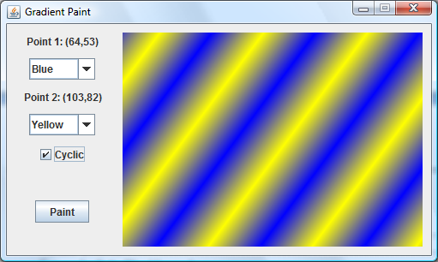
Java 2D Graphics

Slide 36
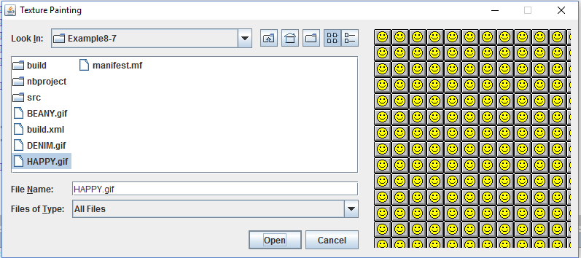
Java 2D Texture Paint

Slide 37
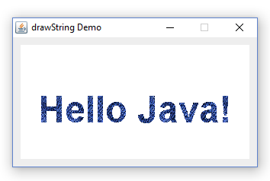
Java 2D Texture Paint

