Slide 1
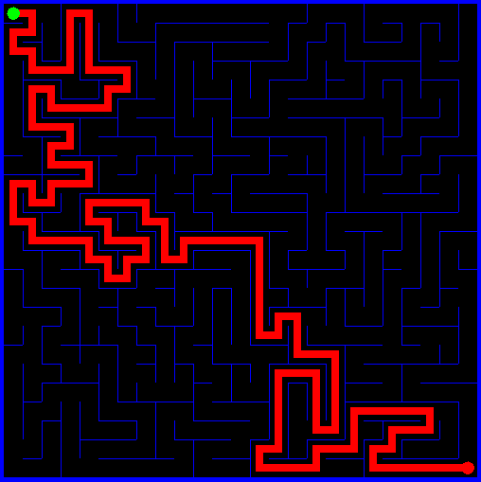
Graphical User Interfaces
Gooey
JOptionPane
JFrame
JPanel

Slide 2
Graphical User Interface
-pronounced “gooey” -type of interface that allows users to
interact through graphical icons and
visual indicators

Slide 3
JOptionPane
A class that offers the easiest alternative to using the console window for input and output.
Has the ability to display any message, an optional icon, and a selected set of buttons.
Link to Oracle

Slide 4
JOptionPane
While the JOptionPane class may appear complex because of the large number of methods, almost all uses of this class are one-line calls to one of the static showXxxDialog methods shown below:
Method Name | Description
showConfirmDialog | Asks a confirming question, like yes/no/cancel.
showInputDialog | Prompt for some input.
showMessageDialog | Tell the user about something that has happened.
showOptionDialog | The unification of the above three.

Slide 5
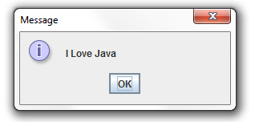
Show Message Dialog Method
JOptionPane.showMessageDialog(null,"I Love Java");

Slide 6
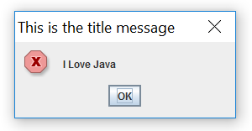
Show Message Dialog Method
JOptionPane.showMessageDialog(null,"I Love Java","This is the title message", JOptionPane.ERROR_MESSAGE);

Slide 7
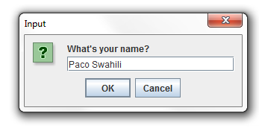
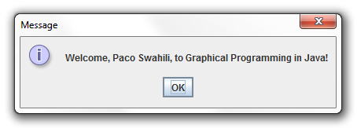
JOptionPane
String name = JOptionPane.showInputDialog("What's your name?");
String message = String.format("Welcome, %s, to Graphical Programming in Java!",name);
JOptionPane.showMessageDialog(null, message);

Slide 8
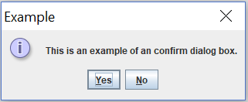
Confirm Dialog Method
title
message
Icon
buttons

Slide 9
Confirm Dialog Method
To use the confirm dialog method, you decide what the message should be, what title you desire, and what icon and buttons are appropriate. To display the confirm dialog box in code, you use the showConfirmDialog method.
JOptionPane.showConfirmDialog(null, message);
JOptionPane.showConfirmDialog(null, message, title, buttons);
JOptionPane.showConfirmDialog(null, message, title, buttons, icon);
Notes:
showConfirmDialog has several more overloaded methods

Slide 10
JOptionPane Button Constants
Member | Description
DEFAULT_OPTION | Displays an OK button
OK_CANCEL_OPTION | Displays OK and Cancel buttons
YES_NO_CANCEL_OPTION | Displays Yes, No and Cancel buttons
YES_NO_OPTION | Displays Yes and No buttons

Slide 11
JOptionPane Icon Constants
Member | Description
PLAIN_MESSAGE | Display no icon
INFORMATION_MESSAGE | Displays an information icon
ERROR_MESSAGE | Displays an error icon
WARNING_MESSAGE | Displays an exclamation point icon
QUESTION_MESSAGE | Displays a question mark icon

Slide 12
JOptionPane
When you invoke the showOptionDialog method, the method returns a JOptionPane constant (an int type) indicating the user response. The available members are:
Member | Description
CLOSED_OPTION | Window closed without pressing button
OK_OPTION | The OK button was selected
YES_OPTION | The Yes button was selected
NO_OPTION | The No button was selected
CANCEL_OPTION | The Cancel button was selected

Slide 13
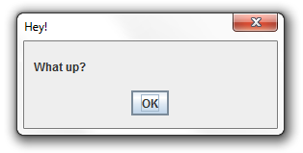
JOptionPane
JOptionPane.showConfirmDialog(null, “What up?", "Hey!", JOptionPane.DEFAULT_OPTION, JOptionPane.PLAIN_MESSAGE);

Slide 14
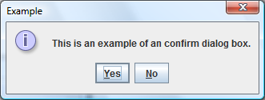
int response = JOptionPane.showConfirmDialog(null, "This is an example of an confirm dialog box.", "Example", JOptionPane.YES_NO_OPTION, JOptionPane.INFORMATION_MESSAGE);
if (response == JOptionPane.YES_OPTION){
// Pressed Yes
}
else if (response == JOptionPane.NO_OPTION){
// Pressed No
}
else{
// Closed window without pressing button
}

Slide 15
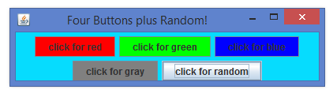
Event-driven Programming
Actions performed on a graphical component generate an event.
In event driven programming the program responds to these events.

Slide 16
Object
Other classes
Component
Other AWT components
Button
Container
Canvas
JComponent
Window
Panel
Frame
Applet
JFrame
JApplet
Notes:
Hierarchy

Slide 17
Some Swing Classes
JComponent
JButton
JLabel
JPanel
JSlider
JTextComponent
Notes:
Hierarchy

Slide 18
JFrame
A JFrame is just a window.
It’s a container object so GUI components may be placed in it.

Slide 19
Basic GUI Program
import java.awt.*;
import javax.swing.*;
public class GUI {
public static void main(String[] args) {
JFrame frame = new JFrame(“Basic GUI Program");
frame.setSize(200, 100);
frame.setVisible(true);
frame.setDefaultCloseOperation(JFrame.EXIT_ON_ CLOSE);
}
Notes:
If you forget to setVisible to true your frame won’t show up but it does exist in memory.

Slide 20
JPanel
Just a blank rectangle.
Two ways to make it useful:
Draw something in the panel
Add other components to the panel

Slide 21
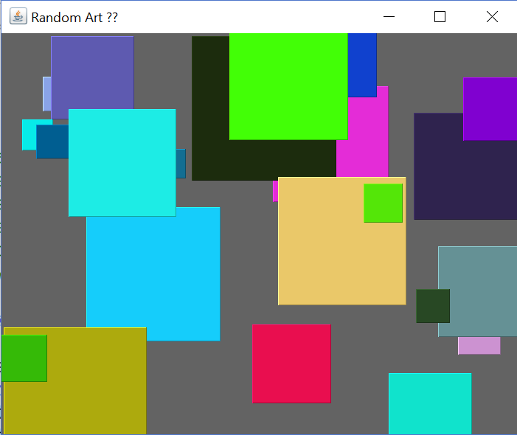
JPanel

Slide 22
JPanel
public class Drawing extends JFrame {
public Drawing() {
setTitle("Drawing");
setSize(new Dimension(300,300));
setVisible(true);
setDefaultCloseOperation(JFrame.EXIT_ON_CLOSE);
add(new DrawingPanel());}
public static void main(String[] args) {
new Drawing();
}
private class DrawingPanel extends JPanel{
public void paintComponent(Graphics g){
super.paintComponent(g);
// your code goes here to draw stuff
}
}
}

