Slide 1
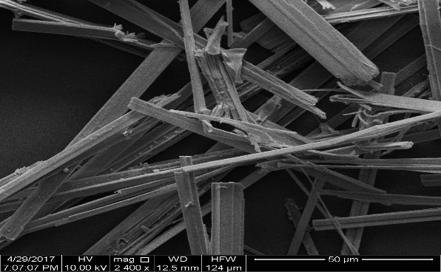
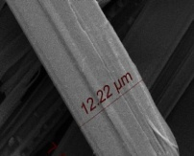
a
b
c
Figure 1: a) SEM image of as prepared Black Phosphorous (BP) (b) Room temperature Raman spectra showing its characteristic peaks, A¹_{g}, B_{2g}, and A²_{g} modes. Scattered points are experimental data and solid line is the fitted spectra, The difference between B_{2g} and A²_{g} is 27.5 cm⁻¹, suggests layer number is not more than 8 (c) Edge phonon of BP.

