Slide 1

Introduction to Course
Data Structure - Lecture 0

Slide 2
Outline
Introduction of Self, Course and Welcome
About Course (Scheme, Syllabus)
About Laboratory
Case Studies
Etiquette of Class & Laboratory
Evaluation Scheme
Design and Performance Measurement Approach
Conclusion

Slide 3
Introduction of Self, Course and Welcome

Slide 4
Vision & Mission of CGU
Vision of the C. V. Raman Global University:
To emerge as a global leader in the area of higher education through the pursuit of excellence with future of skills and innovation to match the ever changing global scenario.
Vision of the Department of CSE :
To become a leader in providing high quality education and research in the area of Computer Science, Information Technology, and allied areas.
Mission of C.V. Raman Global University :
Providing State-of-the art education both at undergraduate, postgraduate and research.
Working collaboratively with technical Institutes / Universities/ Industries of National and International repute
Keeping abreast with latest technological advancements with a view to enhancing future of skills, R&D and start-up activities at large;
Realising its’ goals and objectives in a time bound phased manner.

Slide 5
Mission of Dept. of Computer Science & Engineering
M1: To develop human resource with sound theoretical and practical knowledge in the discipline of Computer Science & Engineering.
M2: To work in groups for Research, Projects, and Co-Curricular activities involving modern methods, tools and technology.
M3: To collaborate and interact with professionals from industry, academia, professional societies, community groups for enhancement of quality of education.

Slide 6
Program Outcome (PO)
Environment and sustainability: Understand the impact of the professional engineering solutions in societal and environmental contexts, and demonstrate the knowledge of, and need for sustainable development.
Ethics: Apply ethical principles and commit to professional ethics and responsibilities and norms of the engineering practice.
Individual and team work: Function effectively as an individual, and as a member or leader in diverse teams, and in multidisciplinary settings.
Communication: Communicate effectively on complex engineering activities with the engineering community and with the society at large, such as, being able to comprehend and write effective reports and design documentation, make effective presentations, and give and receive clear instructions.
Project management and finance: Demonstrate knowledge and understanding of the engineering and management principles and apply these to one’s own work, as a member and leader in a team, to manage projects and in multidisciplinary environments.
Life-long learning: Recognize the need for, and have the preparation and ability to engage in independent and life-long learning in the broadest context of technological change.

Slide 7
PROGRAM EDUCATIONAL OBJECTIVE (PEO)
PEO1- To provide the fundamental knowledge in mathematics, science and engineering concepts for the development of engineering system (Fundamental Knowledge).
PEO2- To apply current industry accepted computing practices and emerging technologies to analyze, design, implement, test and verify high quality computing systems and computer based solutions to real world problems (Design and development).
PEO3- To enable the use of appropriate skill sets and its applications towards social impacts of computing technologies in the career related activities (Skill Set) and to produce Efficient team leaders, effective communicators and capable of working in multi-disciplinary environment following ethical values(Communication).

Slide 8
Introduction
Dr. Dillip Rout
Algorithm Modeling, Network Optimization, Applied Machine Learning
Teaching, Project Development, Research, Organizing
Data Structure
A basic (core) and native to Computer Science
Literally means containers and how to operate on those
Useful for any programming language, independent
Industry, Education and Research
MAANG companies ask a lot about this course

Slide 9
About Course

Slide 10
Scheme
5 units
35-40 hours of classes; Each class 1 hour
Theory and Laboratory contents
Theory 100 marks
Laboratory 100 marks
12-14 weeks of time

Slide 11
Syllabus
UNIT 1: Introduction & Linear Data Structures Part-I : Stack & Queue
Definitions, Abstract Data Types (ADT) with examples (Types: Primitive, Non-primitive), Categories of Data Structures: Linear vs Nonlinear, Static vs Dynamic Data Structures. Stack:
Fundamentals of stack, representation using array, Applications of stack: Recursion, Expression conversions and evaluations, etc.
Queue: Fundamentals of queue, representation using array, Circular queues, Double ended queues (Dequeue), Applications of queue to solve problems.
UNIT 2: Linear Data Structures Part-II : Linked List
Single linked lists: operations and implementation.
Double linked list: operations and implementations.
Circular linked list: concepts and implementation.
Applications: Stack & Queue implementation using linked list, Polynomial manipulation using linked list.

Slide 12
Syllabus…
UNIT 3: Nonlinear Data Structures Part-I : Tree
Basic terminology, Representation using array and linked list, Complete Binary Tree.
Tree Traversals: Recursive and Non-recursive. Operations on binary tree: Finding Height, Leaf nodes, Counting number of nodes, etc. Construction of binary tree from traversal paths.
Binary Search Trees (BST): Insertion, Deletion of nodes to/from BST.
Height Balanced Tree (AVL): Insertion, Deletion, Rotations on AVL tree, Searching.
UNIT 4: Nonlinear Data Structures Part-II : Graph
Graphs: Graph terminology, Representation of graphs (Adjacency Matrix, Adjacency List), Path matrix.
Traversals: Breadth First Search (BFS), Depth First Search (DFS).
Spanning Trees, Minimum Spanning Trees.
Shortest Paths: Bellman’s Ford Algorithm (Single Source).

Slide 13
Syllabus…
Unit 5: Sorting & Searching
Sorting techniques: Bubble Sort, Selection Sort, Insertion Sort, Counting Sort.
Heaps: Max Heap, Min Heap, Heap Sort.
Searching techniques: Linear and Binary search methods (recursive and non-recursive).
Hashing: Different hash functions, Collision resolution techniques.
100% Syllabus Coverage is Compulsory
Classes will speed up after two weeks, so be in sync

Slide 14
Course Outcomes
CO1: Understanding of linear data structure such as Queue and Stack for solving problems.
CO2: Analyse linear data structure such as Linked List for solving problems.
CO3: Apply non-linear data structure such as Tree for solving problems.
CO4: Apply non-linear data structure such as Graph for solving problems.
CO5: Create a program using different sorting and searching mechanisms.

Slide 15
About Laboratory

Slide 16
Scheme
Syllabus will follow Theory
10-12 weeks
Only 1 week for revision
About 40-50 experiments (programs)
Case Study will be evaluated too.
Coding and Theory must be synchronized

Slide 17
Case Studies

Slide 18
Scheme
Case Studies will be shared
6-10 students per group
Groups must be formed by the students
Groups should learn the shared Case Studies, consult me
Groups will be assigned Case Studies between 2nd and 3rd week
The assignment will be ordered based on Laboratory Test
All settings will be done during the laboratory classes
One Case Study may be repeated but at most twice
Research Paper will attract highest marks for sessional

Slide 19
Etiquette of Class & Laboratory

Slide 20
Classroom Discipline
Do’s
Arrive to class on time.
Read the material before class.
Take notes while your professor is lecturing.
Ask questions when something does not make sense.
If you do miss a class, cover up from your classmate/friend.
Don’ts
Don’t talk while your professor is lecturing or when other students are called on to speak.
Don’t attend phone calls inside the class, rather go out if it is urgent.
Don’t be afraid to ask your teacher about any questions you may have.
Do not disturb/provoke others.

Slide 21
Laboratory Discipline
Always be respectful of your laboratory mates and their workspace, laboratory materials.
Avoid distracting and obstructing lab mates when carrying out an experiment for this can compromise their safety and the integrity of their experiments.
Communicate when others are not adhering to lab safety rules and nonhazardous techniques.
Always keep a mental note and written-record of your experiments. If you are lost or confused, do not hesitate to ask.
Be aware of yourself and your surroundings at all time.

Slide 22
Evaluation Scheme

Slide 23
Marks Distribution
Theory
Assignment 10 marks (5 Assignments, 1 per Unit)
Mid-semester 20 marks (2 Units)
1 Case Study (Experiential Learning) 20 marks (inclusive all units) in groups
Surprise Test (MCQ) – (1-2 tests per Unit) 20 marks*
End-semester Examination 30 marks
*May change as necessary: mostly Technical Talk in Groups (Flip Classroom)
Laboratory
Daily evaluation 50 marks (5 marks per laboratory)
Laboratory Test 30 marks (Part-I Coding and Part-II Viva-voce)
Case Study 20 marks

Slide 24
Design and Performance Measure Approach

Slide 25
Computer Science Foundation
Subjects:
Discrete Mathematics
Algorithms
Computer Architecture and Organization
Designing:
Algorithms (Data Structure) | Software | Hardware
Performance Evaluation:
Algorithms: Time and Space Complexity
Software: Lines of Code, Reliability, Scalability, Maintenance Cost, etc.
Hardware: Power Analysis, Reliability, Fault Analysis, Maintenance Cost, etc.

Slide 26
Designing Algorithms
Definition:
Algorithm is a finite sequence of rigorous instructions, typically used to solve a class of specific problems or to perform a computation.
Or, it is a process or set of rules to be followed in calculations or other problem-solving operations, especially by a computer.
Algorithms are used as specifications for performing calculations and data processing.
Importance of Algorithms:
Data processing: Algorithms are used to process and analyze large amounts of data, such as sorting and searching algorithms.
Problem solving: Algorithms are used to solve computational problems, such as mathematical problems, optimization problems, and decision-making problems.
Expressing Algorithms:
Flow Chart
Structured English
Pseudo Code (Structured English + Mathematical Symbols)

Slide 27
Problem Statement Example
Description:
Given a number test if it is a prime number or not.
Input(s):
n = the number to be tested
Output(s):
Yes or No
Specification:
The number is a positive integer. The number can be either prime or composite.

Slide 28
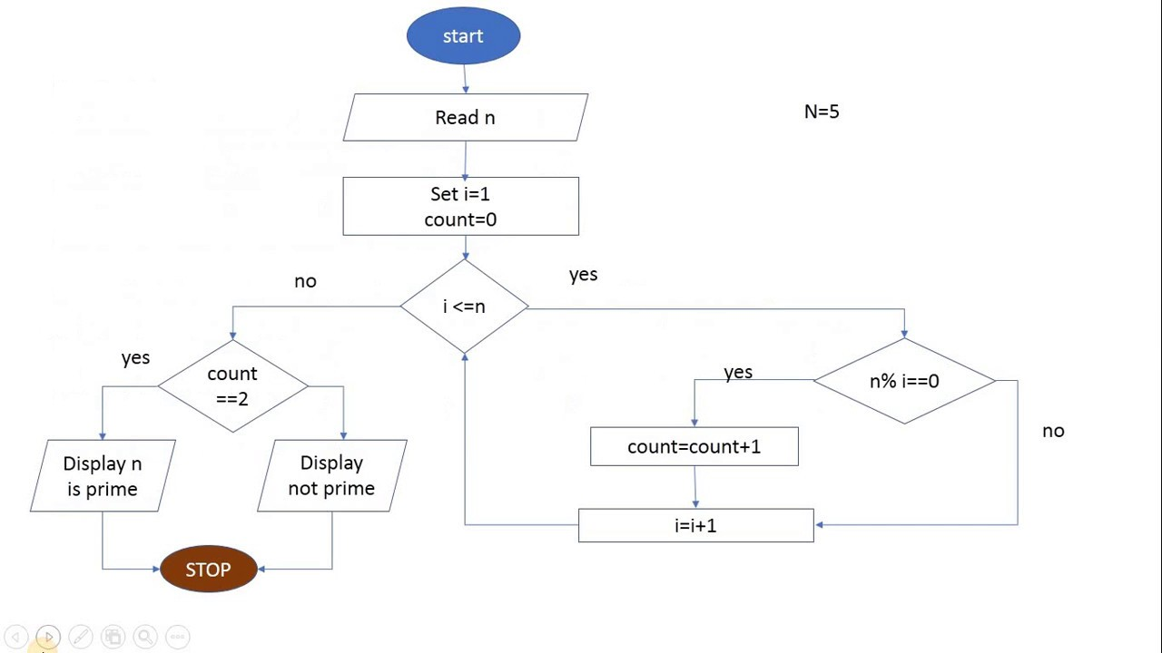
Flowchart

Slide 29
Structured English
Take a number as input.
List its divisors.
If the number of divisors are more than two (inclusive 1 and itself) then it is not a prime number.
Otherwise, it is a prime number

Slide 30
Pseudo Code
Read the number n
Let count = 0
For i= 1 to n do
If n % i == 0 then
count = count + 1
If count > 2 then
n is not a prime number
Else, n is a prime number

Slide 31
Performance Evaluation
Time and Space complexity to be measured which estimates the respective cost of an algorithm without being implemented.
The complexity is measured in terms of input size n (no. of elements taken as input). That is, n is taken as the unit of measurement.
The output, the complexity is expressed as a function of n.
For example:
For prime number: n=1 but its magnitude or value is considered
For sorting: n = 10, 100, and so on
For sorting: n = 10, 100, and so on
Complexity??? See the next slide

Slide 32
Time and Space Complexity
Time Complexity
Measures the unit time in terms of number of operations carried out.
The number of operations is expressed in the input size n.
For example:
Prime number algorithm: time complexity is O(n), n is the value of the input.
For searching: O(n), n is the number of elements in the list
For sorting: O(n^2), n is the number of elements to be sorted
Space Complexity
Measures the unit memory in terms of number of blocked to be used.
The number of blocks is expressed in the input size n.
For example:
Prime number algorithm: space complexity is O(1), only one number.
For searching: O(n+1), n is the number of elements in the list
For sorting: O(n), n is the number of elements to be sorted: assuming in-place sorting algortihm

Slide 33
Conclusion

Slide 34
Summary
Hard work pays back
Hard work (75%) + Smart work (25%)
Discipline and Dedication may do wonders
Assignment and Case Studies are the keys to success
Similarity check is a must and heavy penalty for copying

Slide 35
References
Text books:
“Data Structure- A Pseudo code approach with C” by Gilberg and Forouzan, Thomson publication.
“Data structure in C” by Tanenbaum, PHI publication / Pearson publication.
”Data Structures & Algorithms; Concepts, Techniques & Algorithms ” by Pai,Tata McGraw Hill.
“Data Structures Using C”, Reema Thareja, Oxford University Press
Reference Books:
“Fundamental of Data Structure”– (Schaums Series) Tata-McGraw-Hill.
“Fundamentals of data structure in C”– Horowitz, Sahani & Freed, Computer Science Press.
“Data Structure Through C: A Practical Approach” by G. S. Baluja, DhanpatRai Publications.
Open Sources
https://www.wctmgurgaon.com/wctm/dsa%20lab-it-labmanual.pdf

Slide 36
Supplementary Materials
Books for C Programming
The C Programming Language, Brian W. Kernighan and Dennis M. Ritchie, Prentice Hall of India.
Schaum’s Outline of Programming with C, Byron Gottfried, Tata McGraw-Hill
Books on Data Structures
Data Structures, Schaum’s Outline Series, Seymour Lipschutz, Tata McGraw-Hill
Fundamentals of Data Strcutures in C , Ellis Horowitz, Satraj Sahni and Susan Anderson-Freed, W. H. Freemn and Company
Classic Data Structures, D. Samanta, Prentice Hall of India.
Take the help of the Internet, if you need…

Slide 37
Supplementary Materials…
Web references:
http://cse.iitkgp.ac.in/~pds/
Some useful software:
http://cse.iitkgp.ac.in/~pds/software/
Notes:
http://cse.iitkgp.ac.in/~pds/notes/
Course related information and announcements:
http://cse.iitkgp.ac.in/~pds/semester/2017a/
http://www.nid.iitkgp.ernet.in/DSamanta/
These resources are very carefully developed and really good…

Slide 38
Happy Learning!

