Slide 1

Introduction to Data Structure
Unit-1 Lecture-1
Dr. Dillip Rout, Assistant Professor, Dept. of Computer Science and Engineering

Slide 2
Outline
Terminologies
Abstract Data Types (ADT)
Categories of Data Structures
Homework
Conclusions

Slide 3
Terminologies

Slide 4
Data Structure
Data structure is representation of the logical relationship existing between individual elements of data.
Otherwise, a data structure is a way of organizing all data items that considers not only the elements stored but also their relationship to each other.
Data structure affects the design of both structural & functional aspects of a program.
Program=algorithm + Data Structure

Slide 5
Data Structure…
Simply, a Data Structure is a container with defined operations.
Data Structure:
Attributes/Properties
Operations/Functions
Examples:
Array:
Attributes: Type, Size, Number of Elements, Address, etc.
Operations: Creation, Insertion of Elements, Deletion of Elements, Searching of Elements, Shuffling of Elements, etc.
Queue:
Attributes: Type, Size, Front, Rear, Address, etc.
Operations: Creation, Insertion of Elements, Removal of Elements, etc.

Slide 6
Data Structure vs Data Types
Data Structure
A Data structure is a collection of data of different data types. This collection of data can be represented using an object and can be used throughout the program.
The implementation of data structure is known as abstract implementation.
It can hold multiple types of data within a single object.
Some operations are used to assign the data to the data structure object.
Time complexity plays an important role.
The examples of data structure are stack, queue, tree, graph, etc.
Data Types
A Data type is one of the forms of a variable to which the value can be assigned of a given type only. This value can be used throughout the program.
The implementation of data type is known as concrete implementation.
It can hold value but not data. Therefore, we can say that it is data-less.
A value can be assigned directly to the variables.
No problem in the time complexity.
The examples of data type are int, float, char, etc.

Slide 7
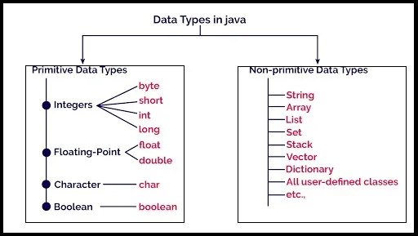
Primitive vs Non-Primitive Data Types

Slide 8
Primitive vs Non-Primitive Data Types
Primitive
Pre-defined by the programming language.
The size and type of variable values are specified, and it has no additional methods/functions.
Cannot be used to call methods to perform certain operations.
Always has a value, may be garbage.
Starts with a lowercase letter.
The size of a primitive type depends on the data type.
Non-Primitive
Not defined by the programming language but are created by the programmer. “reference variables” or “object references”
The size and type of variable depends on underlying combination.
Can be used to call methods to perform certain operations like assing, insert,etc.
Can be null as well.
Starts with an uppercase letter.
Non-primitive types have all the same size.

Slide 9
Abstract Data Types

Slide 10
Definition ADT
The most general Abstract Data Type (ADT) is that of a container.
The Container ADT
A container describes structures that store and give access to objects
The queries and operations of interest may be defined on:
The container as an entity, or
The objects stored within a container
The operations we may wish to perform on a container are:
Create a new container
Copy or destroy an existing container
Empty a container
Query how many objects are in a container
Query what is the maximum number of objects a container can hold
Given two containers:
Find the union (merge), or
Find the intersection

Slide 11
Data Type, ADT and Data Structure
An ADT is a mathematical model for data types.
An ADT is defined by its behavior from the point of view of a user, of the data, specifically in terms of possible values, possible operations on data of this type, and the behavior of these operations.
An ADT is an abstraction of a data structure that provides only the interface to which the data structure must adhere. The interface does not give any specific details about something should be implemented or programming language.
Data Type is known to the hardware and/or system softwares/environment and all the operations are known
Data Structure is unknown to the hardware. E.g. addition, subtraction, etc., not defined.
Data Structure is performed on Main Memory.

Slide 12
Categories of Data Structures

Slide 13
Classification
Based on Arrangement (Shape) and Traversal:
How the elements are arranged while represented as a structure/shape?
High level view (abstract)
Types: Linear vs Nonlinear
Based on Memory Allocation:
How the elements are arranged while stored in a memory organization?
Low level view (implementation)
Types: Static vs Dynamic

Slide 14
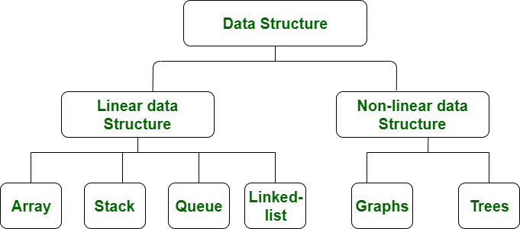
Linear vs Non-Linear Data Structures

Slide 15
Linear vs Non-Linear Data Structures
S.NO | Linear Data Structure | Non-linear Data Structure
1. | Data elements are arranged in a linear order, each element is attached to its previous and next adjacent. | In a non-linear data structure, data elements are attached in hierarchically manner.
2. | Single level is involved. | Multiple levels are involved.
3. | Its implementation is easy in comparison to non-linear data structure. | While its implementation is complex in comparison to linear data structure.
4. | Elements can be traversed in a single run only. | Elements can’t be traversed in a single run only, backtracking required.

Slide 16
Linear vs Non-Linear Data Structures…
S.NO | Linear Data Structure | Non-linear Data Structure
5. | Memory is not utilized in an efficient way. | Memory is utilized in an efficient way.
6. | Its examples are: array, stack, queue, linked list, etc. | While its examples are: trees, graphs, heaps, etc.
7. | Applications of linear data structures are mainly in application software development. | Applications of non-linear data structures are in Artificial Intelligence and image processing.
8. | Useful for simple data storage and manipulation. | Useful for representing complex relationships and data hierarchies, such as in social networks, file systems, or computer networks.

Slide 17
Static vs Dynamic Data Structures
Data Structures
Static
Dynamic
Arrays
Stack, Queue, Set
Linked List, Heap, Tree, Graph
Hash Table, Set

Slide 18
Static vs Dynamic Data Structure
Aspect | Static Data Structure | Dynamic Data Structure
1. Memory allocation | Memory is allocated at compile-time | Memory is allocated at run-time
2. Size | Size is fixed and cannot be modified | Size can be modified during runtime
3. Memory utilization | Memory utilization may be inefficient | Memory utilization is efficient as memory can be reused
4. Access | Access time is faster as it is fixed | Access time may be slower due to multiple indexing and pointer usage
5. Examples | Arrays, Stacks, Queues (with fixed size), etc. | Linked Lists, Trees, Graphs, Hash tables, etc.

Slide 19
Conclusions

Slide 20
Summary
Data Structure is a container with defined operations.
Attributes/Properties
Operations/Functions
Examples: Array, String, Stack, Queue, Linked List, Tree, Heap, Graph, Hash Table
Abstract Data Type -> Data Structure -> Data Type
Shape & Traversal: Linear vs Non-Linear Data Structures
Memory Allocation: Static vs Dynamic Data Structures
Data Structure is a key concept in Computer Science

