Slide 1

Queue
Unit-1 Lecture-3
Dr. Dillip Rout, Assistant Professor, Dept. of Computer Science and Engineering

Slide 2
Outline
Fundamentals of Queue
Representation using Array
Applications of Queue:
Downloading from Web Server
Level Order Traversal
CPU Job Scheduling
Circular Queue
Double Ended Queue (Deque)
Homework
Conclusions

Slide 3
Fundamentals of Queue
Introduction
Real-life Usages
Attributes
Operations
Knowledge Check

Slide 4
Overview
Queue is a linear data structure.
Queue is open at both its ends.
One end is always used to insert data (enqueue) and the other is used to remove data (dequeue).
The elements in the queue have a particular order.
Follows FIFO ( First In First Out )/ LILO (Last In Last Out)
The element inserted first will be removed/served first.
A Queue is like a line waiting to purchase tickets, where the first person in line is the first person served. (i.e. First come first serve).

Slide 5
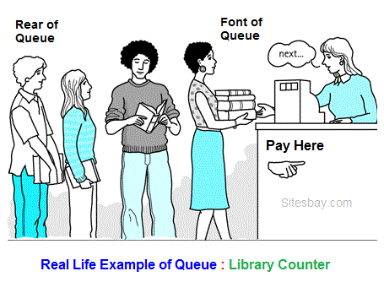
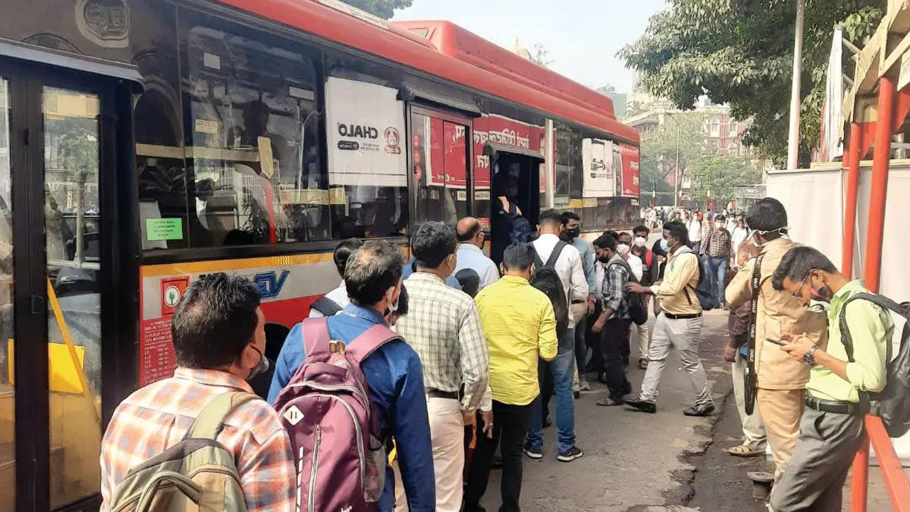
Queue in Real-life
BEST Buses

Slide 6

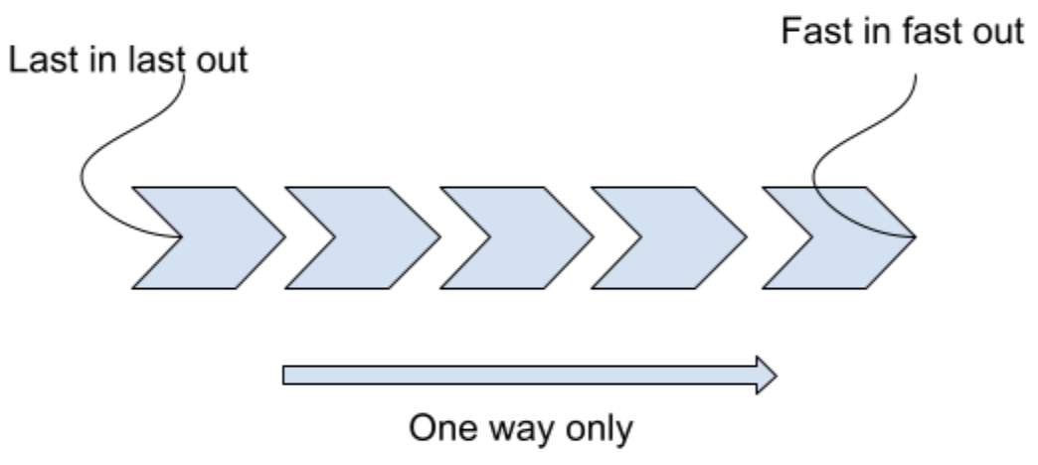

Queue in Real-life…
Both ends are open
One end entry
Another end exit

Slide 7
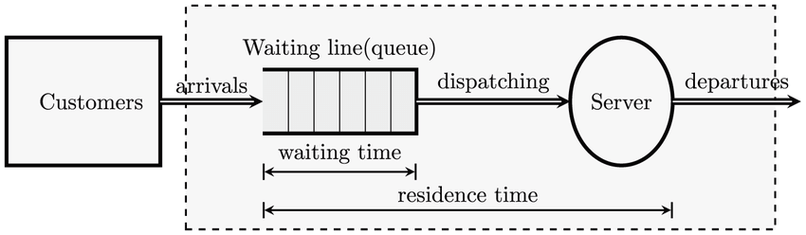
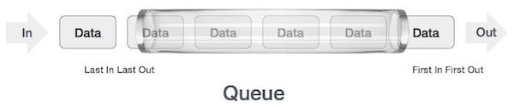
Queue in Computer

Slide 8
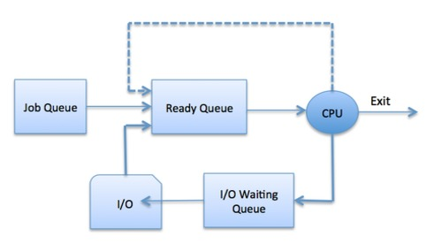
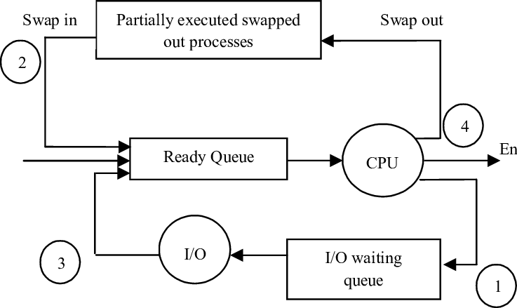
Queue in Computer…

Slide 9
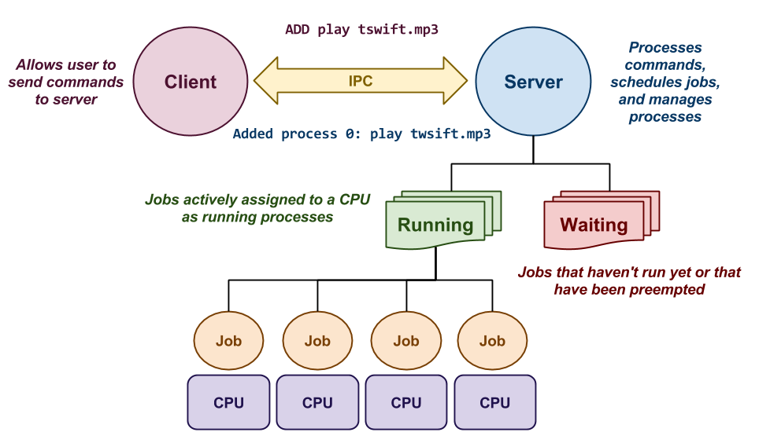
Queue in Computer…
A server may have multiple CPUs
Many clients are connected concurrently
The data processing is interleaved, unnoticed by clients
Waiting can be at communication channel, processing unit, etc.

Slide 10
Attributes of Queue
Size:
Mostly predefined (fixed) and static.
Dynamic size is applied in some cases.
Rear End:
The end/gate where elements are entered into queue.
Rear:
The marker which points to the Rear End of the queue. Why said as marker?
Front End:
The end/gate where elements are exited from queue.
Front:
The marker which points to the Front End of the queue.
Type:
Depends on the dataset

Slide 11
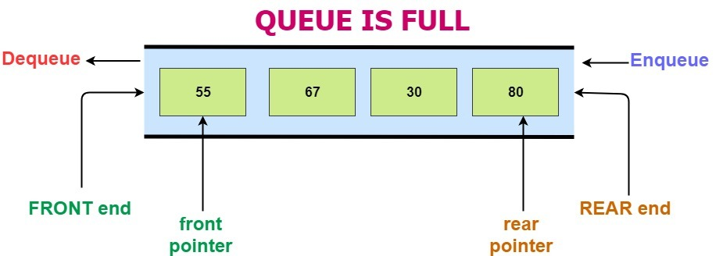
Queue Visualization as Data Structure

Slide 12
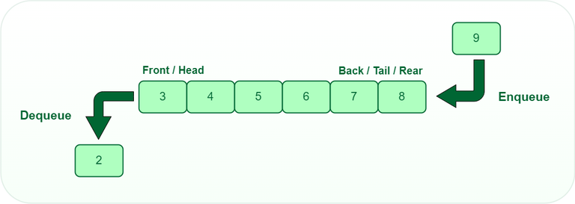
Operations on Queue
Native:
Enqueue (insert), Dequeue (delete)
Auxiliary:
Display (all elements), Peek() or Front() first element, Rear() last element

Slide 13
Example of Operation
Create a size with N
Insert elements:
5, 10, 15, 25, 30, 40
What is the state of Queue?
What are the values of Rear and Front?
Delete 3 elements
What are the values of Rear and Front?
How many elements are remaining?
Create a size with N
Insert elements:
A, C, E
What is the state of Queue?
What are the values of Rear and Front?
Delete 3 elements
What are the values of Rear and Front?
How many elements are remaining?
Insert elements:
G, I, K
What is the state of Queue?
What are the values of Rear and Front?

Slide 14
Enequeue
Inserts an element at the end of the queue i.e. at the rear end.
Algorithm Enqueue(Q: queue, N: size of queue, Rear, x: element to be inserted)
If Rear < N - 1 (size of queue) then
Rear = Rear + 1
Q[Rear] = x
If Front == -1 then
Front = Front + 1
Return

Slide 15
Dequeue
Retrieves and deletes an element from the queue (if possible).
Algorithm Dequeue (Q: queue, N: size of queue, Front)
If Front >= 0 then
x = Q[Front]
If Front == N-1 or Front == Rear then
Front = -1 (What about Rear?)
Else, Front = Front + 1
Return x

Slide 16
Usages of Queue
Task Scheduling: Queues can be used to schedule tasks based on priority or the order in which they were received.
Resource Allocation: Queues can be used to manage and allocate resources, such as printers or CPU processing time.
Batch Processing: Queues can be used to handle batch processing jobs, such as data analysis or image rendering.
Message Buffering: Queues can be used to buffer messages in communication systems, such as message queues in messaging systems or buffers in computer networks.
Event/Interrupt Handling: Queues can be used to handle events in event-driven systems, such as GUI applications or simulation systems.
Traffic Management: Queues can be used to manage traffic flow in transportation systems, such as airport control systems or road networks.

Slide 17
Knowledge Check
Application of Queue Data Structure is:-
The resource is shared among multiple consumers.
Data is transferred asynchronously between two processes.
Load Balancing
All of the above
A linear list of elements in which deletion can be done from one end (front) and insertion can take place only at the other end (rear) is known as _____________
Queue
Stack
Tree
Linked list
All of the above
???

Slide 18
Representation using Array
Define
Underflow
Overflow
Knowledge Check

Slide 19
Define
Defining a Queue means
(Data) Type, Size, Assumptions
It is an non-primitive type, so it needs other data types to be implemented.
For simplicity, let us implement using Array (another non-primitive data type)
Queue can be implemented statically as well as dynamically but assume that it is static.
Let the size of the queue be N (fixed)
Let us assume that the indexing starts with 0
Let Front = -1, Rear = -1 as there are no elements
While performing insertion operation, initially rear pointer is forwarded by one location then value is enqueued.
While performing deletion operation, item is deleted from the queue then front pointer can be moved to one place forward.

Slide 20
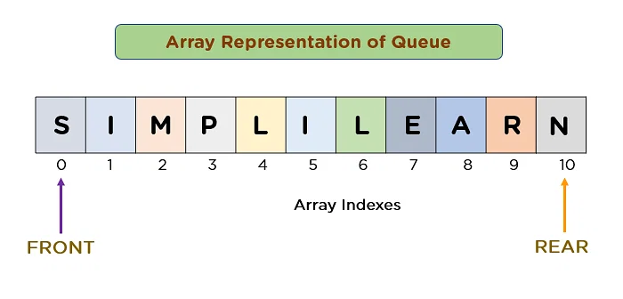
Implementation using Array
What is the size of this queue?
What is the type of this queue?

Slide 21
Queue Underflow vs Overflow (Phenomenon)
Overflow
Occurs while doing Enqueue() operations
Happens if the queue is full
Condition:
Rear == N-1 (Pseudo)
Rear == N-1 and Front == 0
Is there any change required in Enqueue operation?
Underflow
Occurs while doing Dequeue() operations
Happens if the queue is empty
Condition:
Front == -1 (Any other option???)
Is there any change required in Dequeue operation?

Slide 22
Knowledge Check
How many scenarios are there where Front and Rear have the same value? Illustrate with an example.
What are the possible values of Front when the queue (simple) if full?

Slide 23
Example Problem-1
A normal queue, if implemented using an array of size MAX_SIZE, gets full when?
a) Rear = MAX_SIZE – 1 b) Front = (rear + 1)mod MAX_SIZE
c) Front = rear + 1 d) Rear = front
If the elements “A”, “B”, “C” and “D” are placed in a queue and are deleted one at a time, in what order will these be removed?
a) ABCD b) DCBA c) DCAB d) ABDC
What will be value of Rear and Front after removing all these elements?

Slide 24
Example Problem-2
Suppose in a queue, Q1 you are inserting the elements from 1 to 10. Before inserting any element into Q1, it is checked for prime number, if the element is prime number then it is inserted into another queue, Q2. Assume size of both queues to be 10.
What will be the states of both the queues after inserting all the elements from 1 to 10?
You decide to save space and move all the items into one queue. Which queue you would like to retain and which one you would like to delete?
Suppose you move every element from Q2 to Q1 then what are the values of Rear and Front of Q2?
What will be the state of Q1 after moving all the elements from Q2 to Q1?
How many Dequeue() operations are required to make Q1 empty?

Slide 25
Example Problem-3
Consider the following pseudo-code. Assume that IntQueue is an integer queue. What does the function fun do?
void fun(int n)
{ IntQueue q = new IntQueue();
q.enqueue(0); q.enqueue(1);
for (int i = 0; i < n; i++) {
int a = q.dequeue(); int b = q.dequeue();
q.enqueue(b); q.enqueue(a + b);
print(a); }
}

Slide 26
Example Problem-4
Suppose you are given an implementation of a queue of integers. The operations that can be performed on the queue are:
i. isEmpty (Q) — returns true if the queue is empty, false otherwise.
ii. delete (Q) — deletes the element at the front of the queue and returns its value.
iii. insert (Q, i) — inserts the integer i at the rear of the queue.
void f (queue Q) { // Consider the following function:
int i ;
if (!isEmpty(Q)) {
i = delete(Q); f(Q); insert(Q, i);
} }
What operation is performed by the above function f ?
A. Leaves the queue Q unchanged
B. Reverses the order of the elements in the queue Q
C. Deletes the element at the front of the queue Q and inserts it at the rear keeping the other elements in the same order
D. Empties the queue Q

Slide 27
Applications of Queue
Download from Web
Level Order Traversal
CPU Scheduling

Slide 28
Real Applications of Queue
Direct applications:-
Waiting lists
Grocery stores, banks, and airport security use queues
Access to shared resources (e.g., printer)
Multiprogramming
Process scheduling
Interrupt handling in operating systems.
Buffering in networks (live streaming)
Buffering in Music/Video players
Most shared computer services are servers:
Web, file, ftp, database, mail, printers, WOW, etc.
The most common application is in client-server models
Multiple clients may be requesting services from one or more servers
Some clients may have to wait while the servers are busy
Those clients are placed in a queue and serviced in the order of arrival
The SSH Secure Shell and SFTP are clients
Indirect applications:-
Auxiliary data structure for algorithms
Component of other data structures

Slide 29
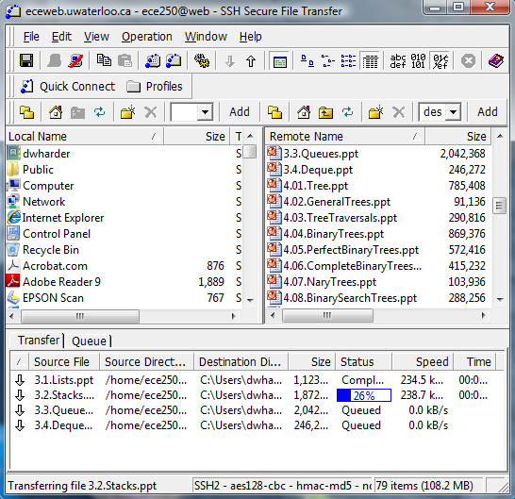
Downloading from Web Server
While downloading multiple files (large) from the web server
All files cannot be downloaded simultaneously
those requests not currently being downloaded are marked as “Queued”

Slide 30
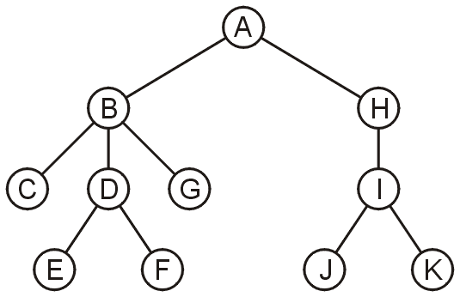
Level Order Traversal
Consider searching/listing the directory structure as shown in hierarchical order.
Output: A, B, H, C, D, G, I, E, F, J, K
How to do? Which data structure? Work out please.

Slide 31
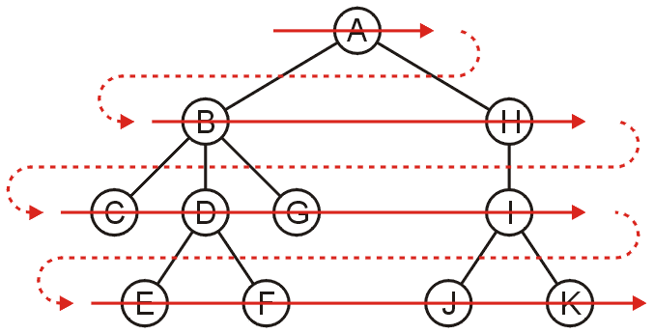
Level Order Traversal…
Search all the directories at one level before descending a level.
Place the root directory into a queue
While the queue is not empty:
Dequeue the directory at the front of the queue
Enqueue all of its sub-directories into the queue
The order in which the elements are dequeued is level ordered, also known as Breadth-First-Search (BFS)

Slide 32
CPU Scheduling Problem
Consider 5 processes and their respective execution time in CPU (in seconds) are as follows: A:10, B:12, C:8, D:15, E:5 (in order). Each of these processes has to share a common CPU, i.e., only 1 CPU is available. Apart from the CPU time, a process needs I/O time if it is longer. Processes may need I/O operations.
Assume that a process needs 1 second of I/O time after each 5 seconds of CPU execution time. In such a case, the process has to leave CPU and go for I/O operation. The operating system applies a non-preemptive scheduling policy.
What is the order of completion of the processes? Will data structure help?

Slide 33
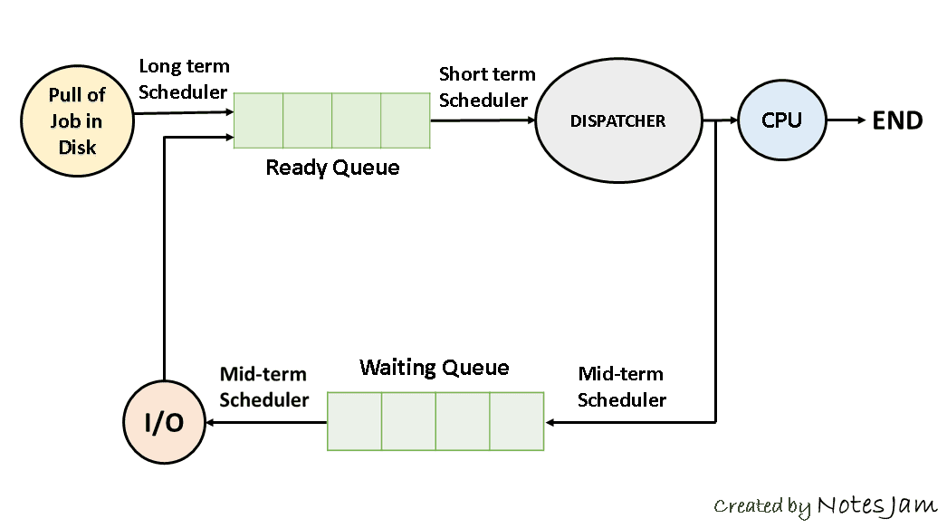
CPU Scheduling Problem…
Simply use a Queue for the processes who are waiting for CPU.
You may also use another Queue for I/O operations. Is it really needed in your case? Well, when will it be compulsory to use the second Queue?

Slide 34
Knowledge Check
1. Application of Queue Data Structure is:-
The resource is shared among multiple consumers.
Data is transferred asynchronously between two processes.
Load Balancing
All of the above
2. Which of the following is NOT a common operation in a queue data structure?
A. Enqueue
B. Dequeue
C. Peek
D. Shuffle
D
???

Slide 35
Circular Queue

Slide 36
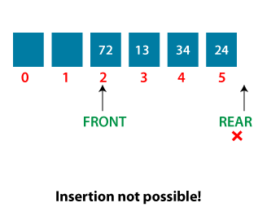
Limitations of Linear Queue
The operations such as insertion and deletion of elements from the middle are time consuming.
If some empty cells occur at the beginning of the queue then we cannot insert new element at the empty space as the rear cannot be further incremented.
On deletion of an element from existing queue,front pointer is shifted to next position. This results into virtual deletion of an element. By doing so memory space which was occupied by deleted element is wasted and hence inefficient memory utilization is occur.
When such scenarios happen? Is this the only one case?

Slide 37
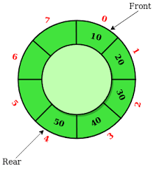
Circular Queue Fundamentals
In a linear queue, dequeue operation causes the starting elements of the array to be empty, and there is no way you can use that space, while in a circular queue, you can effectively use that space.
Attributes are same as Queue
Enqueue (Q, x)
Rear = (Rear + 1) % MAX_SIZE (Capacity)
If Front == -1 then Front = 0 or Front + 1
Dequeue
If Front == Rear then (What does it mean?)
Front = Rear = 0
Else
Front = (Front + 1) % MAX_SIZE
Rear???

Slide 38
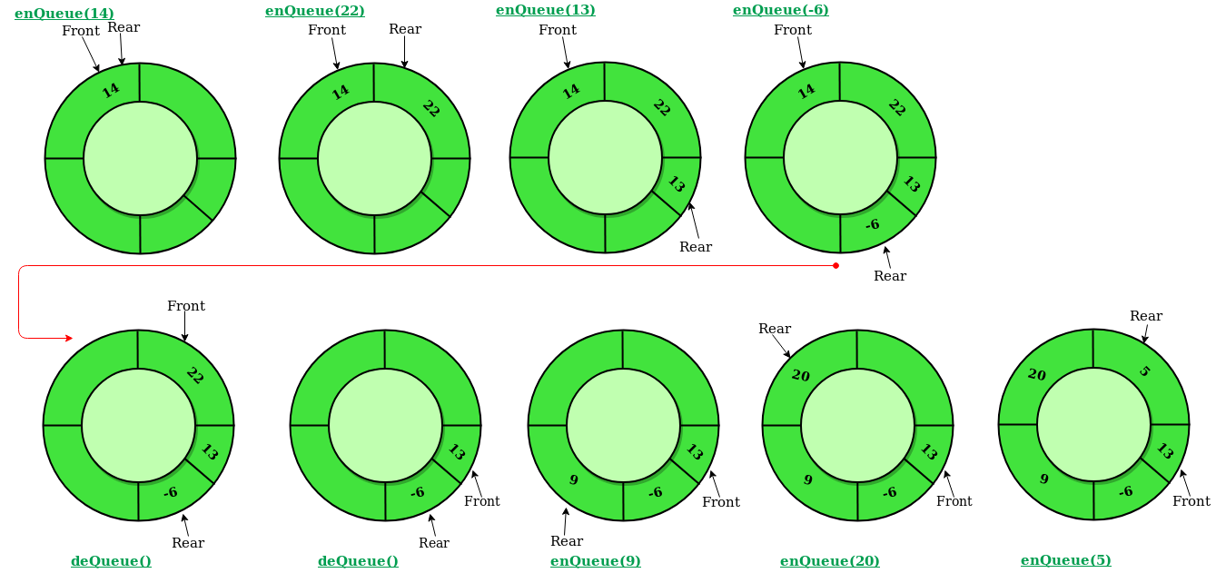
Circular Queue Fundamentals

Slide 39
Underflow and Overflow Conditions
Overflow in Circular Queue
Are Rear and Front both involved in it?
(Rear + 1) % MAX_SIZE == Front
Overflow will arise when the circular queue is full and we try to insert a new element. This happens when the position/index where the new element is to be inserted [(Rear + 1)th position] is the start position, ie., the position with the first element pointed by the front pointer.
Underflow in Circular Queue
Are Rear and Front both involved in it?
Front == -1 && Rear == -1
Underflow will arise when the circular queue is empty and we try to remove an element. This happens when the position/index of both Front and Rear are NULL or -1.
Is Front == -1 a sufficient condition?

Slide 40
Knowledge Check
Which of the following properties is associated with a circular queue?
a) First In Last Out
b) First In First Out
c) Last In First Out
d) Last In Last Out
In a circular queue, how do you increment the rear end of the queue?
a) rear++
b) (rear+1) % CAPACITY
c) (rear % CAPACITY)+1
d) rear–
B
2. ???

Slide 41
Example Problem-1
Suppose a circular queue of capacity (n – 1) elements is implemented with an array of n elements. Assume that the insertion and deletion operation are carried out using REAR and FRONT as array index variables, respectively. Initially, REAR = FRONT = 0. The conditions to detect queue full and queue empty are:
Full: (REAR+1) mod n == FRONT, empty: REAR == FRONT
Full: (REAR+1) mod n == FRONT, empty: (FRONT+1) mod n == REAR
Full: REAR == FRONT, empty: (REAR+1) mod n == FRONT
Full: (FRONT+1) mod n == REAR, empty: REAR == FRONT

Slide 42
Example Problem-2
A standard circular Queue 'q' implemented whose size is 11 from 0 to 10. The front & rear pointers start to point at q[2]. Suppose you have a series of elements to be inserted in the said circular queue. The ninth element be added at which position?
q[0]
q[1]
q[9]
q[10]
How many elements are there before the start of any insertion?

Slide 43
Double Ended Queue
Deque

Slide 44
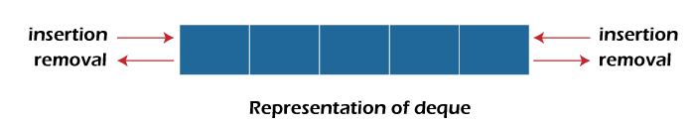
Fundamentals of Deque
Deque stands for Double Ended Queue.
Deque is a linear data structure where the insertion and deletion operations are performed from both ends.
We can say that deque is a generalized version of the queue.
Though the insertion and deletion in a deque can be performed on both ends, it does not follow the FIFO rule.
There are the following operations that can be applied on a deque -
Insertion at front
Insertion at rear
Deletion at front
Deletion at rear
Mainly two types of deque:
Input restricted queue
Output restricted queue

Slide 45
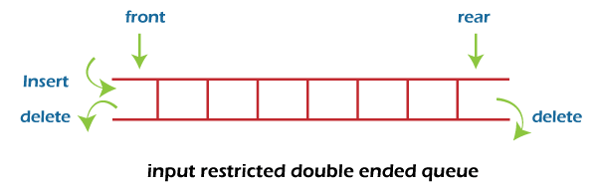
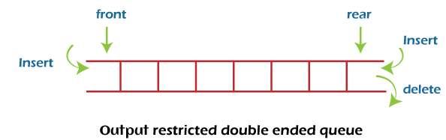
Fundamentals of Dequeue…
In input restricted queue, insertion operation can be performed at only one end, while deletion can be performed from both ends.
In output restricted queue, deletion operation can be performed at only one end, while insertion can be performed from both ends.

Slide 46
Applications of Deque
Palindrome checking: Check if a word or phrase is a palindrome, by comparing the first and last characters, the second and second-to-last characters, and so on.
Graph traversal: Used as an alternative for Breadth-First Search (BFS) on a graph
Multi-level undo/redo functionality: Each time a user performs an action, the current state of the application is pushed onto the deque. When the user undoes an action, the front of the deque is popped, and the previous state is restored. When the user redoes an action, the next state is popped from the deque.
Task scheduler: Deques can be used to implement a task scheduler that keeps track of tasks to be executed. Tasks can be added to the back of the deque, and the scheduler can remove tasks from the front of the deque and execute them.
Hybrid stack and queue: It supports both operations.
K Maximum: next maximum in a subarray (sliding-window-maximum-of-all-subarrays-of-size-k) by using monotonically decreasing deque)

Slide 47
Knowledge Check
1. What is a deque?
a) A queue with insert/delete defined for both front and rear ends of the queue ←
b) A queue implemented with a doubly linked list
c) A queue implemented with both singly and doubly linked lists
d) A queue with insert/delete defined for front side of the queue
2. What are the applications of dequeue?
a) A-Steal job scheduling algorithm
b) Can be used as both stack and queue
c) To find the maximum of all sub arrays of size k
d) All of the mentioned ←

Slide 48
Homework
Theory
Practice

Slide 49
Homeworks
Is there any role/change of Front while inserting an element into the queue? If yes then state the case(s) with suitable examples.
Is there any role/change of Rear while deleting an element from the queue? If yes then state the case(s) with suitable examples.
How many cases exist in queue operations where Front and Rear have the same value? List out all of those and explain the cases.
Write full-proof/intense algorithm for Enqueue and Dequeue operations in Queue. Note- Please ensure that the overflow or underflow conditions are mentioned.
Write the algorithm for Enqueue operation in Circular Queue. Note- Please ensure that the overflow or underflow conditions are mentioned.
Write the algorithm for Dequeue operation in Circular Queue.
List out the limitations of a linear queue. Which data structure overcomes such limitations?
When the memory spaces are wasted in a linear queue? Is there only one case? Write all the conditions.

Slide 50
Conclusions
Summary
Conclusions
Further Reading

Slide 51
Summary
The queue is one of the most common abstract data structures
Understanding how a queue works is trivial
The implementation is only slightly more difficult than that of a stack
Applications include:
Queuing clients in a client-server model
Breadth-first traversals of trees/graphs
CPU Scheduling
Special queues exist to make better utility:
Circular Queue: efficiently use the spaces
Deque: mixed up operations and quick but complex

