Slide 1

(Single) Linked List
Unit-2 Lecture-4
Dr. Dillip Rout, Assistant Professor, Dept. of Computer Science and Engineering

Slide 2
Outline
Fundamentals of Linked List
Representation on Memory
Operations of Single Linked List:
Inserting an element
Searching an element
Deleting an element
Applications of Single Linked List
Homework
Conclusions

Slide 3
Fundamentals of Linked List

Slide 4
Overview
Linked List or Singly Linked List is a linear data structure
It is allocated dynamically.
It does not have fixed size.
Elements are randomly stored in memory. All the elements of Linked List are non-contiguously stored in the memory but logically those are sequenced. In fact, the elements are linked together with the help of pointers/reference.
It only allows sequential traversal.
Why???
Limitations of Array / Dynamic array: need contiguous memory. May not available always and/or not properly utilized.
The list is not required to be contiguously present in the memory. The element can reside anywhere in the memory and linked together to make a list. This achieves optimized utilization of space.
List size is limited to the memory size and doesn't need to be declared in advance.
Empty node can not be present in the linked list.

Slide 5

Linked List in Real-life
Conga Line
The conga line is a novelty line dance that was derived from the Cuban carnival dance of the same name and became popular in the US and UK during the first half of the 20th century.
In order to perform the dance, dancers form a long, processing line
How would one replace someone?

Slide 6
Linked List in Real-life…
Scavenger Hunt
You have a clue, and that clue has a pointer to place to find the next clue.
So you go to the next place and get another piece of data, and another pointer.
To get something in the middle, or at the end, the only way to get to it is to follow this list from the beginning (or to cheat ;) )

Slide 7
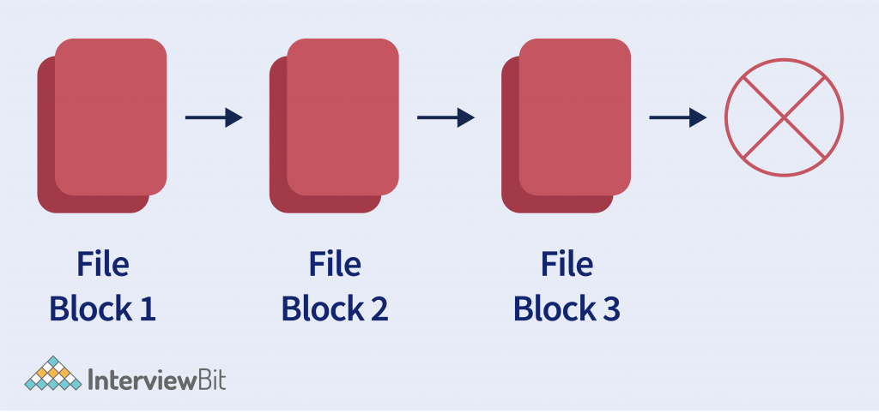
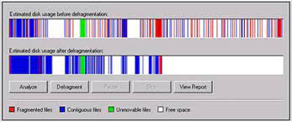
Linked List in Computer
Dynamic memory allocation: We use a linked list of free blocks.
Defragmentation of memory disk.

Slide 8
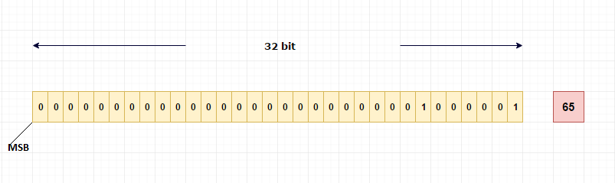
Linked List in Computer…
Large Integers > 2^32
May require more than one word
Memory words are linked

Slide 9
Attributes
Linked List can be defined as collection of objects/elements called nodes that are randomly stored in the memory.
Node: A node contains two fields i.e. data stored at that particular address and the pointer/reference which contains the address of the next node in the memory.
Data field: can be of any type and it holds the actual data.
Pointer: it must be a pointer type (???) and it does not have data, rather metadata.
Head: Always points to the first node. What if the list is empty?
Tail (optional): Always points to the last node. What if the list is empty?
Size??? NULL???

Slide 10
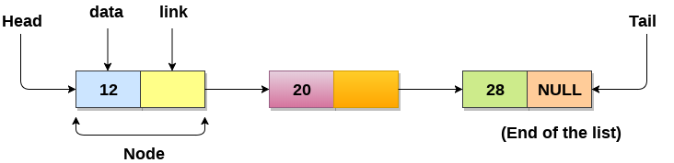
Visualization of Singly Linked List
A node contains two fields i.e. data stored at that particular address and the pointer which contains the address of the next node in the memory.
The last node of the list contains pointer to the NULL. Sometimes this NULL is considered as a sentinel/end.

Slide 11
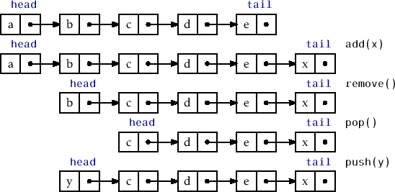
Operations on Linked List
Native:
Insertion (Add)
Deletion (Remove)
Search/Find
Auxiliary:
Display
Head/First
Tail/Last
Is there only one way to insert?
Is there only one way to delete?

Slide 12
Example of Operations
Create a linked list and do the following operations.
Insert elements:
5, 10, 15
What is the value of Head?
25 after 5
30 before 5
Delete elements:
10
What is the value of Head?
15
How many elements are remaining?
30
5, 25
Create a linked list and do the following operations.
Insert elements:
B, D, E
What is the value of Head?
C after B
A before B
Delete elements:
A, B
What is the value of Head?
E, D, C
How many elements are remaining?

Slide 13
Usages of Linked List
It is used to implement stacks and queues which are like fundamental needs throughout computer science.
To prevent the collision between the data in the hash map, we use a singly linked list.
We can think of its use in a photo viewer for having look at photos continuously in a slide show (only forward).
In the system of train, the idea is like a singly linked list, as if you want to add a Boggie, either you have to take a new boggie to add at last or you must spot a place in between boggies and add it. It can be used for simulation.
GPS navigation systems- Linked lists can be used to store and manage a list of locations and routes, allowing users to easily navigate to their desired destination.
Robotics- Linked lists can be used to implement control systems for robots, allowing them to navigate and interact with their environment.

Slide 14
Operations

Slide 15
Insertion Cases
Inserting at the beginning/start
Inserting at the last/end
Inserting at the middle
Before a node
After a node
In all these cases, we need to know:
Algorithms
Updates/Movement of pointers
Search Requirements

Slide 16
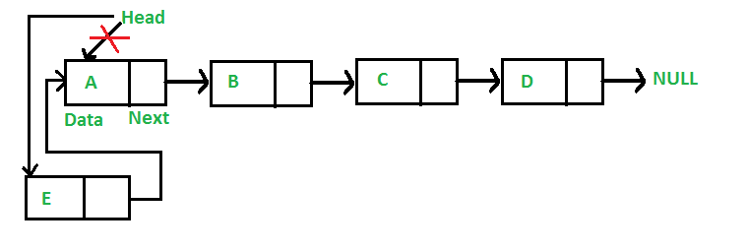
Insert at Start
Algorithm Insert (Head, x: value)
Let/Create n be the new node
n.value = x
n.next = Head
Head=n

Slide 17
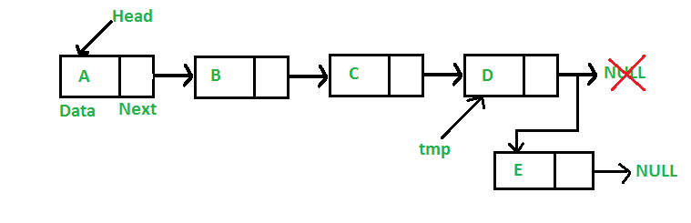
Insert at End
Algorithm Insert (Head, x: value)
Let/Create n be the new node
n.value = x, n.next = NULL
Let itr = Head
while itr.next != NULL
itr = itr.next
itr.next = n
Can you write an algorithm to traverse in a linked list?

Slide 18
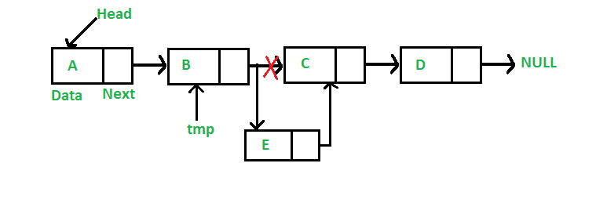
Insert in Middle
Algorithm Insert (Head, x: value, nodeVal: element value ) AFTER A NODE
Let/Create n be the new node
n.value = x
Let itr = Head
while itr.next != NULL
if itr.value == nodeVal then
n.next = itr.next
itr.next = n
exit
itr = itr.next
After B

Slide 19
Deletion
Deleting at the beginning/start
Deleting at the last/end
Deleting at the middle
Before a node
After a node
In all these cases, we need to know:
Algorithms
Updates/Movement of pointers
Search Requirements

Slide 20
Searching in Linked List
Classwork: Q. Write the algorithm for search a given element. You may assume any number of elements present in the Linked List. However, you need to take care of the cases like (i) empty list (ii) failure: the element may not present (iii) success: the element is present, you need to display its position count from the start.
Search:
12
28
30
20
50

Slide 21
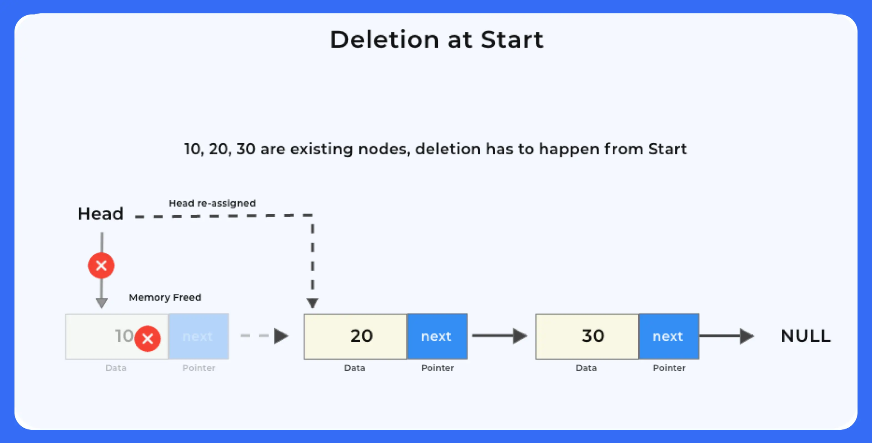
Delete at Start
Algorithm Delete (Head)
if Head == NULL then
Print “The list is empty”
tmp = Head
Head = Head.next
Delete tmp or Free(tmp)
exit

Slide 22
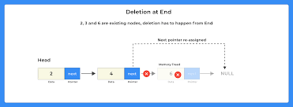
Delete at End
Algorithm Delete (Head)
if Head == NULL then
Print “The list is empty”
else if Head.next == NULL then
tmp = Head
Head = Head.next
Delete tmp
else
Let itr = Head
while itr.next.next != NULL
itr = itr.next
tmp = itr.next
itr.next = NULL
Delete tmp
Which line is showing the case of only one element in the list?

Slide 23
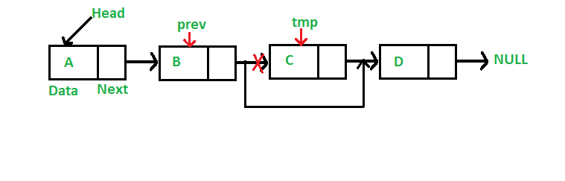
Delete in Middle
Algorithm Delete (Head, x: value) [After B]
Let itr = Head
while itr.next != NULL
if itr.value == x then
itr.next = itr.next.next
tmp = itr.next
Delete tmp
exit
itr = itr.next
Can you write an algorithm to delete before a specific node?
Can you write an algorithm to delete a specific node?

Slide 24
Representation
Define
Underflow
Overflow
Knowledge Check

Slide 25
Define
Linked List can be defined by allocating memory dynamically.
Uses of pointer/reference are important.
Any data of the linked list is represented as a node.
A node contains two fields i.e. data stored at that particular node and the pointer/reference which contains the address of the next node.
Data field: can be of any type and it holds the actual data.
Pointer: it must be a pointer type (???) and it does not have data, rather metadata.
Head: A special pointer that always points to the first node.
Tail (optional): A special pointer that always points to the last node. What if the list is empty?
Size: Not an attribute of Linked List.

Slide 26
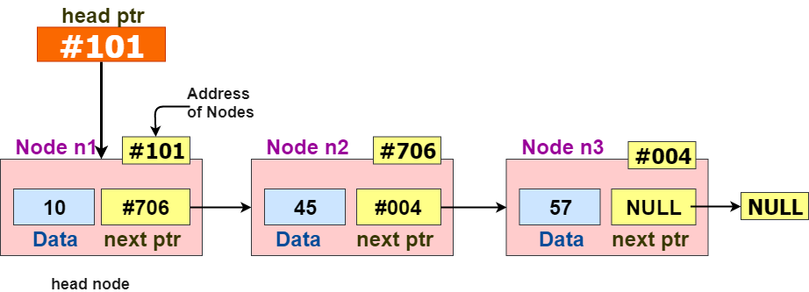
Implementation using Pointers
Node is implemented using a structure or class, and the pointer of node is a self-referential pointer.

Slide 27
Linked List Underflow vs Overflow (Phenomenon)
Overflow
Occurs while doing insertion operations
Happens if the the memory is full and new node cannot be created
Condition:
NewNode == NULL (whole node is null)
Is there any change required in Insertion operation?
Underflow
Occurs while doing deletion operations
Happens if the list is empty
Condition:
Head == NULL
Is there any change required in Deletion operation?

Slide 28
Knowledge Check
What is the optimal time complexity to count the number of nodes in a linked list?
a) O(1)
b) O(n)
c) O(logn)
d) O(n^2)
Which of these is not an application of a linked list?
a) To implement file systems
b) For separate chaining in hash-tables
c) To implement non-binary trees
d) Random Access of elements
3. Let P be a singly linked list, Let Q be the pointer to an intermediate node x in the list.What is the worst-case time complexity of the best known algorithm to delete the node x from the list?
a) O(1)
b) O(n)
c) O(logn)
d) O(n^2)

Slide 29
Example Problem-1
Consider the problem of reversing a singly linked list. To take an example, given the linked list below before and after reversing:
How to reverse it? What is the time complexity of the best algorithm?

Slide 30
Example Problem-2
void funx1(struct node* head)
{
if (head == NULL)
return;
funx1 (head -> next) ;
printf (" %d ", head -> data ) ;
}
What is the function doing?
It will print all the nodes of linked lists.
It will print all the nodes of the linked list in reverse order.
It will print alternate nodes of the Linked List
It will print alternate nodes in reverse order

Slide 31
Homework
Theory
Practice

Slide 32
Homework
Is there any size constraint on Linked List? Justify your answer.
Write an algorithm for searching in a Linked List.
What is the datatype of Head and Tail? Is it necessarily be the same as nodes?
Suppose there are 10 elements in a Linked List. How many pointers are there? What if there are n elements?
How to count the number of nodes in a Linked List?
Suppose you are asked to design a Linked List so that it uses indices to reach out the nodes. State what are the data structures needed for it. Write an algorithm to implement such a Linked List.
Suppose you are working on a computer which does not support pointers, i.e., you cannot access the memory locations. Then, how do you implement Linked List in this case? Write algorithms for insertion and deletion operations on Linked List.
How many types of deletions are possible in Linked List? State those with the help of examples.
Compare insertion operation of Linked List with Stack and Queue. Discuss the similarity and differences with the help of examples.
Write an algorithm for inserting an element in the middle after a specific given element (a value). Demonstrate it with various cases through appropriate figure(s). What if the value is not found?
Write an algorithm to find maximum and minimum in a Linked List. How many iterations you need?
Write an algorithm to merge two lists.
Write an algorithm to split a list into two lists.

Slide 33
Conclusion

