Slide 1

Doubly Linked List
Unit-2 Lecture-5
Dr. Dillip Rout, Assistant Professor, Dept. of Computer Science and Engineering

Slide 2
Outline
Fundamentals of Doubly Linked List
Representation on Memory
Operations of Doubly Linked List:
Inserting an element
Searching an element
Deleting an element
Homework
Conclusions

Slide 3
Fundamentals of Doubly Linked List

Slide 4
Overview
Doubly Linked List is a linear data structure.
It is allocated dynamically.
It does not have fixed size.
Elements are randomly stored in memory. All the elements of Doubly Linked List are non-contiguously stored in the memory but logically those are sequenced. In fact, the elements are linked together with the help of pointers/reference.
It only allows sequential traversal on both directions.
Why???
Array / Dynamic array: need contiguous memory. May not available always and/or not properly utilized.
Limitations of Singly Linked List is that it can be only be traversed in one direction.

Slide 5
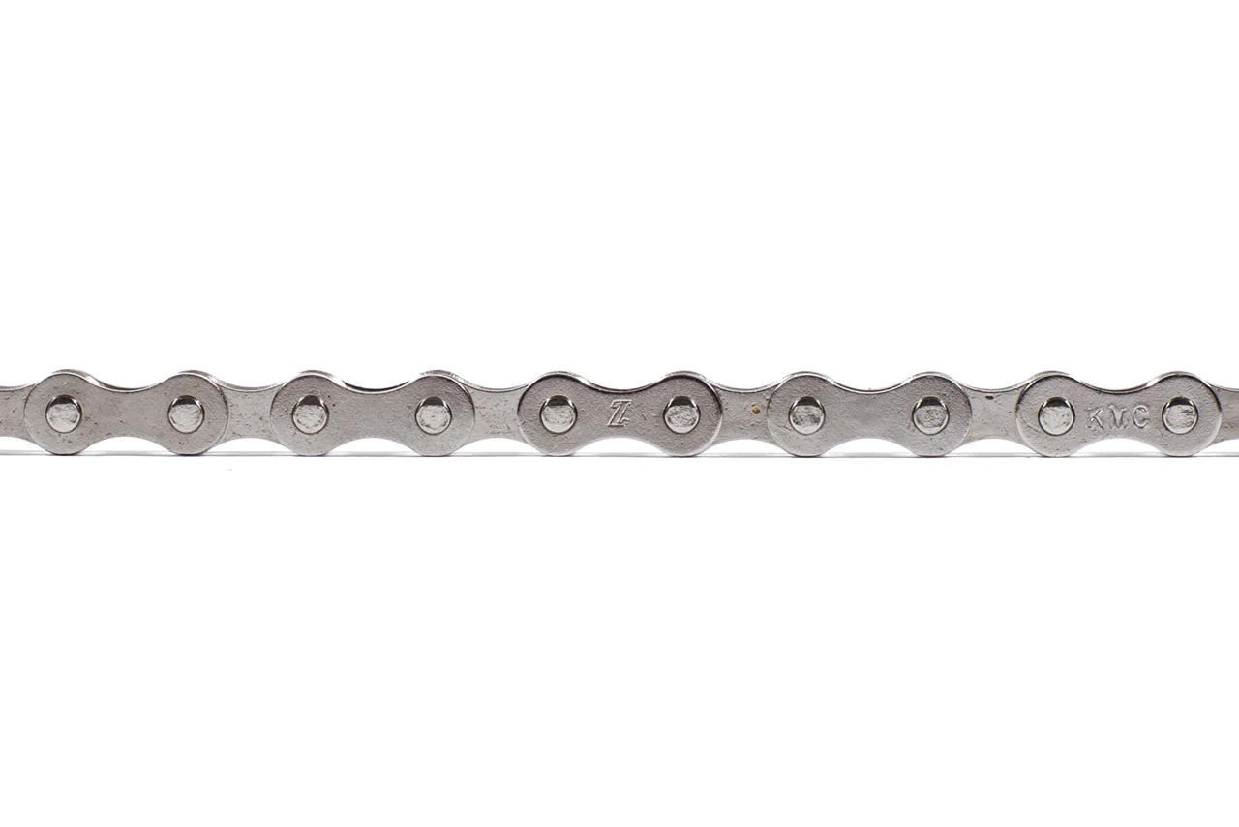
Doubly Linked List in Real-life…
Bicycle Chain
The units of the chain are connected to each other.
Assume only forward direction for realizing a linked list.
If you want to replace some units then you can do it in the middle by disassembling and reassembling.
Will it be still a linked list if you just reverse the direction?

Slide 6
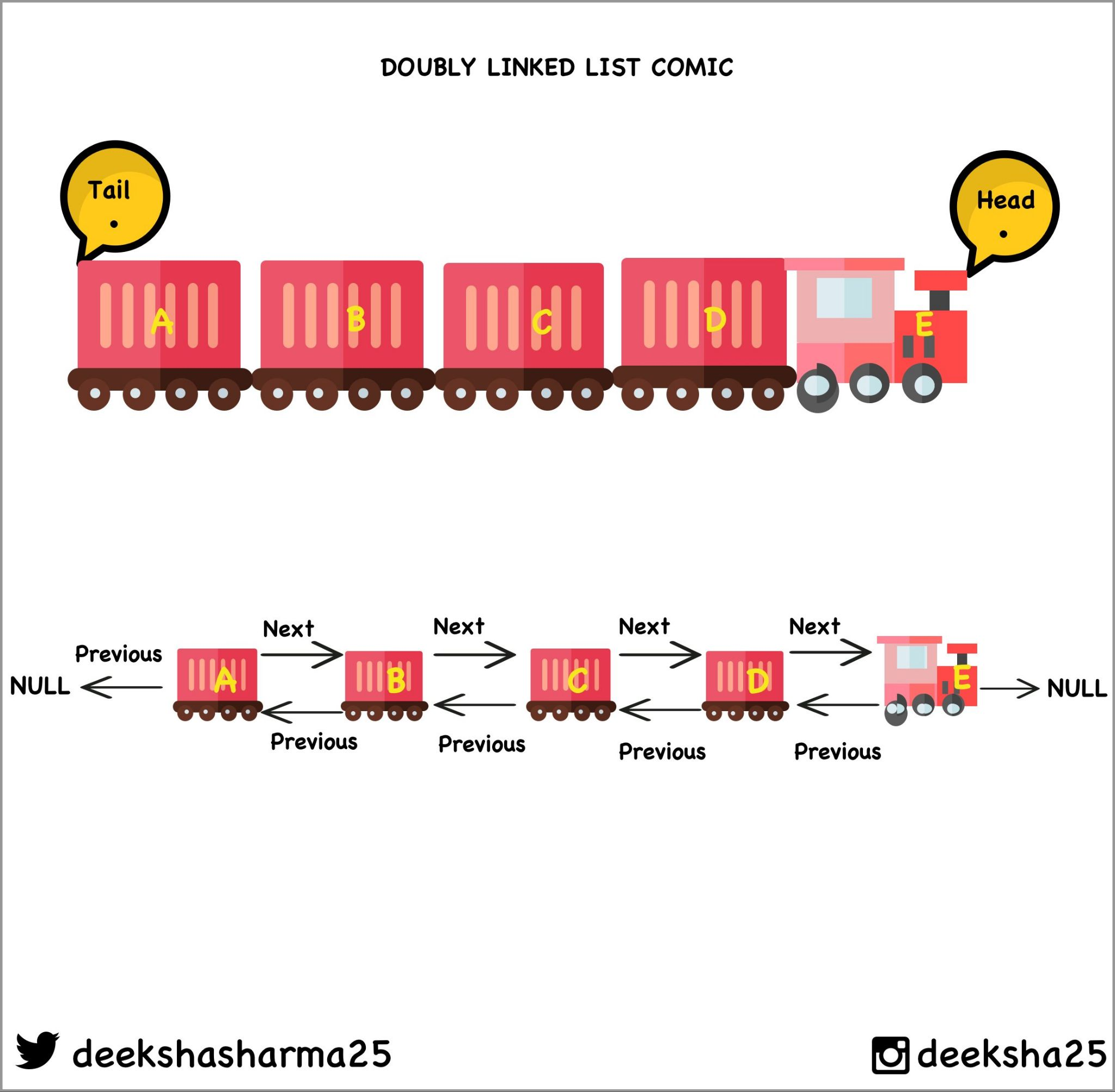
Doubly Linked List in Real-life…
Train
The buggies of the chain are connected to each other.
Assume only forward direction for realizing a linked list.
If you want to replace some units then you can do it in the middle by disassembling and reassembling.
Will it be still a linked list if you just reverse the direction?

Slide 7


Doubly Linked List in Computers
While browsing you may navigate forward and backward.
The addresses of these can be stored in a doubly linked list that makes the navigation easier.
A similar thought can be realized about the music players on a computer or digital devices.

Slide 8
Attributes
Doubly Linked List can be defined as collection of objects/elements called nodes that are randomly stored in the memory having forward and backward traversal facility.
Node: A node contains three fields i.e. data stored at that particular address, and a forward pointer/reference and a backward pointer/reference.
Data field: can be of any type and it holds the actual data.
Forward Pointer: it must be a pointer type and point to the next node*.
Backward Pointer: it must be a pointer type and point to the previous node*.
Head: Always points to the first node. What if the list is empty?
Tail (optional): Always points to the last node. What if the list is empty?
Size??? NULL???

Slide 9
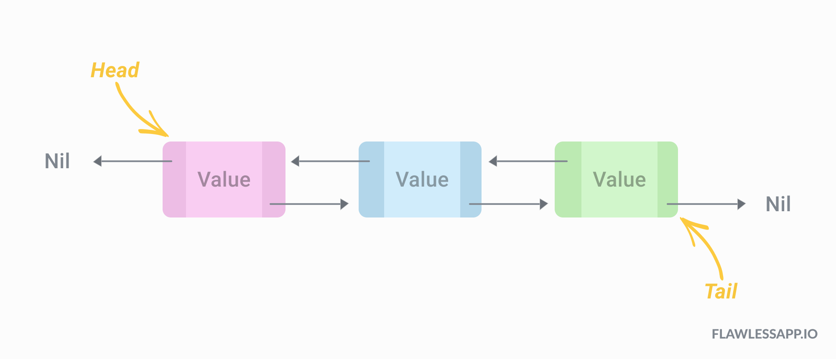
Visualization of Doubly Linked List
The last node of the list contains pointer to the NULL. Sometimes this NULL is considered as a sentinel/end.
Is tail necessary here? If yes then in which operation(s)?

Slide 10
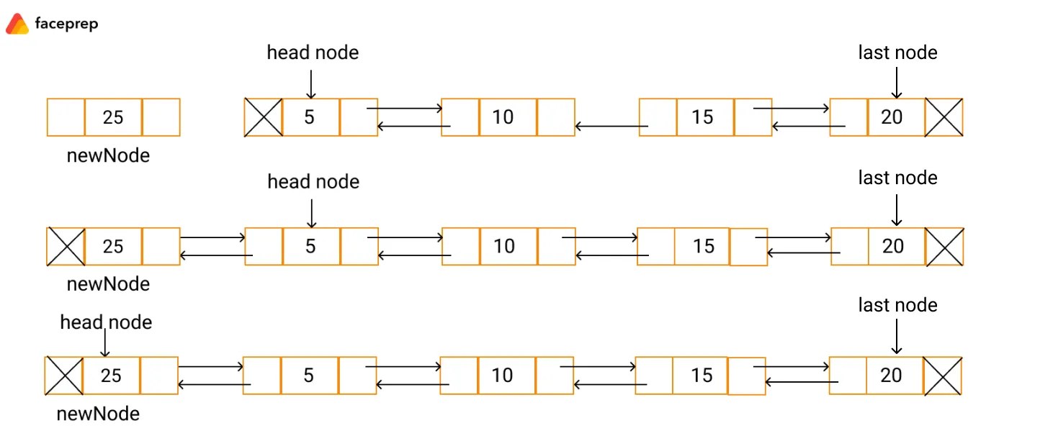
Operations on Doubly Linked List
Native:
Insertion (Add)
Deletion (Remove)
Search/Find
Auxiliary:
Display
Head/First
Tail/Last
Is there only one way to insert?
Is there only one way to delete?

Slide 11
Example of Operations
Create a doubly linked list and do the following operations.
Insert elements:
5, 10, 15
What is the value of Head?
25 after 5
30 before 5
Delete elements:
10
What is the value of Head?
15
How many elements are remaining?
30
5, 25
Create a doubly linked list and do the following operations.
Insert elements:
B, D, E
What is the value of Head?
C after B
A before B
Delete elements:
A, B
What is the value of Head?
E, D, C
How many elements are remaining?

Slide 12
Usages of Doubly Linked List
Navigation systems where front and back navigation is required.
In browser to implement backward and forward navigation of visited web pages that is a back and forward button.
Used to represent a classic game deck of cards.
It is also used by various applications to implement undo and redo functionality.
Constructing MRU/LRU (Most/least recently used) cache.
Other data structures like stacks, Hash Tables, Binary trees can also be constructed or programmed using a doubly-linked list.
Also in many operating systems, the thread scheduler maintains a doubly-linked list of all processes running at that time.

Slide 13
Operations

Slide 14
Insertion Cases
Inserting at the beginning/start
Inserting at the last/end
Inserting at the middle
Before a node
After a node
In all these cases, we need to know:
Algorithms
Updates/Movement of pointers
Search Requirements

Slide 15
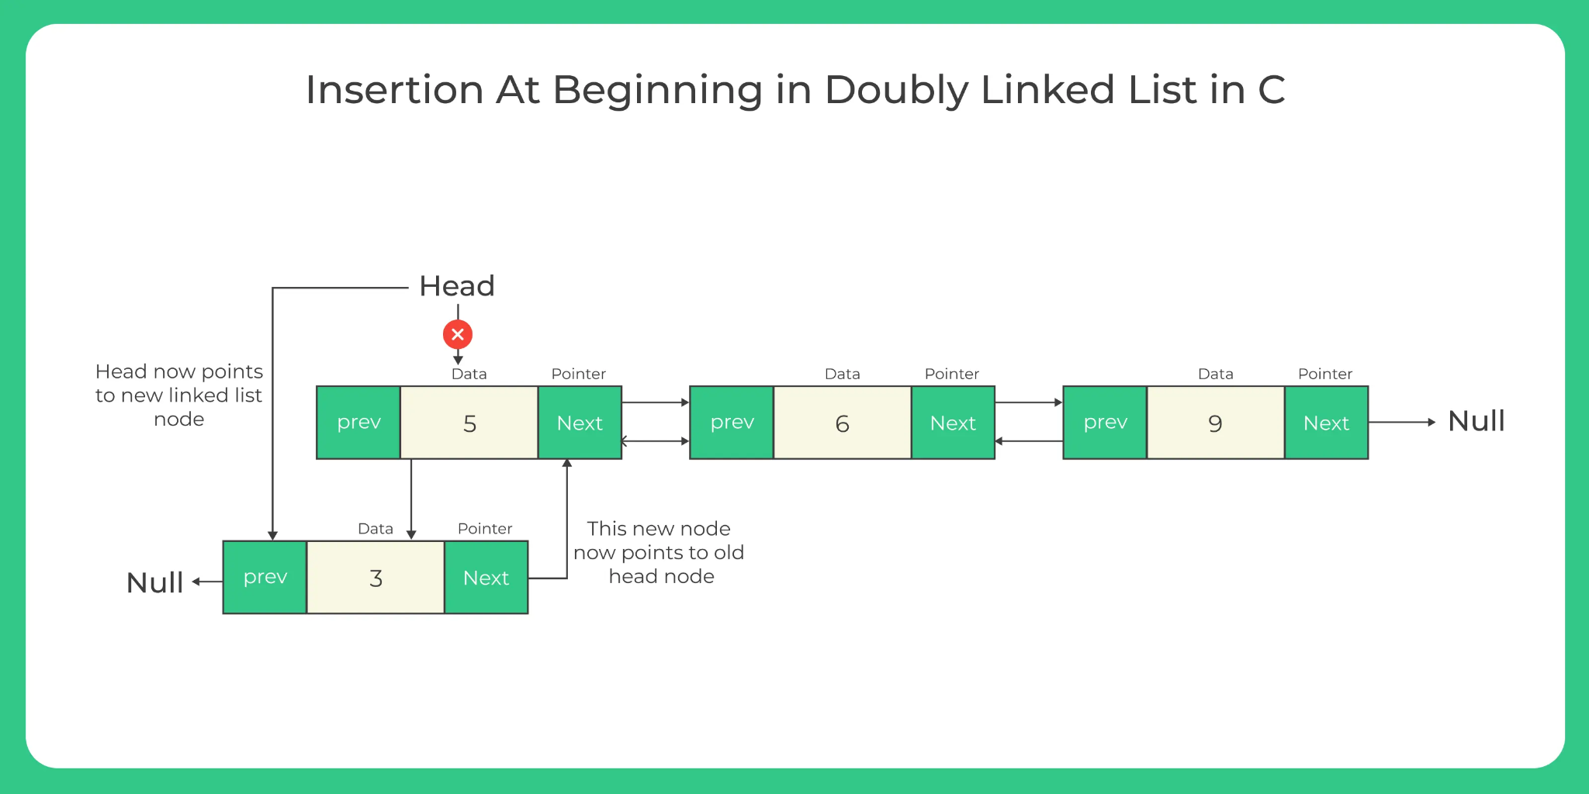
Insert at Start
Algorithm Insert (Head, x: value)
Let/Create n be the new node
n.value = x
n.next = Head
n.prev = NULL
Head=n
Which line differs from singly linked list?

Slide 16
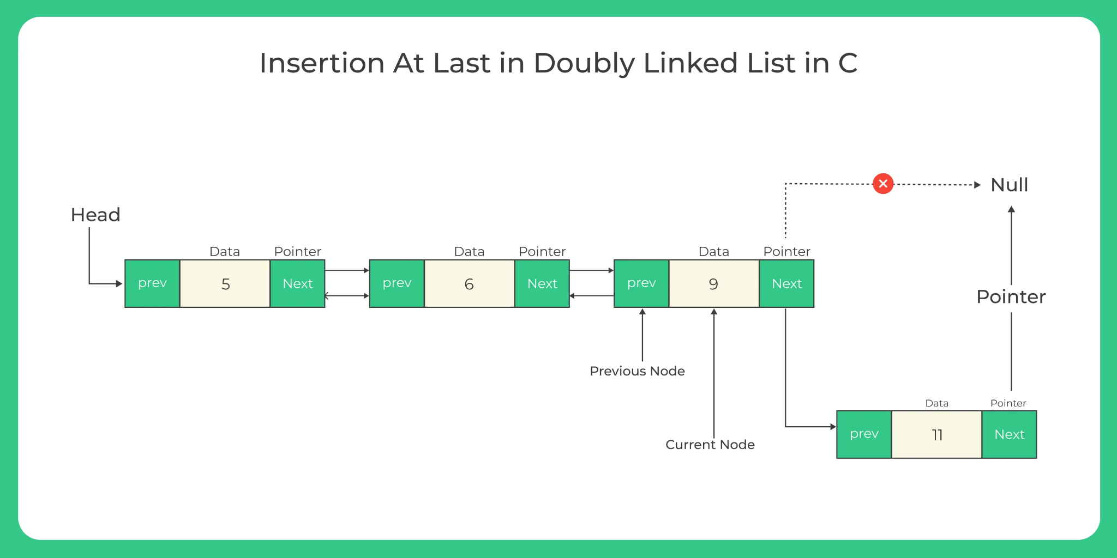
Insert at End
Algorithm Insert (Head, x: value)
Let/Create n be the new node
n.value = x, n.next = NULL
Let itr = Head
while itr.next != NULL
itr = itr.next
itr.next = n
n.prev = itr
Which line differs from singly linked list?
Can you write an algorithm to traverse in a doubly linked list?

Slide 17
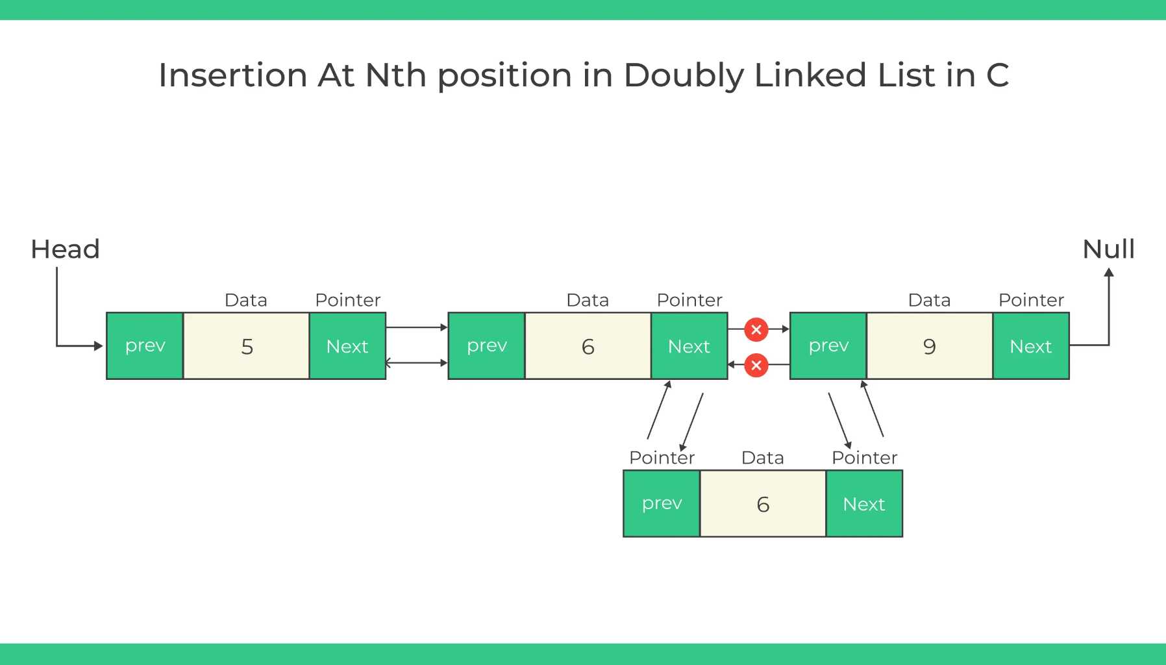
Insert in Middle
Algorithm Insert (Head, x: value, nodeVal: element value ) AFTER A NODE
Let/Create n be the new node
n.value = x
Let itr = Head
while itr.next != NULL
if itr.value == nodeVal then
n.next = itr.next
n.prev = itr
itr.next.prev = n What???
exit
itr = itr.next
After 6
How many pointers are changing? Is it guaranteed to change?

Slide 18
Deletion
Deleting at the beginning/start
Deleting at the last/end
Deleting at the middle
Before a node
After a node
In all these cases, we need to know:
Algorithms
Updates/Movement of pointers
Search Requirements

Slide 19
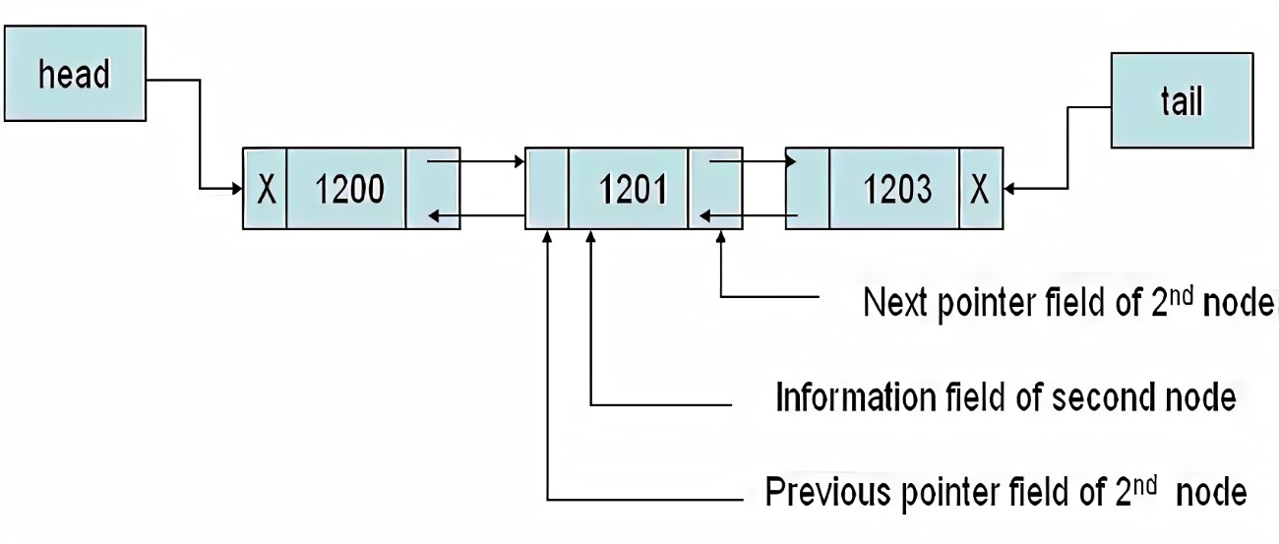
Searching in Doubly Linked List
Classwork: Q. Write the algorithm for search a given element. You may assume any number of elements present in the Linked List. However, you need to incorporate the cases like (i) empty list (ii) failure: the element may not present (iii) success: the element is present, you need to display its position count from the start.
Search:
1200
1203
3000
1201
2500

Slide 20
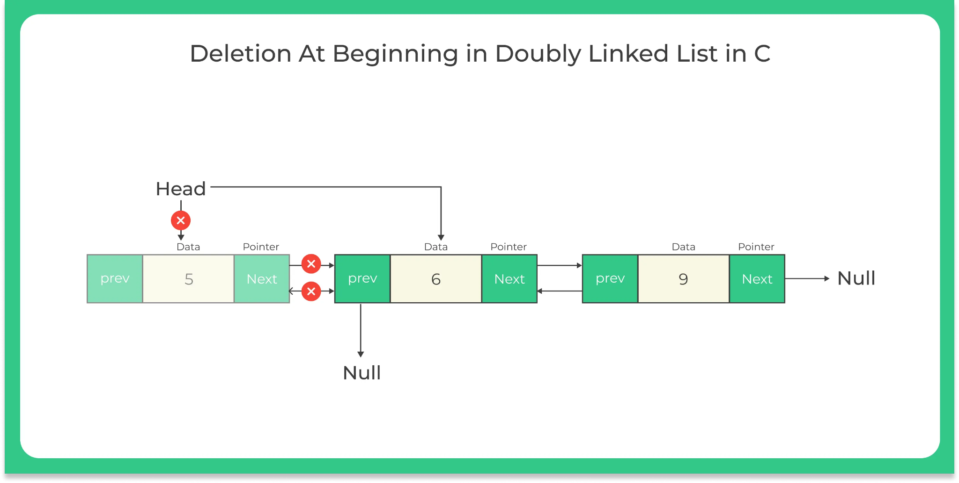
Delete at Start
Algorithm Delete (Head)
if Head == NULL then
Write “The list is empty”
tmp = Head
Head = Head.next
Head.next.prev = NULL
Delete tmp or Free(tmp)
exit

Slide 21
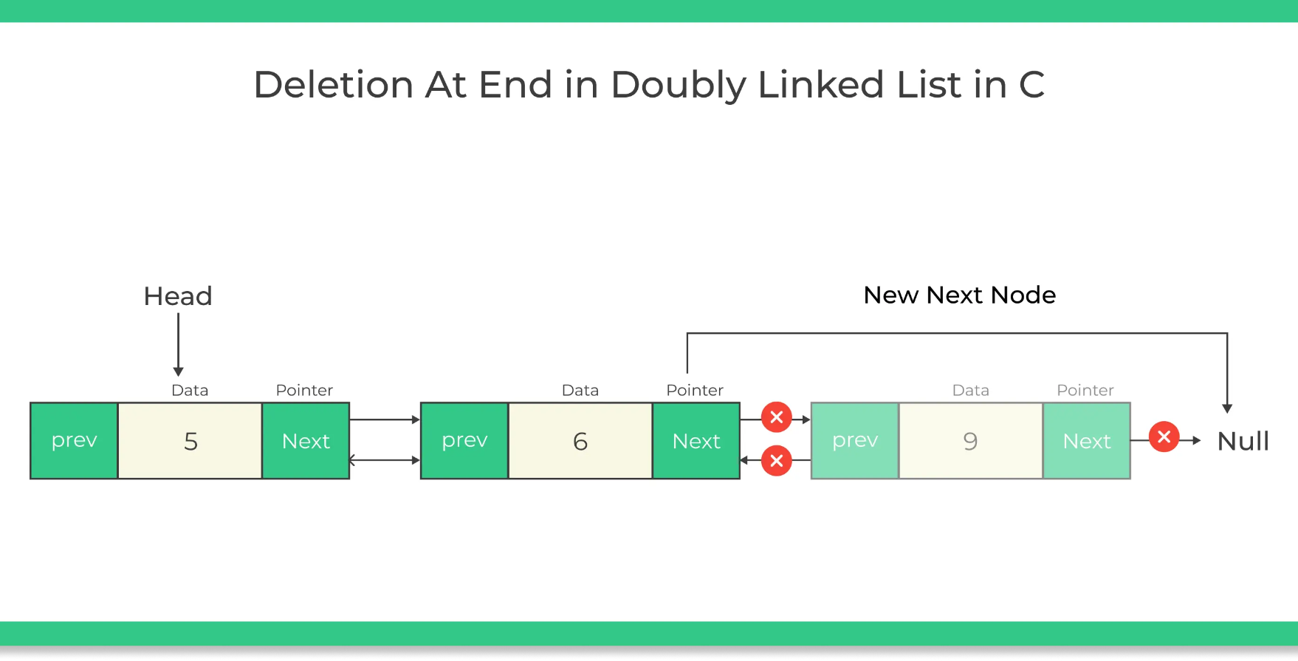
Delete at End
Algorithm Delete (Head)
if Head == NULL then
Write “The list is empty”
else if Head.next == NULL then
tmp = Head
Head = Head.next Alternative???
Delete tmp
Let itr = Head
while itr.next.next != NULL
itr = itr.next
tmp = itr.next
itr.next = NULL
Delete tmp
exit
Which line is showing the case of only one element in the list?

Slide 22
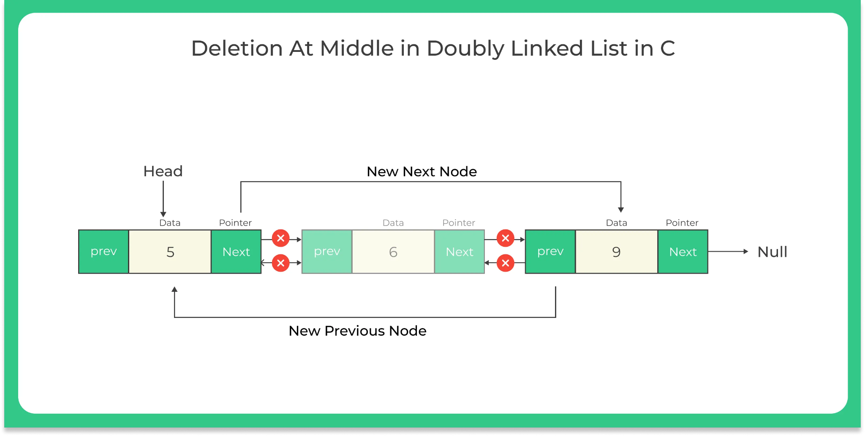
Delete in Middle
Algorithm Delete (Head, x: value) [After 5]
Let itr = Head
while itr.next != NULL
if itr.value == x then
tmp = itr.next
ptr = tmp.next
ptr.prev = itr
itr.next = ptr
Delete tmp
exit
itr = itr.next
Can you write an algorithm to delete before a specific node?
Can you write an algorithm to delete a specific node or after a count?

Slide 23
Generic Deletion Algorithm
Can you design a generic algorithm for deleting a node in a doubly linked list? The value of the node or its position will be given. It must handle any cases like deletion at the start, end, middle, etc.
Your algorithm must be efficient, unambiguous and most importantly short and the lines are not repetitive.

Slide 24
Representation on Memory
Define
Underflow
Overflow
Knowledge Check

Slide 25
Define
Doubly Linked List can be defined by allocating memory dynamically.
Uses of pointer/reference are important.
Any data in the linked list is represented as a node.
A node contains three fields i.e. data stored at that particular node, and a forward (next) pointer and a backward (previous) pointer to store the address of the next node and previous node respectively.
Data field: can be of any type and it holds the actual data.
The pointers are initially NULL by default.
Head: A special pointer that always points to the first node.
Tail (optional): A special pointer that always points to the last node. What if the list is empty? Is it important in Doubly Linked List?
Size: Not an attribute of Linked List.

Slide 26
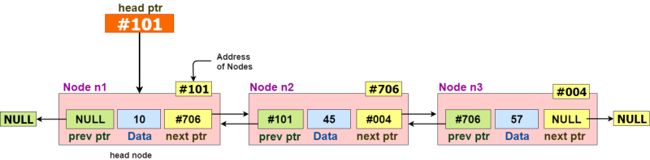
Implementation
Where the tail pointer can be placed? What is its value?

Slide 27
Doubly Linked List Underflow vs Overflow
Overflow
Occurs while doing insertion operations
Happens if the the memory is full and new node cannot be created
Condition:
NewNode == NULL (whole node is null)
Is there any change required in Insertion operation?
Is it different from singly linked list?
Underflow
Occurs while doing deletion operations
Happens if the list is empty
Condition:
Head == NULL
Is there any change required in Deletion operation?
Is it different from singly linked list?

Slide 28
Knowledge Check
1. Which of the following is false about a doubly linked list?
a) We can navigate in both the directions
b) It requires more space than a singly linked list
c) The insertion and deletion of a node take a bit longer
d) Implementing a doubly linked list is easier than singly linked list
Ans- D
2. What is a memory efficient doubly linked list?
a) Each node has only one pointer to traverse the list back and forth
b) The list has breakpoints for faster traversal
c) An auxiliary singly linked list acts as a helper list to traverse through the doubly linked list
d) A doubly linked list that uses bitwise AND operator for storing addresses
Ans- ???
Notes:
Explanation: Memory efficient doubly linked list has only one pointer to traverse the list back and forth. The implementation is based on pointer difference. It uses bitwise XOR operator to store the front and rear pointer addresses. Instead of storing actual memory address, every node store the XOR address of previous and next nodes.

Slide 29
Example Problem-1
Let SLLdel be a function that deletes a node in a singly-linked list given a pointer to the node and a pointer to the head of the list. Similarly, let DLLdel be another function that deletes a node in a doubly-linked list given a pointer to the node and a pointer to the head of the list.
Let n denote the number of nodes in each of the linked lists. Which one of the following choices is TRUE about the worst-case time complexity of SLLdel and DLLdel?
SLLdel is O(1) and DLLdel is O(n)
Both SLLdel and DLLdel is O(logn)
Both SLLdel and DLLdel is O(1)
SLLdel is O(n) and DLLdel is O(1)

Slide 30
Example Problem-2
void fun(struct node **head_ref)
{ struct node *temp = NULL;
struct node *current = *head_ref;
while (current != NULL) {
temp = current->prev; current->prev = current->next;
current->next = temp; current = current->prev;
}
if(temp != NULL )
*head_ref = temp->prev;
}
Consider that reference head of the Doubly Linked List is passed to the above function as (1<->2<->3<->4<->5<->6). Which of the following is a modified, linked list after the function call?
2 <-> 1 <-> 4 <-> 3 <-> 6 <->5
5 <-> 4 <-> 3 <-> 2 <-> 1 <->6
6 <-> 5 <-> 4 <-> 3 <-> 2 <-> 1
6 <-> 5 <-> 4 <-> 3 <-> 1 <-> 2

Slide 31
Homework

Slide 32
Homework
Write the advantages and disadvantages of Doubly Linked List.
Compare Singly Linked List and Doubly Linked List. Illustrate the difference on various grounds.
How many pointers are changing if you are deleting a node in the middle of a Doubly Linked List? Showcase with an example.
Write an algorithm to find maximum and minimum in a Doubly Linked List. How many iterations you need?
Write an algorithm to merge two Doubly Linked Lists.
Write an algorithm to split a Doubly Linked List into two Singly Linked Lists. Assume that you are having the series of numbers from 1 to N. The first Singly Linked List will have all the odd numbers whereas the second Singly List will have all the even numbers.
Is splitting helping in operations on those numbers?
Construct a memory efficient Doubly Linked List by using only a single pointer per node and XOR operator. Write algorithm for doing the following operations on that List.
Insert elements
Search elements
Delete elements

Slide 33
Conclusions

