Slide 1

Circular Linked List
Unit-2 Lecture-6
Dr. Dillip Rout, Assistant Professor, Dept. of Computer Science and Engineering

Slide 2
Outline
Fundamentals of Circular Linked List
Representation on Memory
Operations on Circular Linked List:
Inserting an element
Searching an element
Deleting an element
Homework
Conclusions

Slide 3
Fundamentals of Circular Linked List

Slide 4
Overview
Circular Linked List or Circular Singly Linked List is a linear data structure
It is allocated dynamically. It does not have fixed size.
Elements are randomly stored in memory. All the elements of Linked List are non-contiguously stored in the memory but logically those are sequenced.
In fact, the elements are linked together with the help of pointers/reference.
The last element in the list points to the first element of the list.
It only allows sequential traversal.
Why???
Memory: One Head will do the work, no need of Tail pointer.
Application: Implementing Circular Queue or Round Robin Scheduling where the processes have different burst time.

Slide 5
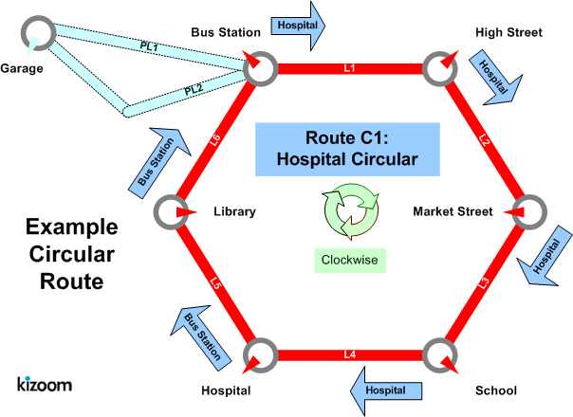
Circular Linked List in Real-life
The buses on this route start from a stop and end on the same stop.
The stops on the route are contiguous.
The shape may not be exactly circular but the loop is important.

Slide 6
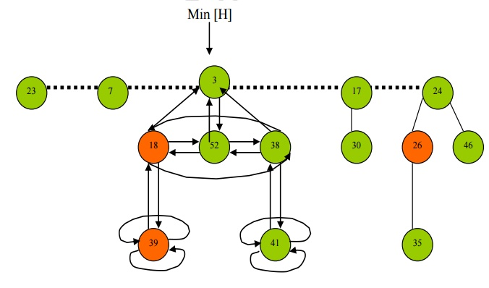
Circular Linked List in Computer
Dynamic memory allocation for Fibonacci Heap that has circular motion at some levels.
Fibonacci heap is a data structure for priority queue operations, consisting of a collection of heap-ordered trees.
It is called a fibonacci heap because the trees are constructed in a way such that a tree of order n has at least Fn+2 nodes in it, where Fn+2 is the (n + 2)th Fibonacci number.
All tree roots are connected using a circular doubly linked list, so all of them can be accessed using a single 'min' pointer.
It has a better amortized running time than many other priority queue data structures including the binary heap and binomial heap.

Slide 7
Attributes
Circular Linked List can be defined as collection of objects/elements called nodes that are randomly stored in the memory.
Node: A node contains two fields i.e. data stored at that particular address and the pointer/reference which contains the address of the next node in the memory.
Data field: can be of any type and it holds the actual data.
Pointer: it must be a pointer type (???) and it does not have data, rather metadata.
Head: Always points to the first node.
The last node points to the first node.
Tail???

Slide 8
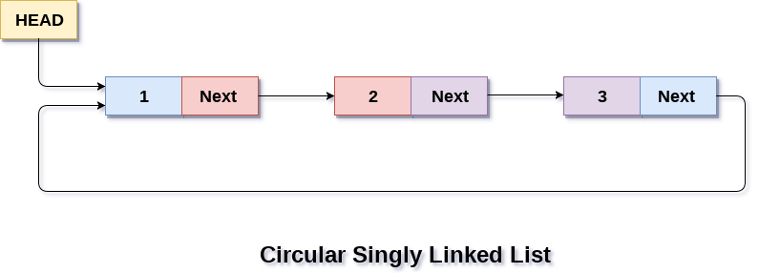
Visualization of Circular Linked List
A node contains two fields as Singly Linked List.
The last node does not point to NULL, rather to the first node

Slide 9
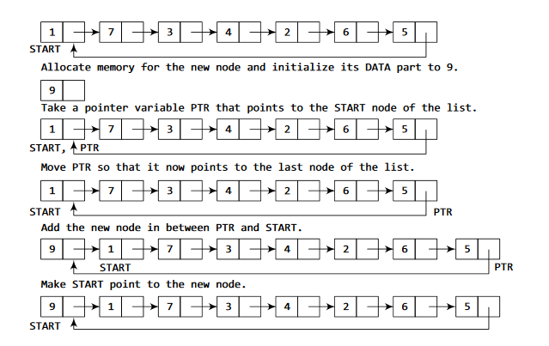
Operations on Linked List
Native:
Insertion (Add)
Deletion (Remove)
Search/Find
Auxiliary:
Display
Head/First
Is there only one way to insert?
Is there only one way to delete?

Slide 10
Example of Operations
Create a circular linked list and do the following operations.
Insert elements:
5, 10, 15
What is the value of Head?
25 after 5
30 before 5
Delete elements:
10
What is the value of Head?
15
How many elements are remaining?
30
5, 25
Create a circular linked list and do the following operations.
Insert elements:
B, D, E
What is the value of Head?
C after B
A before B
Delete elements:
A, B
What is the value of Head?
E, D, C
How many elements are remaining?

Slide 11
Usages of Circular Linked List
Circular lists are used in applications where the entire list is accessed one-by-one in a loop.
Round Robin Scheduling: Operating system (OS) to share time for different users, generally uses a Round-Robin time-sharing mechanism.
Multiplayer games use a circular list to swap between players in a loop.
Implementation of Advanced data structures like Fibonacci Heap
Circular linked list used Most recent list (MRU LIST) by OS
Implementation of a Circular Queue.
Music or Media Player: Circular linked lists can be used to create a playlist in a loop. to allow for continuous playback of the playlist.
Navigation systems: Circular linked lists can be used to model the movements of vehicles on a circular route, such as buses, trains or planes that travel in a loop or circular route. Each node in the list represents the location of the vehicle on the route, with the next node pointing to the next location on the route.

Slide 12
Operations

Slide 13
Insertion Cases
Inserting at the beginning/start
Inserting at the last/end
Inserting at the middle
Before a node
After a node
After a count of position
In all these cases, we need to know:
Algorithms
Updates/Movement of pointers
Search Requirements

Slide 14
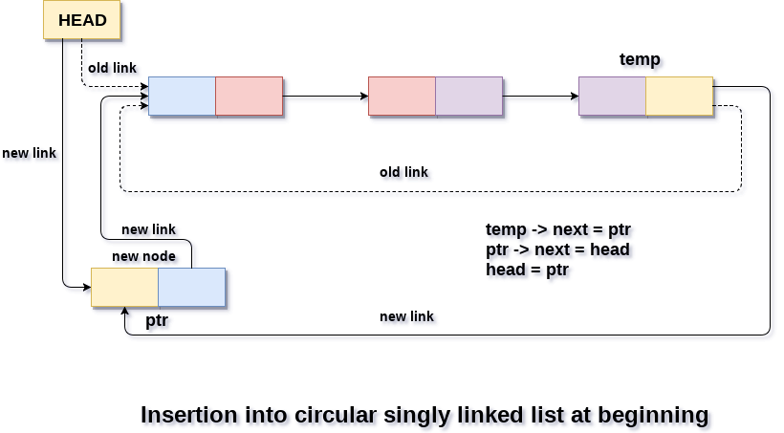
Insert at Start
Algorithm Insert (Head, x: value)
Let/Create n be the new node
n.value = x
Let itr = Head
while itr.next != Head then
itr = itr.next
n.next = Head
Head=n
itr.next = n
Is it different from linked list? If yes then which lines?
What is the role of line number 8?

Slide 15
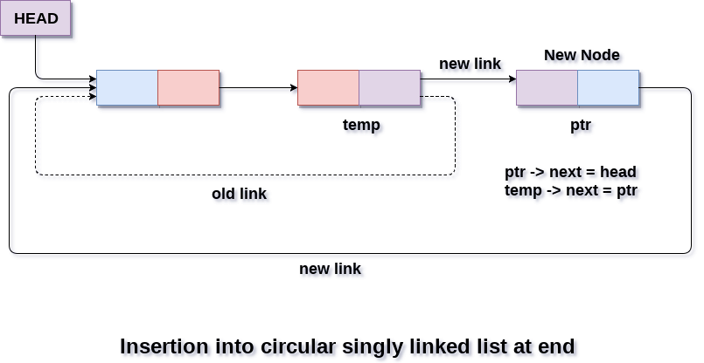
Insert at End
Algorithm Insert (Head, x: value)
Let/Create n be the new node
n.value = x
Let itr = Head
while itr.next != Head
itr = itr.next
n.next = Head
itr.next = n
Is it different from inserting at start?
Can you write an algorithm to traverse in a circular linked list?

Slide 16
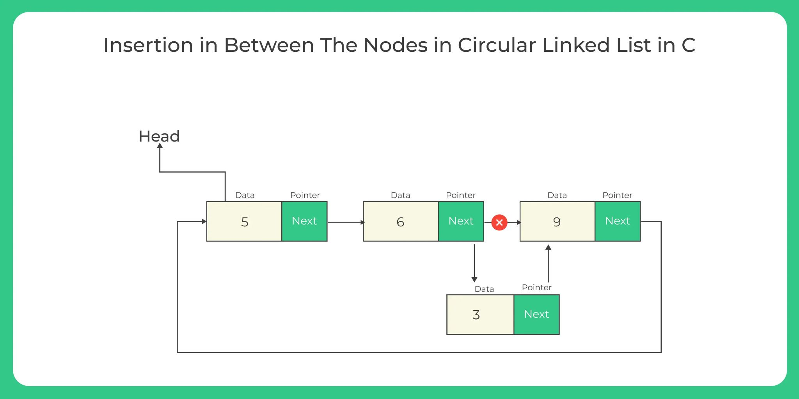
Insert in Middle
Algorithm Insert (Head, x: value, nodeVal: element value ) AFTER A NODE
Let/Create n be the new node
n.value = x
Let itr = Head
while itr.next != Head
if itr.value == nodeVal then
n.next = itr.next
itr.next = n
exit
itr = itr.next
After 6
Is it different from Singly Linked List?
Write an algorithm to insert an element after k elements.

Slide 17
Deletion
Deleting at the beginning/start
Deleting at the last/end
Deleting at the middle
Before a node
After a node
In all these cases, we need to know:
Algorithms
Updates/Movement of pointers
Search Requirements

Slide 18
Searching in Circular Linked List
Classwork: Q. Write the algorithm for search a given element. You may assume any number of elements present in the Circular Linked List. However, you need to take care of the cases like (i) empty list (ii) failure: the element may not present (iii) success: the element is present, you need to display its position count from the start.
Search:
1
3
20
2

Slide 19
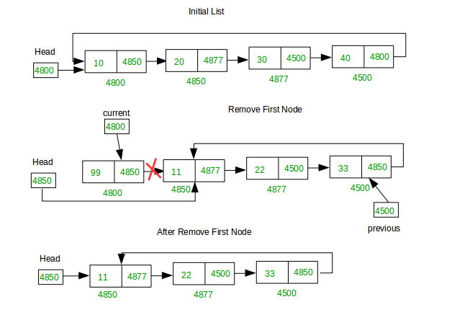
Delete at Start
Algorithm Delete (Head)
if Head == NULL then
Print “The list is empty”
Let tmp = Head
Let itr = Head
while itr.next != Head then
itr = itr.next
itr.next = Head.next
Head = Head.next
Delete tmp or Free(tmp)
exit
Is it different from Singly Linked List? If yes then which line?

Slide 20
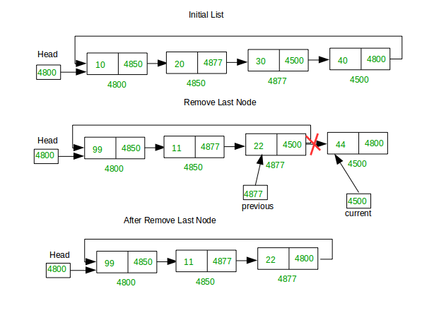
Delete at End
Algorithm Delete (Head)
if Head == NULL then
Print “The list is empty”
else if Head.next == Head then
tmp = Head
Head = NULL
Delete tmp
else
Let itr = Head
while itr.next.next != Head
itr = itr.next
tmp = itr.next
itr.next = NULL
Delete tmp
What is the meaning of line 5?

Slide 21
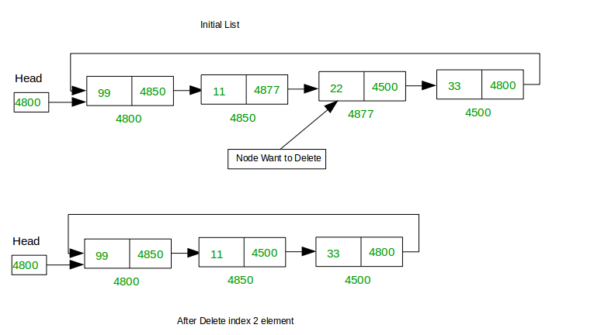
Delete in Middle
Algorithm Delete (Head, x: value) [After 11]
Let itr = Head
while itr.next != Head
if itr.value == x then
itr.next = itr.next.next
tmp = itr.next
Delete tmp
exit
itr = itr.next
Can you write an algorithm to delete a specific node?

Slide 22
Representation on Memory
Define
Underflow
Overflow
Knowledge Check

Slide 23
Define
Circular Linked List can be defined by allocating memory dynamically.
Any data of the linked list is represented as a node.
A node contains two fields i.e. data stored at that particular node and the pointer/reference which contains the address of the next node.
Data field: can be of any type and it holds the actual data.
Pointer: it must be a pointer type (???) and it does not have data, rather metadata.
Head: A special pointer that always points to the first node.
The last node points to the first node.
Size: Not an attribute of Circular Linked List.

Slide 24
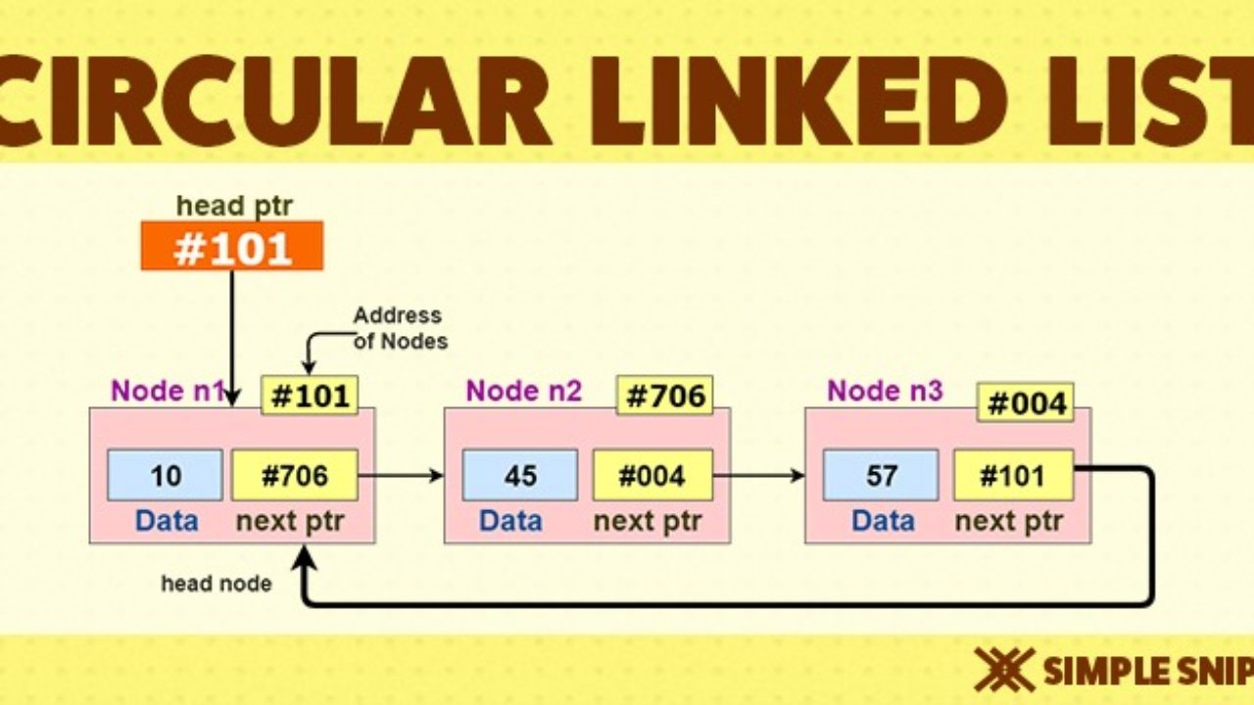
Implementation
Mark the memory addresses.
The last node has the address of the first node in its next ptr.

Slide 25
Linked List Underflow vs Overflow (Phenomenon)
Overflow
Occurs while doing insertion operations
Happens if the the memory is full and new node cannot be created
Condition:
NewNode == NULL (whole node is null)
Is there any change required in Insertion operation?
Underflow
Occurs while doing deletion operations
Happens if the list is empty
Condition:
Head == NULL
Is there any change required in Deletion operation?

Slide 26
Knowledge Check
In a circular linked list organization,insertion of a record involves modification of how many pointers at most:
a) 1
b) 2
c) 5
d) 0
What is the time complexity of searching for an element in a circular linked list?
a) O(n)
b) O(nlogn)
c) O(1)
d) O(n^2)
3. What differentiates a circular linked list from a normal linked list?
a) You cannot have the ‘next’ pointer point to null in a circular linked list
b) It is faster to traverse the circular linked list
c) You may or may not have the ‘next’ pointer point to null in a circular linked list
d) Head node is known in circular linked list

Slide 27
Example Problem-1
A circular queue has been implemented using a singly linked list where each node consists of a value and a single pointer pointing to the next node. We maintain exactly two external pointers FRONT and REAR pointing to the front node and the rear node of the queue, respectively. Which of the following statements is/are CORRECT for such a circular queue, so that insertion and deletion operations can be performed in O(1) time?
Next pointer of front node points to the rear node.
Next pointer of rear node points to the front node.
(I) only.
(II) only.
Both (I) and (II).
Neither (I) nor (II).

Slide 28
Example Problem-2
public void function(int data)
{ int flag = 0;
if( head != null){
Node temp = head.getNext();
while((temp != head) && (!(temp.getItem() == data)))
{ temp = temp.getNext();
flag = 1; break;
}
}
if(flag)
System.out.println("success");
else
System.out.println("fail");
}
What is the function doing?

Slide 29
Homework

Slide 30
Homework
Write an algorithm to merge two Circular Linked Lists.
Is it different from Singly Linked List?
Write an algorithm to split a Circular Linked List into two Circular Linked Lists.
Is it different from singly linked list?
Compare insertion operations of Singly Linked List and Circular Linked List. State the similar cases and different cases with adequate illustration.
Compare deletion operations of Singly Linked List and Circular Linked List. Do you find any difference in any of the cases? If yes then state it with adequate illustration.
How many pointers are changing while insertion happens in circular linked list? Is it the same for all the cases?
Write an algorithm to insert an element in Circular Linked List after k elements. You need to input k and the value of the new node/element.

Slide 31
Conclusion

