Slide 1

Applications of Linked List
Unit-2 Lecture-7
Dr. Dillip Rout, Assistant Professor, Dept. of Computer Science and Engineering

Slide 2
Outline
Revision of Linked List
Implementation of Stack
Implementation of Queue
Polynomial Manipulation
Homework
Conclusions

Slide 3
Revision of Linked Lists

Slide 4
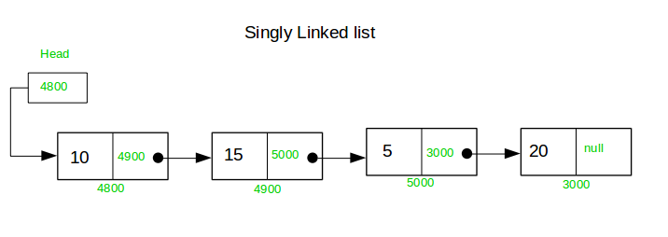
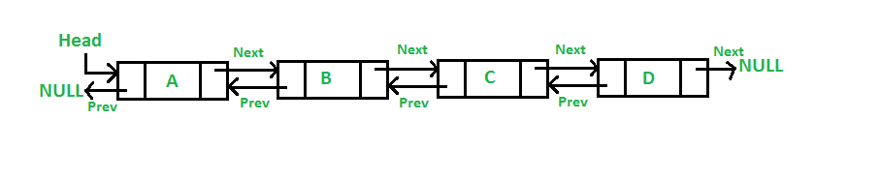
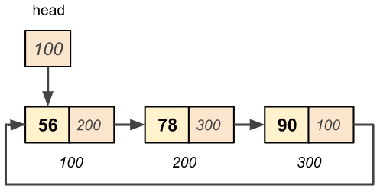
Linked Lists
Attributes:
Head: pointer to start node of the list
Tail: pointer to end node of the list
Node: data + next pointer and/or previous pointer
Operations:
Insert
Delete
Search
Merge
Split
Reverse

Slide 5
Insertion and Deletion in Linked Lists
Insertion / Deletion
at the beginning/start
at the last/end
at the middle
Before a node
After a node
Before a count
After a count
In all these cases, we need to know:
Algorithms
Updates/Movement of pointers
Search Requirements
All these are application to Singly,Doubly and Circular Linked Lists.

Slide 6
Implementation of Stack

Slide 7
Stack and Linked List
Stack
Attributes
Size
Top
Operations
Push
Pop
If Stack is implemented using Linked List then it becomes a dynamic Stack.
Mapping
Size: not a constraint
Top is the Head
Push is Inserting at Start
Pop is Deleting at Start
Linked List
Attributes
Head
Tail
Node: value + Pointer
Operations
Insert
Start
End
Middle
Delete
Start
End
Middle

Slide 8
Operation Example
Q. Define a stack using linked list and do the following operations.
Push 5
Push 10
Pop
Push 15, 20, 25
Pop, Pop, Pop
Write the state after 3 Pops
Did you encounter overflow?
Did you encounter underflow?
Which operations are needed to perform to have underflow for this stack?
Q. Define a stack using linked list and do the following operations.
Push A, B
Pop
Pop
Pop
Write the state after 3 Pops
Push C, D, E
Pop, Pop
Did you encounter overflow?
Did you encounter underflow?
Which operations are needed to perform to have overflow for this stack?

Slide 9
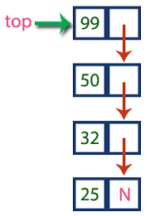
Stack using Linked List: Push(Top,x:value)
Algorithm Push (Top/Head, x: value)
Let/Create n be the new node
If n== NULL then
Write “Overflow” and exit
n.value = x
n.next = Top
Top=n
Top is a pointer here.

Slide 10
Stack using Linked List: Push(Top,x:value)
Algorithm Pop (Top/Head)
if Top == NULL then
Write “ Empty Stack, Underflow” and exit
tmp = Top
Top = Top.next
x = tmp.value
Delete tmp or Free(tmp)
return x
Top is a pointer here.

Slide 11
Example Problem-1
Which of the following is true about linked list implementation of stack?
In push operation, if new nodes are inserted at the beginning of linked list, then in pop operation, nodes must be removed from end.
In push operation, if new nodes are inserted at the end, then in pop operation, nodes must be removed from the beginning.
Both of the above
None of the above

Slide 12
Example Problem-2
Consider the following statements:
S1: If a STACK is implemented through a LINKED LIST, PUSH operation will take O(1) time and POP operation will take O(n) time.
S2: If a QUEUE is implemented through an ARRAY, ENQUEUE operation will take O(logn) time and DEQUEUE operation will take O(n) time.
Which of the above statements is/are TRUE?
Only S1 is correct.
Only S2 is correct.
Neither S1 nor S2 is correct.
Both S1 and S2 are correct.

Slide 13
Implementation of Queue

Slide 14
Queue and Linked List
Queue
Attributes
Front
Rear
Operations
Enqueue
Dequeue
If Queue is implemented using Linked List then it becomes a dynamic Queue.
Mapping
Size: not a constraint
Front is Head
Rear is Tail
Enqueue is Inserting at End
Dequeue is Deleting at Start
What are the values of Rear and Front initially while implementing through Linked List?
Linked List
Attributes
Head
Tail
Node: value + Pointer
Operations
Insert
Start
End
Middle
Delete
Start
End
Middle

Slide 15
Operation Example
Q. Define a queue using linked list and do the following operations.
Enqueue 5
Enqueue 10
Dequeue
Enqueue 15, 20, 25
Dequeue, Dequeue, Dequeue
Write the state after 3 Dequeues
Did you encounter overflow?
Did you encounter underflow?
Which operations are needed to perform to have underflow for this queue?
Q. Define a stack using linked list and do the following operations.
Enqueue A, B
Dequeue
Dequeue
Dequeue
Write the state after 3 Dequeues
Enqueue C, D, E
Dequeue, Dequeue
Did you encounter overflow?
Did you encounter underflow?
Which operations are needed to perform to have overflow for this queue?

Slide 16
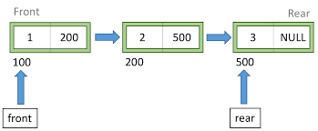
Queue using Linked List: Enqueue(Q,Rear, Front, x:value)
Algorithm Enqueue(Q: queue, Rear, Front, x: value to be inserted)
Let/Create n be the new node
if n == NULL then
Write “ Overflow” and exit
n.value = x, n.next = NULL (???)
If Rear == NULL (???)
Rear = Front =n
Rear.next = n
Rear = n
Rear/Tail is a pointer here.

Slide 17
Queue using Linked List: Dequeue(Q, Rear, Front)
Algorithm Dequeue (Q: queue, Rear, Front)
if Front == NULL then
Write “Underflow” and exit
tmp = Front
Front = Front.next
x = tmp.value
Delete tmp or Free(tmp)
If Front == NULL then (???)
Rear = NULL
return x
Front/Head is a pointer here.

Slide 18
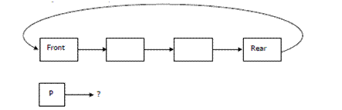
Example Problem-1
A circularly linked list is used to represent a Queue. A single variable p is used to access the Queue. To which node should p point such that both the operations enQueue and deQueue can be performed in constant time?
(A) rear node
(B) front node
(C) not possible with a single pointer
(D) node next to front

Slide 19
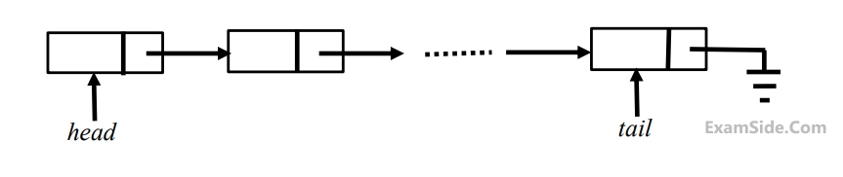
Example Problem-2
A queue is implemented using a non-circular singly linked list. The queue has a head pointer and a tail pointer, as shown in the figure. Let n denote the number of nodes in the queue. Let Enqueue be implemented by inserting a new node at the head, and Dequeue be implemented by deletion of a node from the tail.
Which one of the following is the time complexity of the most time-efficient implementation of Enqueue and Dequeue respectively, for this data structure?
O(1), O(1)
O(1), O(n)
O(n), O(1)
O(n), O(n)

Slide 20
Polynomial Manipulation
Overview of Polynomials
Representation using Linked List
Operations
Addition
Subtraction
Multiplication

Slide 21
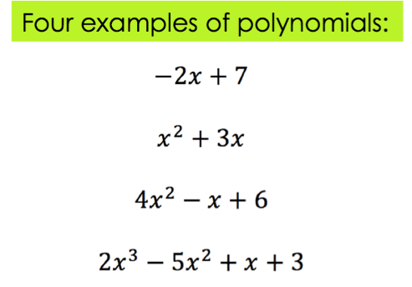
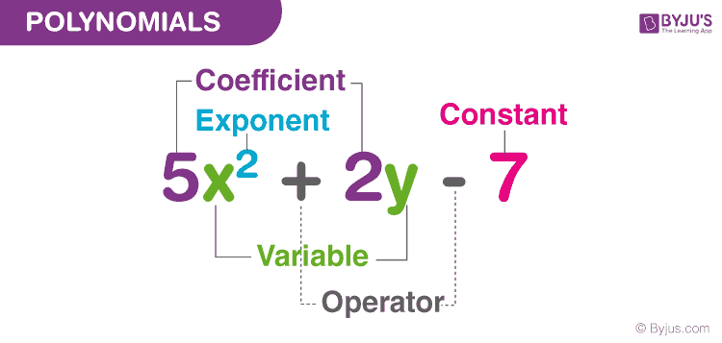
Polynomial (one variable)
A polynomial is a collection of different terms, each comprising coefficients, and exponents. For example:
What is the degree?

Slide 22
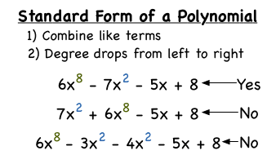
Standard Form and Practice
Polynomials are an important part of mathematics not inherently supported as a data type by most programming languages.
It can be represented using a linked list. This representation makes polynomial manipulation efficient.

Slide 23
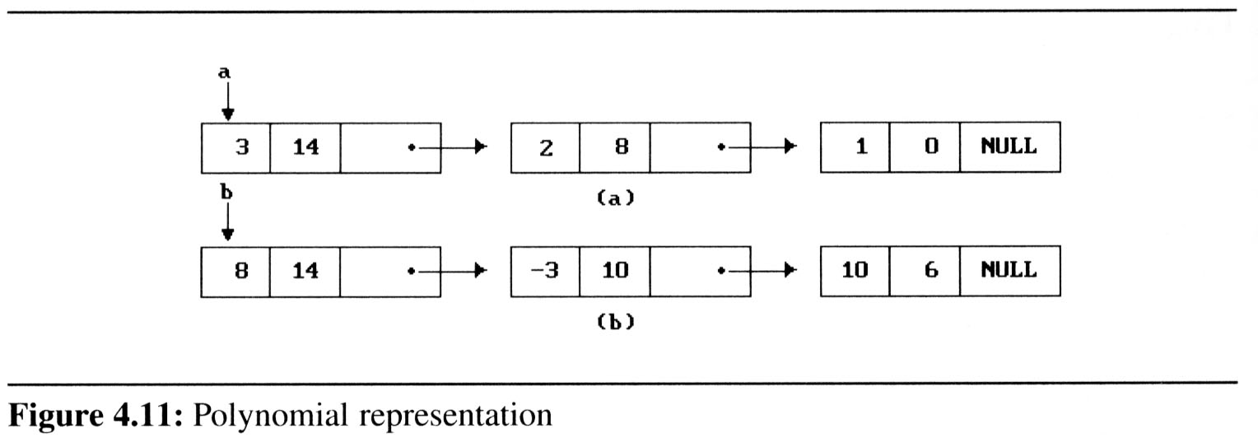
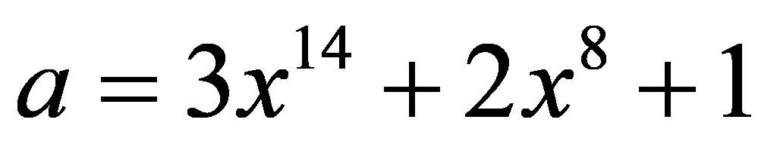
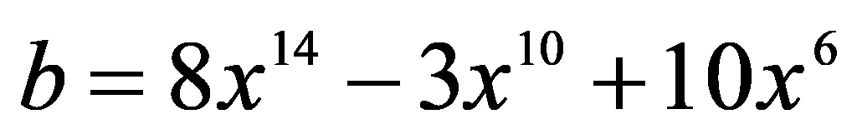

Polynomial Representation using Linked List
Node as 3-tuple:

Slide 24
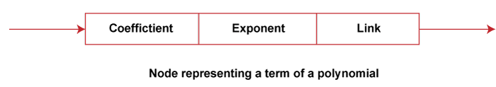
Polynomial Representation using Linked List…
While representing a polynomial using a linked list, each polynomial term represents a node in the linked list. Each node is represented as a 3-tuple.
To get better efficiency in processing, we assume that the term of every polynomial is stored within the linked list in the order of decreasing exponents.
Also, no two terms have the same exponent, and no term has a zero coefficient and without coefficients. The coefficient takes a value of 1.

Slide 25
Polynomial Addition
Examine their terms starting at the nodes pointed to by a and b.
If the exponents of the two terms are equal
add the two coefficients
create a new term for the result.
If the exponent of the current term in a is less than b
create a duplicate term of b
attach this term to the result, called d
advance the pointer to the next term in b.
If the exponent of the current term in a is greater than b
create a duplicate term of a
attach this term to the result, called d
advance the pointer to the next term in a
This process is repeated until each term in both the polynomials are executed

Slide 26
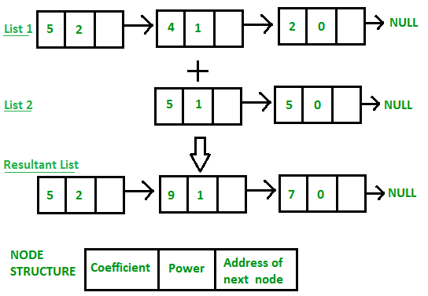
Polynomial Addition Example
1st Polynomial: 5x^2+4x^1+2x^0
2nd Polynomial: 5x^1+5x^0
Resultant polynomial:
5x^2 - 9x^1 + 7 x^0

Slide 27
Polynomial Addition Example Problem-1
a = 2x^5 - 2x^2 + 5
b = 3x^3 - 5x^2 + 5x -10
d = a + b

Slide 28
Polynomial Subtraction
Examine their terms starting at the nodes pointed to by a and b.
If the exponents of the two terms are equal
subtract the two coefficients
create a new term for the result.
If the exponent of the current term in a is less than b
create a duplicate term of b with a negative sign of the coefficient
attach this term to the result, called d
advance the pointer to the next term in b.
If the exponent of the current term in a is greater than b
create a duplicate term of a
attach this term to the result, called d
advance the pointer to the next term in a
This process is repeated until each term in both the polynomials are executed

Slide 29
Polynomial Subtraction Example
a = 6x^3 - 2x^2 -11
b = 7x^2 - 12x - 3
d= ???

Slide 30
Polynomial Subtraction Example Problem-1
a = 2x^5 - 2x^2 + 5
b = 3x^3 - 5x^2 + 5x -10
d = a - b

Slide 31
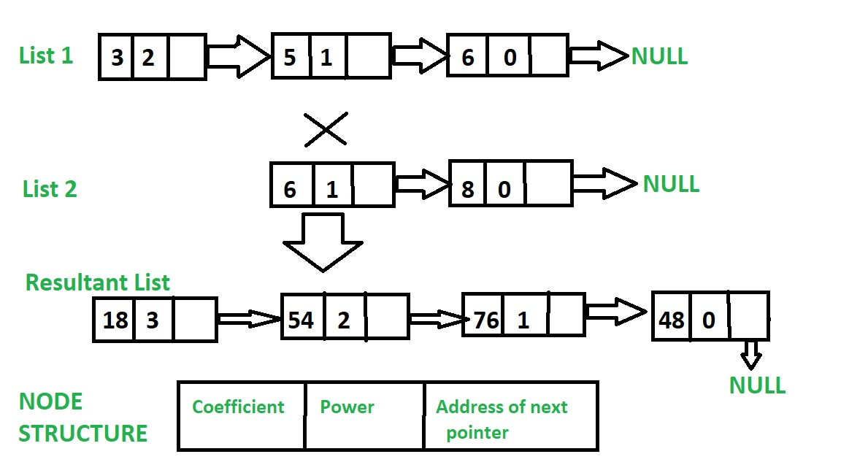
Polynomial Multiplication
In this approach we will multiply the 2nd polynomial with each term of 1st polynomial.
Store the multiplied value in a new linked list.
Then we will add the coefficients of elements having the same power in resultant polynomial.
Q. What is the order of the resultant polynomial? Is it less than the 1st or 2nd polynomial?

Slide 32
Polynomial Multiplication
a = 3x^2 + 5x^1 + 6
b = 6x^1 + 8
d = 18x^3 + 54x^2 + 76x^1 + 48
—-
a = 3x^3 + 6x^1 – 9
b = 9x^3 – 8x^2 + 7x^1 + 2
d = ???

Slide 33
Knowledge Check
Polynomial addition can be implemented using which of the following data structure?
Polynomial subtraction can be implemented using which of the following data structure?
If the order of the polynomial (single variable) is 6 then how many nodes will be there in the linked list which represents it?
Q. How many terms are there in the resultant polynomial? Is it less than the 1st or 2nd polynomial?

Slide 34
Homework

Slide 35
Homework
Write an algorithm for push operation of a stack which is implemented using a linked list. In this case, push is performed by inserting the new element at the end of the list.
Write an algorithm for pop operation of a stack which is implemented using a linked list. In this case, pop is performed by deleting the element at the end of the list.
Write an algorithm for Enqueue operation of a Queue which is implemented using a Linked List. In this case, Enqueue is performed by inserting the new element at the start of the list.
Write an algorithm for Dequeue operation of a Queue which is implemented using a Linked List. In this case, Dequeue is performed by deleting the element at the end of the list.
Write an algorithm for adding three polynomials. The order of the first, second and third polynomials are 4, 3, and 4 respectively.
Write an algorithm for subtracting three polynomials. The order of the first, second and third polynomials are 3, 3, and 4 respectively.
Write an algorithm for multiplying two polynomials. It must work for any kind of order.

Slide 36
Conclusions

