Slide 1
IMPLEMENTATION DESIGN FOR FASTER ENCRYPTION IN RSA
presented by Group Number 13
under the supervision of Mr.Biswanath Dey

Slide 2
Team Members
Suhrid Barthakur 14-1-5-039
Partha Pritam Paul 14-1-5-059
Jasbir Singh Birdi 14-1-5-083
Anirban Chatterjee 14-1-5-032

Slide 3
Acknowledgement
I would like to express my sincere gratitude to our supervisor Mr. Biswanath Dey for providing his invaluable guidance, comments and suggestions throughout the course of the project. I would specially thank HOD Sir and the faculties in the reviewer’s panel for constantly motivating us to work harder and improve our work. Also I would like to thank my batchmates for their help and support during the preparation of the project,

Slide 4
Introduction
Encryption is what guarantees the security of sensitive information. It provides the mechanisms in information confidentiality, functioned with digital signature, authentication, secret sub-keeping, system security and etc.
At present, the best known and most widely used public key system is RSA
Here , we are to propose an implementation design/procedure for faster encryption process mainly through optimizing the modular exponentiation process for large key of sizes 1024 bits or more.

Slide 5
Introduction(Cont.)
The design provides a recoding scheme and makes use of montgomery multiplication for reducing the total no. of operations and faster modular multiplication respectively.
The design is based on parallel processing by two processor for achieving optimal performance.In addition to this a systolic array design is implemented to provide potentially higher throughput for a large number of computations

Slide 6
Introduction(Cont.)
For better security it has been found that the large size key are hard to factorize ,and the integrity of the RSA system depends solely on factorization of N which is the product of two large prime numbers. As it can seen from the RSA algorithm:

Slide 7
Proposed Work
The proposed implementation design aims to make the RSA cryptosystems faster through faster encryption and decryption process
The encryption is slow process when the key size is large like 1024 bits ,2048 bits or greater (for better security) ,due to computation of modular exponentiation C=M^E (mod N) which becomes expensive for large public key (E,N).
Thereby the design makes the modular exponentiation faster by making use of recoding scheme and montgomery multiplication technique. Also a parallel processing optimization has been studied and proposed .

Slide 8
Proposed Work(Cont.)
The well known algorithm for computing M^E is exponentiation by repeated squaring and multiplication and called the binary algorithm. Computing M^E (mod N) by this algorithm requires 2|log E | modulo multiplications in the worst case where N is the product of two large prime numbers.
Our work consists of three main parts:
Recoding,
Montgomery Multiplication
Effect of Parallel Processing in code optimization.

Slide 9

Modular Exponentiation Algorithm(RECODING)
Recoding
The proposed technique in order to compute C= ME mod N, involves representing E in recoded binary form, unlike binary algorithm which represents E in binary.
i.e
,where n is number of bits in E and e_{i}​ ∈{0,1} similar to binary algorithm.
Now it known that the binary algorithm requires (n + E1) total operations, where E1 is no of 1's representation in binary representation of E and n is the number of bits in E. Thus we need to reduce the value of E1 in order to make it faster.

Slide 10

Modular Exponentiation Algorithm(RECODING)
To achieve this ,we define a redundant expression of E say E'(E= E') which is given as:
,where e​_{i}*​∈ {0,1,-1} and E| is a redundant representation of E in base of 0 ,1 ,-1.

Slide 11
Modular Exponentiation Algorithm(RECODING)
Let us represent -1 in the redundant representation as 1
For example E=11110=E|=100010=100000-10
Thus as in the above example used reduce the number of non zero digit with the help of the redundant expression. For any given integer E, E<2^n ,the time complexity of computing C= ME mod N is (n+|n/2 |+1) Tn ,Tn is the time for each modular multiplication. By applying the recording sccheme and using redundant binary algorithm we reduce the no. of operations that needs to be performed as it can be seen from the next slide.

Slide 12
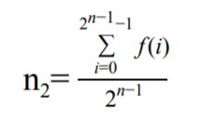
Modular Exponentiation Algorithm(RECODING)
The average number of non-zero’s after applying the recoding algorithm for the integers distributive in the range of 2^(n-1) and (2^n) -1 can be calculated by the following equation:
where f(i) is the number of non zero’s after execution of the recoding scheme to the integer 2^{n-1} +i. ( i=0,1,2,.....,2^{n-1} -1).

Slide 13
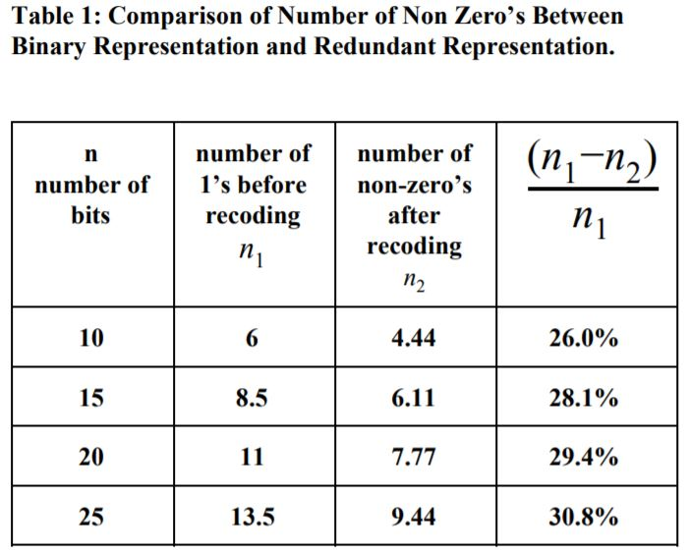
Modular Exponentiation Algorithm(RECODING)
As we can see from table 1 that the number of reduced non- zero terms for keys of different sizes.With the increasing key size the number of non- zero terms are reduced hence.

Slide 14
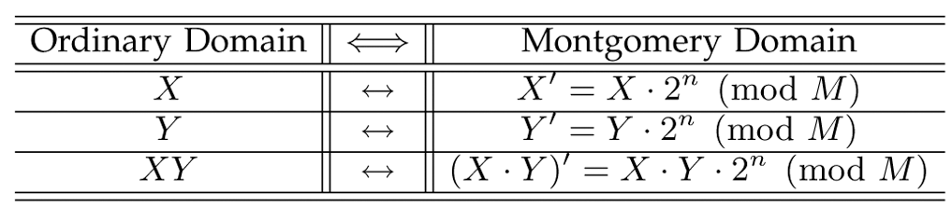
Modular Exponentiation Algorithm(MONTOGOMERY REDUCTION)
Now in order to perform a modular exponentiation we use the montgomery multiplication Montgomery modular multiplication, more commonly referred to as Montgomery multiplication, is a method for performing fast modular multiplication. For computations using montgomery multiplication , first perform modular exponentiation in Montgomery form ,and then convert back the obtained result out of montgomery form to obtain the required result i.e C =M^E mod N.

Slide 15
Modular Exponentiation Algorithm(MONTOGOMERY REDUCTION)
For montgomery multiplication it is defined as, given an integer a < N , where N is the k-bit modulus, A is said to be its N-residue with respect to R if , A = a*R (mod N) , where R=2^k
The Montgomery product of A and B can then be defined as: Z = A*B*R' (mod N), where R' is the inverse of R, modulo N. i.e RR'= 1 (mod N).
Since GCD(N,R')=1 ,extended Euclidean algorithm can efficiently determine integers R' and N' that satisfy Bézout's identity: 0<R'<N, 0<N'<R and RR'-NN'=1..

Slide 16
Modular Exponentiation Algorithm(MONTOGOMERY REDUCTION)
The montgomery reduction computes this product Z in montgomery form as given by REDUCE, where X =( AR mod N )*(BR mod N). function REDUCE(X) begin q := (X mod R)N' mod R; Z := (X + qN)/R; if Z > N then Z := Z−N;
return Z; end This reduction algorithm is used for converting in and out of Montgomery form and calculating the Montgomery product. And hence can be used for modular exponentiation algorithm.

Slide 17
Modular Exponentiation Algorithm(THE ALGORITHM)
For computing C= M^E (mod N) ,repeat the following steps of the algorithm. It is assumed that R', N' and R are predetermined as required for montgomery reduction.
Input M as integer , E as E' i.e. redundant representation of binary expression for E and N as integer value.
Take a variable result to store the temporary result for each iteration .Initialize result as the montgomery form of 1.Thus we initialize result= R mod N , where gcd(R,N) =1 and R>N.
If k is the no of bits in E then starting from most significant bit in E i.e. (k-1)th bit to the least significant bit, and for each bit i from k-1 to 0 do the following:
Step 3a :
result=REDUCE((result.R mod N)*(result.R mod N))
result= (result. R') mod N

Slide 18
Modular Exponentiation Algorithm(THE ALGORITHM)
Step 3b :
If the ith bit is 1 then set
result=REDUCE((result.R mod N)*(M.R mod N)) result=result.R' mod N
OR
If the ith bit 1 then set
result=REDUCE((result.R mod N)*(M^(-1).R mod N)) result=result.R' mod N
OR
else if the ith bit is 0 then set result=result

Slide 19
Modular Exponentiation Algorithm(THE ALGORITHM)
4. After completion of all iterations return result, which is in Montgomery form and we convert it out of Montgomery form to obtain the final result of encryption C=REDUCE(result . R mod N)=M^E (mod N).
.
The algorithm computes modular exponentiation in O((T(n))(n+E1)) where T(n) is time complexity of Montgomery reduction algorithm, n is the no. of bits in redundant representation of E and E1 is no of non zero elements in redundant representation
This is much faster in comparison to the binary algorithm which has complexity of O(M(n)(n +Z)),n being the number of bits in E,Z being the no of 1’s in the binary form of E. M(n) is time complexity for performing modular multiplication . Since M(n) > T(n) and E1 < Z.

Slide 20
Code Implementations and Results
The project has been implemented in JAVA programming language with the help of Eclipse Neon IDE. The project contains three main java files. MontgomeryReducerDemo.java , MontgomeryReduce.java and RecodingScheme.java. The functionalities of the two is described below:
MontgomeryReduce.java is used for pre-processing the R’ and N’ which is required for the Montgomery multiplication of two number. It includes the MontgomeryReducer class used for this purpose and also a set of other functionalities as described later.
RecodingScheme.java is used for recoding the binary string as a redundant representation. In the code we use ‘x’ instead of 1 for ease of coding purpose.
MontgomeryReduceDemo.java is used as the entry point of the main function and is used for initializing the private/public keys. It makes a execution time comparison between original RSA encryption and proposed encryption technique.

Slide 21
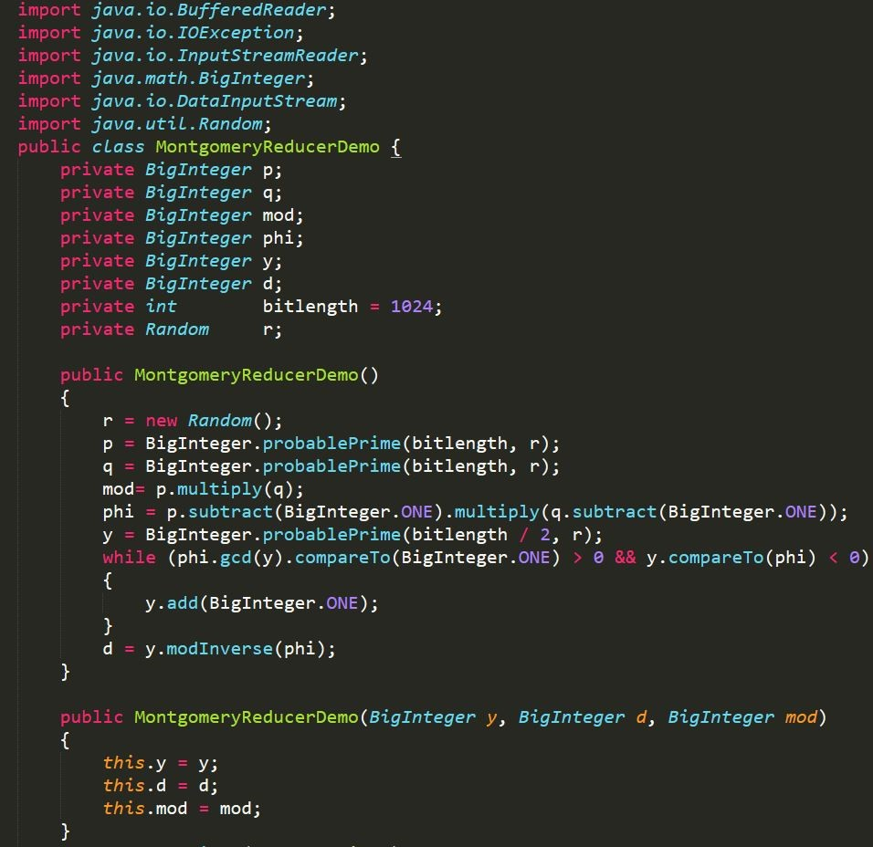
Code Implementations and Results
MontogomeryReducerDemo class defines the initialization of values of public key (N, E) and private keys in its constructor method. In our code y is used in place of E As shown below:

Slide 22
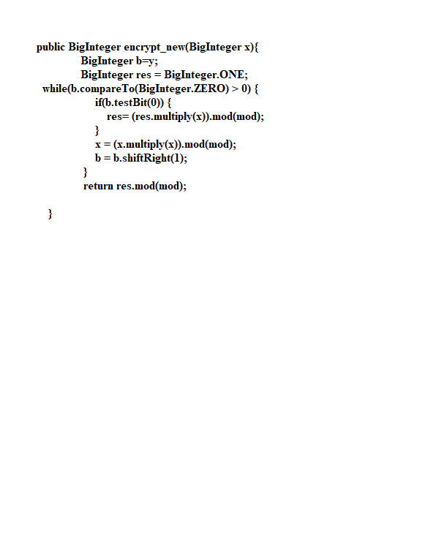
Code Implementations and Results
MontgomeryReducerDemo class defines other sets of methods which are defined below:
encrypt_new(): For encryption of plain using original RSA algorithm. It takes the BigInteger data type representation of message byte string as arguments and returns the encrypted value.

Slide 23
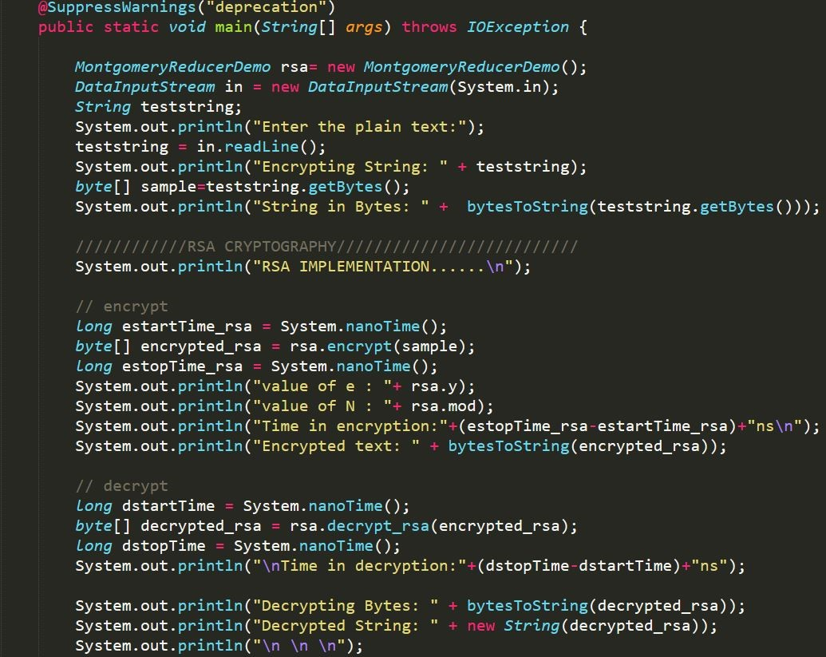
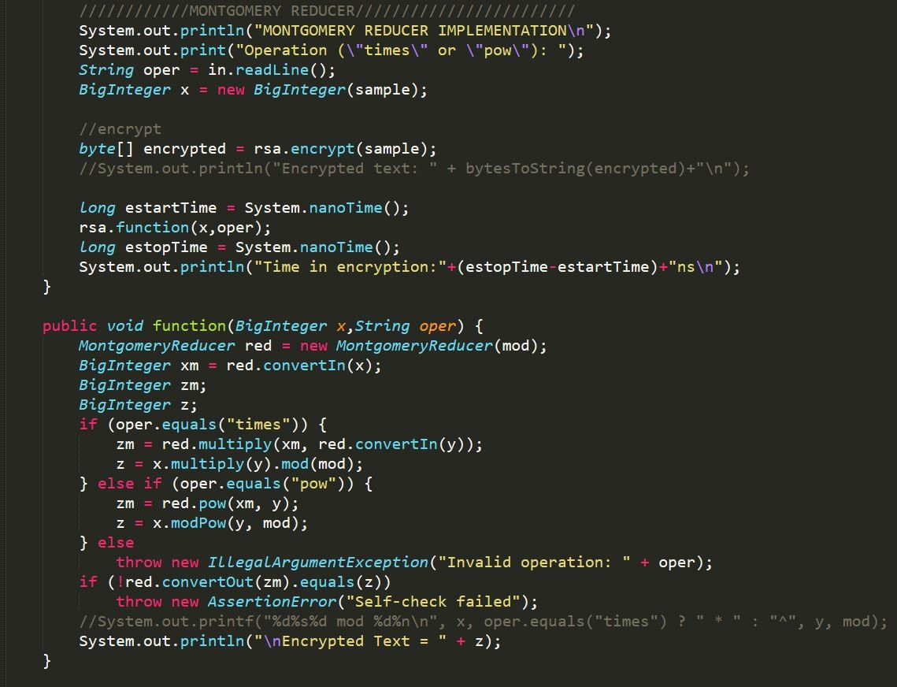
Code Implementation and Results
The MontgomeryReducerDemo class measures the encryption time between original RSA and Montgomery Implementation as shown :

Slide 24
Code Implementation and Results
The MontgomeryReducer class implements the reduce algorithm for modular exponentiation ,it reduces the modular exponentiations into a sequence of Montgomery montgomery modular multiplications . The functions defined in this class for these operations are :
convertIn():This method is used for convert the numbers into the montgomery domain for using the Montgomery modular exponentiation algorithm for encryption
convertOut():This method is used to convert the results out of montgomery domain to the original domain and return the final encryption result.
multiply(): This method is used to perform montgomery modular mulplications of two BigIntegers.
pow():This method is used for obtaining the result of exponentiation in the Montgomery domain by performing montgomery modular multiplication iteratively and return the result which is fetched to convertOut() to obtain the final result.

Slide 25
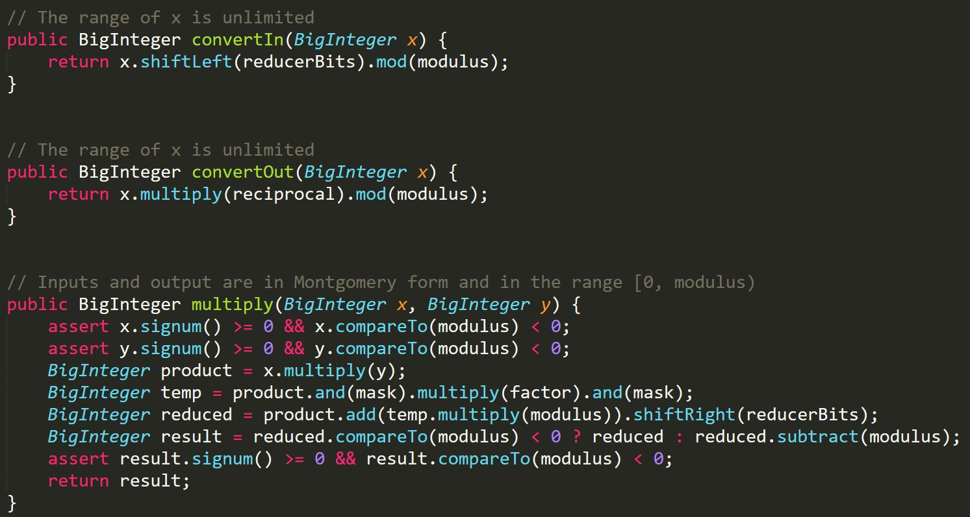
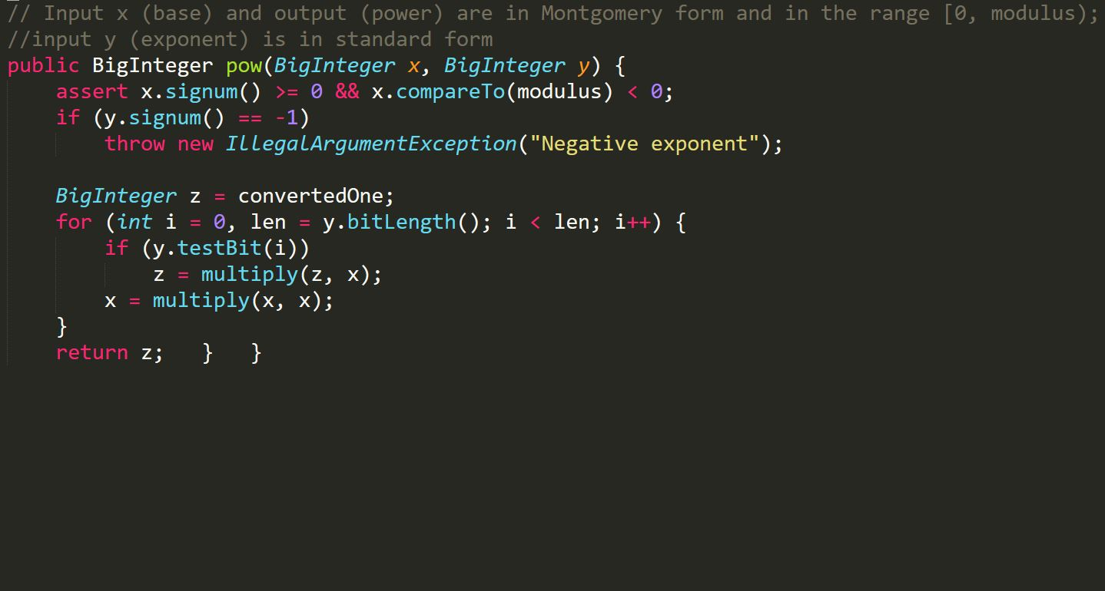
Code Implementation and Results
Figure shows the code snippet for implementing the methods defined in Montgomery Reduce class.

Slide 26
Code Implementation and Results
The result obtained from the execution of the program has been laid out for comparison in tabular form as below:
Input String | Size of '(N,E)' (in bits) | Encryption time in RSA (a) (in nanosecond) | Encryption time in Montgomery (b) (in nanosecond) | Speed Up Efficiency(in %)= (a - b)*100 a
Nit Silchar | 565 | 28889714 | 1777774 | 93.8
Institute of Electrical and Electronics Engineers | 630 | 28738602 | 2296884 | 92
Computer Science and Engineering | 443 | 28763492 | 2484439 | 91.3

Slide 27
Code Implementation and Results
Input String
Size of '(N,E)' (in bits) | Encryption time in RSA (a) (in nanosecond) | Encryption time in Montgomery (b) (in nanosecond) | Speed Up Efficiency(in %)= (a - b)*100 a
Assam | 230 | 28244470 | 1787113 | 93.6
ZigBee and IEEE 802.15.4 are standards based protocols that provide the network infrastructure required for wireless sensor network applications | 800 | 29064471 | 2676002 | 90.7
Table showing comparison between encryption time of original RSA and Montgomery algorithm for varying key sizes.

Slide 28
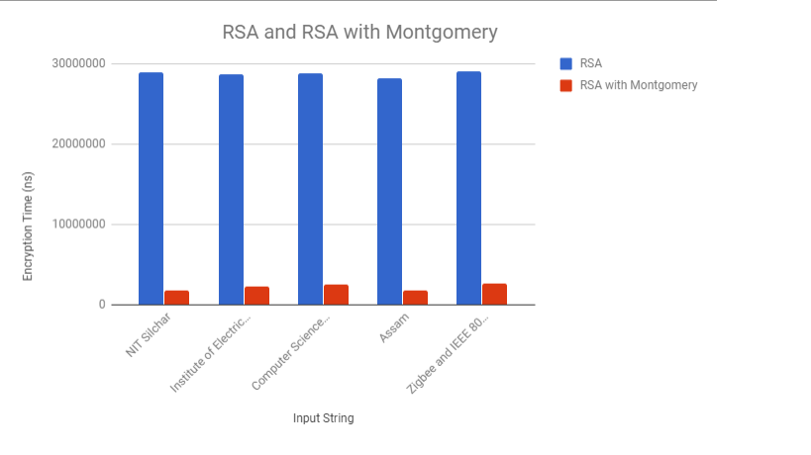
Code Implementation and Results
Graphs plotted based on obtained to get a better understanding of efficiency achieved.

Slide 29
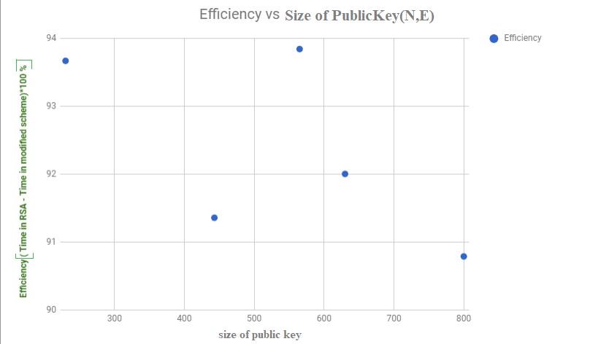
Code Implementation and Results

Slide 30
Code Implementation and Results
It can been observed from the graphs that with different inputted words while keeping the public key same for both original RSA and proposed algorithm for each input word, that:
• efficiency/speed up is achieved over classical RSA encryption.
• efficiency decreases minimally with the increasing size of public key.Thus even for large keys the speed up is achieved.

Slide 31
Conclusion
Thus the proposed algorithm makes the encryption faster by reducing the number of iterations with recoding of E into a redundant representation. The encryption process achieves further speed up by optimizing the modular multiplications through the use of Montgomery reduction algorithm . On top of it the parallel processor and systolic array design further increases computation speed by factor of 2 and enables fast encryption of a sequence of messages for xed public and private key. The proposed algorithm reduces the total operations and optimizes each of the operation by the underlying algorithm, ,the computational speed in case of very large keys is increased amd this optimization makes a great effort in reducing the time for encryption.
Experimental analysis of the algorithm in parallel environments is left as a future scope of study .Enhancements and side effects on the other supporting processes in the cryptosystems are kept as future scope of study.
An IEEE based paper on our research project has also been submitter.

Slide 32
REFERENCE
REFERENCES
[1] Chang N.Zhang , Herold L.Martin, “Parallel algorithms and Systolic Array Design For RSA Cryptosystems” Systolic Arrays, 1988., Proceedings of the International Conference on 25-27 May 1988,San Diego, CA, USA, USA.
[2] Martin Kochanski, "Montgomery Multiplication" a colloquial explanation.
[3] Alfred J. Menezes, Paul C. van Oorschot, and Scott A. Vanstone. “Handbook of Applied Cryptography”. CRC Press, 1996. ISBN 0-8493-8523-7, chapter 14.
[4] N. Petkov: Systolic Parallel Processing; North Holland Publishing Co, 1992
[5] S. Y. Kung: VLSI Array Processors; Prentice-Hall, Inc., 1988
[6] H. T. Kung, C. E. Leiserson: Algorithms for VLSI processor arrays; in: C. Mead, L. Conway (eds.): Introduction to VLSI Systems; Addison-Wesley, 1979
[7]A Parallel Implementation of Montgomery Multiplication on Multicore Systems: Algorithm, Analysis, and Prototype,Issue No. 12 - December (2011 vol. 60) Zhimin Chen , Virginia Polytechnic Institute and State University, Blacksburg,Patrick Schaumont , Virginia Polytechnic Institute and State University, Blacksburg.

Slide 33
THANK YOU

