Slide 1
Introduction to Selenium For UI Automation
Prepared by:
Partha Paul
Alok Ranjan

Slide 2
TODAY’S AGENDA
What Is Selenium
Components of Selenium
Integration of Selenium WebDriver
Testing with Selenium

Slide 3
I. What is Selenium
Selenium is a free (open-source) automated UI testing framework used to validate web applications across different browsers and platforms.
We can use multiple programming language like Java, Python, C#, PHP etc.
Selenium can be easily deployed on platforms such as Windows, Linux, macOS.
It also support OS for mobile application like iOS and Android.

Slide 4
II. Components of selenium
Selenium IDE
Selenium Remote Control
Selenium WebDriver
Selenium Grid

Slide 5
Selenium Ide
IDE stands for Integrated Development Environment.
It is implemented as a Firefox Add-On and as a Chrome Extension.
It allows for recording, editing and debugging of functional tests.
It does not require any programming logic to write its Test Scripts rather we can simply record our interactions with the browser to create test cases.

Slide 6
Selenium rc
RC stands for Remote Control.
Selenium Remote Control (RC) is a server, written in Java, that accepts commands for the browser via HTTP.
With the release of Selenium 2, Selenium RC has been officially deprecated in favor of Selenium WebDriver.

Slide 7
Selenium webdriver
SELENIUM GRID
Selenium WebDriver is the Successor to
Selenium RC, which has been officially
deprecated.
Selenium Grid will be Discussed in next session

Slide 8
III. Integration of Selenium WebDriver
Installation Requirements:-
Download Java 8 and above
Download and Configure Eclipse
Download Selenium Server
Download Selenium WebDriver
Configure Selenium WebDriver and Selenium Server

Slide 9
Contd…
Installation:-
A. Download Java 8 and above :-
Open CMD.
Type both “java –version” and “javac” in CMD to check Java is installed or not.
Download java(both JDK and JRE) from given link :-https://www.oracle.com/java/technologies/javase-downloads.html

Slide 10
B. Download and Configure Eclipse :-
Download Eclipse package and click on Download from given link(Eclipse Enterprise Edition is recommended) :-
https://www.eclipse.org/downloads/

Slide 11
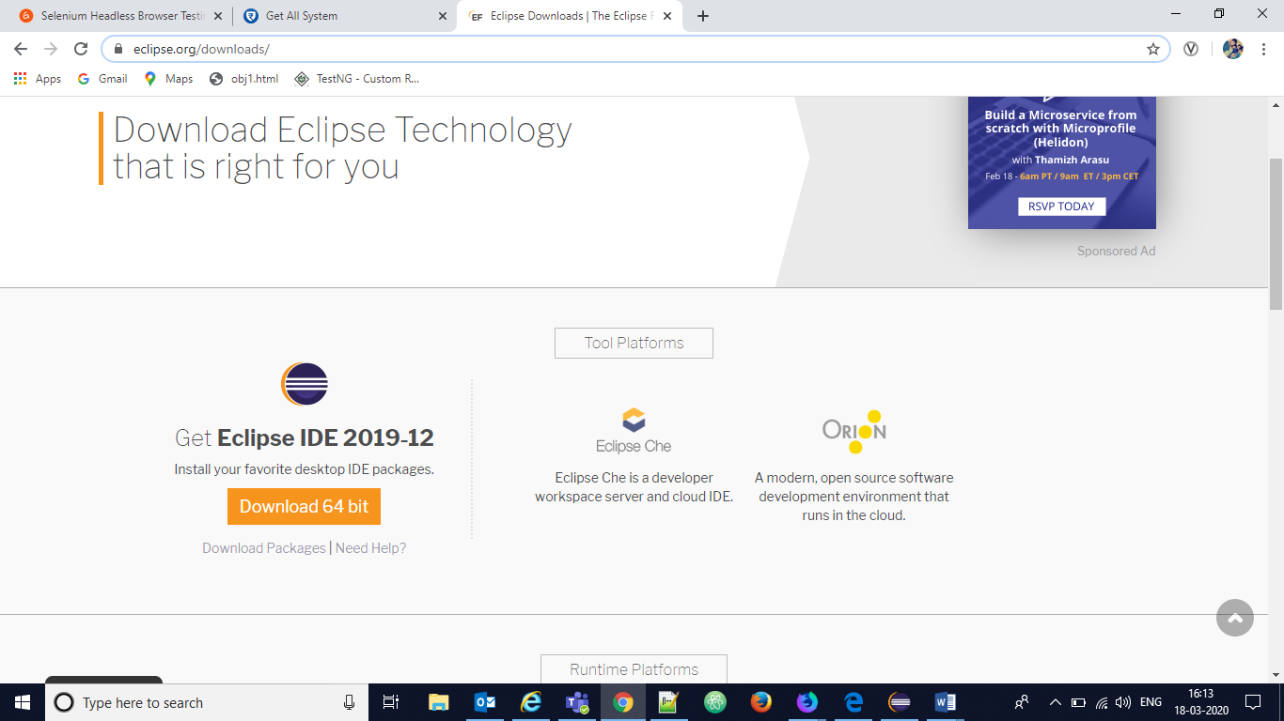

Slide 12
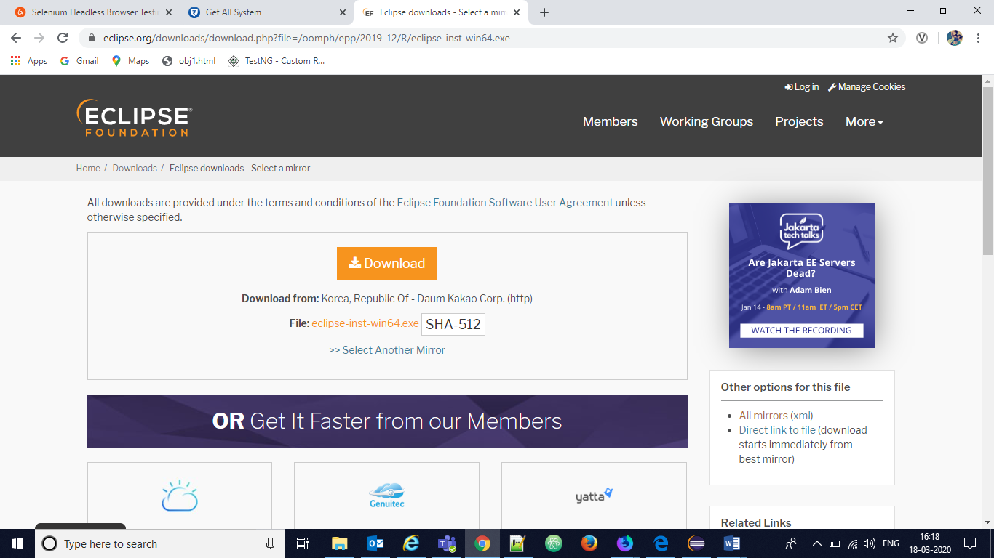

Slide 13
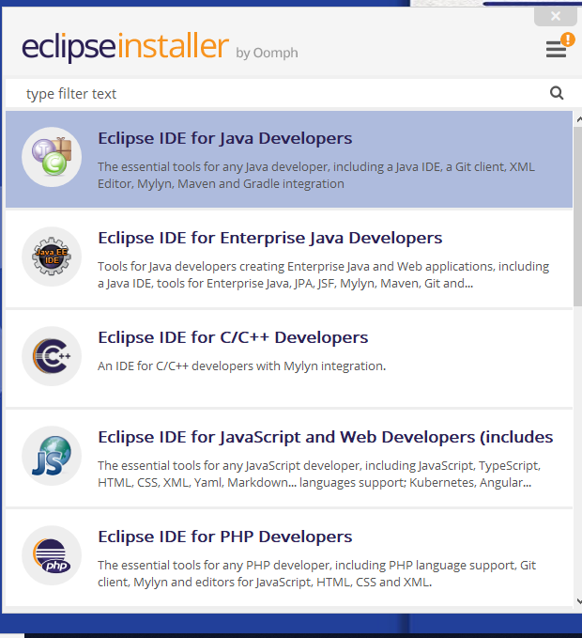
Open Eclipse Installer and click on Eclipse IDE for Java Developer

Slide 14
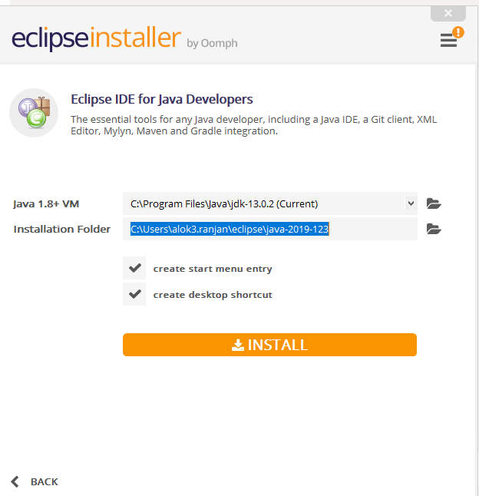
Click on Install and accept License Confirmation

Slide 15
C. Download Selenium Server: -
Follow this link:
https://selenium-release.storage.googleapis.com/index.html
or https://www.selenium.dev/downloads/ > “Previous Releases” > click on “Previous Releases, a complete list can be seen here” from the New Screen.
Click the latest stable one (Currently 3.9)
Download ‘selenium-server-3.9.1.zip’ and ‘selenium-server-standalone-3.9.1.jar’

Slide 16
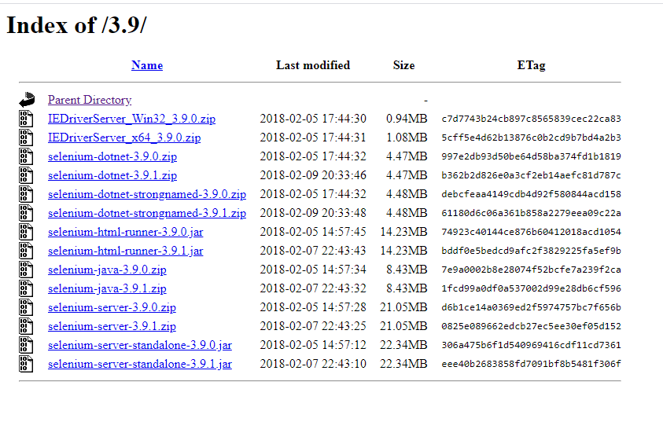

Slide 17
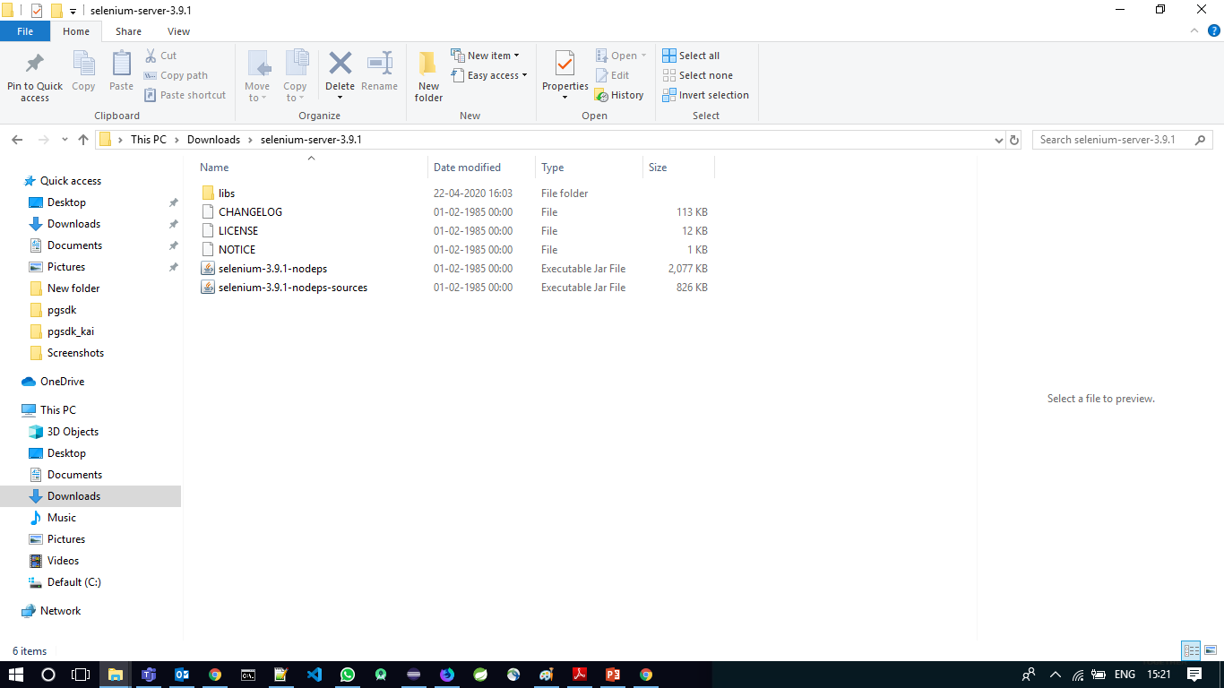
Extract the Zip File.

Slide 18
D. Download Selenium WebDriver: -
Download selenium WebDriver from:
https://www.selenium.dev/downloads/

Slide 19
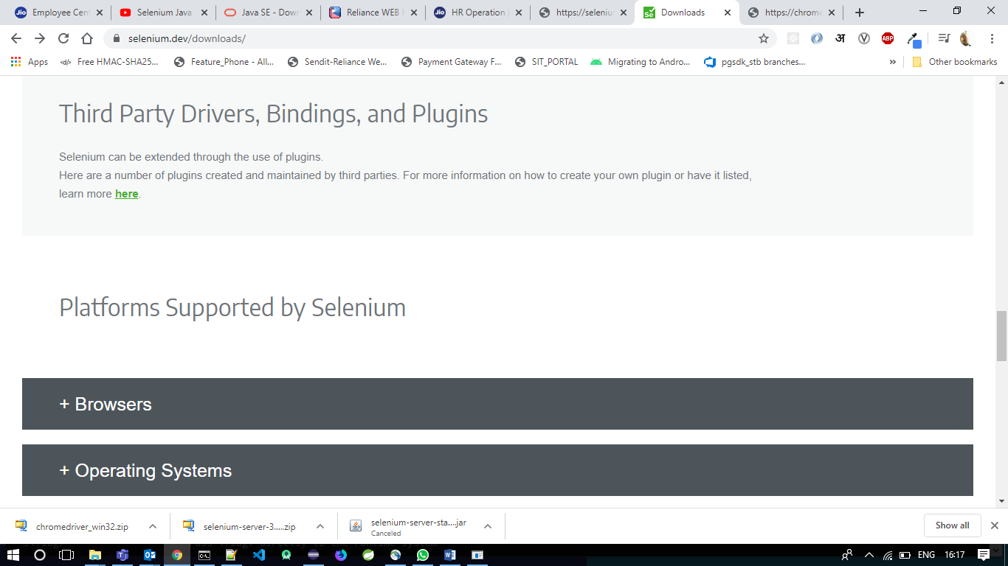
Click on ‘+Browsers’ and select ‘documentation’ under ‘Chrome’ section:

Slide 20
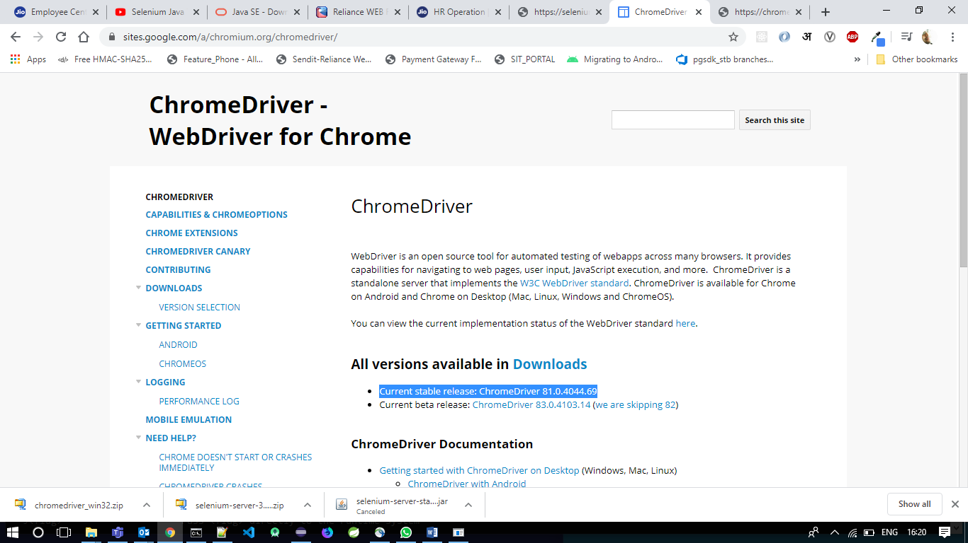
Download current stable release

Slide 21
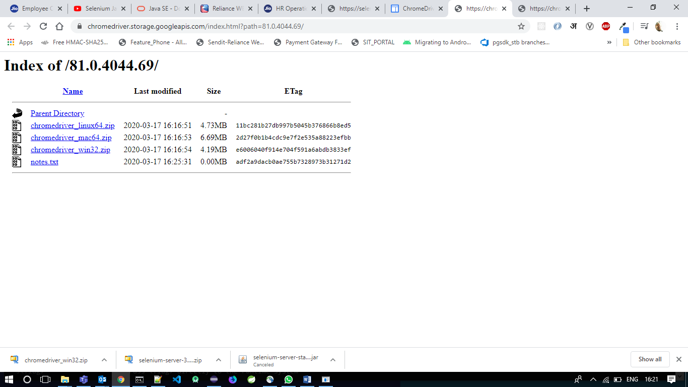
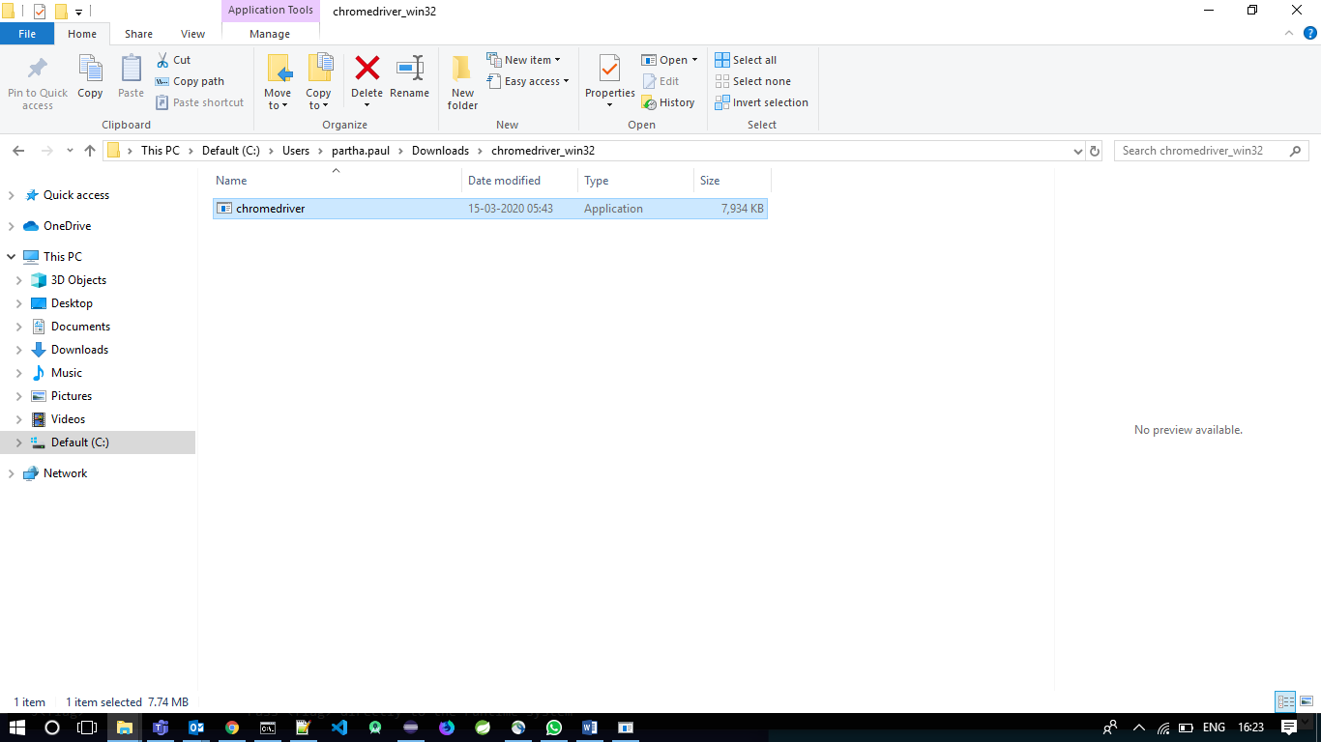
Download driver for windows (win 32)
Unzip the file:

Slide 22
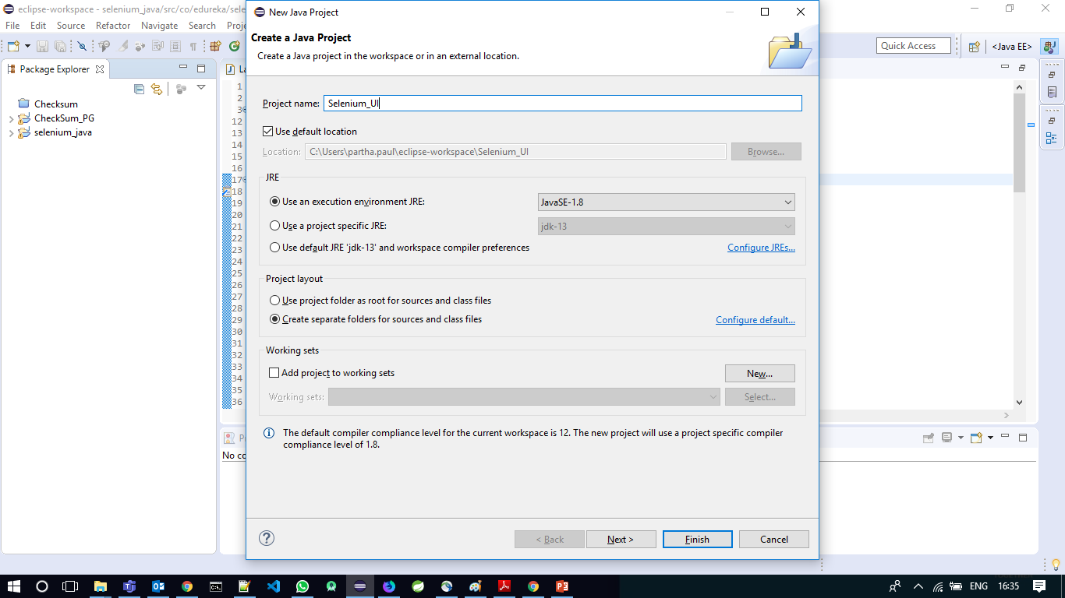
E. Configure Selenium WebDriver: -
Launch Eclipse IDE
Select File > New > java Project. Or Press “Alt+ Shift+ N” > Java Project

Slide 23
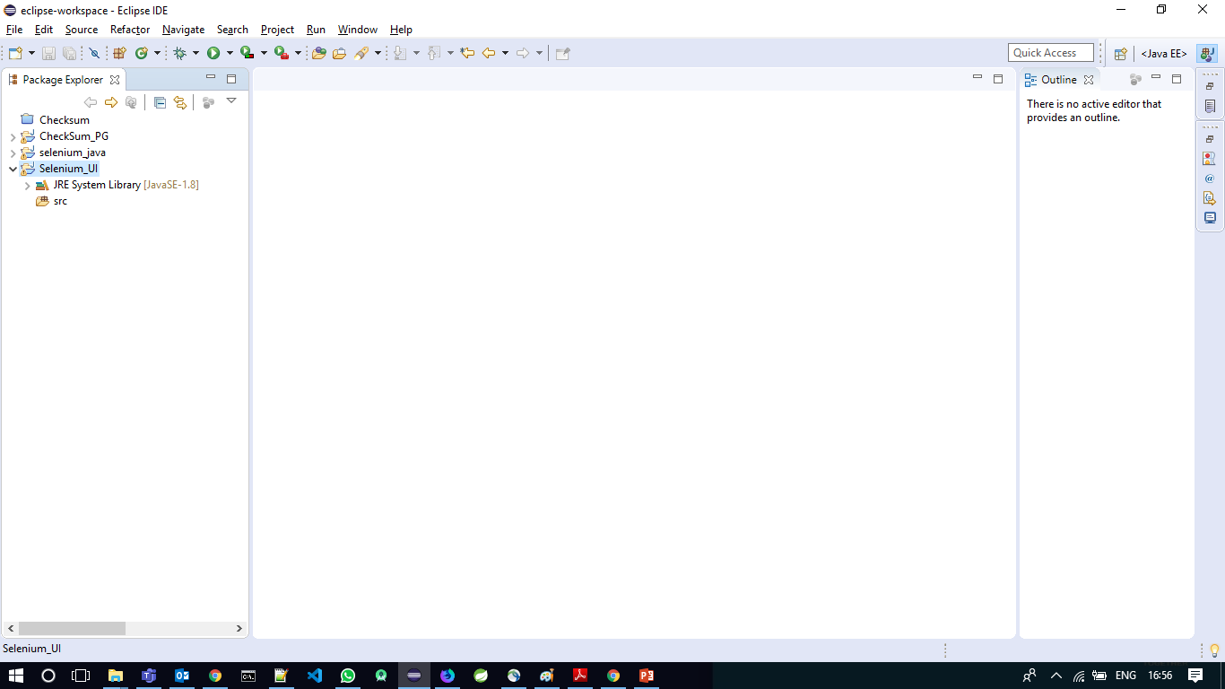
Create Project Name as “Selenium_UI”.

Slide 24
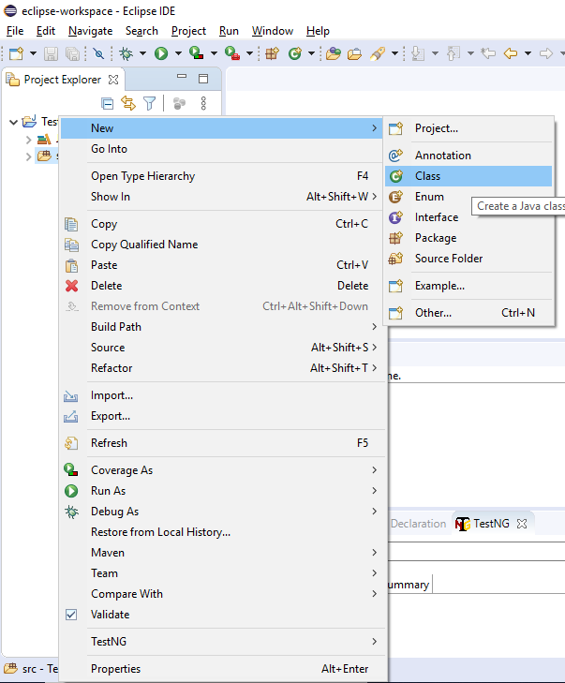
Right Click on ‘src’ and create a new Java Class.

Slide 25
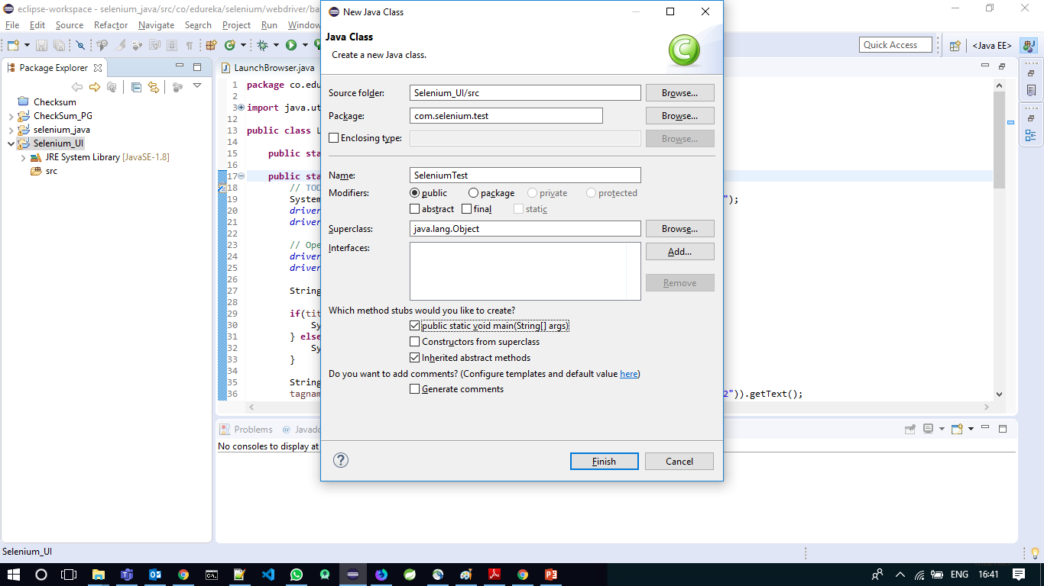
Create a Package name as “com.selenium.test” and Class name as “SeleniumTest” and select “Public static void main(String[] args)” and click ‘Finish’.

Slide 26
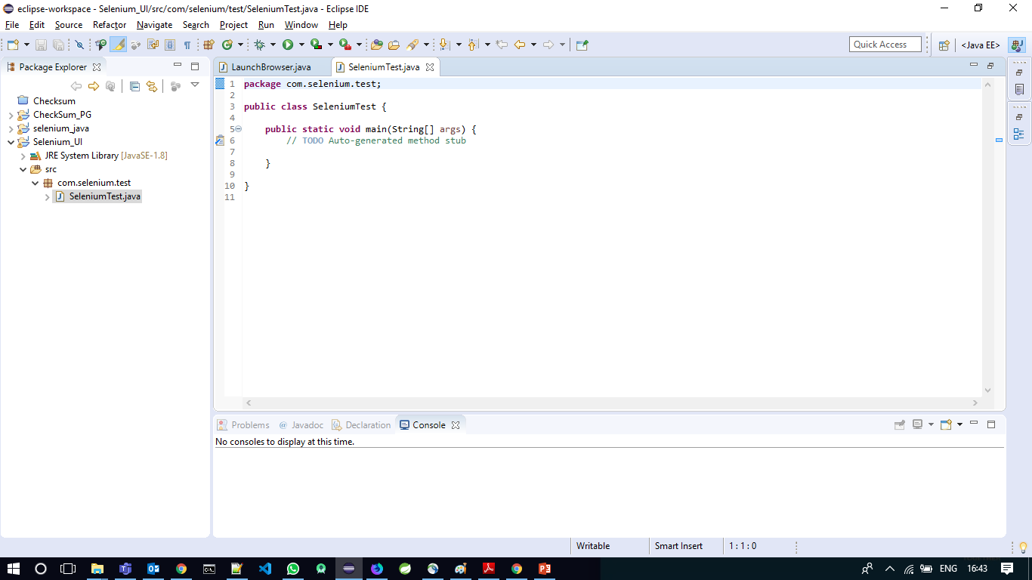

Slide 27
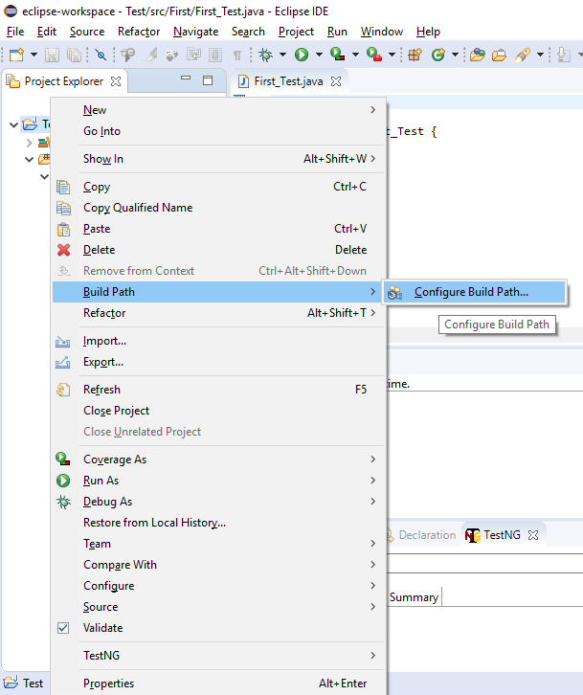
Right Click on “Selenium_UI” and Go to Build Path and Configure Build Path. :-

Slide 28
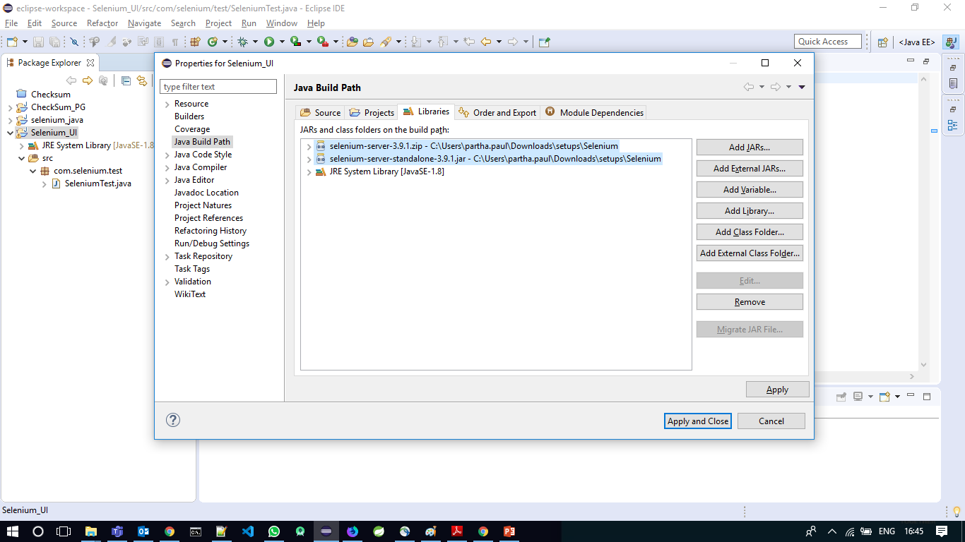
Click on ‘Add External JAR’ under ‘Libraries’ tab and add both ‘selenium-server-3.9.1.zip’ and ‘selenium-server-standalone-3.9.1.jar’ files one by one. Click on Apply and Close :-

Slide 29
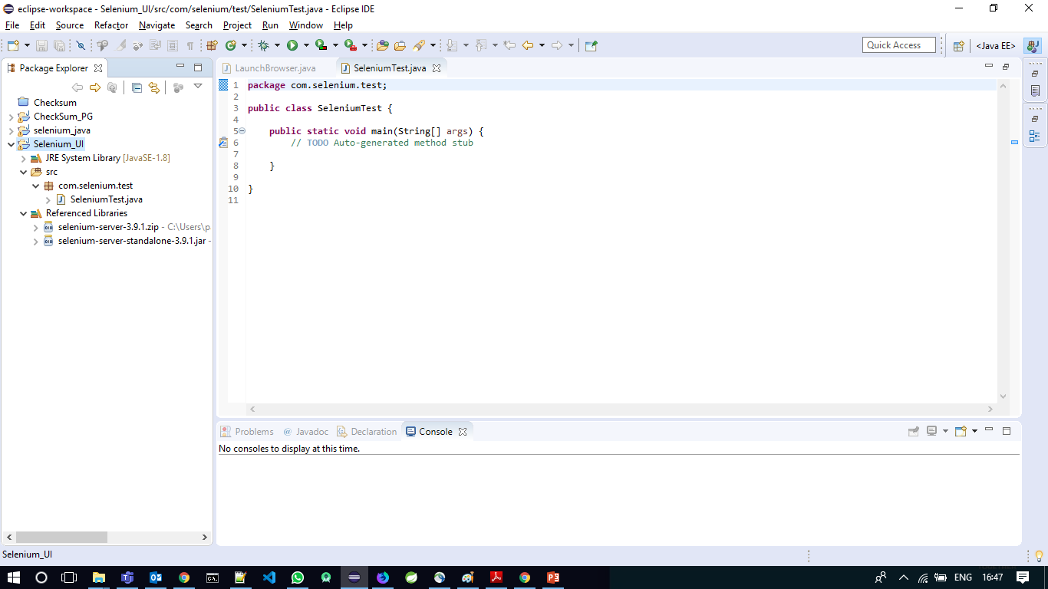
It will create “Referenced Libraries” section inside “Selenium_UI”:

Slide 30
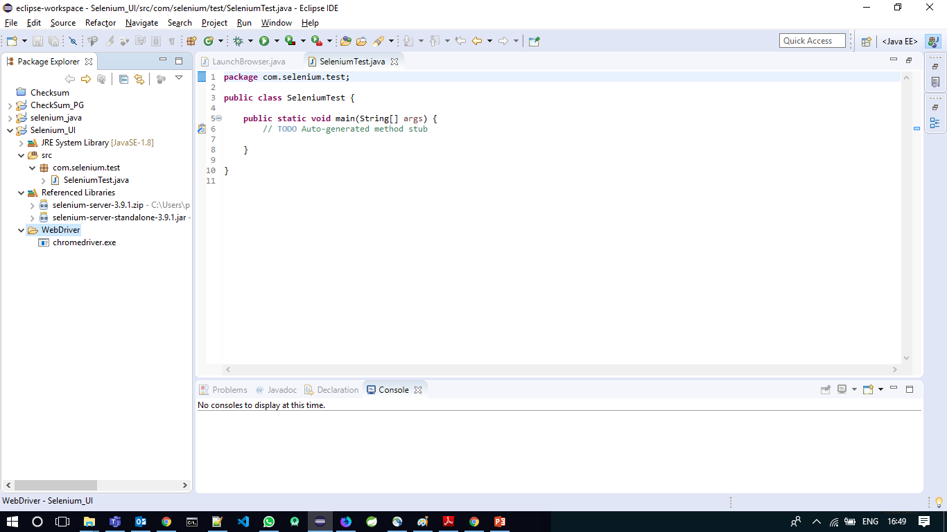
Now to add WebDriver, Create a folder inside “Selenium_UI”, Right click on “Selenium_UI” > New > Folder. Set a name, Say “WebDriver” and Finish.
Now copy and paste the selenium WebDriver for Chrome i.e. “chromedriver.exe” into this “WebDriver” folder

Slide 31
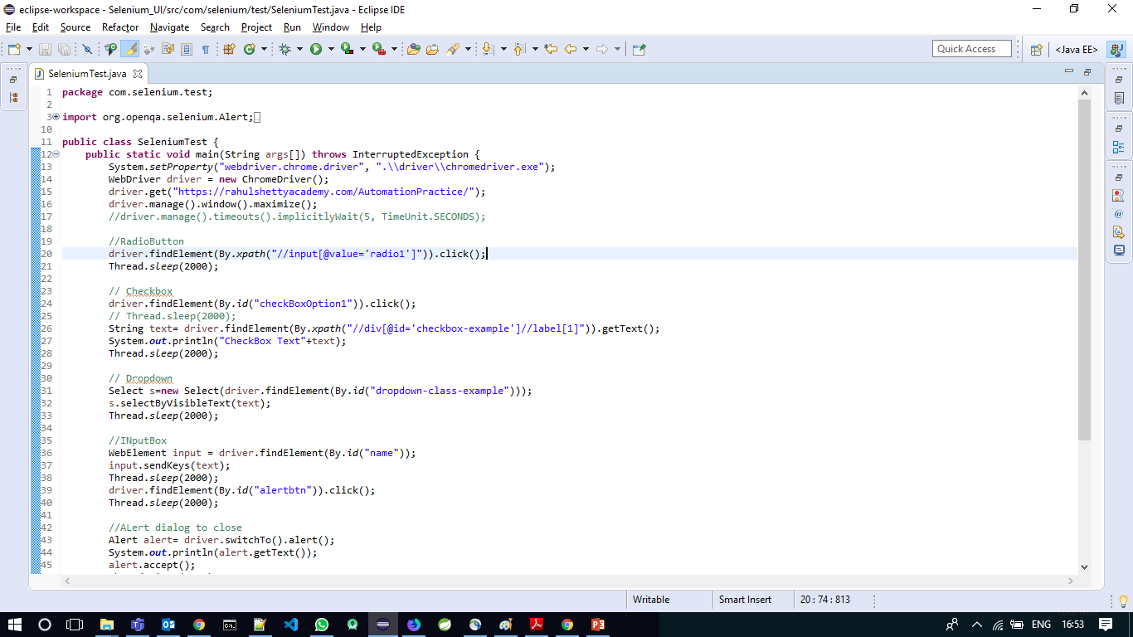
iv. Testing with selenium
Code walkthrough

Slide 32
Thank you for watching

