Slide 1


Interpretable Medical Imaging via Probabilistic Strip-CNNs
Presented By:
Parth Bhad
TE (Computer Engineering)
Roll No. : TCA46
Under the guidance of
Dr. Ajitkumar Shitole
Department of Computer Engineering
A.Y. 2026-27
Hope Foundation’s
International Institute of Information Technology, Hinjawadi, Pune-411057
Notes:
1
1

Slide 2

Introduction
Core Technology: Convolutional Neural Networks (CNNs) have become the default standard for medical image analysis (X-rays, CT scans, MRIs).
Standard Assumptions: Conventional CNNs rely on small square convolution kernels and deterministic output layers providing single, uncalibrated predictions.
Clinical Limitations: Pathological structures like blood vessels, nerve fibers, and fractures are directionally elongated, making standard square kernels geometrically suboptimal.
Reliability Risk: Models frequently output overconfident misdiagnoses without any indication of prediction confidence for clinicians.
Aug 22, 2026
Department of Computer Engineering, International Institute of Information Technology, Hinjawadi, Pune-411057
2
Notes:
2
2

Slide 3

Motivation
Geometrical Mismatch: Standard isotropic square windows fail to efficiently capture elongated or oriented anatomical structures.
The Trust Gap: High-stakes clinical environments demand not just high accuracy, but quantified confidence to flag uncertain cases for expert review.
Cross-Domain Inspiration: Recent advances in remote sensing demonstrate that large strip (anisotropic) convolutions substantially improve elongated object detection.
Research Opportunity: Combining anisotropic convolutions with uncertainty quantification (UQ) creates a more geometrically aware and trustworthy diagnostic tool.
Aug 22, 2026
Department of Computer Engineering, International Institute of Information Technology, Hinjawadi, Pune-411057
3
Notes:
3
3

Slide 4

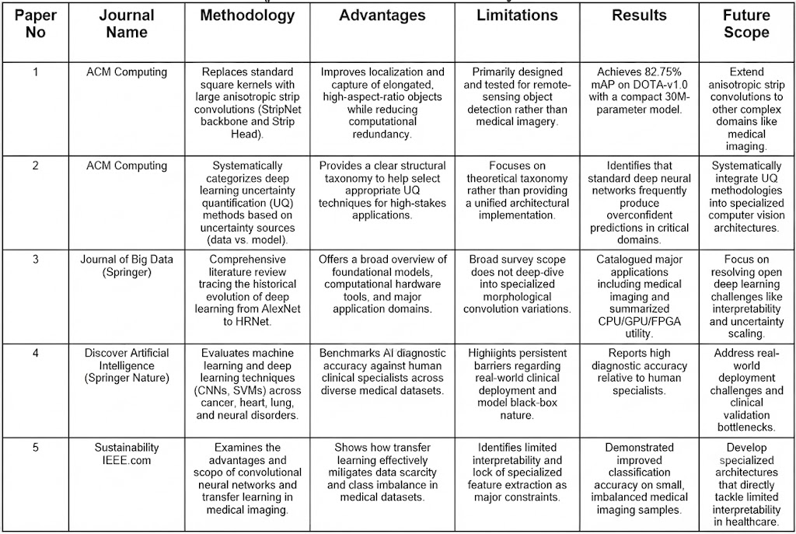
Literature Survey
Aug 22, 2026
Department of Computer Engineering, International Institute of Information Technology, Hinjawadi, Pune-411057
4
Notes:
4
4

Slide 5

Summary/Findings of Literature Survey
Common Trend: High diagnostic performance of CNNs across medical and remote-sensing image analysis.
Identified Gaps: Limited structural adaptability for elongated pathological features and a complete lack of built-in prediction confidence estimation.
Core Opportunity: Integrating spatial strip convolutions with robust uncertainty quantification can resolve both interpretability and reliability gaps.
Aug 22, 2026
Department of Computer Engineering, International Institute of Information Technology, Hinjawadi, Pune-411057
5
Notes:
5
5

Slide 6

Objectives of Existing System
Utilize standard square convolution kernels for uniform spatial feature aggregation across image grids.
Apply deterministic classification or segmentation layers to yield single-value categorical outputs.
Leverage transfer learning techniques to overcome data scarcity and class imbalance in medical repositories.
Maximize raw classification metrics (like pixel accuracy and standard loss minimization) without evaluating confidence calibration.
Aug 22, 2026
Department of Computer Engineering, International Institute of Information Technology, Hinjawadi, Pune-411057
6
Notes:
6
6

Slide 7
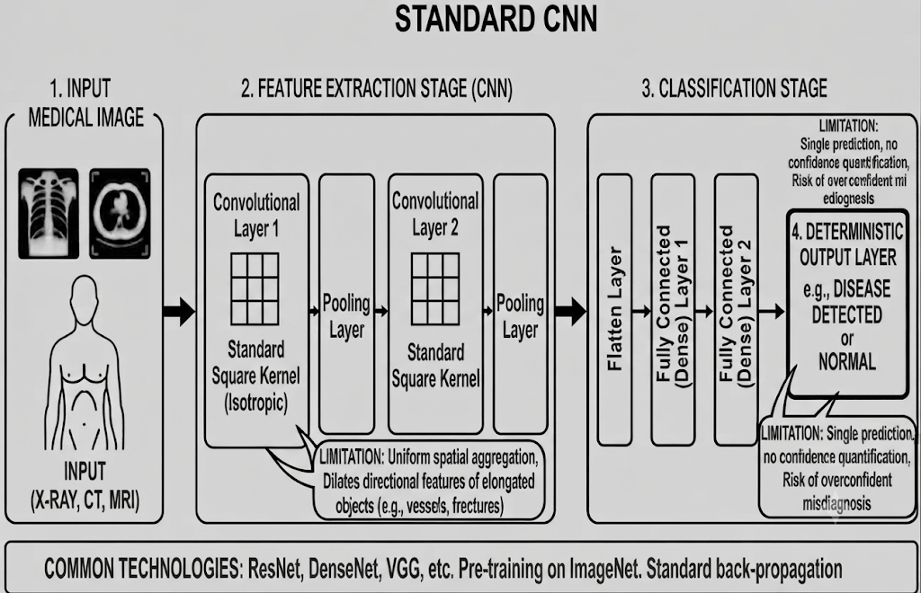
Architecture of Existing Systems
Diagram of how current systems work
Explanation of system components
Technologies used in existing systems
Aug 22, 2026
Department of Computer Engineering, International Institute of Information Technology, Hinjawadi, Pune-411057
7
Notes:
7
7

Slide 8

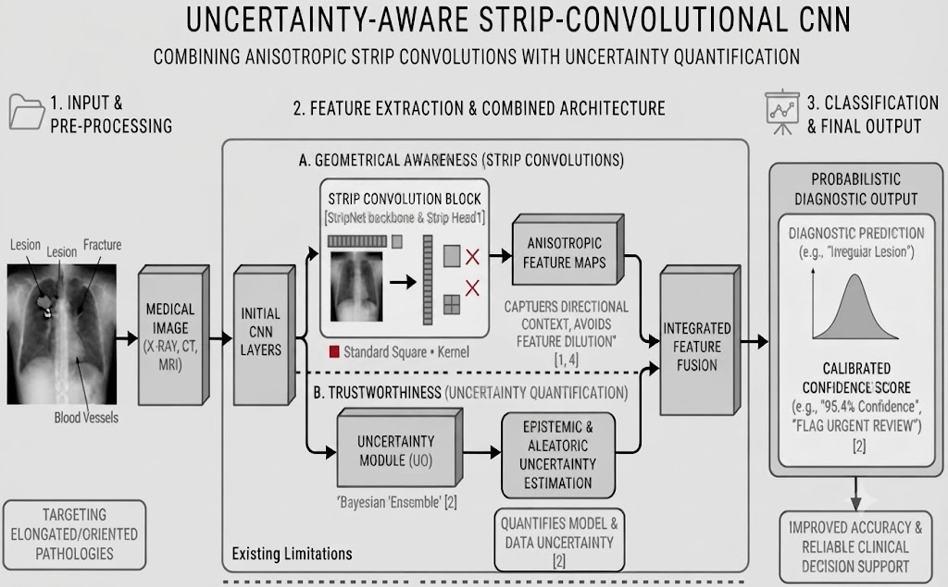
Proposed System
Spatial Inefficiency: Conventional square kernels fail to capture elongated structures (e.g., vessels, hairline fractures, linear lesions) accurately.
Overconfidence Risk: Standard CNNs produce uncalibrated predictions, leading to potentially dangerous, overconfident misdiagnoses in clinical environments.
Actionable Need: A specialized medical imaging framework is required that simultaneously improves geometrical awareness via strip convolutions and supplies calibrated confidence metrics.
Aug 22, 2026
Department of Computer Engineering, International Institute of Information Technology, Hinjawadi, Pune-411057
8
Notes:
8
8

Slide 9

Aim and Objectives (Proposed System)
Aim: Design an interpretable, reliable CNN architecture for medical image classification and segmentation using probabilistic strip convolutions.
Objective 1: Study limitations of standard square kernels regarding elongated anatomical structures.
Objective 2: Review and map uncertainty quantification (UQ) techniques to deep medical diagnostic networks.
Objective 3: Design a unified CNN architecture integrating strip convolutions with an uncertainty estimation module.
Objective 4: Evaluate performance on public medical datasets using accuracy, Dice score, and Expected Calibration Error (ECE).
Aug 22, 2026
Department of Computer Engineering, International Institute of Information Technology, Hinjawadi, Pune-411057
9
Notes:
9
9

Slide 10
Progress & Technical Understanding
Detailed study: retinal vessel segmentation using an encoder-decoder U-Net.
Strip convolutions: horizontal 1 × 7 and vertical 7 × 1 filters capture directional features.
Monte Carlo dropout: repeated predictions produce a mean vessel map and variance map.
Technologies explored: Python, PyTorch, OpenCV, Streamlit and WebRTC.
Implementation: vessel segmentation, fracture localization, pneumonia screening and PDF reports.
9-Oct-26
Department of Computer Engineering, International Institute of Information Technology, Hinjawadi, Pune-411057
10

Slide 11
Analysis & Findings
Approach comparison: square filters collect local features. Strip filters focus on horizontal and vertical patterns.
Uncertainty comparison: deterministic inference gives one prediction. Dropout sampling shows variation across runs.
Pneumonia test findings: AUROC 0.95549, sensitivity 98.46% and specificity 65.81%. False alarms remain common.
Fracture findings: the published checkpoint has 47.3% recall. A negative screen can miss fractures.
Key observation: controlled square-versus-strip results and independent retinal validation remain pending.
9-Oct-26
Department of Computer Engineering, International Institute of Information Technology, Hinjawadi, Pune-411057
11

Slide 12

Conclusion
Summary: Standard CNN limitations in medical imaging stem from rigid square kernels and uncalibrated deterministic outputs.
Significance: Integrating anisotropic strip convolutions and uncertainty quantification bridges critical interpretability and reliability gaps.
Future Work: Implementation, rigorous benchmark testing against standard baselines, and evaluation on medical imaging datasets (e.g., ISIC, DRIVE).
Aug 22, 2026
Department of Computer Engineering, International Institute of Information Technology, Hinjawadi, Pune-411057
10
Notes:
10
10

Slide 13

References
Yuan, X., et al. (2025). Strip R-CNN: Large Strip Convolution for Remote Sensing Object Detection. arXiv:2501.03775.
He, W., et al. (2025). A Survey on Uncertainty Quantification Methods for Deep Learning. ACM Computing Surveys.
Alzubaidi, L., et al. (2025). Review of Deep Learning: Concepts, CNN Architectures, Challenges, Applications, Future Directions. Journal of Big Data.
Ghaffar Nia, N., et al. (2023). Evaluation of Artificial Intelligence Techniques in Disease Diagnosis and Prediction. Discover Artificial Intelligence.
Salehi, A. W., et al. (2023). A Study of CNN and Transfer Learning in Medical Imaging... Sustainability.
Aug 22, 2026
Department of Computer Engineering, International Institute of Information Technology, Hinjawadi, Pune-411057
11
Notes:
11
11

Slide 14

Queries…?
Aug 22, 2026
Department of Computer Engineering, International Institute of Information Technology, Hinjawadi, Pune-411057
12
Notes:
12
12

Slide 15

Thank You….!
Aug 22 2026
Department of Computer Engineering, International Institute of Information Technology, Hinjawadi, Pune-411057
13
Notes:
13
13

