Slide 1
Robustness Analysis of Social Networks under Different Attack Models
Presented by - Ghosh, Partha & Thapa, Manish Jung & Acharya, Dinesh

Slide 2
Networked society
Network := individual with independent behavior is connected with certain other individual in different ways.
One city is influenced by other
One country is influenced by other
One individual is influenced by other
Complicated group behavior emerge from simple individual behavior.
We form network without noticing.
Power grid
Supply chain
Transportation
Are they Perfect? How do they behave when expected behavior is not received in individual level.
Notes:
We start with definition of a network - Each individual has a desired behavior on his own, but we are constantly affected by behavior of people around us. Each block of a city has its local authority and they are linked to other blocks. Each city operates on its own but is connected to other cities. And so on
More complicated than each individual
We live in a networked world but are they perfect? What happens if one doesn’t do his job. Important to see because otherwise we unknowingly depend upon one person/ entity too muc.

Slide 3
Research Problem
Determine Robustness of Randomly Generated Graphs
Effect of simplification of model is also explored
Notes:
We define a robustness metric and use it to study robustness of randomly generated graphs. We use the cascading model by Lubos et. al. to model the evolution of disease spread.
Rather than trying to model evolution of epidemic within a given population, as done by the models discussed earlier, we interpret the spread of disease from one city to another.
We also explore what happens if we simplifify the model i.e. disregard the effect of some parameters from the model.

Slide 4
Relevant Works
Epidemic Theory
Susceptible-Infected-Recovered (SIR) Model
Susceptible-Infectious-Susceptible (SIS) Model
Network Theory Model
Models based on simulation mechanism:
Rate of Infection = Transmission Rate * Number of Infected Neighbours
Probabilistic Spread of Infection
Notes:
SIR and SIS models are based on compartmentalization of the whole population into respectively two or three compartments and study the evolution of number of individuals in each compartments. Correspondingly they use two or three differential equations to model population dynamic. These models have the disadvantage that they cannot account for the dynamics that may arise due to individual behaviour.
Network Theory Based models try to capture the transfer of disease from one individual to another and study the dynamics of evolution of the epidemics. Based on the method of simulation of spread of disease, different methods are used. In one of the models, rate with which a node gets infected is equal to product of transmission rate and number of infected neighbours. In one of the models, a randomly chosen vertex can probabilistically infect any or all of its neighbours.

Slide 5
Networked models
Powerful tool to capture interaction between individual entities
Can be modeled in any granularity.
Nodes could be cities or every individual
Complicated and varying interactions can be captured by suitable edge models
It is easy to model individual participants in a system and then find their inter relation rather than trying to figure out everything at once.
The structure plays rather critical role
We explore exactly how critical this parameter in some of the well-known networks
Notes:
Obvious way to model a networked society is to model it with a network. Decouples the complexity of modeling individual behavior and their interraction

Slide 6
Assumptions
Disturbance rejection capability of a network is a good metric of measure of robustness
Each individual behaves fairly and takes part by propagating some part of its disturbance level and rejecting some part
Self-healing
No node tries to intentionally destabilize the whole network
The disturbance is of one kind
If there is a disease that is spreading there is only that entity. Panic over social media is not spreading and effecting individual behavior.

Slide 7
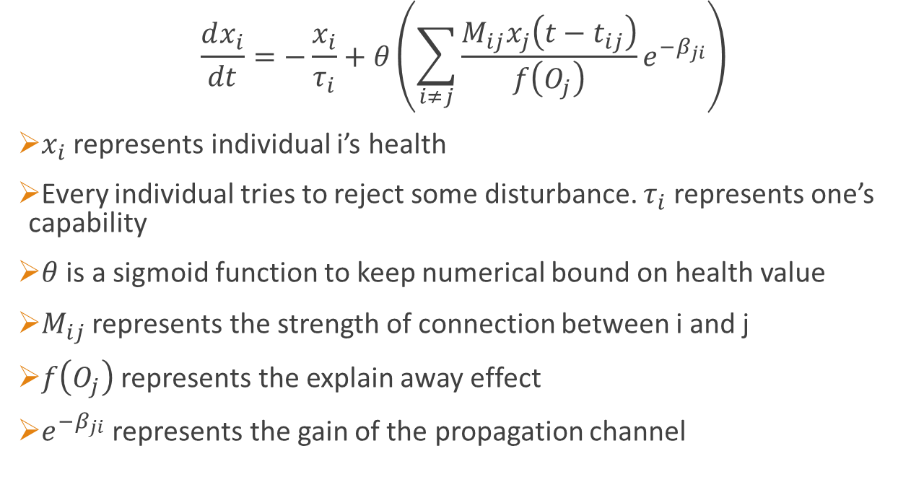
Model
represents individual i’s health
Every individual tries to reject some disturbance. represents one’s capability
is a sigmoid function to keep numerical bound on health value
represents the strength of connection between i and j
represents the explain away effect
represents the gain of the propagation channel
Notes:
Now before you think the model has too many hyper parameters let me explain you the physical meaning of the parameters and how we might sensibly set them.
Point 5 - Let us assume that two causes have same effect for example earthquake can make you house tremble. Same can happen if a truck hits your house. Now if you know only that you house trembled then you have equal probability of earthquake and a truck hitting your house. But if you know that there was an earthquake the then what is the probability of a truck hitting at the same time? It is much less. So knowledge about one cause explains away the effect. Here is a similar thing happening. If a node is connected to many different nodes its influence gets washed away.

Slide 8
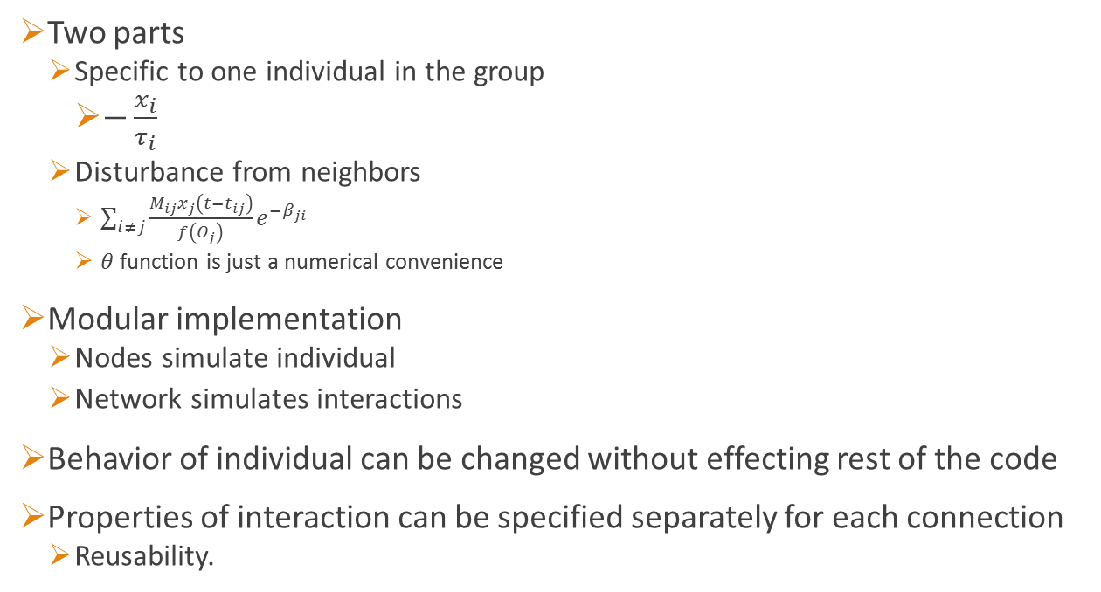
Implementation
Two parts
Specific to one individual in the group
Disturbance from neighbors
function is just a numerical convenience
Modular implementation
Nodes simulate individual
Network simulates interactions
Behavior of individual can be changed without effecting rest of the code
Properties of interaction can be specified separately for each connection
Reusability.
Notes:
We decided to take the execution hit in exchange to this convenience.

Slide 9
Implementation
Two parts
Specific to one individual in the group
Disturbance from neighbors
function is just a numerical convenience
Modular implementation
Nodes simulate individual
Network simulates interactions
Behavior of individual can be changed without effecting rest of the code
Properties of interaction can be specified separately for each connection
Reusability.
Notes:
We decided to take the execution hit in exchange to this convenience.

Slide 10
Results and their interpretations.

Slide 11
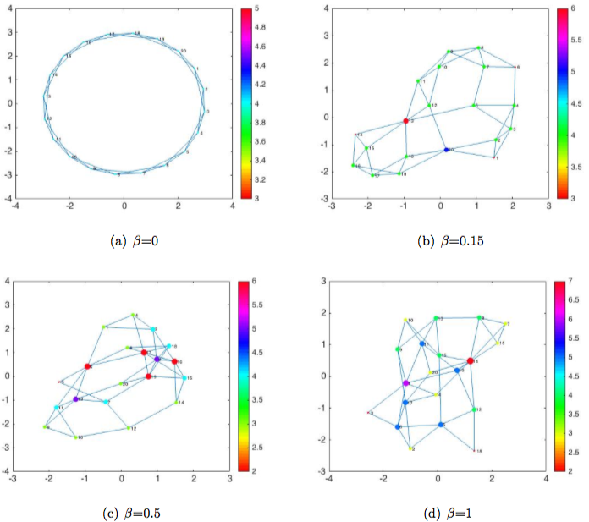
Small-world Networks
Small world networks created with Watts-Strogatz
The size is fixed, and average node degree is at 2
The beta parameter defines the probability of rewiring
Beta=0 is ideal small-world; large beta is random network

Slide 12
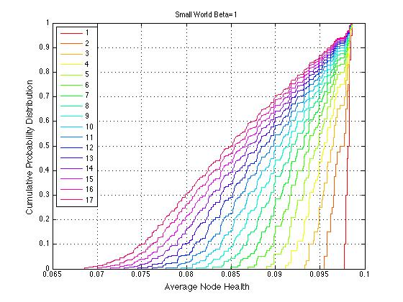
Evolution Plot
A node is infected
The evolution of other nodes’ health recorded in each iteration
This process is repeated for all other nodes
Each of this plots corresponds to CPD of node health for each iteration

Slide 13
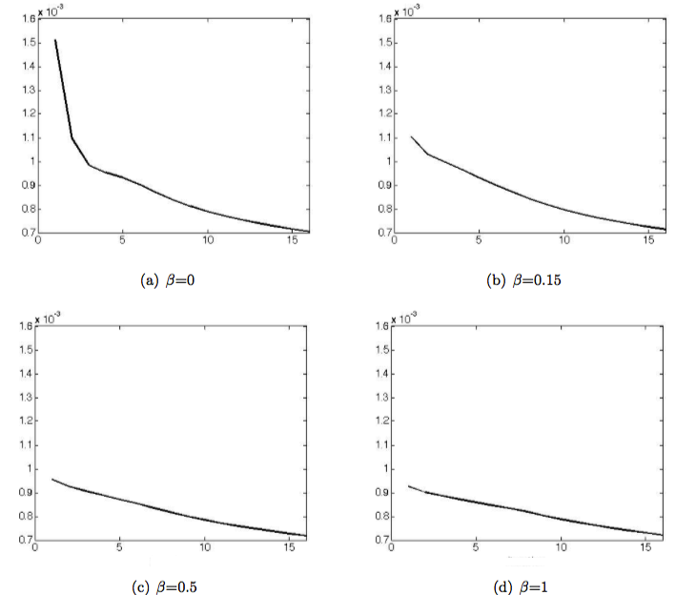
Average Node Health
Represents the average damage for each of the network
It is calculated as the area betw. two neighboring CPD plot
Bigger area signifies more damage
We call this average node health
Average node health
Average node health
iteration
iteration
Average node health
Average node health
iteration
iteration

Slide 14
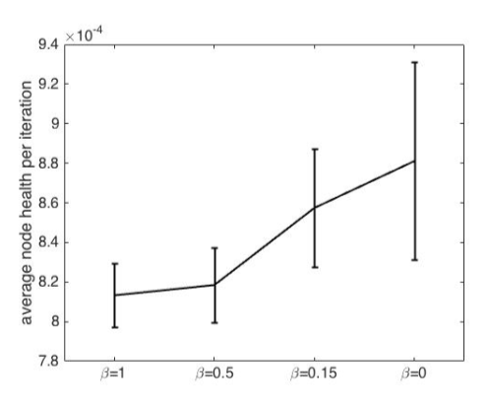
Robustness Metric
This plot quantifies the final robustness metric of network
It is defined as the average of ‘average node health’
The network with beta=0 is the least robust, while beta=1 is the most robust; long range interaction taking place

Slide 15
Conclusion
The tool developed in our project could be used to study the robustness of social networks
This tool is more practical; quantifies arbitrary node-failure
The metric is weighted, and transcends many domains of flow networks
With this tool, one can come up with better protection strategy because we are finally looking at optimizing the robustness metric of the network
Notes:
-We don’t just look at damage the network encounters under single particular node failure, but under any arbitrary single random node failure so this tool is more practical, because in flow networks you never know which node might fail at any given time.

Slide 16
References
Shirley, Mark D.F. and Rushton, Steve P. The impacts of network topology on disease spread, Ecological Complexity, 2005.
Buzna, Lubos; Peters, Karsten; Ammoser, Hendrik; Kuhnert, Christian and Helbing, Dirk. Efficient Response to Cascading Disaster Spreading, Physical Review, 2007.
Keeling, Matt J. and Ken T.D. Eames. Networks and Epidemic Models, Journal of the Royal Society Interface, 2015.

