Slide 1
Robustness Analysis of Social Networks under Different Attack Models
Presented by - Ghosh, Partha & Thapa, Manish Jung & Acharya, Dinesh

Slide 2
Networked society
Network := individual with independent behavior is connected with certain other individual in different ways.
One city is influenced by other
One country is influenced by other
One individual is influenced by other
Complicated group behavior emerge from simple individual behavior.
We form network without noticing.
Power grid
Supply chain
Transportation
Are they Perfect? How do they behave when expected behavior is not received in individual level.
Notes:
We start with definition of a network - Each individual has a desired behavior on his own, but we are constantly affected by behavior of people around us. Each block of a city has its local authority and they are linked to other blocks. Each city operates on its own but is connected to other cities. And so on
More complicated than each individual
We live in a networked world but are they perfect? What happens if one doesn’t do his job. Important to see because otherwise we unknowingly depend upon one person/ entity too muc.

Slide 3
Networked models
Powerful tool to capture interaction between individual entities
Can be modeled in any granularity.
Nodes could be cities or every individual
Complicated and varying interactions can be captured by suitable edge models
It is easy to model individual participants in a system and then find their inter relation rather than trying to figure out everything at once.
The structure plays rather critical role
We explore exactly how critical this parameter in some of the well-known networks
Notes:
Obvious way to model a networked society is to model it with a network. Decouples the complexity of modeling individual behavior and their interraction

Slide 4
Assumptions
Disturbance rejection capability of a network is a good metric of measure of robustness
Each individual behaves fairly and takes part by propagating some part of its disturbance level and rejecting some part
Self-healing
No node tries to intentionally destabilize the whole network
The disturbance is of one kind
If there is a disease that is spreading there is only that entity. Panic over social media is not spreading and effecting individual behavior.

Slide 5
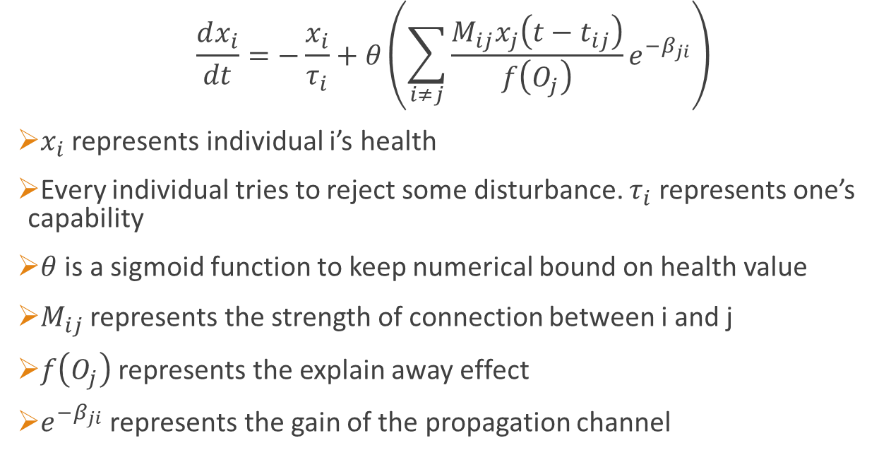
Model
$$\frac{dx_{i}}{dt}=−\frac{x_{i}}{τ_{i}}+θ\left(\sum_{i≠j}{\frac{M_{ij}x_{j}\left(t−t_{ij}\right)}{f\left(O_{j}\right)}e^{−β_{ji}}}\right)$$
$x_{i}$ represents individual i’s health
Every individual tries to reject some disturbance. $τ_{i}$ represents one’s capability
$θ$ is a sigmoid function to keep numerical bound on health value
$M_{ij}$ represents the strength of connection between i and j
$f\left(O_{j}\right)$ represents the explain away effect
$e^{−β_{ji}}$ represents the gain of the propagation channel
Notes:
Now before you think the model has too many hyper parameters let me explain you the physical meaning of the parameters and how we might sensibly set them.
Point 5 - Let us assume that two causes have same effect for example earthquake can make you house tremble. Same can happen if a truck hits your house. Now if you know only that you house trembled then you have equal probability of earthquake and a truck hitting your house. But if you know that there was an earthquake the then what is the probability of a truck hitting at the same time? It is much less. So knowledge about one cause explains away the effect. Here is a similar thing happening. If a node is connected to many different nodes its influence gets washed away.

Slide 6
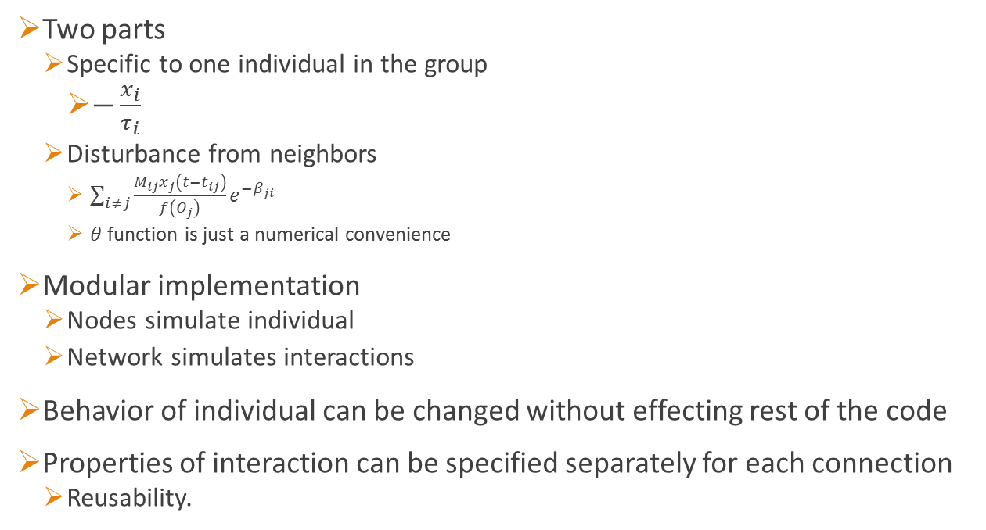
Implementation
Two parts
Specific to one individual in the group
$−\frac{x_{i}}{τ_{i}}$
Disturbance from neighbors
$\sum_{i≠j}{\frac{M_{ij}x_{j}\left(t−t_{ij}\right)}{f\left(O_{j}\right)}e^{−β_{ji}}}$
$θ$ function is just a numerical convenience
Modular implementation
Nodes simulate individual
Network simulates interactions
Behavior of individual can be changed without effecting rest of the code
Properties of interaction can be specified separately for each connection
Reusability.
Notes:
We decided to take the execution hit in exchange to this convenience.

Slide 7
Results and their interpretations.

Slide 8
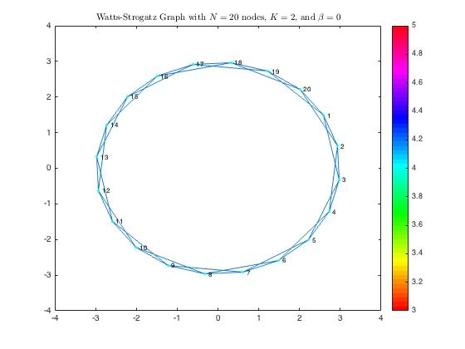
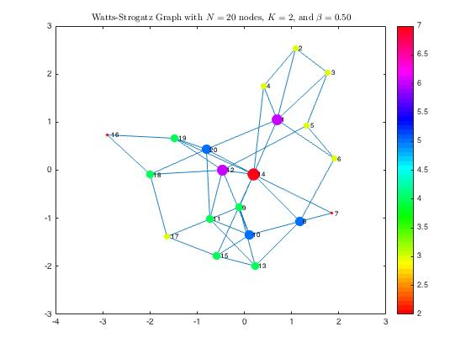
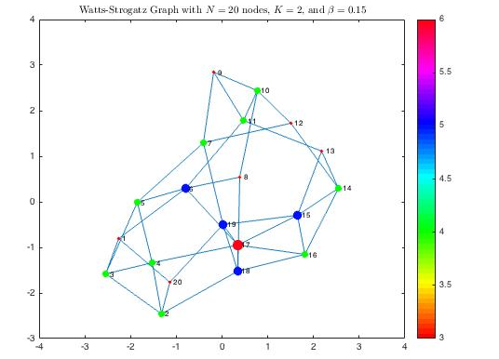
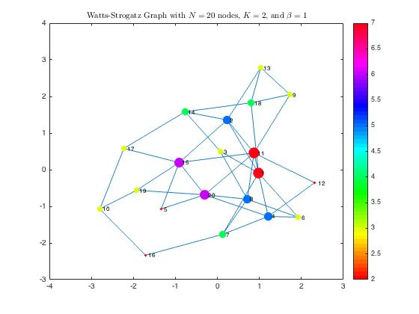

Slide 9
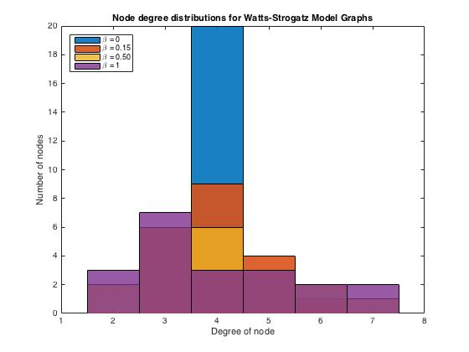

Slide 10
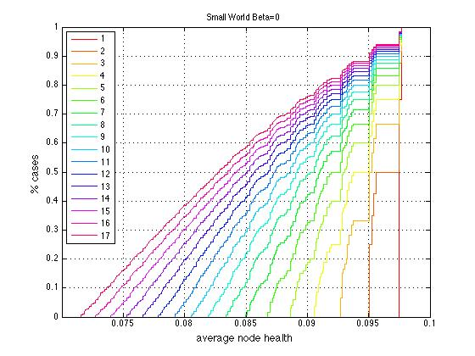

Slide 11
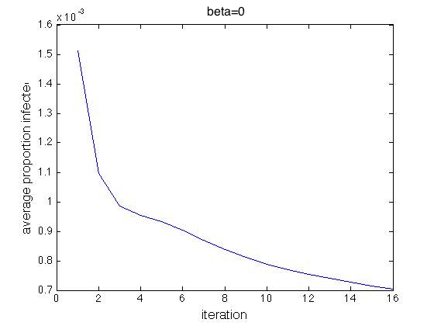
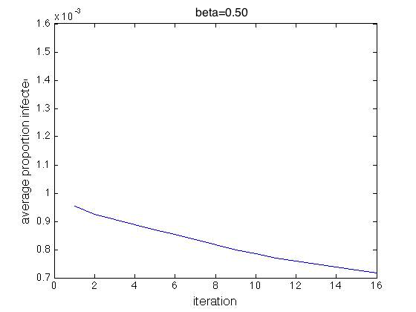
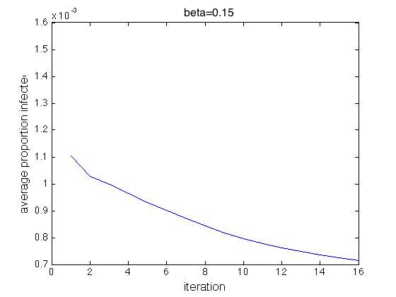
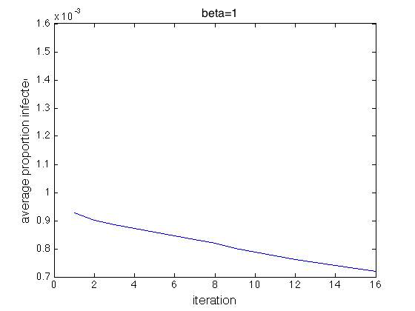

Slide 12
