Slide 1
Credit Score Classification
By Varun Iyer, Partha Sarathi Dutta, and Stoyan Stoyanov

Slide 2
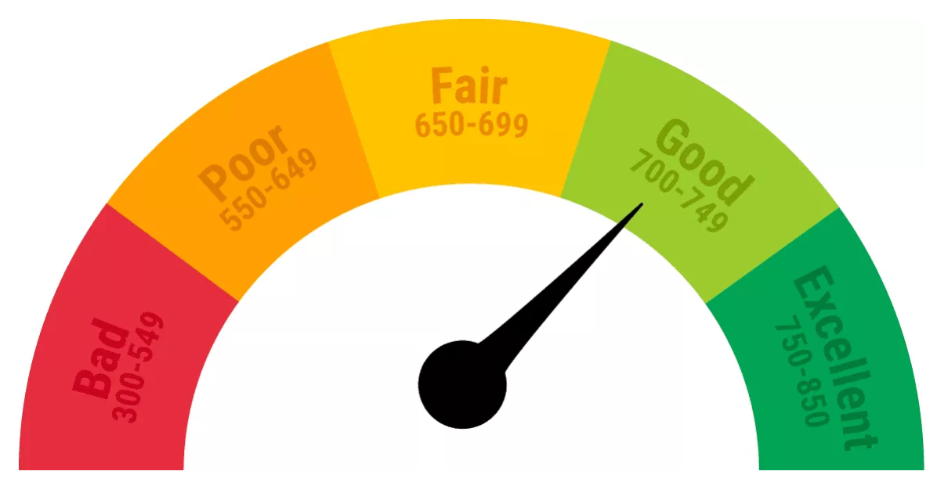
Credit Score
Numerical expression, ranging from 300 to 850, based on a level analysis of a person's credit history, used to represent the creditworthiness of an individual.
Assess the credit risk and interest on a loan.
Used by many financial institutions that use a risk-based system to determine the possibility that the borrower may default on financial obligations to the lender.

Slide 3
Task
Predict whether credit score is poor, standard, or good
Use both numerical and categorical features like:
Age
Annual income
Occupation
Credit mix
Outstanding debt
Monthly balance
Number of bank accounts
Evaluate variety of machine learning models, using accuracy and F1 score.

Slide 4
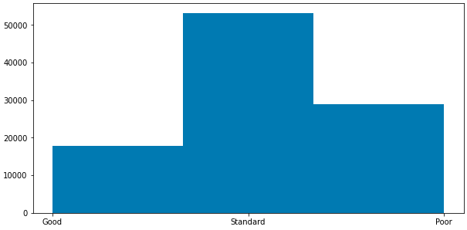
Dataset
From Kaggle, containing 100,000 rows (data points) and 28 columns (features)
Categorical variables converted to one-hot vectors for modeling purposes
44 total features after accounting for one-hot feature vectors
Frequency
Credit score

Slide 5
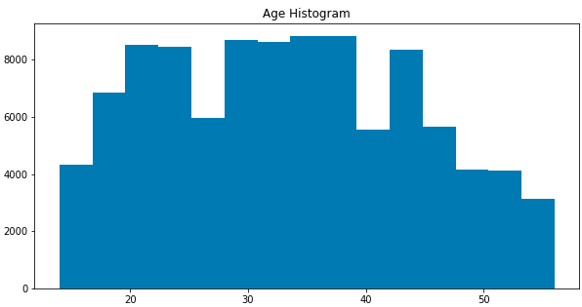
Dataset
Frequency
Age [years]

Slide 6
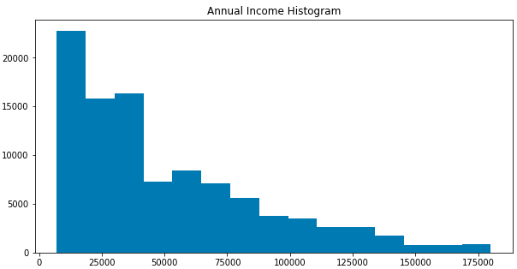
Dataset
Frequency
Annual Income [dollars/year]

Slide 7
Models
Random Forest
Leverages many independently trained decision trees to get a majority vote for classification
100 trees of max depth 30, fixed random state for reproducibility
Random attributes are chosen for each split in trees, each split maximizes information gain
XGBoost
Widely used boosting algorithm used in to perform well in Kaggle datasets
Iteratively forms decision trees to correct mistakes made by previous trees
100 trees, fixed random state for reproducibility
Learning rate of 0.1
Max depth of 30

Slide 8
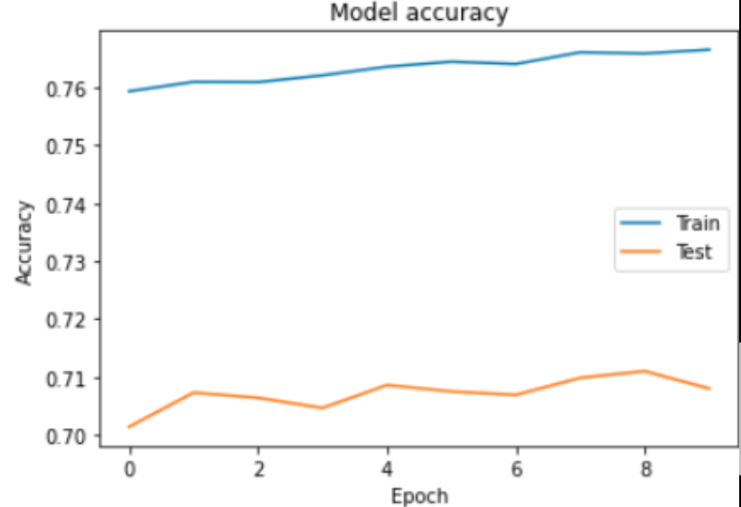
Models
Logistic Regression
Optimized using LBGFS
Support Vector Machines
Polynomial (degree 3) kernel
RBF kernel
Regularization constant C={0.1, 1, 10}
Multi-layer Perceptron
ReLU/Sigmoid activation
Adam optimizer
Dropout regularization
2 hidden layers of size 100

Slide 9
Results
Model | Train Accuracy (%) | Test Accuracy (%) | Test F1 Score (%)
Random Forest | 99.91 | 77.96 | 75.91
XGBoost | 100.00 | 79.12 | 78.29
Logistic Regression | 66.31 | 61.61 | 57.12
SVM (Polynomial) | 67.67 | 67.64 | 66.17
SVM (RBF) | 71.67 | 67.79 | 64.42
MLP | 76.65 | 70.80 | 69.23

Slide 10
Conclusion
XGBoost performs best in F1 and accuracy scores on test set
MLP is not yet achieving high enough performance -> bigger network needed
RBF kernel outperforms polynomial kernel in SVM
Future work
More hyperparameter tuning
More detailed study of how individual variables such as age and occupation affect performance

