Slide 1
Parthasarathi D
2021506060
B.Tech Information Technology
Madras Institute of Technology
TNSDC - Machine Learning to
Generative AI
Final Project
DATE:02/04/2024

Slide 2
PROJECT TITLE
Animal Classification Using CNN ( Deep Learning Algorithm )
GITHUB LINK:https://github.com/Parthasarathi-D/animal-finder

Slide 3


AGENDA
Problem Statement
Project Overview
Objectives
End Users
Solution and Value Proposition
Model Explanation
Results
Conclusion
3/21/2024 Annual Review

Slide 4

PROBLEM STATEMENT
Identifying and categorizing animals from images can be challenging due to the diversity and complexity of animals. Manual classification of animals is time-consuming and prone to errors, hindering the efficiency of tasks such as menu management, food blogging, and culinary education.

Slide 5

PROJECT OVERVIEW
The project involves training a neural network model to classify images into one of six predefined classes. The model is built using a convolutional neural network (CNN) architecture and trained using preprocessed image data.

Slide 6
OBJECTIVES
Train a neural network model to accurately classify images into six classes.
Validate the model's performance using a separate dataset to ensure generalization.
Test the trained model on a separate set of unseen data to evaluate its real-world performance.
Optimize the model's architecture and hyperparameters to achieve high accuracy and robustness.

Slide 7

WHO ARE THE END USERS?
Researchers and practitioners in the field of computer vision and deep learning.
Developers and engineers working on applications requiring image classification, such as autonomous vehicles, medical imaging, and surveillance systems.
Industries leveraging image recognition technology for various purposes, including marketing, e-commerce, and security.

Slide 8

YOUR SOLUTION AND ITS VALUE PROPOSITION
High Accuracy: The trained model aims to achieve high accuracy in classifying images into predefined categories.
Efficiency: The use of preprocessed bottleneck features and transfer learning helps in training the model efficiently, especially with limited computational resources.
Real-world Applicability: The trained model can be deployed in real-world scenarios to automate image classification tasks, saving time and resources.

Slide 9

THE WOW IN YOUR SOLUTION
The wow factor of this project lies in its ability to accurately identify and categorize a wide range of Indian dishes, irrespective of variations in presentation or ingredients. The solution provides users with a seamless and intuitive experience, empowering them to efficiently manage, share, and explore Indian cuisine.
3/21/2024 Annual Review

Slide 10
SYSTEM REQUIREMENTS
HARDWARE REQUIREMENTS
CPU: A multi-core processor (such as Intel Core i5 or higher) is recommended for efficient training and inference.
GPU (Optional): A dedicated graphics processing unit (GPU) from NVIDIA (such as GeForce GTX 1060 or higher) can significantly accelerate deep learning tasks, especially training large models like CNNs.
RAM: At least 8 GB of RAM is recommended for running deep learning frameworks and handling large datasets.
Storage: Sufficient disk space to store the dataset, trained models, and related files. SSDs are preferable for faster data access.

Slide 11
SYSTEM REQUIREMENTS
SOFTWARE REQUIREMENTS
.Python: Python 3.x installed with essential libraries such as NumPy, pandas, and Matplotlib.
Deep Learning Framework: TensorFlow or PyTorch for building and training the CNN model. The code provided in the project uses TensorFlow.
Image Processing Libraries: Libraries like OpenCV and PIL (Python Imaging Library) for image pre-processing and augmentation.
Development Environment: An integrated development environment (IDE) like Jupyter Notebook or PyCharm for coding and experimentation.
Additional Dependencies: Libraries such as scikit-learn, seaborn, and h5py may be required for data analysis, visualization, and model serialization

Slide 12
Algorithm:
The project employs an InceptionV3 CNN model, adept at hierarchical feature extraction from images, ideal for image classification tasks.
Deployment:
The trained CNN model can be deployed across diverse environments like local machines, cloud platforms (Google Cloud, AWS, Azure), and edge devices (Raspberry Pi, NVIDIA Jetson), serialized in HDF5 format for easy sharing and storage.
Evaluation:
Utilizing split datasets for training, validation, and testing, the project evaluates the CNN model's performance using metrics like accuracy, precision, recall, and F1-score, offering insights into its classification capabilities.
Prediction:
After training and evaluation, the project enables real-time prediction of Indian dishes from images, providing users with instant classification results along with confidence scores for each prediction.

Slide 13
MODELLING
The model architecture consists of multiple layers, including Flatten, Dense, and Dropout layers.
The Flatten layer reshapes the input data to a 1D array before passing it to the fully connected Dense layers.
Dense layers with LeakyReLU activation functions introduce non-linearity to the model, enabling it to learn complex patterns in the data.
Dropout layers help prevent overfitting by randomly dropping a fraction of input units during training.
The model is compiled with categorical cross-entropy loss and RMSprop optimizer for training.
Training, validation, and testing are performed using preprocessed bottleneck features and corresponding labels.

Slide 14
MODELLING
This Project utilizes the InceptionV3 architecture, a pre-trained deep learning model known for its exceptional performance in image recognition tasks.
InceptionV3 is capable of extracting intricate features from images, enabling accurate classification of complex objects.
The model is fine-tuned on a dataset comprising various types of animals to adapt it specifically to the task of animal classification.

Slide 15
RESULTS
The training process involves training the model for 7 epochs with the provided training data.
The model's performance is evaluated on separate validation and testing datasets using accuracy and loss metrics.
The final accuracy and loss values on the validation dataset are printed, indicating the model's performance.
The total time taken for model training and evaluation is recorded.

Slide 16
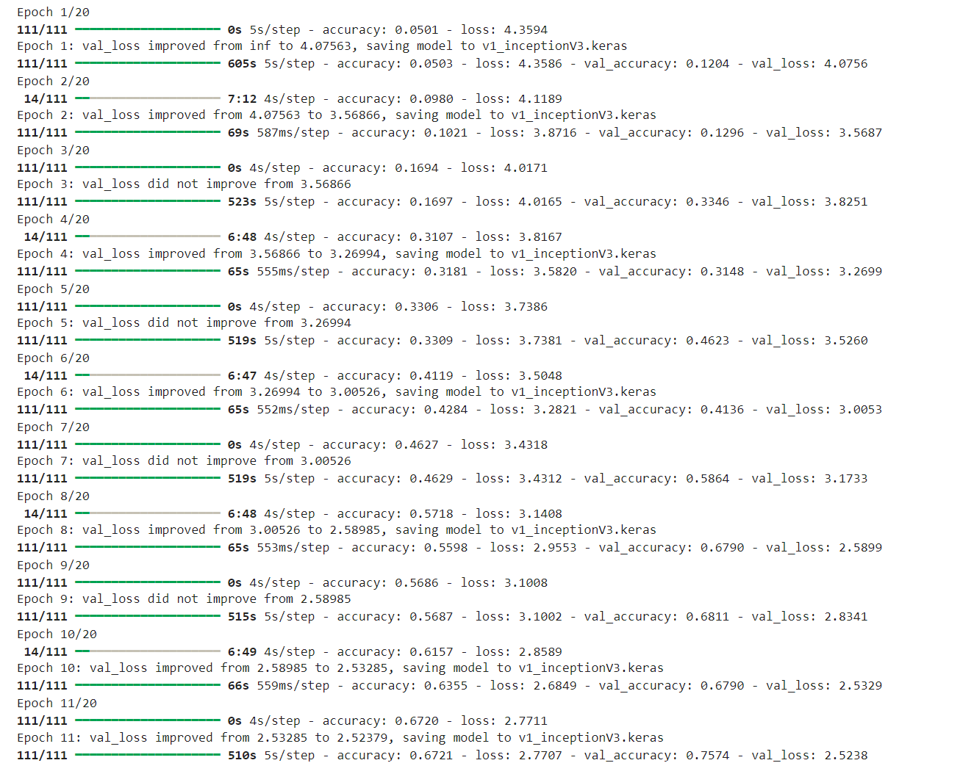
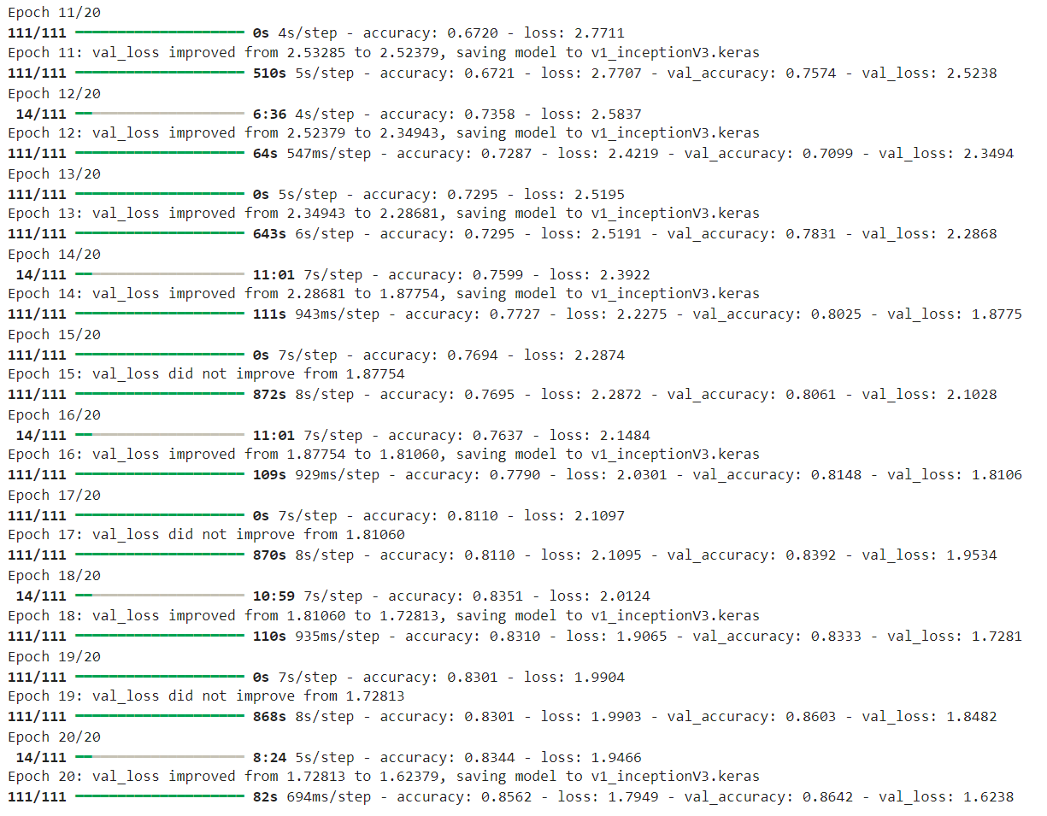
RESULTS

Slide 17
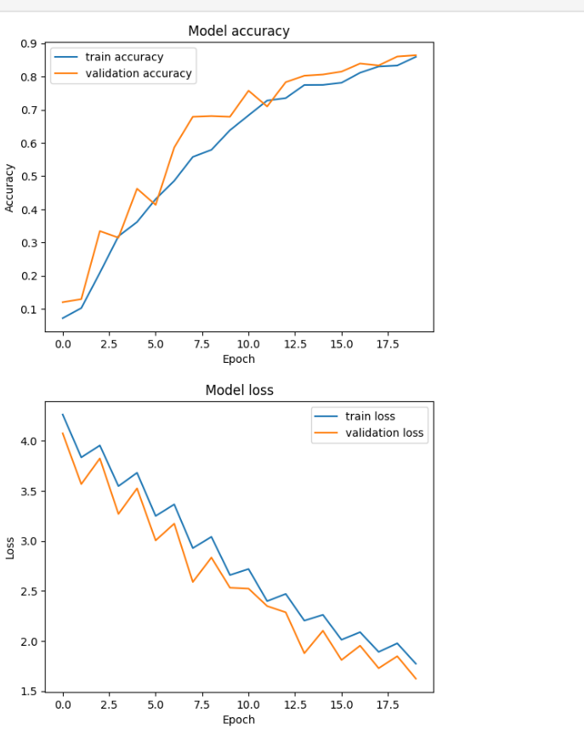
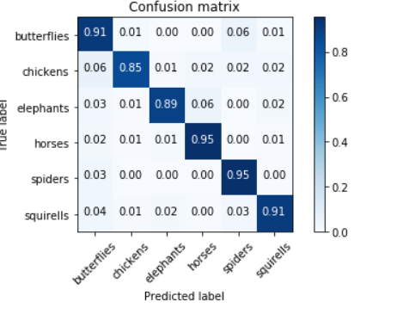
RESULTS

Slide 18
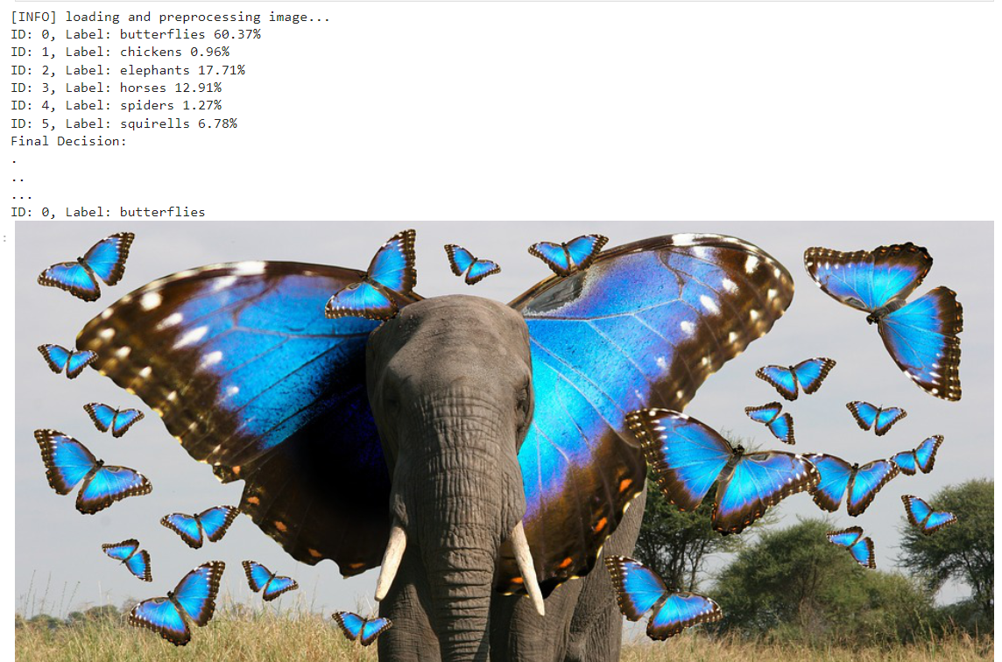
RESULTS

Slide 19
CONCLUSION
The provided code snippet showcases the implementation of a neural network model for image classification.
The project demonstrates the feasibility of using deep learning techniques for accurate classification tasks.
Further optimization and fine-tuning of the model architecture may be explored to enhance performance.
Overall, the project contributes to advancing the field of computer vision and offers practical solutions for image classification tasks.
:

