Slide 1
Janatahack: Cross-sell Prediction

Slide 2
Aim
To predict whether the policyholders (customers) from past year will also be interested in Vehicle Insurance provided by the company.
Result
45.5% people will be interested in Vehicle loan based on the previous year data.

Slide 3
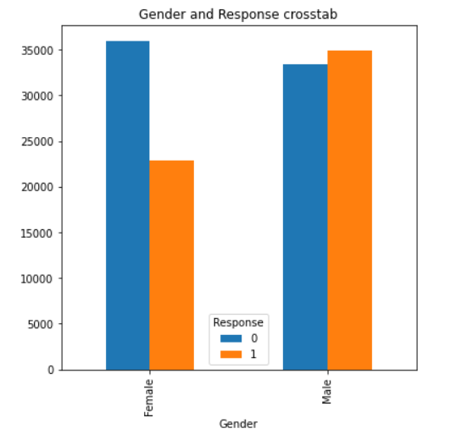
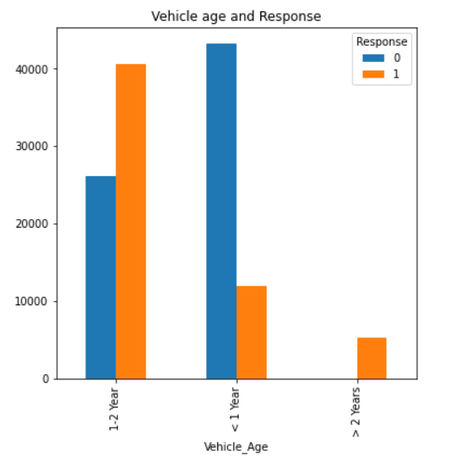
OBSERVATIONS MADE

Slide 4
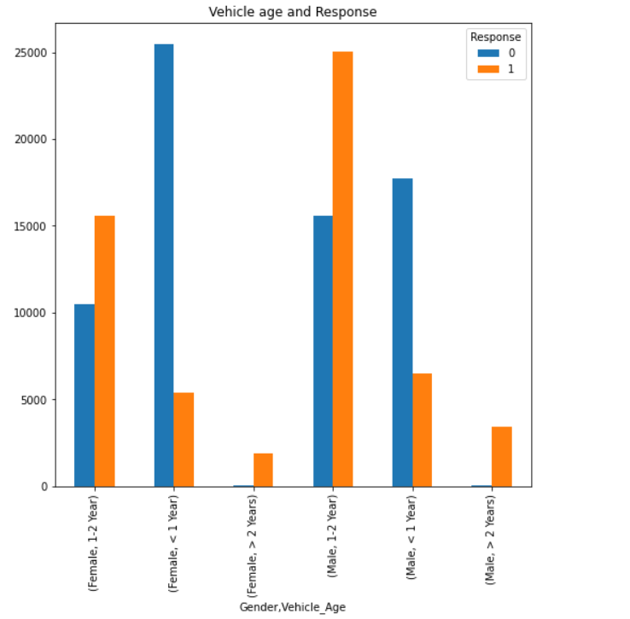
Male who has a vehicle which is 1-2 years old opted for insurance in larger quantity.
Vehicle older then 2 years have very less chances of saying NO to insurance.
It is not recommended to target vehicle owners who’s vehicle are less than a year old irrespective of the gender.

Slide 5
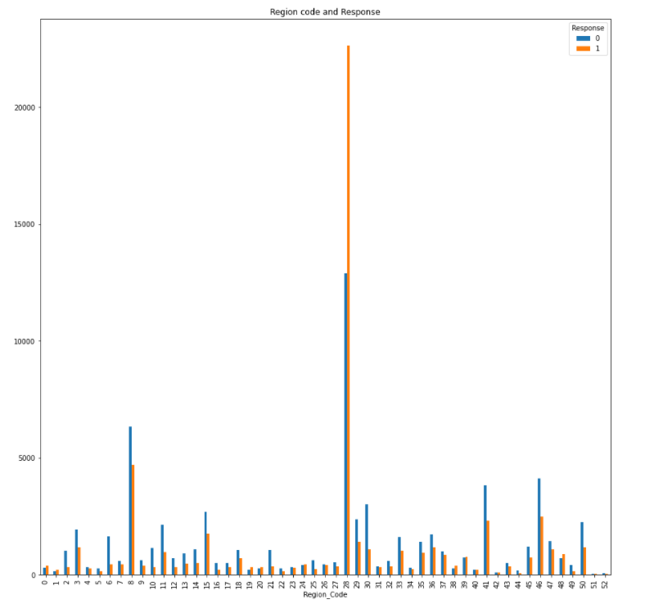
Region 28 has the most acceptance as well ad rejection rate.
Followed by region 8.

Slide 6
Submission score

Slide 7
Melanoma Tumour Size Prediction

Slide 8
Aim
To predict the melanoma tumour size based on various attributes and the data from the past.
Result
Majority of the predicted results lie under 4 to 8 mm.

Slide 9
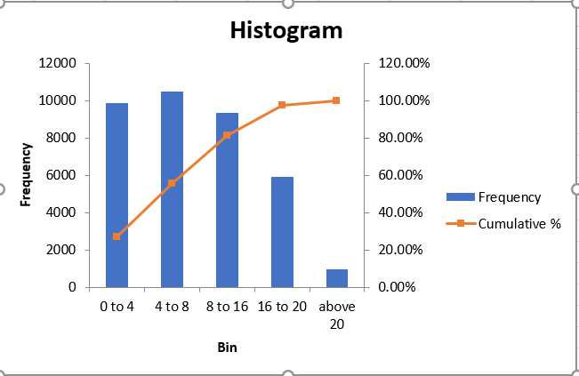
Size (mm) | People count
0 to 4 | 9845
4 to 8 | 10501
8 to 16 | 9341
16 to 20 | 5934
above 20 | 963

Slide 10
Submission score

