Slide 1




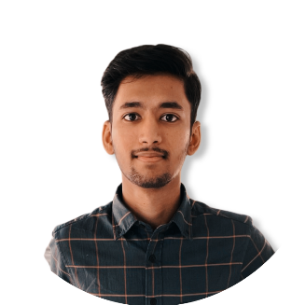

SUMMARY
3+ years of experience as a Salesforce developer with a strong ability to learn and adapt to new technologies quickly. Experience in Salesforce Development/Customizations, Lightning Components experience and Salesforce communities.
Parthasarathy K G
Salesforce Developer
EXPERIENCE
github.com/Parthasarathykg
GitHub
https://trailblazer.me/id/parkg
Trailblazer
01/01/2021 - Present
Associate Engineer
ROLES AND RESPONSIBILITIES
Owning the design and technical solution of the project/ enhancement by leading the planning and estimating efforts for technical delivery on assigned project.
Taking up new initiatives to improve salesforce platform and deliver Salesforce product/enhancement through best practices and high standards of quality.
Increasing more collaboration within the team by sharing the knowledge and review my peers code and provide useful feedback
Work with Business POC's and independently perform development, testing, implementation and documentation related to the SalesForce.com development
E-MAIL
parthukg1@gmail.com
PHONE
+91 8220065852
KEY HIGHLIGHTS
Contributed towards the development of global Patient support platform.
Played a significant role in development and migration of the Omnichannel Tool (Initial Phase).
Contributed towards the development of Patient access platform portal.
Location
Chennai, India
EDUC A TION
10/06/2019 – 31/12/2020
Junior Engineer
Understanding Business requirement, doing impact analysis on existing system and mapping business requirements to Salesforce functionality.
Actively involved in the development of Change Requests/enhancements and perform development activities including customization and configuration.
Documenting work as prescribed by the team lead, including code comments and Unit testing results.
Managing work through JIRA by putting tasks in their appropriate status, log time spent, commenting for questions and blockers.
Kumaraguru College of technology
CGPA 8.7
B.E. Electrical and Electronics Engineering
2015 - 2019
ROLES AND RESPONSIBILITIES
SKILLS
Salesforce Development - Lightning Web Components, Apex, System integration, SOQL / SOSL, Web services, Health Cloud, Communities, JavaScript, Object-oriented programing.
KEY HIGHLIGHTS
Delivered enhancement CR’s for GMIP which includes person search updates and overall performance.
Delivered a major enhancement on medical academy user interface and improved overall user experience.
Contributed towards the development of resource management application and integrated JIRA to track availability within teams.
Languages
Python, C, C++, Web technologies - JavaScript, CSS, HTML
SUPERBADGES
Database
MySQL
Aura Components Specialist
App customization Specialist
Tools
Trailblazer - April 6, 2020
Trailblazer - December 4, 2019
Source Control – Git, Bitbucket
Editor – VS Code
OTHER CERTIFICATIONS
Python Specialization
Problem Solving Using Computational Thinking
Coursera - Sep 05, 2018
Coursera - June 26, 2022

