Slide 1
Recurrent Neural Networks - Working and Applications
A09 Damor Parth
A21 Aarati Karangiya
A22 Aaftab Khanusiya
A34 Shruti Nagar
A58 Dhruvi Sanghvi
A70 Henil Thakkar

Slide 2

What is RNN?
A recurrent neural network (RNN) is a deep learning model that is trained to process and convert a sequential data input into a specific sequential data output. Sequential data is data—such as words, sentences, or time-series data—where sequential components interrelate based on complex semantics and syntax rules.

Slide 3
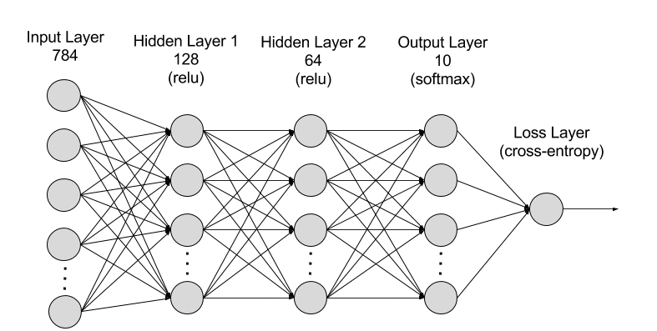
How does a recurrent neural network work?
RNNs are made of neurons: data-processing nodes that work together to perform complex tasks. The neurons are organized as input, output, and hidden layers. The input layer receives the information to process, and the output layer provides the result. Data processing, analysis, and prediction take place in the hidden layer.

Slide 4
Hidden layer
RNNs work by passing the sequential data that they receive to the hidden layers one step at a time. However, they also have a self-looping or recurrent workflow: the hidden layer can remember and use previous inputs for future predictions in a short-term memory component.
It uses the current input and the stored memory to predict the next sequence.
For example, consider the sequence: Apple is red. You want the RNN to predict red when it receives the input sequence Apple is.
When the hidden layer processes the word Apple, it stores a copy in its memory. Next, when it sees the word is, it recalls Apple from its memory and understands the full sequence: Apple is for context. It can then predict red for improved accuracy.
This makes RNNs useful in speech recognition, machine translation, and other language modelling tasks.

Slide 5
Training
Machine learning (ML) engineers train deep neural networks like RNNs by feeding the model with training data and refining its performance.
In ML, the neuron's weights are signals to determine how influential the information learned during training is when predicting the output.
Each layer in an RNN shares the same weight.
ML engineers adjust weights to improve prediction accuracy.
They use a technique called backpropagation through time (BPTT) to calculate model error and adjust its weight accordingly.
BPTT rolls back the output to the previous time step and recalculates the error rate.
This way, it can identify which hidden state in the sequence is causing a significant error and readjust the weight to reduce the error margin.

Slide 6

Applications Of RNNs :-
Natural Language Processing (NLP) applications: RNNs are widely used in tasks such as sentiment analysis, machine translation, named entity recognition, and more.
Time-Series Prediction applications: RNNs are effective in modeling sequential data, making them valuable for time-series forecasting tasks like stock price prediction, weather forecasting, energy consumption prediction, and more.
Speech Recognition applications: RNNs is commonly employed in speech recognition systems. They can process sequential audio data and extract relevant features for accurate transcription.

Slide 7
Sequence Generation applications: RNNs can generate sequences of data, which is useful in various applications such as text generation, music composition, image captioning, and even generating code. They learn to mimic the patterns present in the training data and produce coherent outputs.
Sequence-to-Sequence Learning applications: This refers to tasks where an input sequence is mapped to an output sequence, such as machine translation, text summarization, and dialogue generation.
Anomaly Detection applications: RNNs can learn the normal behavior of sequential data and identify deviations from this norm, making them suitable for anomaly detection tasks.

Slide 8
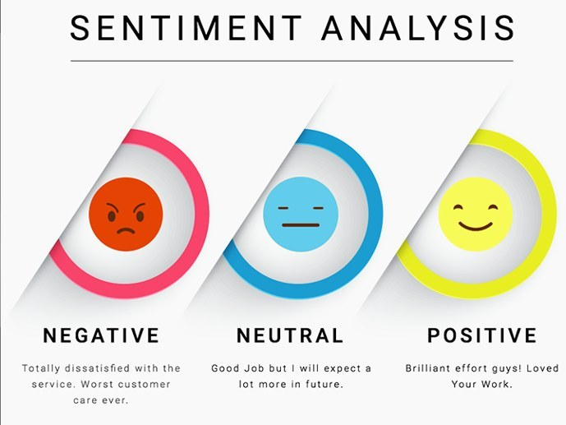
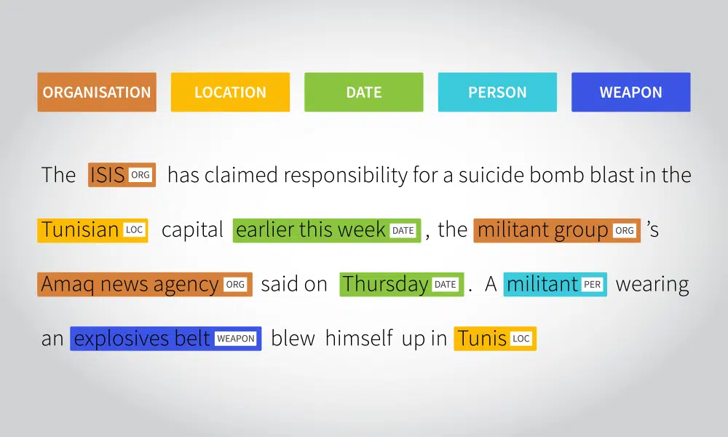
Natural Language Processing (NLP) applications:
Sentiment Analysis: RNNs can analyze text to determine the sentiment expressed within it, whether it's positive, negative, or neutral. This is valuable for applications like social media monitoring, customer feedback analysis, and product reviews.
Named Entity Recognition (NER): RNNs can identify and classify named entities (such as names of people, organizations, locations, etc.) within a body of text. NER is essential for tasks like information extraction, document classification, and question answering systems.

Slide 9
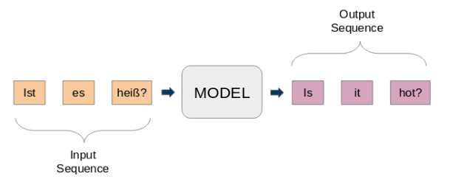
Machine Translation:
RNNs, especially in the form of sequence-to-sequence models with attention mechanisms, have revolutionized machine translation systems. They can effectively translate text from one language to another by learning to map input sequences to output sequences.

Slide 10
Time-Series Prediction applications:
Weather Forecasting: RNNs are employed in weather forecasting models to predict temperature, precipitation, wind speed, and other meteorological variables. By analyzing historical weather data, RNNs can learn seasonal patterns and trends to provide accurate short-term and long-term forecasts.
Energy Load Forecasting: RNNs are used by utility companies to forecast electricity demand and consumption patterns. By analyzing historical energy consumption data along with factors like weather conditions, time of day, and day of the week, RNNs can predict future energy loads, helping utilities optimize resource allocation and manage grid stability.

Slide 11

Stock Market Prediction:
RNNs can analyze historical stock price data to forecast future price movements. They can learn complex patterns from past stock prices, trading volumes, and other relevant factors to make predictions about future market trends.

Slide 12

Speech recognition application :
1. Speech to Text conversation :
Speech-to-text conversion, also known as automatic speech recognition (ASR), involves transforming spoken language into written text.
It's used in various applications like virtual assistants, dictation software, and transcribing spoken content into text for accessibility purposes.
2.Voice command recognition :
Voice command recognition is the process of identifying and understanding spoken commands issued by users. It's a crucial component of virtual assistants, smart home devices, and hands-free systems.
Typically, voice command recognition systems employ automatic speech recognition (ASR) technology, which converts spoken words into text, followed by natural language understanding (NLU) algorithms to interpret the meaning and intent behind the commands

Slide 13
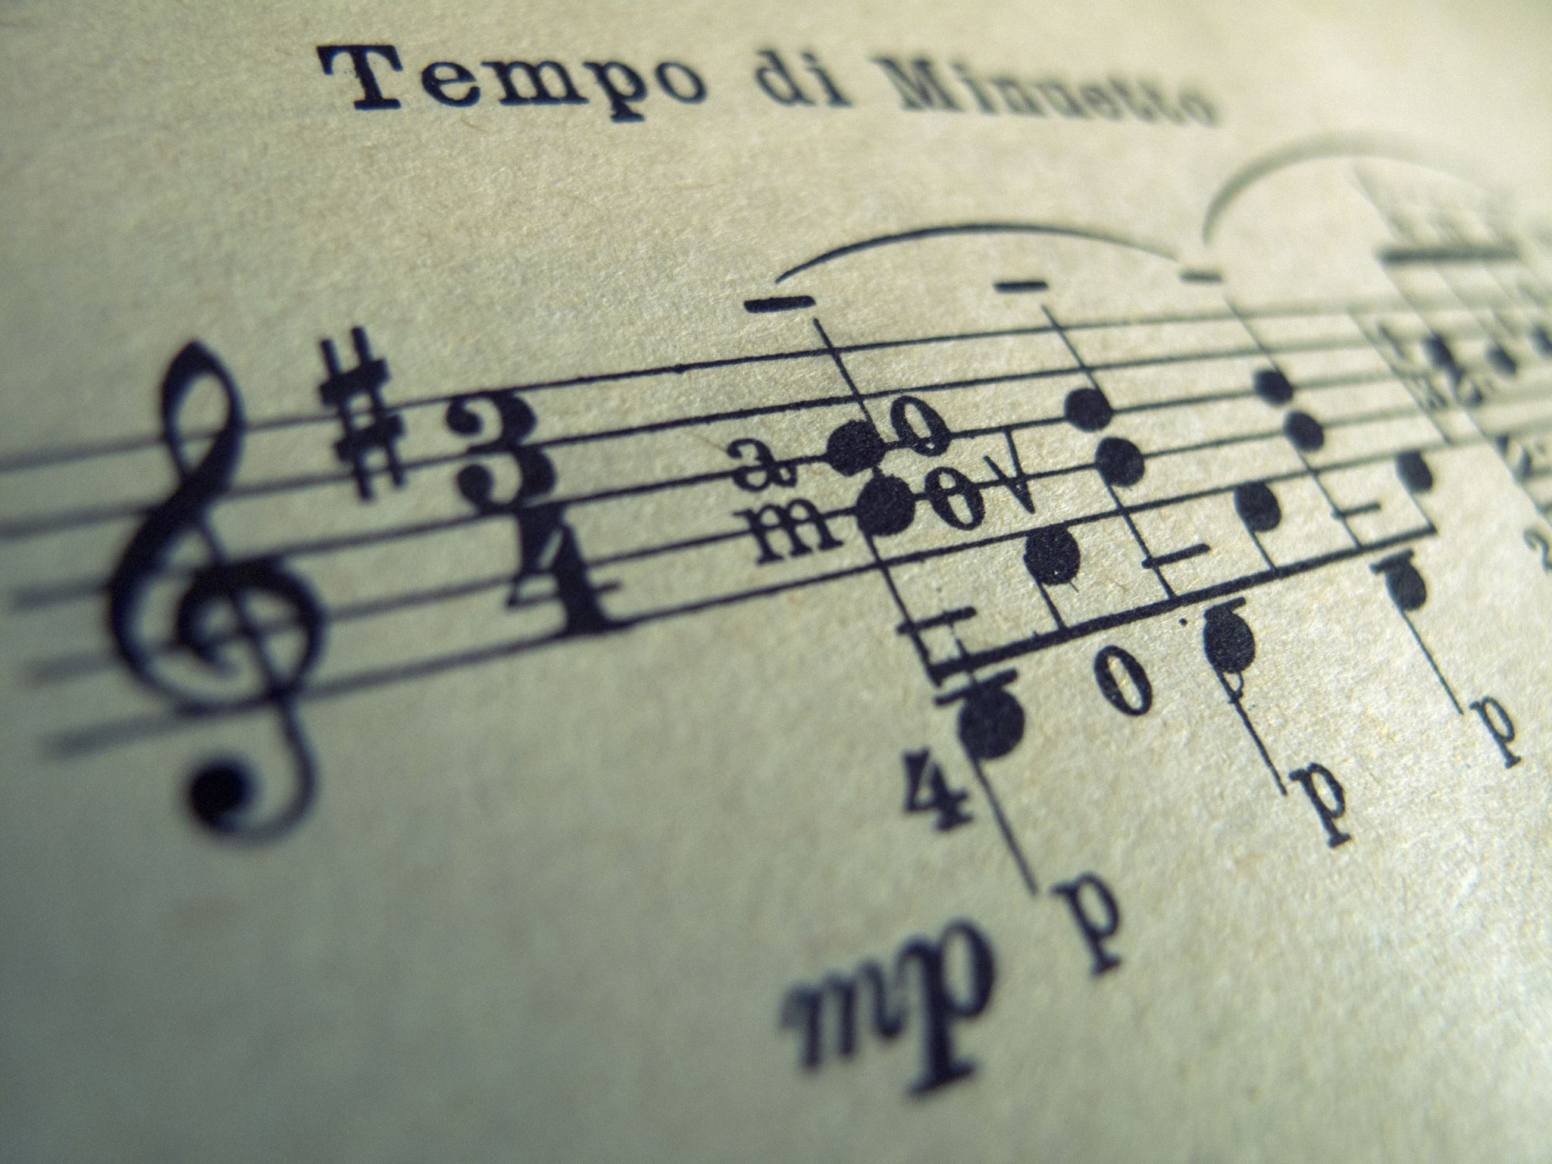
Sequence generation application:
1.Music composition :
In music composition, sequence generation algorithms, particularly recurrent neural networks (RNNs) and generative adversarial networks (GANs), are used to create original pieces of music. These algorithms analyze patterns and structures in existing music data and generate new sequences of notes, melodies, or even entire compositions.
2.Text generation :
Text generation involves creating new text based on a given input or context. It's a task commonly tackled using natural language processing (NLP) techniques. These models are trained on vast amounts of text data and learn to generate coherent and contextually relevant text. They can be used for various applications, including content creation, dialogue generation, storytelling, and language translation.

Slide 14
Sequence to sequence learning application :
Machine translation:
Machine translation refers to the automated process of translating text from one language to another using computational techniques.
It has become increasingly important with the globalization of communication and the rise of digital content.
Machine translation systems range from rule-based approaches to statistical methods and more recently, neural machine translation (NMT) models.
NMT, particularly using sequence-to-sequence (seq2seq) models with attention mechanisms, has significantly improved translation quality compared to previous approaches.

Slide 15
2.Image captioning :
Image captioning is the process of generating textual descriptions for images.
It combines computer vision techniques for understanding image content with natural language processing (NLP) methods for generating human-like captions.
One common approach to image captioning involves using convolutional neural networks (CNNs) to extract features from the image and recurrent neural networks (RNNs), such as Long Short-Term Memory (LSTM) or Transformer models, to generate captions based on those features.
The model learns to associate visual features with corresponding textual descriptions during training.

Slide 16
Anomaly Detection Applications
Fraud Detection :
Credit Card Fraud Detection: RNNs can analyze sequences of credit card transactions to detect unusual patterns indicating fraudulent activity. For example, sudden large transactions, transactions in unusual locations, or unusual spending patterns.
Insurance Fraud Detection: RNNs can analyze sequences of claims data to identify anomalies, such as sudden spikes in claims or patterns indicating potential fraudulent behavior.
Account Takeover Detection: RNNs can analyze sequences of user behavior (e.g., login attempts, browsing history) to detect anomalies indicating potential account takeovers or unauthorized access.

Slide 17
2. Equipment Malfunction Detection:
Predictive Maintenance: RNNs can analyze sequences of sensor data from industrial equipment to detect anomalies indicating potential malfunctions or failures. By detecting anomalies early, maintenance can be performed proactively to prevent costly downtime.
Anomaly Detection in IoT Devices: RNNs can analyze sequences of sensor data from IoT devices to detect anomalies indicating potential malfunctions or security breaches. For example, abnormal temperature readings in a smart thermostat could indicate a malfunction or tampering.

Slide 18
Advantages of RNNs
1. Handling Variable-Length Sequences:
RNNs can process sequences of varying lengths, which is particularly useful in applications like natural language processing where sentences or documents can vary in length.
This flexibility allows RNNs to handle inputs of different lengths without the need for padding or truncation, which can be inefficient or lead to information loss.
2. Capturing Temporal Dependencies:
RNNs are designed to capture temporal dependencies in sequential data, making them effective for tasks where the order of elements matters.
The recurrent connections in RNNs allow them to maintain a form of memory or context from previous time steps, enabling them to model complex temporal patterns.

Slide 19
Challenges in RNNs
1)
Vanishing/Exploding Gradients:
RNNs are susceptible to the vanishing or exploding gradient problem, where gradients either become extremely small or extremely large during training.
This can make it difficult for RNNs to learn long-range dependencies in sequential data, as gradients may either vanish before reaching distant time steps or explode and destabilize the training process.
2)
Memory Limitations:
Standard RNN architectures have limited memory capacity, meaning they may struggle to effectively capture long-term dependencies in sequential data.
Although the recurrent connections allow RNNs to maintain some memory of previous time steps, this memory can decay over time or become diluted as new inputs are processed.

Slide 20
3)
Computational Intensity:
RNNs can be computationally intensive to train, especially when processing long sequences or using large model architectures.
The sequential nature of RNNs also makes them less parallelizable compared to other types of neural networks, which can lead to slower training times, especially on large datasets.

Slide 21
Conclusion
In conclusion, Recurrent Neural Networks (RNNs) stand as a pivotal innovation in the realm of artificial intelligence, offering a potent framework for processing sequential data. Their operational mechanism, characterized by iterative processing of input sequences while retaining internal context, empowers them to discern temporal dependencies and contextual nuances. Across diverse domains, from Natural Language Processing (NLP) to time series analysis and autonomous systems, RNNs find extensive utility. They excel in tasks such as language translation, sentiment analysis, anomaly detection, and decision-making in dynamic environments. However, RNNs are not without challenges, grappling with issues like vanishing gradients and computational complexity. Despite these hurdles, ongoing research into advanced architectures and optimization techniques promises to bolster their efficacy. Looking forward, RNNs hold vast potential for further innovation and interdisciplinary collaboration, shaping the trajectory of intelligent systems and fostering new frontiers in AI-driven applications.

Slide 22
THANK YOU

