Slide 1
Sales Dashboard
Task 4 - Tableau Dashboard
By Parthasarathi

Slide 2
Dataset Information
• Dataset: Superstore Sales Dataset
• Type: Sales & Financial Data
• Fields: Order Date, Sales, Profit, Category, Region
• Purpose: Analyze business performance

Slide 3
Key Performance Indicators (KPIs)
• Total Sales
• Total Profit
• Total Orders
• Profit Ratio

Slide 4
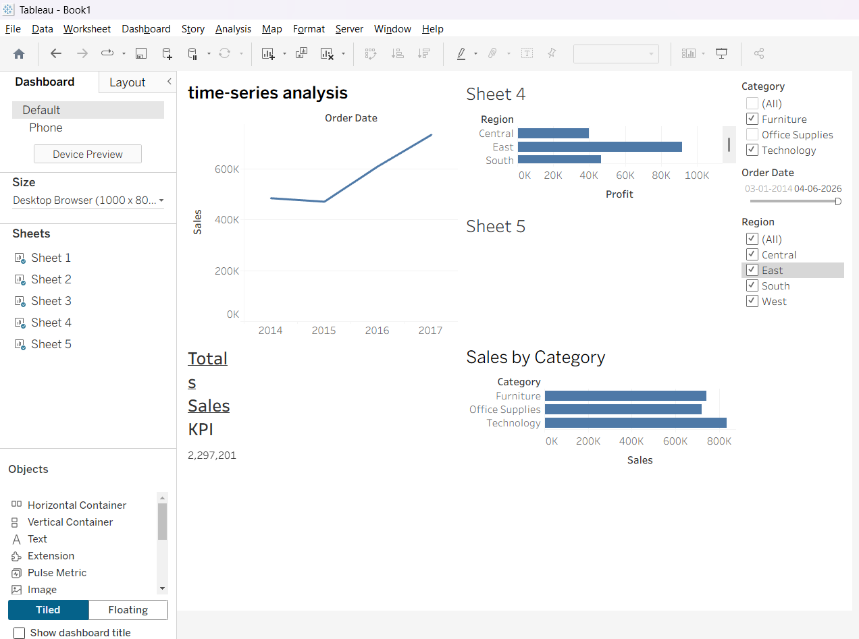
Dashboard Overview
Insert your Tableau Dashboard Screenshot here

Slide 5
Key Insights
• Sales show an increasing trend over time
• Technology category has highest sales
• West region generates highest profit
• Sub-category analysis shows top performing products

