Slide 1

Customer Shopping Behavior Analysis
3,900 transactions · 18 features · Python · SQL · Power BI

Slide 2
Dataset at a Glance
3,900
18
Purchases
Features
37
$59.76
Missing Ratings
Avg Purchase
Review Rating column
Demographics, purchase details, and shopping behavior across 50 locations.

Slide 3

Data Preparation in Python
Clean
Imputed missing Review Ratings by category median
Standardize
Renamed columns to snake_case; dropped redundant promo_code_used
Engineer
Created age_group and purchase_frequency_days features
Load
Connected to PostgreSQL for SQL analysis

Slide 4
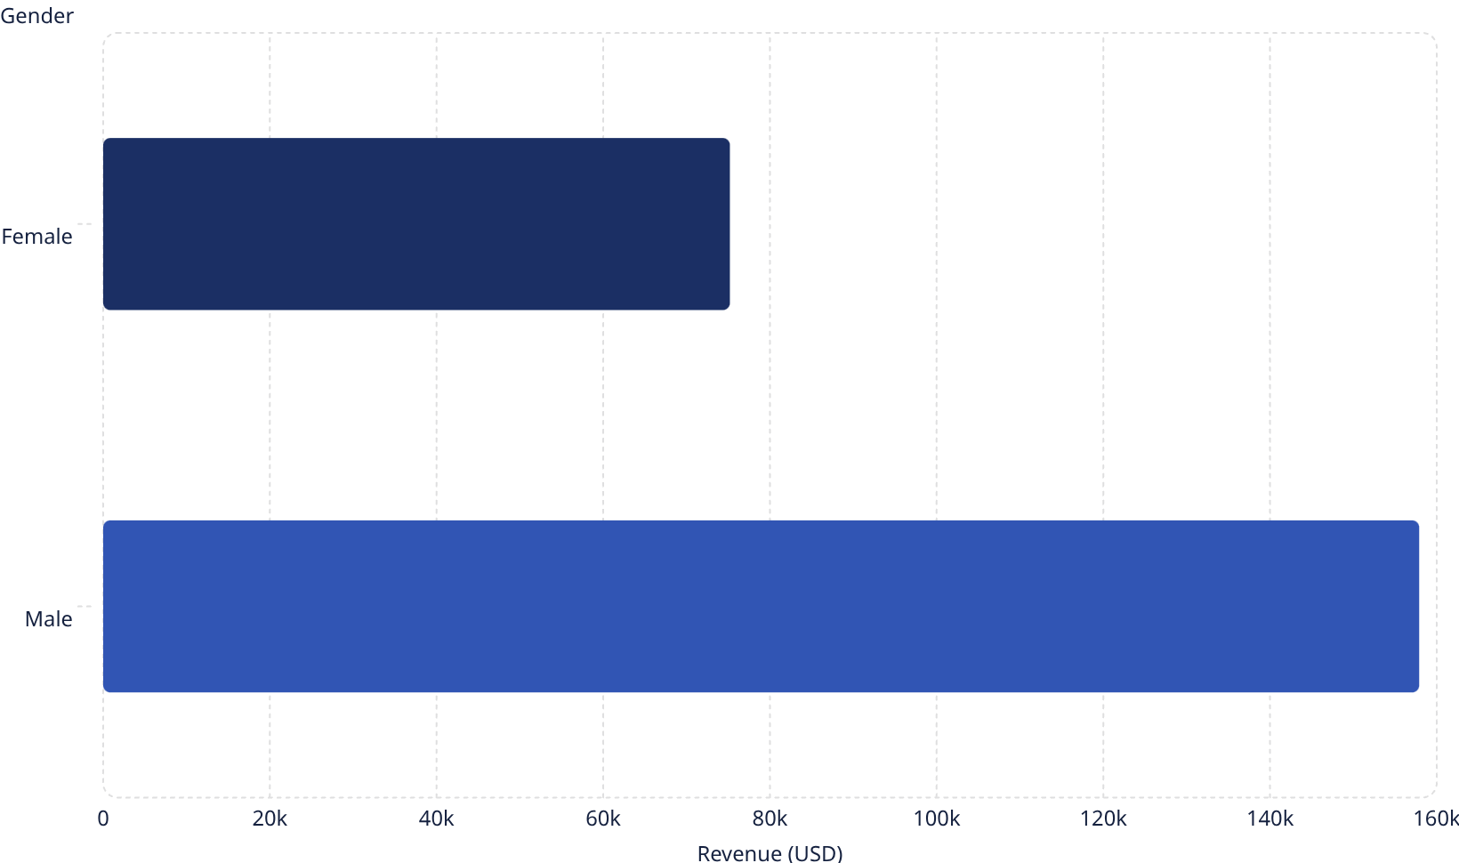

Revenue by Gender
Male Customers Drive Revenue
Male customers generated $157,890 — more than double female revenue of $75,191.
2,652 male vs. female customers in dataset

Slide 5
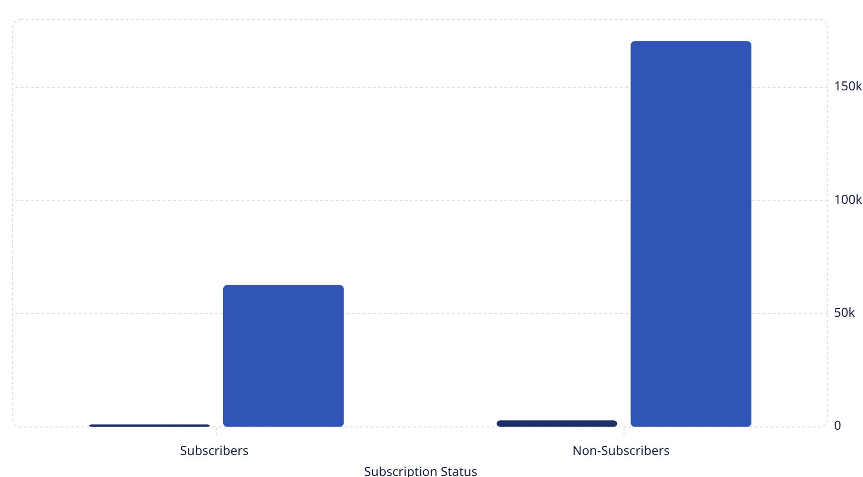
Subscribers vs. Non-Subscribers
Customers
Revenue (USD)
Non-Subscribers Dominate
73% of customers are non-subscribers, generating $170K in revenue.
Avg spend nearly identical: $59.49 vs $59.87
958 repeat buyers are subscribers

Slide 6
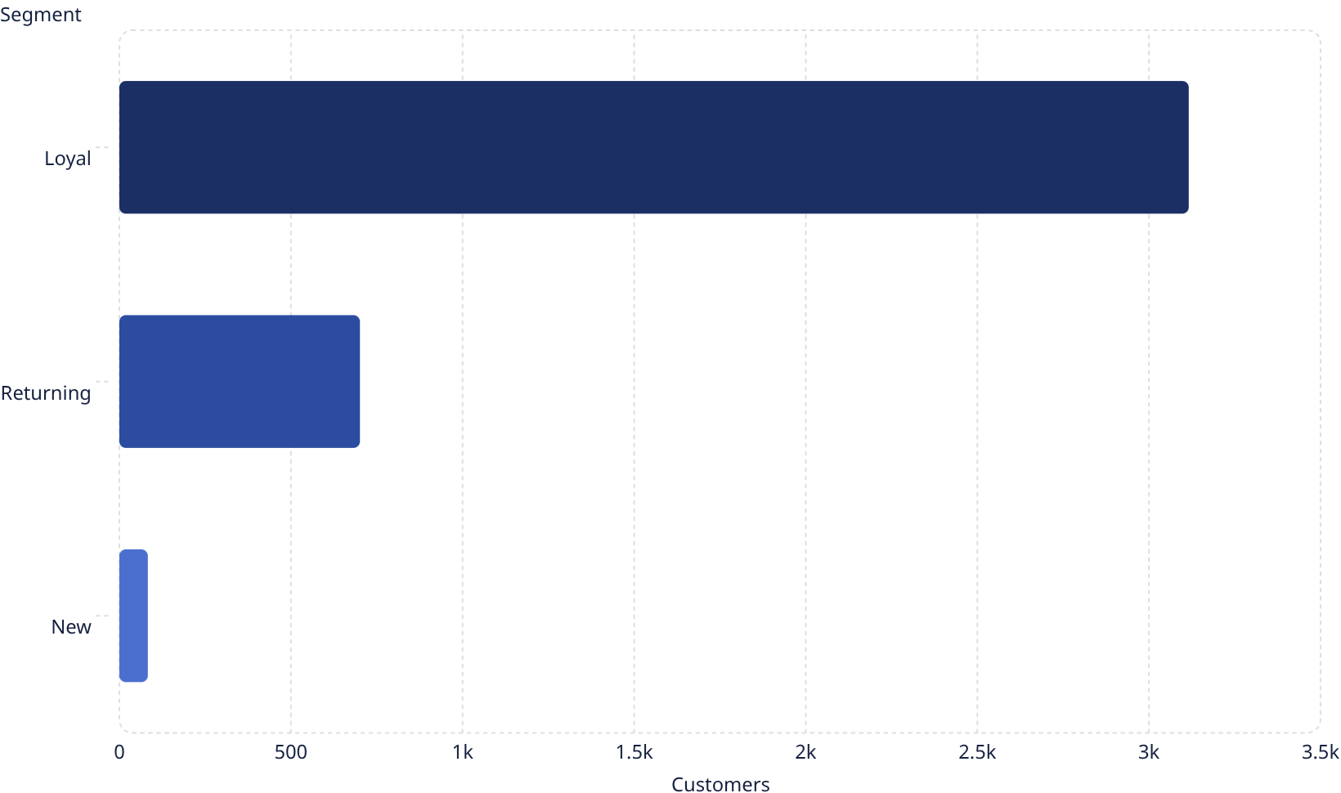

Customer Segmentation
Loyal Customers = 80%
3,116 loyal customers form the core base. Only 83 are new.
Segmented by purchase history: New, Returning, Loyal

Slide 7
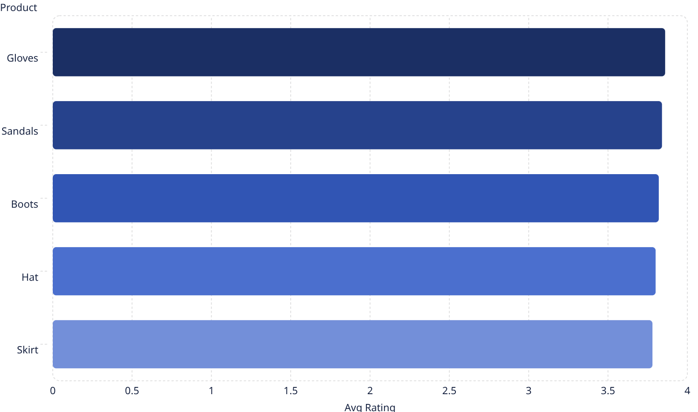
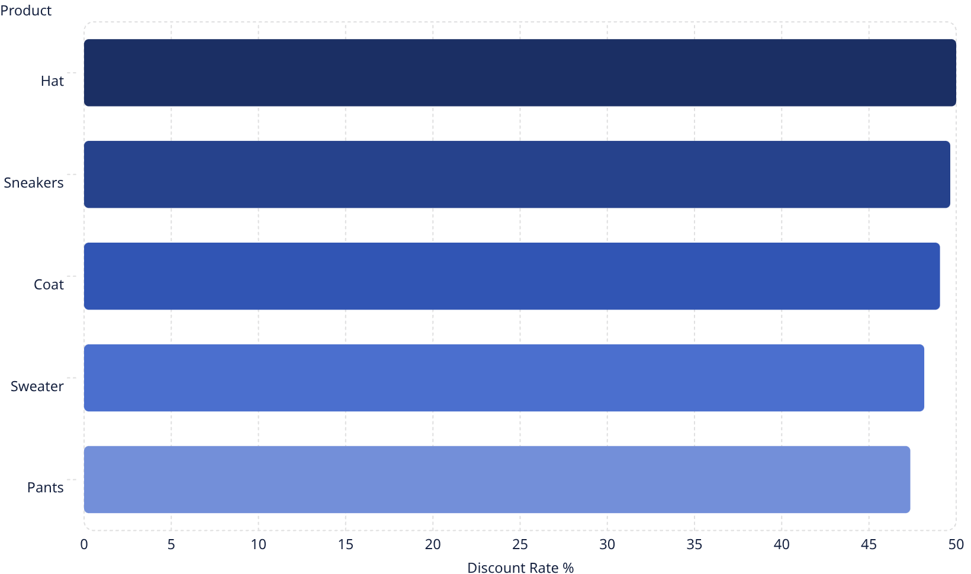
Top Products & Discount Trends
Highest Rated Products
Most Discounted Products

Slide 8
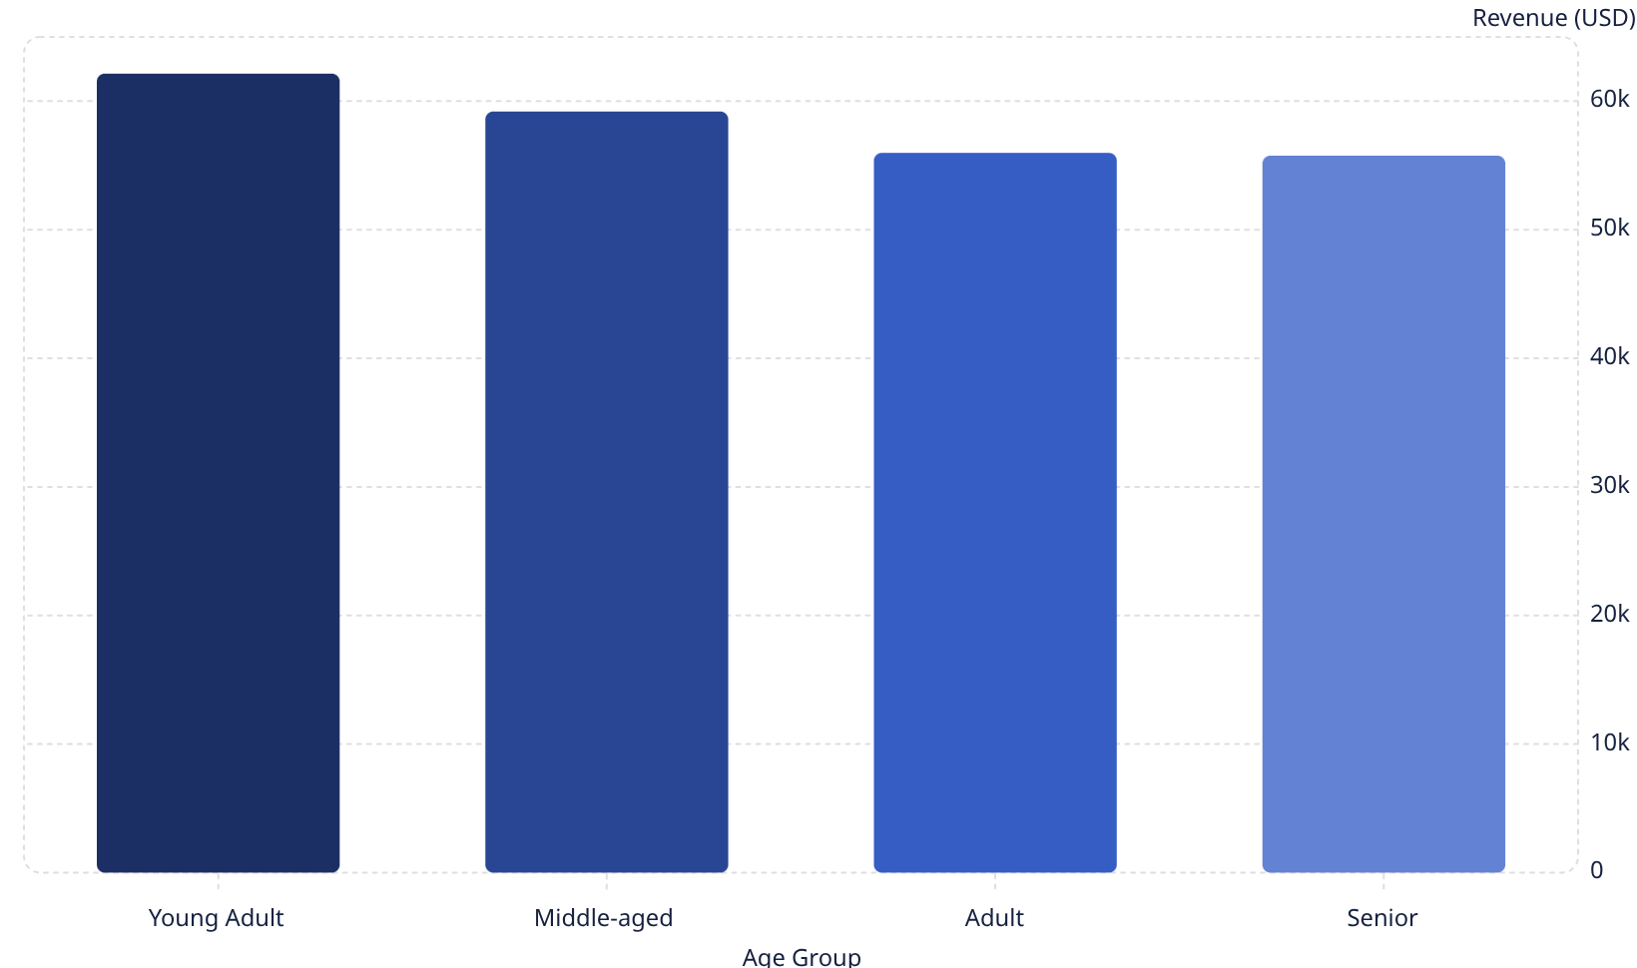
Revenue by Age Group
Young Adults Lead Spending
Young Adults contribute the highest revenue at $62,143. Revenue is relatively balanced across all age groups.

Slide 9

Power BI Dashboard
KPIs
Filters
3.9K customers · $59.76 avg purchase · 3.75 avg rating
Subscription · Gender · Category · Shipping Type
Visuals
Revenue by category & age group · Subscription donut · Sales breakdown

Slide 10

Business Recommendations
Boost Subscriptions
Loyalty Programs
Review Discounts
Promote exclusive subscriber benefits
Reward repeat buyers to grow Loyal segment
Balance sales boosts with margin control
Targeted Marketing
Product Positioning
Focus on high-revenue age groups & express-shipping users
Highlight top-rated & best-selling products in campaigns

