Slide 1
Secure data hiding in image using steganography
CAPSTONE PROJECT
Presented By: Parthiban M
Student Name : Parthibam M
College Name & Department : Rathinam technical campus &SOC

Slide 2
OUTLINE
Problem Statement
Technology used
Wow factor
End users
Result
Conclusion
Git-hub Link
Future scope

Slide 3
Problem Statement
In the modern digital era, safeguarding data security and privacy is crucial. Encryption protects information by making it unreadable, yet it can still attract suspicion. Steganography provides a subtle approach by embedding hidden data within everyday files, such as images, ensuring it remains inconspicuous.
Hide a text message inside an image by slightly modifying pixel values.
Protect the concealed message with a passcode to restrict access.
Retrieve and decode the message only when the correct passcode is provided.
Preserve the image’s original look with minimal visual changes.

Slide 4
Technology used
Libraries Used:
cv2 (OpenCV) – Used for image processing (reading, modifying, and saving images).
os – Used to interact with the operating system (opening the encrypted image).
string – Imported but not used in the code (can be removed).
2. Platform Compatibility:
OS: Windows (uses os.system("start encryptedImage.jpg") to open the image).
For Linux/macOS, replace start with xdg-open or open.
Python Version: Works with Python 3.x.

Slide 5
Wow factors
Simple and Lightweight Implementation
Custom Character Mapping for Encoding
Pixel-Based Encoding Approach
Passcode-Based Security Layer
No Visible Alteration to the Image

Slide 6
End users
Those studying data hiding techniques and cryptography.
Useful for learning about steganography without complex tools.

Slide 7
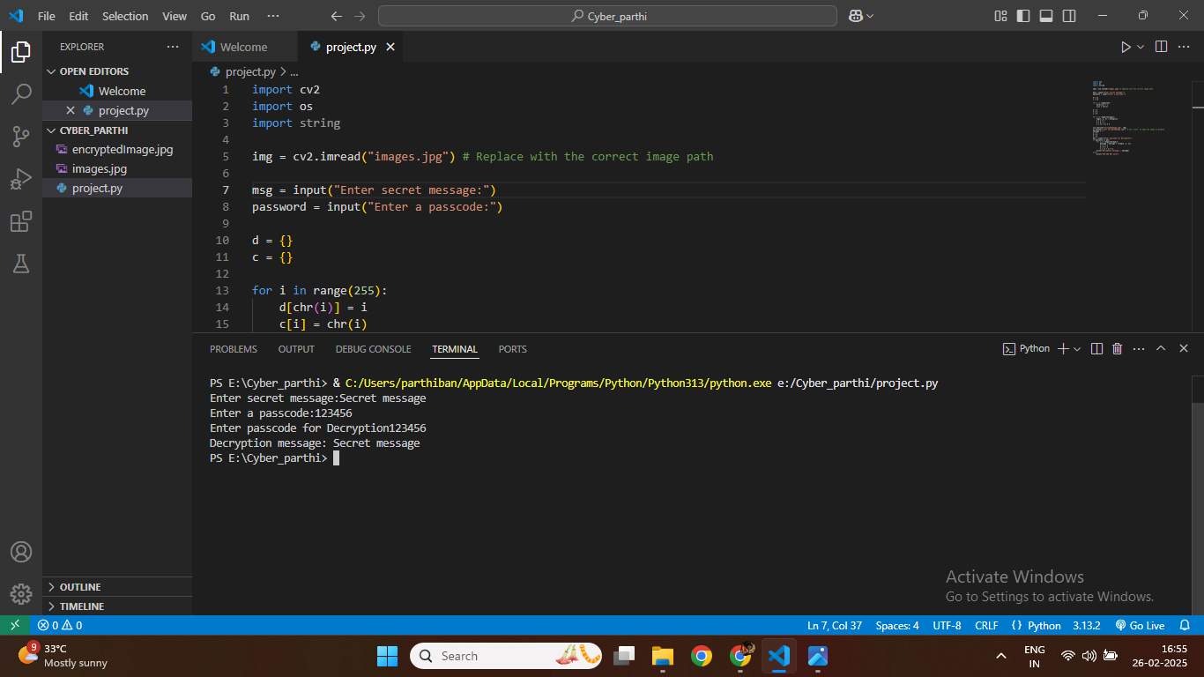
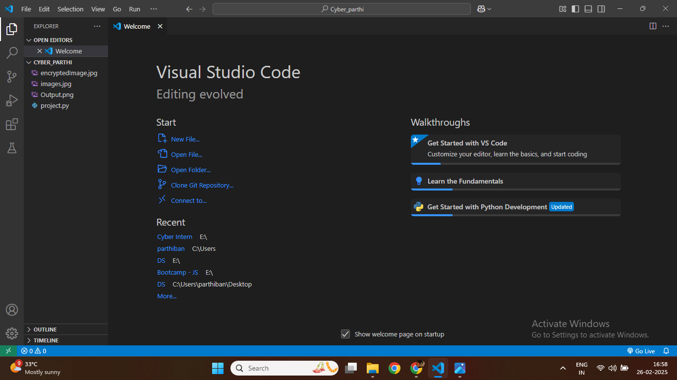
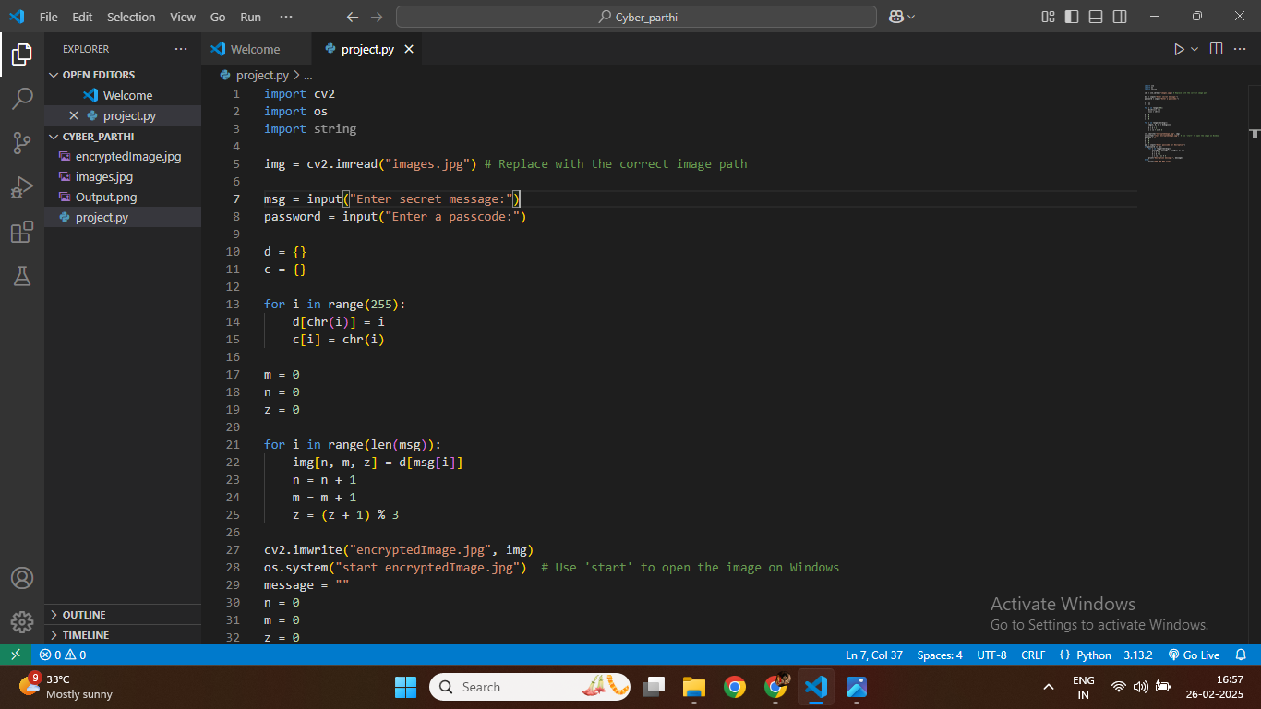
Results
Screenshots of the outcome (min 3)

Slide 8
Conclusion
This steganography project provides a reliable way to embed and retrieve hidden messages within images using Python and OpenCV. Its key features include a lightweight design, custom character mapping, pixel-based encoding, and robust passcode security. It is an excellent choice for cybersecurity enthusiasts, privacy-conscious individuals, ethical hackers, and students eager to learn data-hiding techniques..

Slide 9
GitHub Link
https://github.com/Parthiban2168/IBM-Cyber-security.git

Slide 10
Future scope(optional)

Slide 11
THANK YOU

