Slide 1

Q-SMART
Smart Crowd Prediction & Queue Management Platform
-By UrbanX
Domain: Smart Living and Daily Life
Team Members: Aswiny B Kaimal
Nafih Nazar
Neeraj P Raju
Parthip Rajesh

Slide 2
Introduction
Crowd congestion and long waiting times at public and commercial places such as hospitals, transport hubs, government offices, and retail centers significantly affect service efficiency and user experience. In many cases, visitors are unaware of peak hours and expected queue lengths, leading to unnecessary delays and overcrowding. There is a growing need for a smart, scalable, and privacy-preserving solution that enables people to plan their visits more efficiently without relying on additional hardware infrastructure.
Q-SMART by UrbanX is a software-based crowd prediction and queue management platform designed to estimate expected crowd levels and waiting times across multiple public locations. The system combines historical baseline crowd patterns with real-time queue registrations made by users on the platform to predict the expected crowd at a given location and time. By analyzing time-based trends and registered queue data, Q-SMART determines crowd levels, estimates waiting times, and suggests the best time to visit a selected location.
The platform provides key functionalities including user queue registration, real-time crowd status checking, multi-location monitoring through a dashboard, automatic clearing of outdated queue data, and visual classification of crowd levels. The system is designed to be privacy-first, collecting no personal user information, and is fully deployable as a web-based solution. Q-SMART aims to reduce overcrowding, improve service accessibility, and help users make informed decisions while planning visits to essential public and commercial spaces.

Slide 3
The Crisis of Congestion
Urban areas frequently experience overcrowding and long waiting times at public and commercial locations such as hospitals, transport hubs, government offices, and retail centers. Due to the absence of real-time crowd information and predictive planning, visitors often arrive during peak hours, resulting in excessive queues, reduced service efficiency, and user discomfort.
Conventional crowd management methods are largely manual, hardware-dependent, or location-specific, making them costly and difficult to scale. In most cases, users have no access to advance information regarding expected crowd levels or waiting times, which further aggravates congestion.
This growing congestion impacts public safety, productivity, and overall service accessibility. Therefore, there is a clear need for a scalable, software-based system that can predict crowd conditions, estimate waiting times, and guide users toward better visit planning without relying on additional hardware.

Slide 4
The Q-SMART Paradigm
The Q-SMART paradigm is a software-based approach to crowd prediction and queue management that aims to reduce congestion through proactive planning. It combines historical crowd trend data with real-time queue registrations from users to estimate the expected crowd at different locations and time periods.
By analyzing time-based patterns and current demand, Q-SMART predicts crowd levels, estimates waiting times, and suggests optimal visiting periods. The paradigm is designed to be scalable, cost-effective, and privacy-preserving, as it operates without additional hardware and does not collect personal user information. This approach enables efficient crowd management and improved accessibility across public and commercial spaces.

Slide 5
The Predictive Engine
The predictive engine of Q-SMART is responsible for estimating the expected crowd level and waiting time at a selected location. It operates by combining historical baseline crowd data with real-time queue registrations made by users on the platform. The baseline data represents typical crowd behavior across different days and time intervals, while the registered user count reflects the current demand.
For a given location and time, the engine selects the nearest relevant historical data point and adjusts it using the number of active queue registrations. Based on the predicted crowd value, the system classifies congestion levels as low, moderate, or high and calculates the estimated waiting time using predefined service capacity parameters. Additionally, the engine analyzes historical trends to determine the best time to visit a location.
This lightweight and rule-based predictive mechanism ensures transparency, reliability, and easy scalability, making it suitable for real-time deployment without the need for complex machine learning models.

Slide 6
Technical Architecture
The technical architecture of Q-SMART follows a modular, web-based design that integrates data processing, prediction logic, and user interaction within a unified framework. The system is built using the Python Flask web framework, which handles request routing, backend processing, and dynamic page rendering.
Historical baseline crowd data is stored in a structured CSV dataset, while real-time queue registrations are maintained using a lightweight SQLite database. The predictive engine processes both data sources to compute expected crowd levels, congestion classification, waiting time estimation, and optimal visit periods. Automatic cleanup mechanisms periodically remove outdated queue entries to ensure data relevance.
The frontend interface is delivered through HTML and CSS, providing dashboards, forms, and status views that communicate with the backend through HTTP requests. The entire system is deployed as a cloud-hosted web application, enabling scalable access without requiring additional hardware or client-side installations.

Slide 7
The User Journey
The user journey in Q-SMART is designed to be simple, intuitive, and efficient. A user begins by accessing the Q-SMART web platform, where a dashboard provides an overview of predicted crowd conditions across multiple locations. This enables users to quickly assess congestion levels before making a decision.
To obtain detailed information, the user selects a specific location to view the expected crowd, crowd level classification, estimated waiting time, and the best time to visit. If the user intends to visit the location, they can register themselves in the queue through the join queue feature, which updates the system’s real-time data.
The system continuously integrates user registrations with historical crowd trends to refine predictions. Outdated queue entries are automatically removed, ensuring accurate and relevant results. This streamlined journey allows users to plan visits efficiently while contributing to improved crowd management across locations.

Slide 8
The system architecture
The system architecture of Q-SMART is organized into four primary layers: the user interface layer, application layer, data layer, and deployment layer. Each layer plays a specific role in ensuring efficient crowd prediction and queue management.
The User Interface Layer allows users to interact with the system through a web browser. It includes the dashboard, queue registration page, and crowd status view, enabling users to access predictions and submit queue registrations.
The Application Layer, implemented using the Python Flask framework, handles request processing, data integration, and prediction logic. This layer contains the predictive engine, which combines historical baseline data with live queue registrations to compute expected crowd levels, waiting times, crowd classifications, and best visiting periods.
The Data Layer consists of two components: a baseline crowd dataset stored in CSV format and a real-time queue database implemented using SQLite. The baseline dataset provides time-based historical patterns, while the database stores temporary user queue entries that are automatically cleared after a defined duration.
The Deployment Layer hosts the complete system on a cloud-based platform, enabling scalable and remote access. This layered architecture ensures modularity, scalability, and ease of maintenance while maintaining a privacy-preserving and hardware-independent design.

Slide 9
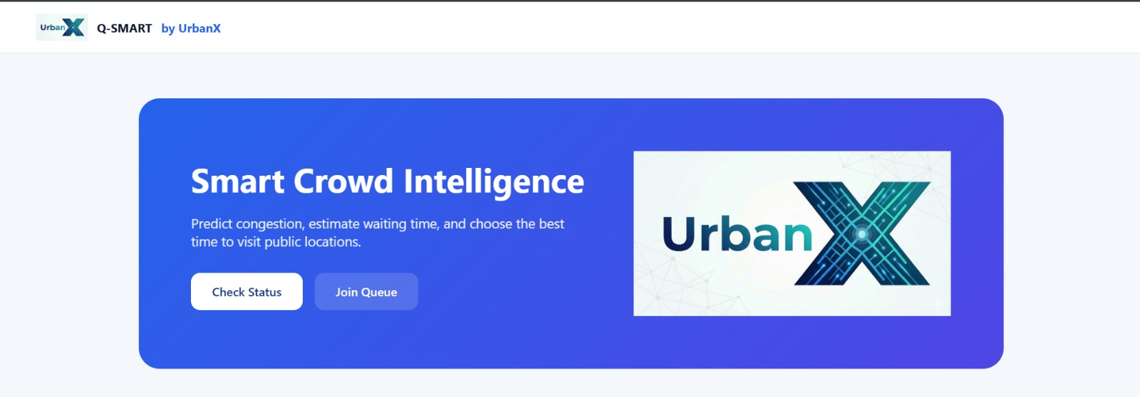
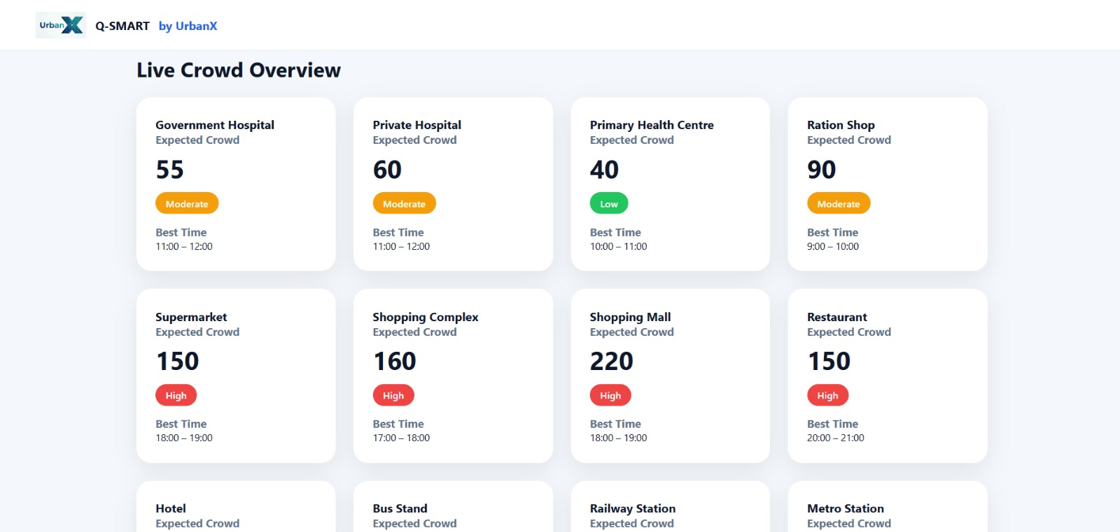
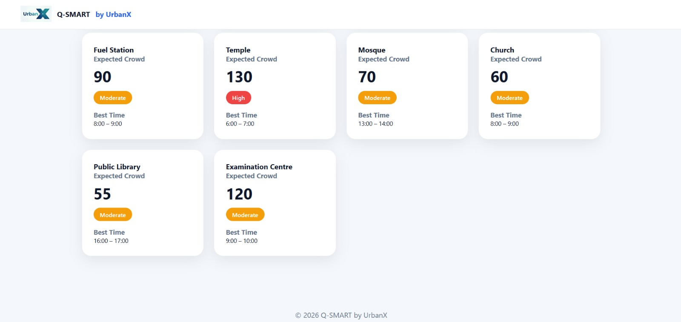
WEBPAGE SCREENSHOTS

Slide 10
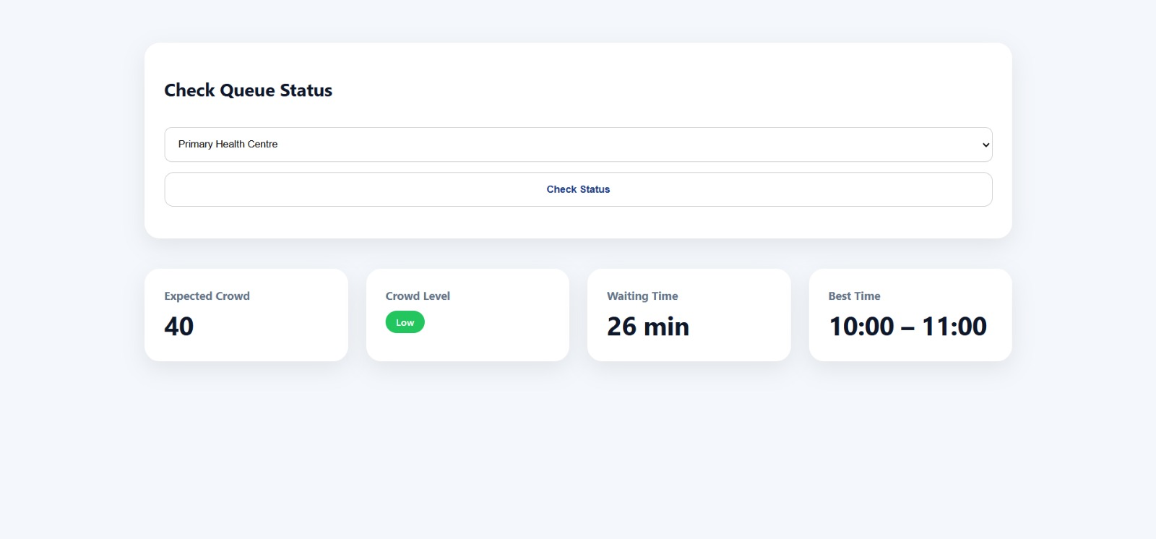
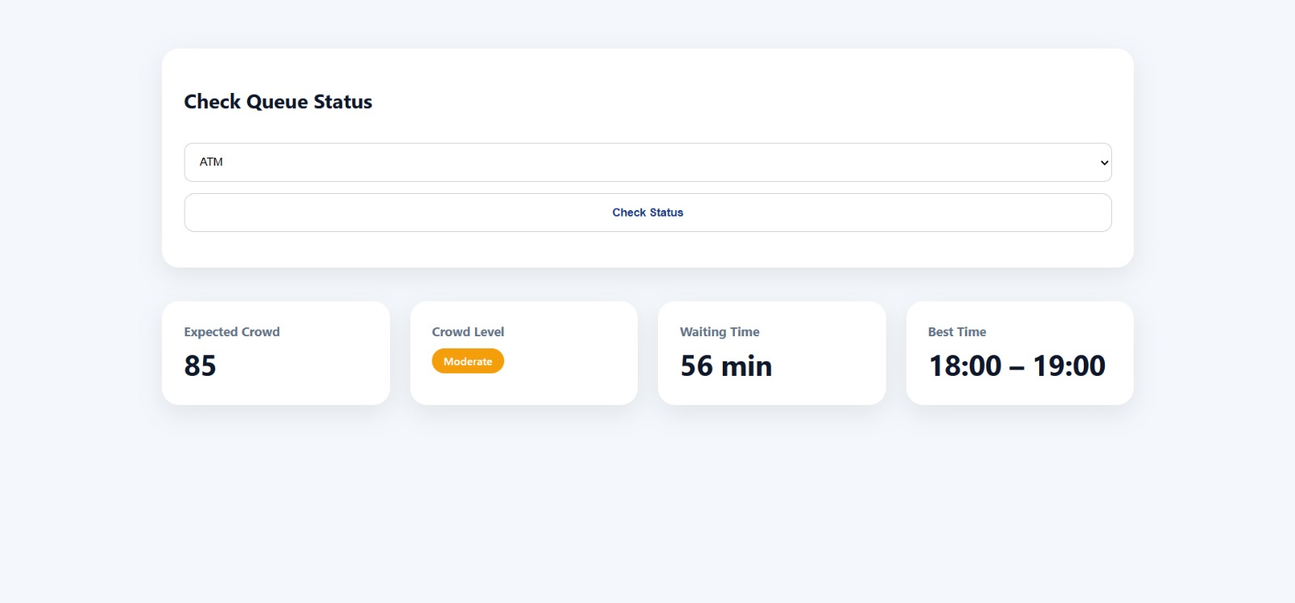
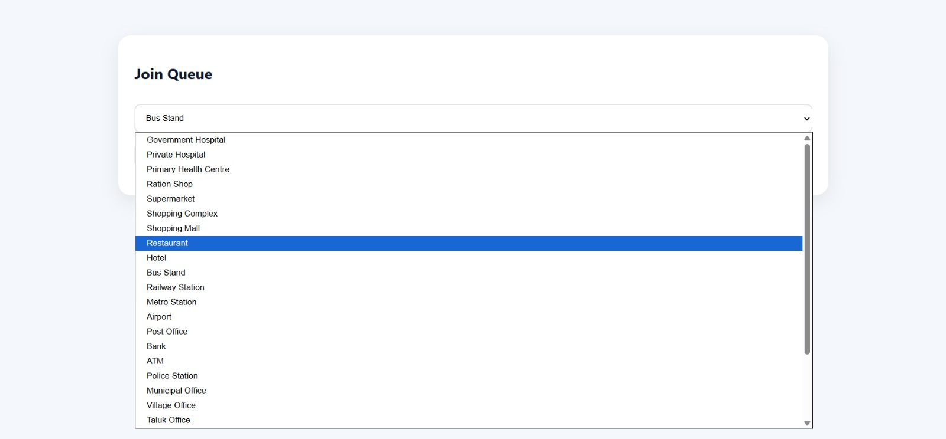
WEBPAGE SCREENSHOTS

Slide 11
methodology
User Access and Location Selection :The user accesses the Q-SMART web platform through a browser and views the dashboard displaying predicted crowd information for multiple locations. The user may select a specific location to obtain detailed crowd status
Baseline Data Retrieval :The system retrieves historical baseline crowd data corresponding to the selected location, current day, and nearest relevant time interval. This data represents typical crowd behavior patterns
Queue Registration Handling :If the user chooses to join a queue, the system records the registration with a timestamp in the database. This data reflects the current demand at the selected location
Data Integration and Prediction :The predictive engine combines the baseline crowd data with active queue registrations to calculate the expected crowd level for the location
Crowd Classification and Waiting Time Estimation :Based on the predicted crowd value, the system classifies congestion levels as low, moderate, or high and estimates waiting time using predefined service capacity parameters
Best Time Recommendation :The system analyzes historical crowd trends to identify and suggest the optimal time period with the lowest expected congestion for the selected location
Automatic Data Cleanup :Outdated queue registrations are automatically removed after a fixed duration to ensure data accuracy and relevance
Result Presentation :The computed results are displayed to the user through an intuitive interface, enabling informed visit planning and congestion avoidance

Slide 12
Comparison & Competitive Edge
Traditional crowd and queue management systems largely depend on manual monitoring, physical tokens, surveillance cameras, or sensor-based counting mechanisms. These approaches are often expensive to deploy, limited to specific locations, and difficult to scale across multiple public spaces. Additionally, most existing systems provide only reactive information, offering insights after congestion has already occurred.
In contrast, Q-SMART adopts a predictive and software-driven approach to congestion management. By combining historical crowd patterns with real-time queue registrations, the system estimates expected crowd levels and waiting times before users arrive at a location. Unlike hardware-dependent solutions, Q-SMART requires no additional infrastructure, making it cost-effective and easy to deploy across diverse environments.
The competitive edge of Q-SMART lies in its scalability, privacy-preserving design, and multi-location monitoring capability. The platform supports proactive visit planning, provides best-time recommendations, and operates entirely through a web-based interface. These features enable Q-SMART to offer a flexible, efficient, and user-centric alternative to conventional crowd management solutions

Slide 13
Socio-Economic Impact
Q-SMART contributes positively to society by reducing overcrowding and waiting times at essential public and commercial locations. By enabling users to plan visits during less congested periods, the system helps improve service accessibility, user comfort, and overall public satisfaction. Reduced congestion also enhances safety, particularly in high-risk or high-traffic environments such as hospitals and transportation hubs.
From an economic perspective, Q-SMART supports more efficient utilization of public infrastructure and services. Optimized crowd distribution reduces operational strain on service providers, minimizes idle time, and improves productivity. Since the system is software-based and does not require additional hardware, it significantly lowers deployment and maintenance costs, making it suitable for large-scale adoption.
Additionally, the privacy-preserving design of Q-SMART ensures ethical data usage by avoiding the collection of personal information. By promoting informed decision-making and efficient urban mobility, Q-SMART supports smarter cities, sustainable public services, and improved quality of life for citizens.

Slide 14
Conclusion & The Path Forward
Q-SMART by UrbanX presents an effective, software-based solution for predicting crowd levels and managing queues across multiple public and commercial locations. By integrating historical crowd patterns with real-time queue registrations, the system provides reliable predictions of expected crowd density, waiting times, and optimal visiting periods. The platform’s scalable, privacy-preserving, and hardware-independent design makes it suitable for wide deployment in urban environments.
The current implementation demonstrates the feasibility of proactive crowd management using lightweight predictive logic and user participation. Through features such as multi-location dashboards, crowd classification, and automatic data cleanup, Q-SMART enhances user decision-making and improves service accessibility.
As a path forward, the system can be further enhanced by incorporating larger datasets, advanced predictive models, location-specific service capacities, and mobile application support. Integration with public information systems and analytics dashboards could also enable administrators to monitor congestion trends and optimize resource allocation. These extensions would strengthen Q-SMART’s role as a comprehensive smart-city solution for congestion mitigation and urban planning.

