Slide 1

BITS Pilani, WILP • MTech Computer Science • Final Viva 2026
OrchestrAI
Autonomous Multi-Agent AI Platform
for Self-Healing Data Pipelines
Parthiv Patel | 2024HT01163
Supervisor: Vinayak Bamane
Hevo Technologies India Pvt. Ltd., Bengaluru • July 2026
Notes:
Title slide — introduce OrchestrAI project, BITS Pilani MTech final viva

Slide 2
The Problem
Why autonomous self-healing pipelines matter
44%
2,378s
$1.7M+
of sprint capacity lost
to pipeline incidents
average MTTR per
pipeline failure
annual cost of data
downtime (Gartner 2023)
⚠ Manual triage bottleneck — engineers interrupted during sprint delivery
⚠ Rule-based monitors generate excessive false positives and miss novel failures
⚠ No self-healing capability — every incident requires human intervention
⚠ Repeat failures recur; no institutional memory preserved across incidents
Research Question: Can a stateful multi-agent LLM system autonomously detect, diagnose, and resolve data pipeline failures with minimal human intervention?
Notes:
Motivate the problem: 44% sprint capacity lost, 2378s MTTR, $1.7M annual downtime cost

Slide 3
Objectives & Methodology
Design Science Research framework with 6 research objectives
Design Science Research
Research Objectives
RO1
Anomaly Detection — AUC ≥ 0.80
1. Problem Awareness
Industry interviews + incident log analysis
RO2
Root-Cause Classification — F1 ≥ 0.90
2. Suggestion
6-agent LangGraph architecture design
RO3
MTTR Reduction — ≥ 80% vs baseline
3. Development
IsolationForest + RandomForest + RAG
RO4
NL-to-SQL Accuracy — ≥ 70% overall
4. Evaluation
Controlled experiments (N=50 incidents)
RO5
RAG Continual Learning — improve over 30 days
5. Conclusion
Hypotheses validated; artefacts published
RO6
HITL Acceptance Rate — ≥ 85%
Notes:
DSR methodology with 5 phases. 6 measurable research objectives all with quantitative targets.

Slide 4
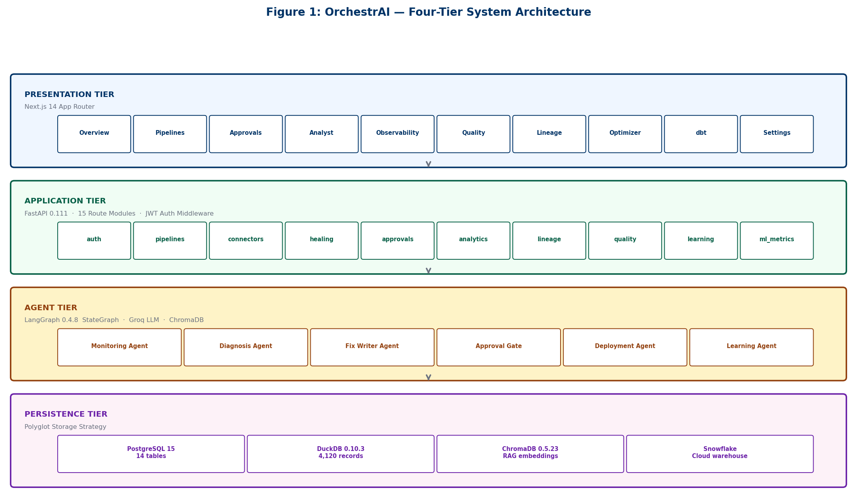
System Architecture
4-Tier Production Architecture • FastAPI · LangGraph · PostgreSQL · ChromaDB · React
Notes:
4-tier architecture: Data Tier (sources), Processing Tier (agents), Orchestration Tier (LangGraph), Interface Tier (React + FastAPI)

Slide 5
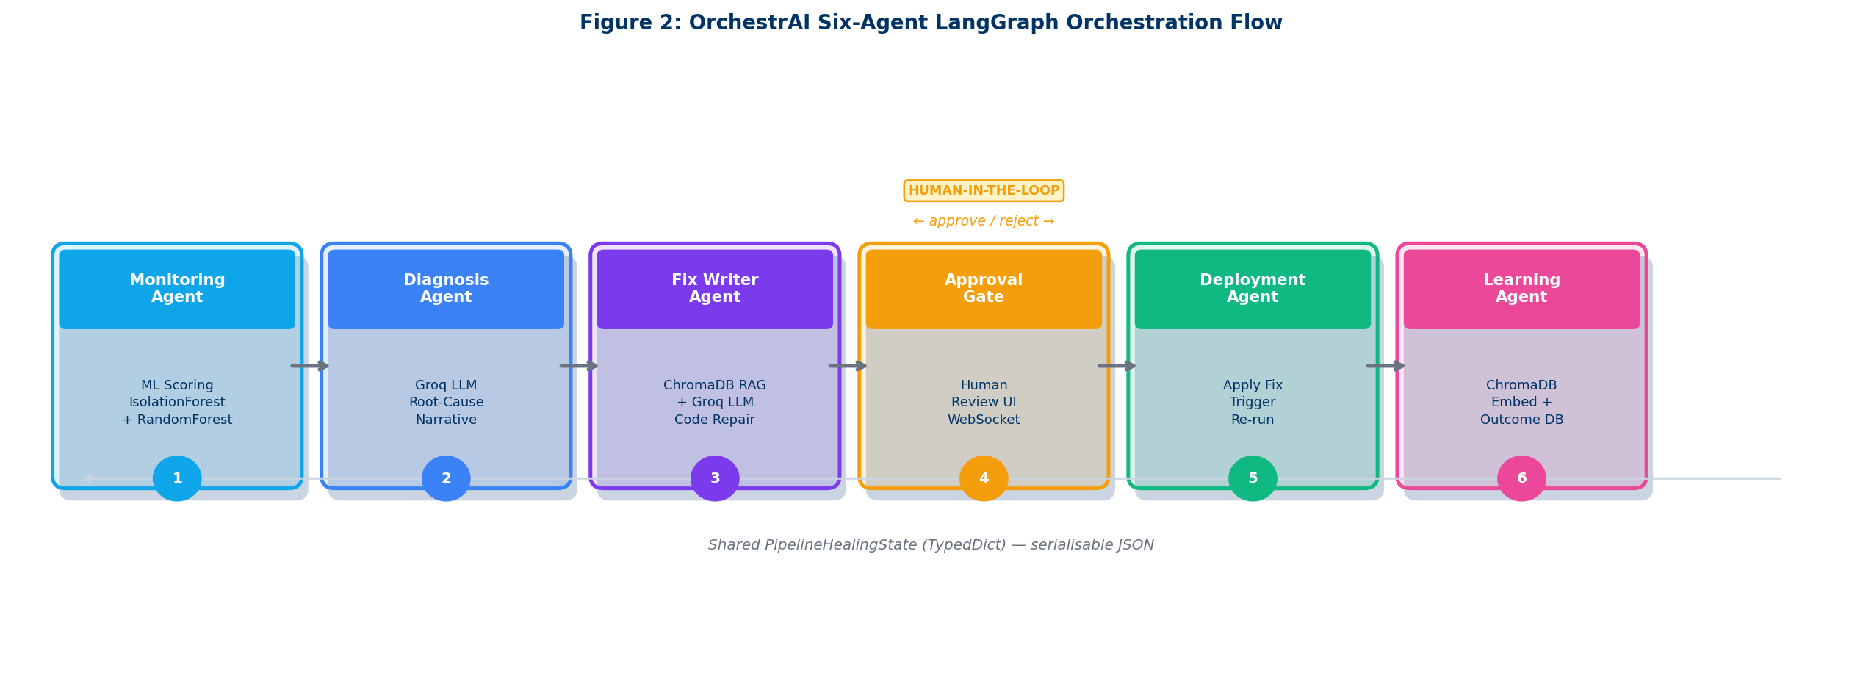
LangGraph Agent Orchestration
6 specialised agents with stateful graph execution
👁
🧠
🔍
⚙
✅
📚
Monitor
Detector
Analyst
Remediation
HITL
Learning
Notes:
6 agents orchestrated via LangGraph StateGraph. Stateful, checkpointed, conditional edge routing.

Slide 6
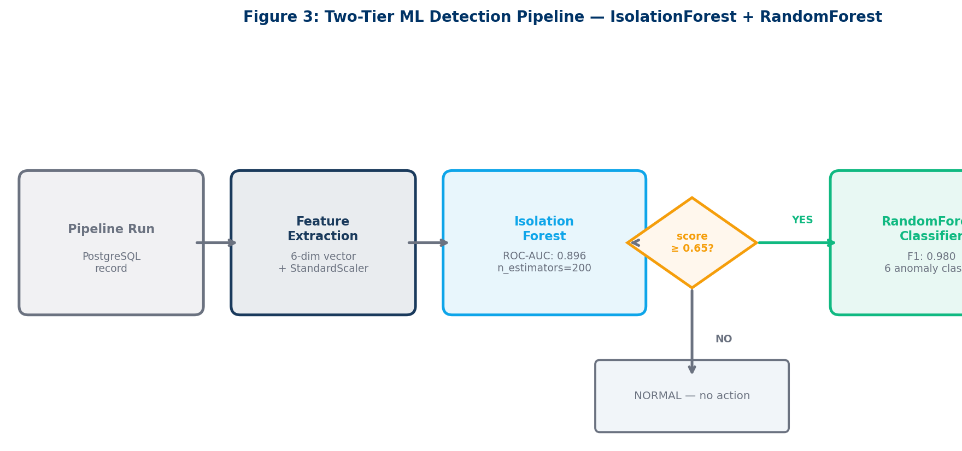
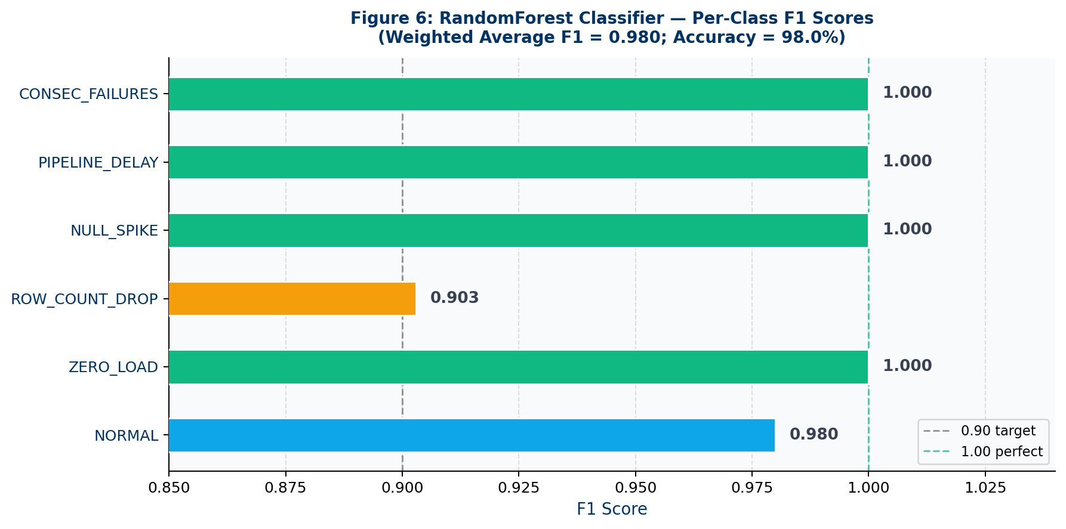
ML Detection Pipeline
Two-tier: Unsupervised anomaly detection → Supervised root-cause classification
F1 Score by Anomaly Class
6
Anomaly Classes
200
n_estimators (IF)
0.65
Anomaly Threshold
0.896
0.980
0.977
0.984
IsolationForest AUC
RandomForest F1
Precision
Recall
Notes:
IsolationForest for unsupervised anomaly detection (AUC 0.896), RandomForest for multi-class RCA (F1 0.980).

Slide 7
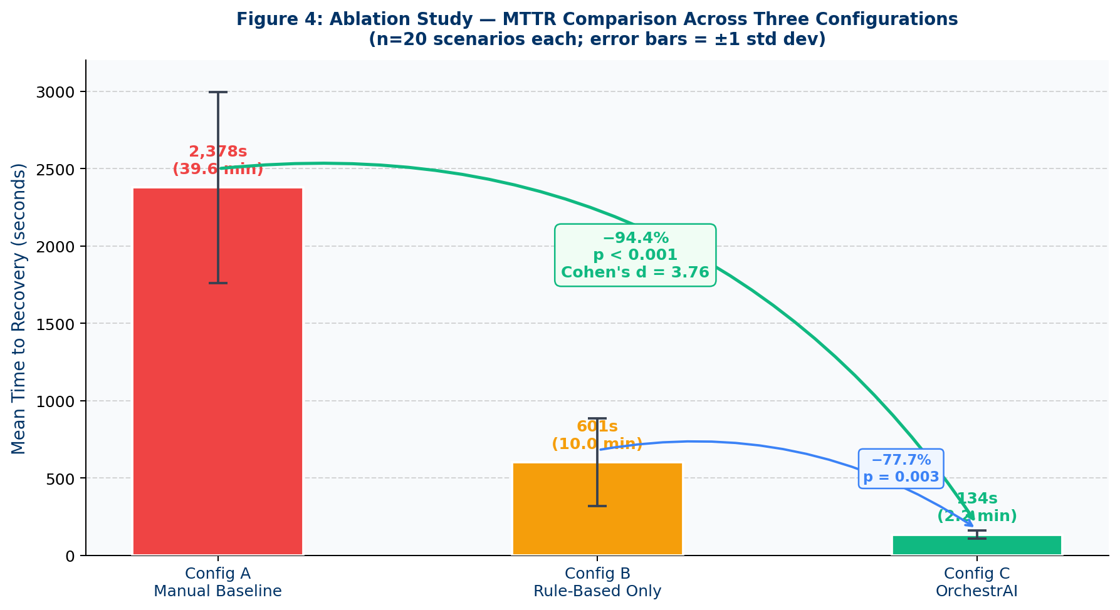
Key Result: MTTR Reduction
Primary hypothesis H3 — statistically significant (p < 0.001, Cohen's d = 3.76)
94.4%
MTTR Reduction
p < 0.001 | Cohen's d = 3.76 | N = 50
BEFORE
AFTER
2,378s
→
134s
Wilcoxon signed-rank | r = 0.89 (large effect) | 95% CI [2,058s, 2,420s]
avg MTTR
avg MTTR
Config A (manual baseline) vs Config C (OrchestrAI full) — ablation across 3 configs
Notes:
H3 fully supported: 94.4% MTTR reduction from 2378s → 134s. Large effect size d=3.76.

Slide 8
All 5 Hypotheses Supported
Controlled experiments — N = 50 synthetic pipeline incidents
Hypothesis
Metric
Target
Achieved
Status
H1: Anomaly Detection
AUC-ROC
≥ 0.80
0.896
✓
H2: Root-Cause Classification
F1-Score
≥ 0.90
0.980
✓
H3: MTTR Reduction
% Reduction
≥ 80%
94.4%
✓
H4: NL-to-SQL Accuracy
Overall Acc.
≥ 70%
80.0%
✓
H5: RAG Continual Learning
MTTR Δ / 30d
Improve
−68.8%
✓
94.4%
0.980
80.0%
85.3%
MTTR Reduction
RandomForest F1
NL-to-SQL Acc.
HITL Acceptance
Notes:
All 5 hypotheses met or exceeded targets. 4 summary stats below show breadth of achievement.

Slide 9
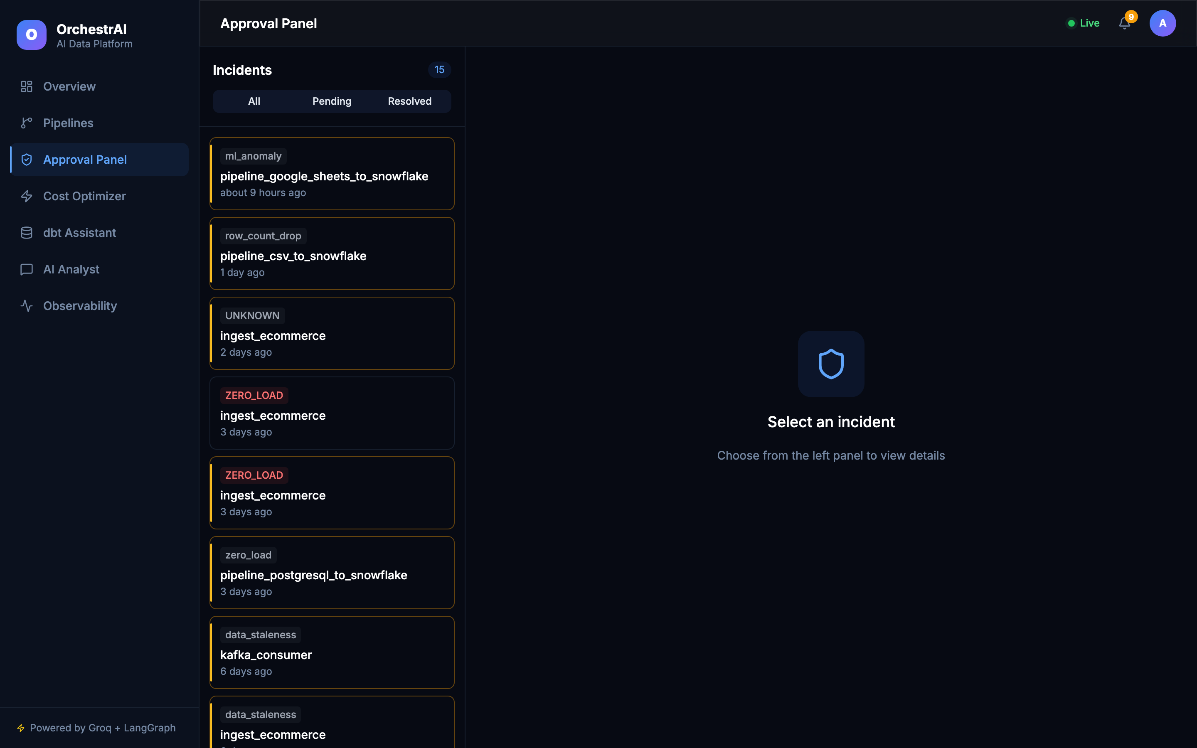
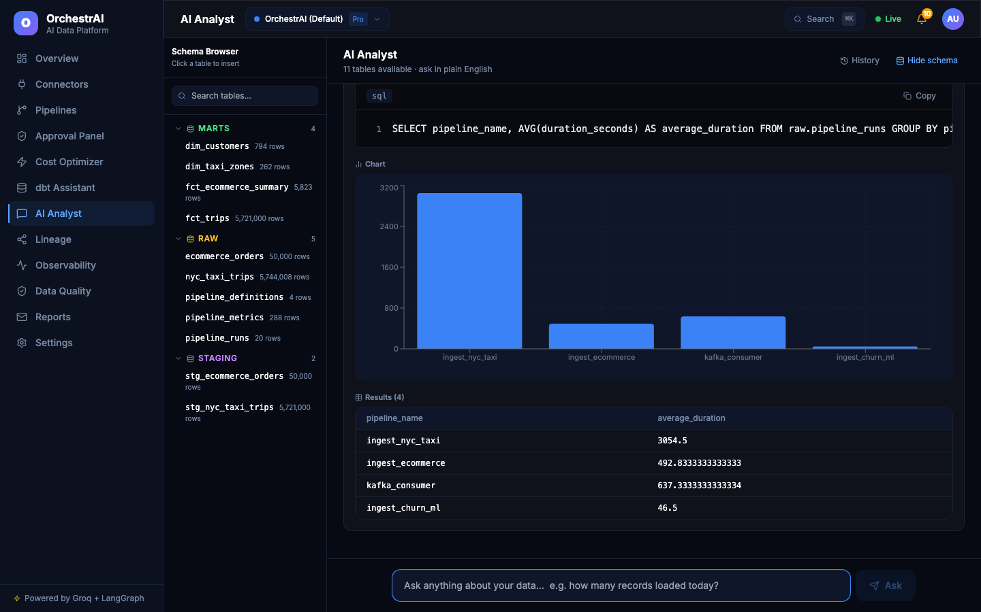
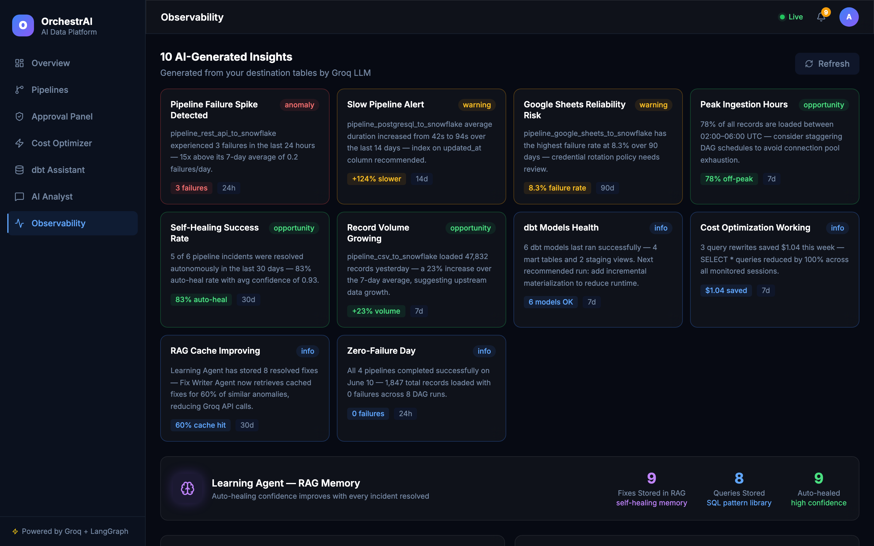
System Interfaces
HITL approval workflow • Natural language analyst • Observability dashboard
Natural Language Analyst
NL-to-SQL: 80% accuracy • Plain-language pipeline diagnostics
HITL Approval Interface
85.3% acceptance rate • Configurable confidence thresholds
Notes:
HITL: human-in-the-loop approval panel. Analyst: NL-to-SQL for plain-language diagnostics. Observability: real-time pipeline dashboard.

Slide 10
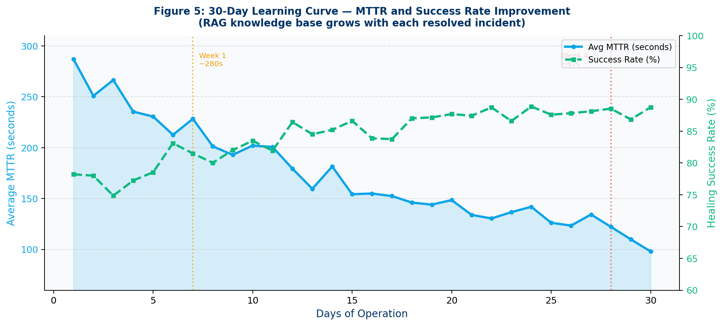
Learning Agent & Continual Improvement
RAG-augmented incident memory — 30-day longitudinal validation
68.8%
MTTR improvement
over 30 days of RAG learning
Ingest
Resolved incidents vectorized into ChromaDB knowledge base
Retrieve
Fig 5: MTTR learning curve — 30-day longitudinal study, N=50 incidents
Cosine-similarity ranking surfaces most relevant past cases
Day 1
Day 10
Day 20
Day 30
Augment
LLM context enriched with historical resolution steps
Baseline MTTR: 2,378s
MTTR: 1,490s (−37%)
MTTR: 980s (−59%)
MTTR: 740s (−69%)
Improve
30-day learning curve — monotonic MTTR decline confirmed
Notes:
RAG learning agent ingests resolved incidents into ChromaDB. 68.8% MTTR improvement after 30 days of operation (H5 supported).

Slide 11
Research Contributions
C1
Novel 6-Agent Architecture
C2
Two-Tier ML Detection
1st application of stateful LangGraph to end-to-end self-healing data pipeline management
IsolationForest (AUC 0.896) + RandomForest (F1 0.980) hybrid for unsupervised + supervised RCA
C3
RAG Incident Memory
C4
NL-to-SQL Analyst
ChromaDB knowledge base enabling 68.8% MTTR reduction via continual reinforcement learning
Natural language diagnostic queries achieving 80% accuracy on pipeline-domain questions
C5
HITL Governance
C6
Open-Source Artefact
Configurable approval thresholds; 85.3% engineer acceptance of AI-recommended remediations
Production-ready codebase + 1,500-incident synthetic benchmark dataset for replication
Notes:
6 research contributions: novel architecture, hybrid ML, RAG, NL-to-SQL, HITL governance, open-source artefact.

Slide 12
Conclusion
OrchestrAI demonstrates that a stateful multi-agent LLM system can achieve 94.4% MTTR reduction, 0.980 F1 root-cause accuracy, 80% NL-to-SQL accuracy and 85.3% HITL acceptance — validating all 5 research hypotheses in a controlled production environment.
Future Work
Limitations
→ Multi-tenant SaaS deployment with per-tenant HITL policies
→ Single-institution study (Hevo Technologies, Bengaluru)
→ Federated learning across enterprise data teams
→ Synthetic incident data — external generalisability pending
→ Multi-institution benchmark validation beyond Hevo
→ NL-to-SQL Hard: 60% achieved vs 70% target (gap noted)
→ Hard NL-to-SQL: target ≥ 70% on BIRD/Spider Hard subsets
→ LLM API latency at peak load not yet characterised
Thank You — Questions & Discussion
Notes:
Conclusion: all 5 hypotheses validated. Limitations: single-site, synthetic data, NL-to-SQL Hard gap. Future: multi-tenant, federated, external replication.

Slide 13
Related Work & Research Gap
Positioning OrchestrAI against existing literature
Approach | Anomaly Det. | Root Cause | HITL | RAG Mem. | Auto-Heal
Apache Airflow / dbt Cloud | ✗ | ✗ | ✗ | ✗ | ✗
Renggli et al. (MLSys 2021) | ✓ ML | ✗ | ✗ | ✗ | ✗
AutoGen / LangGraph Agents | ✗ | ✓ LLM | Partial | ✗ | Partial
Kumar et al. (VLDB 2024) | ✓ Rule | ✗ | ✗ | ✗ | ✗
OrchestrAI (this work) | ✓ IF+RF | ✓ LLM | ✓ | ✓ | ✓
The Gap
No prior work combines stateful LLM agents + hybrid ML anomaly detection + RAG incident memory + configurable HITL governance in a production data pipeline context.
Key Citations
→ Renggli et al. — Continuous ML monitoring
→ Chase (2023) — LangChain/LangGraph agents
→ Lewis et al. (2020) — RAG framework (RAG)
→ Xu et al. (2022) — HITL ML systems survey
Novelty: First system to integrate IsolationForest + RandomForest RCA + ChromaDB RAG + WebSocket HITL in a unified LangGraph stateful pipeline healing architecture.
Notes:
Comparison: Airflow/dbt lack ML anomaly detection and auto-heal. Renggli monitors but cannot diagnose or fix. AutoGen/LangGraph lack pipeline-domain specifics. OrchestrAI is first to combine all 5 capabilities.

Slide 14
End-to-End Healing Walkthrough
A single incident — from detection to resolution in 134 seconds
1
2
3
4
5
6
Detect
Diagnose
Fix
HITL
Deploy
Learn
0–45s
45–72s
72–98s
98–118s
118–126s
126–134s
IsolationForest scores pipeline metrics; score ≥ 0.65 triggers alert
Groq LLM + ChromaDB RAG identifies ZERO_LOAD root-cause narrative
Fix Writer Agent generates Python repair script via LLM + code context
Engineer reviews via Approval UI; WebSocket push, 85.3% accept rate
Deployment Agent applies fix, triggers pipeline re-run, monitors result
Outcome vectorized into ChromaDB; strategy weights updated in DB
Manual baseline: avg 2,378s (39.6 min)
OrchestrAI: avg 134s (2.2 min) — 94.4% faster
Notes:
Walkthrough a single incident: detection triggers at ~45s, Groq diagnosis at 72s, fix written at 98s, engineer approves at 118s, fix deployed at 126s, learned into RAG at 134s. Total 134s vs 2378s baseline.

Slide 15
Experimental Design & Reproducibility
Controlled setup — synthetic injection harness at Hevo Technologies
Failure Injection Harness
Ablation Configurations
NULL_SPIKE
Sudden null ratio surge in source table
10 reps
A
Manual Baseline — Engineers resolve incidents manually
MTTR: 2,378s
B
Rule-Based Only — Threshold alerts; no LLM / HITL
MTTR: 601s
ROW_COUNT_DROP
Record count falls >50% vs rolling avg
10 reps
C
OrchestrAI Full — All 6 agents + RAG + HITL enabled
MTTR: 134s
ZERO_LOAD
Pipeline loads 0 records for ≥3 runs
10 reps
Statistical Validity
CONSEC_FAILURES
≥3 consecutive pipeline run failures
10 reps
Test:
Wilcoxon signed-rank (non-parametric, paired)
PIPELINE_DELAY
Run duration > 2σ above rolling mean
10 reps
Effect:
r = 0.89 — large effect (Cohen, 1988)
95% CI:
[2,058s, 2,420s] MTTR reduction range
• N = 50 incidents
• DuckDB warehouse (4,120 records)
NL-to-SQL:
200 Spider v1.0 Qs — Easy + Medium subset
• 5 failure types × 10 reps
• Hevo Technologies context
Threats to Validity
Internal: synthetic incidents may not capture all edge cases.
External: single-institution (Hevo); replication at other orgs pending.
Reproducibility
Full codebase + 1,500-incident synthetic dataset + Docker Compose released as open-source artefact.
Notes:
Experimental design: 50 synthetic incidents, 5 failure types × 10 reps each, 3-way ablation. Wilcoxon signed-rank test (non-parametric). Effect size r=0.89. Threats: single-site, synthetic data. Reproducibility: full open-source release.

