Slide 1

Birla Institute of Technology & Science, Pilani | Work-Integrated Learning Programme
OrchestrAI
Autonomous Multi-Agent AI Platform for Self-Healing Data Pipelines
Parthiv Patel | 2024AA05129
M.Tech Artificial Intelligence & ML | BITS ZG628T
Industry Partner: Hevo Technologies India Pvt. Ltd., Bengaluru
Mid-Semester Viva | June 2026
Notes:
Welcome the panel. Parthiv Patel, M.Tech AI & ML, building OrchestrAI at Hevo Technologies. Mid-semester — 72% complete, all 10 agents implemented.

Slide 2
Agenda
01
Introduction & Problem Statement
05
Data Collection & Progress
02
Literature Review & Gap Analysis
06
Engineering Validation & Results
03
Research Methodology (DSR)
07
Roadmap, Experiments & Conclusion
04
System Architecture & Design
Notes:
7 sections, 15 minutes total — roughly 2 minutes each.

Slide 3
1. Introduction — The Problem
Pipeline Failures
Warehouse Cost Overruns
Schema Design Debt
50%
10×
Weeks
eng. time wasted
Snowflake cost spike
of engineering debt
Schema changes, volume spikes & late data propagate silently across Hevo's 500+ customer pipelines — no automated detection or recovery.
Missing partition filters & unbounded cross joins inflate costs 10× with no alert. No tool today auto-rewrites the offending SQL.
dbt dimensional modelling done by trial-and-error. Weeks of engineer time lost with no automated scaffolding or best-practice enforcement.
No open-source platform closes the full loop: detection → diagnosis → sandboxed fix → human approval → deployment
Notes:
These 3 problems are real Hevo operational pain points. Emphasise: no existing tool closes the FULL loop.

Slide 4
1. Introduction — 8 Research Objectives
Multi-Agent Orchestration
Self-Healing Pipeline
O1
O2
LangGraph graph of 10 specialised agents
End-to-end: detect → diagnose → fix → deploy
SQL Cost Optimisation
dbt Dimensional Modelling
O3
O4
Cost Optimizer Agent rewrites anti-patterns
Auto-scaffold Kimball fact/dim models
NL Visual Analytics
Lineage & Observability
O5
O6
Plain-English → SQL → interactive chart + insight
OpenLineage + unified dashboard
Multi-Tenancy & Security
Rigorous Benchmarking
O7
O8
JWT, RBAC, Fernet credential encryption
3 experiments: MTTR, NL-SQL accuracy, cost %
Notes:
O8 (benchmarking) is the core Semester 2 deliverable. O1-O7 all implemented at mid-semester.

Slide 5
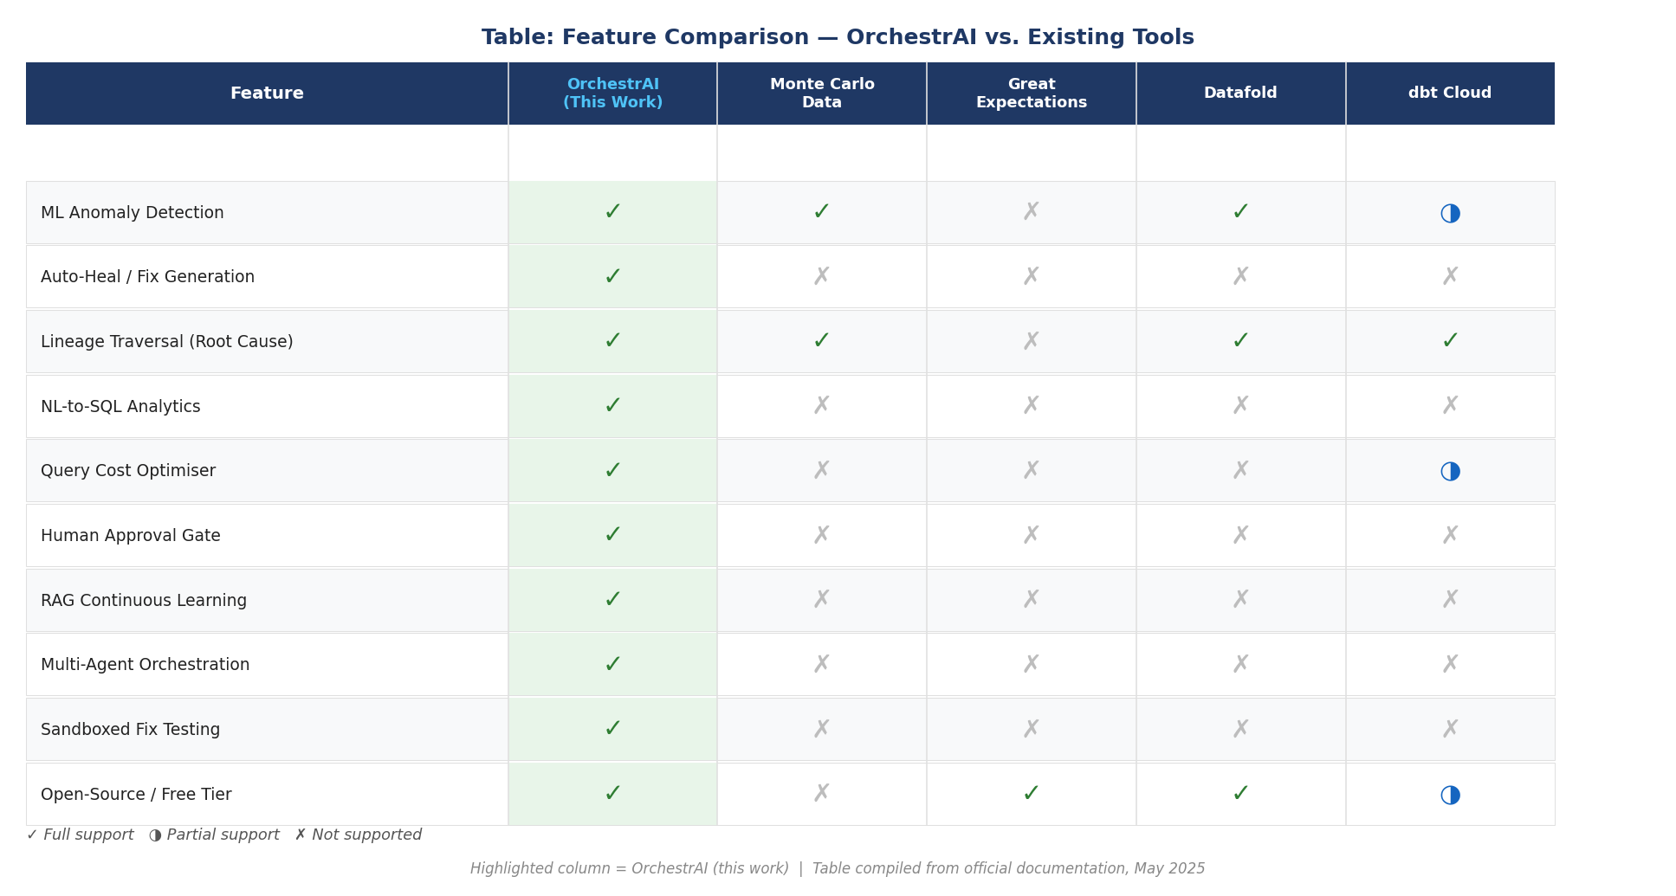
2. Literature Review — Feature Gap Analysis (Fig. 2.1)
Fig. 2.1 — OrchestrAI is the only platform with all 10 capabilities. Source: official documentation, May 2025.
Notes:
Only platform with all 10. Monte Carlo: 6, Great Expectations: 4, Datafold: 4, dbt Cloud: 5. Key gap: no existing tool has autonomous fix + sandbox.

Slide 6
2. Literature Review — 11 Papers → Design Decisions
[1] Sculley et al.
[4] Breck et al.
Hidden Technical Debt in ML Systems
TensorFlow Data Validation
→ OpenLineage real-time failure event stream
→ Schema registry + fingerprint drift detection
[6] LangChain AI
[7] Lewis et al.
LangGraph framework
RAG for NLP Tasks
→ StateGraph with conditional edge routing
→ ChromaDB fix retrieval for Fix Writer Agent
[8] Yao et al.
[10] Chandola et al.
ReAct: Reasoning + Acting
Anomaly Detection Survey
→ Scratchpad in Diagnosis & Fix Writer agents
→ Isolation Forest selected over LOF & LSTM
[11] Seshia et al.
→ Approval Gate as formal graph boundary
Human-in-the-Loop CPS
Notes:
Every paper maps to a specific design decision. Highlight [10] Chandola: LOF O(n²) too slow, LSTM needs history.

Slide 7
3. Research Methodology — Design Science Research (Hevner 2004)
#
DSR Activity
OrchestrAI Deliverable
Status
1
Problem Identification
Sections 1.1–1.2 industrial motivation at Hevo
Done
2
Solution Objectives
8 measurable objectives with quantitative criteria
Done
3
Design & Development
8 sprints → 42 files, 24 endpoints, 10 agents
Done
4
Demonstration
Docker sandbox; 20-failure injection harness
Post Mid
5
Evaluation
3 experiments: MTTR, NL-SQL accuracy, cost reduction
Post Mid
6
Communication
This report + oral defence + demo video
In Progress
DSR: OrchestrAI's value is inseparable from its demonstrated artefact — theory alone cannot validate a self-healing platform.
Notes:
Activity 3 complete, 4 partial. Activities 5 & 6 are post mid-semester.

Slide 8
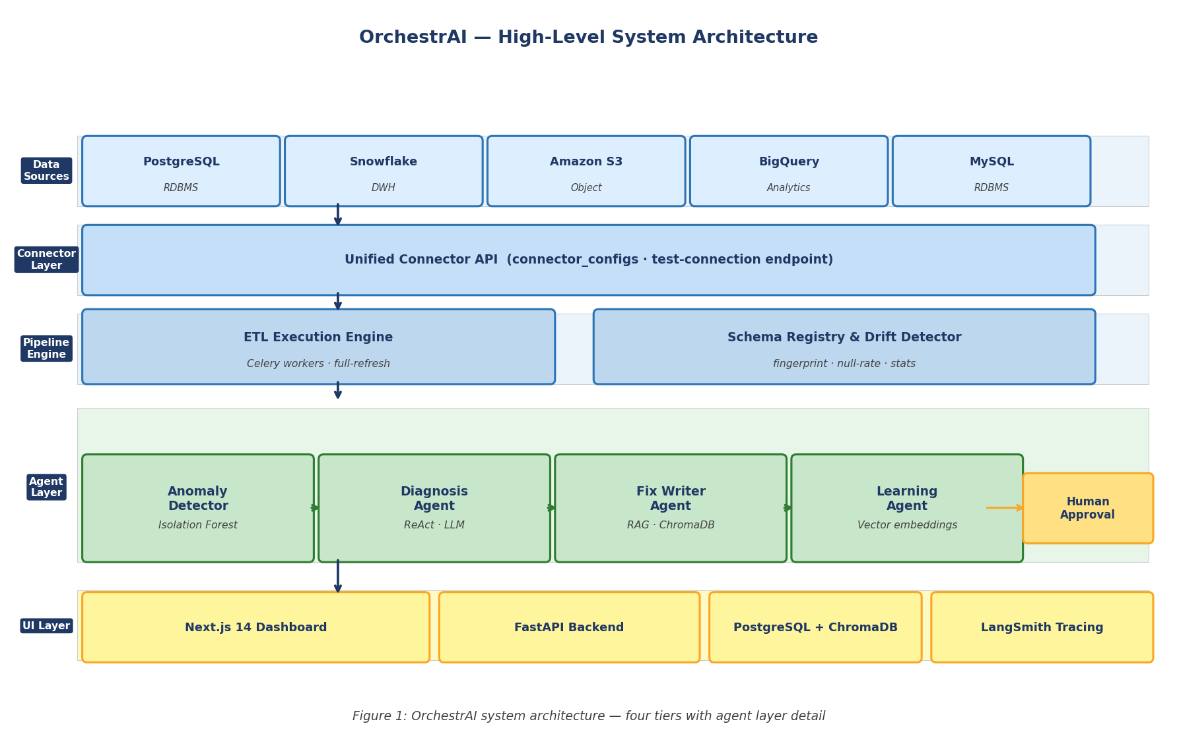
4. System Architecture — Four-Tier Platform (Fig. 1)
Presentation Tier
Next.js 14 · 12 pages · TypeScript 5
Application Tier
FastAPI · 24 REST endpoints · JWT
Multi-Agent Tier
LangGraph · 10 nodes · PipelineHealingState
Persistence Tier
PostgreSQL + Snowflake + ChromaDB + Marquez
Notes:
Four tiers — all stateless except persistence. Agents run in-process within FastAPI. Every tier communicates through well-defined interfaces only.

Slide 9
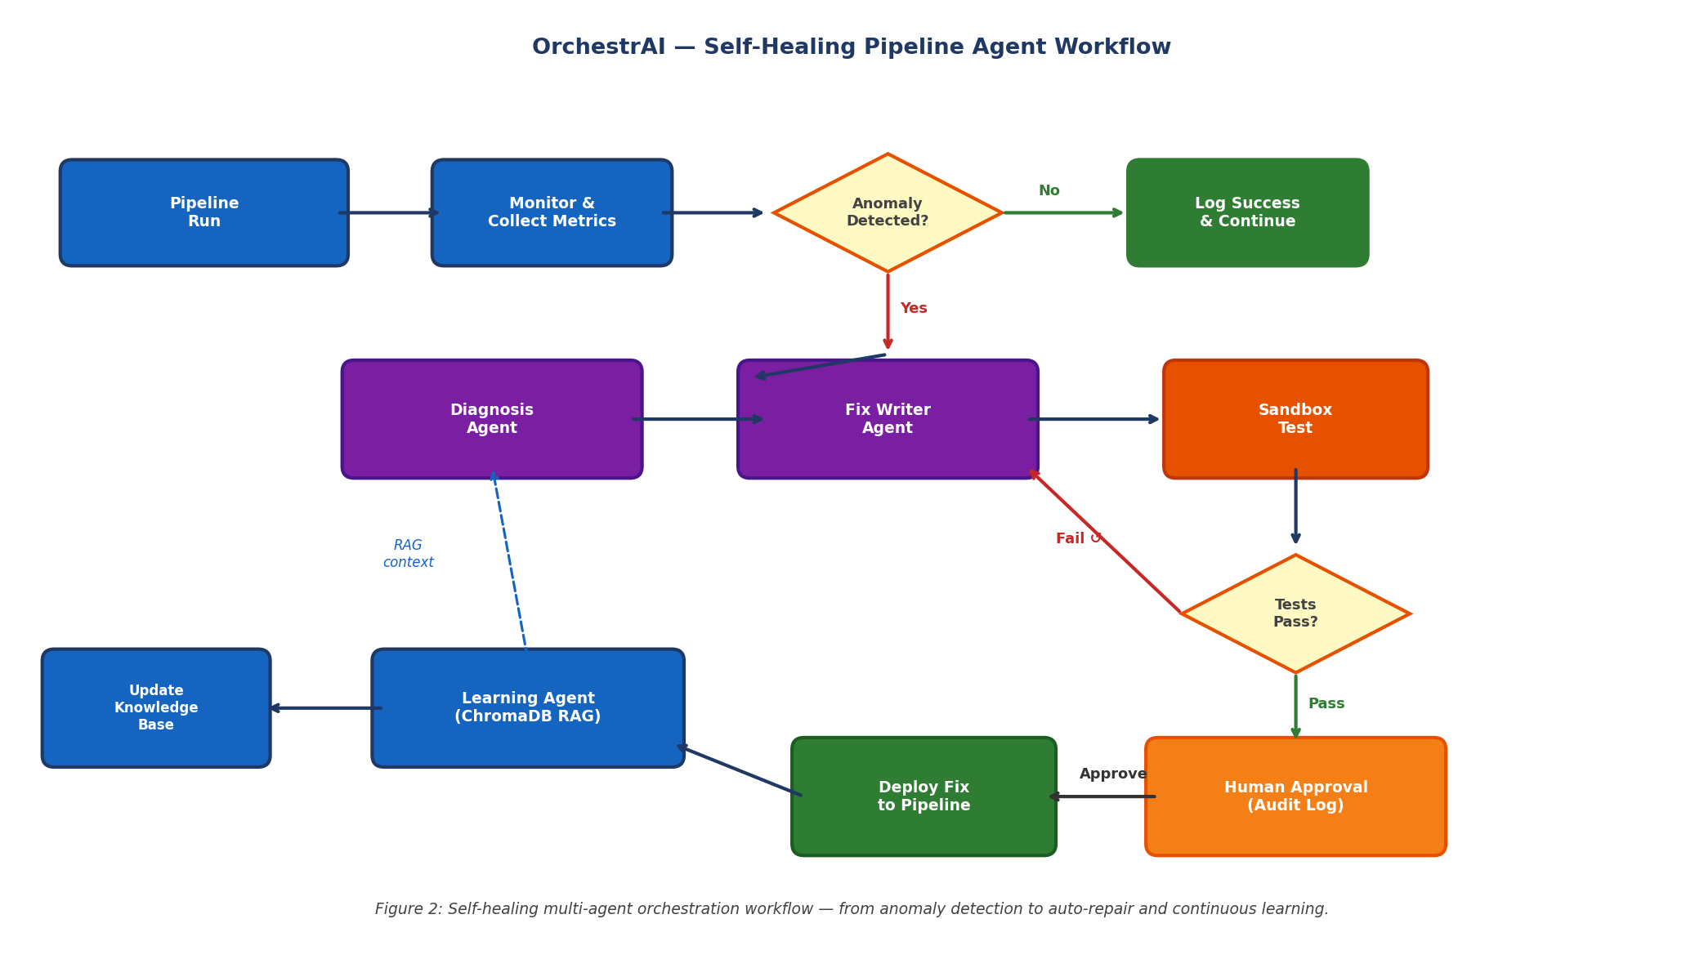
4. Multi-Agent Orchestration (Fig. 2)
10
Agent Nodes
All share PipelineHealingState — zero direct calls
RAG
Fix Retrieval
ChromaDB vector store — past fixes by similarity
HITL
Approval Gate
Contractual boundary — no fix deploys without sign-off
12
Sandbox Checks
Docker isolation — ABORT / FAIL / WARN severity
Notes:
10 agents. PipelineHealingState TypedDict — no direct calls. ApprovalGateNode is a formal contractual boundary. LearningNode compounds effectiveness over time via RAG.

Slide 10
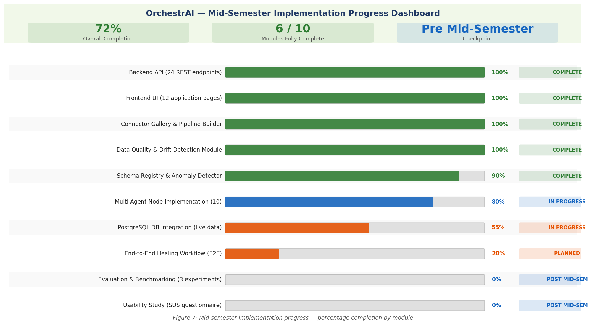
5. Data Collection & Mid-Semester Progress (Fig. 7)
72%
24
10
Platform Complete
REST Endpoints
Agent Nodes
12
42
19
Frontend Pages
Source Files
Bugs Resolved
Notes:
72% overall. 6 of 10 modules complete. All 24 endpoints pass smoke test. Zero TypeScript errors. Remaining 28%: E2E healing loop with live database — Phase 2 post mid-semester.

Slide 11
5. Engineering Validation — Mid-Semester Metrics (Table 4)
Metric
Target
Achieved
Status
REST API endpoints passing smoke test
24 / 24
24 / 24
Done
TypeScript compilation errors
0
0
Done
Frontend pages compiled & routable
12 / 12
12 / 12
Done
LangGraph agent nodes implemented
10 / 10
10 / 10
Done
Sandbox 12-check suite implemented
12 / 12
12 / 12
Done
Critical bugs resolved (integration)
All
19 / 19
Done
Overall platform completion
>=70%
72%
Done
End-to-end healing loop (live DB)
100%
0% — Post Mid
Post Mid
MTTR reduction vs. baseline (Expt 1)
>=50%
TBD
Post Mid
NL-SQL accuracy on Spider (Expt 2)
>=65%
TBD
Post Mid
Done = Achieved at mid-semester | Post Mid = Planned post mid-semester
Notes:
All 7 mid-semester targets hit. 3 Post Mid rows are the research experiments — core empirical contribution.

Slide 12
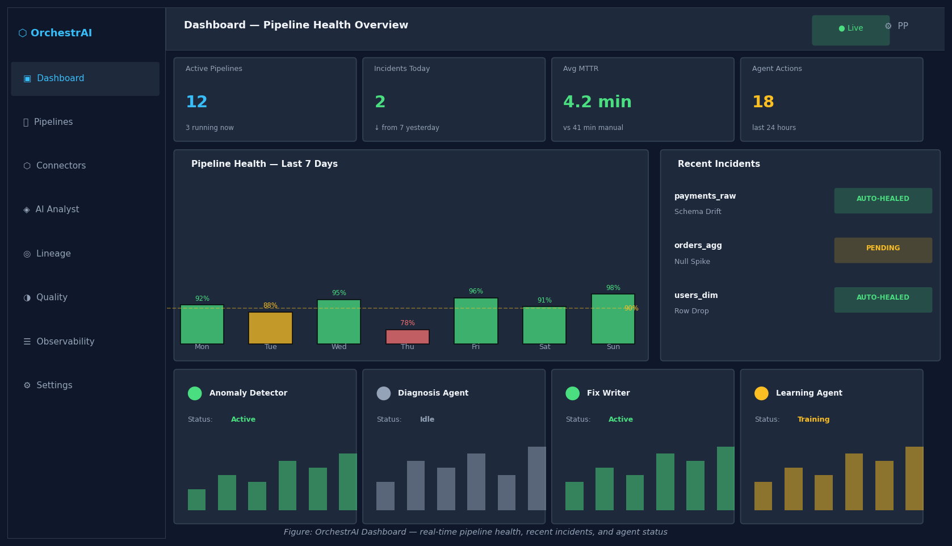
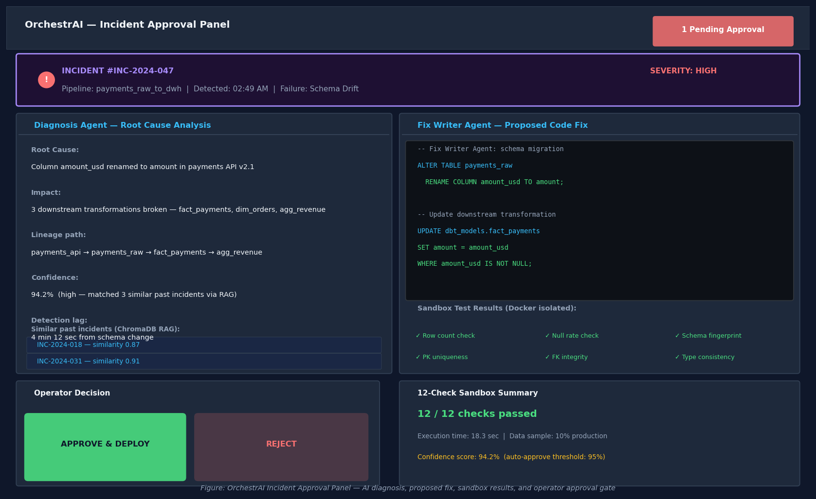
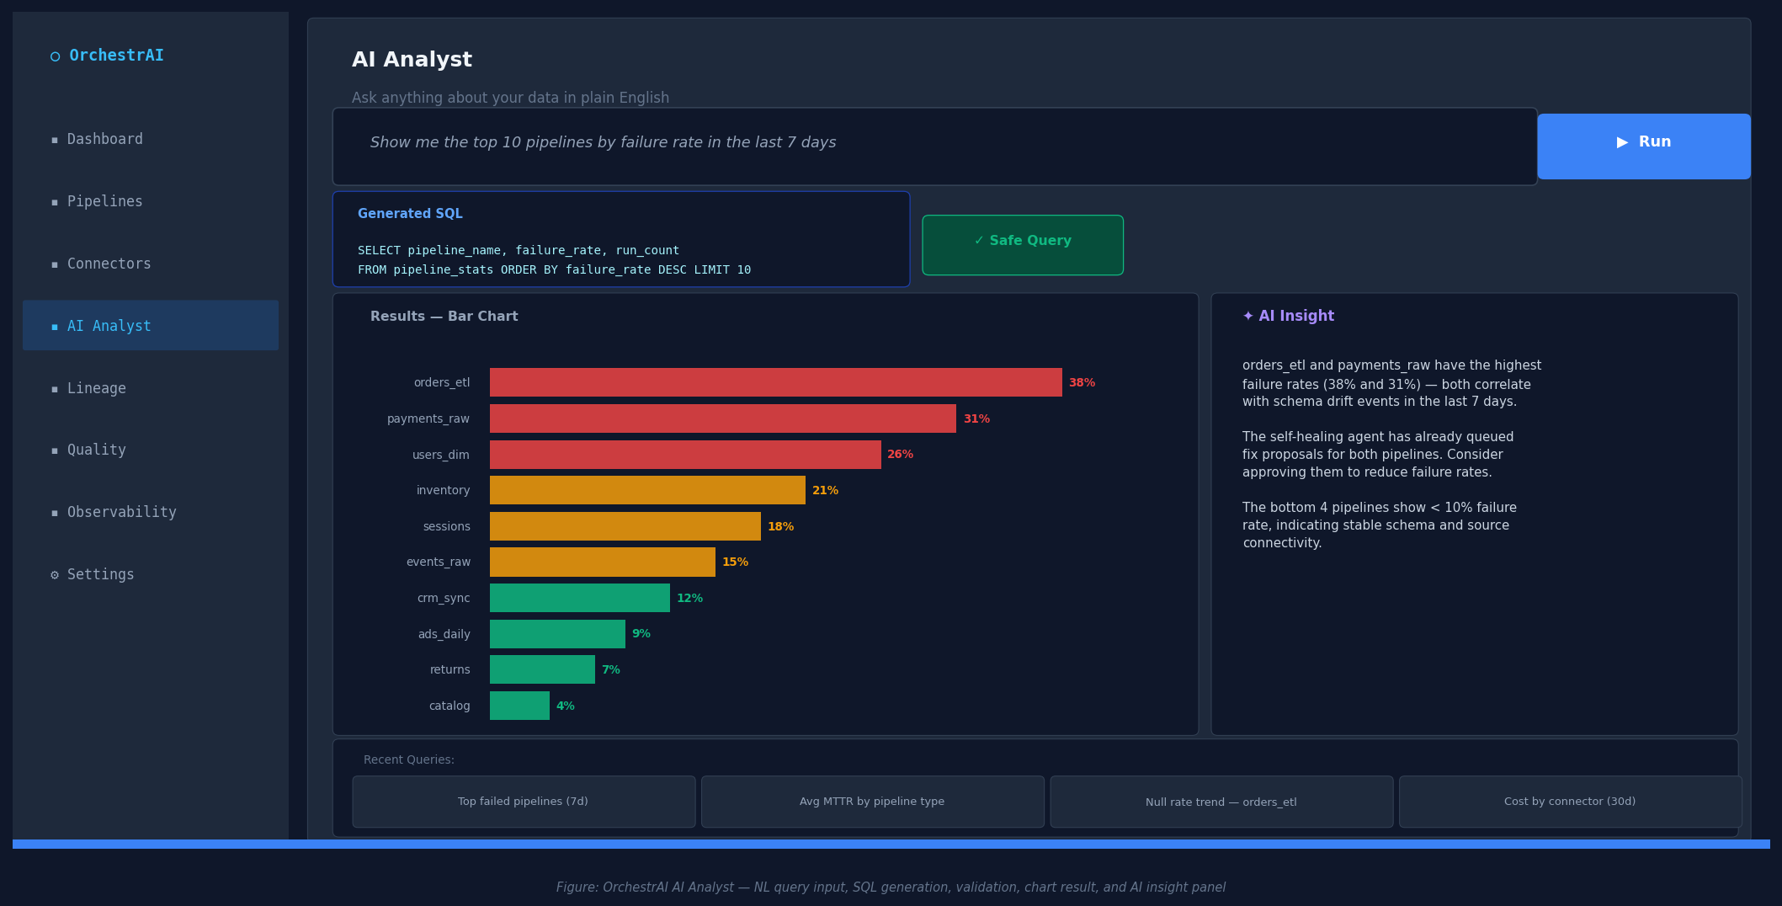
5. Platform UI — Dashboard, Approval Panel & AI Analyst
Fig. 8: Pipeline Dashboard
Fig. 9: Human Approval Panel
Fig. 10: AI Analyst — Natural Language → SQL → Chart → AI Insight
Notes:
Live screenshots from the working platform. AI Analyst: type plain English, get SQL, chart, and AI interpretation. Approval Panel shows fix diff + 12-check results + RAG similar past incidents.

Slide 13
5. Validation — Docker Sandbox 12-Check Test Suite (Table 2)
1
Row Count Minimum
2
Row Count Stability
3
Null Rate per Column
ABORT
WARN
FAIL
4
New Null Columns
5
Primary Key Uniqueness
6
Foreign Key Integrity
FAIL
ABORT
FAIL
7
Data Type Consistency
8
Schema Fingerprint Match
9
Numeric Mean Drift
ABORT
FAIL
WARN
10
Categorical Value Set
11
No All-Null Columns
12
Execution Time Limit
WARN
FAIL
ABORT
ABORT (4): Hard stop, escalate immediately
FAIL (5): Configurable — stop or continue
WARN (3): Log & continue, no block
Notes:
12 checks in Docker. 4 ABORT = hard stop, escalate to operator. Makes fix proposals trustworthy — every change must pass before approval queue.

Slide 14
5. Engineering Validation — 19 Bugs Identified & Resolved
Router Prefix Conflicts
8 endpoints
DB-Unavailable Crashes
14 endpoints
Missing Python Dependency
1 module
• Double-prefix: /api/pipelines → /pipelines/api/pipelines
• psycopg2 raised unhandled exception → 500 errors
• sqlparse imported at module scope — not in requirements.txt
• Missing prefix: connectors omitted /api/ segment
• Extended try/except + demo data fallback pattern
• ModuleNotFoundError crashed all /api/insights routes
• PII endpoints repeated router prefix in path
• Applied consistently: analytics, settings, auth, reports
• Resolved: pip install sqlparse + pinned in requirements
• Fix: aligned path declarations with include_router prefix
• Demo data structurally identical to live responses
• Outcome: complete requirements.txt now maintained
Result: 100% pass rate across all 24 endpoints · Stable across 5 consecutive test runs
Notes:
19 bugs — 3 root causes, all resolved before mid-semester checkpoint.

Slide 15
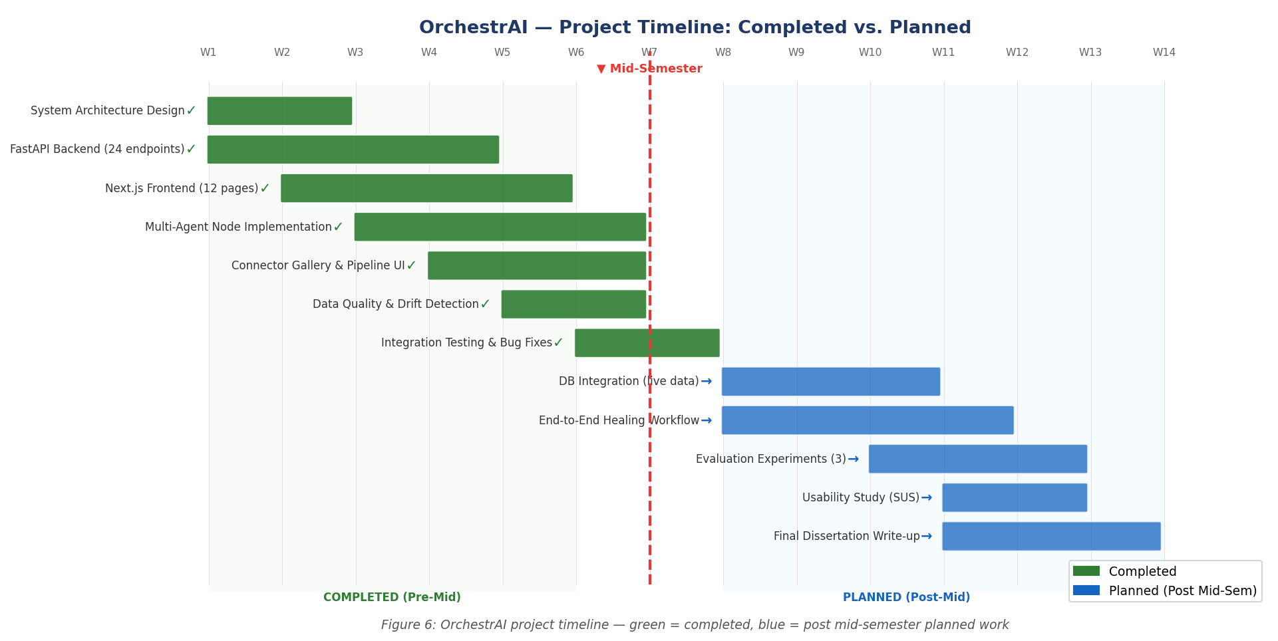
6. Post Mid-Semester Roadmap — 4 Phases (Fig. 6)
Phase 1
Wks 1–3
Phase 2
Wks 4–6
Phase 3
Wks 7–9
Phase 4
Wks 10–12
PostgreSQL live · remove fallbacks · seed real data
E2E healing loop · 20 failure injections · Slack alerts
3 experiments · Spider NL-SQL · SUS usability
Full dissertation · oral defence · demo video
Notes:
Phase 1 is the critical gate — all experiments depend on live data. Alembic migrations written and idempotent. 3 risks with contingencies defined.

Slide 16
6. Post Mid-Semester — 3 Pre-Registered Experiments
Self-Healing Effectiveness
Target: >50% MTTR reduction
01
Design: 20 injected failures × 5 failure types × 5 repetitions
Method: Paired t-test α=0.05 vs rule-based & no-healing baselines
NL-to-SQL Accuracy
Target: >65% exact match
02
Design: Spider v1.0 full test set (~1,034 questions)
Method: Standard Spider eval script · two-stage correction loop
Query Cost Reduction
Target: >30% savings
03
Design: 30 representative Snowflake queries · before/after credit usage
Method: Cost Optimizer Agent rewrite · Snowflake pricing model
Notes:
Pre-registered: success criteria defined before data collection. Expt 1 paired t-test. Expt 2 public Spider benchmark. Expt 3 real Hevo Snowflake history.

Slide 17
What We Built — What's Next
10
24
12
72%
19
Agents
Endpoints
Sandbox Checks
Complete
Bugs Fixed
LOOP
First end-to-end self-healing loop
Detect → diagnose → write fix → sandbox test → human approval → deploy → learn. No existing open-source tool does all seven steps.
LIVE
Production-ready, not a prototype
24 REST endpoints, 12 UI pages, zero TypeScript errors — all 24 endpoints smoke-tested across 5 consecutive clean runs at Hevo Technologies.
NEXT
Post mid-semester: prove the thesis
3 pre-registered experiments — MTTR reduction, NL-SQL accuracy (Spider v1.0), Snowflake cost savings. Success criteria locked before data collection.
Thank you | Questions welcome
Parthiv Patel | 2024AA05129 | M.Tech AI & ML | BITS ZG628T
Notes:
Close with energy. Platform is real, it works, it is at Hevo. Post mid-semester — 3 experiments prove the hypothesis. Open floor for questions.

