Slide 1
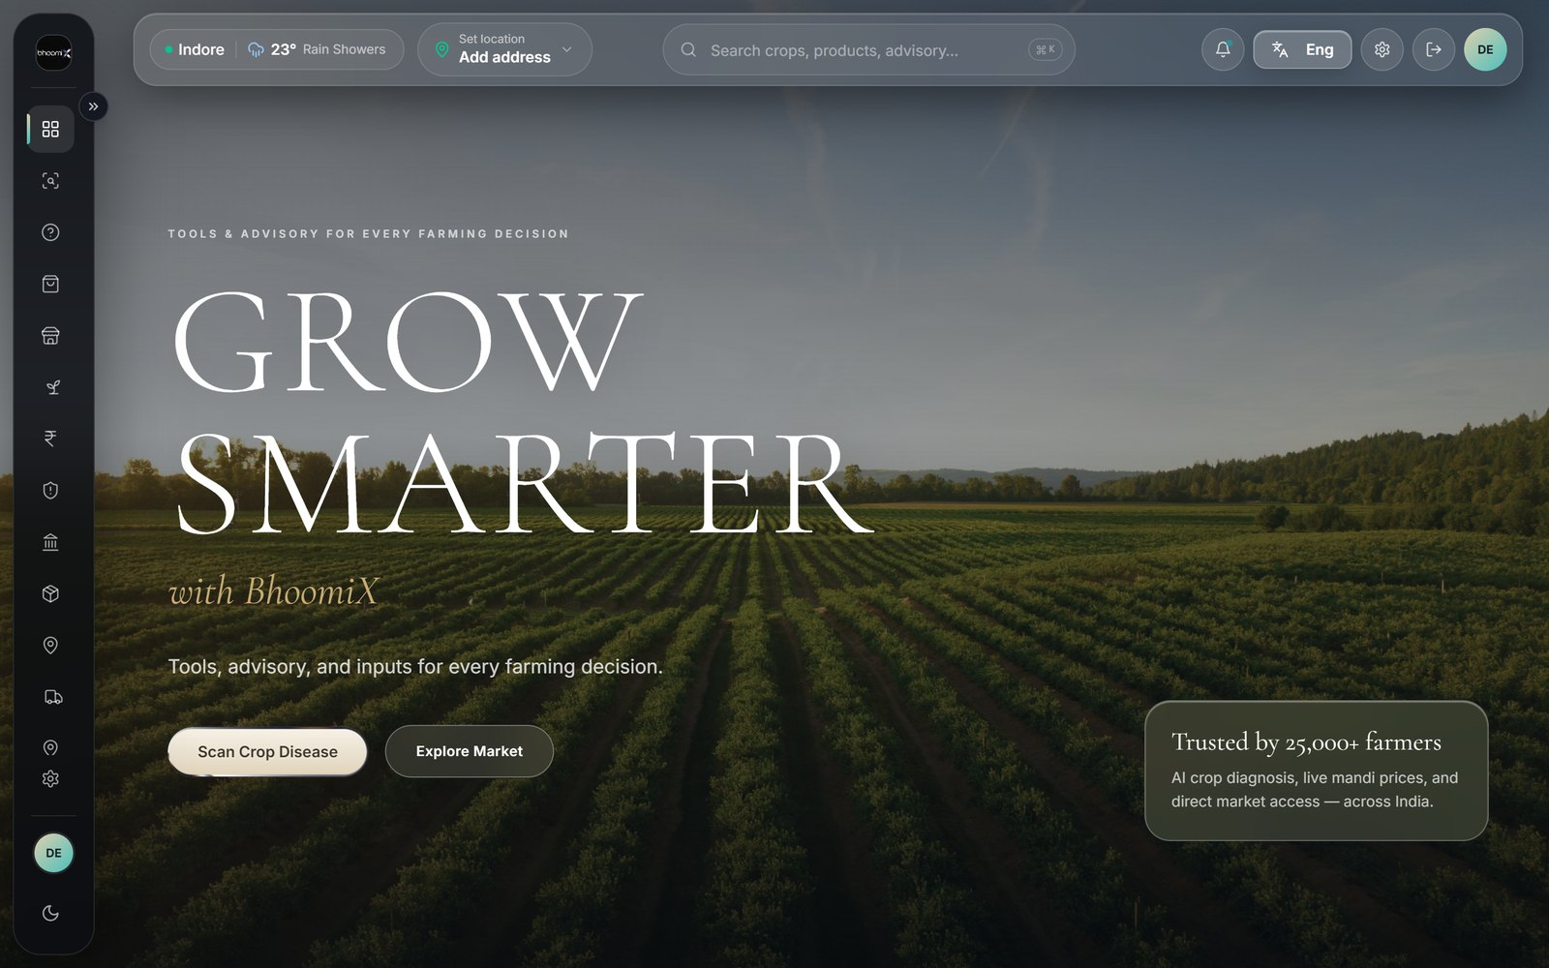
BhoomiX
Business Plan
Every farmer deserves the right price —
and eventually, the right loan to go with it.
[TEAM NAMES] · Indore · bhoomix.vercel.app
1

Slide 2
WHY THIS EXISTS
It started at home
"I come from a farming background.
My family belongs to a village."
The problem was rarely the crop itself. It was almost always something around the crop — the wrong market, a disease caught too late, a deadline missed.
Not a school topic that went looking for a problem. A problem that was already there.
2

Slide 3
WHY THIS EXISTS
And it showed up in the city too
What Indore has
What Indore cannot get
Quick-delivery grocery apps everywhere — delivering packaged and frozen food.
Genuinely fresh produce — grown a short distance away, by farmers who cannot reach that buyer.
A farmer who cannot reach the city. A city that cannot reach the farmer. Same gap, both directions.
3

Slide 4
THE PROBLEM
Three ways money disappears
Each one needs a different fix — which is why a single-purpose app is not enough.
4

Slide 5
LOSS 1 OF 3
He sells at the wrong mandi
Rs. 826
lost per quintal — same crop,
same day, same state
On ten quintals that is Rs. 8,000 the farmer never knows he lost.
5

Slide 6
LOSS 2 OF 3
He catches disease too late
By the time damage is obvious to the naked eye,
meaningful crop loss has already happened.
Expert diagnosis exists
So the decision gets made
— but it is a bus ride and a working day away.
by guesswork, or not at all, until it is too late.
6

Slide 7
LOSS 3 OF 3
He misses a deadline that is not his fault
72 hours
to report a localised crop loss under the national insurance scheme
Miss it, and a genuine loss is rejected
on a technicality — not on the merits.
7

Slide 8
THE COMPETITIVE GAP
What existing crop apps actually solve
 | Other crop apps | BhoomiX
Identify a plant problem | Yes | Yes
Live mandi prices | No | Yes
Insurance deadline help | No | Yes
Buy the remedy in-app | No | Yes
Built for one district | No | Yes
They answer "what is wrong with my plant." None answer "what do I do next."
8

Slide 9
MARKET REALITY
Two farmers, not one
They buy seed in completely different ways — designing for the average satisfies neither.
9

Slide 10
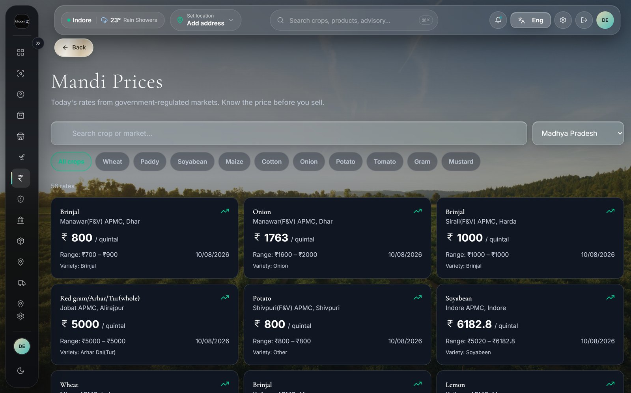
SEGMENT 1
The advanced, market-linked farmer
Knows the brands
Compares yield claims before buying.
Checks three sources
Will price a seed across sellers.
Converts on proof
Show certification and price — he decides.
He already behaves like this. We just remove a margin layer.
For him our job is simple: show the certified option and an honest price.
10

Slide 11
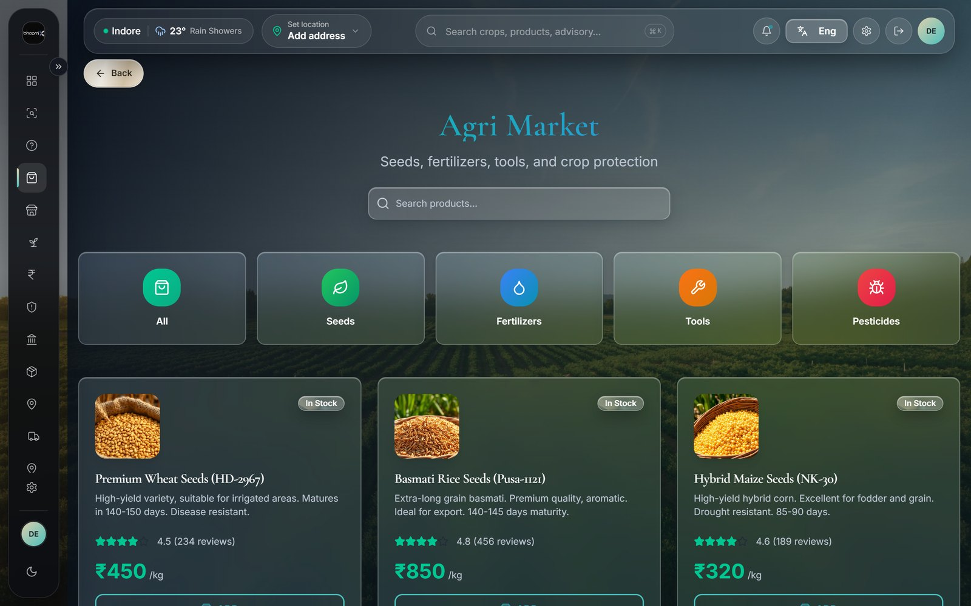
SEGMENT 2
The traditional, relationship-based farmer
Buys on trust
One local dealer, sometimes for a generation.
Will not switch cold
An app alone does not earn that relationship.
Needs no convincing from us
His dealer has to trust us. Once.
The app has to arrive through someone he already trusts.
He does not need to trust us. He needs his dealer to trust us.
11

Slide 12
THE STRATEGIC CALL
We do not remove the local dealer
What most platforms try
What we do instead
Cut out every middleman.
Loses on trust long before it ever competes on price.
Upgrade what the dealer sells, and the price he can afford to sell it at.
Wins on trust and price together.
This is the single biggest strategic decision in the whole plan.
12

Slide 13
PROOF FIRST
Everything here is live today
bhoomix.vercel.app — openable on any phone, right now, during this presentation.
13

Slide 14
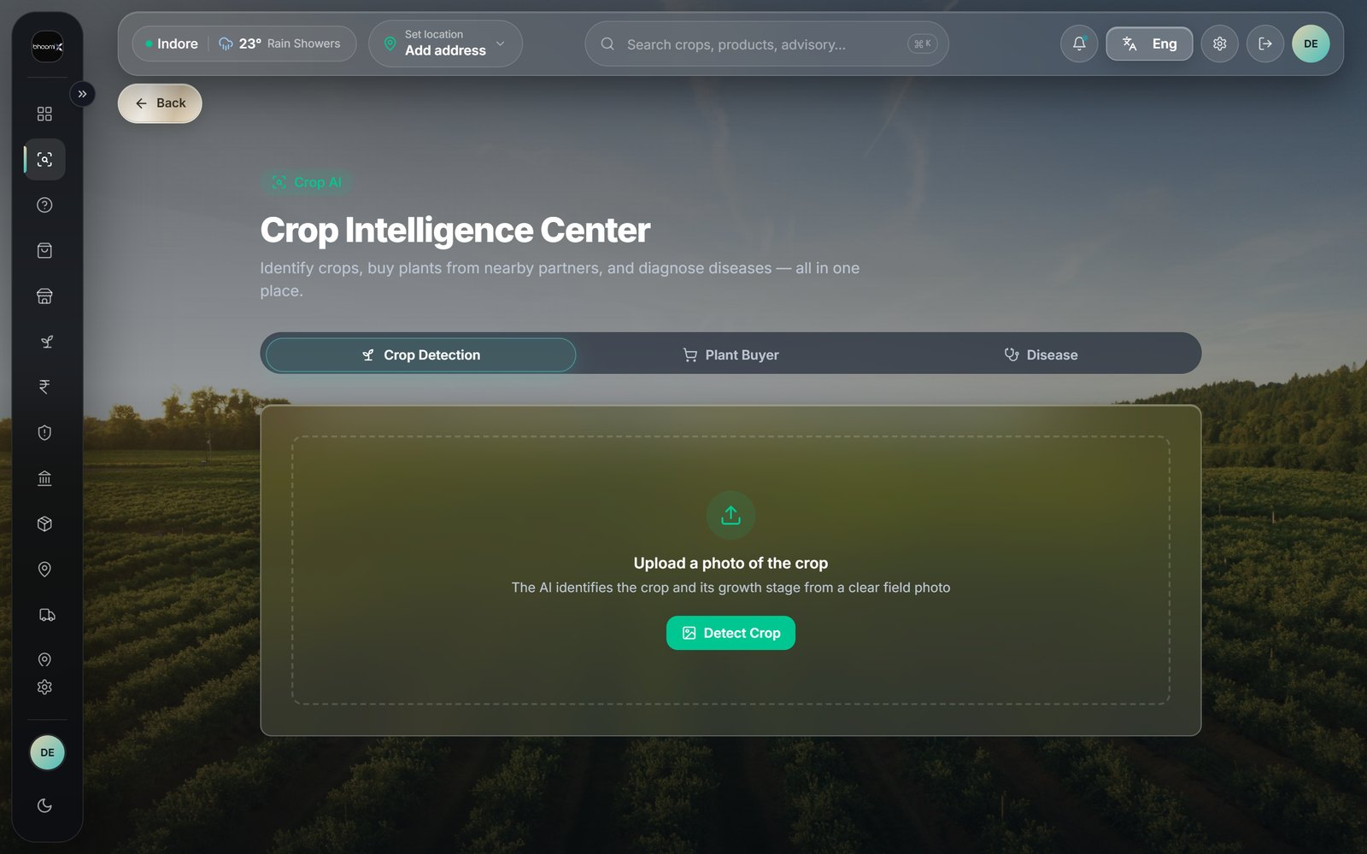
LIVE FEATURE
Crop Intelligence
Photograph a leaf
Identifies the crop and its growth stage.
Names the likely disease
With a confidence score, not a guess.
Suggests a treatment
One the farmer can buy in the same app.
Crop Intelligence Center — live.
14

Slide 15
LIVE FEATURE
Mandi Prices
Government open data
Pulled from data.gov.in, refreshed daily.
Filter by crop and state
Compare markets before loading the cart.
Full price band shown
Modal price plus the low-to-high range.
Live rates across Madhya Pradesh.
This is the feature that closes the Rs. 826 gap.
15

Slide 16
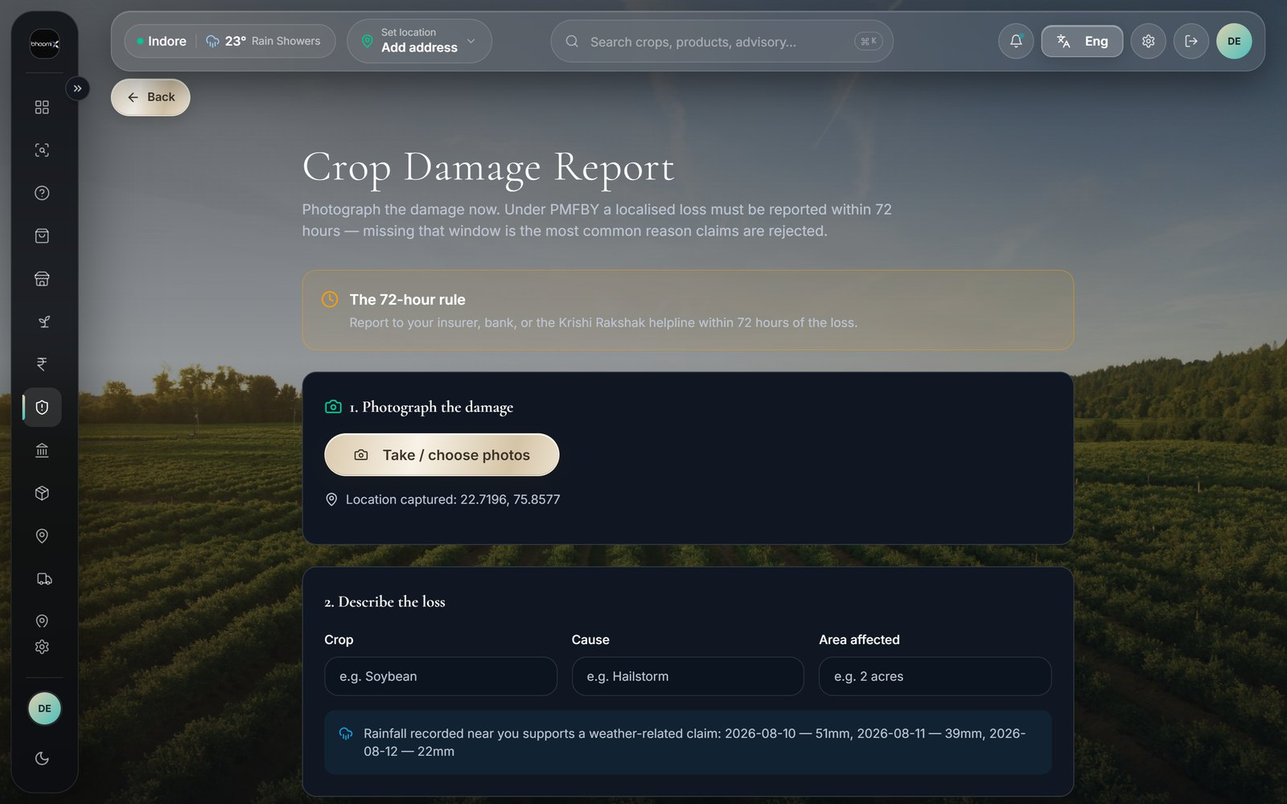
LIVE FEATURE
Crop damage and insurance
GPS and timestamp
Stamped at capture, not at export.
Rainfall attached
Recorded for those exact coordinates.
72-hour countdown
The deadline is on screen, not in memory.
Damage report with the live 72-hour rule.
16

Slide 17
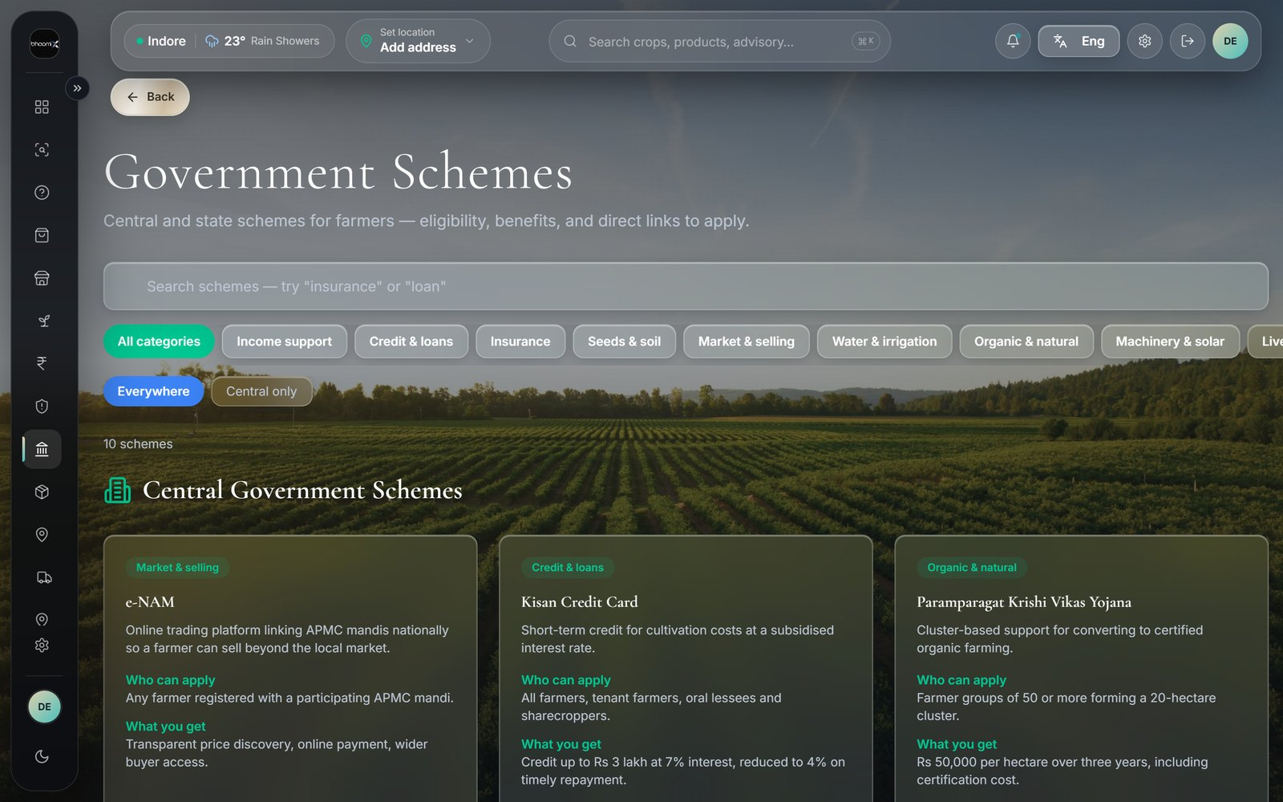
LIVE FEATURE
Government schemes, in plain language
Who can apply
A sentence, not a legal clause.
What you actually get
The rupee figure or subsidy rate.
A direct link
Straight to the official application page.
Ten central and state schemes, already integrated.
Most farmers miss schemes because nobody explains them simply.
17

Slide 18
LIVE FEATURE
Advisory, marketplace and mart
1
2
3
Crop Advisory
Agri Market
AgriNova Mart
Answers questions by text or photo, in the farmer’s own language, at any hour.
Seeds, fertiliser and tools — linked straight from the diagnosis that recommended them.
Everyday groceries with farmers as the supply — the fresh-food gap, addressed.
Advice and the ability to act on it live in the same place.
18

Slide 19
LIVE FEATURE
Built for who actually farms
23
Mobile sign-in
Role-aware
For farmers who have a phone number but no email address at all.
Separate views for farmers, delivery partners and administrators.
languages — the 22 of the Eighth Schedule, plus English
An app in English only would exclude most of the people it is built for.
19

Slide 20
THE DIFFERENTIATOR
The question nobody else asks
Every crop app in India has millions of photographs of unhealthy plants.
Not one knows what actually cured them.
1
2
3
4
Day 0
Day 7
One tap
Next farmer
Farmer scans a leaf and receives a treatment.
BhoomiX asks: did the treatment work?
Cured · Better · No change · Worse
The advice is sharper than it was yesterday.
A dataset that compounds. A competitor can clone the screens in a month — not three seasons of outcomes.
20

Slide 21
UNDER THE HOOD
How this was actually built
A real full-stack product — not a clickable prototype, not a no-code demo.
21

Slide 22
TECHNOLOGY
The stack — front of house
Layer | What is used
Frontend framework | React 18 with TypeScript, built using Vite
Styling | Tailwind CSS with a shared component library (shadcn/ui)
Routing | React Router, with role-aware protected routes
State management | React Context, scoped per concern — not one global store
Hosting | Vercel, auto-deployed on every change; source controlled with Git
22

Slide 23
TECHNOLOGY
The stack — data, AI and delivery
Layer | What is used
Backend database | Managed PostgreSQL (Supabase) — auth, serverless functions, storage
AI — crop diagnosis | Google Gemini, multimodal: reads a photo, returns structured analysis
AI — advisory chat | A vision-capable model served through NVIDIA’s inference platform
Live market data | data.gov.in, proxied through a serverless function with hourly caching
Weather data | Open-Meteo — a keyless public API, chosen after a paid key failed
Transactional email | Resend, with delivery events logged back for troubleshooting
23

Slide 24
ARCHITECTURE
How a single leaf photo travels
Farmer’s phone
Serverless function
AI model
Database
Browser — no app store install
Holds every secret key
Returns disease + confidence
Row-level security per user
No secret ever reaches the browser — keys live only inside functions the browser calls.
24

Slide 25
SECURITY
What is actually enforced — part 1
1
2
3
Row Level Security
No secret in the browser
Server-side role checks
The database denies access by default. A user reads only rows a policy explicitly allows.
AI keys, market-data keys and the admin key exist only inside serverless functions.
Who may create a manager or partner is enforced in the function — not by hiding a button.
25

Slide 26
SECURITY
What is actually enforced — part 2
1
2
3
Partner privacy by design
Anti-enumeration reset
Signed, replay-proof hooks
A delivery partner cannot see a phone or address until they accept that order — the query returns blanks.
Forgot-password answers identically whether or not the account exists, so it cannot reveal who has one.
Email events are verified with HMAC-SHA256; anything older than five minutes is rejected outright.
26

Slide 27
HONEST GAP
What we have not done yet
There is no automated test suite
in the codebase today.
Every feature was verified manually against the live deployment. That confirms it works today — it does not catch a regression introduced by a future change. Automated tests for sign-in, cart logic and the insurance deadline are the known next step.
Listed here rather than left unmentioned.
27

Slide 28
METHOD
Prompt-driven development, as an engineering method
What it is not
What it is
A no-code demo. A static prototype. A template with the logo swapped.
Describing required behaviour precisely and iterating in days — every feature tested against the live deployment before being called done.
The execution risk was never "can we build it." It is "can we move as fast as the field tells us to."
28

Slide 29
THE SEED BUSINESS
How the seed actually gets there
"We will sell seed cheaper" is not a plan. Here is the mechanism.
29

Slide 30
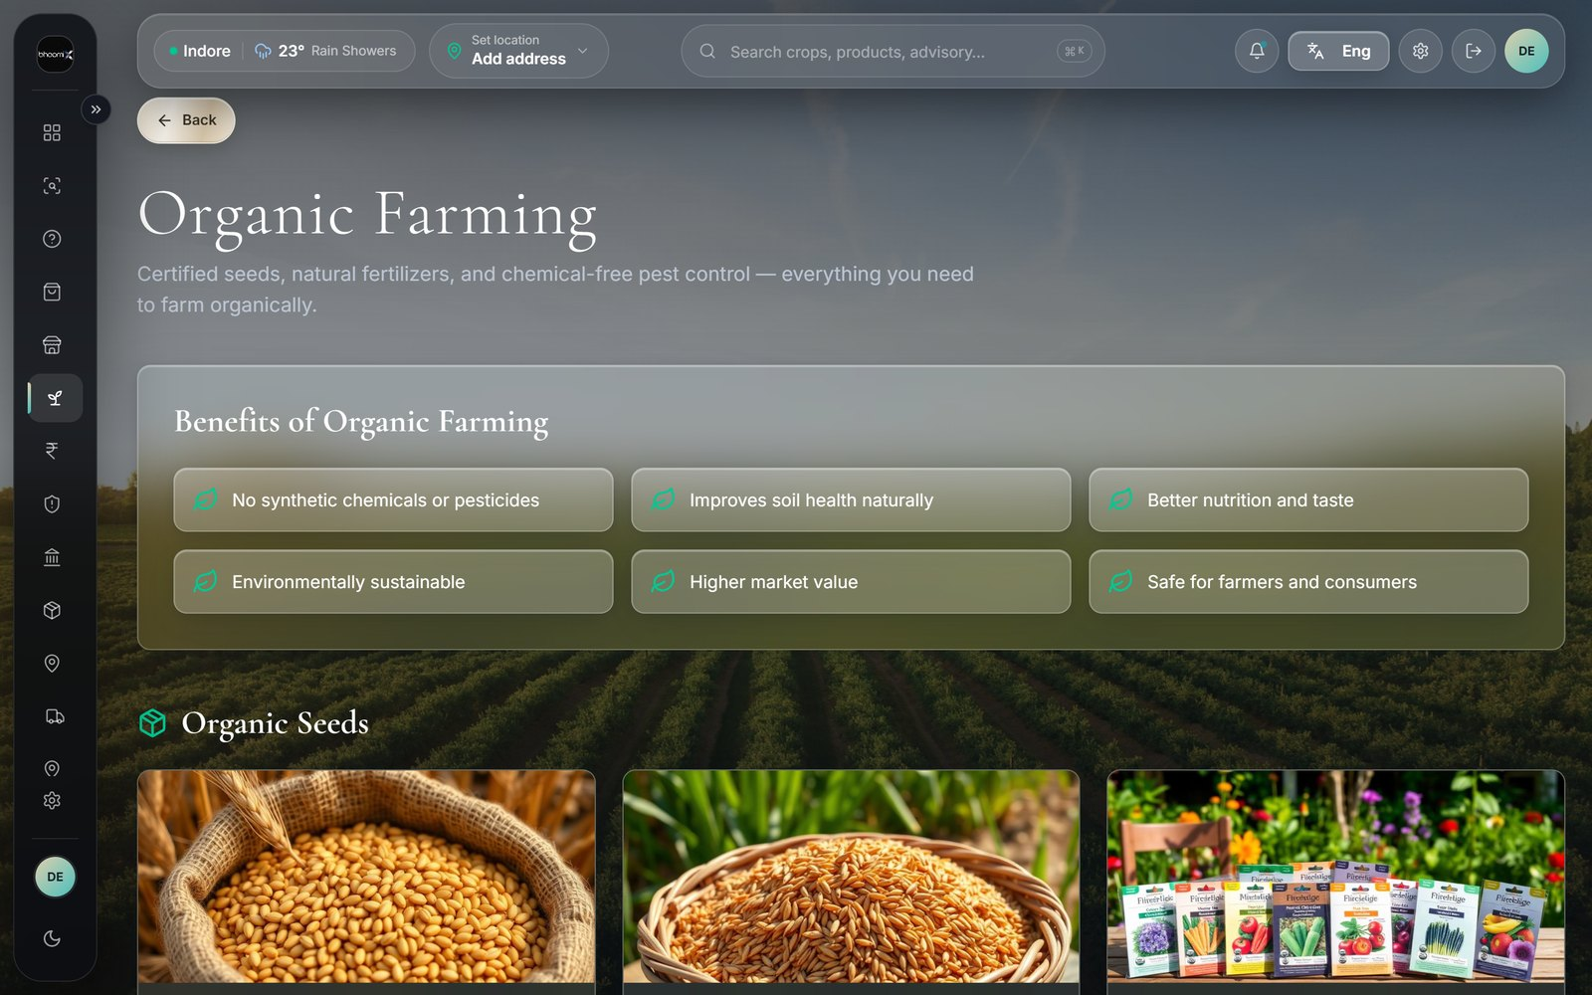
MECHANISM 1
Certified sources only
State Seed Corporations
And the National Seeds Corporation.
ICAR-affiliated seed hubs
Plus lab-certified private suppliers.
Certification tag on every listing
With a batch reference the farmer can see.
Not whatever a local godown happens to be holding.
The farmer sees why it is trustworthy — not just that we said so.
30

Slide 31
MECHANISM 2
Aggregate demand, then negotiate
The trick
Best price is not a discount we invent. It is a wholesale rate we unlock by turning many small orders into one large one — then pass most of it through.
Pre-orders collected in the six weeks before a sowing window.
31

Slide 32
MECHANISM 3
Compress the margin stack
Today
With BhoomiX
Distributor margin
One commission line
Wholesaler margin
Smaller than the sum it replaces — our cost to serve is an app and a delivery network, not four warehouses.
Retail dealer margin
Three layers of margin become one — and the one is smaller.
32

Slide 33
MECHANISM 4
Extend outcome tracking to seed itself
Ask once, a season later:
how did this variety actually perform?
That turns every purchase into a data point about which seed performs in which district and soil — something no seed company collects at this resolution, because they sell through dealers who never report back.
Not built yet — the natural next use of infrastructure we have already proven works.
33

Slide 34
FIELD RESEARCH
The distributor tour
We are not going to guess who the right seed partners are from a spreadsheet.
34

Slide 35
THE TOUR
Four stops in every district
1
2
3
4
Krishi Vigyan Kendra
Seed Certification Agency
Certified distributors
Farmers themselves
The government’s district farm science centre — the fastest route to a credible shortlist.
Verify a distributor’s claims against the actual certificate, not their word.
Negotiate volume terms, using real aggregated demand from the app.
Both segments — because the tour is validation, not only sourcing.
35

Slide 36
THE DISCIPLINE
One output per district visit
Either
Or
A signed or verbally committed sourcing relationship
A documented reason it did not work
We are not touring for the sake of touring. Starting in [DISTRICT].
36

Slide 37
GOVERNMENT
Schemes we build with, not around
Most of this already has a public funding channel designed for exactly this problem.
37

Slide 38
GOVERNMENT SUPPORT
Seed and input subsidy channels
National Food Security Mission
Aatmanirbharta in Pulses
Already subsidises certified seed in identified districts. We route procurement through it — a farmer should stack the subsidy on top of our price, not choose.
Funds quality seed access and assured procurement for pulse farmers — a direct match for one of our highest relief categories.
Real, current schemes — already integrated into the app’s own Schemes page.
38

Slide 39
GOVERNMENT SUPPORT
Infrastructure and bargaining power
Agriculture Infrastructure Fund
10,000 FPO scheme
Concessional-interest financing for post-harvest and storage — the intended vehicle for a regional seed hub, instead of further equity dilution.
A Farmer Producer Organisation is collective bargaining power with a legal structure — it makes aggregated-demand pricing stronger and more durable.
We are not asking to replace what government already funds — only to make it usable from a phone.
39

Slide 40
BUSINESS MODEL
Free for the farmer, on purpose
A farmer unsure whether he can afford advice will not ask for it. Getting him to ask is the point.
40

Slide 41
REVENUE
Four ways we earn
1
2
3
4
Marketplace commission
Partner and dealer fees
Delivery margin
Data licensing
On seed, fertiliser and tools — smaller than the multi-layer margin it replaces.
Local shops pay to be listed and routed demand they did not have to find.
On orders fulfilled through the registered partner network.
Years 3-5 only. Consented, anonymised. Not revenue today.
41

Slide 42
REVENUE
How the mix is expected to shift
Illustrative shape, not a forecast — the point is that data revenue is late, not first.
42

Slide 43
THE ASK
What we are raising, and for what
[AMOUNT] for [EQUITY %]
1
2
3
Seed working capital
The district field tour
Platform hardening
So aggregated-demand pricing has capital behind it to actually execute.
Because sourcing decisions should follow research, not precede it.
So what we scale second is infrastructure that carries real transaction volume.
43

Slide 44
MARKETING
Earned trust, not paid reach
Rural agri-marketing fails the moment it looks like marketing.
44

Slide 45
CHANNEL
The tour is the campaign
The field tour
The local dealer
Every KVK visit and farmer conversation is also the first hundred relationships in that district. We do not tour and then market — the tour is the go-to-market.
Stocked with certified seed at a better rate, he has a direct financial reason to tell his own customers — who already trust him more than any advertisement.
Distribution and marketing turn out to be the same person.
45

Slide 46
CHANNEL
Proof, WhatsApp and existing gatherings
1
2
3
The outcome loop as proof
WhatsApp, not paid social
Government extension events
Real farmers, real seasons, real yields — turned into vernacular testimony.
Where rural word-of-mouth actually travels. Support it rather than fight it.
Ask for five minutes on an agenda that already exists, instead of building a gathering.
A farmer trusts another farmer’s harvest more than any brand claim.
46

Slide 47
YEARS 3 TO 5
Data a bank will pay for
The part that turns a marketplace into infrastructure.
47

Slide 48
THE ASSET
What accumulates on its own
A genuine longitudinal
farm-performance history.
What was grown. What was bought. Whether the treatment worked. Whether the seed performed. Whether a claim was filed, and how it resolved.
Exactly what a lender has almost none of when underwriting a smallholder today.
48

Slide 49
THE PROBLEM IT SOLVES
Why good farmers pay bad rates
Lending today
With a verified record
Priced on land collateral alone. A farmer with three excellent seasons is indistinguishable from one with none.
A lender who currently cannot see him at all can price him fairly — instead of declining him by default.
The thinnest paperwork currently means exclusion, not a fair assessment.
49

Slide 50
NON-NEGOTIABLE
This only works through real consent
RBI Account Aggregator
DPDP Act
India’s existing, regulated consent framework for exactly this kind of data sharing.
The Digital Personal Data Protection Act — opt-in, explicit, per request, every time.
Not a legal footnote. It is what separates this from a data-selling business that would rightly destroy farmer trust.
50

Slide 51
THE MODEL
Two ways a lender pays
Portfolio licensing
Per-loan referral
A fee for anonymised, aggregated regional risk signal — useful for pricing a whole loan book more accurately.
A consenting farmer’s verified history becomes part of his own loan application, and earns him a better rate.
Not because we sold his data — because we gave him a way to prove something paperwork never could.
51

Slide 52
ROADMAP
Where this goes
1
2
3
Year 1
Year 2-3
Year 4-5
Marketplace live, outcome loop running, first district piloted.
Seed network at scale across districts, dealer partnerships compounding.
Verified farm history becomes a credit signal — with consent, under DPDP.
Each stage is only possible because the one before it earned the data.
52

Slide 53
IMPACT
Sustainable Development Goals — 1, 2, 8
1
2
3
SDG 1 — No Poverty
SDG 2 — Zero Hunger
SDG 8 — Decent Work
Closing the market-price gap protects income a farmer has already earned.
Early disease detection protects yield before a field is lost.
Fair price discovery, plus livelihoods for local delivery partners.
53

Slide 54
IMPACT
Sustainable Development Goals — 9, 10, 13
1
2
3
SDG 9 — Innovation
SDG 10 — Reduced Inequalities
SDG 13 — Climate Action
AI diagnostics and government open data, in a smallholder’s pocket.
23-language support removes the literacy barrier that locks farmers out.
Rainfall recorded with every damage report, building a real risk record.
Tied to features that already exist — not to aspiration.
54

Slide 55
UNEXPECTED VALUE
A second audience we did not design for
Medicinal plant catalogue
Organic treatment efficacy
Tulsi, Ashwagandha, Aloe Vera, Stevia — with real price, unit, supplying nursery and distance. Standard Pharmacognosy subjects, with live sourcing data attached.
Neem oil, Trichoderma, Panchagavya — combined with the 7-day outcome check, this becomes real efficacy data a pharmacy research project normally cannot get.
An honest observation, not a built feature — the data already exists for another purpose.
55

Slide 56
HONEST ACCOUNT
Where we actually stand today
Proven
Not yet
The product is fully built and live.
Every feature can be demonstrated on request — live, not from screenshots.
No revenue yet. No formal farmer pilot yet. No user interviews yet. The distributor tour has not happened.
A claim that does not survive a follow-up question is worse than being upfront now.
56

Slide 57
It has to earn trust one district,
one dealer, one farmer at a time.
That is not the slow part of this plan. That is the moat.
BhoomiX
bhoomix.vercel.app · [TEAM NAMES] · Indore
57

