Slide 1
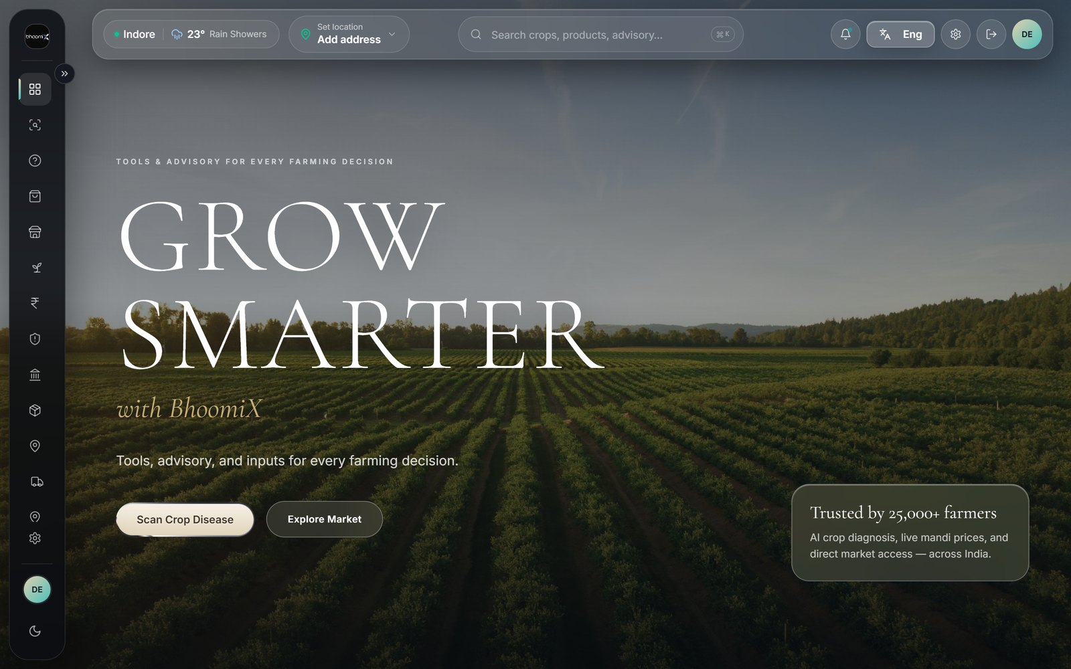
BHOOMIX
Everything a farmer needs, in one app
Diagnose the crop
Sell at the right price
BhoomiX
Claim insurance in time
Buy inputs and essentials
The BhoomiX home screen — live in the browser today.
Learn and ask
bhoomix.vercel.app
[TEAM NAMES] · Indore · 23 Indian languages
Notes:
Opening slide. Speaker 1 begins the wheat-price hook here — do not read the mindmap aloud.

Slide 2
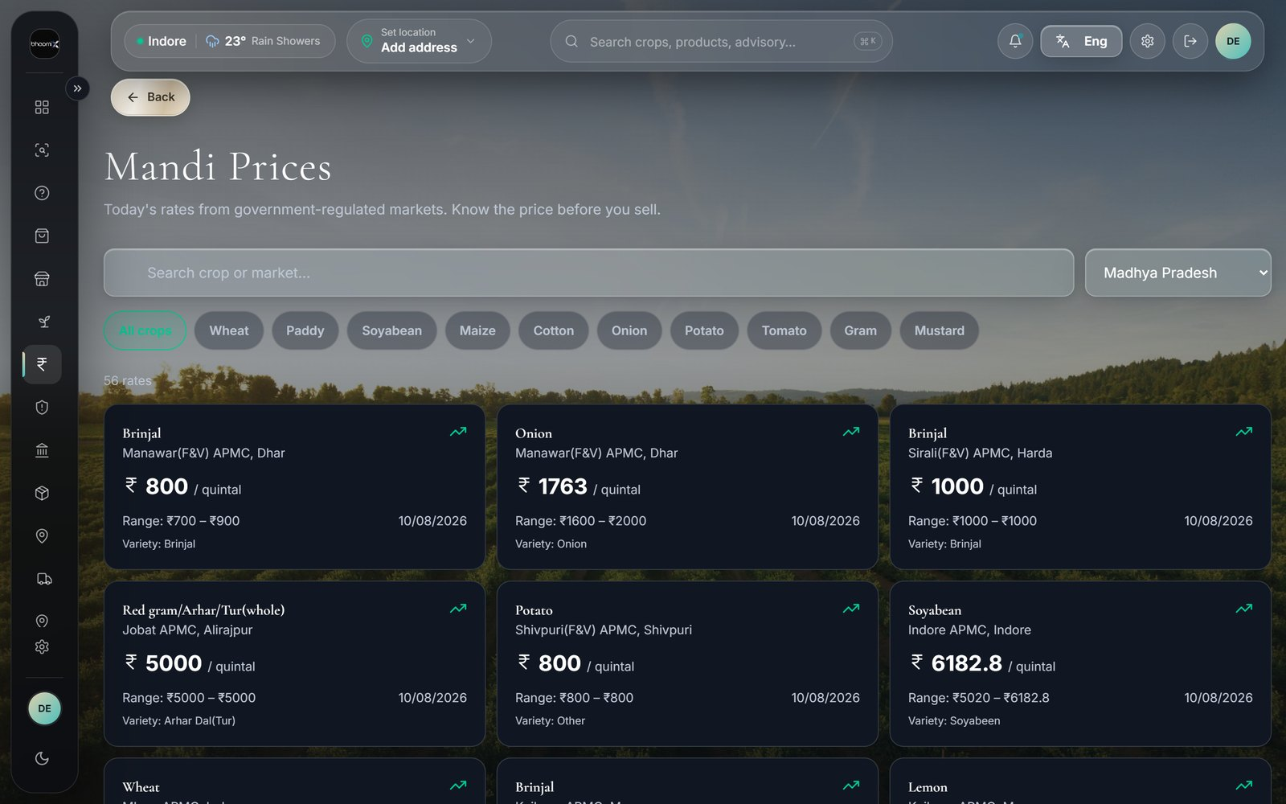
THE PROBLEM
Three ways a farmer loses money
Sells at the wrong mandi
Rates differ by hundreds of rupees on the same day
Money lost, avoidably
Misreads a disease
By the time it looks serious, the field is gone
Misses the 72-hour window
56 live market rates for Madhya Pradesh, 10 Aug 2026.
A late loss report can be rejected outright
THE PRICE GAP
Wheat: ₹2,000/quintal in Raisen, ₹2,826 in Ratlam. On ten quintals that is ₹8,000 a farmer never sees.
Notes:
Wheat figures verified 8 Aug 2026 against data.gov.in. Refresh them the morning you present.

Slide 3
PAGE 01 · HOME
One screen, every decision
Live weather and location
Temperature and conditions for the farmer’s district
Search everything
Home dashboard
Crops, products and advisory from one bar
Every tool, one tap away
Sidebar reaches all fourteen sections
The signed-in home screen.
Role-aware
WHY IT MATTERS
Farmer, delivery partner and admin see different homes
A farmer opening the app in a field has seconds and one hand. Everything important is reachable without scrolling.
Notes:
Page 01 · Home — A farmer opening the app in a field has seconds and one hand. Everything important is reachable without scrolling.

Slide 4
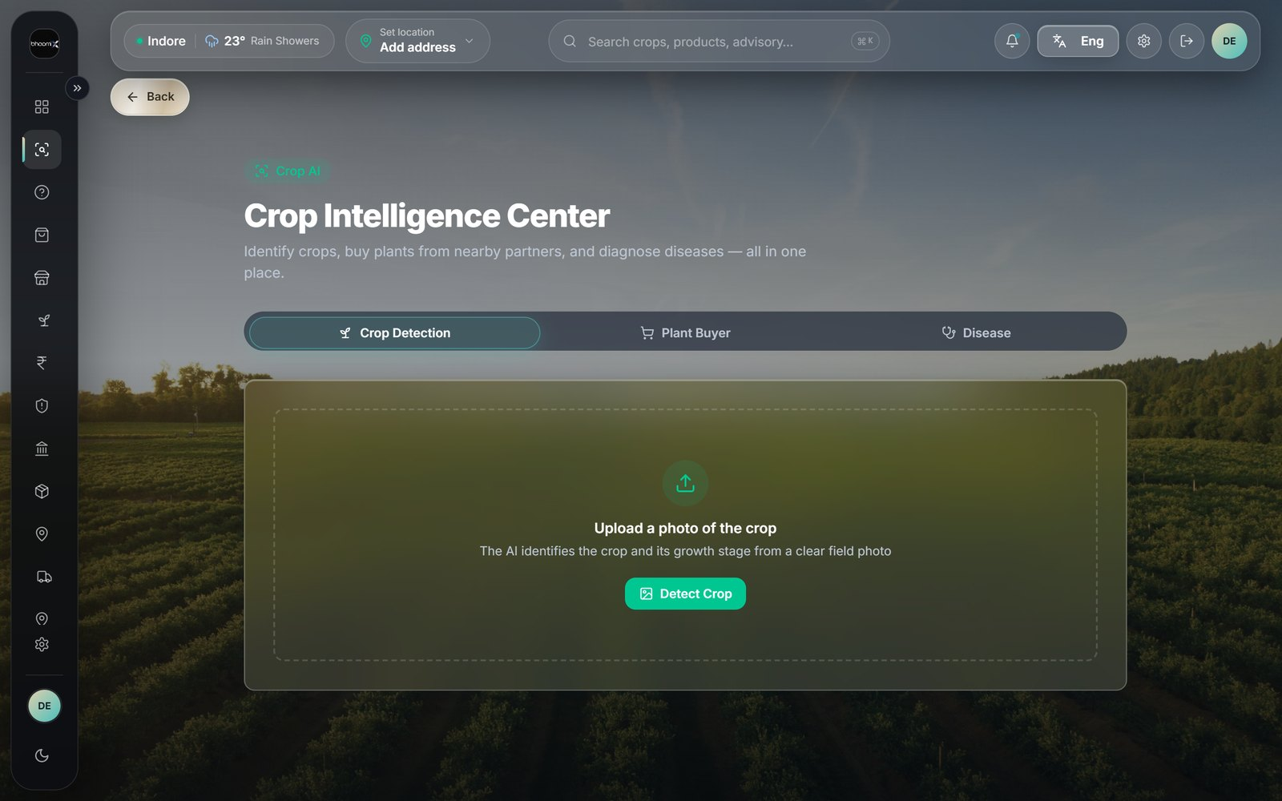
PAGE 02 · CROP AI
Crop Intelligence Center
Crop Detection
Identifies the crop and its growth stage
Disease diagnosis
Crop AI
Names the disease, severity and treatment
Plant Buyer
Order plants from nearby partner nurseries
Three tools behind one page.
Seven-day follow-up
THE DIFFERENTIATOR
Asks whether the treatment actually worked
Other apps stop at the diagnosis. BhoomiX asks a week later whether it worked — that answer is the dataset nobody else has.
Notes:
Page 02 · Crop AI — Other apps stop at the diagnosis. BhoomiX asks a week later whether it worked — that answer is the dataset nobody else has.

Slide 5
PAGE 03 · MANDI PRICES
Know the price before you sell
Government open data
Sourced from data.gov.in, refreshed daily
3,000+ regulated markets
Mandi Prices
Across 200+ commodities nationwide
Filter by state and crop
Wheat, soyabean, onion, potato and more
Live rates, Madhya Pradesh, 10 Aug 2026.
Full price picture
WHAT IT CLOSES
Modal rate, min–max range and arrival date
This is the page that turns the ₹826 gap into a decision the farmer can act on before loading the cart.
Notes:
Page 03 · Mandi Prices — This is the page that turns the ₹826 gap into a decision the farmer can act on before loading the cart.

Slide 6
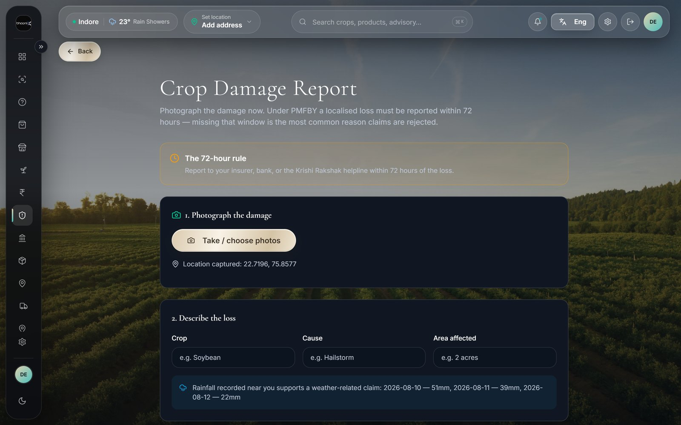
PAGE 04 · DAMAGE REPORT
Evidence before the window shuts
GPS and timestamp
Stamped at capture, not at export
Recorded rainfall
Damage Report
Pulled for those exact coordinates
72-hour countdown
Visible from the moment the loss is logged
Location captured automatically: 22.7196, 75.8577.
Printable evidence pack
THE SCHEME RULE
One document formatted for the insurer
Under PMFBY a localised loss must be reported within 72 hours. Reported late, a claim can be rejected outright.
Notes:
Page 04 · Damage Report — Under PMFBY a localised loss must be reported within 72 hours. Reported late, a claim can be rejected outright.

Slide 7
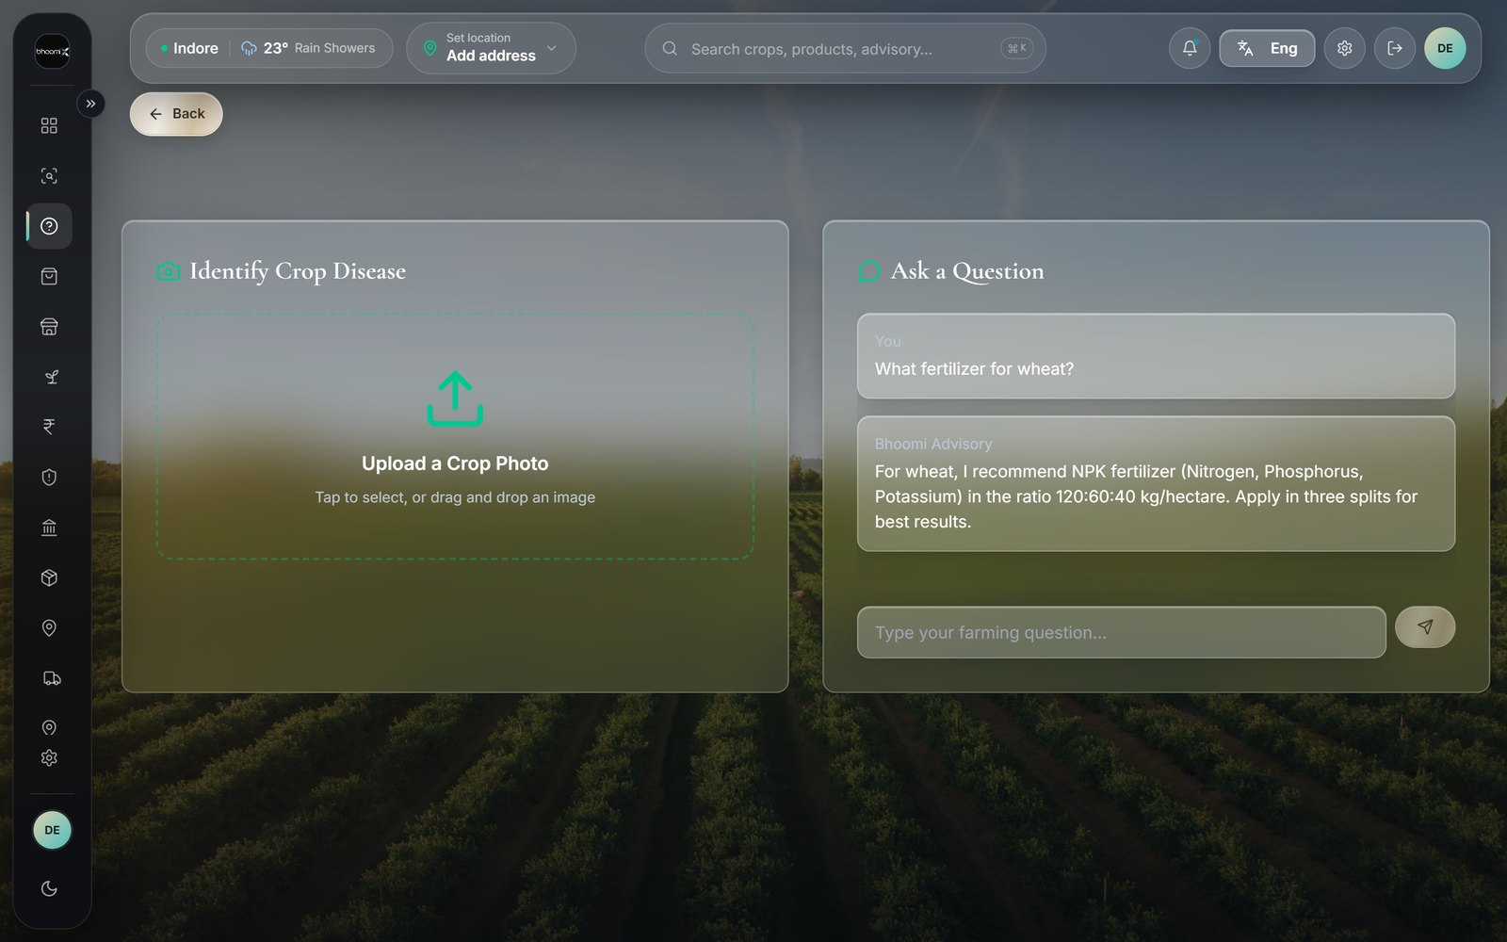
PAGE 05 · CROP ADVISORY
Ask in your own words
Plain-language questions
No forms, no jargon, no menus to learn
Crops, fertiliser and pests
Advisory AI
Practical answers, two or three sentences
Answers in the farmer’s language
Not an English answer with a translation bolted on
The advisory assistant inside the app.
Safe by design
WHY NOT A HELPLINE
Chemical doses always defer to the product label
A helpline is open certain hours and speaks certain languages. This is open at 5am in the language the farmer thinks in.
Notes:
Page 05 · Crop Advisory — A helpline is open certain hours and speaks certain languages. This is open at 5am in the language the farmer thinks in.

Slide 8
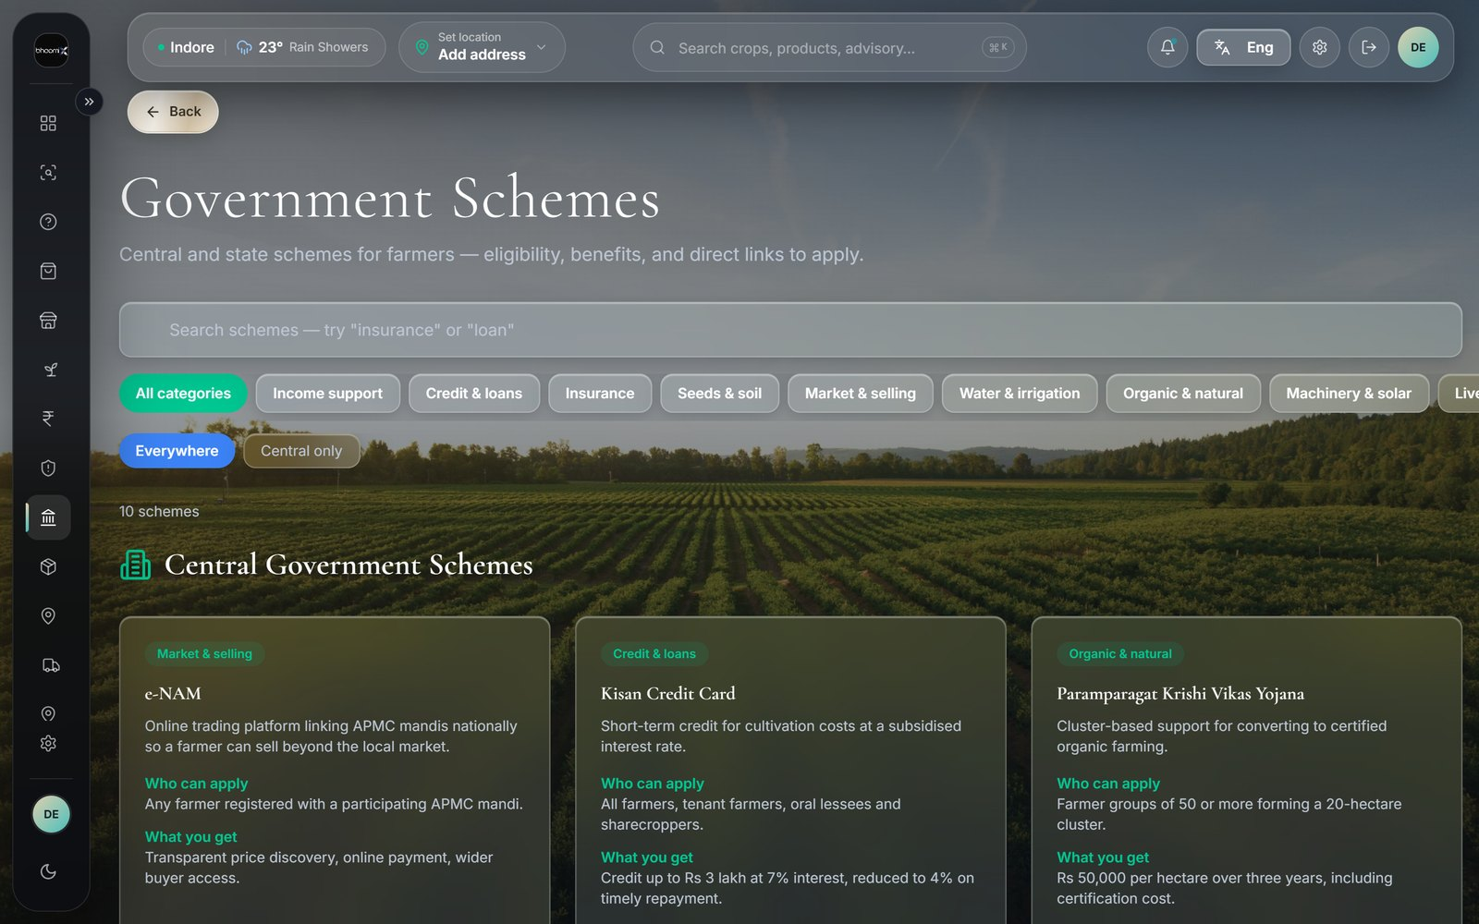
PAGE 06 · SCHEMES
Government schemes a farmer can use
Central and state schemes
Collected in one searchable place
Eligibility at a glance
Gov Schemes
Who qualifies, before reading the fine print
Documents needed
Listed up front so nothing is missed
Schemes listed with eligibility and benefits.
Where to apply
THE REAL BARRIER
Direct route to the official portal
Most schemes fail on awareness, not eligibility. Beside the mandi price is where a farmer will actually see them.
Notes:
Page 06 · Schemes — Most schemes fail on awareness, not eligibility. Beside the mandi price is where a farmer will actually see them.

Slide 9
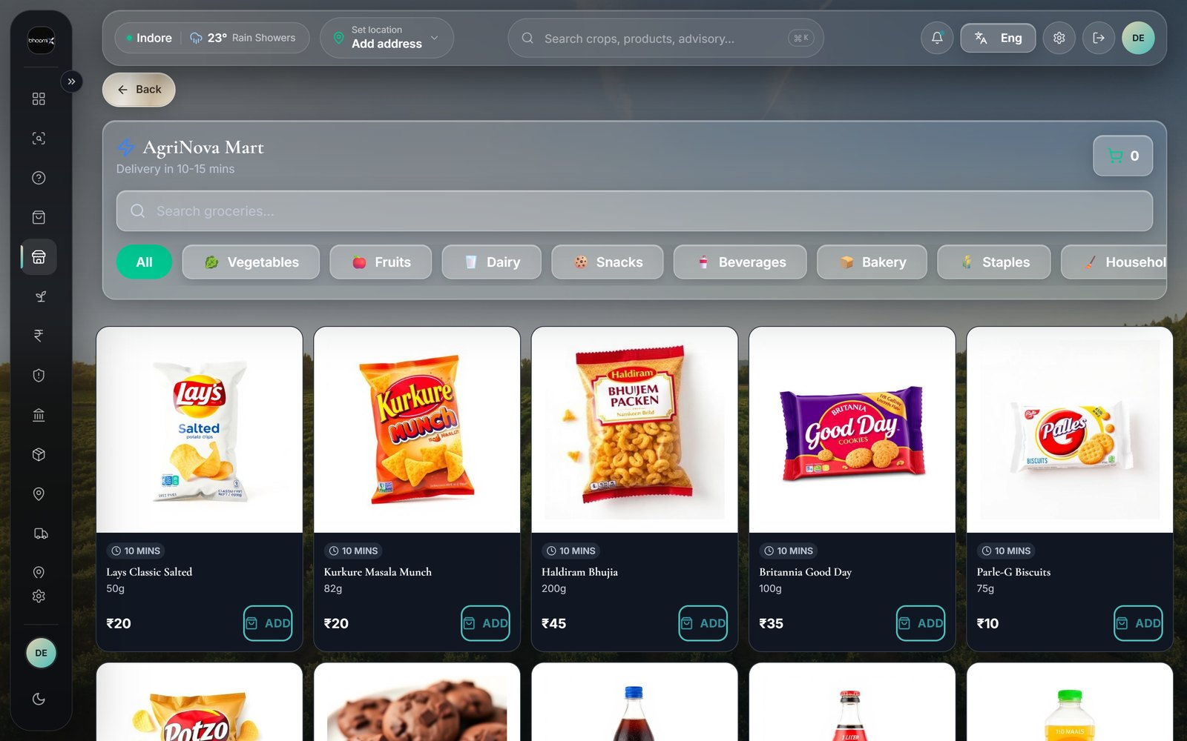
PAGE 07 · AGRINOVA MART
Daily essentials, delivered
Groceries and household
Staples, dairy, snacks, beverages and bakery
Category filters
AgriNova Mart
Eight categories, searchable
Quantity on every item
Weight or volume shown beside the price
AgriNova Mart, with per-item quantity and price.
10–15 minute delivery
WHY IT BELONGS HERE
Fulfilled by local delivery partners
The same trip and the same delivery partner that brings seed can bring the household order. One relationship, not two.
Notes:
Page 07 · AgriNova Mart — The same trip and the same delivery partner that brings seed can bring the household order. One relationship, not two.

Slide 10
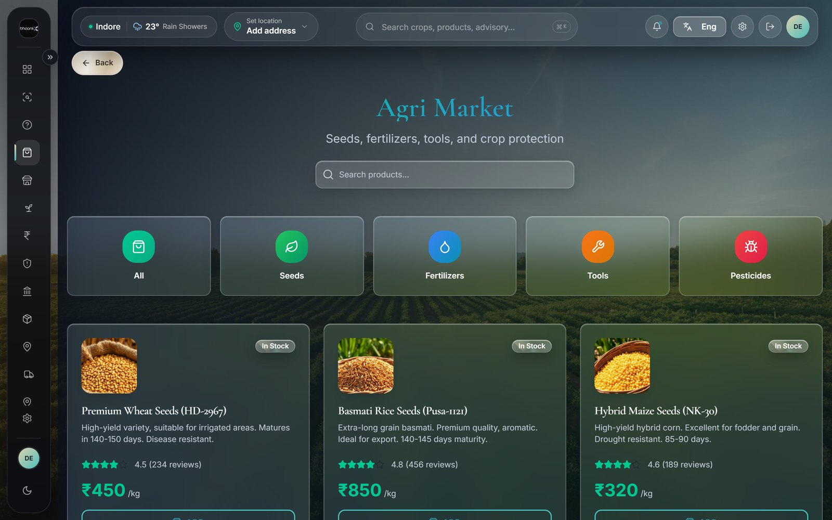
PAGE 08 · AGRI MARKET
Inputs for the field
Seeds and fertiliser
Certified varieties and soil inputs
Tools and equipment
Agri Market
Sprayers, weeders and hand tools
Partner-supplied stock
Sold by nearby registered partners
Farm inputs listed with price and quantity.
One shared cart
CLOSING THE LOOP
Checkout together with mart items
A diagnosis that ends in "buy neem oil" is only useful if neem oil is two taps away. This is that page.
Notes:
Page 08 · Agri Market — A diagnosis that ends in "buy neem oil" is only useful if neem oil is two taps away. This is that page.

Slide 11
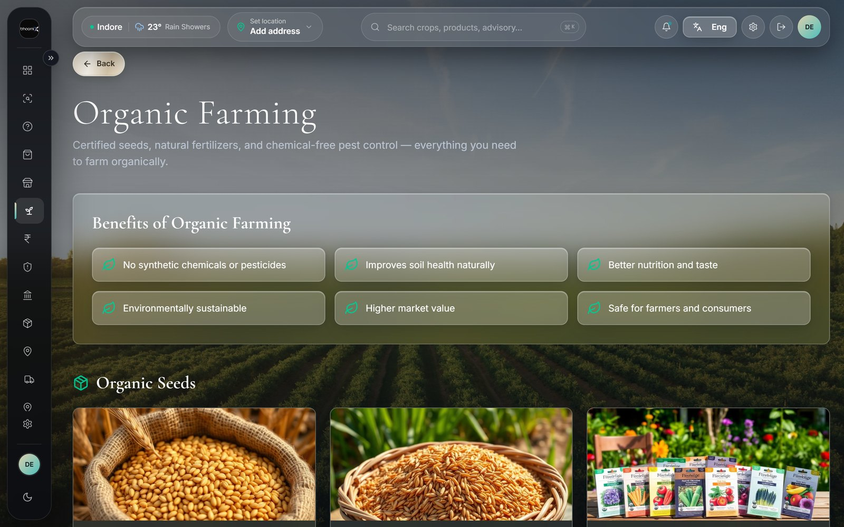
PAGE 09 · ORGANIC FARMING
The organic route
Neem cake and neem oil
For pests and fungal disease
Trichoderma
Organic Store
For soil-borne disease
Panchagavya and compost
Plant tonics and soil health
The organic input store.
Prevention first
LINKED, NOT SEPARATE
Rotation, spacing and drainage guidance
Every disease diagnosis offers an organic option beside the chemical one, and links straight to this store.
Notes:
Page 09 · Organic Farming — Every disease diagnosis offers an organic option beside the chemical one, and links straight to this store.

Slide 12
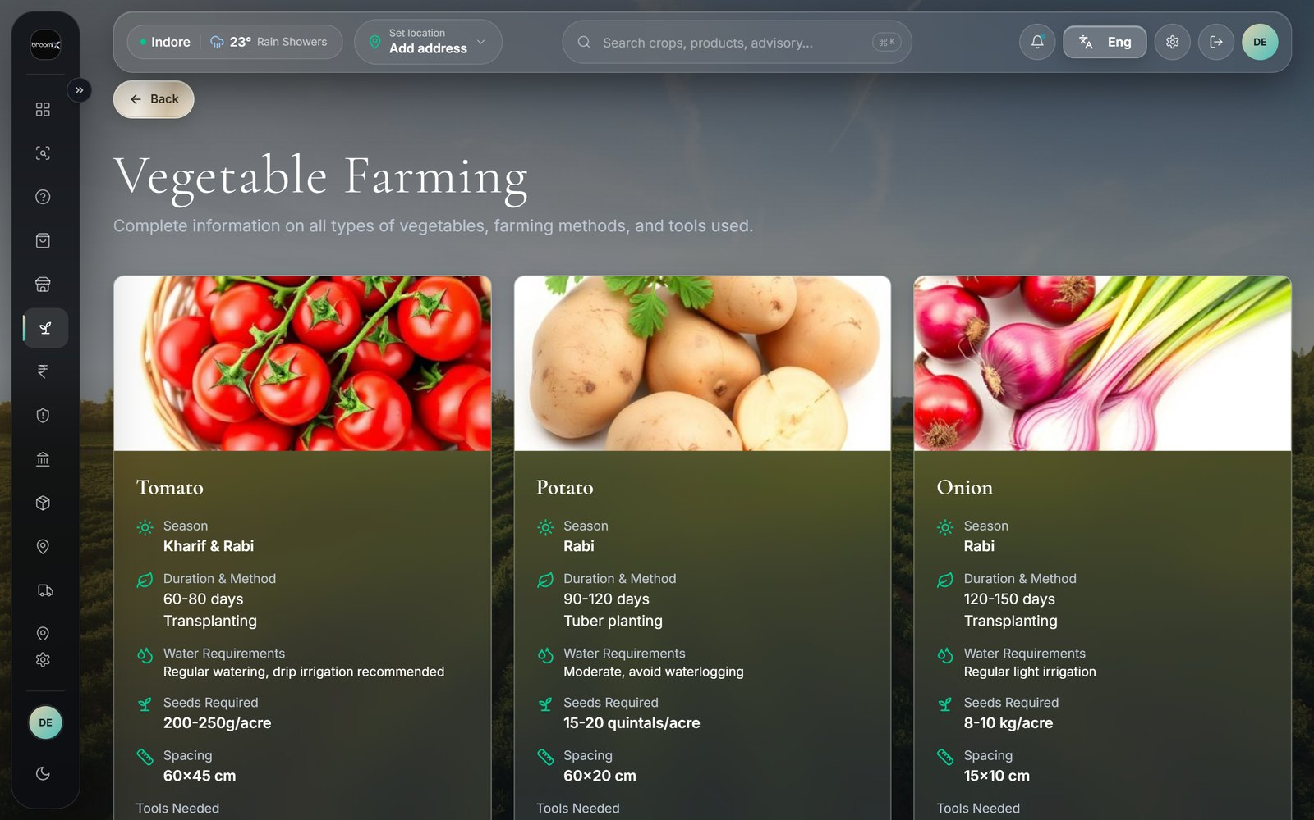
PAGE 10 · VEGETABLE FARMING
Vegetable growing guidance
Season-wise crops
What to sow, and when
Sowing to harvest
Vegetable Guide
Step-by-step for each vegetable
Pests to expect
Matched to the specific crop
Crop-by-crop vegetable guidance.
Straight to inputs
WHO IT IS FOR
Each guide links to what it needs
Vegetables are where a smallholder can change income in one season — short cycles and local demand.
Notes:
Page 10 · Vegetable Farming — Vegetables are where a smallholder can change income in one season — short cycles and local demand.

Slide 13
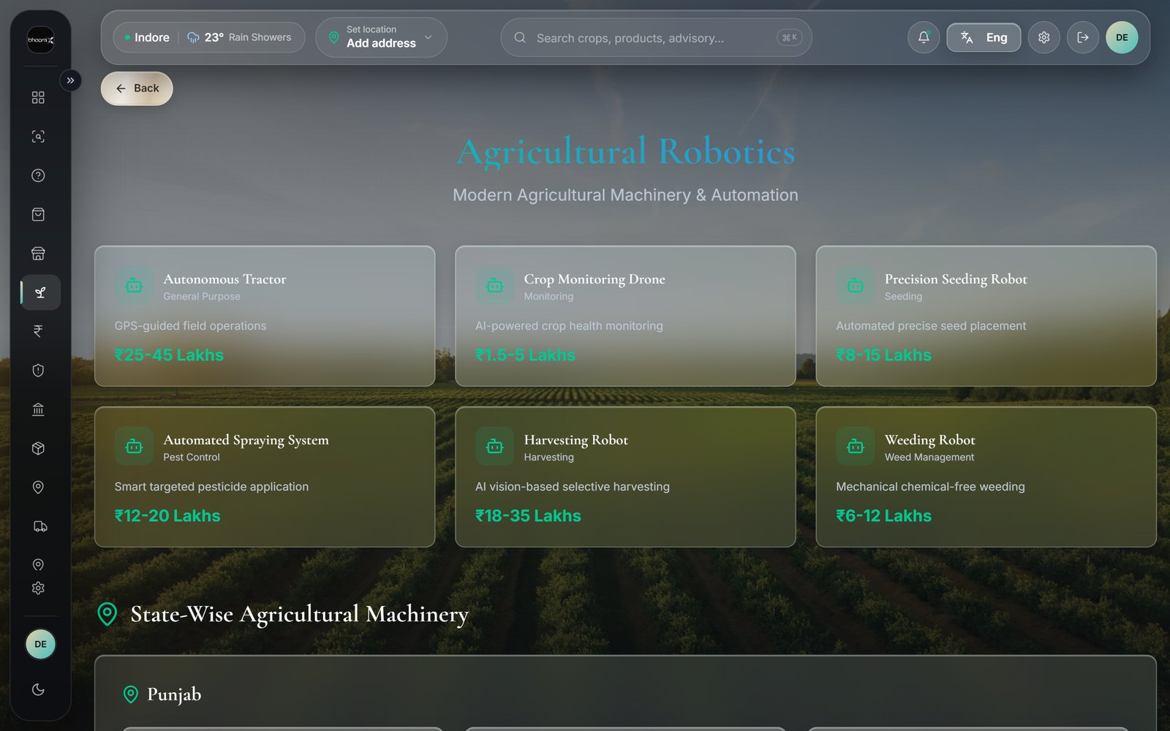
PAGE 11 · ROBOTIC FARMING
Modern farm technology
Machinery and automation
What exists and what it does
Fit for a small farm
Farm Tech
Honest about what suits two acres
Cost and benefit
Framed in seasons, not brochures
Farm technology explained in plain language.
Awareness, not a sales pitch
WHY INCLUDE IT
Nothing is sold from this page
Small farmers are usually told about this technology last. Explaining it plainly costs nothing and closes an information gap.
Notes:
Page 11 · Robotic Farming — Small farmers are usually told about this technology last. Explaining it plainly costs nothing and closes an information gap.

Slide 14
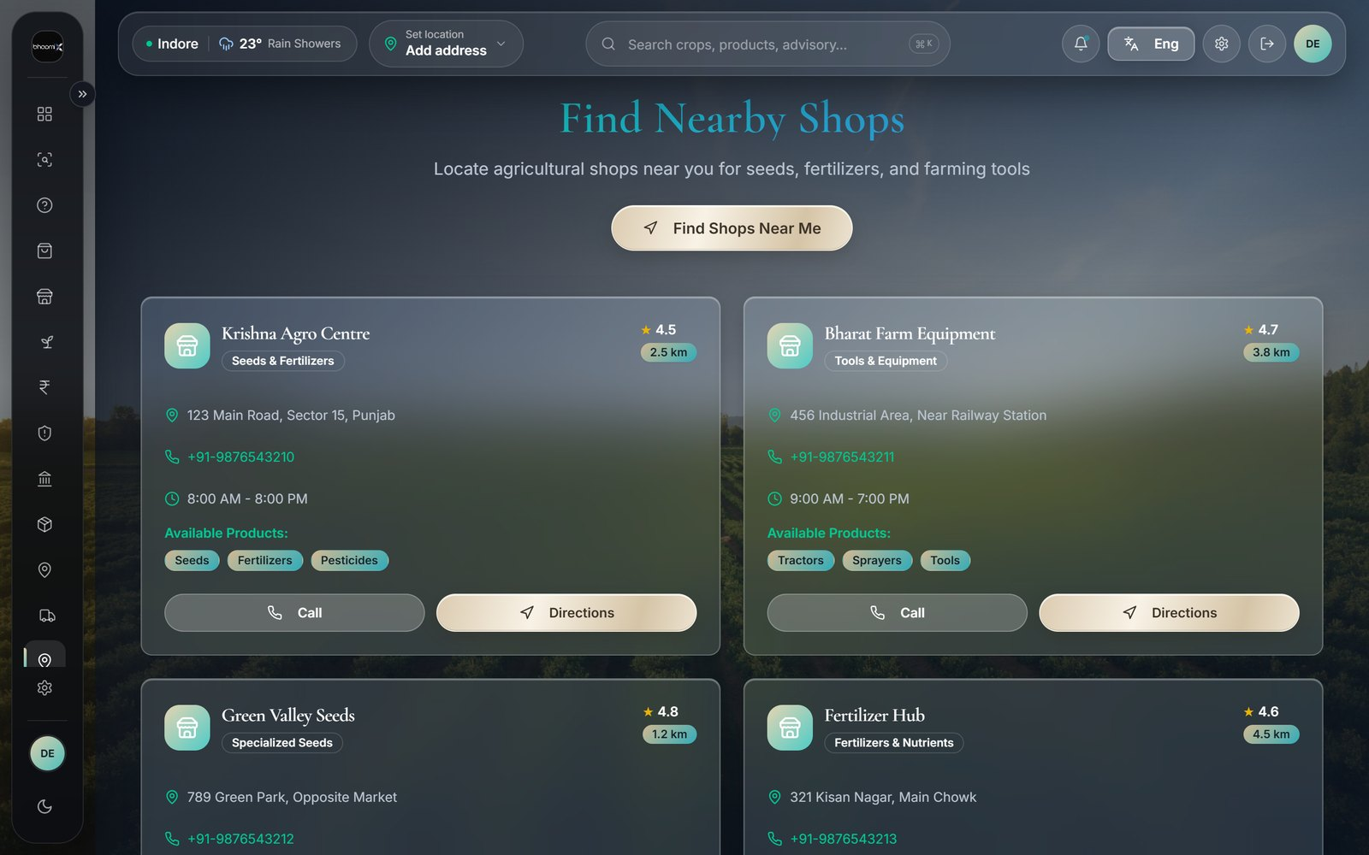
PAGE 12 · SHOPS & ORDERS
Find it nearby, track it after
Nearby shops on a map
Agri stores and input dealers close by
Distance and directions
Shops & Orders
So a wasted trip is avoidable
Order history and status
Every order in one list
The shop locator, centred on the farmer’s district.
Delivery partner assigned
ONLINE PLUS OFFLINE
Tracked from accept to delivered
Not everything should be delivered. Sometimes the right answer is the shop four kilometres away that has it in stock today.
Notes:
Page 12 · Shops & Orders — Not everything should be delivered. Sometimes the right answer is the shop four kilometres away that has it in stock today.

Slide 15
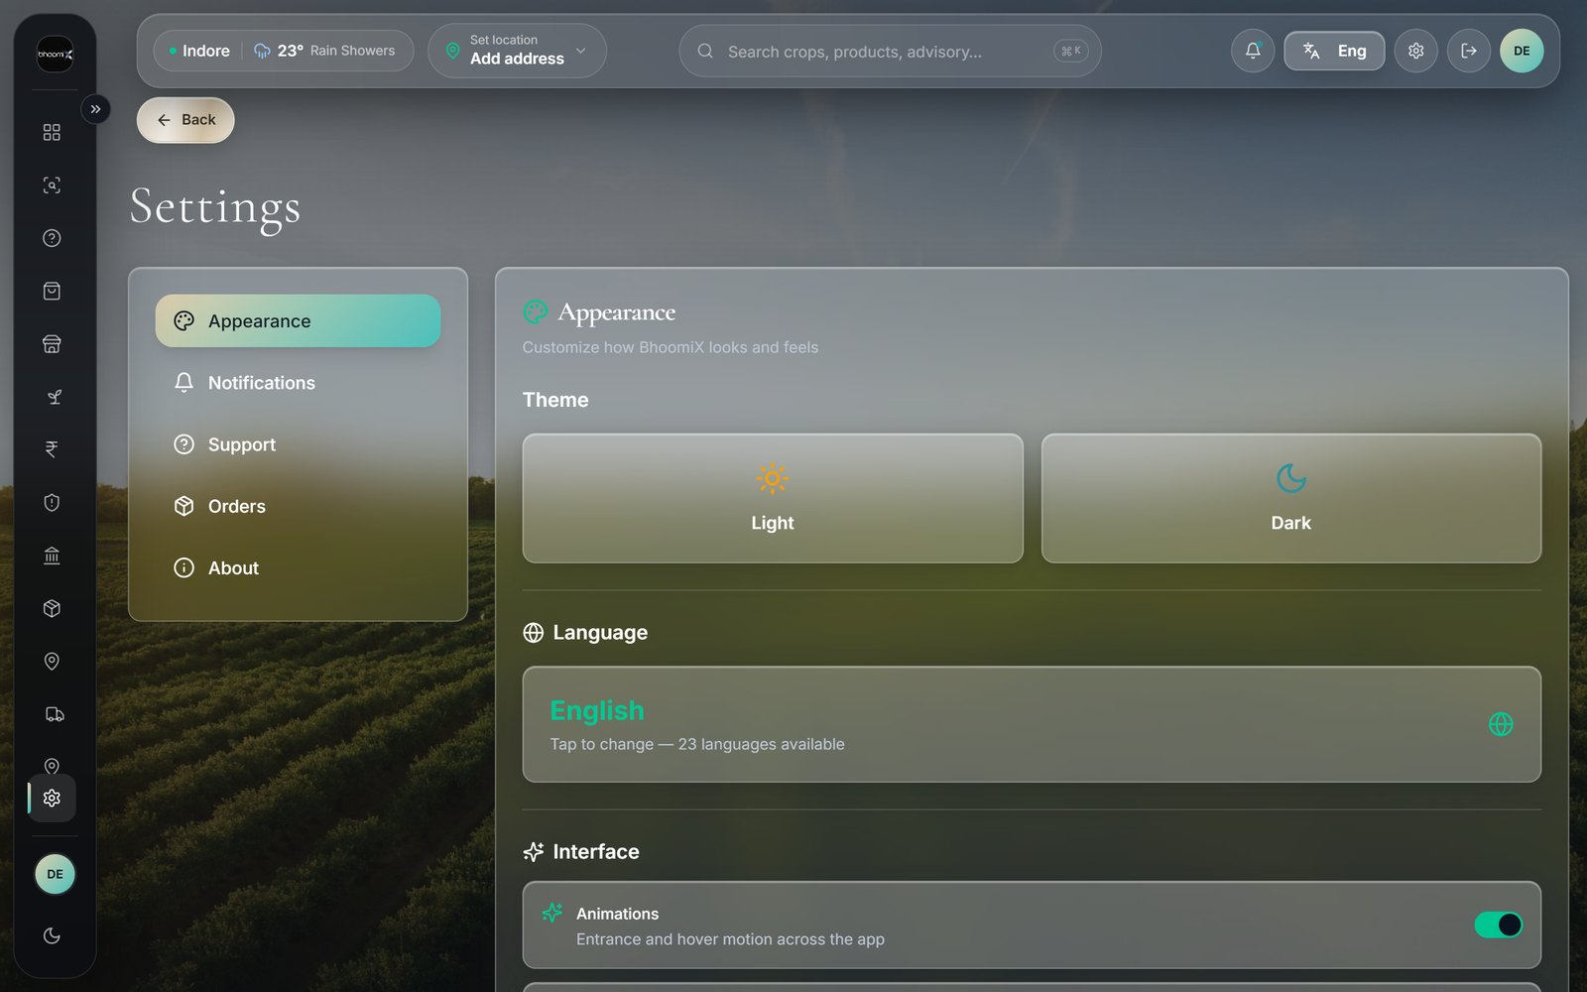
PAGE 13 · ACCESS & TRUST
Built for every farmer
23 Indian languages
The whole interface switches, not a subtitle
Secure accounts
Access & Trust
Sign-in, password recovery and email delivery
Row-level data protection
Every record is checked against its owner
Settings, including the language switcher.
Privacy for buyers
THE QUIET WORK
Partners see contact details only after accepting
A secure backend, an audited database and tracked email delivery sit behind all of this — invisible, and necessary.
Notes:
Page 13 · Access & Trust — A secure backend, an audited database and tracked email delivery sit behind all of this — invisible, and necessary.

Slide 16
Thank you
Every farmer deserves the right price.
bhoomix.vercel.app
BhoomiX · [TEAM NAMES] · Indore
Notes:
Hold this slide during questions.

