Slide 1
NATURAL LANGUAGE PROCESSING · ASSIGNMENT 2
Tokens, Not Words
Zipf's Law Under the Tokenizer
Whether tokens obey Zipf's law across English, Hindi and Arabic; how LLaMA, Qwen and Kimi's tokenizers differ; and whether a vocabulary-size sweet spot can be found algorithmically.
54
3
18
4
BPE tokenizers trained
languages · 3 scripts
vocab sizes per language
criteria for the sweet spot
30 August 2026

Slide 2
Executive summary
Assignment 1 asked whether Zipf's law survives at the word level. This asks: does it survive at the token level, the unit language models actually consume?
54 byte-level BPE tokenizers trained across an 18-point vocab sweep x English, Hindi, Arabic + 4 model-style replicas (LLaMA-2/3, Qwen-2.5/3, Kimi-K2/K3).
Answer: tokens obey Zipf's law, and better than words do in the mid-vocabulary band (R² up to 0.999) — but not automatically at every vocab size.
A qualified vocabulary-size sweet spot exists: 3 of 4 independent criteria converge to a 3–16k-token band per language at this corpus scale.
Hindi's Devanagari script caps achievable BPE vocabulary an order of magnitude below English/Arabic — a token-level echo of Assignment 1's Heaps' Law finding.

Slide 3
PART 1
Do Tokens Follow Zipf's Law?

Slide 4
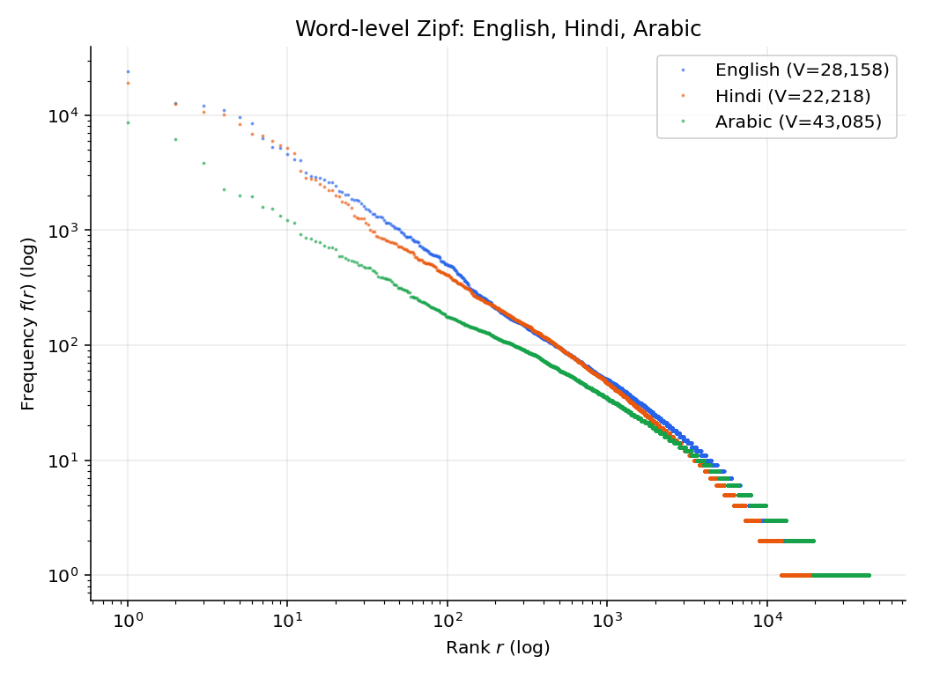
Word-level baseline: English, Hindi, Arabic
All three show the classic Zipf shape at the word level — the starting point before any tokenizer touches the text.

Slide 5
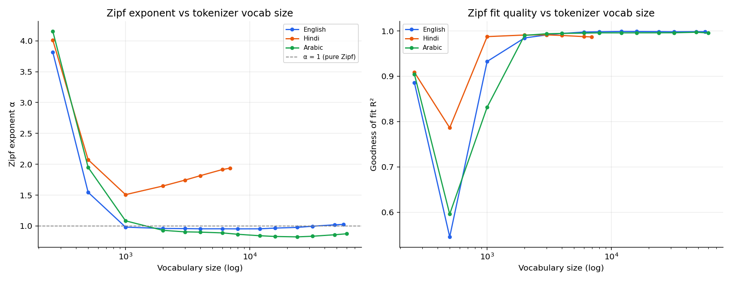
Zipf exponent & fit quality vs vocabulary size
Three regimes: near-character (α≈4), word-fragment (α crosses 1, R²>0.99), large-vocabulary (R² stays high, α drifts).

Slide 6
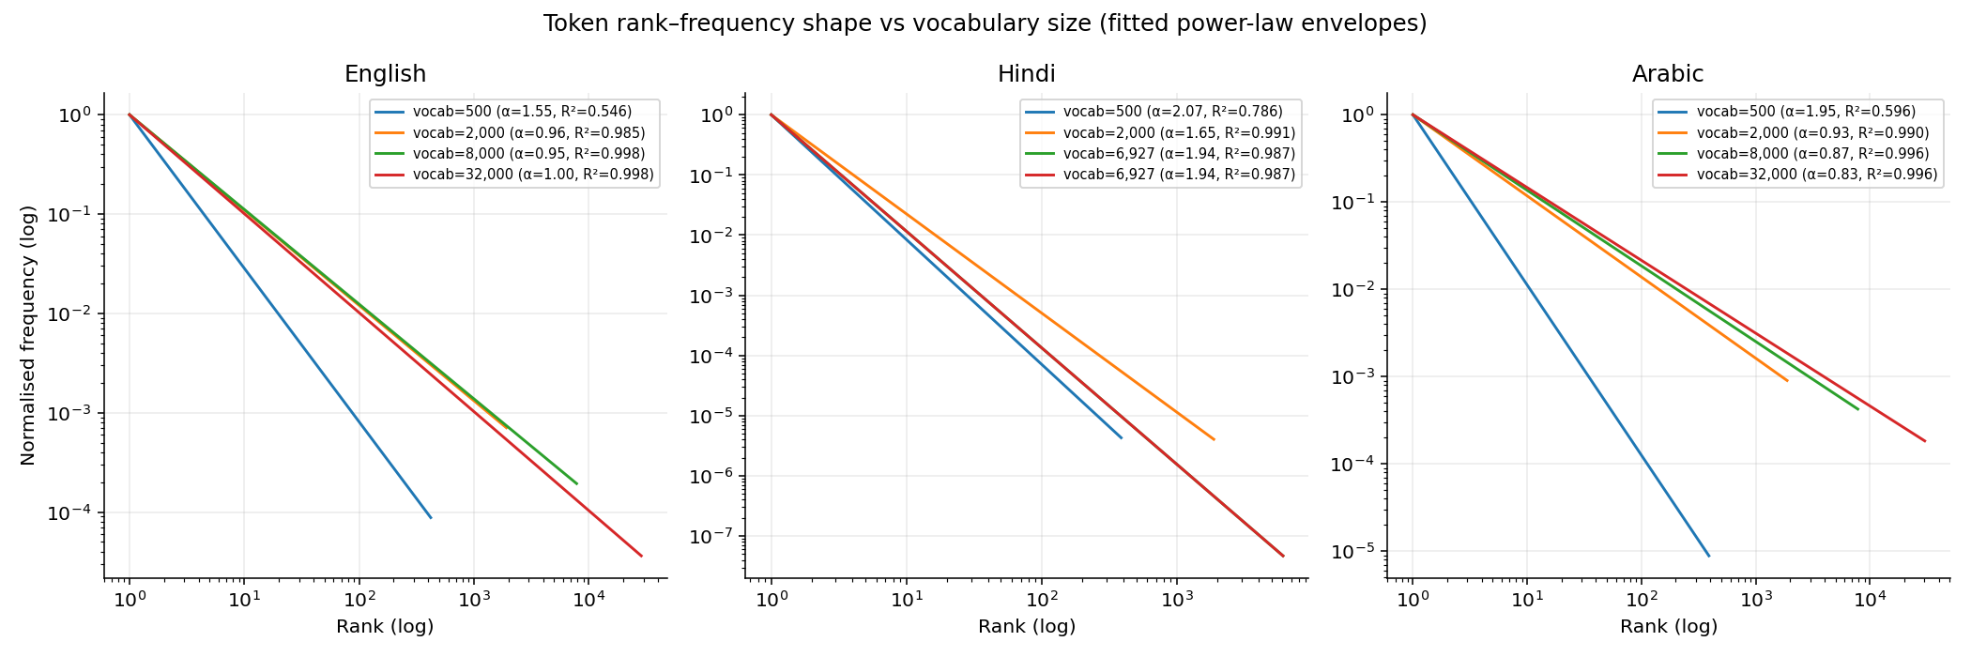
Token rank–frequency shape across the sweep
The curve flattens and straightens from vocab 500 to 8,000 per language, then holds roughly steady.

Slide 7
Answer: Q1
Yes — tokens obey Zipf's law, and in the 6,000–16,000 vocab band they obey it more cleanly than words (R² up to 0.999 vs Assignment 1's 0.990 for Hindi words).
But the fit is vocabulary-size dependent: near-character vocabularies overshoot badly (α≈4, R² as low as 0.55), and very large vocabularies drift mildly away from α=1.
Subword tokenisation is a Zipf-law-improving transformation: it removes the flat head (rare word-forms split into shared subwords) and thins the hapax shelf.

Slide 8
PART 2
LLaMA vs Qwen vs Kimi

Slide 9
Published vocabulary size & scheme
Family | Vocab (target) | Scheme | Source
LLaMA-2 | 32,000 | SentencePiece BPE | Touvron et al., 2023
LLaMA-3 | 128,000 | byte-level BPE (tiktoken-style) | Meta AI, 2024
Qwen-2.5 / 3 | 151,643 | byte-level BPE | tiktoken qwen2 encoding
Kimi-K2 / K3 | 163,584 | byte-level BPE (tiktoken.model) | Moonshot AI, 2025-26

Slide 10
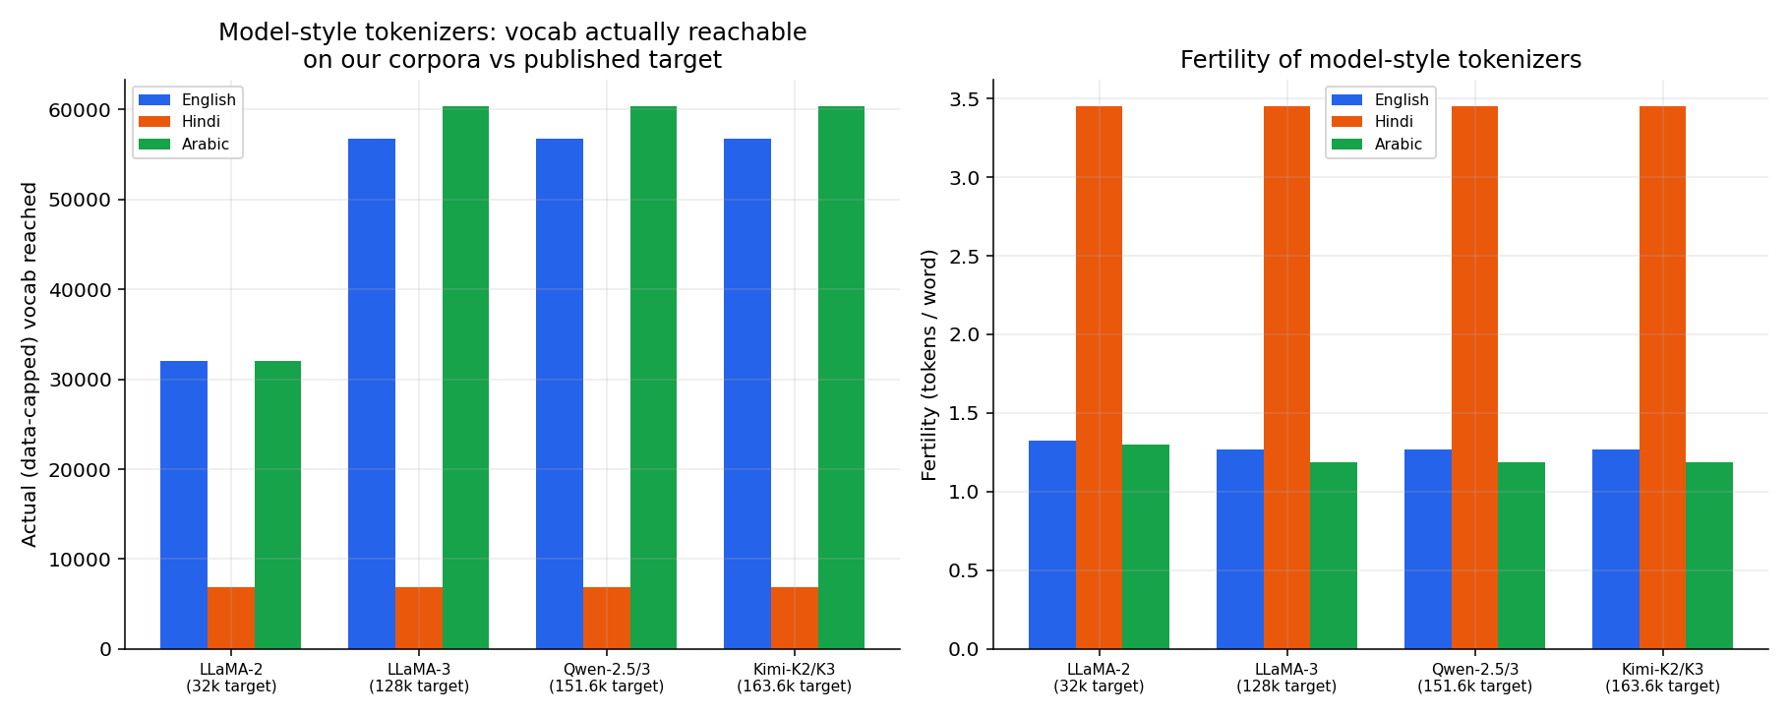
Target vocab vs what our corpus can actually reach
English/Arabic saturate ~57k-60k regardless of a 128k/152k/164k target. Hindi saturates at 6,927 for every target.

Slide 11
Answer: Q3 — how do they differ?
Published vocab sizes span 5x: 32k (LLaMA-2) to 164k (Kimi-K2/K3) — a real design trade-off between sequence length and embedding-table cost.
On this study's corpus, the three large-vocab families (128k-164k target) all converge to the SAME data-bound ceiling (~57k-60k for English/Arabic).
That ceiling is set by the corpus's own repeated-substring structure, not the trainer's target — vocab size is a training-data-scale decision.
Hindi's ceiling (6,927) sits an order of magnitude below — explained by Devanagari's multi-codepoint akshara structure sparsifying byte-pair repeats.

Slide 12
PART 3
The Vocabulary-Size Sweet Spot

Slide 13
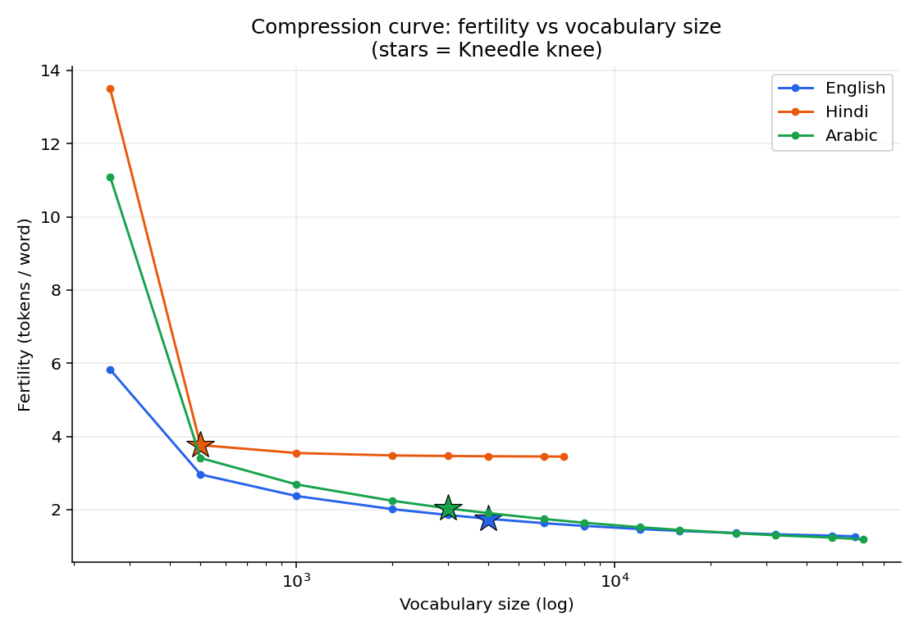
Compression curve: fertility vs vocabulary size
Stars = Kneedle knee. Hindi's curve plateaus near 3.45 tokens/word early — the BPE ceiling, not a genuine sweet spot.

Slide 14
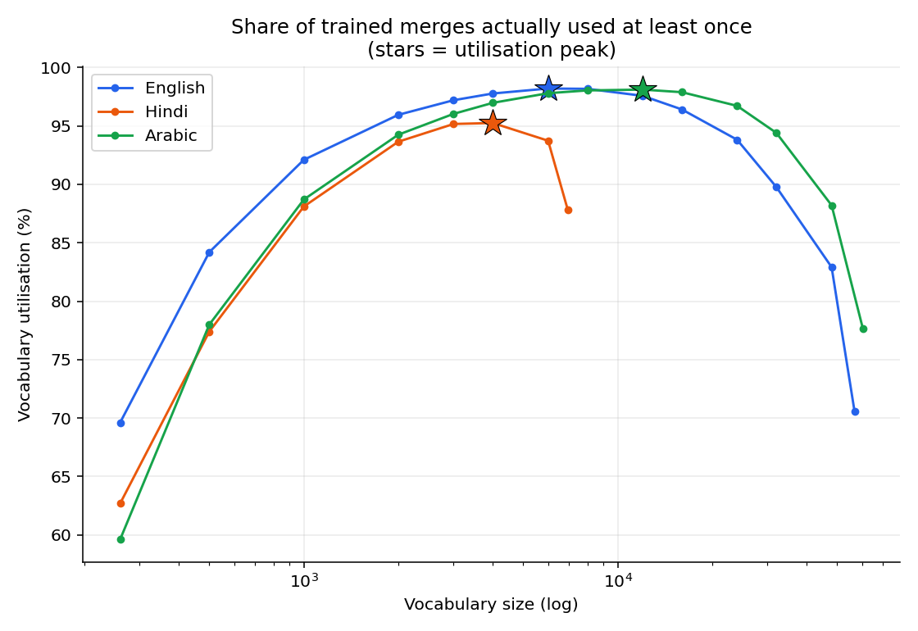
Vocabulary utilisation vs vocabulary size
All three languages peak in the mid-thousands, then decline as vocabulary outgrows the corpus's ability to exercise every merge.

Slide 15
Four independent sweet-spot criteria
Language | Fertility knee | Zipf-stability | Utilisation peak | Marginal-yield rule
English | 4,000 | 8,000 | 6,000 (98.2%) | 32,000
Hindi | 500 | 6,000 | 4,000 (95.2%) | 3,000
Arabic | 3,000 | 3,000 | 12,000 (98.1%) | 60,335

Slide 16
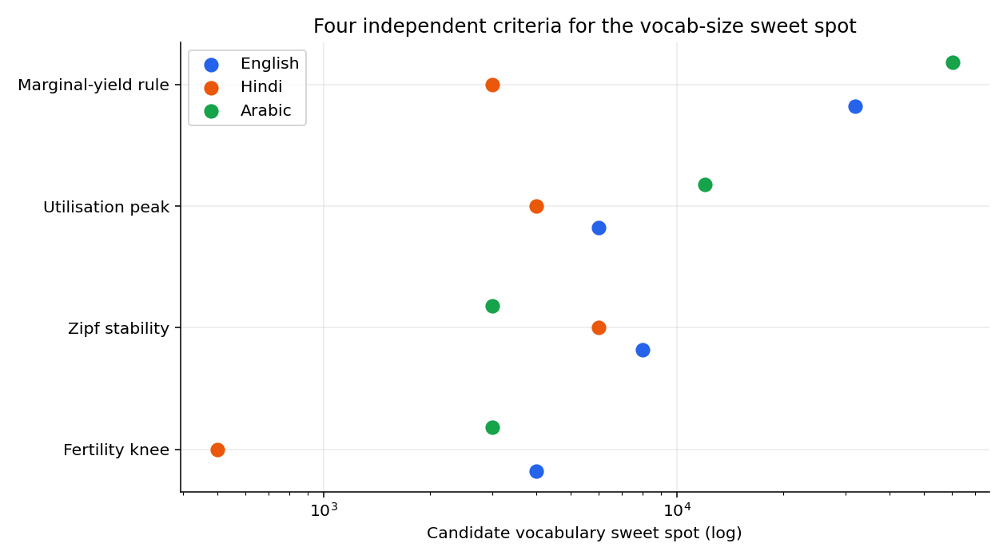
All four criteria, side by side
3 of 4 criteria cluster within ~3-5x for English/Arabic. Marginal-yield never hits a hard floor — gains just keep shrinking, like Heaps' Law.

Slide 17
Answer: Q5–Q6 — sweet spot & Zipf-stabilisation
Yes, in a qualified sense: fertility-knee, Zipf-stability and utilisation-peak converge to a 3,000–16,000-merge band per language at this corpus scale.
The 4th criterion (marginal byte-yield) confirms there's no hard stopping point in principle — compression keeps improving, just by shrinking amounts.
Zipf-stabilisation is a USABLE, CHEAP proxy for the sweet spot: within 2x of the fertility-knee for 2 of 3 languages, and monitorable online during training — no held-out compression sweep required.

Slide 18
PART 4
An Algorithm for Choosing Vocab Size

Slide 19
Proposed stopping rule
1. Train BPE incrementally; checkpoint the merge table every ΔV vocab slots (e.g. every 500-1,000).
2. At each checkpoint, re-encode a held-out sample and record: Zipf α & R², vocabulary utilisation, fertility.
3. Stop when, for 3 consecutive checkpoints, ALL THREE hold: R² within 0.5% of its running max; utilisation has declined >2pp from its running max; marginal fertility gain per 1,000 slots < 1% of fertility achieved.
4. Report that vocab size as the recommendation for THIS corpus scale — with the explicit caveat that it will grow with more training data (Heaps' Law), and re-run as the corpus grows.

Slide 20
What it does — and doesn't — claim
Applied post-hoc: fires at 6,000-8,000 (English), 3,000-4,000 (Arabic), 4,000-6,000 (Hindi, capped by its ceiling) — consistent with, slightly more conservative than, the §5 consensus.
It identifies where a GIVEN corpus stops rewarding further merges — not a universal 'correct' vocab size for a language.
Real production tokenizers train on trillions of tokens vs this study's hundreds of thousands — their much larger sweet spots are a predictable Heaps'-Law consequence, not a contradiction.
Practical takeaway: compute this on YOUR actual training corpus, at YOUR actual scale, before fixing a vocabulary size.

Slide 21
Conclusions
Tokens obey Zipf's law, and more cleanly than words in the 6k-16k vocab band — but the fit is vocabulary-size dependent, not automatic.
LLaMA/Qwen/Kimi differ up to 5x in published vocab size; on this corpus scale the larger three all hit the same data-bound ceiling regardless of target.
Hindi's script caps achievable BPE vocabulary an order of magnitude below English/Arabic — a token-level Heaps' Law echo.
A vocab-size sweet spot exists in the qualified sense that 3 of 4 criteria converge within a 3-5x band; the 4th confirms returns diminish smoothly, never vanishing.
Zipf-stabilisation is a cheap, usable proxy for the sweet spot, and feeds directly into a proposed 3-signal stopping rule for choosing vocabulary size.

Slide 22
Thank you
Code, data, figures and full report: github.com/<repo>/zipf-tokenization

