Slide 1
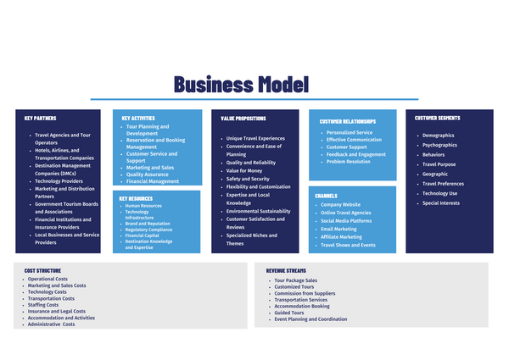

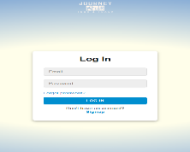
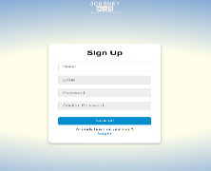
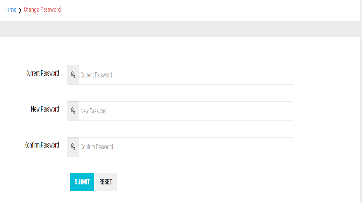
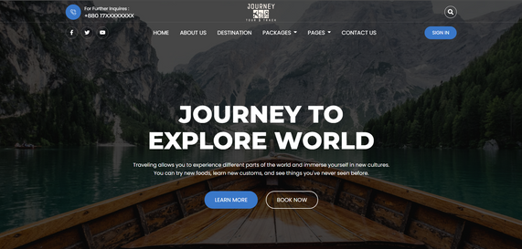

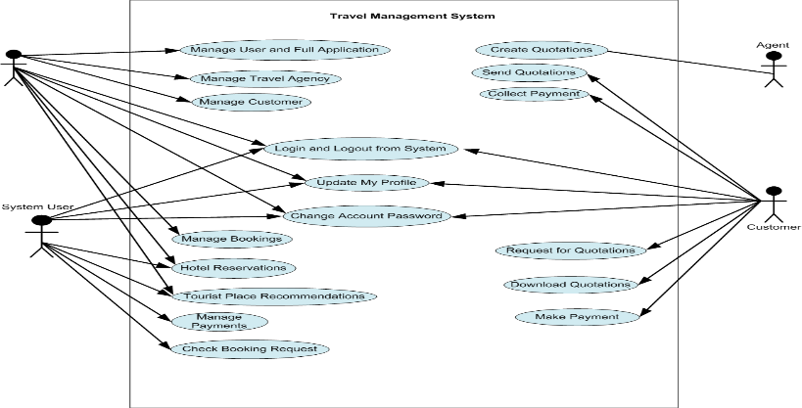
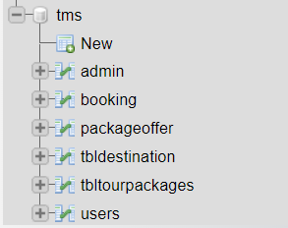
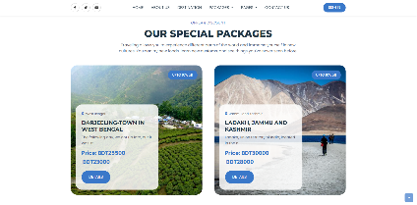
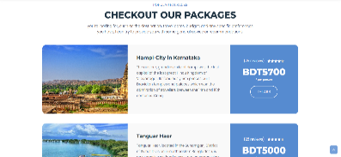
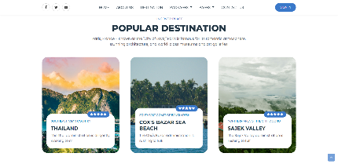
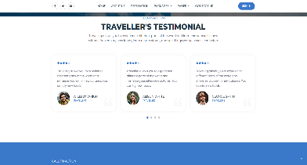

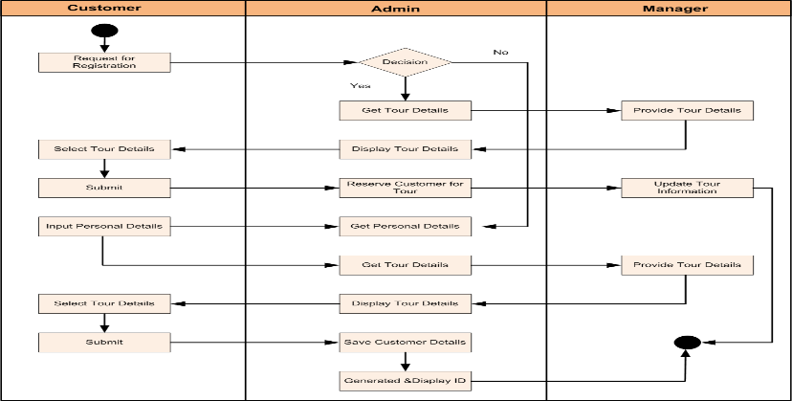
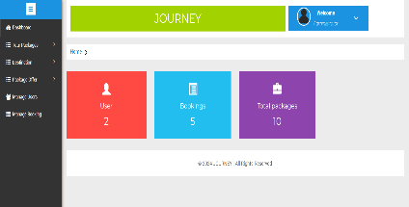
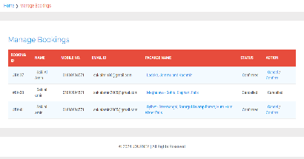
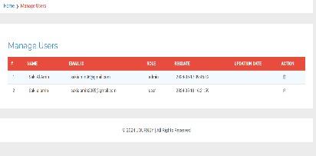
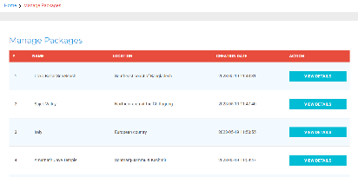

Tour & Travel management
FEATURES
HOME PAGE
Sign in
Sign up
Admin Dashboard
Dynamic Tour package update
Dynamic offer
Destination update
User Create
Password Change
UML DIAGRAM
DATABASE DESIGN
CLIENT-SIDE GUI
ACTIVITY DIAGRAM
Project Cost Estimation
ADMIN-SIDE GUI
Development Costs
Personnel: 5,500,000 BDT
Tools and Software: 550,000 BDT
Miscellaneous: 220,000 BDT
Total Development Costs: 6,270,000 BDT
Deployment Costs
Hosting: 220,000 BDT/year
Maintenance: 550,000 BDT/year
Marketing: 330,000 BDT
Total Deployment Costs: 1,100,000 BDT
Technology
Contribution to the society
TEAM MEMBER DETAILS
Name:Mahmudul Islam Partho
ID:2019-3-60-027
Name:Md. Al amin
ID:2019-3-60-016
Name:Nazia Zaman
ID:2020-2-60-016
Name:Nabila Shaeed
ID:2020-1-60-125
Name:Meherun Hossain Orpa
ID:2020-1-60-123
Web Development Technologies
HTML
CSS
JavaScript
PHP
Database Management Systems
API Integrations
Geolocation Services
Responsive Web Design
Security Technologies
Analytics and Tracking Tools
Promotion of Arts and Culture
Preservation of Natural and Cultural Heritage
Social Connection
Health and Well-being
Education and Learning
Community Development
Environmental Awareness
Cultural Exchange
Economic Growth

