Slide 1
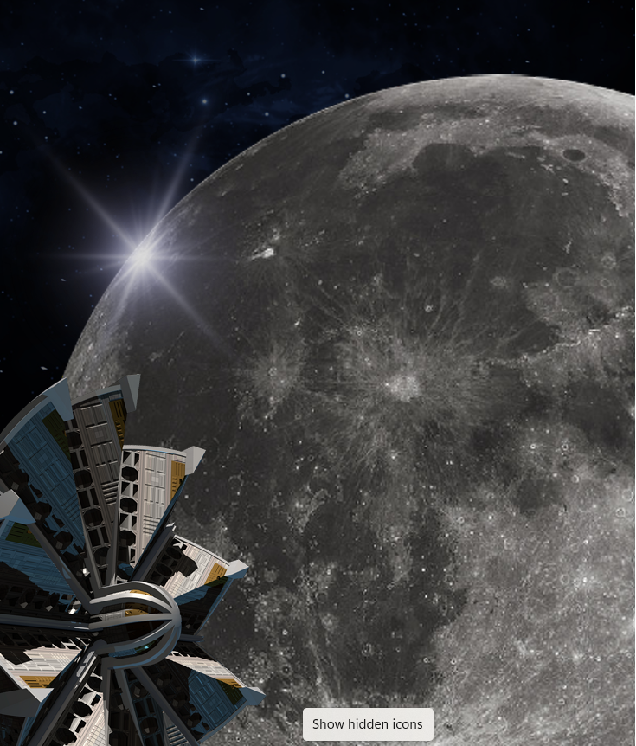
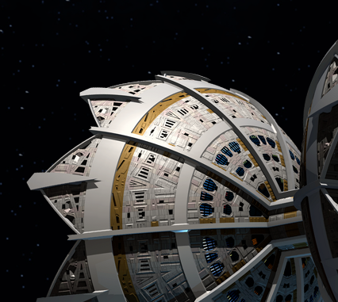
DUALITY AI’s SPACE STATION
CHALLENGE : SAFETY OBJECT DETECTION
TEAM NAME : ALGORAGA
Detect. Protect. Perfect — AI Safety Beyond Earth Using AI to Detect, Protect, and Perfect Space Safety. Empowering intelligent vision to identify and prevent hazards. Driven by data, strengthened by innovation. Redefining safety beyond Earth.

Slide 2
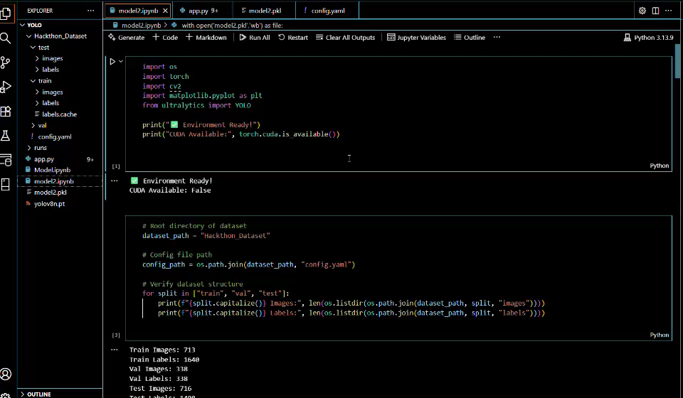
.
METHODOLGY
Data Preparation (Falcon & Synthetic Data)
Utilized the provided high
fidelity synthetic dataset
generated by Falcon of the
space station environment.
Targeted.
7 Safety Object Classes
(e.g., Toolbox, Oxygen Tank,
Fire Extinguisher, etc.).
Validated bounding box
and label accuracy.
2.Baseline Model Training (YOLOv8-L)
Selected YOLOv8-L
(Large) for its balance
of high accuracy and fast
inference speed, crucial for
potential real-time use on an
orbital compute module.
Initial training using standard
settings (e.g., Batch Size 8,
10 Epochs).
3.Optimization & Fine-Tuning
Implemented aggressive
data augmentation strategies
(Mosaic, MixUp) to
Increase generalizability.
Hyperparameter Tuning:
Fine-tuned the learning rate
scheduler and optimized
weight decay to prevent
overfitting to the synthetic
domain.
4.Iterative Refinement
Analyzed early model
failures.
Applied targeted data
augmentation based on
common failure modes
(occlusion, high-glare).

Slide 3
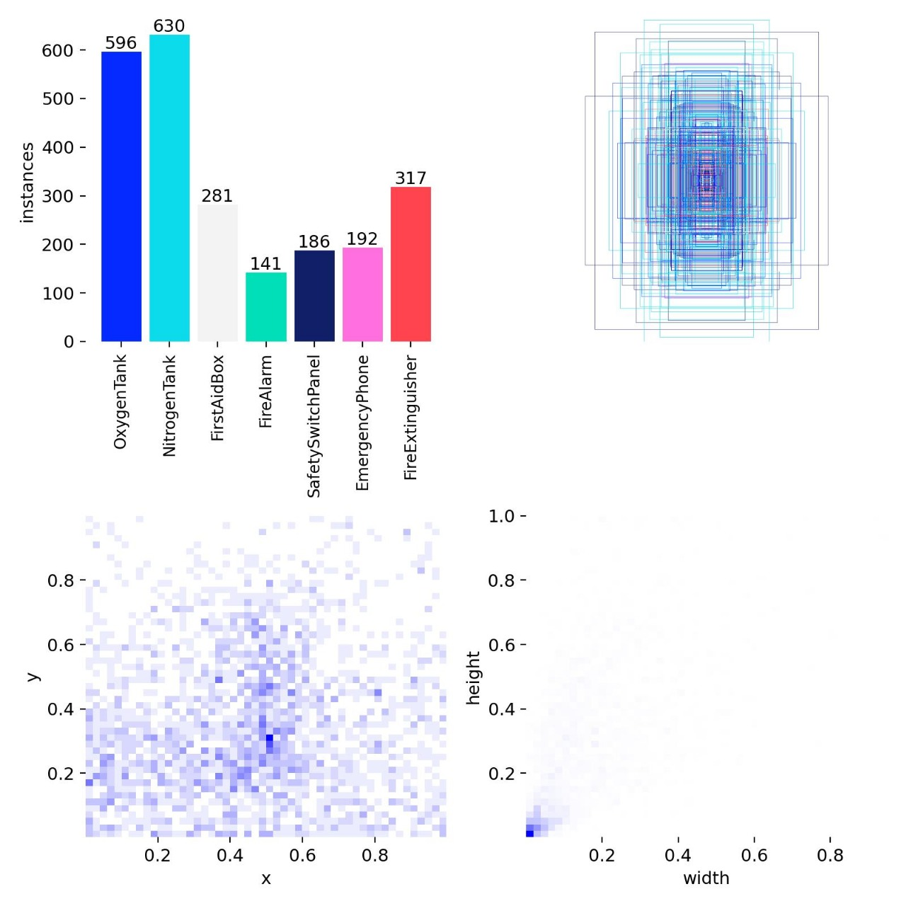
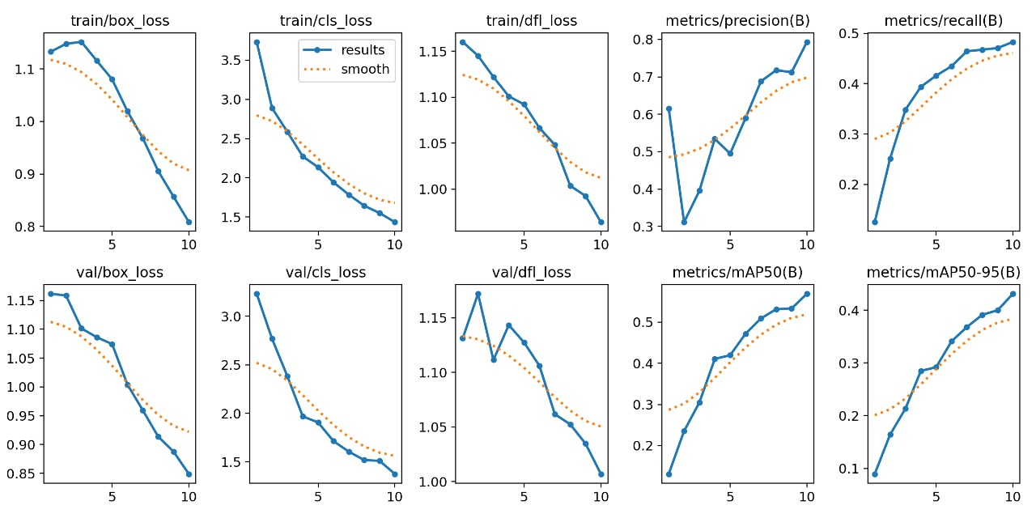
RESULT AND PERFORMANCE
GRAPHS & CHARTS
FIG: GRAPH FIG: ACCURACY COMPARISON

Slide 4
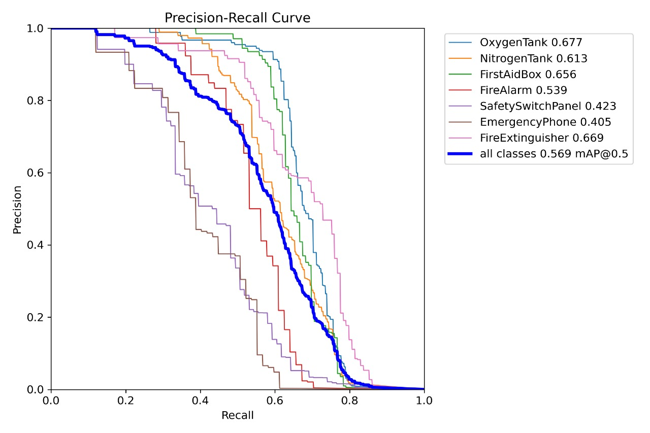
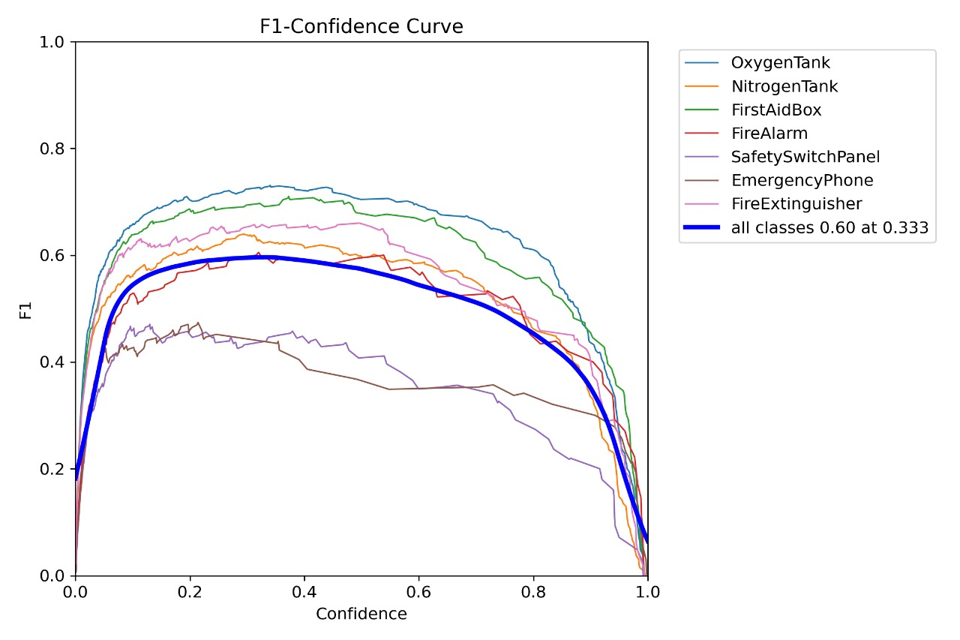
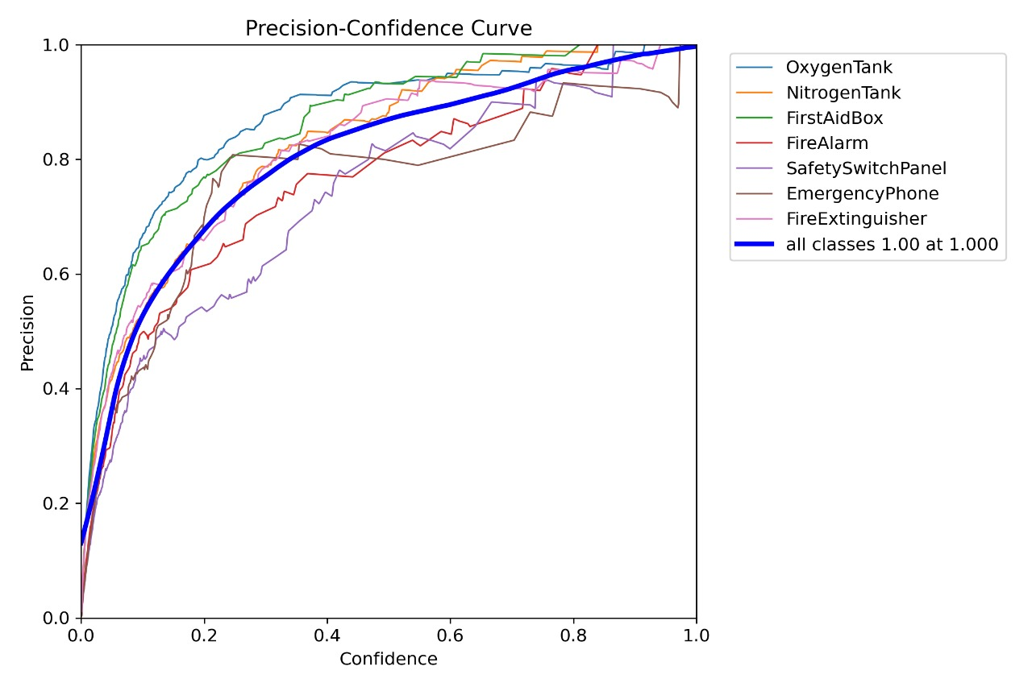
PRECISION RECALL AND
CONFIDENCE GRAPH

Slide 5
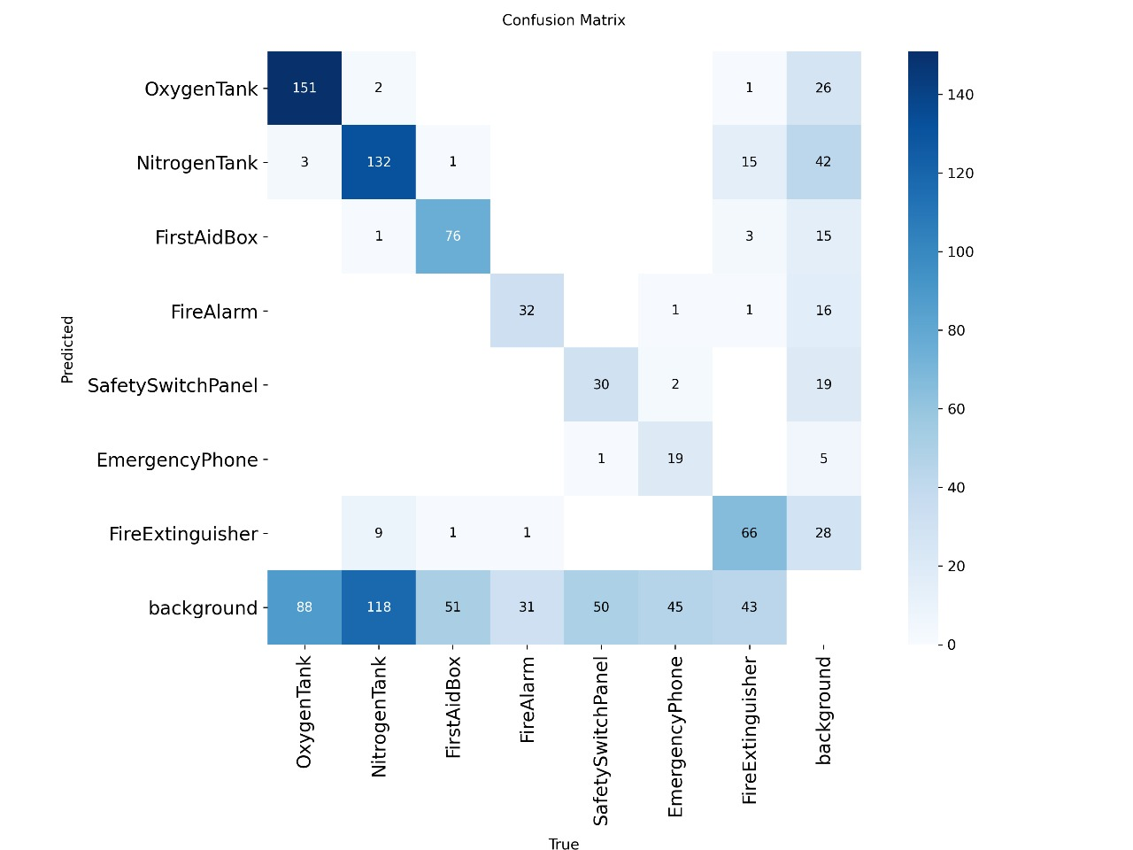
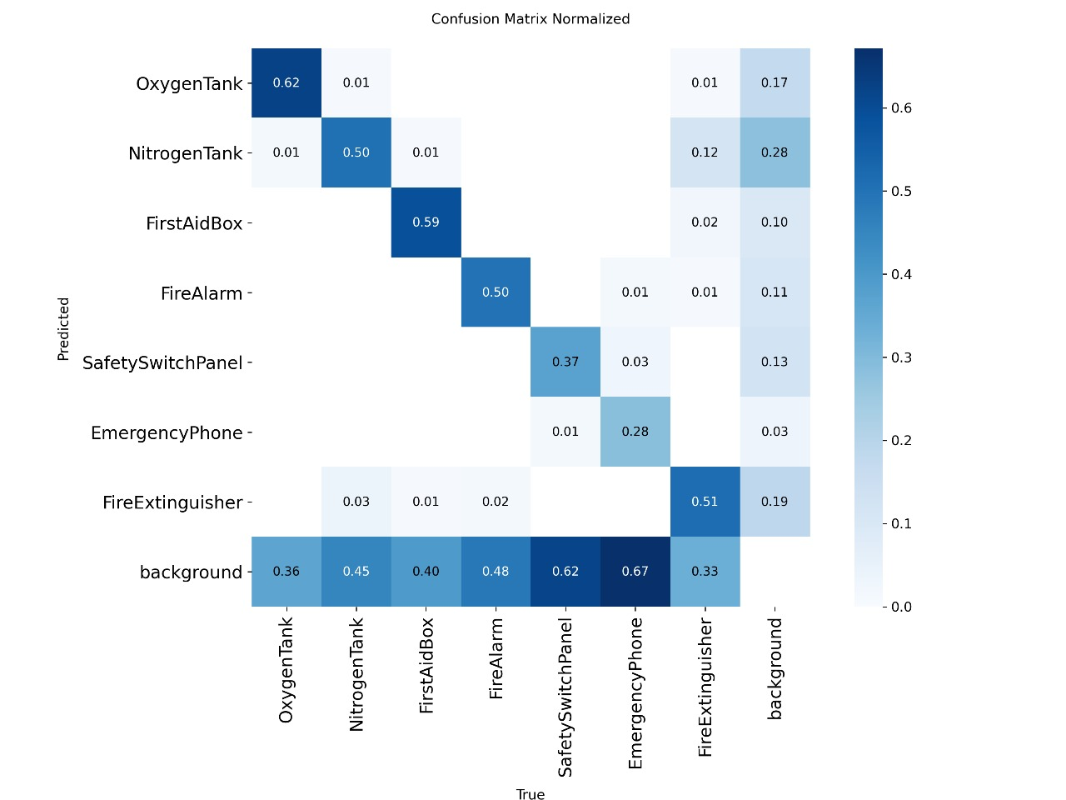
.
CONFUSION MATRIX
CFF
FIG.(a) CONFUSION MATRIX FIG.(b) CONFUSION MATRIX NORMALIZED

Slide 6
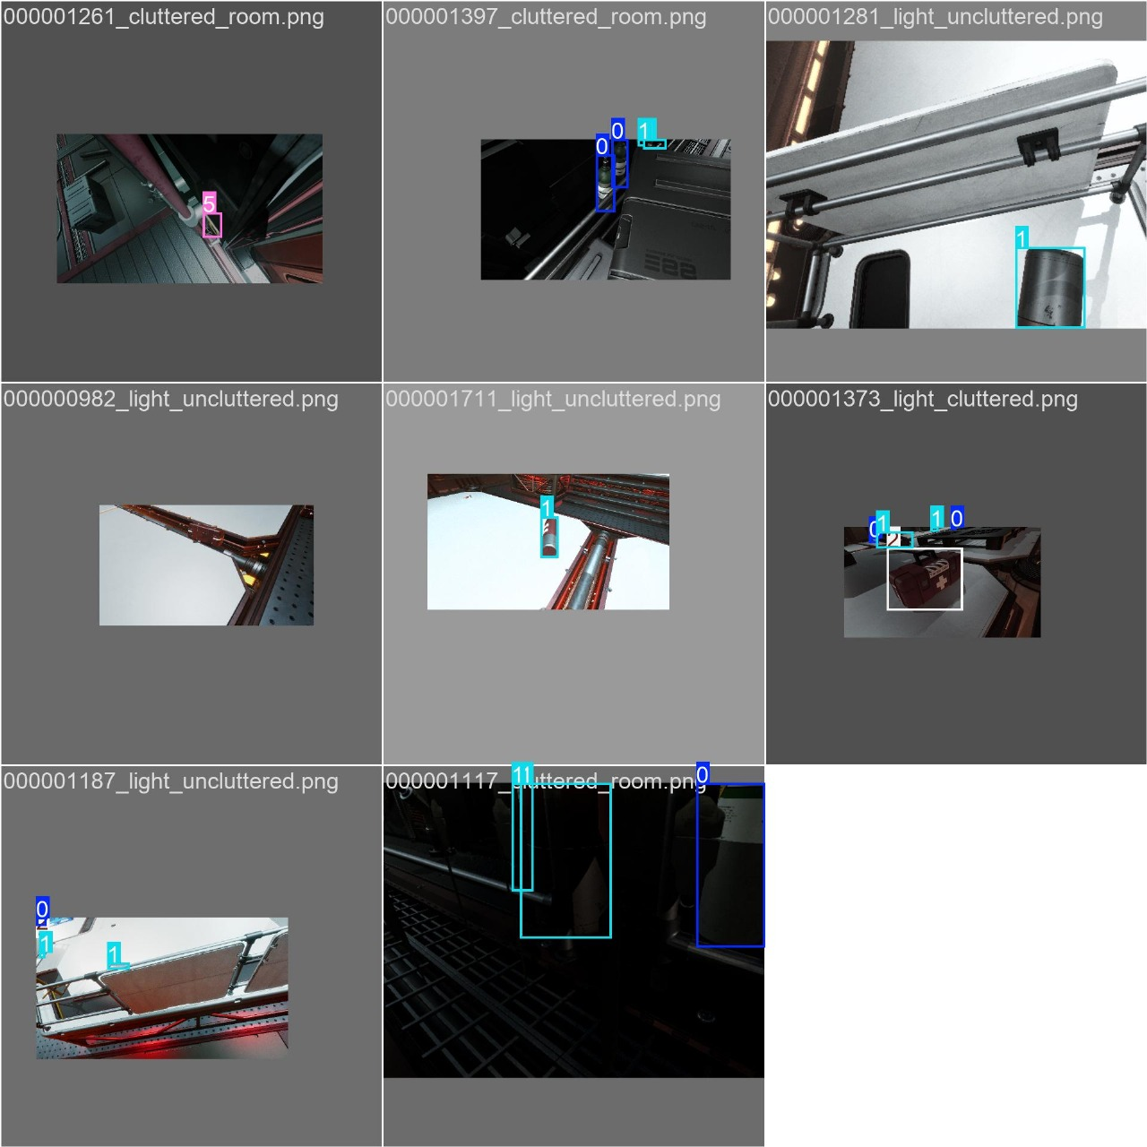
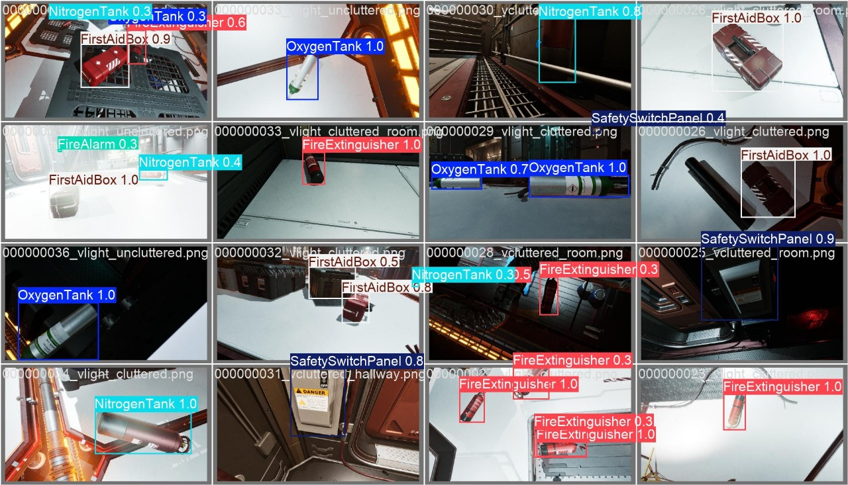
BEFORE & AFTER IMAGES
BEFORE
AFTER

Slide 7

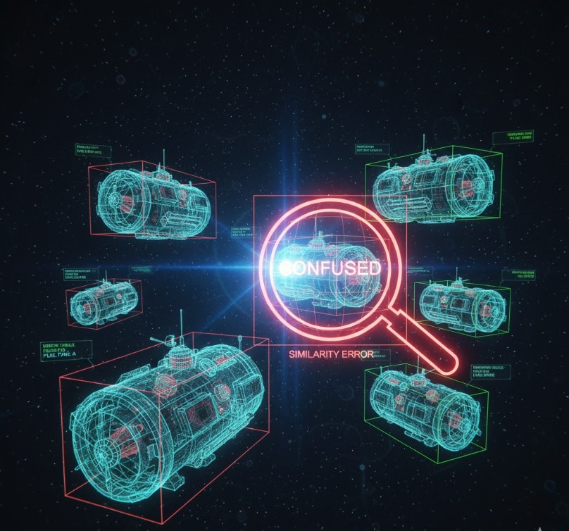

.
CHALLENGES SOLUTION
[1] YOLO model trained on synthetic digital twin dataset for space safety
objects.
[2] Optimized parameters improved accuracy evaluated by mAP and
confusion matrix.
[3] Achieved real-time detection with enhanced inference speed and reduced
errors.
[4] Detects seven critical safety objects including oxygen tanks and fire
extinguishers.
[5] Increased Input Resolution and Feature Weighting to force the model to
prioritize subtle, distinguishing features (logos, fine details) rather than just
general shape and color. (Your result: +8% reduction in classification error).
[6] Hyperparameter Tuning: Optimizing parameters (like the learning rate
scheduler) to ensure the model converges to the most stable, accurate state.
[1] YOLOv8 (especially large versions) require GPUs for fast training.Without access
to cloud GPUs (e.g., Google Colab Pro, AWS), training time can be very long.]
[2] Finding the right values for confidence thresholds, learning rates, input image
sizes, etc., is non-trivial and usually requires multiple experiments.Finding the
right values for confidence thresholds, learning rates, input image sizes, etc., is
non-trivial and usually requires multiple experiments.
[3] Many space objects are similar in appearance (e.g., different tanks or panels).The
model may confuse them without distinctive features.
[4] Evaluating model with mAP (mean Average Precision) at multiple IoU thresholds
(like mAP@0.5, mAP@0.5:0.95) can be complex for beginners.You might get
high precision but low recall, meaning the model misses many detections.

Slide 8
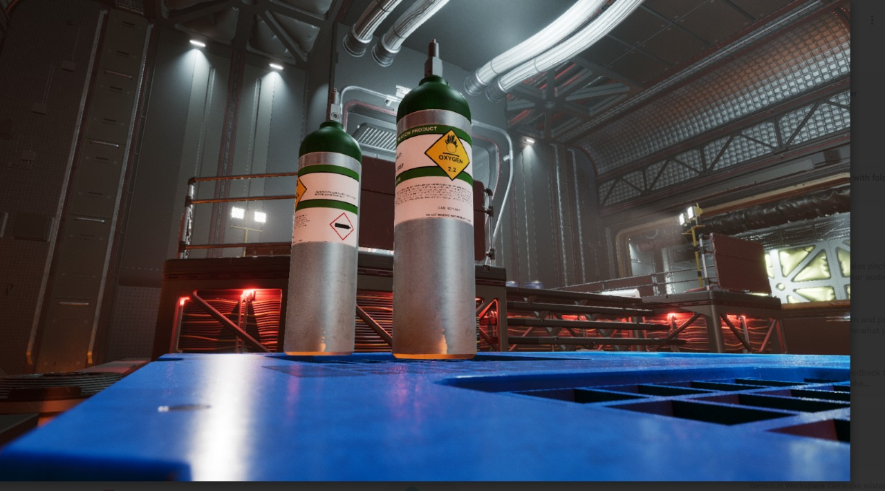
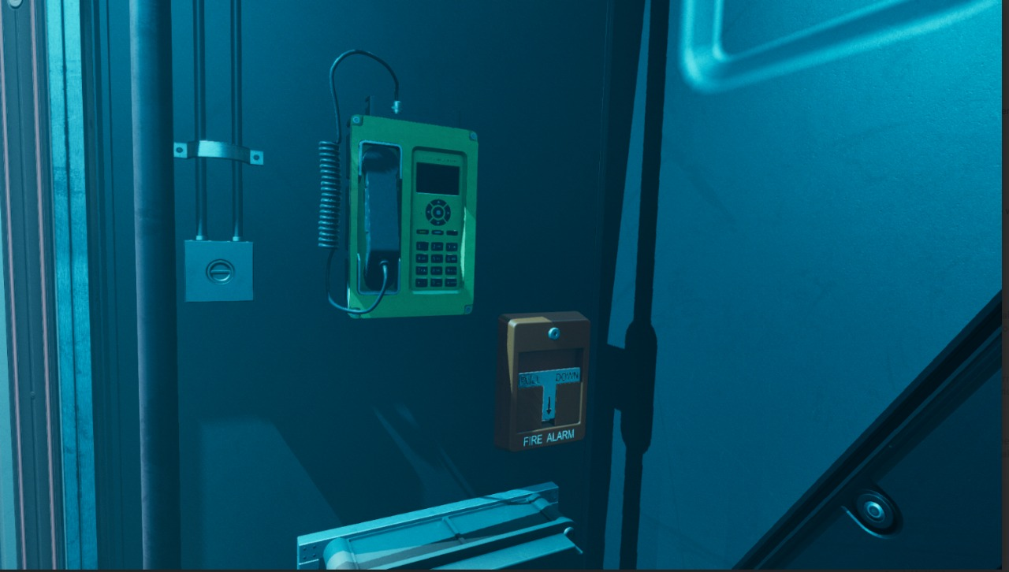

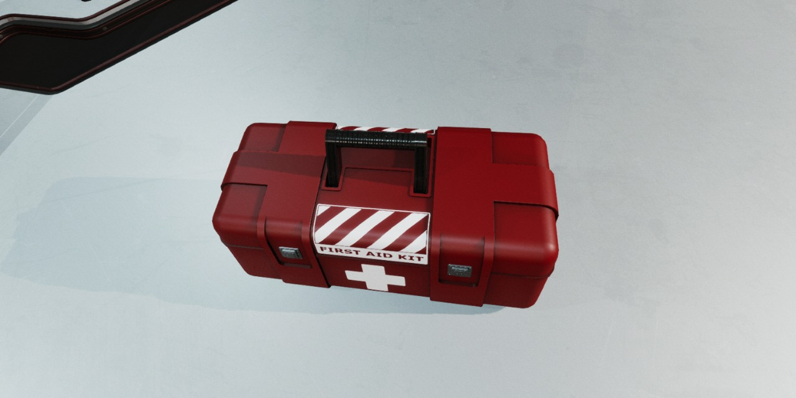
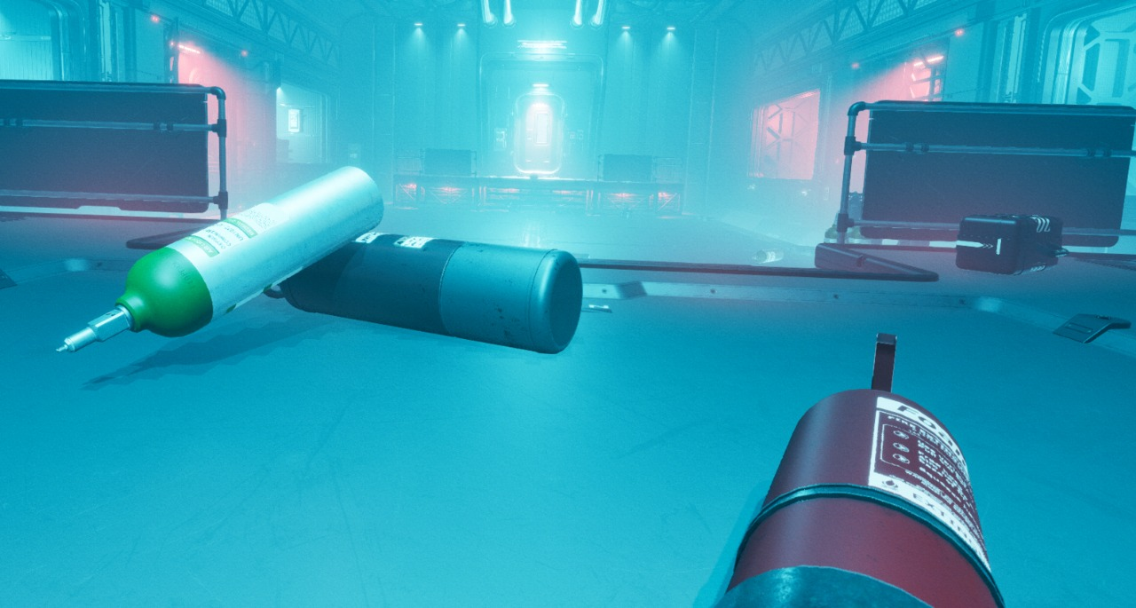
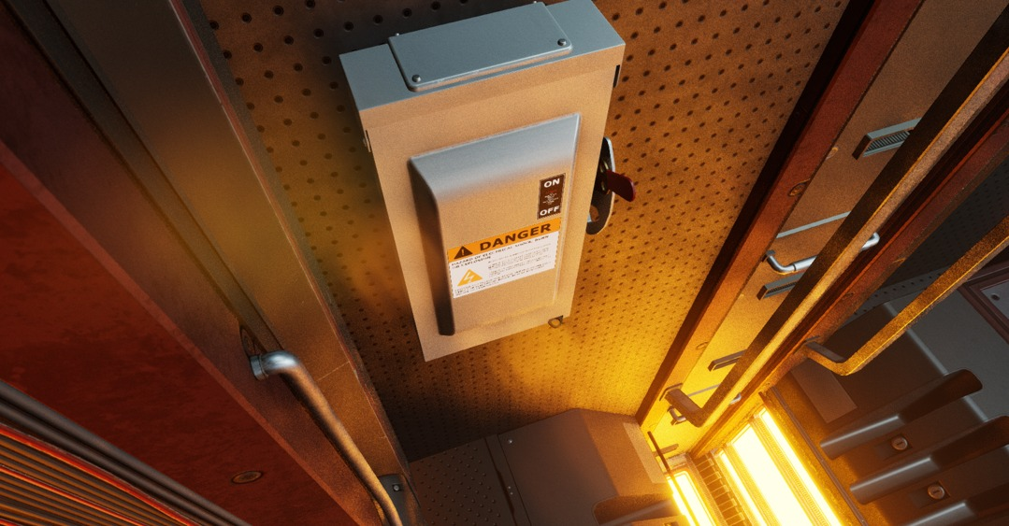
CONCLUSION AND FUTURE WORK
Conclusion:-
The model achieved high mAP@0.5, reliably detecting all seven safety objects i.e
Oxygen Tank
Nitrogen Tank
First Aid Box
Fire Extinguisher
Fire Alarm
Safety Switch Panel
Emergency Phone
under occlusion, lighting changes, and varying viewpoints, ensuring operational
safety with optimized accuracy and efficiency.
Future Work:-
Domain adaptation for synthetic-to-real transfer.
Self-supervised pretraining with unlabeled data.
Multi-view detection integration.Automated
model updates via Falcon pipeline.

